Slide 1
PRIA 5 Implementation Overview: Bilingual Labeling and Grants Updates

Slide 2
PRIA 5 Implementation Update
EPA has made significant progress implementing requirements of PRIA 5 since its passage- for example, OPP:
Conducted significant outreach to a broad array of stakeholders regarding bilingual labeling implementation, including accessibility of labels to farmworkers; stakeholders included farmworkers and farmworker advocacy groups, industry, EPA environmental justice and pesticide federal advisory committees, states, and EPA regions;
Has begun to reduce the backlog of non-PRIA actions and implementing process changes to review these types of actions according to their timeframes;
Issued ESA guidance for review of conventional and biopesticide new a.i.s and pesticides undergoing registration review, as well as guidance for new uses of registered pesticides;
Completed the successful migration of all OPP divisions into the new IT system for electronic registration submission and application tracking;

Slide 3
PRIA 5 Implementation Update (cont’d)
Established the Vector Expedited Review Voucher (VERV) program to incentivize registration of new insecticides to control the spread of vector-borne diseases;
Developed a process for sharing of EPA data evaluation records with the applicant at the time of the regulatory decision;
Published centralized webpage of EPA guidance documents related to pesticide regulation and pesticide-related resources;
Supporting farmworker training and education through continuation of existing cooperative agreements, awarding of new Pesticide Safety Education Program and new Partnership Grant cooperative agreements.
Requested stakeholder input on program designs for new health care provider training and farmworker training grant programs;

Slide 4
PRIA 5 Implementation Update (cont’d)
Provided funding to CDC/NIOSH through interagency agreement to support pesticide incidence reporting through the Sentinel Event Notification System for Occupational Risk (SENSOR):
Supporting SENSOR-Pesticides in 4 states (WA, TX, NC & GA)
Task order for training contract completed and in process with Contracts office
Notice of Funding Opportunity (NOFO) in development for grant for external training
Task orders for process and workforce assessments in development; contract vehicle identified
Accomplishments and upcoming activities are more fully described on the PRIA 5 implementation webpage.

Slide 5
PRIA Annual Report
PRIA Annual Report posted on PRIA webpage May 17
Addresses PRIA 5 reporting requirements regarding:
PRIA fee for service actions
Implementation of PRIA Process Changes
Non-fee PRIA actions
Registration review metrics
Activities carried out under grants relating to farmworker and health care clinician training, partnership grants, pesticide safety education program
Data on initial content and preliminary technical screens
Staffing

Slide 6
PRIA 5 Bilingual Labeling Updates

Slide 7
PRIA 5 Bilingual Labeling Implementation
PRIA 5 provides deadlines for bilingual labeling to appear on pesticide products.
Rolling schedule from December 2025 to 2030 with translations for the most hazardous and toxic pesticide products required first.
Label changes to be through non-notification.
A change may be made to a pesticide label without notifying EPA.
PRIA 5 also outlines that EPA will:
Cooperate and consult with State lead agencies for pesticide regulation to implement bilingual labeling;
Seek stakeholder input on ways to make bilingual labeling accessible to farmworkers – 180 days from enactment (by June 30, 2023);
Develop and implement, and make publicly available, a plan for tracking the adoption of the bilingual labeling – 2 years from enactment (by Dec 2024);
Implement a plan to ensure that farm workers have access to the bilingual labeling – 3 years from enactment (by Dec 2025).

Slide 8
Bilingual Labels – Deadlines
Restricted Use Pesticides (RUPs) – 3 years (Dec 2025)
Agricultural Non-RUPS:
Acute Toxicity Category I – 3 years (Dec 2025)
Acute Toxicity Category II – 5 years (Dec 2027)
Antimicrobials and non-agricultural:
Acute Toxicity Category I – 4 years (Dec 2026)
Acute Toxicity Category II – 6 years (Dec 2028)
All other products – 8 years (Dec 2030)
Other label timing provisions for when the Spanish Translation Guide is updated.

Slide 9
Stakeholder Feedback on Accessibility
Bilingual Pesticide Labeling National Webinar
June 15, 2023
More than 380 participants and 31 speakers
Public docket (EPA-HQ-OPP-2023-0270)
Open from June 20, 2023, to August 21, 2023
36 comment submissions
National Environmental Justice Advisory Committee (NEJAC)
Presented charge questions to NEJAC on March 30, 2023
Received draft recommendations on April 25, 2024
Focus groups with farmworkers in EPA Region 9
December 2023 to February 2024
2 in California, 1 in Nevada and 1 in Arizona

Slide 10
Focus Groups Feedback on Accessibility
Four focus groups held with farmworkers in EPA Region 9
9 to 15 participants in each group (pesticide handlers and farmworkers)
Participants had a range of experience (<1 year to 50+ years)
Recommendations include:
Use of colors and visuals on the label for risk and signal words
Make the information on the label easier to understand
Provide information in a central location for the agricultural community (both on the farm and off the farm)
Provide more and enhanced trainings
Use an app or website that links to reliable up-to-date information
Use videos to explain the label
Provide pesticide safety education to children in agricultural communities

Slide 11
NEJAC Feedback on Accessibility
NEJAC charge questions regarding farmworker accessibility – draft recommendations received April 25, 2024.
Conduct additional outreach
Make the language of pesticide materials accessible
Share Spanish-language pesticide information in different locations
Share updated information immediately
Collaborate with other organizations to expand broadband internet connectivity
Improve annual WPS trainings for farmworkers
Final recommendations – expected summer 2024
Provide an update to NEJAC on how EPA is implementing the recommendations within 6 months and a full report in one year.

Slide 12
FY24 Stakeholder Engagement and Outreach
NEJAC charge questions regarding farmworker accessibility – 4/25/24
SFIREG Meetings – 12/5/23, 4/15/24, & 6/4/24
Quarterly Farmworker Advocacy Stakeholder Calls – 2/22/24
CLA RISE Conference – 4/17/24
OCSPP Regional WPS Quarterly Calls – 10/31/23
PPDC Meetings – 11/16/23 & 6/6/24
U.S., Mexico and Canada Technical Working Group on Pesticides – 11/7/23
Focus Groups with Farmworkers in R9 – 12/5/23, 1/17/24, 2/6/24, & 2/12/24
Quarterly PRIA Coalition Calls – 1/18/24 & 4/18/24

Slide 13
Bilingual Labels – Coordination at EPA/OPP
OPP Interdivisional Spanish Labeling Workgroup
Formed subgroups to address the various provisions of PRIA 5
Accessibility Subgroup – evaluating public feedback
Communications Subgroup – developing a website
Tracking Subgroup - investigating internal systems and processes to develop a plan for tracking
Spanish Translation Guide Subgroup - evaluating public feedback

Slide 14
Planned Stakeholder Engagement and Outreach FY24
Conduct focus groups with Region 9 and farmworkers on accessibility (Dec 2023-Feb 2024) - completed
NEJAC provided responses to the bilingual labeling charge questions (April 2024) - completed
Update the PRIA 5 Website with bilingual labeling information and Q&As from various stakeholder engagements and webinars (June 2024)
Coordinate with CLA and hold webinar on Q&As with registrants (June-July 2024)
Following the update of the PRIA 5 website, CLA will schedule a webinar.
The webinar is intended to answer registrants’ questions about bilingual labeling.
Plan to hold discussion with various stakeholders on the tracking of bilingual labeling (tracking plan due Dec 2024)
Plan to hold discussion with various stakeholders on the accessibility plan throughout FY24 and FY25 (accessibility plan due Dec 2025)

Slide 15
PRIA 5 Updates
Cooperative Agreement Set-Asides

Slide 16
PRIA 5 Cooperative Agreement Set-Asides
Extends set-asides for:
Pesticide safety education program (PSEP) (up to $500K per year)
Partnership grants (up to $500K per year)
New set-asides created for:
Health care provider training (up to $2.5M over 5 years)
Farmworker training and education (up to $7.5M over 5 years)
Grant technical assistance to applicants and grantees for the above programs (up to $1.75M over 5 years)

Slide 17
PRIA 5 Cooperative Agreement Set-Asides
Pesticide safety education program
Partnership grants
Health care provider training program
Farmworker training and education
Grant technical assistance program

Slide 18
Pesticide Safety Education Funds Management Program (PSEFMP)
New five-year cooperative agreement with Extension Foundation began October 1, 2023
Provides funds to Pesticide Safety Education Programs (PSEPs) at Land Grant Universities
New agreement encourages collaboration with Minority-Serving Institutions (MSIs)
Subaward projects include:
Collaborations with MSIs and Tribes
Translation of materials into Spanish and Mandarin
Spanish translation SOPs and glossaries
https://extension.org/national-programs-services/pesticide-safety/

Slide 19
PRIA 5 Cooperative Agreement Set-Asides
Pesticide safety education program
Partnership grants
Health care provider training program
Farmworker training and education
Grant technical assistance program

Slide 20
National Pesticide Information Center
New five-year cooperative agreement with Oregon State University began March 1, 2024
Provides objective, science-based information about pesticides and pesticide-related topics
Phone line service, infographics, and other informational resources
Phone service in over 270 languages including the top 25 languages spoken in the United States, free of charge to NPIC clientele.
In 2023, NPIC received 6,922 inquiries and wrote 1,811 incident reports; NPIC’s website received 4,517,129 page visits (http://npic.orst.edu/reports/NPIC23AR.pdf)
http://npic.orst.edu/

Slide 21
PRIA 5 Cooperative Agreement Set-Asides
Pesticide safety education program
Partnership grants
Health care provider training program
Farmworker training and education
Grant technical assistance program
}formerly, “worker safety activities”

Slide 22
Existing Agreements Supporting Worker Protection Activities
National Farmworker Training Program – Association of Farmworker Opportunity Programs (AFOP)
Current farmworker training cooperative agreement grantee
Provides multiple occupational health safety training topics to the farmworker community
Pesticide Educational Resources Collaborative (PERC) - UC Davis in collaboration with Oregon State University
Coordinates the development of pesticide-related educational resources (e.g., manuals, videos, guides) that meet national needs related to implementing the Worker Protection Standard and CPA regulations.
PERC – Medical – UC Davis in collaboration with Oregon State University
Helped medical professionals prevent, recognize, and treat pesticide-related illness by providing resources focused on pesticides and human health issues.
Agreement concluded in August 2023

Slide 23
PRIA 5 Cooperative Agreement Set-Asides
New set-asides created for:
Health care provider training (up to $2.5M over 5 years)
Farmworker training and education (up to $7.5M over 5 years)
Grant technical assistance to applicants and grantees for the above programs (up to $1.75M over 5 years)
These set asides above replace the worker protection activities set aside (for a minimum of $1M per year) under PRIA 4
New requirements related to the programs’ scope, applicants’ eligibility, and development (i.e., stakeholder outreach on design)

Slide 24
PPDC Farmworker and Clinician Training Workgroup
Workgroup gave recommendations on OPP’s cooperative agreements for worker safety activities
Met monthly for most of a year in 2021
EPA implementing some of their recommendations through the PRIA 5 set-asides grant programs

Slide 25
PRIA 5 Cooperative Agreement Set-Asides
Pesticide safety education program
Partnership grants
Health care provider training program
Farmworker training and education
Grant technical assistance program

Slide 26
Healthcare Provider Training Program
Will fund the training of healthcare providers on the prevention, recognition, treatment, management, and reporting of pesticide-related illness.
Stakeholder engagement
PPDC Workgroup
Published a Request for Information (RFI) on September 25, 2023
Described a proposed design for the Healthcare Provider Training Program.
Posed specific questions to stakeholders related to the program design.
Docket for public comments can be found here: EPA-HQ-OPP-2023-0457 on www.regulations.gov

Slide 27
PPDC Workgroup Clinician Training Recommendations
Improve reporting system for pesticide incidents.
Promote awareness of pesticide illness/injury reporting among clinicians by partnering with professional organizations.
Target a wide range of health care providers (HCPs).
Involve HCPs in development and evaluation of materials.
Invest in needs assessments.
Increase partnerships with and funding opportunities for organizations with front line relationships.
Full list of recommendations here

Slide 28
Healthcare Provider Training Program
Design laid out in the RFI:
Agreement includes training and technical assistance program for HCPs AND a partnership program.
Will help ensure that the training and technical assistance program is culturally responsive through partnership with community-based organizations.
Will promote collaboration with professional organizations, as well.
Broad definition of “healthcare provider” to include community health workers, others.
Increased emphasis on reporting.

Slide 29
Healthcare Provider Training Program
Received 16 comments on the RFI.
Comments echoed and built upon PPDC recommendations.
Commenters suggested that grantees:
Leverage existing relationships (PEHSUs, SLAs, PSEPs, grassroots organizations) to bridge communication between vulnerable communities and HCPs
Have expertise in developing bilingual, culturally contextual educational materials to help HCPs offer information to farmworkers and farmworker family members
Address beliefs around pesticide hazards and how to communicate around them
Should also train/do outreach to childcare and education providers, since they interact with farmworker families on a regular basis

Slide 30
Healthcare Provider Training Program
RFI comments also expressed support for other aspects of proposed design, including:
Focus on occupational screenings, housing screenings, including for pediatric patients
Focus on cultural competence and humility
Importance of reporting
Apply lessons learned from previous agreements
Other suggestions/feedback:
Recognizing that community health care centers use a team approach to care; they provide a basic training for all staff and then role-specific training as well
Other populations at high/unique risk of pesticide exposure

Slide 31
Healthcare Provider Training Program
EPA is currently developing a Notice of Funding Opportunity (NOFO)
Next steps
Issue NOFO in 2024
Fund new Healthcare Provider Training Program in Fiscal Year 2025

Slide 32
PRIA 5 Cooperative Agreement Set-Asides
Pesticide safety education program
Partnership grants
Health care provider training program
Farmworker training and education
Grant technical assistance program

Slide 33
Farmworker Training and Education Program
Will fund innovative training, education, materials development, and outreach to farmworker communities on the WPS, pesticide safety, information related to worker pesticide safety.
Stakeholder engagement
PPDC Workgroup
Published a RFI on January 25, 2024
Laid out a proposed design for the National Farmworker Training and Education Program.
Posed specific questions to stakeholders related to the program design.
Docket for public comments can be found here: EPA-HQ-OPP-2023-0643 on www.regulations.gov

Slide 34
PPDC Workgroup Farmworker Training Recommendations
Specify in future notice of funding opportunities that more farmworkers, farmworker organizations, and WPS trainers are involved in the development and evaluation of WPS training materials.
Improve process for training evaluation/feedback loop.
Require farmworker trainings to work within cultural context of the audience.
Ensure better compliance and enforcement of WPS training requirements.
Increase rigor, thoroughness, and effectiveness of training.
Full list of recommendations here

Slide 35
Farmworker Training and Education Program
NFTEP RFI
Laid out a proposed design for NFTEP that builds on the work of past agreements while incorporating new strategies to support involvement of farmworkers and their communities throughout the process.
RFI emphasized:
Community involvement and cultural context
Understanding language and training needs
Understanding successful outreach and delivery strategies
Evaluation

Slide 36
Farmworker Training and Education Program
Received 27 comments on the RFI from a variety of stakeholders
Non-governmental organizations
Public (i.e., individuals)
State Associations (AAPSE, PAN, CAFS)
State Agencies (WSDA, WSDOH)
A Federal Agency (USDA)

Slide 37
Farmworker Training and Education Program
Comments included…
Need for direct involvement of farmworker communities and organizations in all phases of these agreements; obstacles to involvement.
Barriers for organizations to apply and manage these agreements include resource constraints, complexity and length of the process, language, administrative requirements.
Need for trainings and materials that are linguistically and culturally appropriate and at farmworkers’ reading level.
Interactive training methodologies and TOTs.
Language needs for trainings and materials development.
Haitian Creole, Mesoamerican Indigenous Languages, Asian and Pacific Island Languages, ASL/other sign languages (detailed list in slide notes).
Collaborate on translations with CBOs and vetted language professionals.

Slide 38
Farmworker Training and Education Program
Further comments…
Include people who live near farms and students/staff near farms in the definition of farmworker communities.
Supplemental trainings to consider: chemical-specific, effective training methodologies, heat stress and PPE, pesticide drift, take-home exposure, long-term exposure, resources available to workers.
Areas of focus for handler training (eg, communication with employers).
Outreach must include trusted messengers → increases effectiveness, empowers community itself.
E.g., community outreach worker programs (promotores de salud), community radio.
Geographical considerations for awards – crops with more hand labor and areas with more farmworkers.

Slide 39
Farmworker Training and Education Program
Currently developing NOFO
Next steps
Issue NOFO in 2024
Fund new Farmworker Training and Education Program in Fiscal Year 2025

Slide 40
PRIA 5 Cooperative Agreement Set-Asides
Pesticide safety education program
Partnership grants
Health care provider training program
Farmworker training and education
Grant technical assistance program

Slide 41
Grant Technical Assistance
Up to $1.75 million to support technical assistance (TA) for:
The grant application process.
Drafting of grant applications.
Compliance with grant management and reporting requirements.
TA in the form of a grant to an organization.
Specific to farmworker and healthcare provider agreements.
Grantee(s) must have experience providing TA to organizations that serve farmworkers and healthcare providers.

Slide 42
Grant Technical Assistance
Approach is for OPP to issue TA grants in 2 phases:
Issue 1 or 2 $40,000 noncompetitive grant(s) for TA to support candidates through the grant application process and drafting of grant applications.
Issue a competitive NOFO to support grantees with grants management and reporting requirements.
Will also create resources to support applicants with future applications.
Five-year agreement that aligns with the farmworker training and health care provider training programs.

Slide 43
Grant Technical Assistance
Why a two-phase approach?
Current government-wide efforts underway to simplify and shorten NOFOs.
New OMB regulations to take effect next fiscal year.
This means that all EPA NOFOs will look different beginning in FY25.
As a result, there would be a significant delay to incorporate the changes and issue these NOFOs, resulting in delays in funding new awards.
OPP working expeditiously as possible to initiate the new awards (within FY25).
The two noncompetitive awards to allow for TA to proceed quickly and provide targeted support of the new NOFOs.
The TA NOFO then to allow for longer-term, responsive support and the creation of TA resources for community-based organizations.

Slide 44
PRIA 5 Cooperative Agreement Set-Asides
Pesticide safety education program
Partnership grants
Health care provider training program
Farmworker training and education
Grant technical assistance program
Back to…

Slide 45
Association of Farmworker Opportunities Programs
National Farmworker Training Program
Provides multiple occupational health safety training topics to the farmworker community. Projects include:
Pesticide Safety Training for Children
Project LEAF (Limiting [Pesticide] Exposure Around Families)
Pesticide Exposure & Pregnancy
Children in the Fields Campaign - funded by the W.K. Kellogg Foundation
National Farmworker Women’s Health Social Media Campaign
Photo credit: https://www.pesticideresources.org/

Slide 46
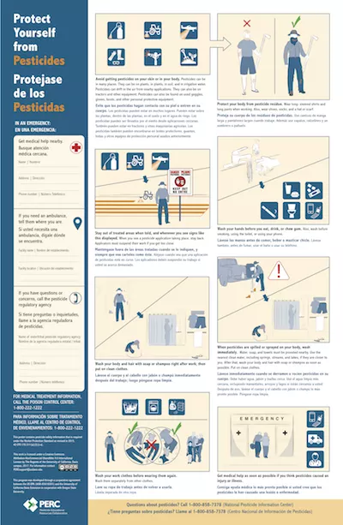
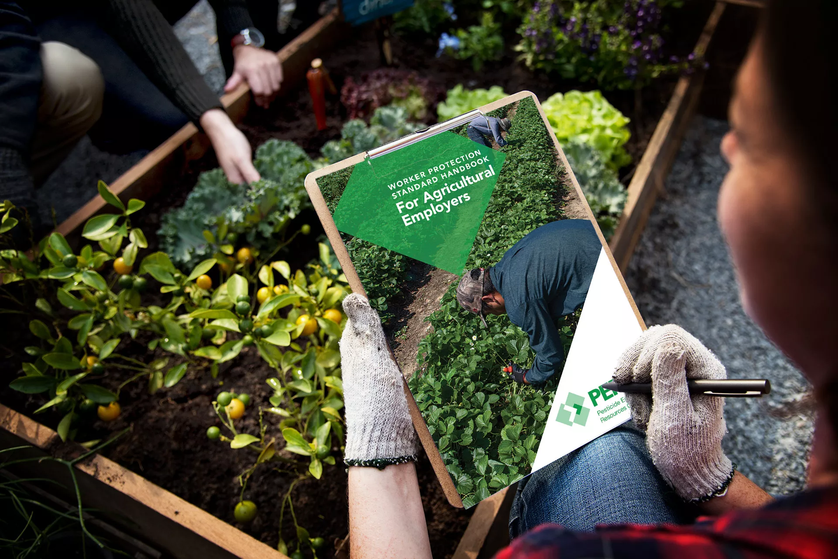
PERC’s Agricultural Community-Based Projects
The Pesticide Education Resources Collaborative (PERC) is an EPA cooperative agreement that coordinates the development of pesticide related educational resources that meet national needs related to implementing the Worker Protection Standard and Certification of Pesticide Applicators regulations.
PERC’s cooperative agreement includes a subaward program for Agricultural Community-Based Projects (AgCBPs).
Funds nonprofits to serve farmworkers, agricultural pesticide handlers, their families, and/or their communities by contributing to the safe use of pesticides and/or working safely in areas where pesticides are used
Currently 6 AgCBPs have been awarded amounting to a total of $546,186 in funds.
Photo credit: https://www.pesticideresources.org/

Slide 47
PERC’s Agricultural Community-Based Projects
Campesinos Sin Fronteras
Award: $100,000 for Two Years
Project: To reach and educate Spanish-speaking Latino farmworkers, pesticide applicators, and their families living and working in the rural surrounding communities of Yuma County, Arizona on pesticide safety.
Toxic Free North Carolina
Award: $50,000 for Two Years
Project: Increase awareness of the Worker Protection Standard (40 CFR Part 170) and pesticide safety among farmworkers and their communities in North Carolina.
Farmworker Association of Florida
Award: $100,000 for One Year
Project: To inspire and enable the farmworker community to reduce their chronic exposure to agricultural pesticides.
Photo credit: https://en.campesinossinfronteras.com/, https://toxicfreenc.org/,& https://floridafarmworkers.org/

Slide 48
PERC’s Agricultural Community-Based Projects
Ag Health and Safety Alliance
Award: $100,000 for Two Years
Project: Focuses on safe pesticide handling and PPE usage with an emphasis on respiratory safety.
National Center for Farmworker Health
Award: $100,000 for Two Years
Project: Increase awareness of the Worker Protection Standard (40 CFR Part 170) and pesticide safety in farmworker communities that speak Mesoamerican Indigenous languages.
Surry Medical Ministries
Award: $96,186 for Two Years
Project: Increase awareness of pesticide exposure health risks for migrant and seasonal farmworkers in western North Carolina.
Photo credit: https://aghealthandsafety.com/, https://surrymedicalministries.com/, & https://www.ncfh.org/

Slide 49
PERC’s Agricultural Community-Based Projects
Third Request for Applications for AgCBPs closed February 1, 2024
Anticipated funding by August 1, 2024
To learn more and apply for this opportunity please visit PERC’s website: www.pesticideresources.org/
Photo credit: https://www.pesticideresources.org/

