Slide 1
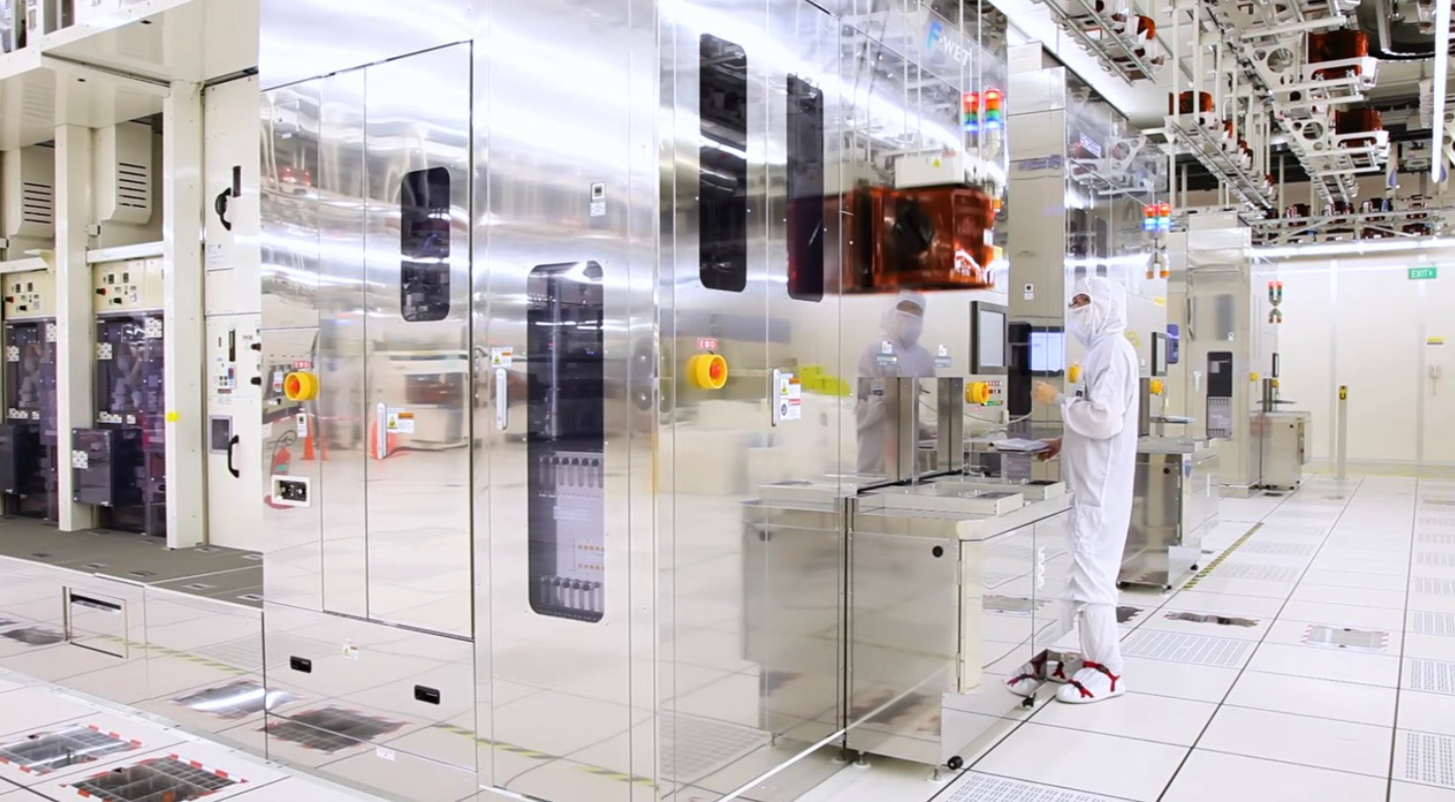
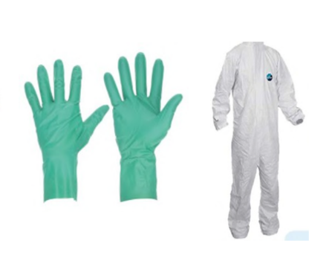
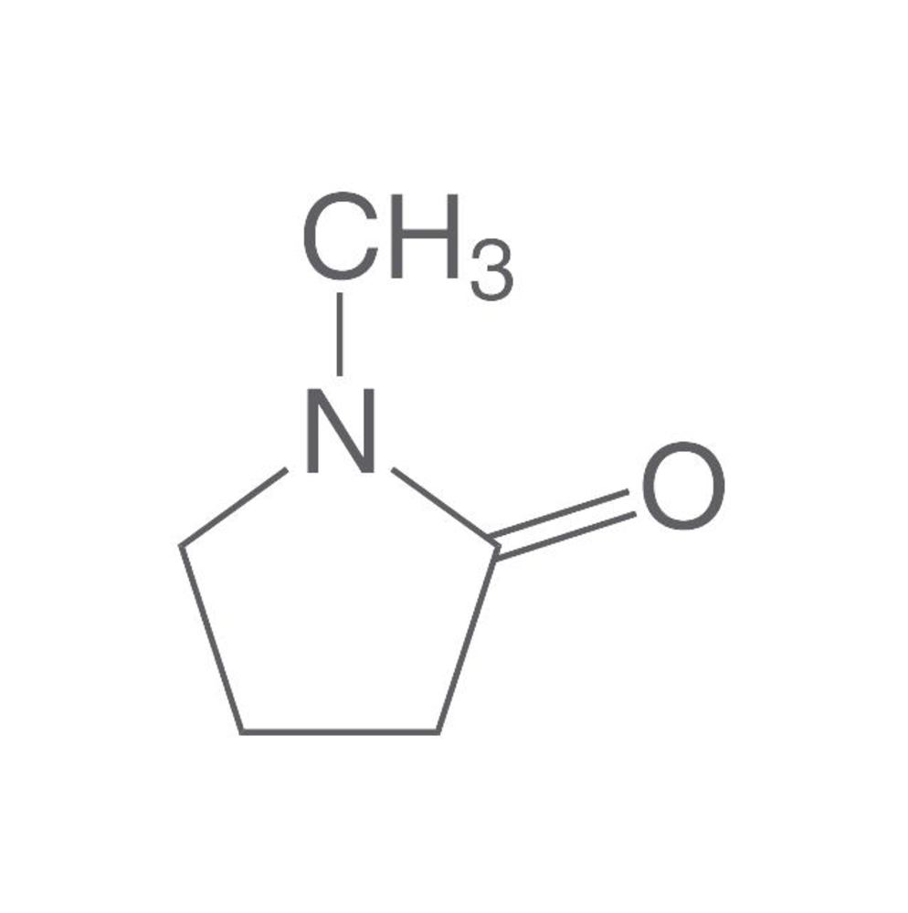

N-Methylpyrrolidone (NMP) Proposed Rulemaking Under TSCA Section 6(a)
Public Webinar
June 20, 2024
RIN 2070-AK85
U.S. Environmental Protection Agency
OCSPP-OPPT-ECRMD

Slide 2
Agenda
Purpose and Overview of Rulemaking
NMP Background
TSCA Regulatory Toolbox
Developing Effective Regulations
Proposed Regulation
Alternative Regulatory Action
Benefits
Requests for Comment and Opportunities for Engagement
Next Steps
Additional Resources

Slide 3
EPA’s Proposal and the Toxic Substances Control Act (TSCA)
In June 2016, Congress amended the Toxic Substances Control Act (TSCA)
  EPA must assess and address risks from chemicals currently in commerce
  Statutory timeframes for regulation
  Protection for the public and predictability for the regulated community
NMP was identified in 2016 as one of the first chemicals for risk evaluation
  2020 Risk Evaluation followed a public draft and peer review process
  2022 Revised Unreasonable Risk Determination
  EPA determined NMP presents an unreasonable risk under its conditions of use

Slide 4
Purpose and Overview Of Rulemaking
Addresses the unreasonable risk identified in the risk evaluation of NMP ​
Rule will protect consumer and occupational users through strict workplace requirements, prescriptive controls, and prohibitions
Public comment period open until 07/29/2024
EPA will consider public comments as it develops a final regulation

Slide 5
NMP Background
NMP is a powerful carrier solvent with low volatility and is used in wide-ranging industrial, commercial, and consumer applications. These include uses such as a processing aid or a solvent, in various coatings and their associated removers, in the production of electronics, and in the production of various polymers including plastics and resins
Risks to workers and consumers for 29 of the 37 conditions of use contribute to the unreasonable risk from NMP. Risks are primarily driven by direct dermal contact rather than inhalation exposure
Timeline:​
  November 2016 – EPA designates NMP as one of the first ten chemicals for risk evaluation​
  December 2020 – Risk Evaluation for NMP​ completed
  December 2022 – Revised Risk Determination​ completed
  June 2024 – EPA Proposal for the Regulation of NMP under Section 6(a)

Slide 6
NMP Risk Evaluation: Unreasonable Risk for Workers and Consumers
Acute developmental effects from inhalation and dermal exposures
Chronic reproductive effects from inhalation and dermal exposures
Dermal exposure is the main driver of unreasonable risk from direct dermal contact. Inhalation exposure contributes to the unreasonable risk but does not drive it.
Reproductive effects from chronic exposure and developmental effects from acute exposure are the most sensitive endpoints
  Additional effects from exposure include liver toxicity, kidney toxicity, immunotoxicity, neurotoxicity, skin irritation, and sensitization
No unreasonable risk to the environment

Slide 7
TSCA Section 6(a) Regulatory Options
TSCA provides authority to regulate entities including: ​
  Manufacturers (including importers) and processors (e.g., formulators)​
  Distributors​
  Commercial users (workplaces and workers) ​
  Entities disposing of chemicals for commercial purposes​
Cannot directly regulate consumer users ​
  Under TSCA, EPA has authority to regulate at the manufacturing, processing and distribution levels in the supply chain to eliminate or restrict the availability of chemicals and chemical-containing products for consumer use​
  These authorities allow EPA to regulate at key points in the supply chain to effectively address unreasonable risks to consumers

Slide 8
TSCA Section 6(a) Regulatory Options (cont.)
Prohibit, limit or otherwise restrict manufacture, processing or distribution in commerce​
Prohibit, limit or otherwise restrict manufacture (includes import), processing or distribution in commerce for particular use or for use above a set concentration​
Require minimum warnings and instructions with respect to use, distribution, and/or disposal​
Require recordkeeping, monitoring or testing​
Prohibit or regulate manner or method of commercial use​
Prohibit or regulate manner or method of disposal by certain persons​
Direct manufacturers/processors to give notice of the unreasonable risk determination to distributors, users, and the public and replace or repurchase​
The section 6(a) menu of regulatory options can be applied alone or in combination.

Slide 9
Principles for Transparency During Risk Management
Transparent, proactive, and meaningful engagement during risk management helps EPA develop practical and protective regulations ​
One-on-one meetings, public webinars, and required consultations with state and local governments, Tribes, environmental justice communities, and small businesses​
Consultation and coordination with other Federal agencies​
  OSHA, NIOSH, and CPSC for a consistent approach, facilitate compliance, and avoid duplicative requirements​
  DOD, DOE, and NASA for uses that might affect U.S. critical infrastructure or national security and to facilitate compliance
  SBA Advocacy and OMB/OIRA for a Small Business Advocacy Review panel to obtain advice and recommendations from small entity representatives​
Extensive dialogue helps people understand risk evaluation findings, the TSCA risk management process, and available options for managing unreasonable risks ​
Have been seeking input from stakeholders on potential risk management approaches, their effectiveness, and impacts those approaches might have on businesses, workers, and consumers

Slide 10
Developing Effective Regulations
EPA’s priority is to address unreasonable risk​
EPA must consider:​
  Effects and magnitude of exposure to human health and the environment​
  Potentially Exposed or Susceptible Subpopulations​​
  Benefits of a chemical substance​
  Economic consequences of the rule​
  Availability of alternatives​
Proposal is based on best available science and reasonably available information

Slide 11
Developing Effective Regulations (cont.)
EPA’s goal is practical and protective regulations. The NMP proposal: ​
Establishes strict worker protections so most uses could continue with appropriate controls in place, including prevention of direct dermal contact
Requires achievable concentration limits for certain uses so they could continue without unreasonable risk to workers and consumers
Prohibits uses that cannot continue safely
Meets TSCA requirement to address risk to the extent necessary so that it is no longer unreasonable, including risk to potentially exposed or susceptible subpopulations (PESS)​
Requires recordkeeping to ensure rule is enforceable

Slide 12
Developing Effective Regulations (cont.)
Requesting comment on all elements of the proposed and alternative regulatory action​
EPA may in the final rule modify elements of the proposed regulatory action
Public comments could result in changes when this rule is finalized

Slide 13
The Proposed Regulation
EPA’s proposed rule would:
Require container size limits and labeling requirements for the manufacture (including import), processing, and distribution in commerce of NMP products for seven consumer uses to prevent commercial use
Require a concentration limit on NMP for the import, processing, and distribution in commerce for one consumer use
Establish recordkeeping and downstream notification requirements
Prohibit the manufacture (including import), processing, distribution in commerce, and industrial and commercial use of NMP for five occupational uses
Require strict workplace controls in an NMP WCPP, which would include requirements to prevent direct dermal contact with NMP for most occupational conditions of use
Require prescriptive controls, including concentration limits and PPE requirements for seven occupational conditions of use

Slide 14
Proposed Regulation: Workplace Chemical Protection Program (WCPP)
A Workplace Chemical Protection Program (WCPP) protects people from risk posed by occupational exposures
EPA is proposing to require owners or operators to implement strict workplace controls, including direct dermal contact controls (DDCC) in accordance with the hierarchy of controls while also providing flexibility in implementation and aligns with existing OSHA requirements wherever possible
  Owners or operators is broader than “employers” and “employees”
  Includes additional recordkeeping, dermal, and exposure control plan requirements
EPA expects many workplaces already have these commonsense stringent controls in place
  Uncertainty regarding ability to comply with WCPP is the primary driver of difference between the proposed approaches

Slide 15
Proposed Regulation: Workplace Chemical Protection Program (WCPP) (Cont.)
EPA is proposing to require a WCPP for all occupational conditions of use not prohibited or subject to other prescriptive controls including (but not limited to):
Manufacturing: domestic manufacturing and import​
Processing: as a reactant/intermediate; incorporation into a formulation, mixture, or reaction products in multiple sectors; incorporation into articles in multiple sectors; repackaging; recycling​
Industrial and commercial use in multiple sectors, including but not limited to:
  As a solvent for cleaning and degreasing in electronic product manufacturing
  As a processing aid in petrochemical manufacturing
  In laboratory chemicals ​
Disposal
EPA is proposing to require a WCPP for two mission- or safety-critical uses for DOD and NASA, which are otherwise regulated by prescriptive controls

Slide 16
Proposed Regulation: Prescriptive Controls
EPA is proposing specific prescriptive controls for certain occupational conditions of use where preventing direct dermal contact through implementation of a WCPP or a prohibition may not be practicable.
  A concentration of NMP no greater than 45% in specific paint and coating products, with requirements for specific dermal PPE and respirators for processing and industrial and commercial uses
  A concentration of NMP no greater than 30% in specific paint and coating removal products, with requirements for specific dermal PPE and respirators for industrial and commercial use
  A concentration of NMP no greater than 5% with requirements for dermal PPE for the industrial and commercial use in ink, toner, and colorant products in printer ink
  A concentration of NMP no greater than 1% with requirements for dermal PPE for the industrial and commercial use in soldering materials
This approach is for uses where variable formulations are available on the market, based on publicly available information. There is uncertainty that these uses can prevent direct dermal contact through engineering and administrative controls​.

Slide 17
Proposed Regulation: Prohibition of Certain Occupational Uses and Manufacturing, Processing, and Distribution in Commerce
EPA is proposing to prohibit the manufacturing (including import), processing, distribution in commerce, and use of NMP for the following conditions of use:
  Processing incorporation into articles in lubricants and lubricant additives in machinery manufacturing;
  Industrial and commercial use in anti-freeze and de-icing products, automotive care products, and lubricants and greases;
  Industrial and commercial use in metal products not covered elsewhere and lubricant and lubricant additives including hydrophilic coatings;
  Industrial and commercial use in cleaning and degreasing and cleaning and furniture care products, including wood cleaners and gasket removers; and
  Industrial and commercial uses in fertilizer and other agricultural chemical manufacturing-processing aids and solvents.
EPA is proposing a prohibition for these conditions of use because:
  Reasonably available information suggests alternatives are available for most of the uses or ongoing use is minimal
  EPA is uncertain regarding feasibility to implement controls to reduce exposures sufficient to address the unreasonable risk and the irreversible health effects associated with NMP exposures
  Additional information about these uses, including about workplace exposure controls, could reduce EPA’s uncertainty and be considered in any changes in the final regulation

Slide 18
Proposed Regulation: Concentration Limits on NMP in Products for Consumer Use
EPA determined one consumer use of NMP contributes to the unreasonable risk (use of NMP in adhesives and sealants in glues and adhesives, including lubricant adhesives and sealants)
TSCA allows EPA to regulate upstream of consumers to address unreasonable risk ​
The proposed rule would restrict the manufacturing (including import), processing, and distribution for consumer use in a concentration of NMP no greater than 45%
Provides time for retailers to reformulate their consumer product inventory​

Slide 19
Proposed Regulation: Container Size Restrictions and Labeling Requirements
While EPA determined that most consumer uses of NMP do not contribute to the unreasonable risk, the commercial counterparts of these conditions of use do from the increased exposure and more frequent use by workers
To prevent the consumer products intended for consumer use from being used in commercial activities, EPA is proposing to prohibit the import, processing, and distribution in commerce of NMP or NMP-containing products in containers above 16 ounces, and is proposing to require labels each product for consumer use:
  In paint and coating removers;
  In adhesive removers;
  In paints and coatings in lacquer, stains, varnishes, primers and floor finishes;
  In paint additives and coating additives in paints and arts and crafts paints;
  In automotive care products;
  In cleaning and furniture care products, including wood cleaners, gasket removers; and
  In lubricant and lubricant additives, including hydrophilic coatings.

Slide 20
Proposed Regulation: Recordkeeping and Downstream Notification
Downstream notification of the prohibitions would be carried out through Safety Data Sheet updates ​
Downstream notification spreads awareness throughout the supply chain of the restrictions on NMP under TSCA and provides information to commercial end users about timeframes for allowable uses of NMP
Recordkeeping requirements include maintenance of normal business records and records related to WCPP requirements, monitoring, and compliance

Slide 21
Primary Alternative Regulatory Action
As with the proposed action, the primary alternative regulatory action considered is a combination of a WCPP and prohibition​
  Prohibits fewer uses than the proposed regulatory action: Instead of prohibition or prescriptive controls requires a WCPP
  Includes prohibitions instead of prescriptive controls (including a concentration limit), for the industrial and commercial use of NMP in adhesives and sealants and the manufacturing, processing, and distribution for consumer use​
  The primary alternative regulatory action would not include restrictions on the container size or label requirements of consumer products (because the commercial uses would be under WCPP, instead of prohibited)
Under the alternative regulatory action, the WCPP would take effect 6 months later than under the proposed regulatory action (within 18 months after date of publication of the final rule in the Federal Register).
The timeframes for prohibitions under the alternative regulatory action for a prohibition are the same as the proposed regulatory action

Slide 22
Proposed Compliance Dates
Regulatory Requirement | Proposed Timeline (after the publication date of the final rule)
WCPP | 12 months
Prescriptive Controls | 12 months for importers 15 months for processors 18 months for distributing to retailers 21 months for all other distributors (including retailers) 24 months for industrial and commercial users
Prohibition | 12 months for manufacturers 15 months for processers 18 months for distributing to retailers 21 months for all other distributors (including retailers) 24 months for industrial and commercial users
Container size restrictions and labeling requirements | 12 months

Slide 23
Benefits of Proposed Rule
Would address unreasonable risks for consumers and workers and provide regulated community with confidence in a protected and healthier workforce
Ensures the unreasonable risk is adequately addressed with commonsense workplace protections while allowing for important uses of NMP in the marketplace to continue, including:
  In the production of specialized electronics like lithium ion batteries and semiconductors
  Uses in national security, aerospace, other critical infrastructure, and the Agency’s efforts to combat the climate crisis
Would use concentration limits to provide protection while allowing uses to continue where appropriate

Slide 24
Request for Comments
Requesting comments and substantiative information regarding several topics, including:​
The Workplace Chemical Protection Program (WCPP) and its various components (e.g., DDCC, restricted areas, process changes)​
Timeframes for implementation of the requirements ​
Specific engineering or administrative controls that could address the unreasonable risk​
Feasibility of alternatives to NMP and their availability​
Feasibility of the proposed concentration limits
Any uses that are currently proposed to be prohibited that may need a longer timeframe
Identification of a 0.1% de minimis concentration limit of NMP in products and formulations

Slide 25
Types of Information that Best Inform Comments
Potentially useful information for key areas of uncertainty should include information within the last 20 years.
Descriptions of commercial worker activities and associated sources of exposure​
Product formulation information​
Relevant unpublished data

Slide 26
Next Steps
Process Step​ | Date​
Publication of proposed rule on NMP in docket (EPA-HQ-OPPT-2020-0744) and open comment period ​ | June 14, 2024
Closure of comment period: EPA will review and consider new information submitted​ | July 29, 2024
Publication of Final Rule for NMP (estimated)​ | 2025
Prohibition and WCPP for most uses would be in full effect 12 months after date of the final rule (estimated)​ | 2026

Slide 27
Additional Resources
Risk management for NMP: https://www.epa.gov/assessing-and-managing-chemicals-under-tsca/risk-management-n-methylpyrrolidone-nmp​
NMP risk evaluation, supplemental risk evaluation materials, and proposed rulemaking are in dockets EPA-HQ-OPPT-2019-0236, EPA-HQ-OPPT-2016-0743, and EPA-HQ-OPPT-2020-0744 respectively, and may be accessed through www.regulations.gov​
General TSCA: https://www.epa.gov/assessing-and-managing-chemicals-under-tsca/frank-r-lautenberg-chemical-safety-21st-century-act​
Chemicals Undergoing Risk Evaluation under TSCA: https://www.epa.gov/assessing-and-managing-chemicals-under-tsca/chemicals-undergoing-risk-evaluation-under-tsca​
Current Chemical Risk Management Activities: https://www.epa.gov/assessing-and-managing-chemicals-under-tsca/current-chemical-risk-management-activities

Slide 28
Contact Us
All comments in order to be considered should be submitted to the docket at EPA-HQ-OPPT-2020-0744
For general questions, email EPA at NMP.TSCA@epa.gov

