Slide 1

Improving the Temporal and Spatial
Characterization of Usage
for Nonroad Equipment
James Warila and Claudia Toro
U.S. Environmental Protection Agency
Office of Transportation and Air Quality
Ann Arbor, Michigan
For help accessing this document, email NEI_Help@epa.gov.
2023 International Emissions Inventory Conference
September 26-29, 2023 | Seattle, WA

Slide 2
Background
The MOVES-Nonroad model
  Estimates emissions inventory for nonroad equipment
    From numerous equipment types
  Used by myriad stakeholders and EPA
For multiple pollutants
  Greenhouse gases, energy consumption
  Gaseous emissions, criteria air pollutants
  Particulate matter
  Toxics, hazardous air pollutants
Equipment Activity (hours/year) is a key model input
  Current model assumptions are dated
  Current activity inputs are simple
    Do not account for equipment size, region, or economic sector

Slide 3
Improvements
Engaged in multi-year effort
  to redesign and update the model
Acquiring and analyzing data from new sources
  Auction house records
    Hour-meter readings at time of sale (see 2019 IEIC presentation)
  Portable instruments
    Portable Activity Measurement Systems (PAMS) deployed in research programs
  Telematics
    Increasingly used by equipment fleets
Leveraging partnerships to acquire new data
  Cooperative Research and Development Agreement with Texas A&M Transportation Institute (TTI)

Slide 4
Telematics
Has been used in onroad emissions inventory work
  To inform key inputs
Increasingly used by nonroad fleets
  For large equipment
Potential to improve current inputs
  Annual hours of operation
  By month, day and hour
Potential to inform new and different processes
  Engine idle
  Engine starts

Slide 5
Recent Data Acquisition
Recently acquired telematics datasets
  Through collaboration with TTI
Representing four fleets
  Three State Departments of Transportation
    Arkansas DOT
    Wyoming DOT
    California DOT (CalTrans)
  One private fleet
    Operating in civil engineering and road construction
    Throughout the southern U.S.
These analyses represent our first attempt
  To incorporate telematics in nonroad inventory

Slide 6
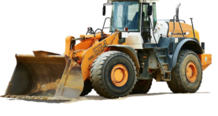
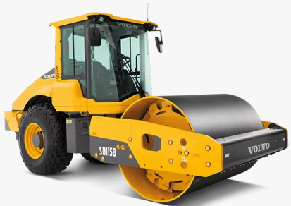
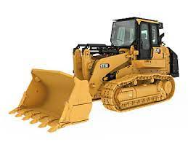
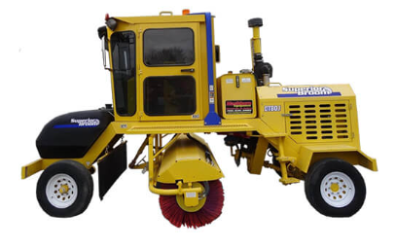
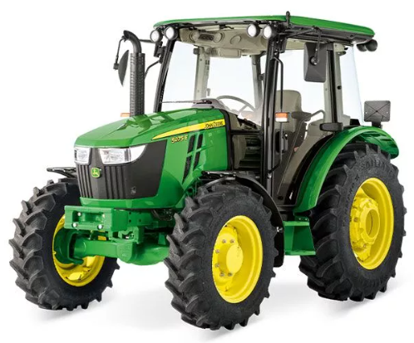
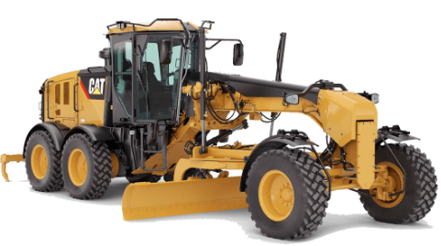
Equipment Types
AR: 11 pieces in 2 types
WY: 51 Pieces in 4 types
CA: 826 pieces in 22 Types
Private: 118 Pieces in 16 types
Following analyses focus on:
  Wheel loaders, utility tractors,
  Dozers, graders, roller compactors
Notes:
These datasets represent the kinds of equipment types of equipment typically used in road construction and maintenance.

Slide 7
Historic Depth
Calendar Year

Slide 8
Temporal Level-of-Detail (based on reporting frequency)

Slide 9
Geographic Level of Detail

Slide 10
Types of Operation

Slide 11
Activity by Month-of-Year

Slide 12
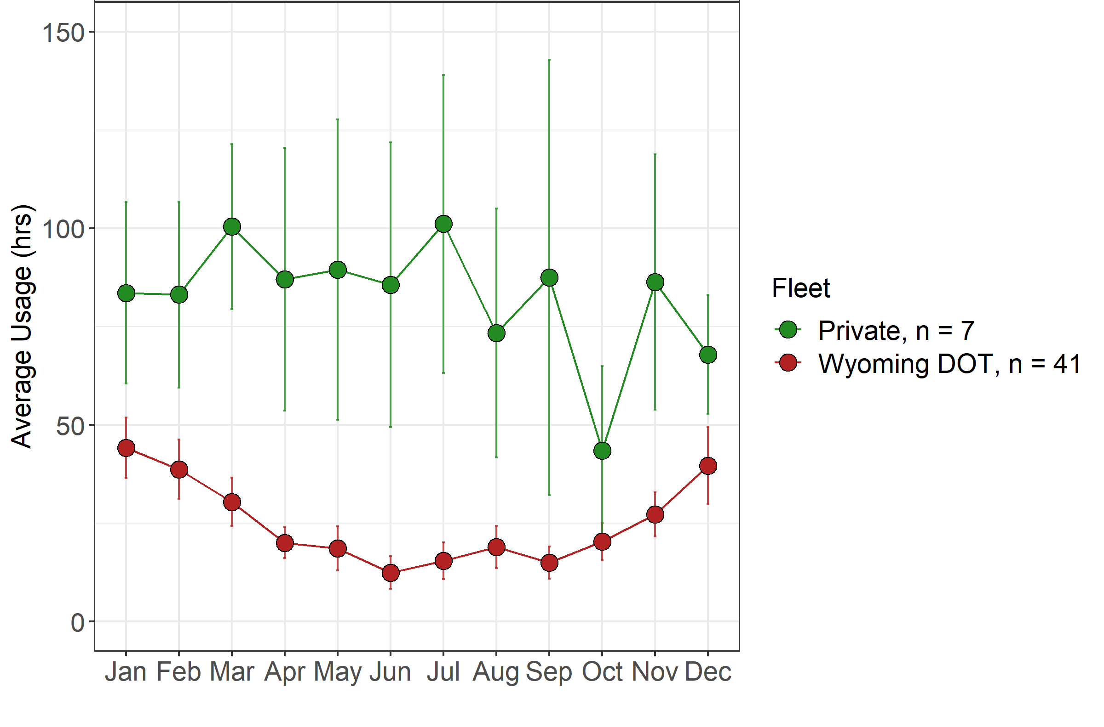
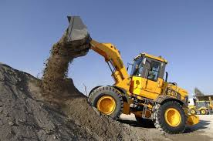
Month-of-Year: Wheel Loaders (75-130 kW)
Private: activity fairly uniform throughout the year
WY: most activity during the winter

Slide 13
Activity by Day-of-Week

Slide 14
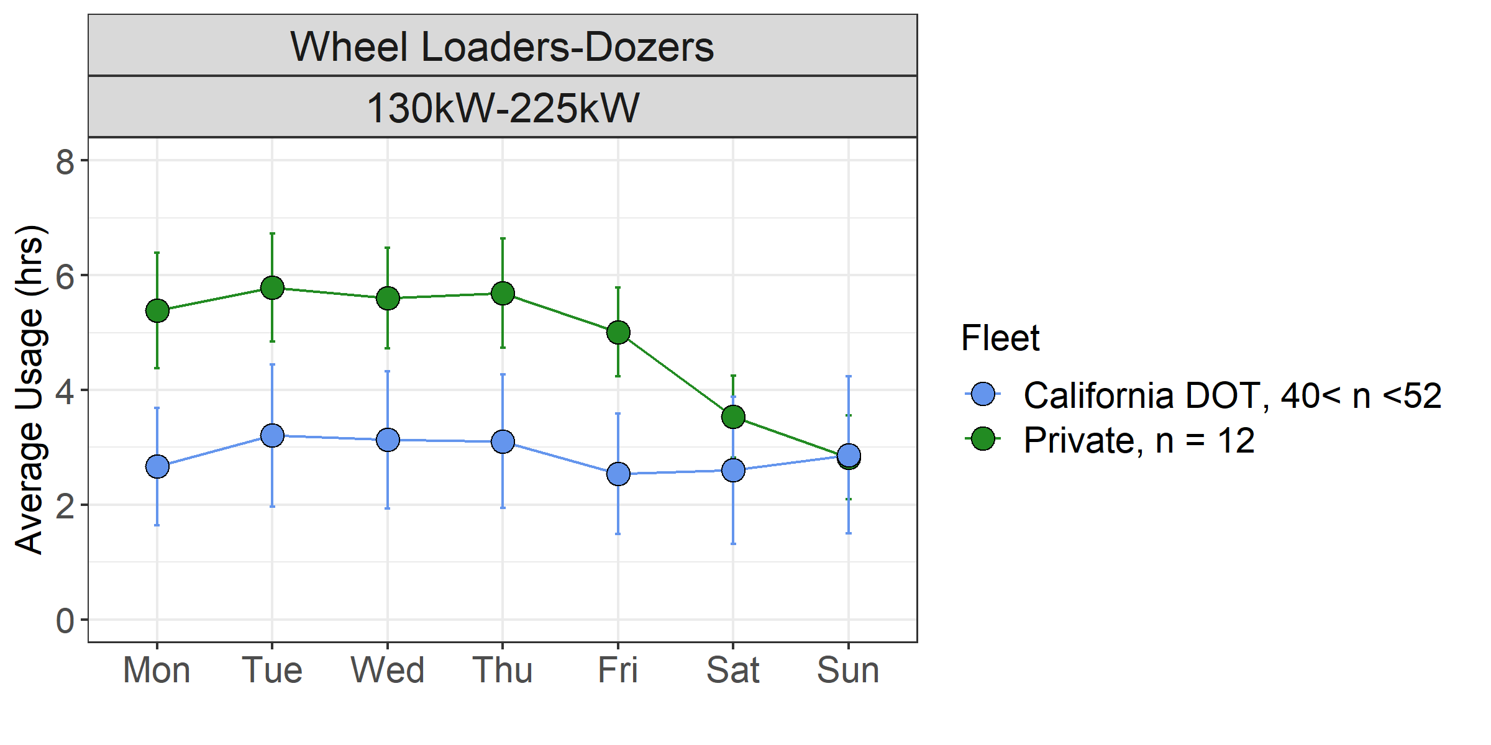
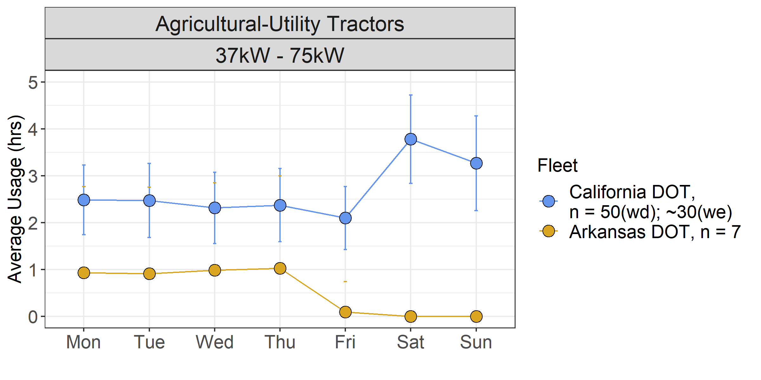
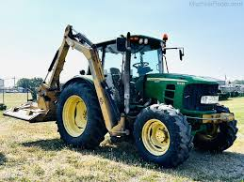
Day-of-Week: Wheel Loaders and Agricultural Tractors
CA: equipment works 7 days/week
Private: operates more during work week
AR: tends to operate 4 days/week

Slide 15
Activity by Hour-of-day
Based on CA data

Slide 16
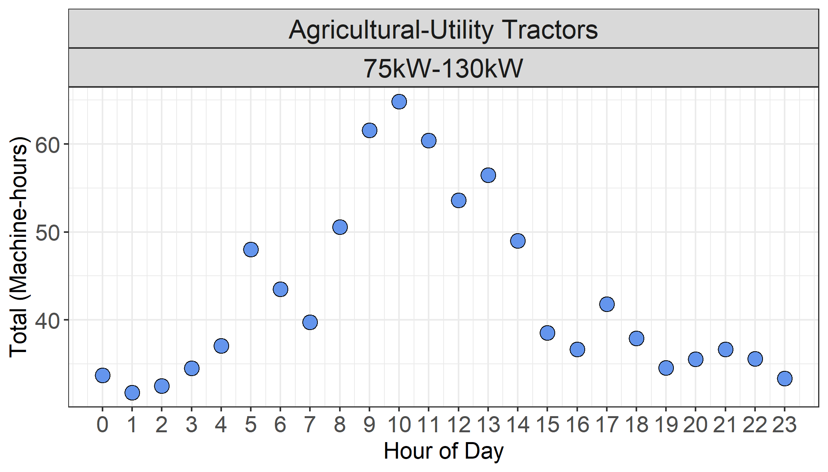
Hour-of-Day: Agricultural-Utility Tractors
Machine-hours =
No. machines × average op. time
Most operation during day
n=30-40
n=90
n=30-40

Slide 17
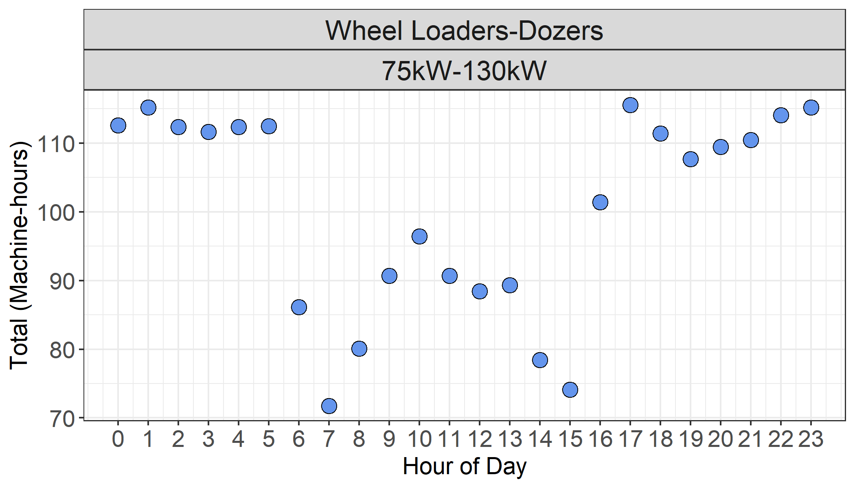
Hour-of-Day: Wheel Loaders
Most operation during night
n=130-150
n=160
n=130-150

Slide 18
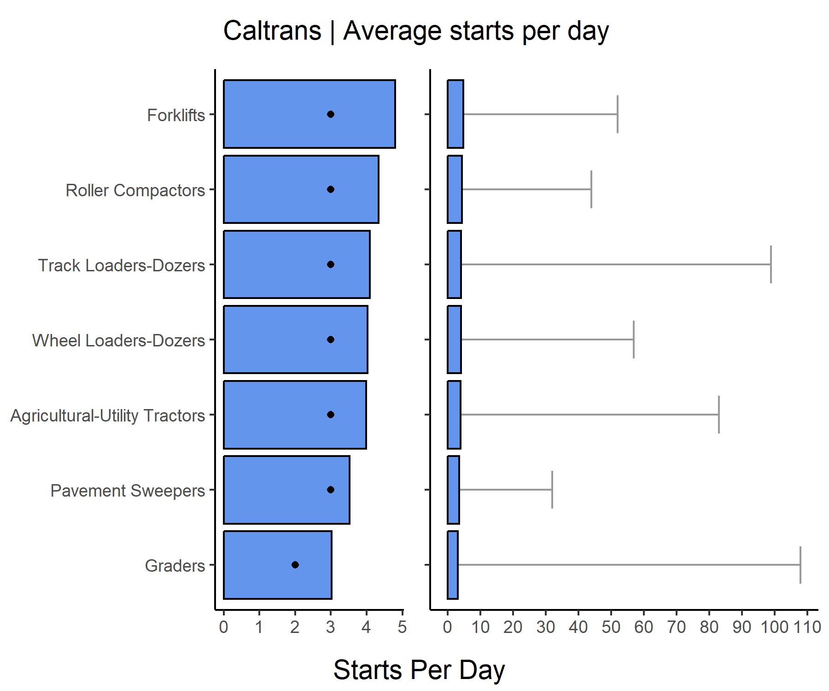
Starts-per-Day: by Equipment Type
n = 40
Means/Medians similar to onroad
Maxima are remarkably high
Could be due to local idle restrictions?
n = 31
n = 38
n = 250
n = 142
n = 129
n = 142
Notes:
Dots are medians, correct? Averages are similar to motor vehicles
Some equipment pieces have high numbers of starts during the day. Maybe that is due to CA idle restrictions?
Some individual pieces have high numbres of very short trips.
These data might not be representative of different states? The means and medians look reasonable though.

Slide 19
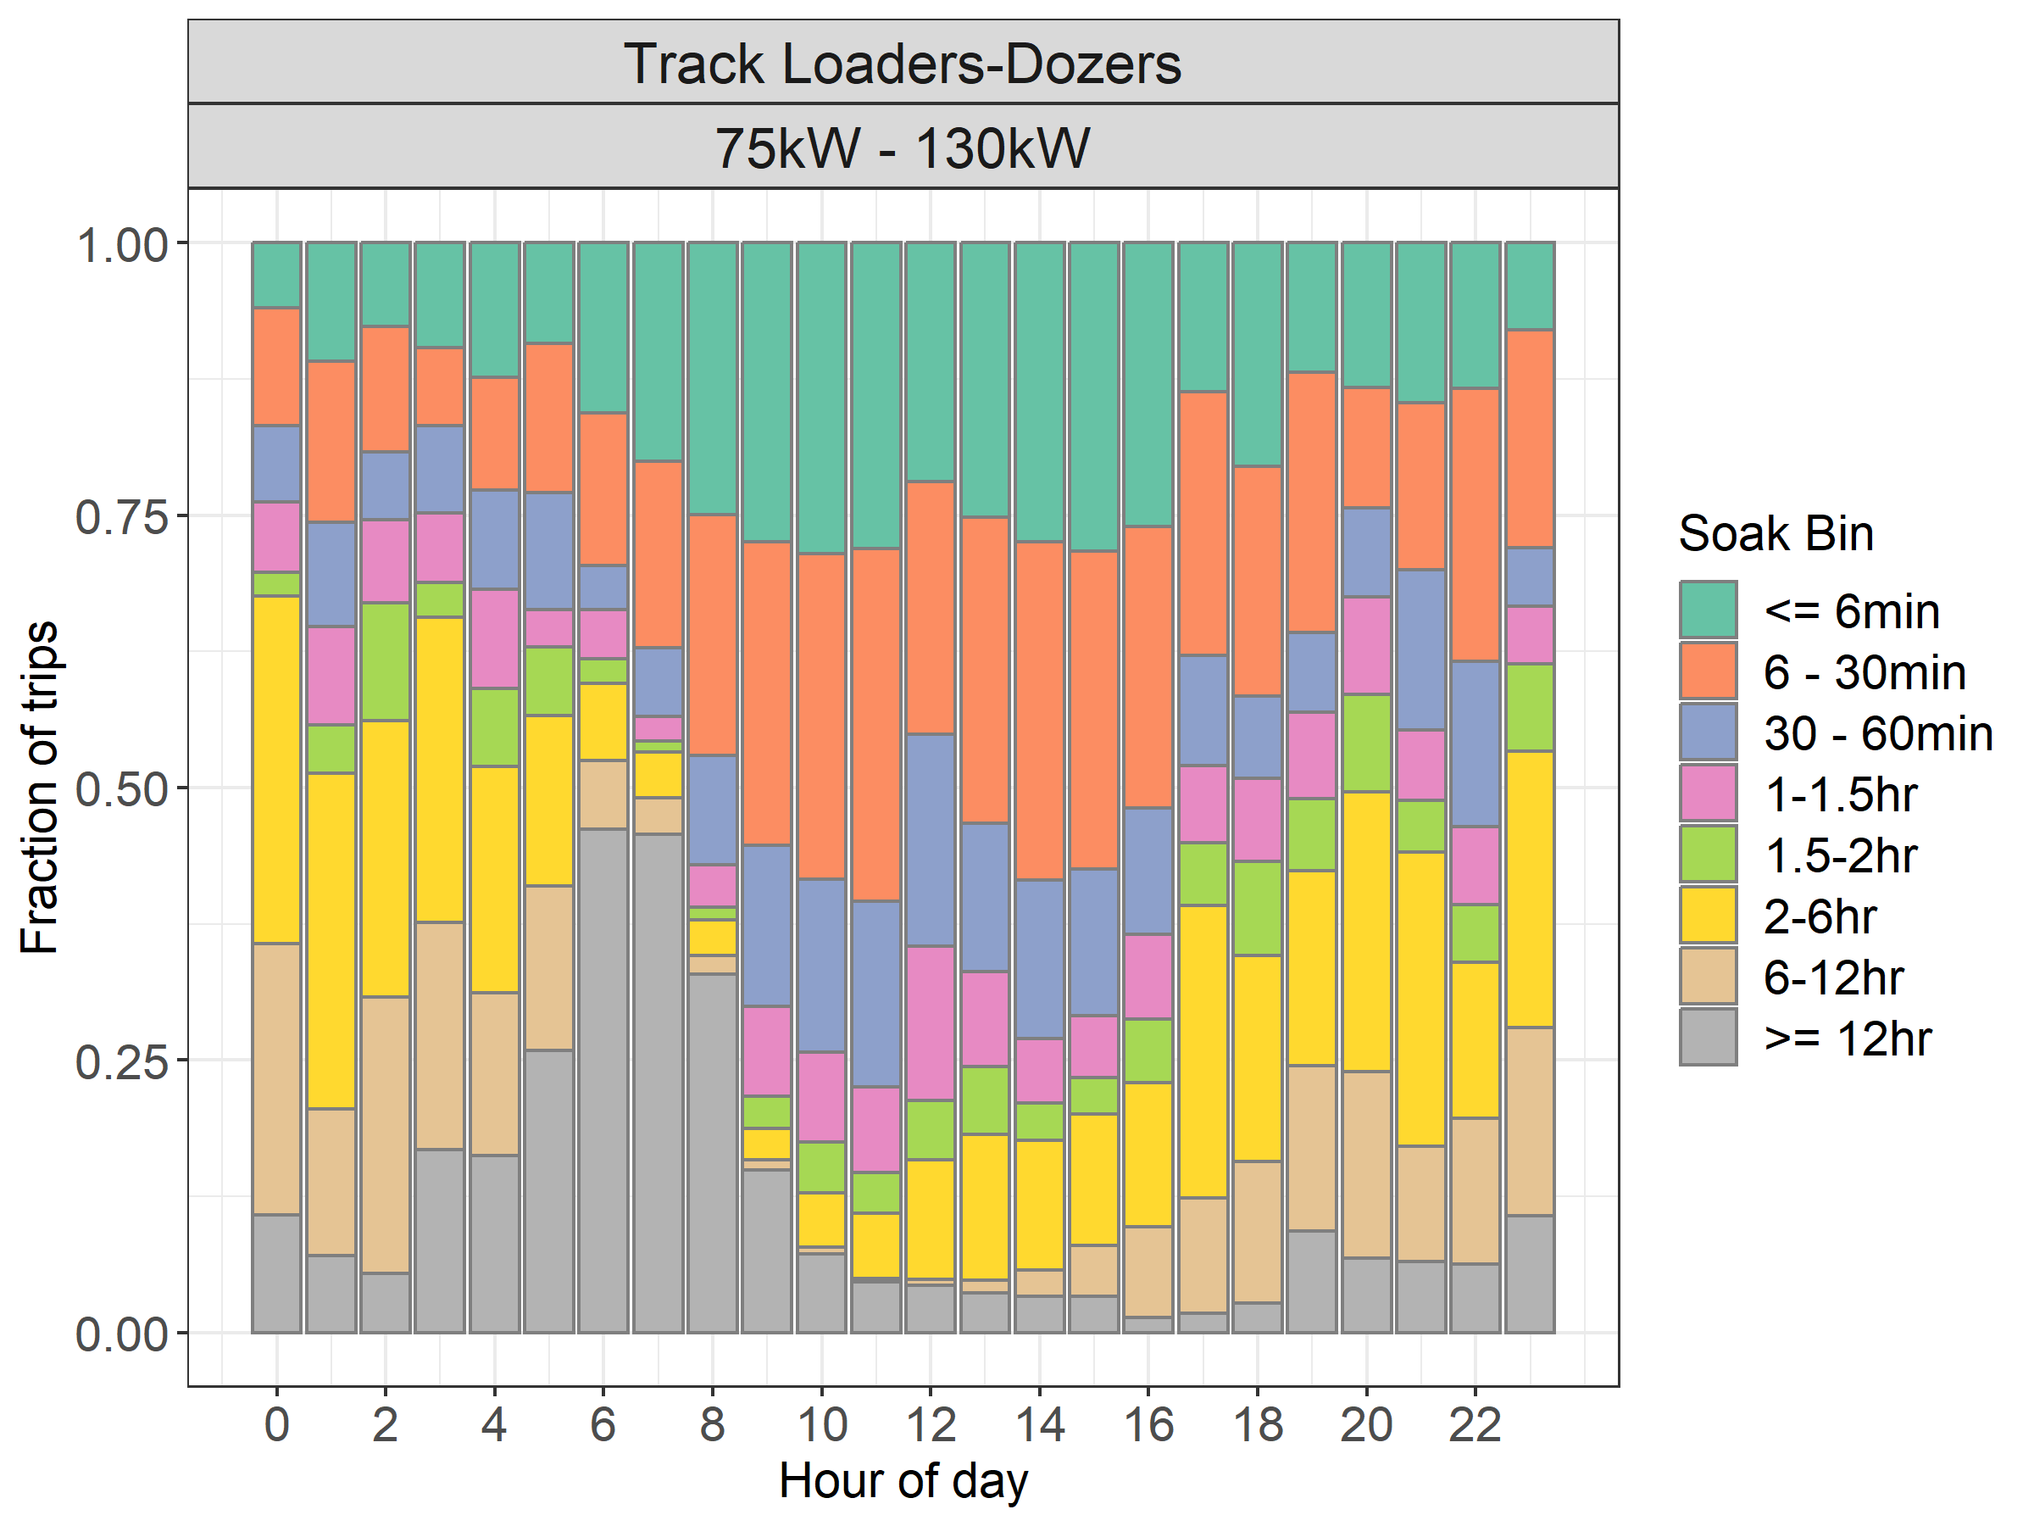
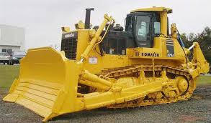
Soak Distributions: Track Dozers
Most short soaks during the work day
Longest soaks in early morning; with a 2nd peak in the evening

Slide 20
Idle Activity

Slide 21
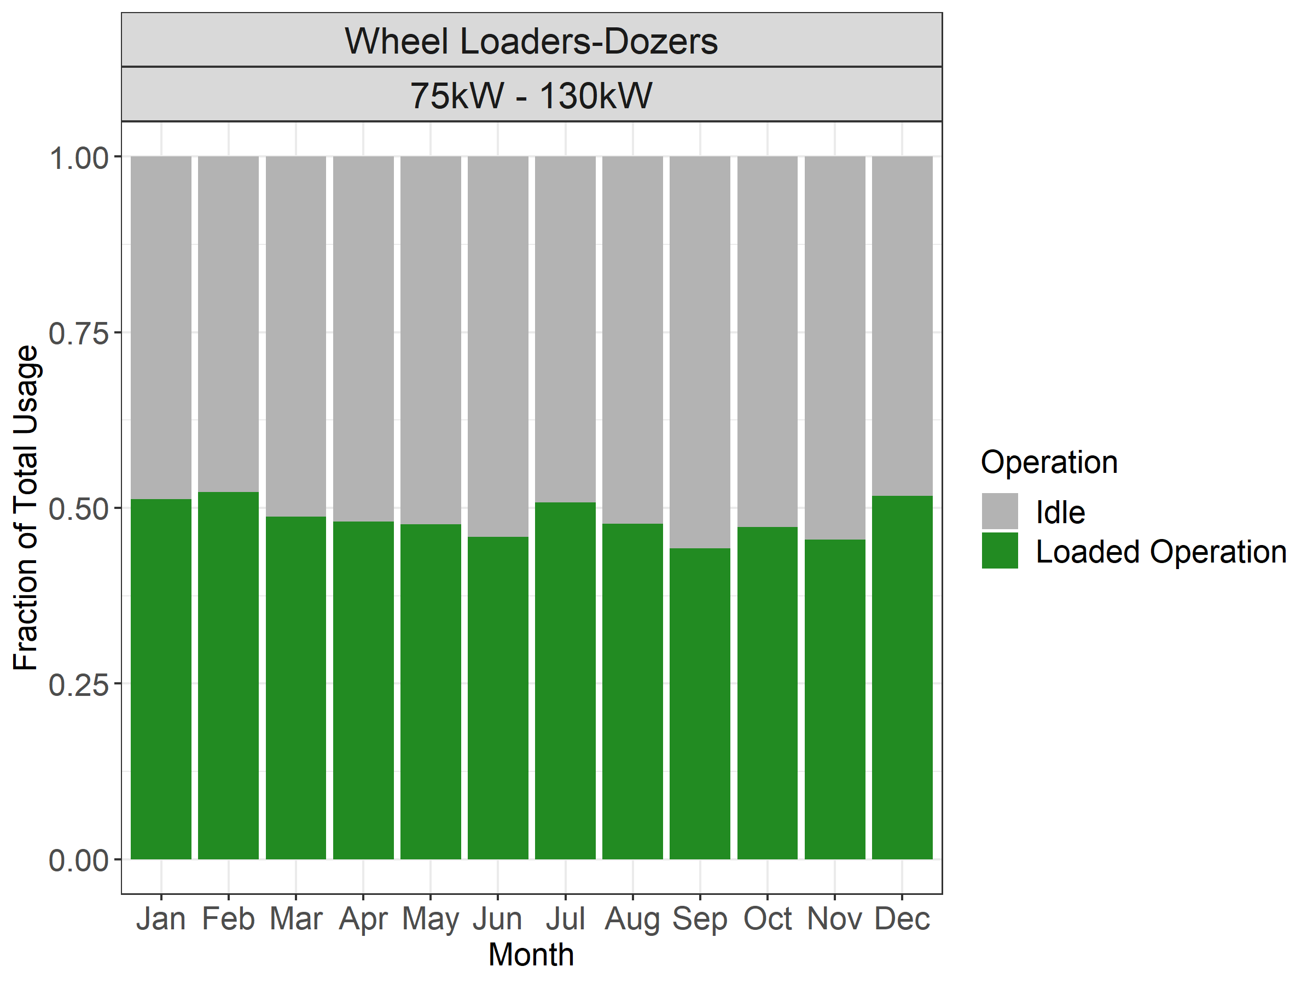
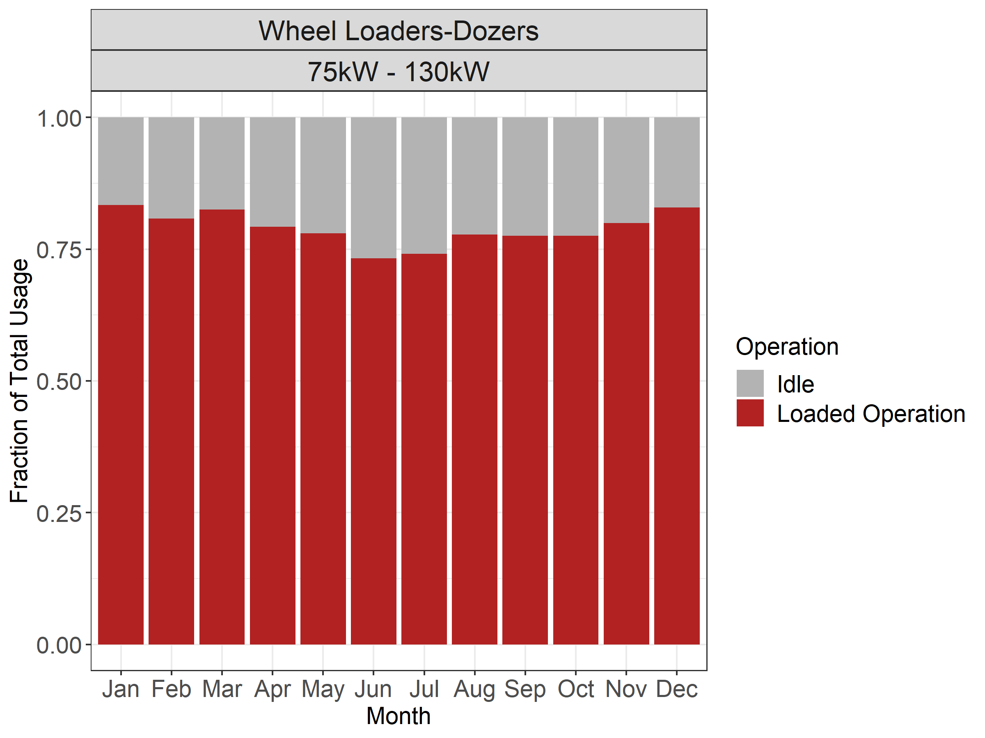
Idle Activity by Month
Private
Wyoming DOT
Privately-owned loaders idle twice as much as Publicly owned

Slide 22
Annual Activity and Comparison to MOVES-Nonroad

Slide 23
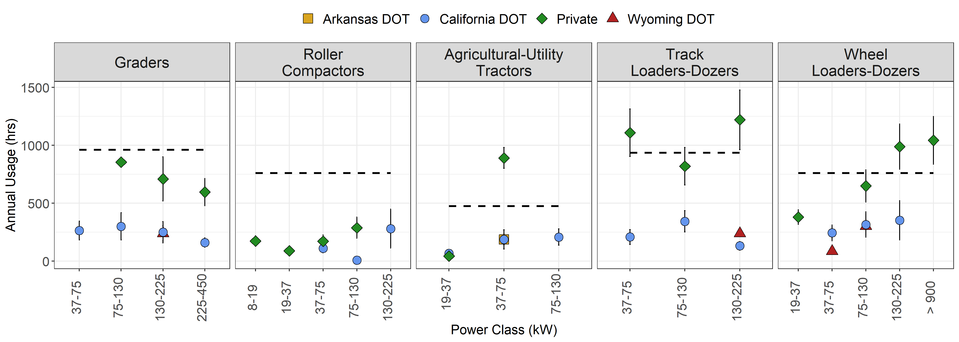
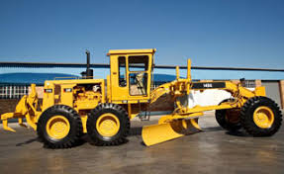
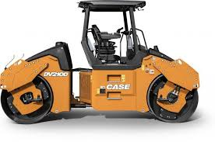
Annual Activity: Five Equipment Types
MOVES-Nonroad
Privately-owned equipment generally operates more than publicly owned.

Slide 24
Annual Activity: Five Equipment Types
MOVES-Nonroad
Lower than current Public Lower Private
Private higher Approximately similar

Slide 25
Summary and Conclusions

Slide 26
Capabilities
Telematics can be very powerful tool for understanding nonroad equipment activity usage
  Provides more detail than any other source
    Except portable instruments
Gives insight into detailed usage patterns
  Temporal (month, day, hour)
  Spatial (region, state, county, city)
  By economic sector
    Construction, agriculture, mining, public utilities, etc.

Slide 27
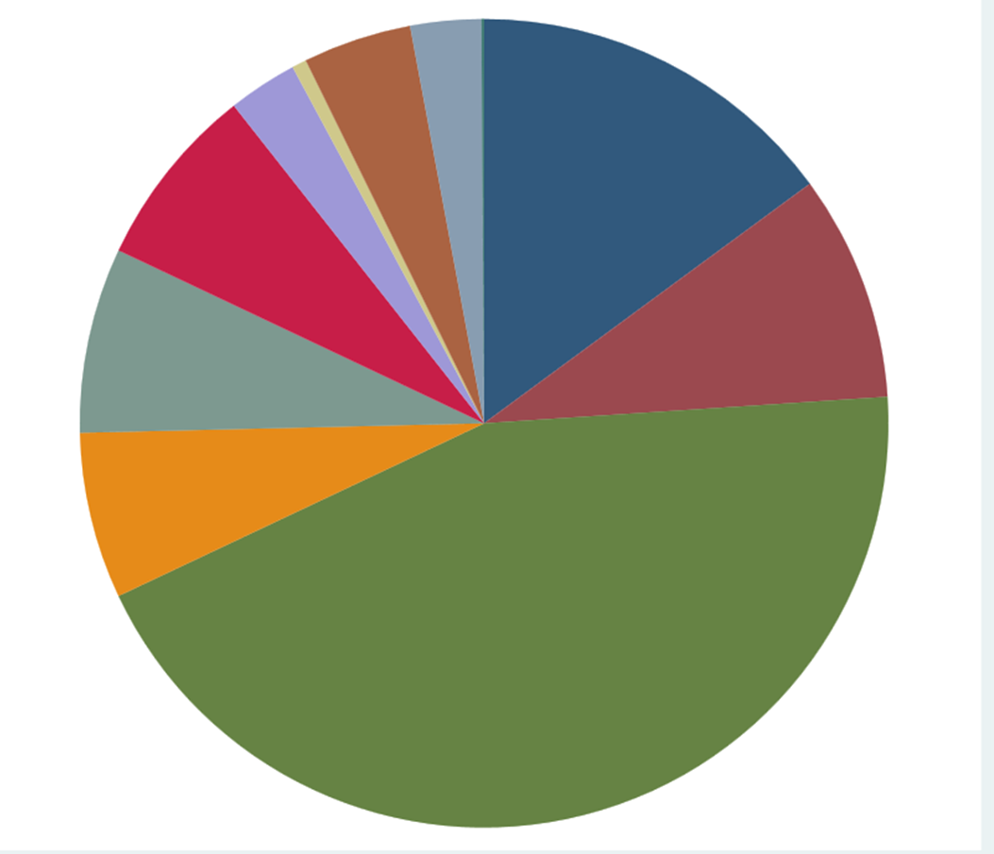
Limitations
Public Utilities
These datasets are detailed, but
  Narrow in scope
    Two economic sectors, one minor
  Shallow in depth
    No more than three years coverage
  Samples small
    When sliced by equipment size
Nonroad different from onroad
  Operation not defined by movement
    Speed, acceleration
  Telematics may not include engine operating parameters
Acquisition of broad, deep datasets may be difficult
  Must acquire from data owners
  What they are willing to share varies
Agriculture
Whole
-sale
Trade
Mining
Transport &
Public Util.
Manufacturing
Construction
Wheel Loaders

Slide 28
Applications
Telematics may be applied as model inputs in supplementary roles
  Developing allocation distributions
    seasonal, weekly, hourly, etc.
Telematics enables estimation of new types of activity
  Idle operation
  Engine starts
We plan to continue
  Leveraging partnerships to acquire new data

Slide 29
Acknowledgements
Texas A&M Transportation Institute (TTI)
  Jeremy Johnson, Phil Lewis, Joe Zietsman
Eastern Research Group (ERG):
  Michael Sabisch, Sandeep Kishan
U.S. EPA Office of Transportation and Air Quality
  Carl R. Fulper, Sarah Roberts
Disclaimer: The views expressed in this presentation are those of the authors and do not necessarily represent the views or policies of the​ U.S. Environmental Protection Agency. Additionally, photos used in this presentation are the property of their respective copyright owners ​and are used here for educational purposes only.

