Slide 1
Emissions from Residential Wood Combustion: A Snapshot of Real-Time Monitoring in Rural Oregon
2023 International Emissions Inventory Conference, Seattle
Dr. Nordica MacCarty
Associate Professor, Oregon State University
Executive Director, Aprovecho Research Center
Samuel Bentson and Jaden Berger, Aprovecho Research Center
Ryan Thompson, Mountain Air Engineering
September 28th, 2023

Slide 2
Introduction
DOE BETO Project “Development of Forced-Air Combustion Systems with Automated Controls to Reduce Emissions from Cordwood Room Heaters in Everyday Use”
Goal to understand real-world use to inform optimized woodstove design
Use cycles, loading, most polluting phases
→ Develop in-house R&D test protocol
In-situ fuel and emissions measurements in 7 households rural Oregon with snowball sampling for 2-4 days per household

Slide 3
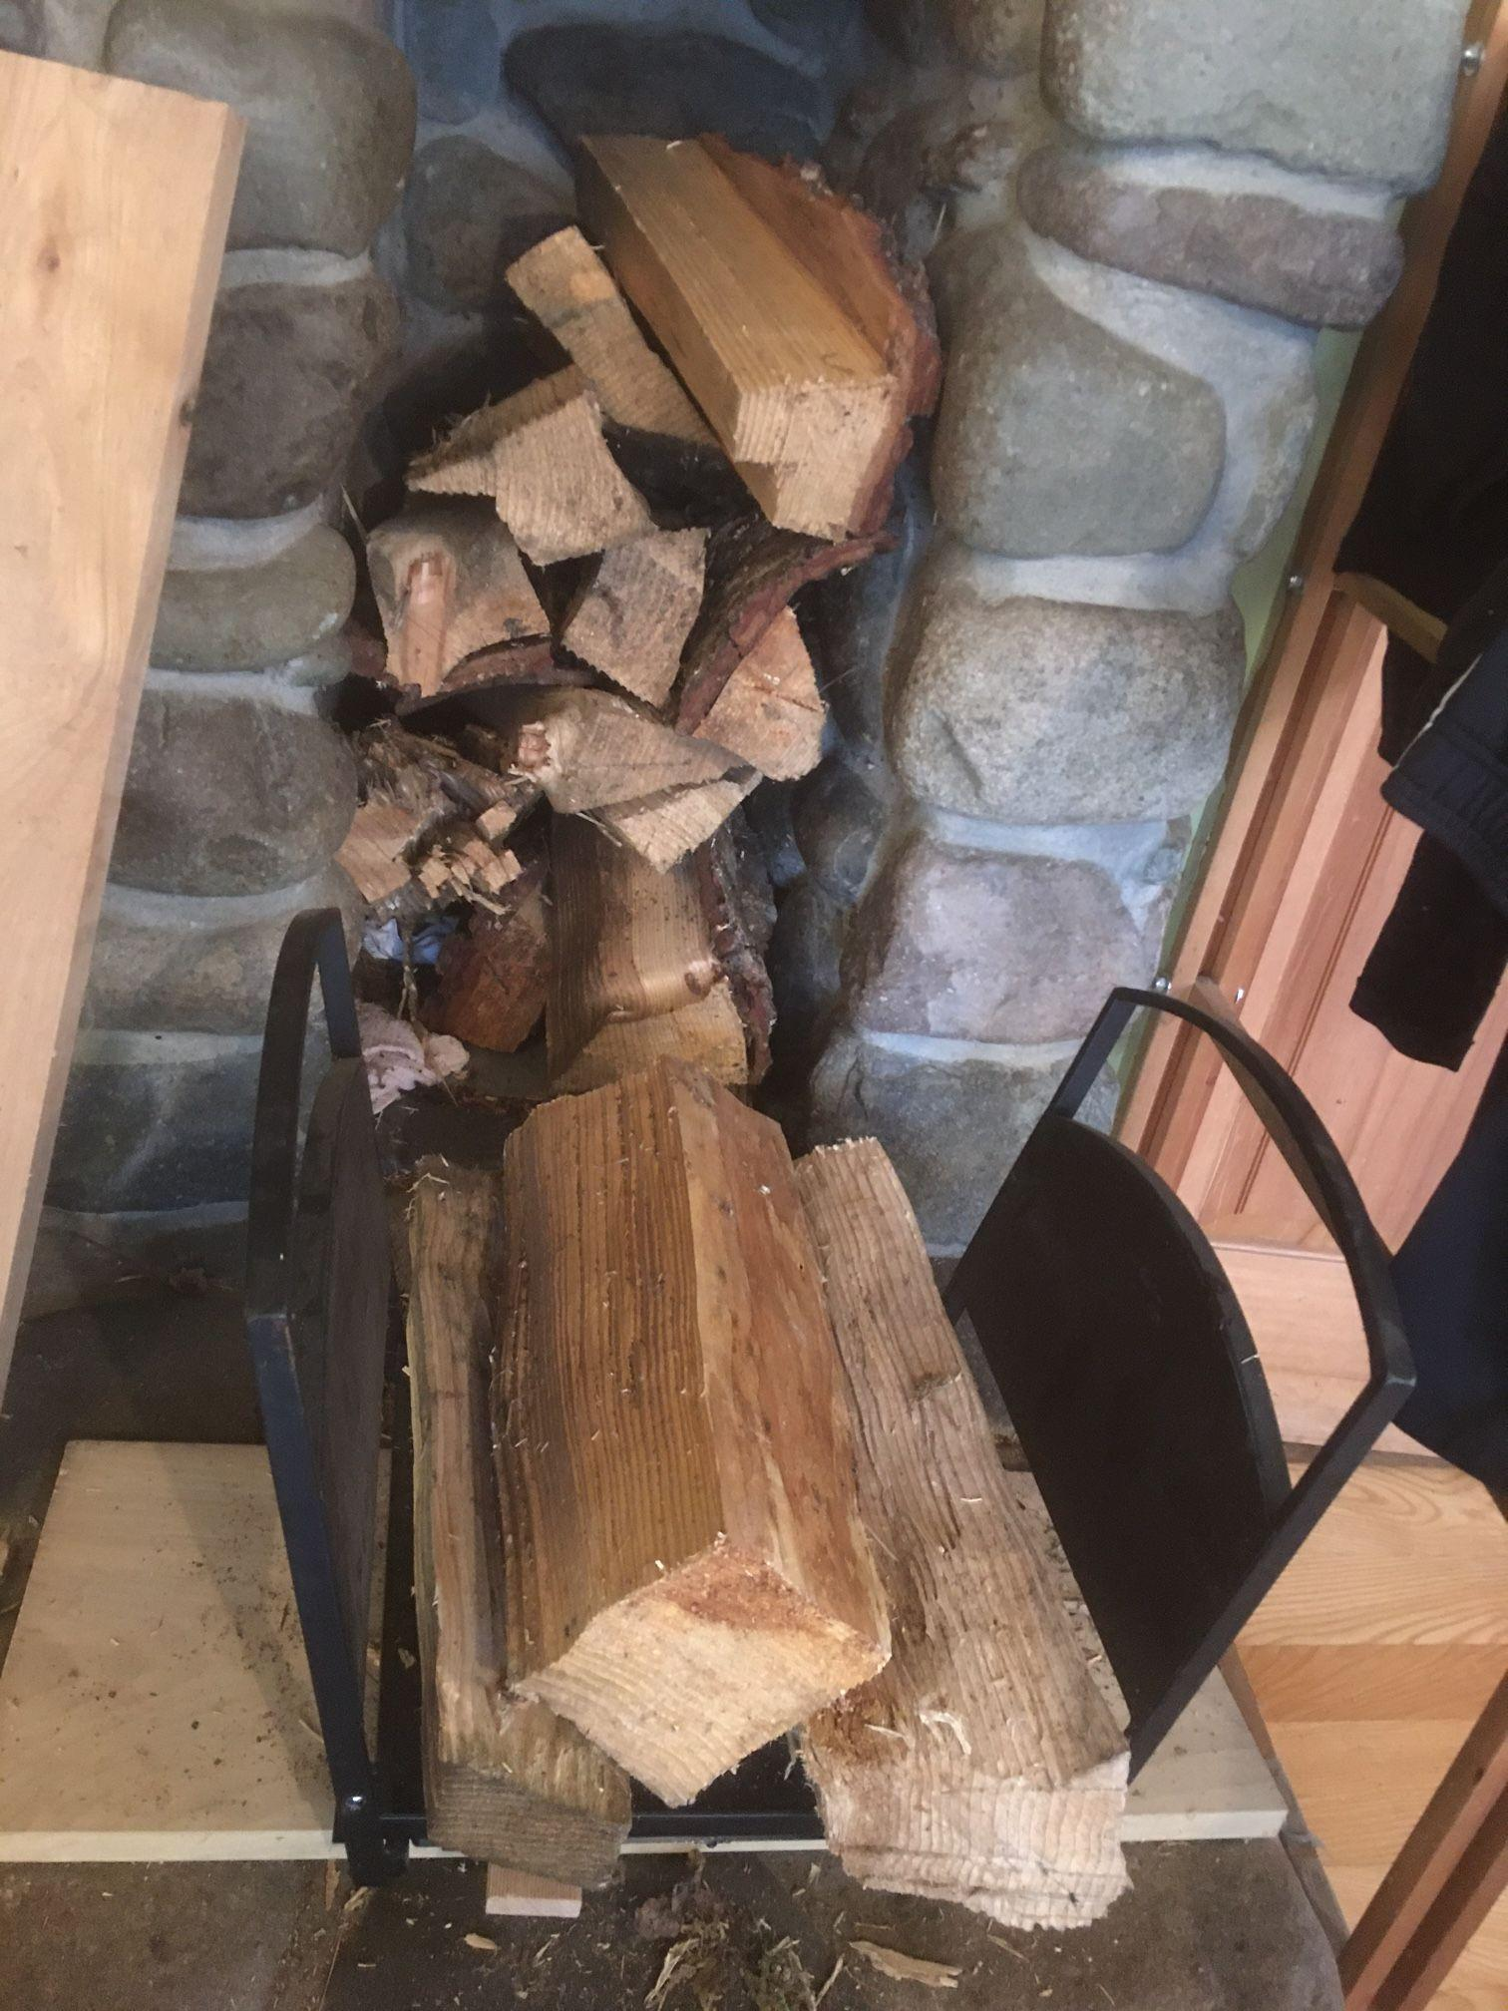
Methods - Equipment
FUEL consumption sensor paired with stove temperature monitor
Enables use of carbon balance method to calculate emissions in addition to stack flow method
Algorithm to identify
Load mass
Stove loading density
Loading frequency and timing
Cold start, kindling, etc.

Slide 4
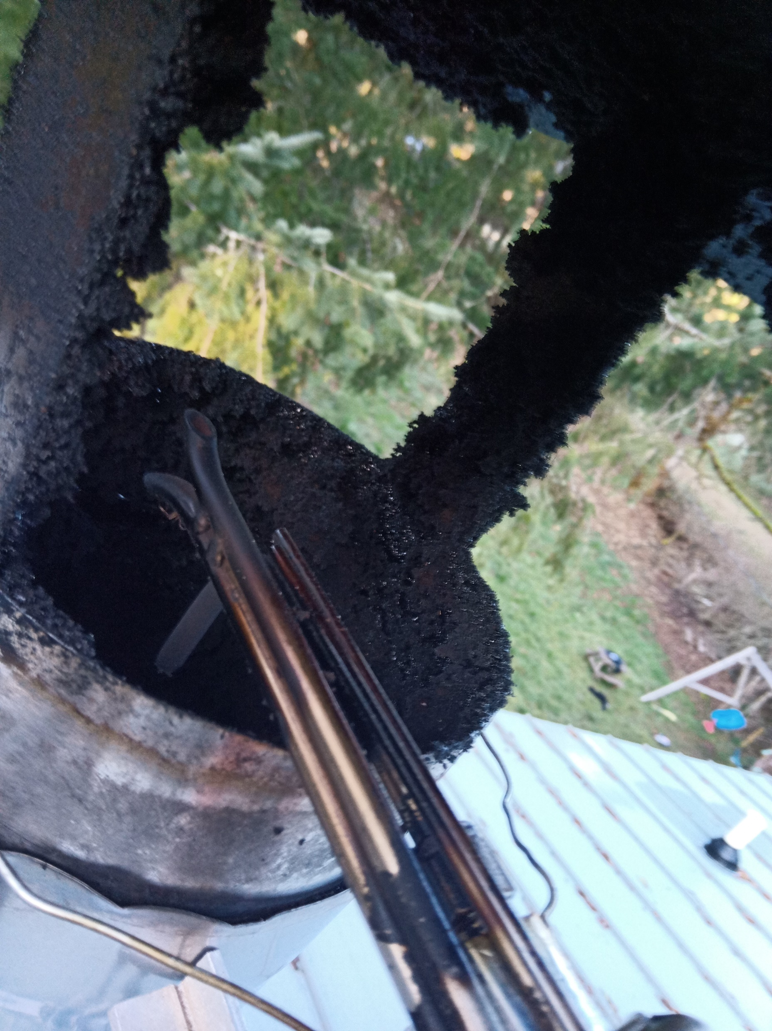
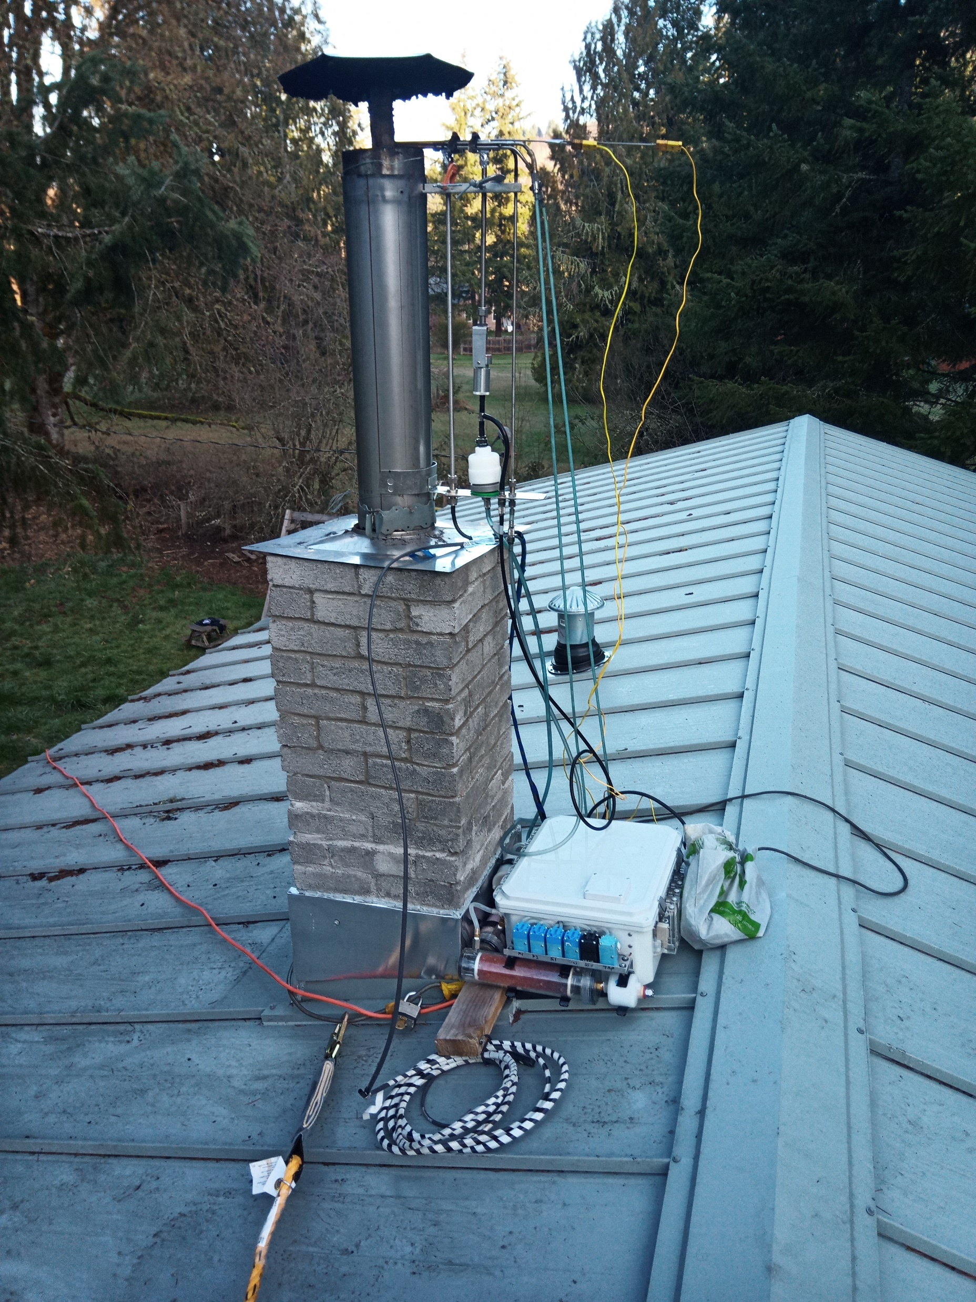
Methods - Emissions Equipment
Possum Portable Sampling System by Mountain Air Engineering
Pitot tube and probe located at chimney outlet
Gravimetric and real-time light-scattering PM_{2.5} with near isokinetic sampling, filter change every 24 hours
Continuous 1 Hz sample for diluted and undiluted PM, CO, CO₂, O₂

Slide 5
Methods – Emissions Equipment
1400 ccm
300 ccm
300 ccm
1500 ccm
0 ccm
1200 ccm
0 ccm
200 ccm
Diluted sample train for PM_{2.5}, CO, CO₂
Undiluted sample train for CO, CO₂, O₂
Dilution ratio = 7-10:1, measured 3 ways

Slide 6
Data Analysis and Uncertainty Discussion: Two Approaches
1. Stack flow method
Flow measurements in transition zone of chimney cap may cause uncertainty
Center line velocity pressure has strong signal, extrapolate to velocity profile challenging
Soot buildup on walls make it hard to determine effective area
2. Carbon balance method
Assumption of constant flow (ratio of average emissions = ratio of total emissions)
Effective fuel carbon fraction/moisture content
Wood in stove/remaining at beginning/end of test
→ Good overall agreement, so use stack flow for better real-time analysis
Future work:
Base approach selection on uncertainty on test-by-test basis
Generate a hybrid method

Slide 7
Other Sources of Uncertainty
PM_{2.5} Measurements
Particle losses
Diluted immediately after probe in a T junction
Possible impaction
Could do acetone wash to correct
Dilution ratio - converting diluted concentrations (PM) to undiluted
Tar buildup varies in different temperatures/households
Use of light-scattering for real-time apportionment, could explore TEOM instead

Slide 8
Samples
Household | Stove Brand | Certified? | Dates Monitored | Fuel Moisture (% DB)
GP003 | Iron Strike | 2015 | March 7 - 11 | 12
GP004 | Lopi 1250 | 2015 | March 15 - 17 | 18
GP010 | Endeavor 380-NT | 1988 | March 24 - 26 | 20
GP012 | Lopi 1750 | 1988 | January 23 - 25 | 17
GP021 | US Stove VG2020 | 2020 | March 21 - 23 | 21
GP026 | Jotul 3 | no | April 11 - 15 | 26
GP027 | unknown, had missing parts | no | April 18 - 21 | 14

Slide 9
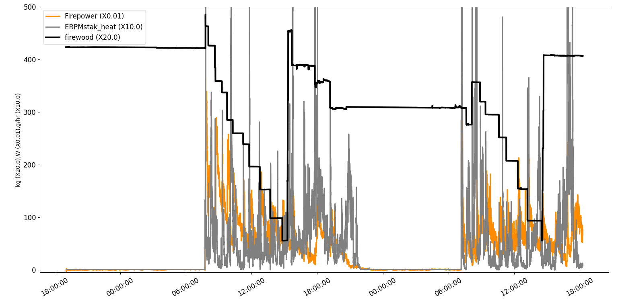
Results – Real-Time Data Example

Slide 10
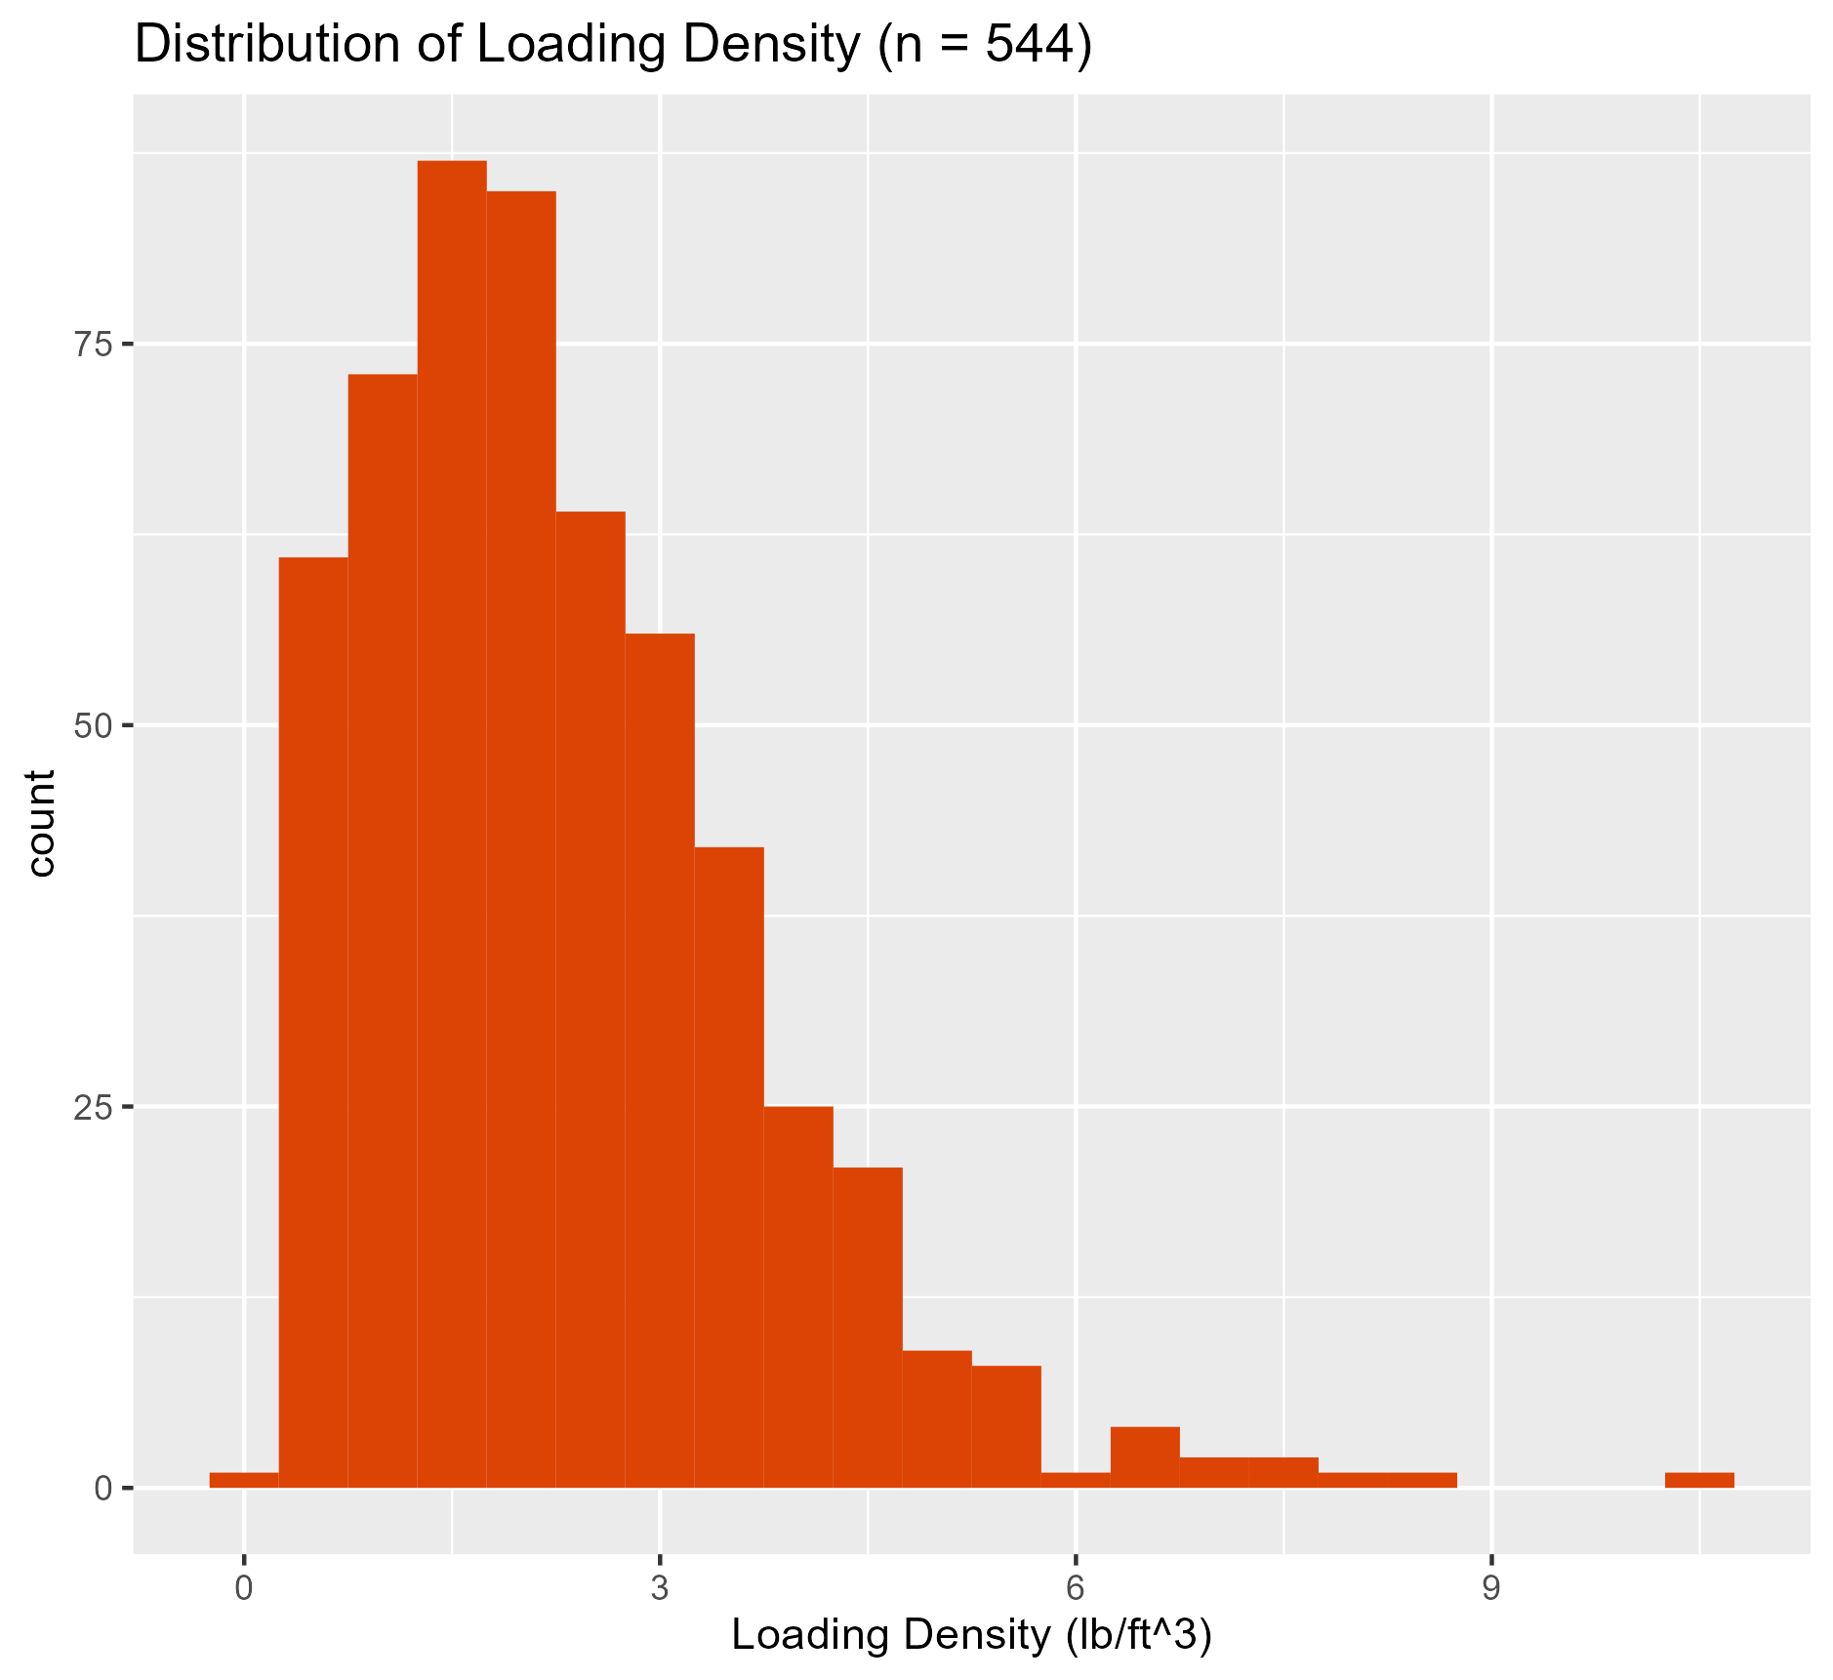
Results - FUEL Loading Density and Frequency

Slide 11
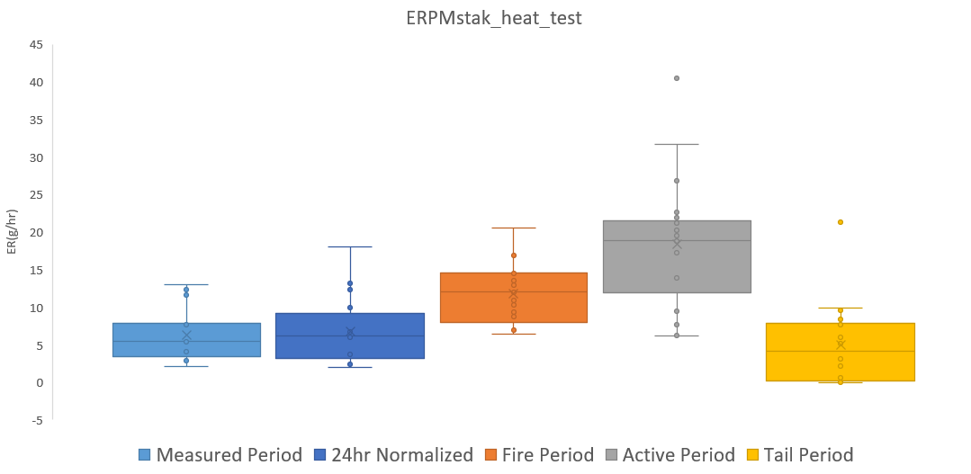
Results – PM_{2.5} Emission Rates by Period
Notes:
Measured - entire period
24 hr normalized
fire period from start to chimney temp back down to 40
Active from start to when it starts dropping back to 160 (chosen based lab data)
Tail from 160 to 40

Slide 12
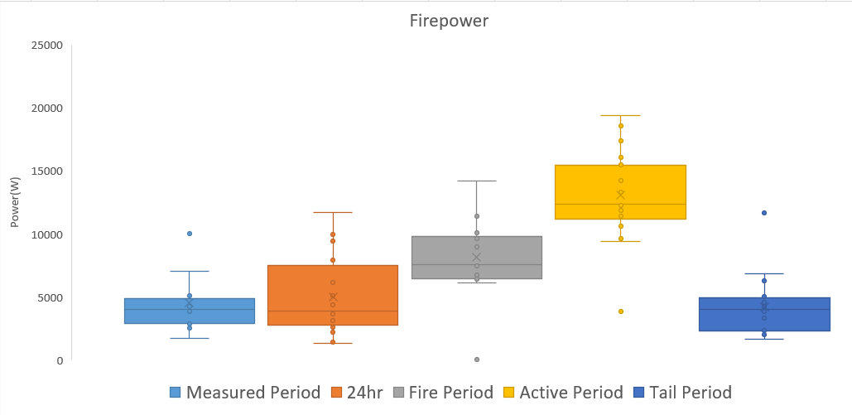
Results – Firepower by Period

Slide 13
Results – Emissions Summary by Household
Household | Stove Brand | Certified? | Emission Rate PM_{2.5} (g/hr) | Emission Factor PM_{2.5} (g/kg) | Emission Rate CO(g/min) | Emission Factor CO(g/kg) | Firepower(W)
GP004 | Lopi 1250 | 2015 | 2.9 +/- 0.5 | 4.9 +/- 1.4 | 0.94 +/- 0.7 | 94.4 +/- 24.0 | 3411 +/- 3376
GP003 | Iron Strike | 2015 | 3.8 +/- 0.5 | 4.1 +/- 1.0 | 1.0 +/- 0.07 | 65.7 +/- 13.5 | 4344 +/- 593
GP026 | Jotul 3 | No | 4.9 +/- 1.4 | 5.0 +/– 0.4 | 0.7 +/- 0.2 | 46.9 +/- 3.1 | 2947 +/- 499
GP021 | US Stove VG2020 | 2020 | 6.1 +/- 9.2 | 10.9 +/- 11.6 | 1.0 +/- 0.9 | 115.3 +/- 88.0 | 1265 +/- 2133
GP027 | unknown | No | 6.8 +/- 1.8 | 7.7 +/- 4.8 | 1.8 +/- 0.4 | 124.8 +/- 53.3 | 5684 +/- 1463
GP010 | Endeavor 380-NT | 1988 | 9.6 +/- 12.425 | 14.1 +/- 4.1 | 1.4 +/- 2.8 | 128.5 +/- 115.9 | 5425 +/- 9942
GP012 | Lopi 1750 | 1988 | 10.4 +/- 16.2 | 12.2 +/- 22.3 | 2.9 +/- 1.3 | 12.2 +/- 22.4 | 10151 +/- 724
Notes:
1988 - since they were pre 2015, both have secondary air tubes

Slide 14
Results – Impact of Startup
Start-up emissions first 20 minutes of fire period relative to total fire period for 25 tests:
Metric | First 20 min/Total fire period | Standard Deviation
Duration (min) | 3% | 3%
CO (g) | 5% | 5%
CO₂ (g) | 7% | 7%
PM_{2.5} (g) | 21% | 20%

Slide 15
24-hr Emissions Summary Table
Average 24-hour/measured period 95% confidence interval (measurement uncertainty forthcoming) under these test conditions/locations
AP-42 emission factor rating of A-C expected
 | Emission Factor (g/kg) | Emission Rate
PM_{2.5} | 7.9 +/- 1.8 | 6.1 +/- 1.3 (g/hr)
CO | 106 +/- 20.0 | 1.4 +/- 0.29 (g/min)
CO₂ | 1795 +/- 444 | 23.2 +/- 4.5 (g/min)
PM comparison to literature:
9.2-32.1 g/hr
3.9-22.2 g/kg

Slide 16
Conclusions and Next Steps
Data show how stoves are actually being used and how they are performing, fulfilling our research objective
Methods are promising
Working on characterizing uncertainty and data quality
Validation begun against total capture with dilution tunnel
May be further validated with DOE CRADA
Hybrid method between stack flow and carbon balance may reduce uncertainty
This particular system is commercially available from Mountain Air Engineering
Additional samples are needed
Different weather, regions, stoves, fuels, etc.

Slide 17
Acknowledgements
DOE BETO Grant EE-00007969
OSU IRB Oversight on study #7257
Kiernan Kilkenny for FUEL data analysis
Research participants

Slide 18
Thank you!
Nordica.MacCarty@oregonstate.edu

