Slide 1
Basics of Green Infrastructure
ADD date and name

Slide 2
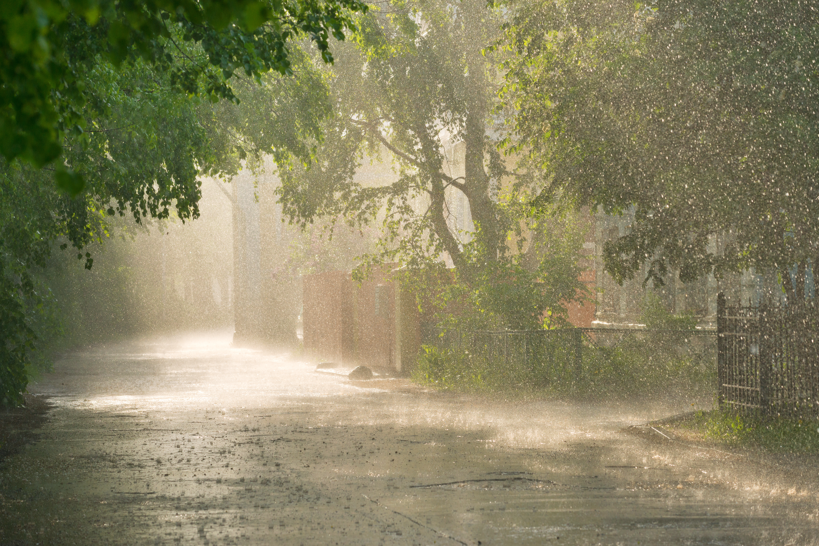
What is stormwater?
Stormwater is water from rain and snow, that can pick up pollutants as it flows over surfaces such as roads, sidewalks, buildings, and landscapes.​
Without management practices in place, stormwater can cause:
Polluted waterways
Increased flooding
Damage to property and infrastructure
Permit non-compliance

Slide 3
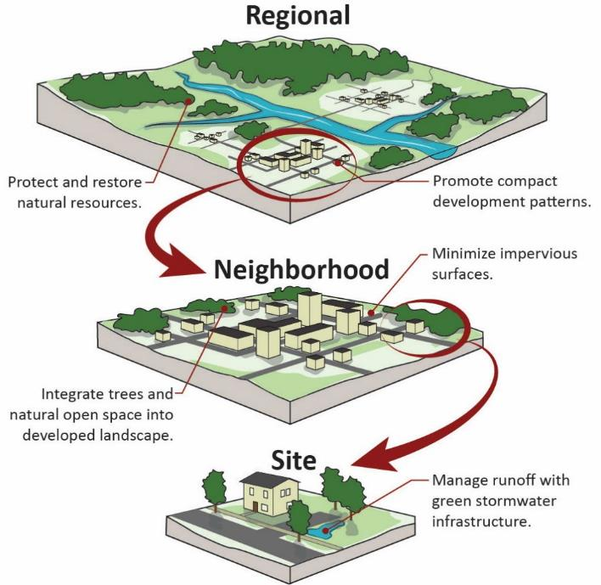
What is green infrastructure?
Green infrastructure uses plants, soils, and other media to capture and treat stormwater at its source. It relies on the natural processes of filtration, infiltration, and evapotranspiration to manage stormwater.
Green infrastructure can be implemented at multiple scales.
Notes:
Specifically, the 2019 Water Investment Act defines green infrastructure as: “the range of measures that use plant or soil systems, permeable pavement or other permeable surfaces or substrates, stormwater harvest and reuse, or landscaping to store, infiltrate, or evapotranspirate stormwater and reduce flows to sewer systems or to surface waters.”
Additional description:
Source: https://www.georgetownclimate.org/adaptation/toolkits/green-infrastructure-toolkit/introduction.html
Conventional development and drainage techniques, also known as gray infrastructure, include man-made, constructed assets like roads and sewers. “Gray surface infrastructure” covers natural landscapes with impervious surfaces such as concrete, asphalt, tile, or compacted gravel that increase the rate and volume of stormwater runoff. Stormwater runoff carries trash, bacteria, heavy metals, and other pollutants from the urban landscape to nearby waterways. Gray stormwater infrastructure generally uses large tunnels or other underground conveyances to move or store stormwater to treatment facilities. Green infrastructure, in contrast, includes techniques such as using permeable pavements and green roofs to both capture rainfall and retain it on site, keeping it out of the stormwater system.

Slide 4
Green infrastructure is a solution
Many communities have aging stormwater infrastructure and regularly experience flooding. Stormwater has traditionally been managed by transporting it—untreated—to waterways quickly with hard infrastructure such as curbs, gutters, and pipes, which can lead to polluted waterways. Green infrastructure can filter pollutants from runoff and soak rainwater into the ground. It provides many environmental, social, and economic benefits and is an essential complement to our current hard infrastructure.

Slide 5
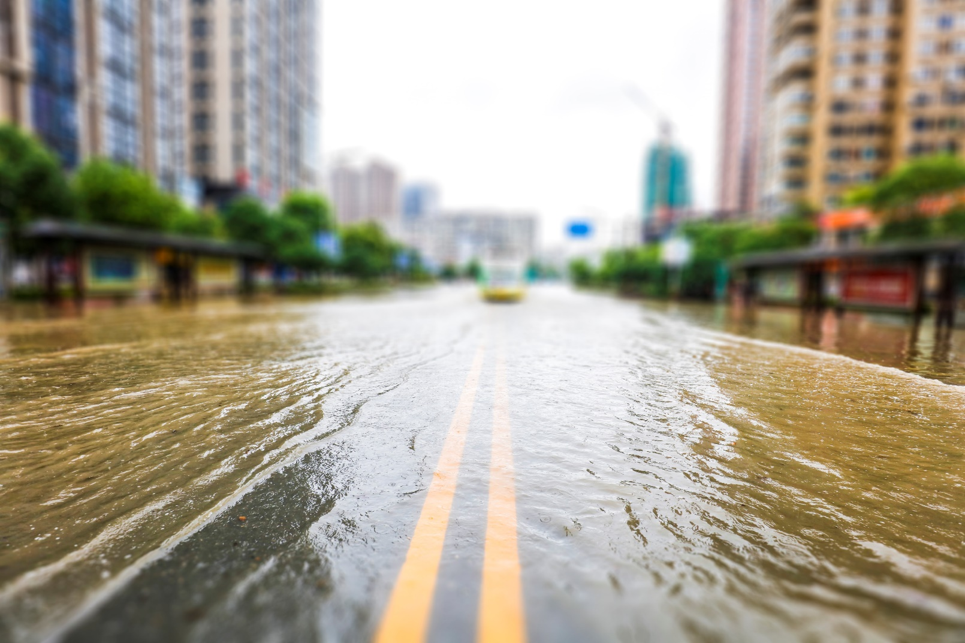
Costs to the community if we don’t manage stormwater better
Increased flooding
Infrastructure and property damage
Polluted waterways
Permit non-compliance
Notes:
The cost of not managing stormwater could be much higher than investing in stormwater management.
These problems often mean we need to spend more money to fix the impacts of stormwater in our community.
NOTE: REPLACE THE PHOTO IF YOU HAD ANY FLOODING IN YOUR COMMUNITY AND CUSTOMIZE WITH COSTS SPECIFIC TO YOUR COMMUNITY (e.g., habitat destruction, closed roads and bridges, business closures from flooding)

Slide 6
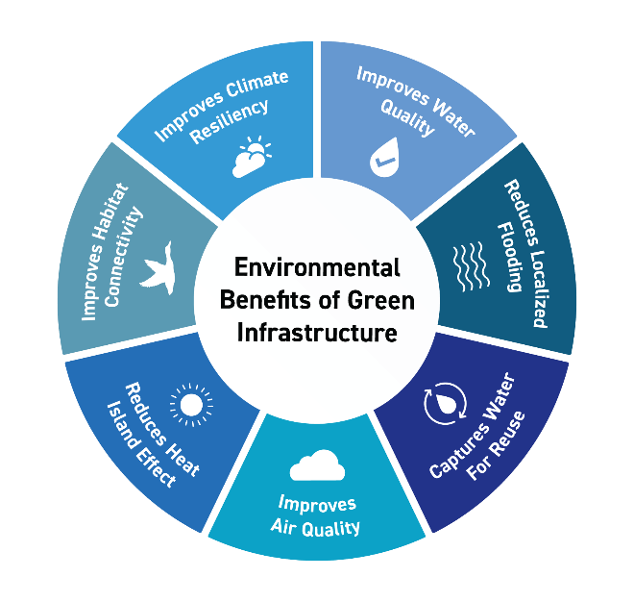
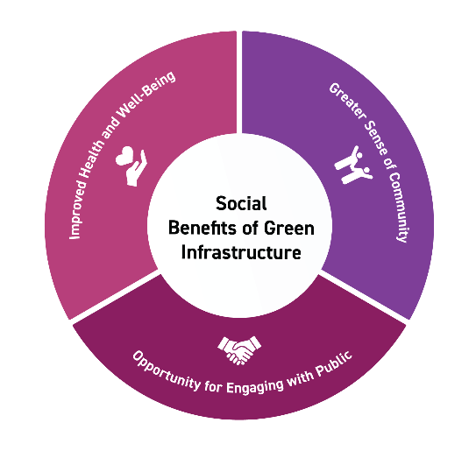
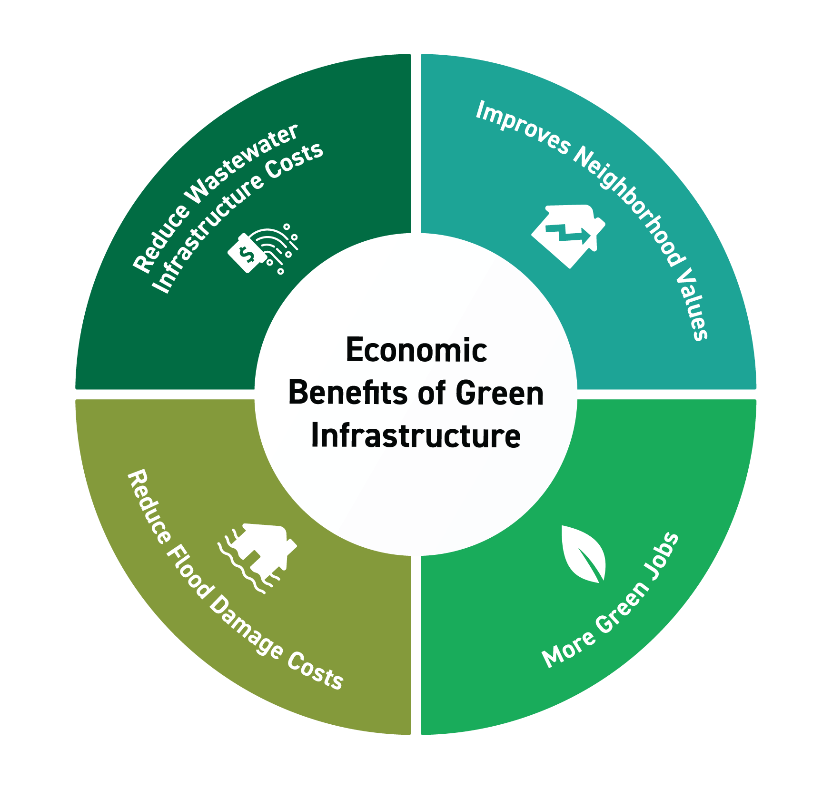
Green infrastructure’s multiple benefits

Slide 7
Benefits of green infrastructure
Green infrastructure helps manage stormwater while providing environmental, social, and economic benefits to the community.
Improves water quality
Reduces flooding and potential damages from flooding
Creates habitats for animals and insects
Enhances aesthetics of a community and creates connections to green spaces
Add a benefit(s) specific to your community

Slide 8
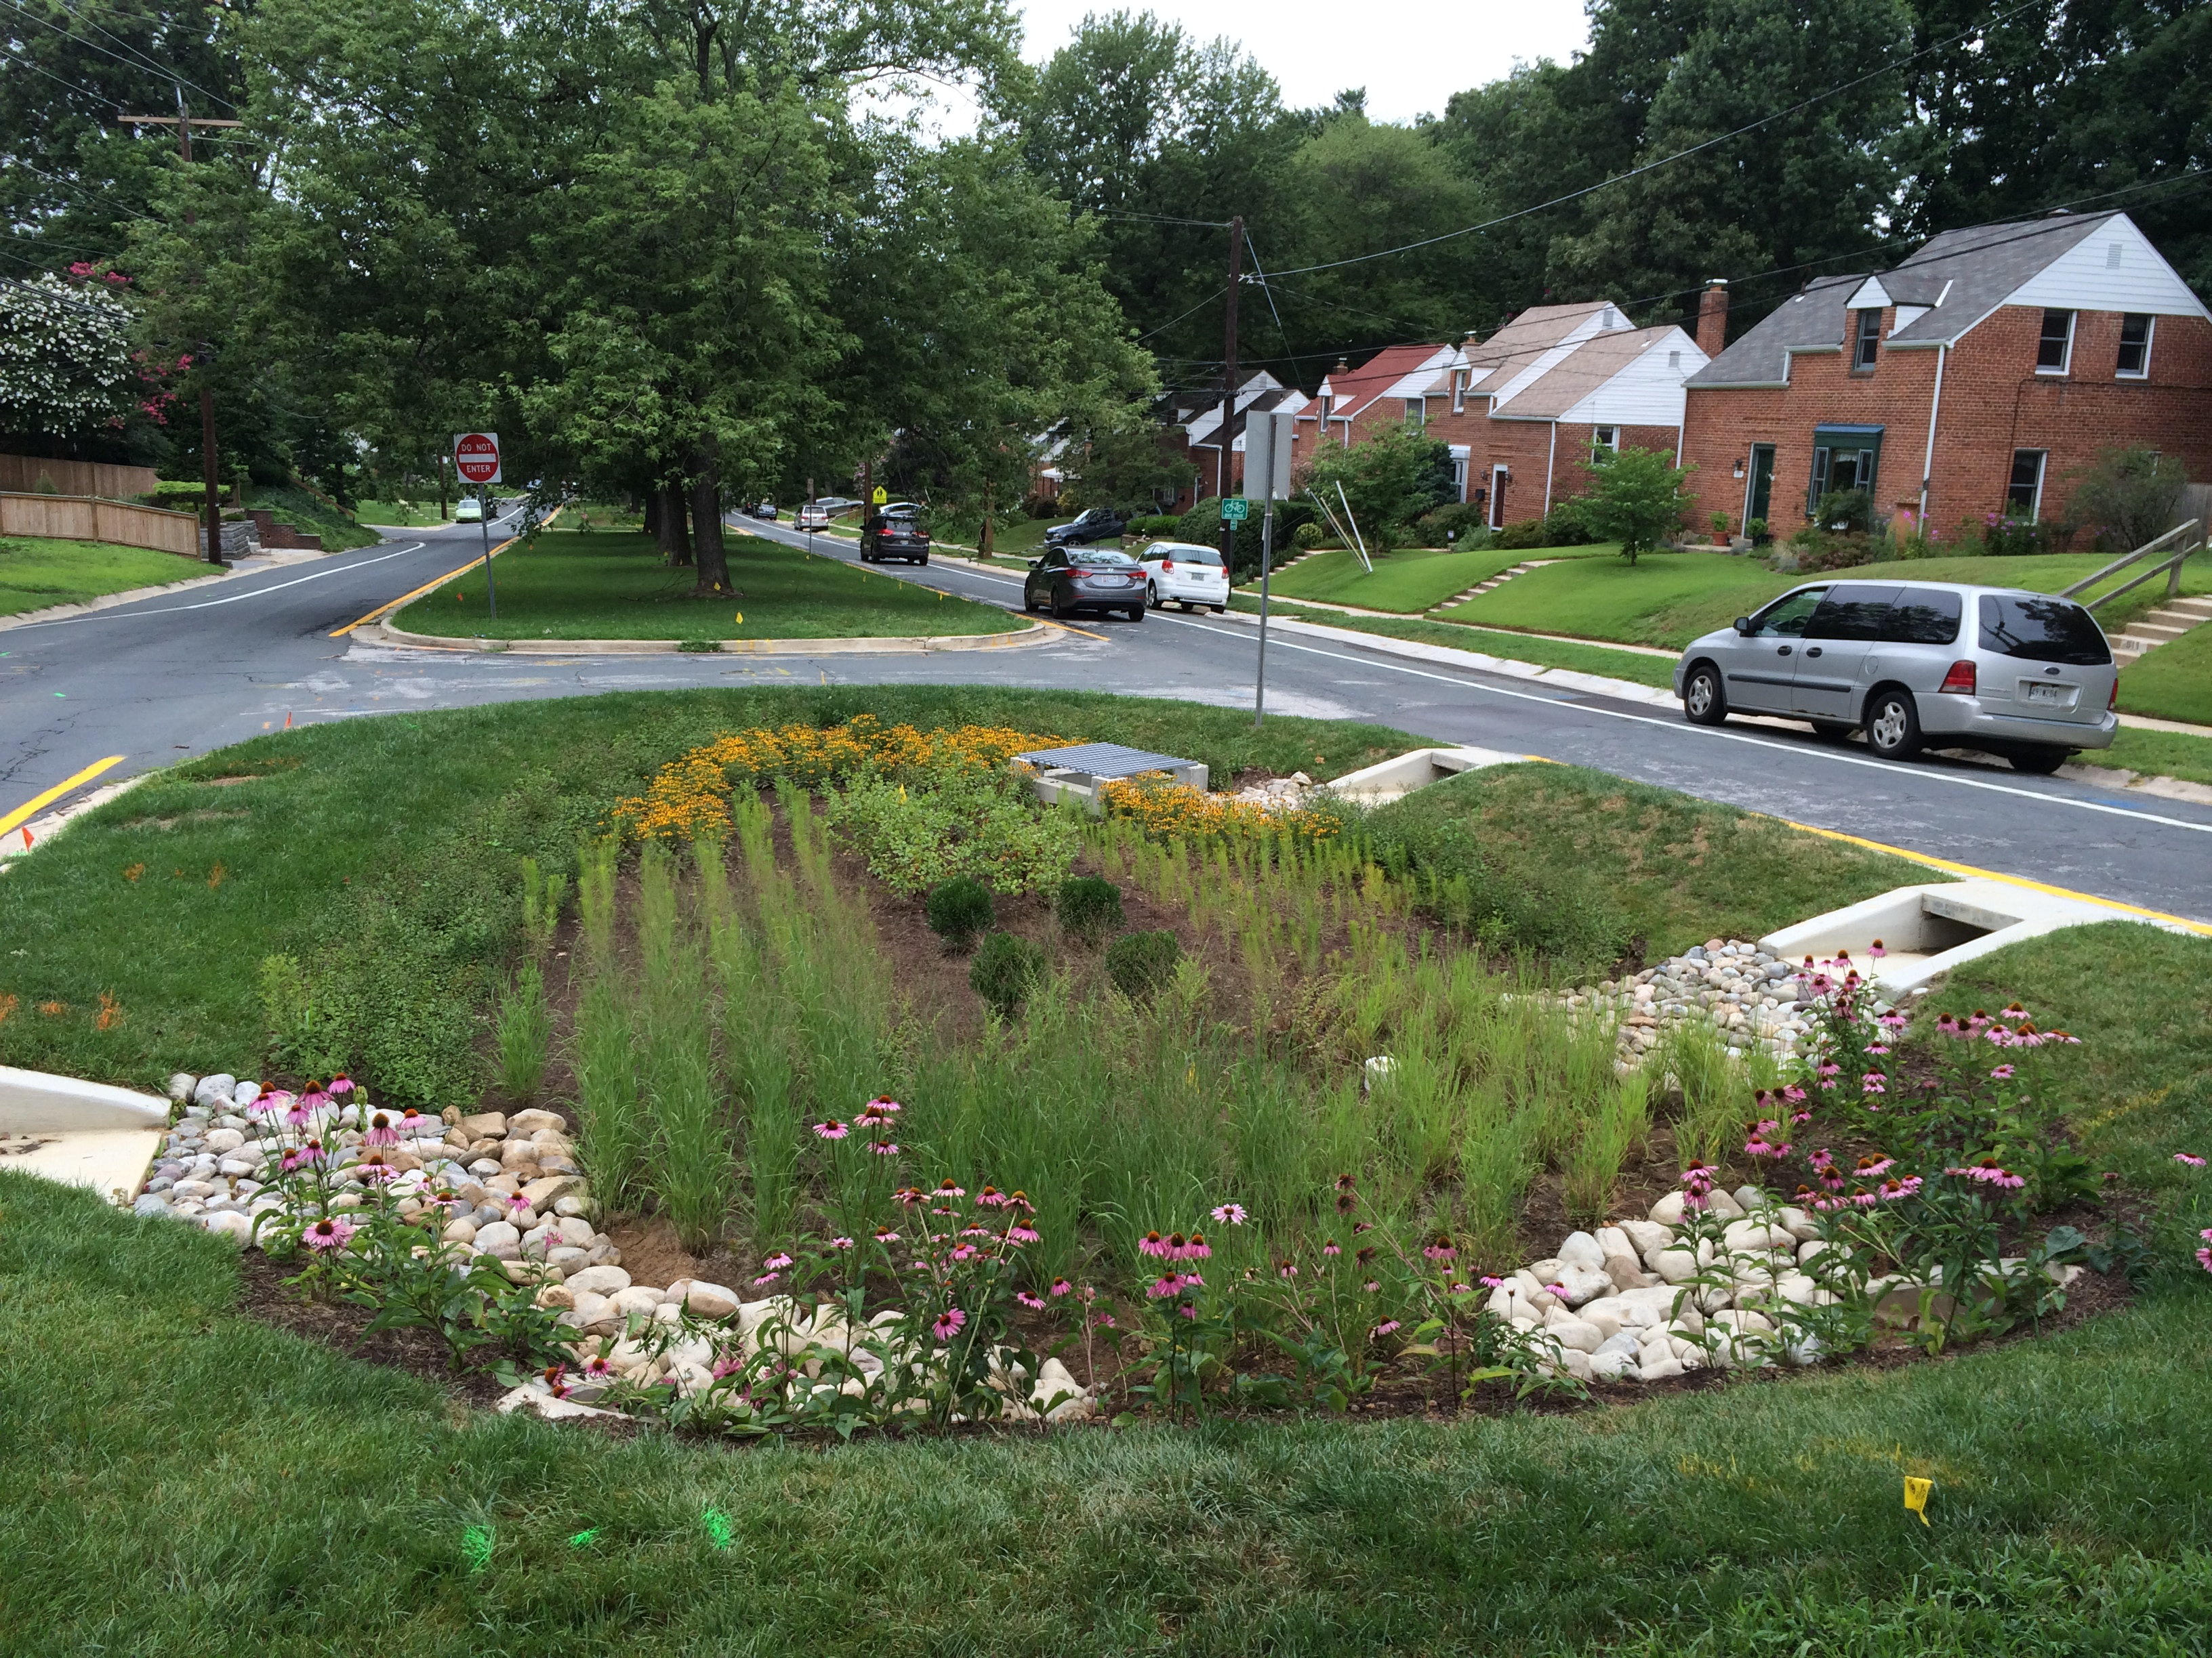
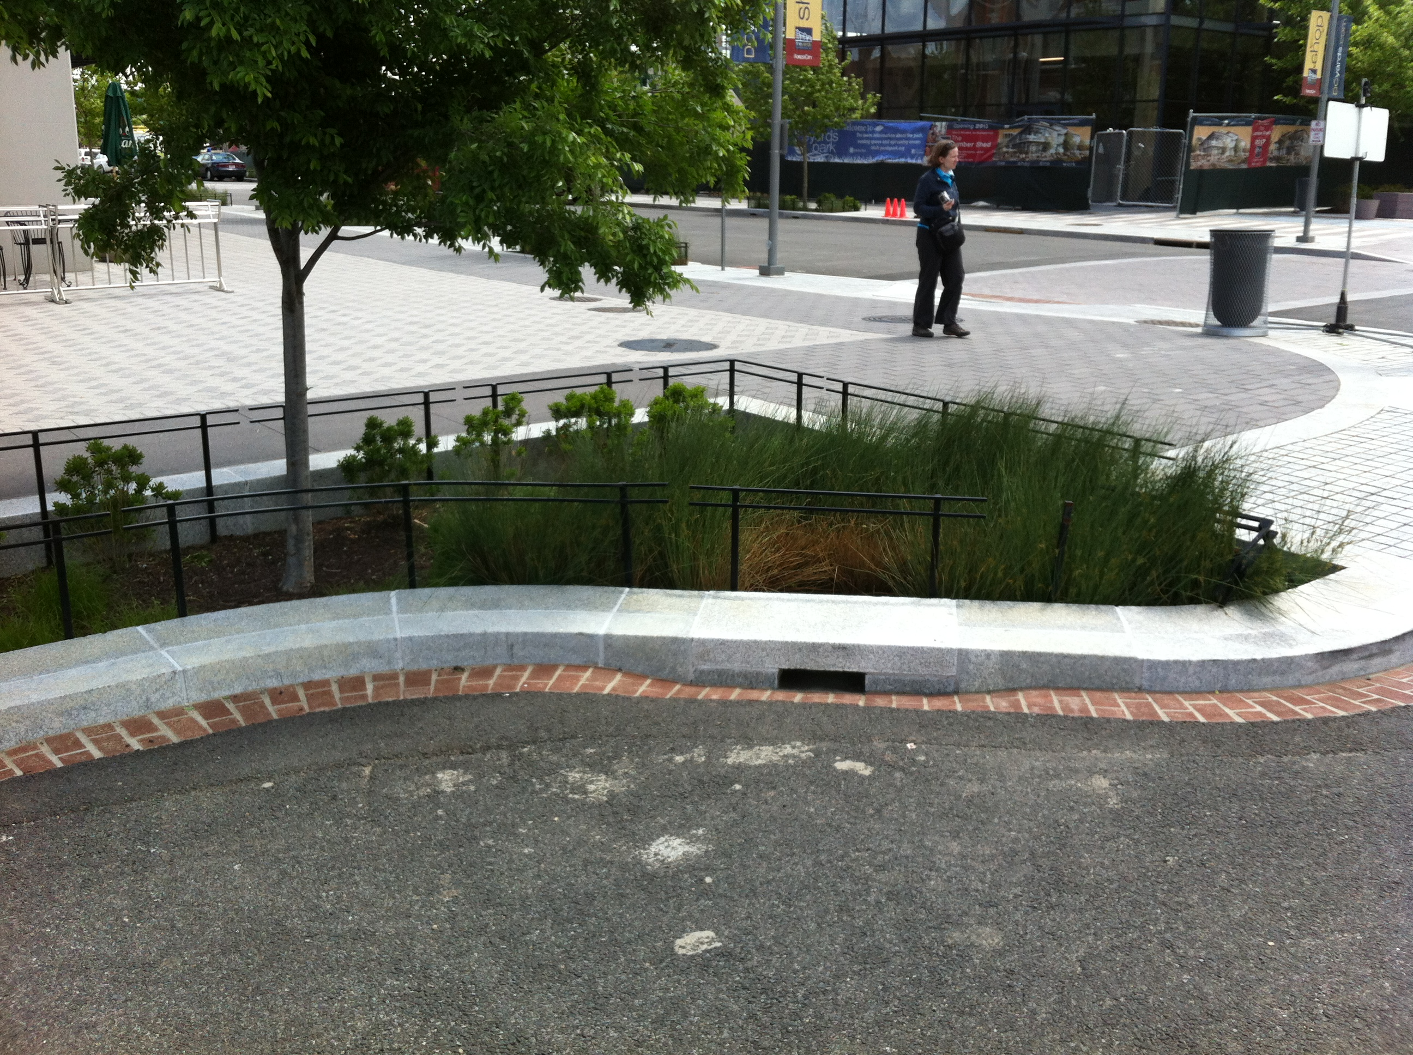
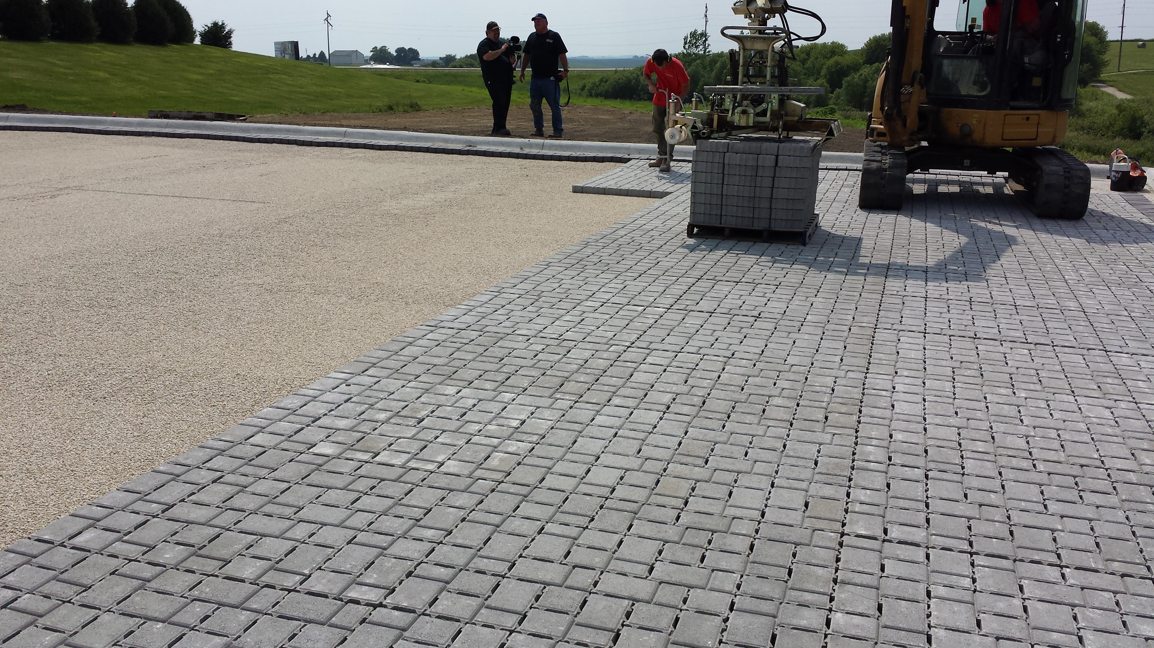
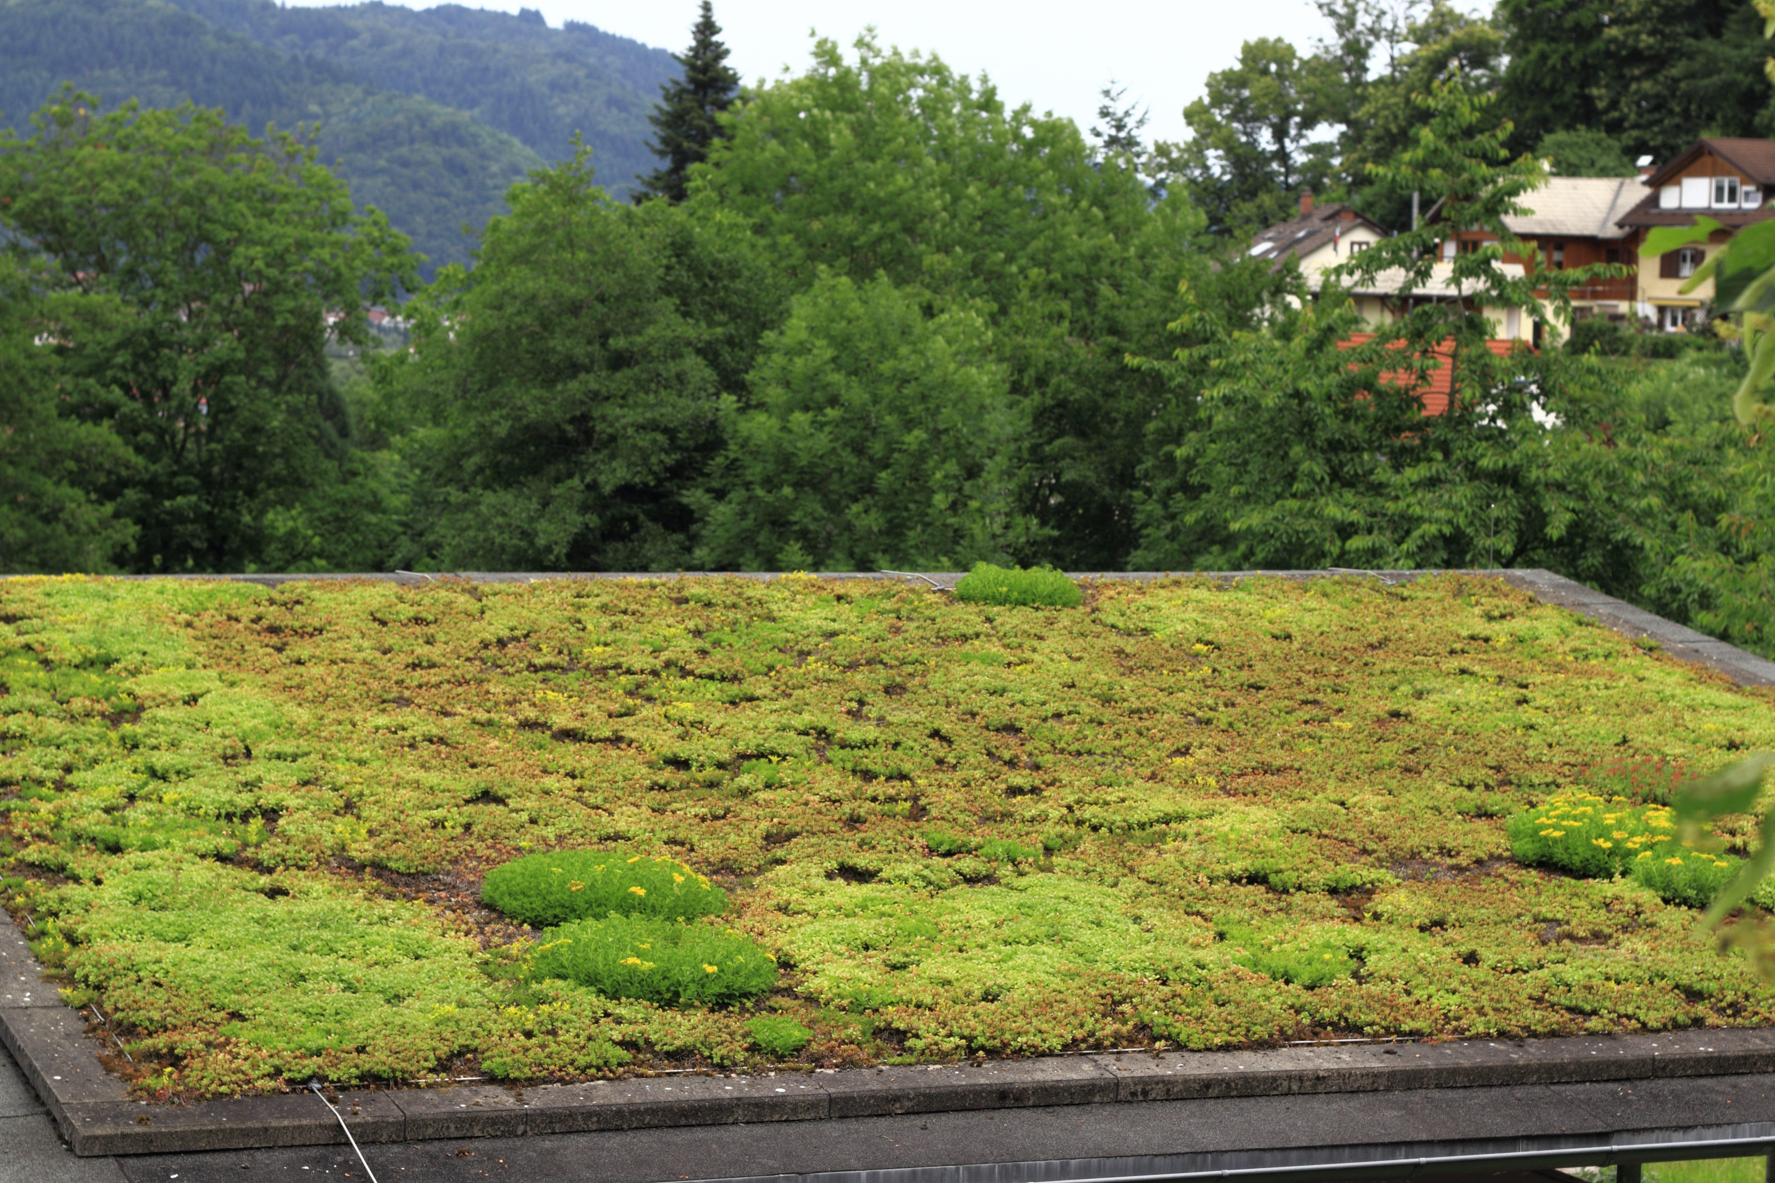
Examples of green infrastructure
Green infrastructure is very adaptable and can be designed to function in a wide variety of locations and at different scales.
Bioretention areas
Planter boxes
Permeable pavement
Green roofs
Top left image reproduced with permission from Montgomery County, MD Department of Environmental Protection.

Slide 9
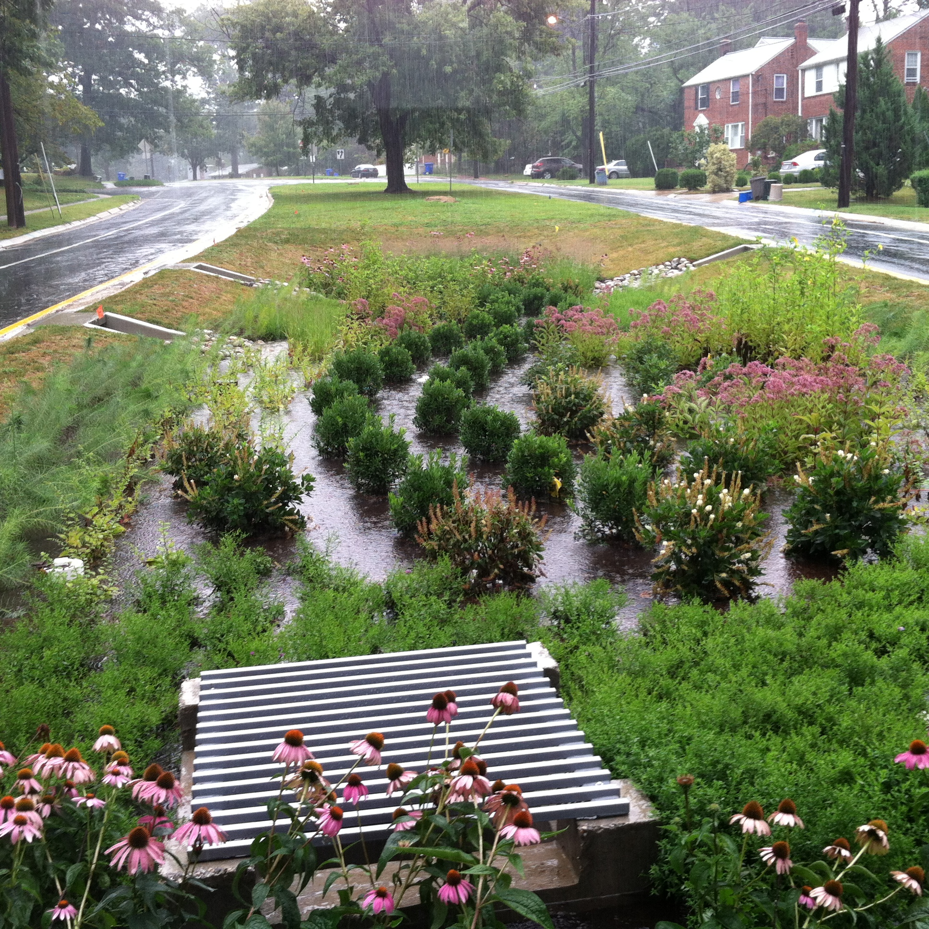
Bioretention areas
These engineered green areas mimic the natural movement of water and can be installed in almost any unpaved space to collect runoff.
Image reproduced with permission from Montgomery County, MD Department of Environmental Protection.
Notes:
A bioretention area is a sunken area in the landscape that collects rainwater from rooftops, sidewalks, and streets. They often consist of different varieties of vegetation, grasses, and perennial flowers.
Bioretention areas are designed to allow water to pond when it rains and then either soak into the ground or flow through an underdrain.
A rain garden is very similar to a bioretention, but it is less engineered. Rain gardens are typically small, do not have underdrains, and are associated with residences. Like bioretention areas, rain gardens also collect rainwater in a shallow depression and allow it to soak into the ground.
Bioretention areas are a green infrastructure practice that can help solve drainage problems and improve water quality.

Slide 10
Permeable pavement
Permeable pavement is an alternative to traditional pavement that allows rainwater and melting snow to seep through the surface to underlying layers of soil and gravel. The permeable surface layer can be made of pervious concrete, porous asphalt, or permeable interlocking pavers.
Image reproduced with permission from Fehr Graham.
Notes:
Image on right from: https://www.epa.gov/green-infrastructure/what-green-infrastructure#permeablepavements

Slide 11
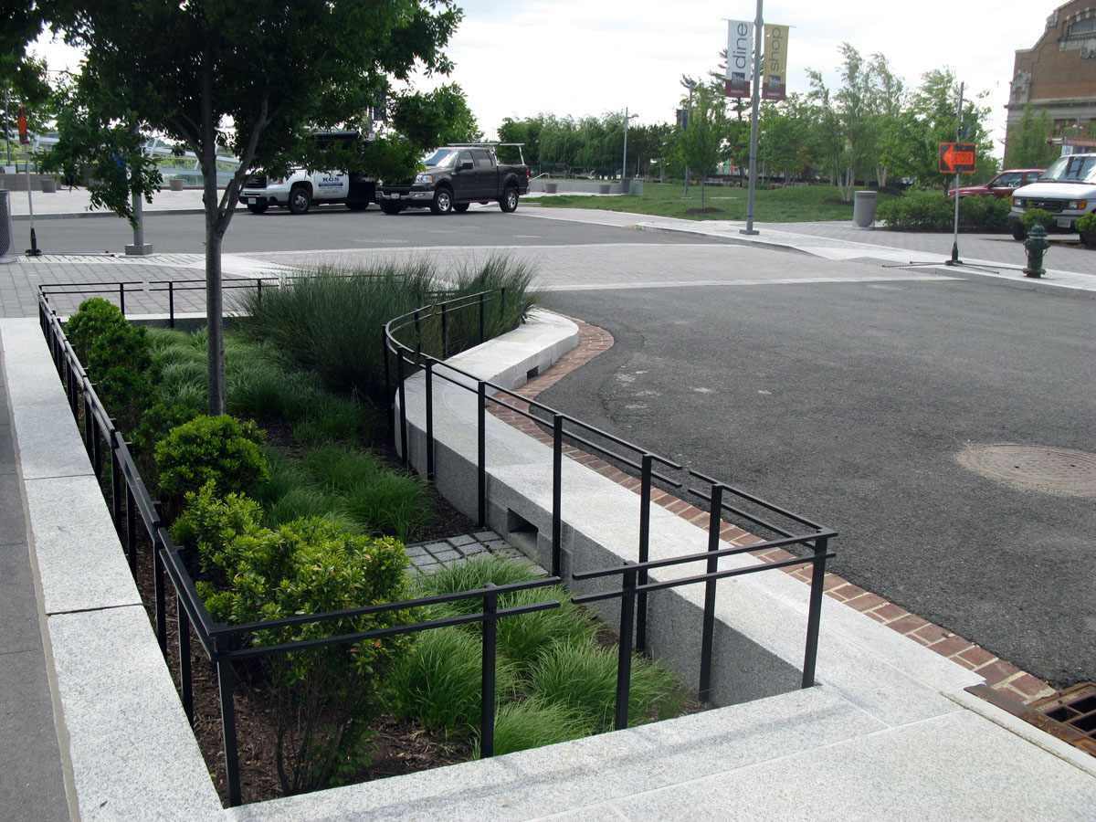
Planter boxes
Stormwater planters are a type of boxed bioretention with vertical walls and either open or closed bottoms. They collect and absorb runoff from streets, sidewalks, and parking lots. They are ideal for areas with limited space.
Notes:
This photo was taken by Clark Wilson (EPA).
They allow stormwater to flow through soil and gravel and either soak into the ground or flow through an underdrain.
Usually found in downtown areas, they collect and absorb runoff from streets, sidewalks, and parking lots. Ideal for areas with limited space, planter boxes can be a useful way to beautify city streets.

Slide 12
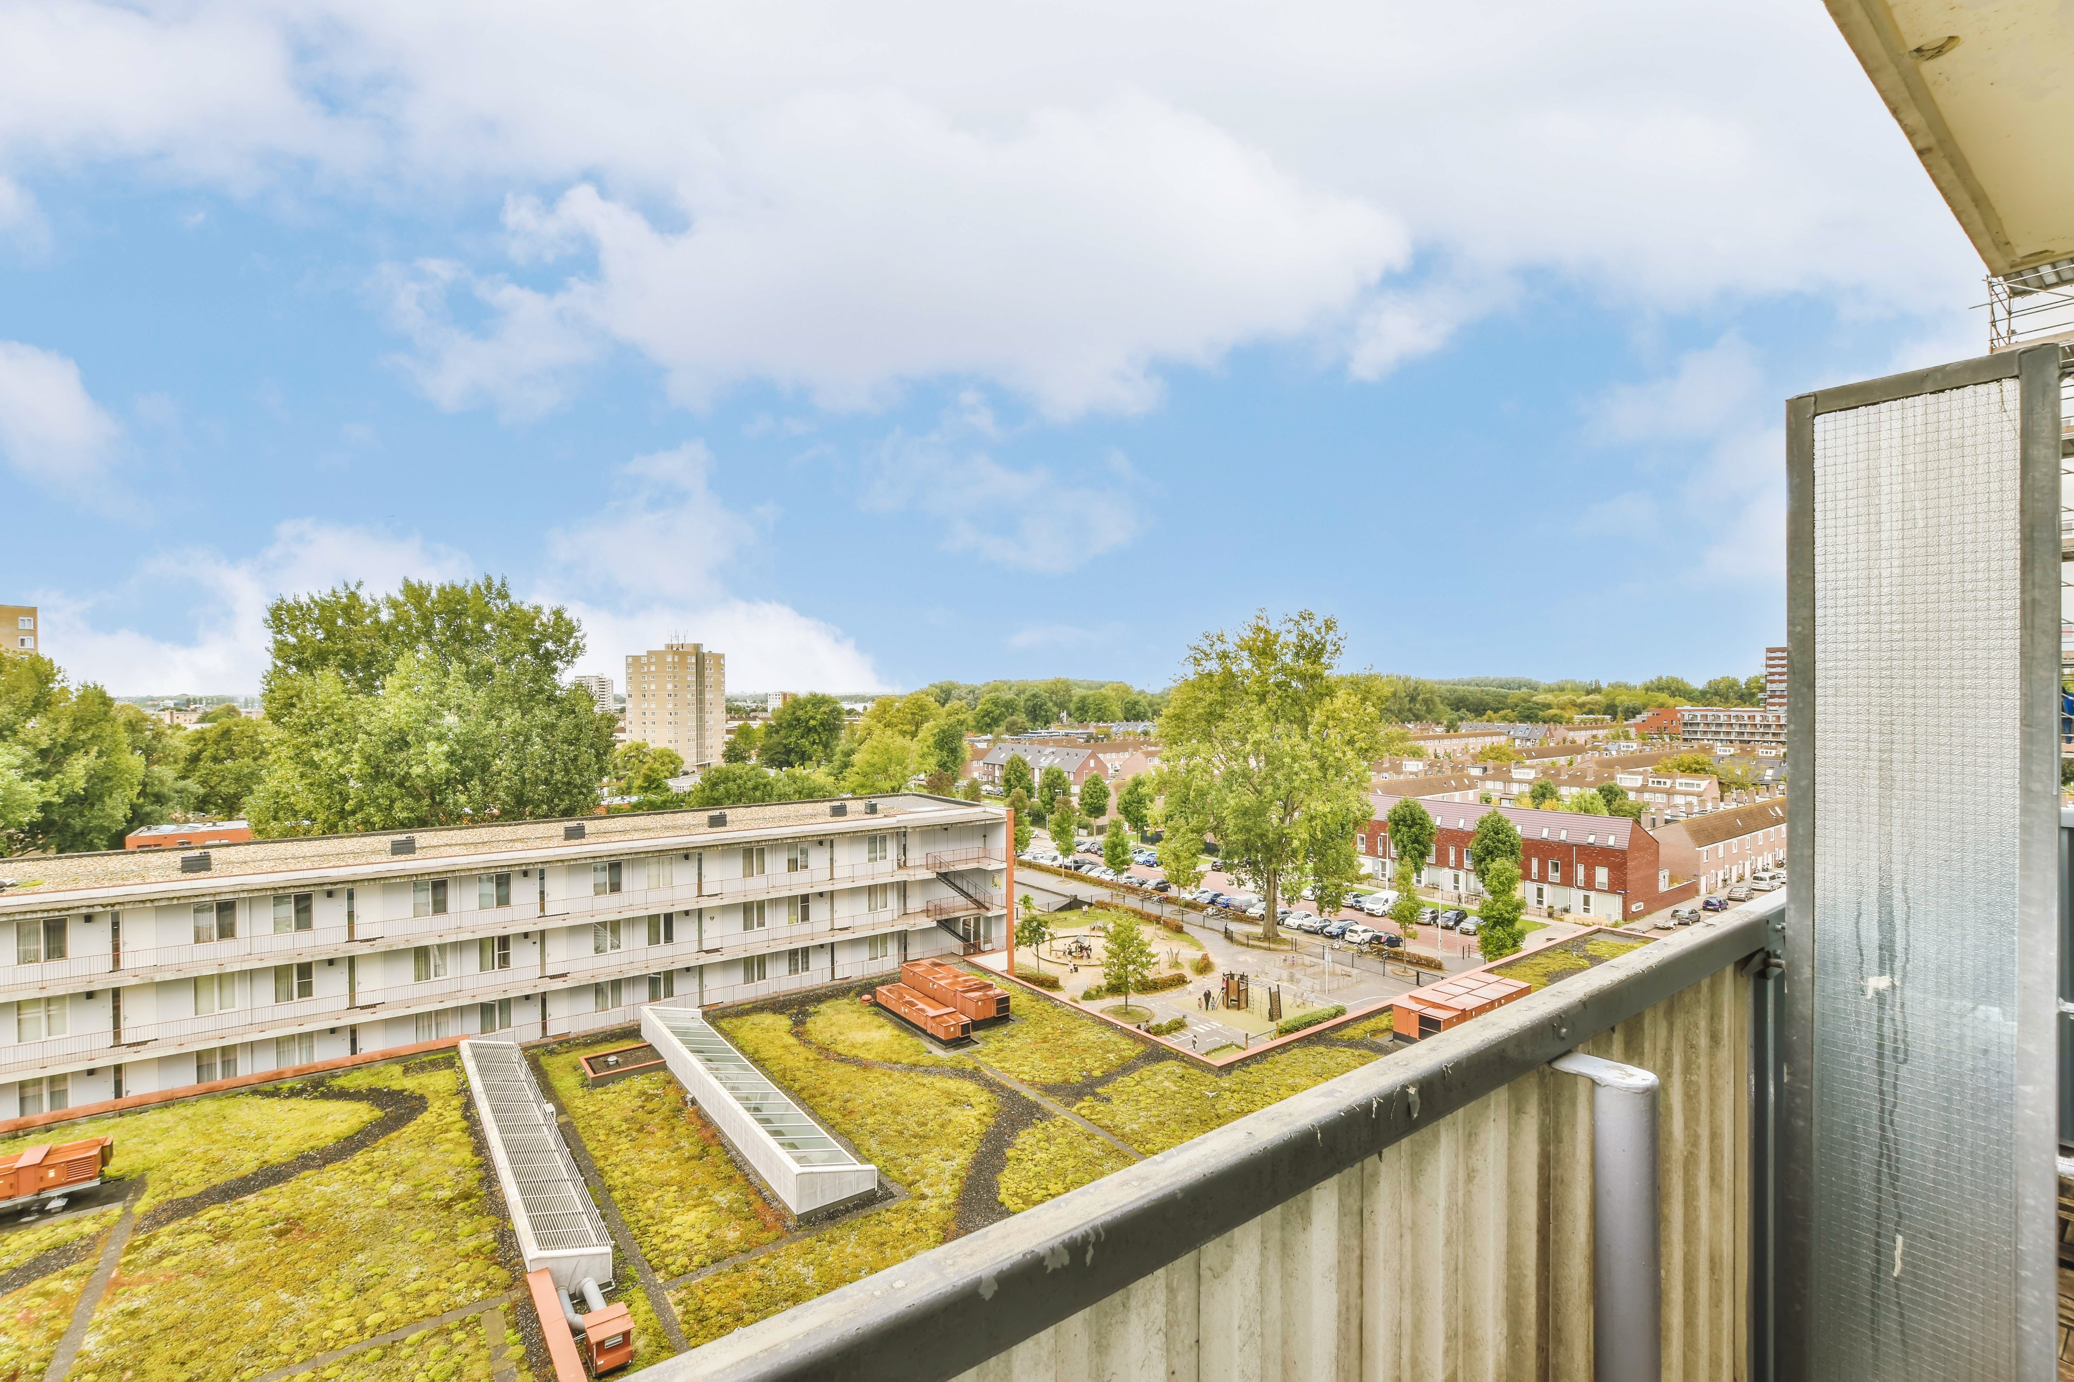
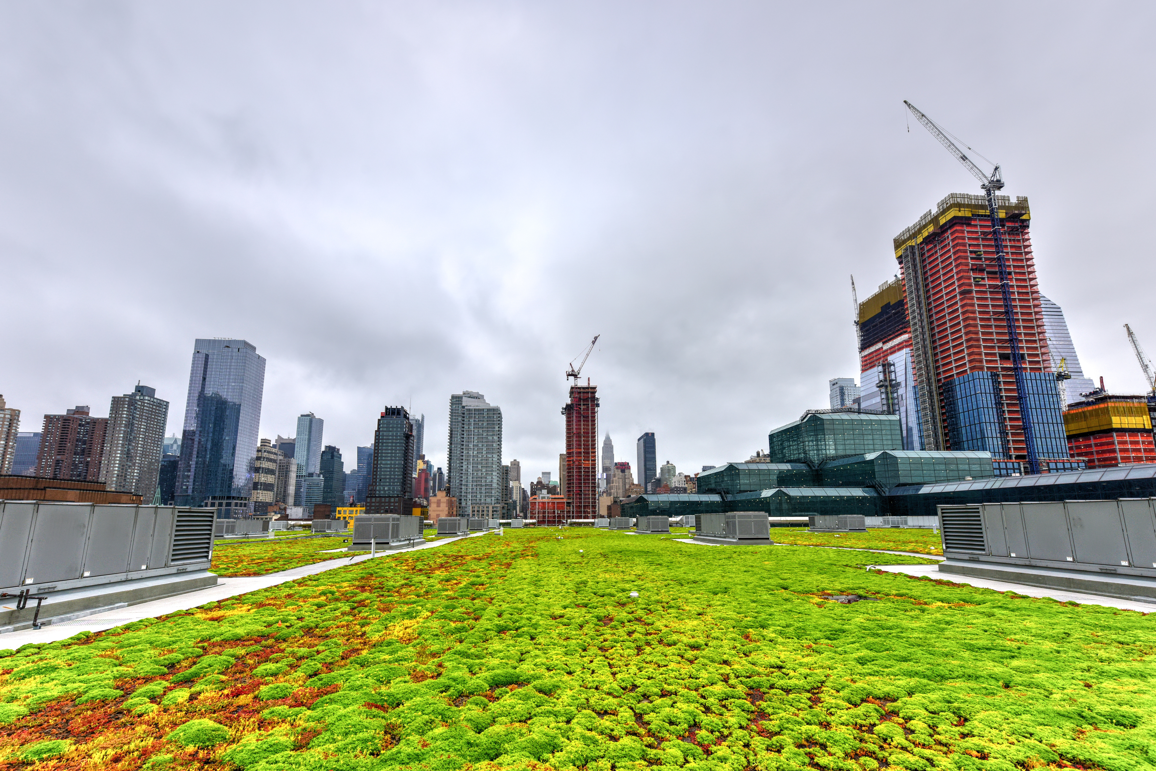
Green roofs
Green roofs are covered with growing vegetation. They capture and absorb rainwater, then slowly release it through drains, evaporation and evapotranspiration.

Slide 13
Green infrastructure in our community
Add examples of green infrastructure in your city/municipality on this slide. Include a few bullets of text and pictures to illustrate the infrastructure.
Potential questions you could include:
Why Green Infrastructure is important to us?
How can we implement green infrastructure to improve our community?
What are we already doing?

Slide 14
Resources
Main EPA Green Infrastructure Webpage and Resources: ​https://epa.gov/green-infrastructure/​
EPA’s GreenStream Listserv:​ join-greenstream@lists.epa.gov​
​
EPA’s National Menu of Best Management Practices (BMPs) for Stormwater:​ https://www.epa.gov/npdes/national-menu-best-management-practices-bmps-stormwater
​
Enhancing Sustainable Communities with Green Infrastructure​: https://www.epa.gov/smartgrowth/enhancing-sustainable-communities-green-infrastructure
Add additional resources specific to your community

