Slide 1
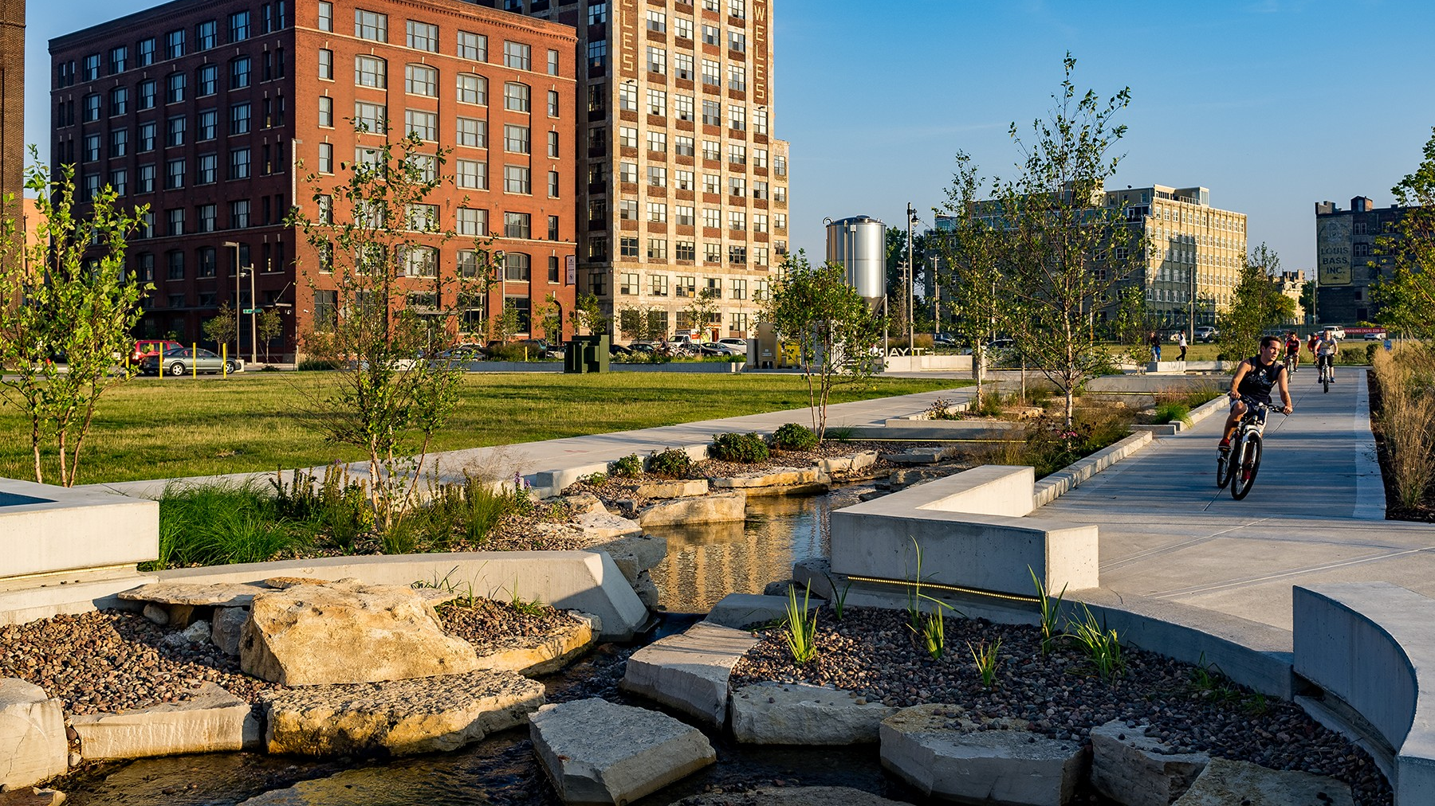
Tips for Photographing Brownfields Projects and Recording Videos/Voiceovers
July 11, 2024

Slide 2
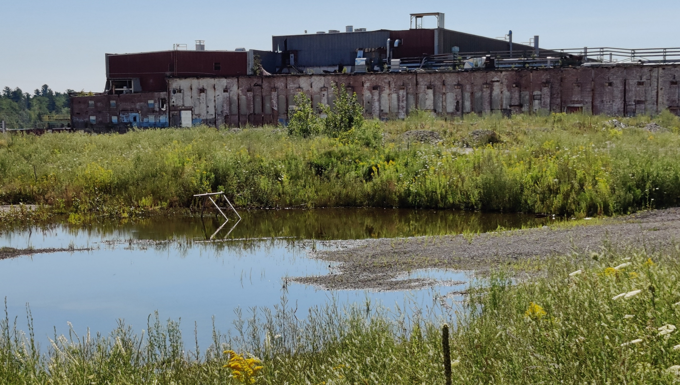
Instructions
Welcome & Zoom Meeting Instructions
Introduction from EPA’s Office of Brownfields & Land Revitalization
Gabriela Okhuysen

Slide 3
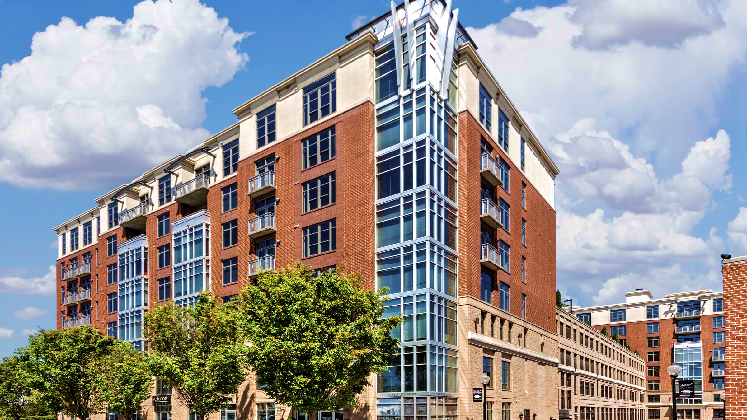
Introductions
Matt Placky – GDIT
Program/Project Manager
Cynthia Jones – GDIT
Graphic Designer / Photographer
Josh Criss – GDIT
Senior Technical Editor / Video Editor

Slide 4
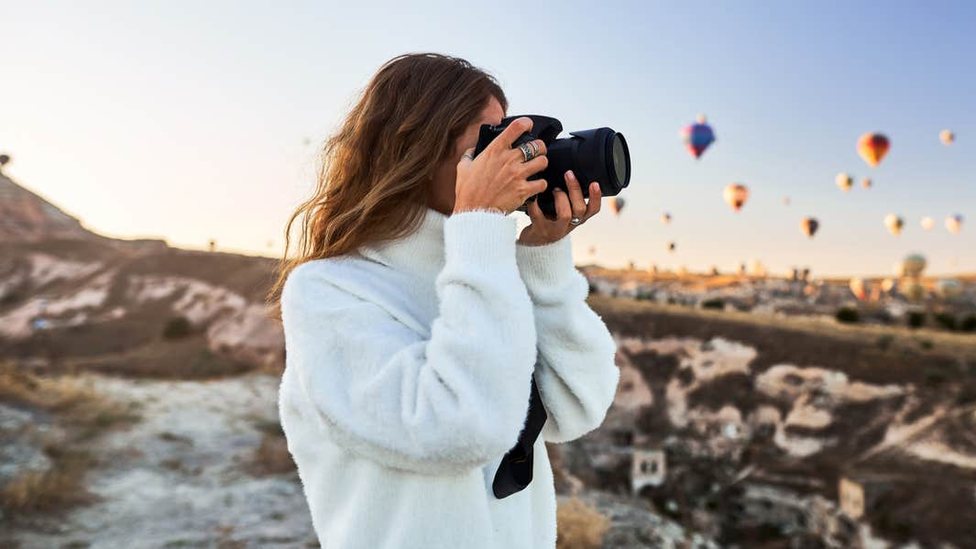
Taking Photographs

Slide 5
Prior to Taking Photographs
Clean the lens of your camera/phone
Charge your battery before going to the site
Choose the best orientation for your image
Change the camera setting to High Dynamic Range (HDR)

Slide 6
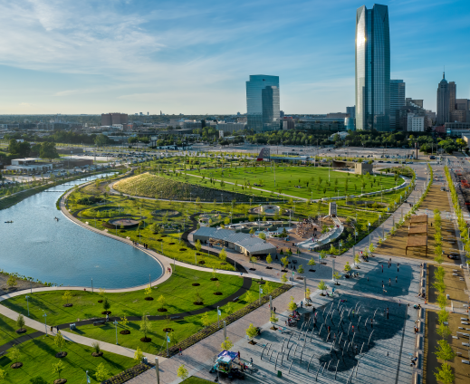
Selecting the Best Time of Day
Try shooting at different times
Exterior shots should take place during the best weather conditions

Slide 7
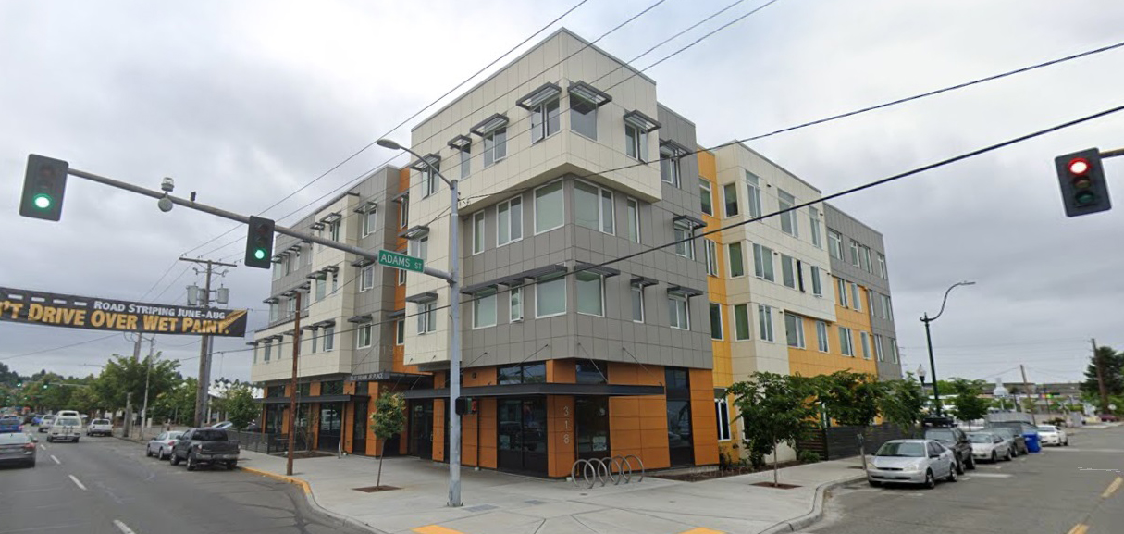
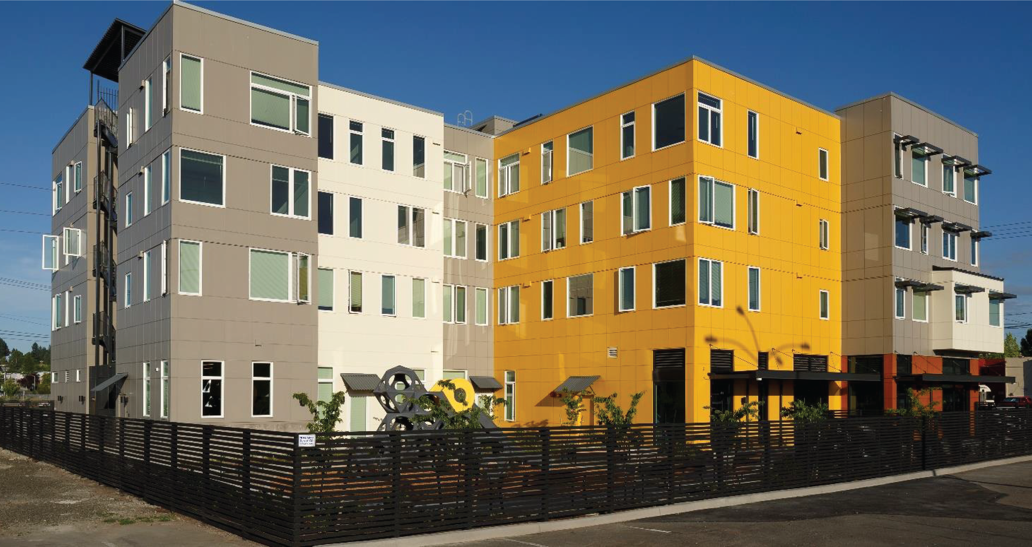
Be Aware of Surroundings
Avoid obstacles in your photos

Slide 8
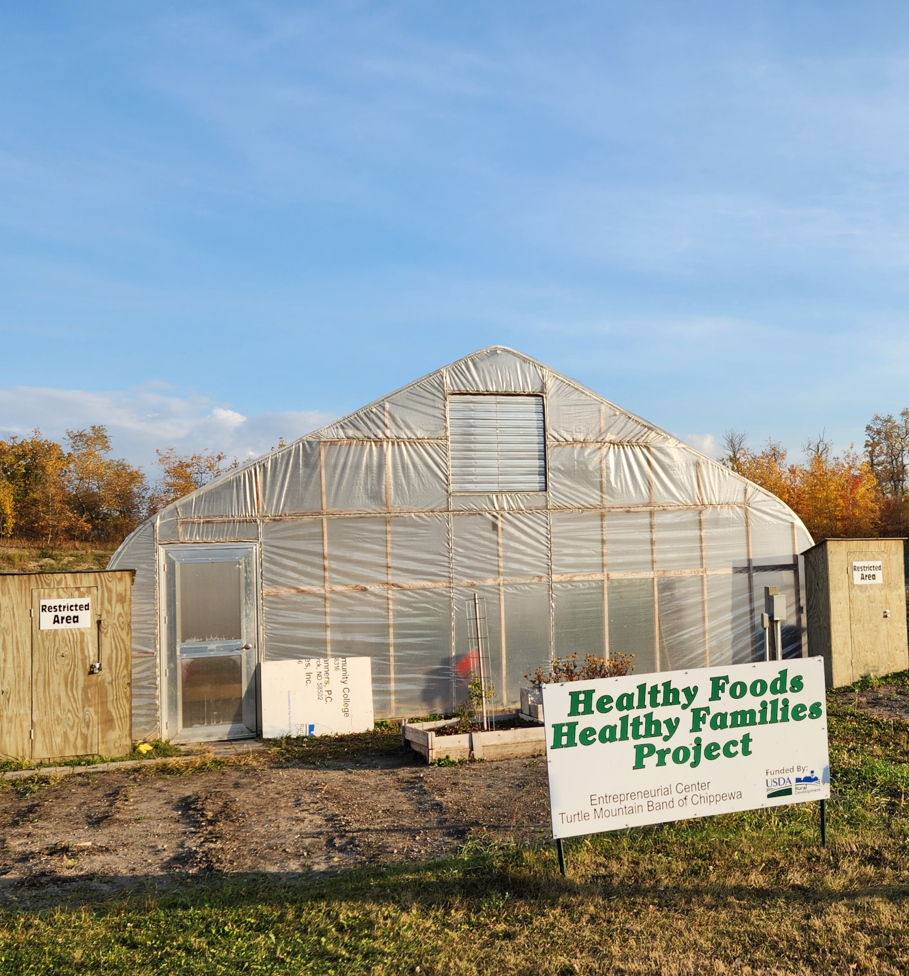
Avoid Obstacles

Slide 9
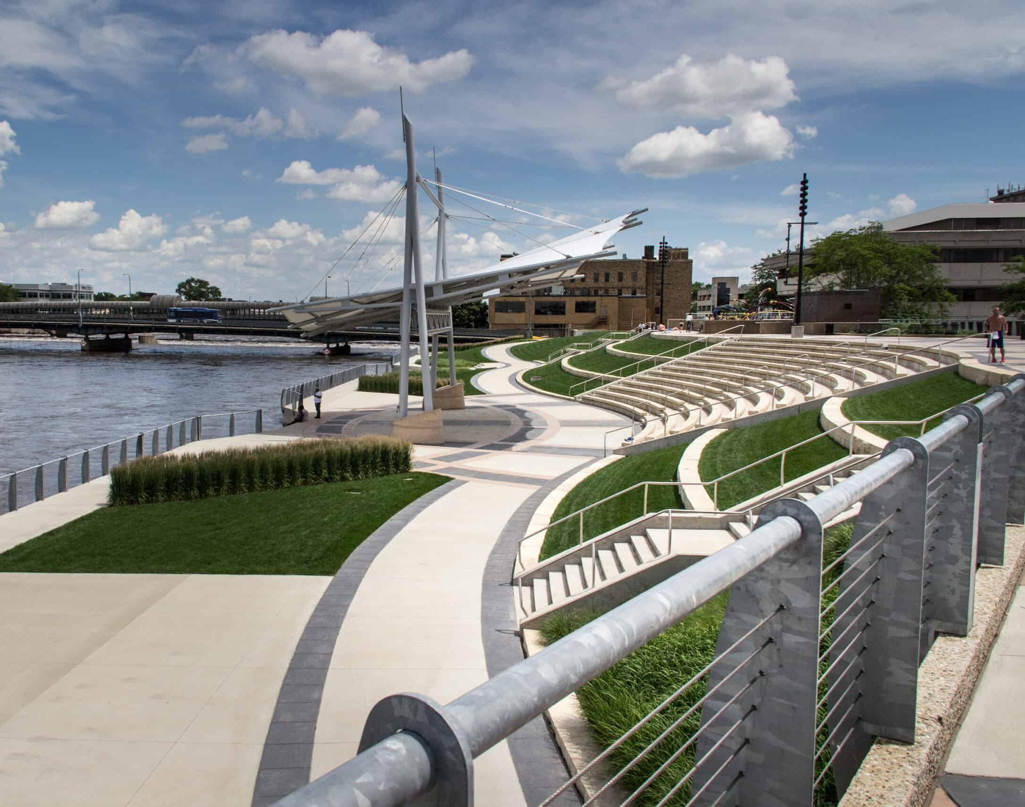
Change Your Perspective
Get shots from different heights, angles, distances, and perspectives
Take close-ups
Don’t always center the subject in the frame

Slide 10
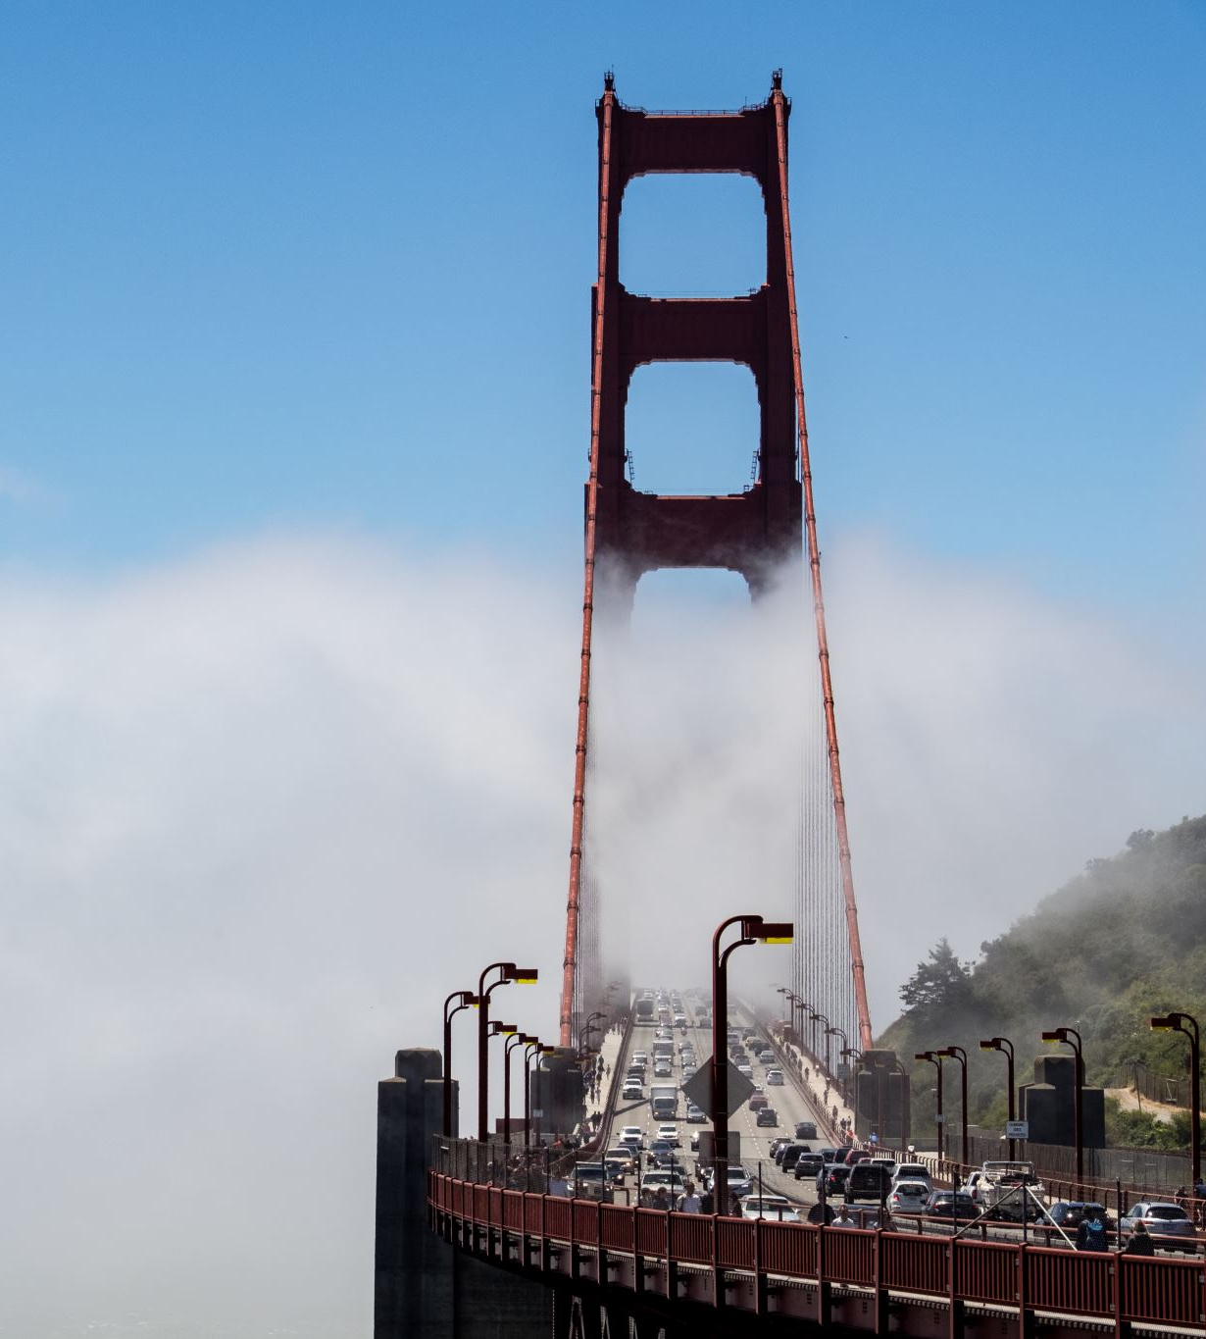
Change Your Perspective

Slide 11
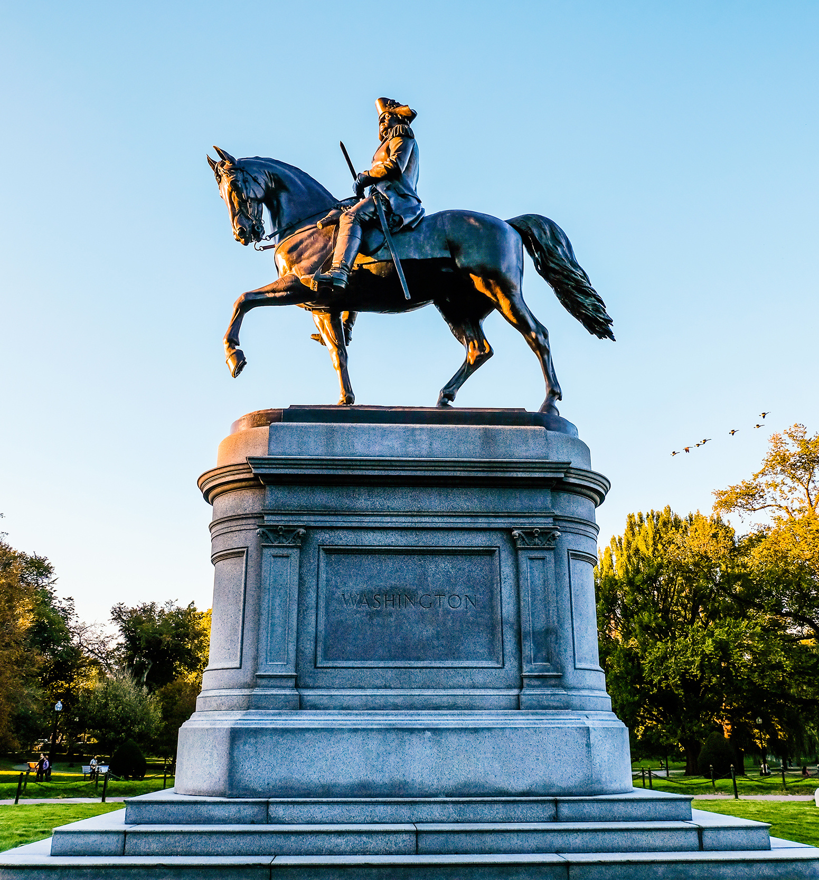
Change Your Perspective

Slide 12
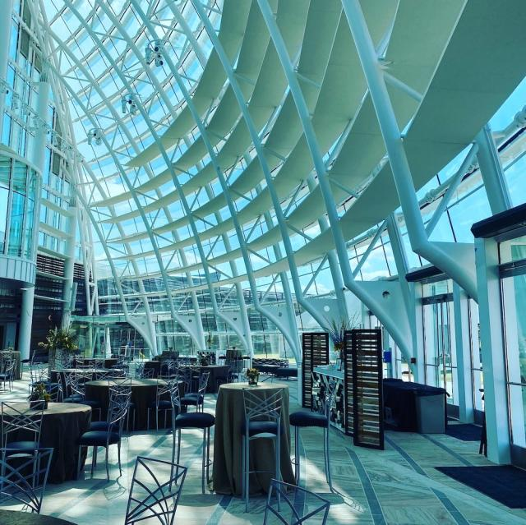
Go Inside
If the site is a restaurant, shopping mall, hotel, or any other business, go inside to take pictures
Getting a new perspective from inside can reveal architectural details
Do not go inside vacant or abandoned properties for photos while along and/or without permission

Slide 13
Pennovation Center Exterior

Slide 14
Pennovation Center Interior

Slide 15
Sample Communications Materials

Slide 16
Sample Communications Materials

Slide 17
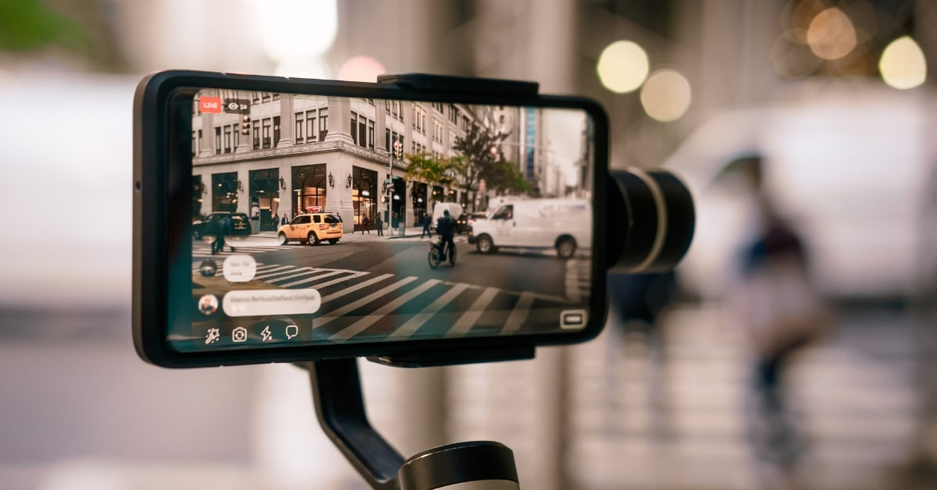
Recording Videos

Slide 18
Prior to Recording
Consider how you plan to use your video
Finalize the “script” and “interview questions” and have those who will be delivering it become comfortable with the material

Slide 19
Prior to Recording
Find a location as free as possible from background noise
Use natural light in front of your subjects

Slide 20
Recording – Audio and Video
Ensure that you are filming at resolution of no less than 1920x1080 (standard HD)
Have the subject take up most of the frame in the shot
Notes:
Be sure to use microphone wind screens when shooting outside

Slide 21
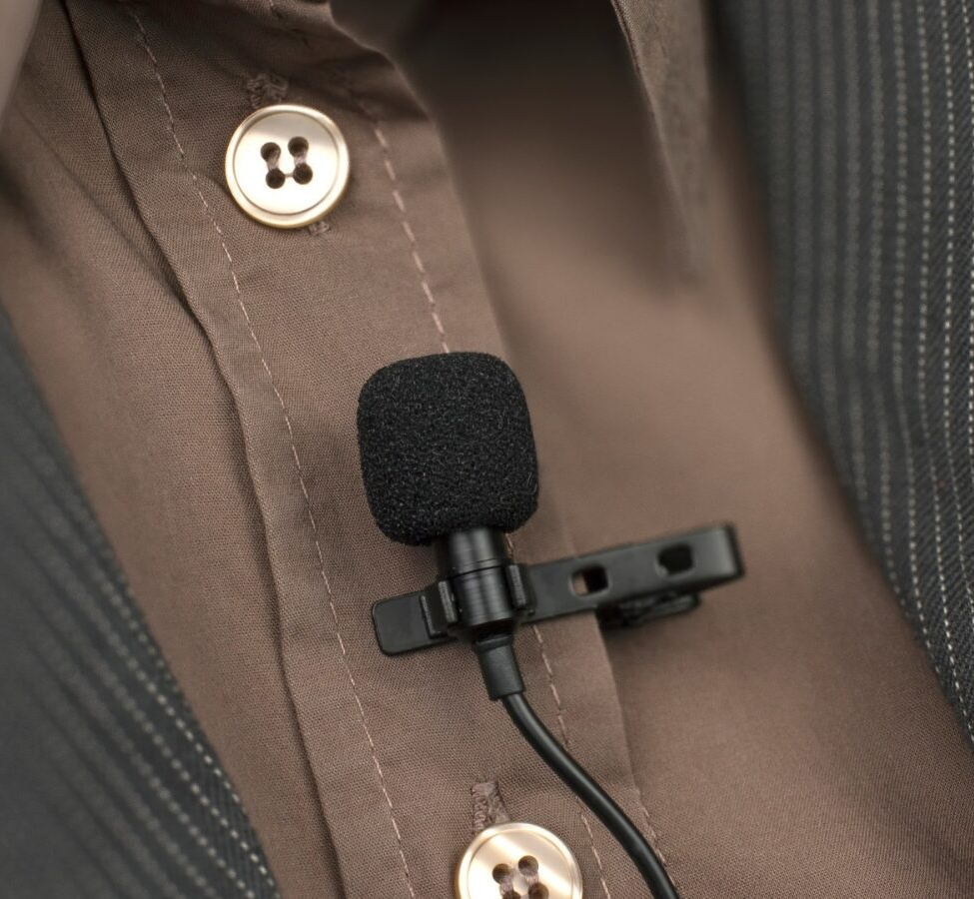
Recording – Audio and Video
Use a wired or wireless lavalier microphone attached to the speakers or a boom mic
Videographer should always wear headphones to hear how the audio recording sounds

Slide 22
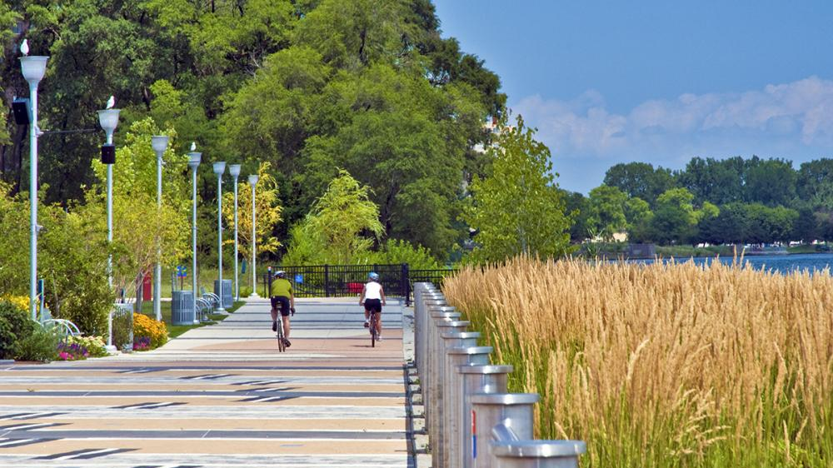
Recording – Audio and Video
For voiceovers (VOs) or supplemental audio, you can use a phone voice recorder app
During site walkthroughs, use a hand-held mount to help steady the shot
Use “B-Roll” video (exterior shots, close-ups, background action, etc.) to supplement interview footage

Slide 23
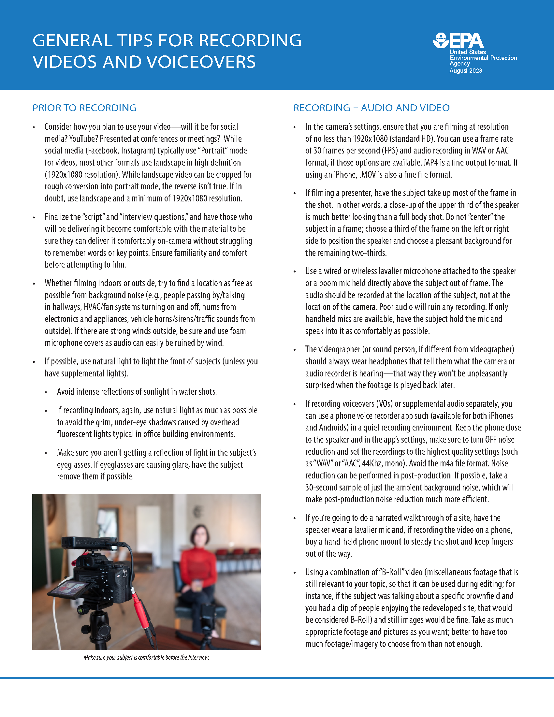
EPA Brownfields Examples and Resources
Provide tips and ideas to maximize your photography and videos
https://www.epa.gov/brownfields/taking-photos-audio-video-your-brownfields-projects

Slide 24
U.S. Environmental Protection Agency Consent Form
Consent to the use of video, photo(s) and/or voice recording as specified for the purpose(s) of the material
Understand that consent to use video, photo(s) and/or voice recording is voluntary
Multimedia Consent Form | US EPA

Slide 25
EPA Region 3 Targeted Brownfields Assessment (TBA) Video https://www.youtube.com/watch?v=k1X3Eh7agXA

Slide 26
Questions or Comments

