Slide 1

Recreational Fire Pit Emissions Testing
Shawn Urbanski, Emily Lincoln, Steve Baker, Bryce Nordgren
USDA Forest Service, Rocky Mountain Research Station
Anne Jackson, Minnesota Pollution Control Agency
US EPA 2023 International Emissions Inventory Conference
Seattle, WA
September 28, 2023

Slide 2
Motivation and Study Questions
Motivation
Initiated and Funded by the Minnesota Pollution Control Agency (MPCA)
Sales of woodburning outdoor recreational wood burning equipment (ORE) – fire pits – have increased significantly since COVID-19 pandemic
Anecdotal evidence of increased use of backyard fire pits in urban/suburban areas
Increased consumer demand for “smokeless” fire pits
Study Questions
Do “low-smoke” fire pits have lower PM_{2.5} emission factors (EFPM) than traditional fire pits?
Provide data for estimating PM_{2.5} emissions from “low-smoke” outdoor recreational fire pit use in Minnesota
What is effect of firewood moisture content (MC) on PM emissions?

Slide 3
Recreational Firepit Emissions Testing
Recreational Fire Pit Emissions Testing
Emission Rate
Emission Factor
Fuel
Consumption
=
×
EPM
(g-PM_{2.5}/hour)
=
EFPM
(g-PM_{2.5}/kg-fuel consumed)
×
FC
(kg-fuel consumed/hour)
Measure EFPM, FC and other factors to estimate EPM for firepit use
FC, a function of user behavior, will drive emissions
Need to: Standardize FC across tests
Extrapolate test results to real world use

Slide 4
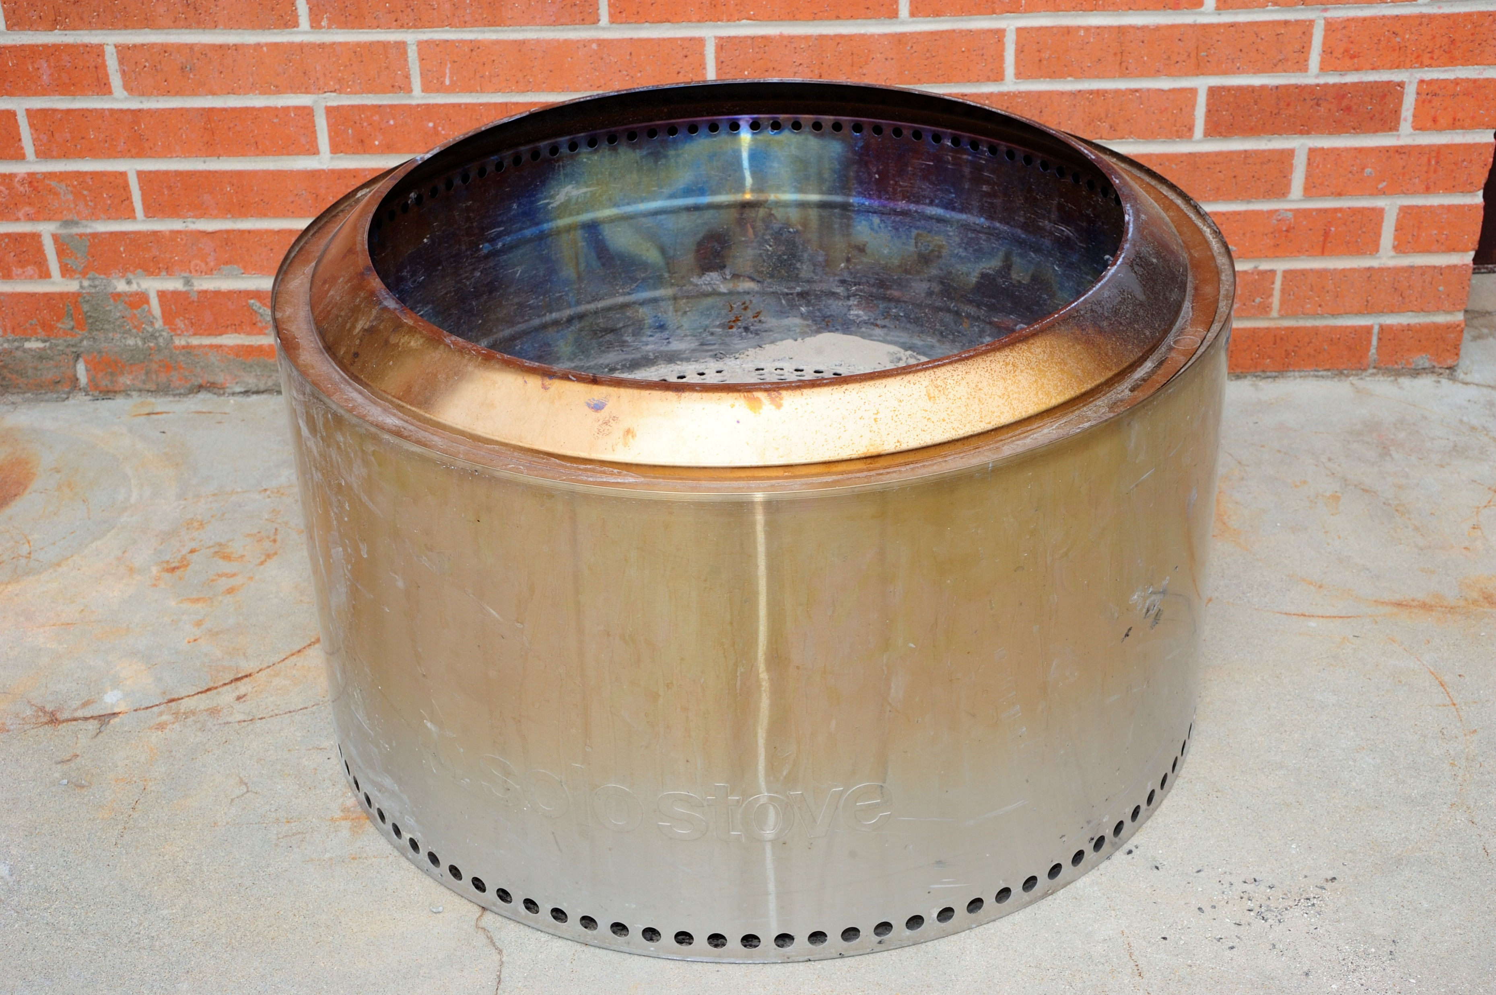
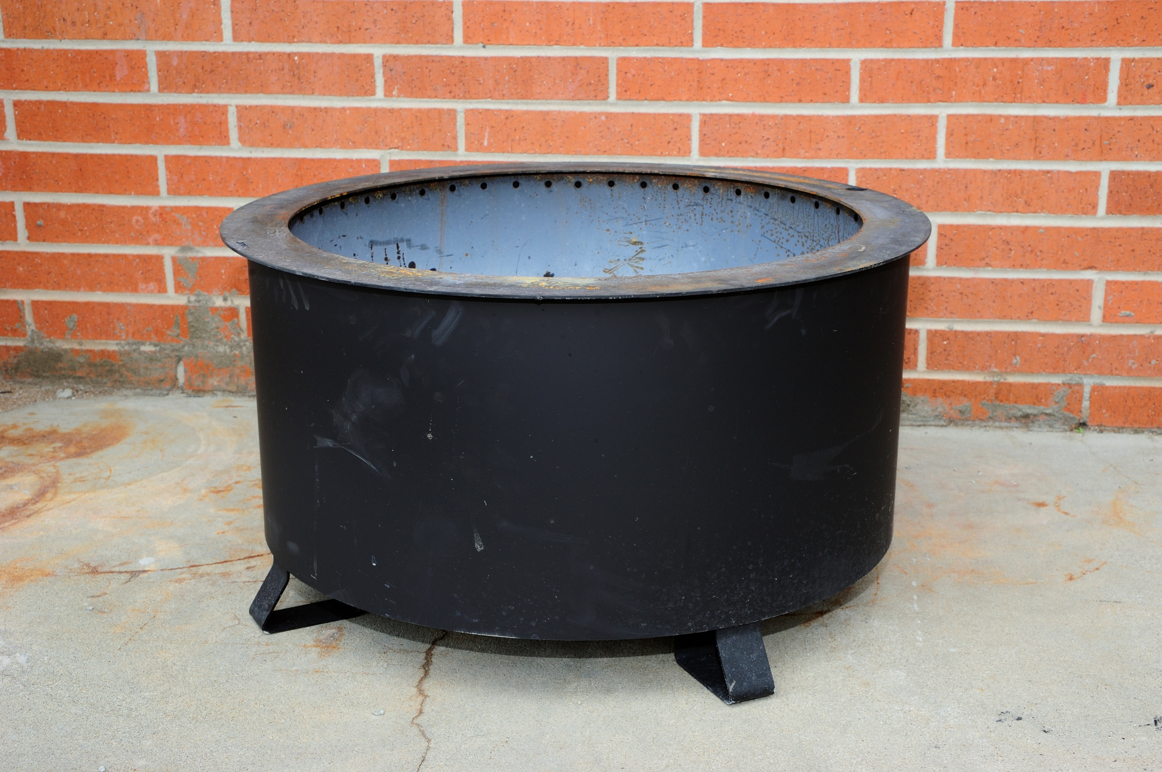
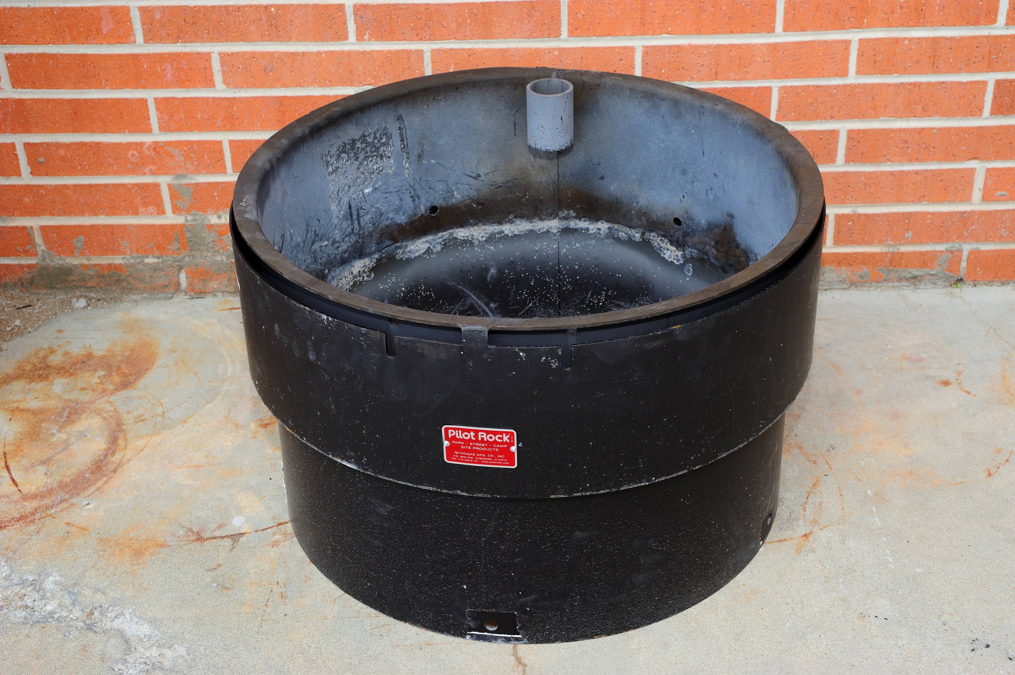
Fire Pits Tested
Recreational Fire Pit Emissions Testing
“Low-smoke” Fire Pits
Accessible Campground Fire Ring
Solo Yukon
Breeo
Pilot Rock
304 stainless steel
38 pounds
27” diameter
17” height
304 stainless steel
62 pounds
24” diameter
16” height
3/16” thick steel
8” high heat shield with cooling air gap.
32” diameter

Slide 5
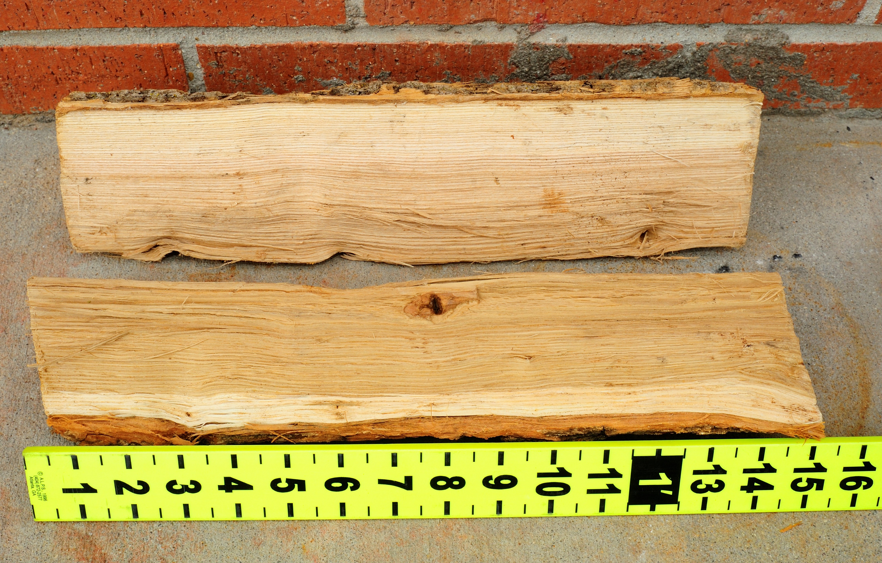
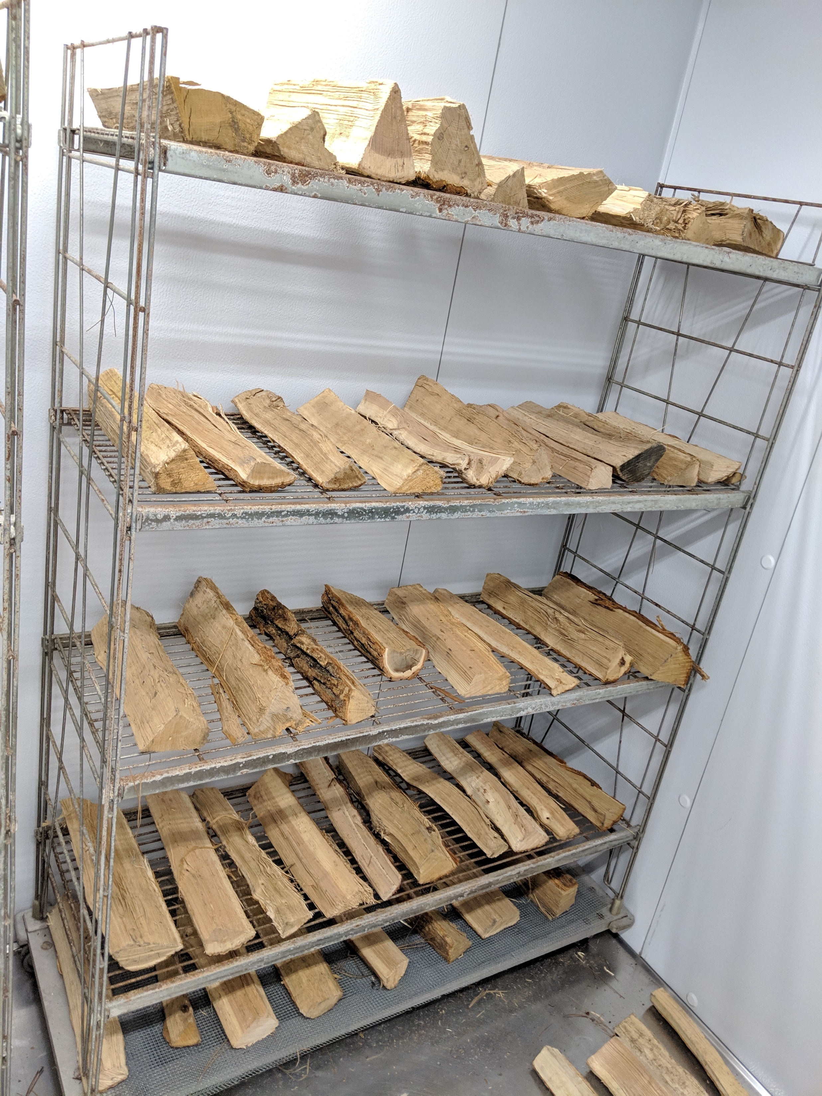
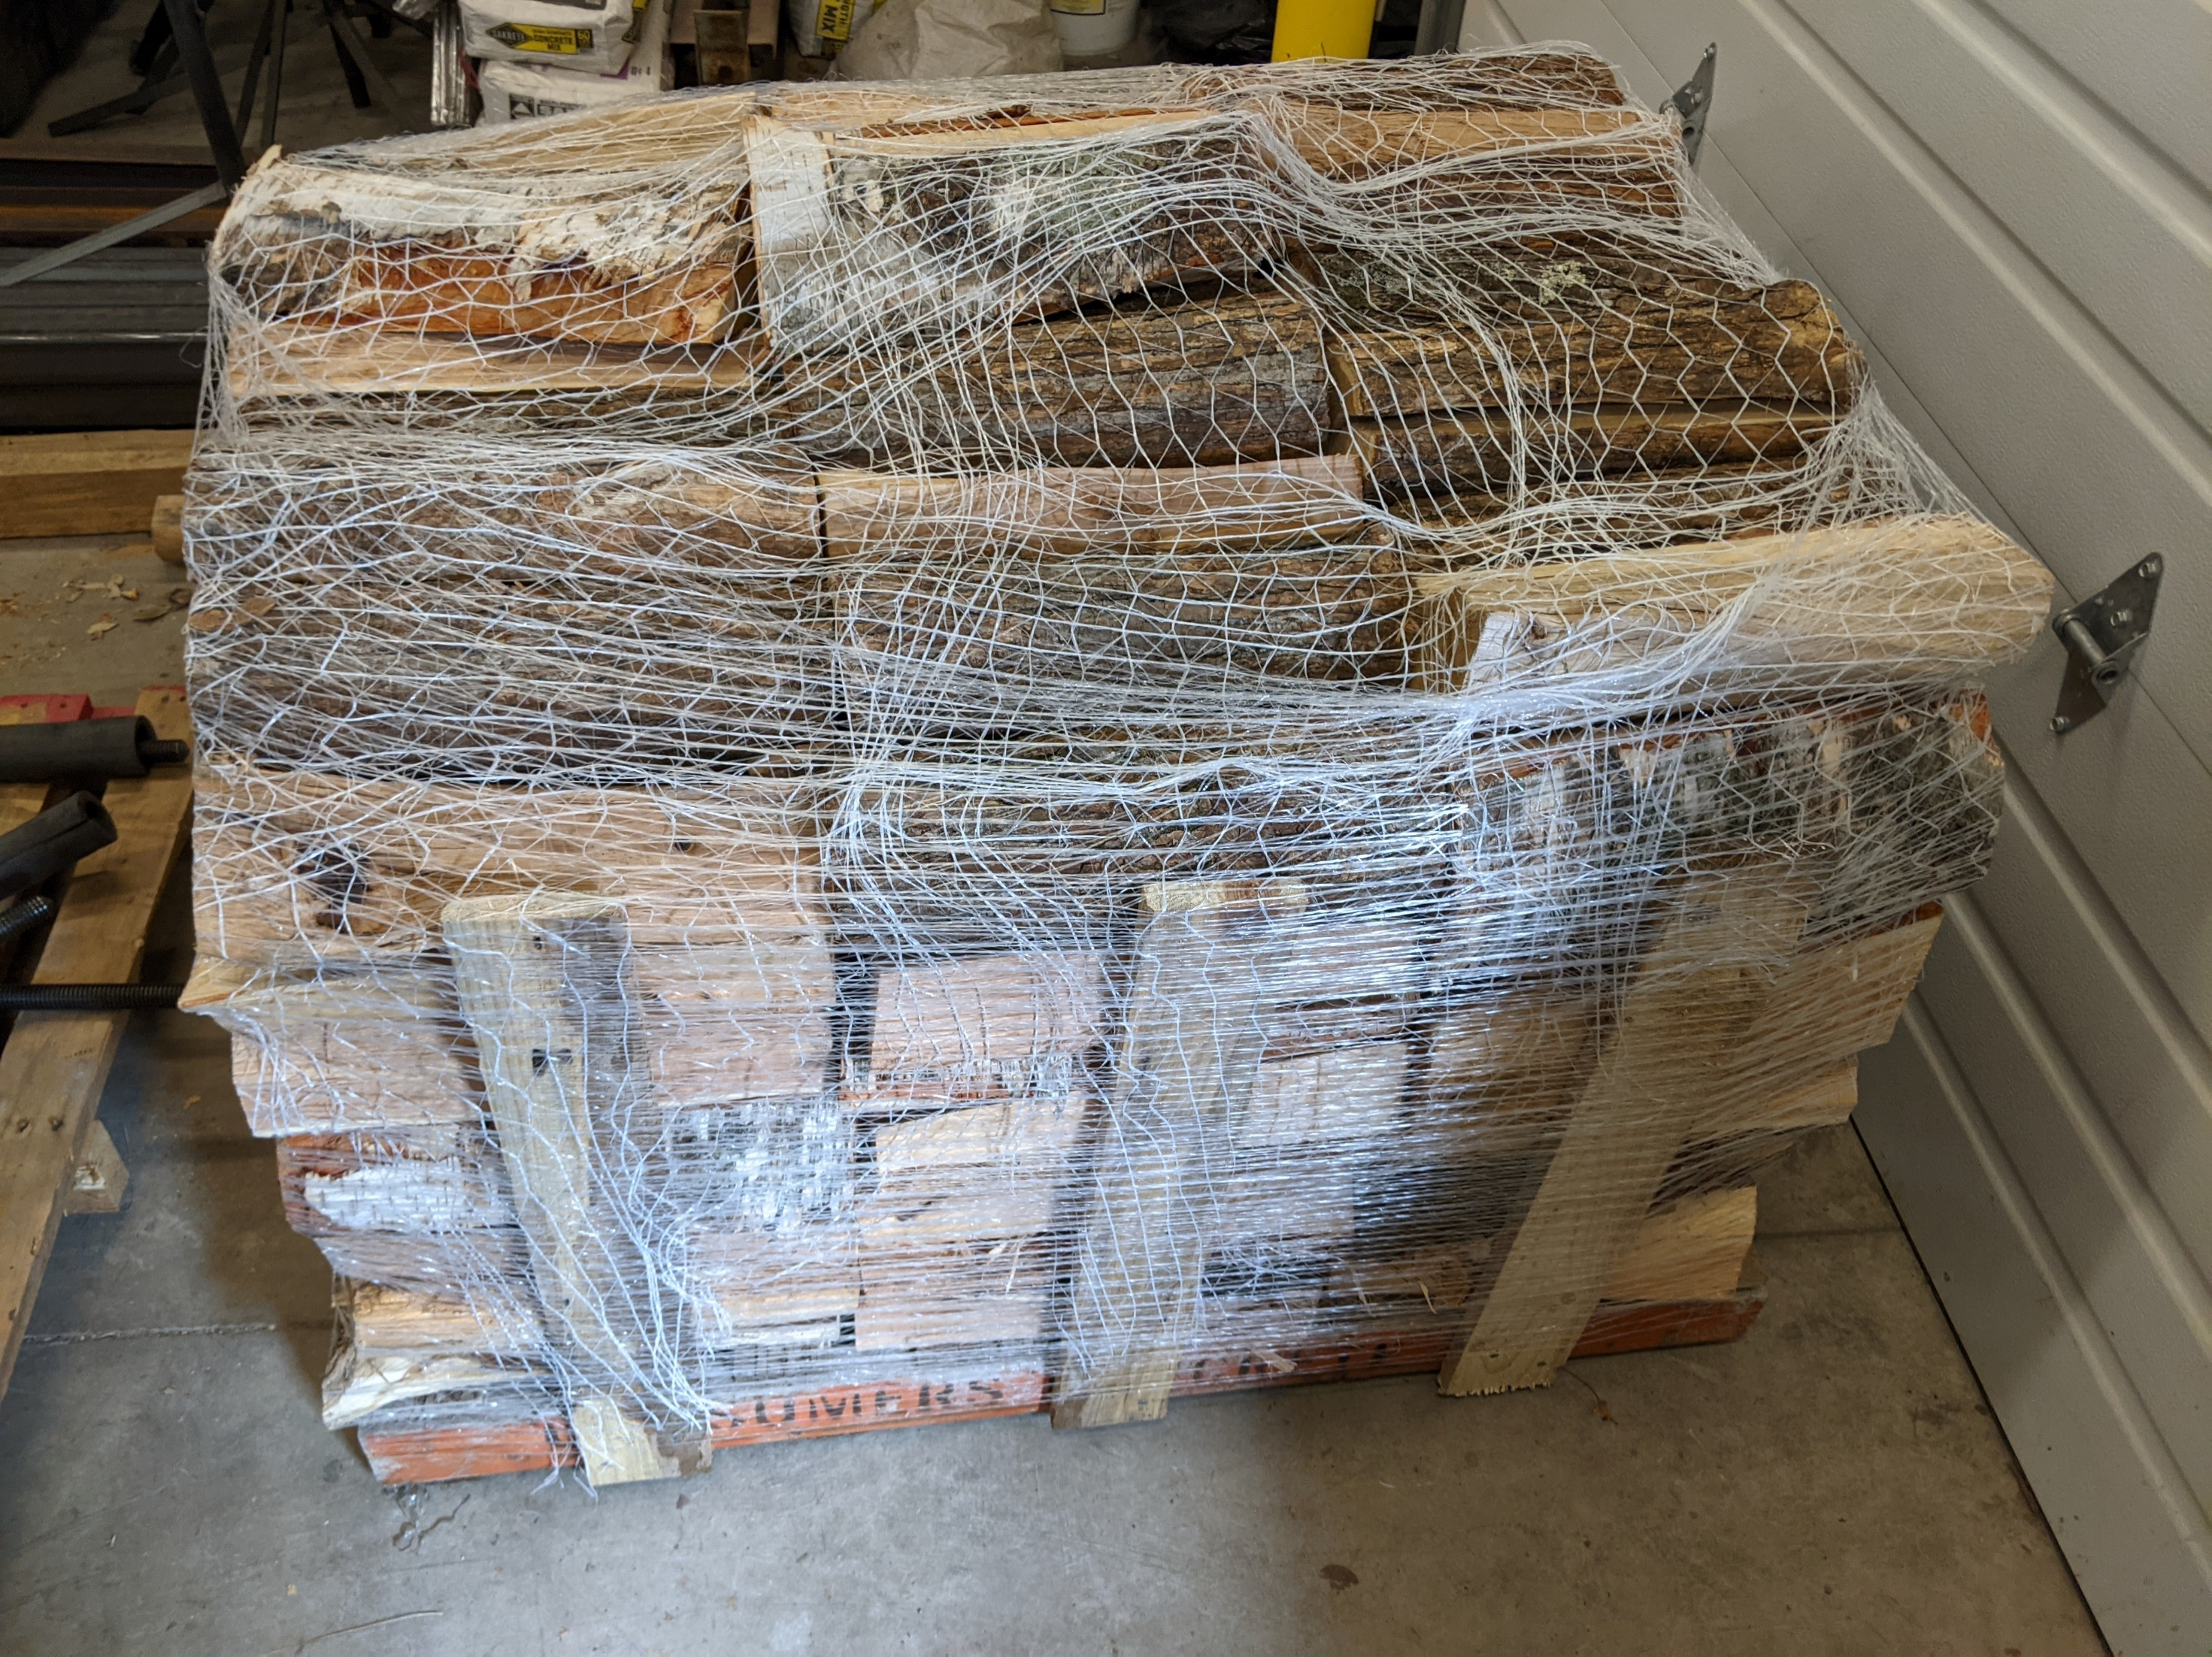
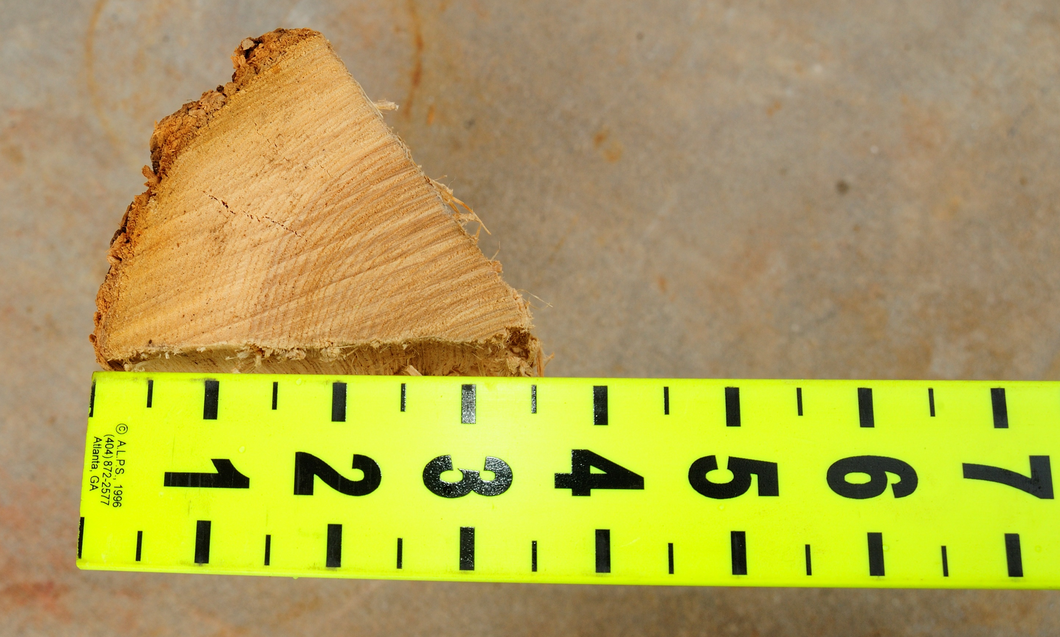
Fuels
Recreational Fire Pit Emissions Testing
Split firewood, red oak, maple, and birch, from Minnesota
Round 1
May 2019
Moderate to low moisture content (MC)
Round 2
June 2021
MC 14-35%
Round 3
December 2019
MC 6-9%
MC 20-27%
Same fuel as round 1, cured for 9 months
New pallet of wood, uncured

Slide 6

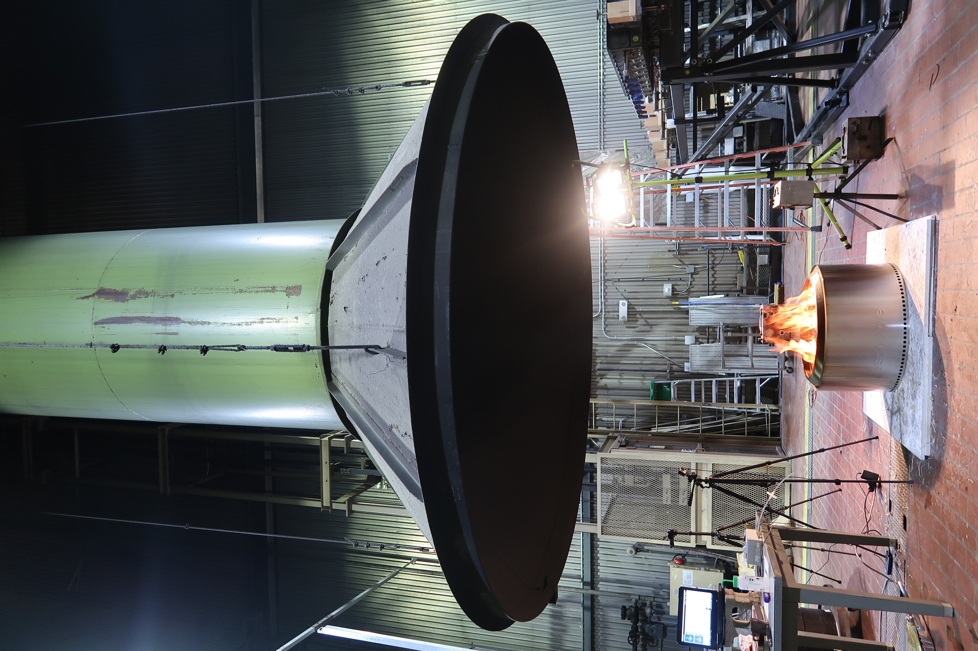
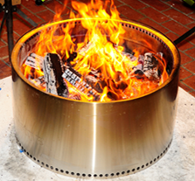

USDA Forest Service
Combustion Facility
Recreational Fire Pit Emissions Testing
exhaust fan
Gas & aerosol instruments sample emissions + ambient air
sa
Mixing ratio & T uniform across the width of the stack
Sampling
platform
Gas & particle sampling
Outdoor air into chamber at floor along the walls and exhausted through stack
Firepit centered under intake funnel of exhaust stack
17 m
1.6 m
diffuser orifice
Diffuser ring mixes the air and entrained emissions
Radiometer
Instruments on chamber floor measure radiant heat flux, T, RH, CO₂
firepit
12.5 m

Slide 7
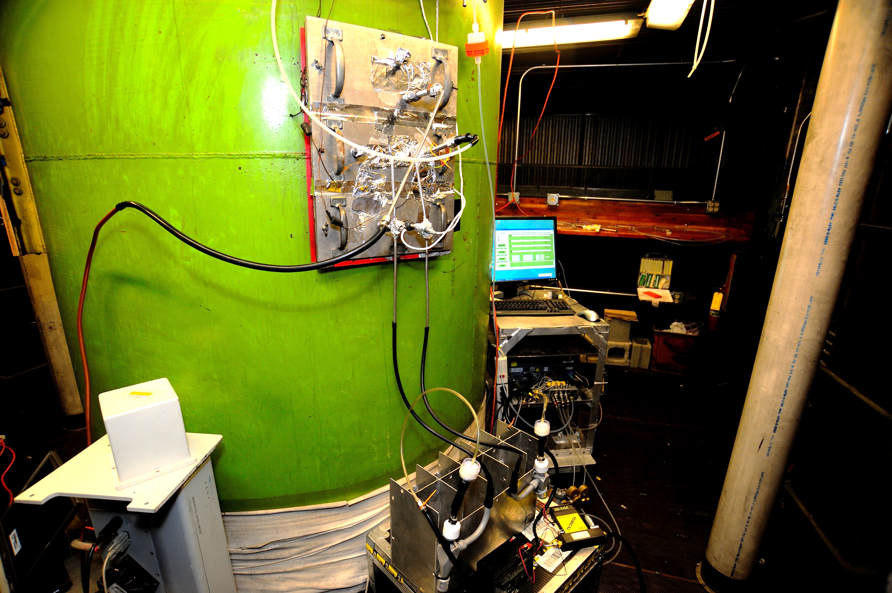
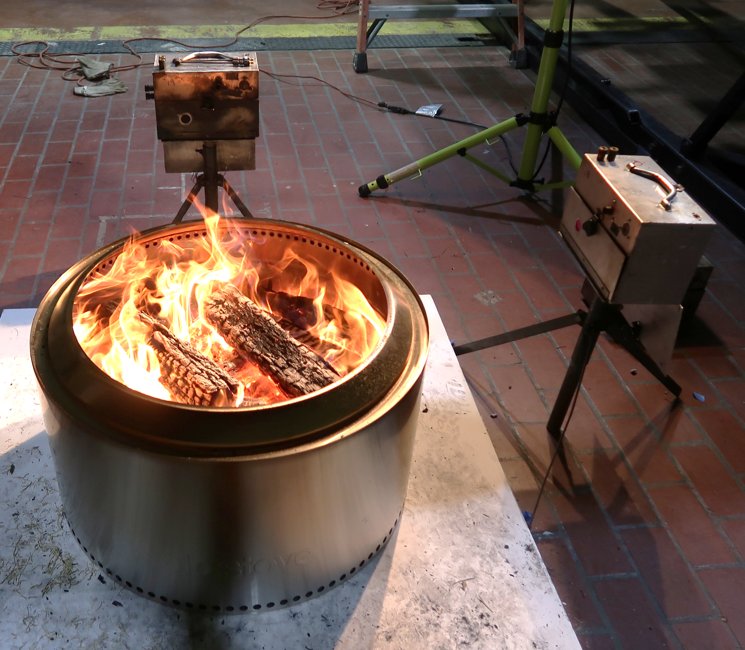
Setup
Recreational Fire Pit Emissions Testing
Sampling Platform
Emissions instrumentation on the sampling platform
Measure PM, CO₂, CO, CH₄
Continuous measurement
CO2, CO, CH4 via
Cavity Ring-down Spectroscopy
Combustion Chamber Floor
The firepit under the center of the exhaust stack
Radiant heat sensors on two sides
Gas analyzer monitored the background CO₂ concentration.
Radiant heat flux
measurement
27 inches
Radiant heat flux
measurement
Fire Pit
27 inches
43 inches
Background
CO₂ measurement

Slide 8
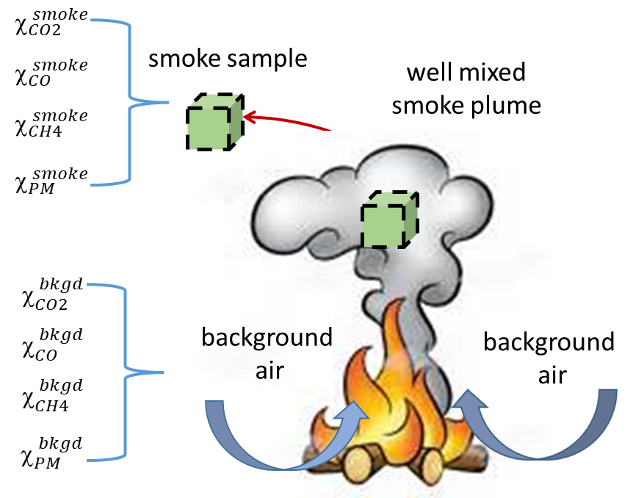


Quantifying EF
Recreational Firepit Emissions Testing
Carbon Mass Balance Method
All volatilized carbon species measured
Emissions are well mixed
volatilized fuel C% = unburnt fuel C%
Excess mixing ratio = Emissions
$$∆_{i}= _{i}^{emitted}=_{i}^{ smoke}−_{i}^{ bkgd}$$
C_{T} = Sum of volatilized carbon
F_{c} = Fuel carbon fraction (C%)
> 90% of volatilized C in CO₂, CO, and CH₄

Slide 9
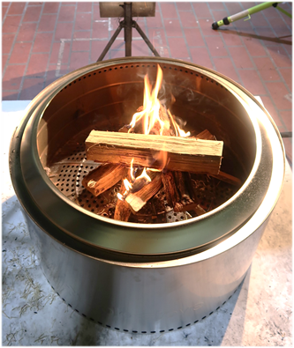
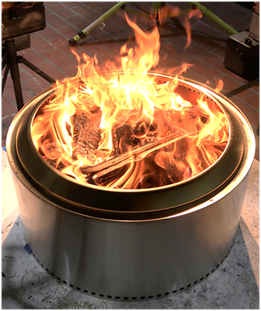
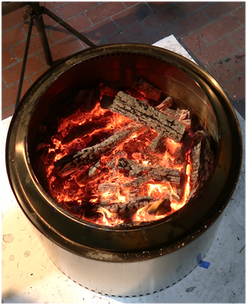
Burn cycle
Recreational Fire Pit Emissions Testing
Burnup Stage
Steady Burn Stage
Burndown Stage
Achieve steady fire
Typical recreational use
Smoldering
Fuel additions ∼5 min.
Duration ∼25 min.
Fuel added ∼15 kg
Fuel additions ∼10 min.
Duration ∼55 min.
Fuel added ∼11 kg
Begins 10 min. after last steady stage fueling
Duration ∼25 min.
Fuel additions weighed. Periodically reserve fuel for moisture content. Extinguish to preserve charcoal & unburnt fuel

Slide 10
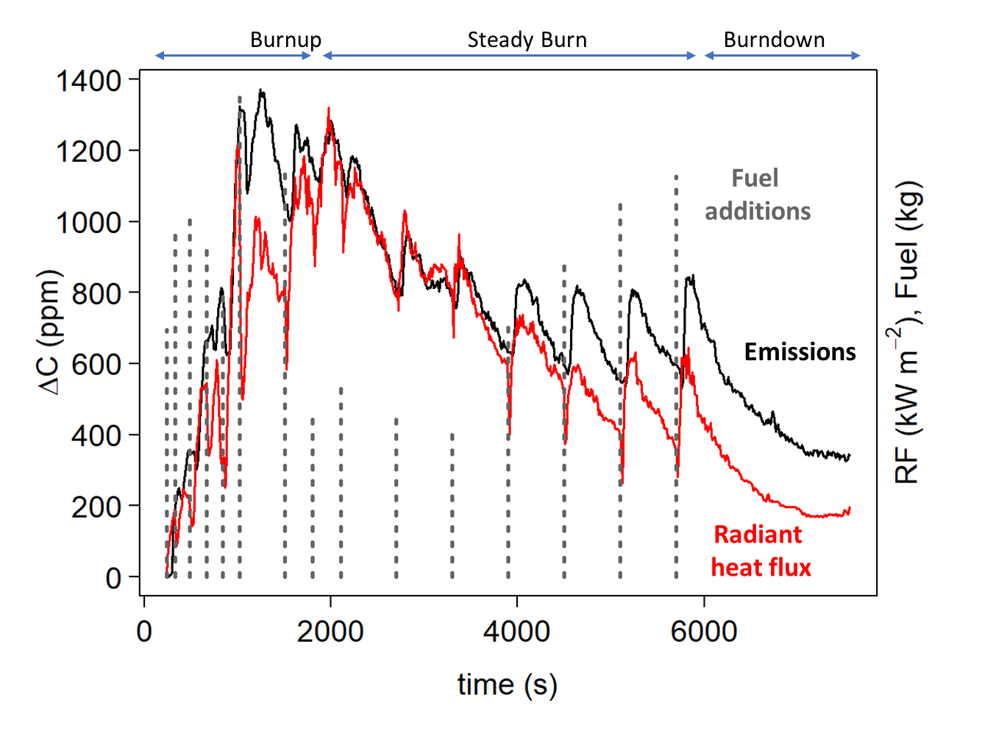
Typical burn profile
Recreational Firepit Emissions Testing
Round 1, May 10, 2019
Solo Firepit (MC = 14%)

Slide 11
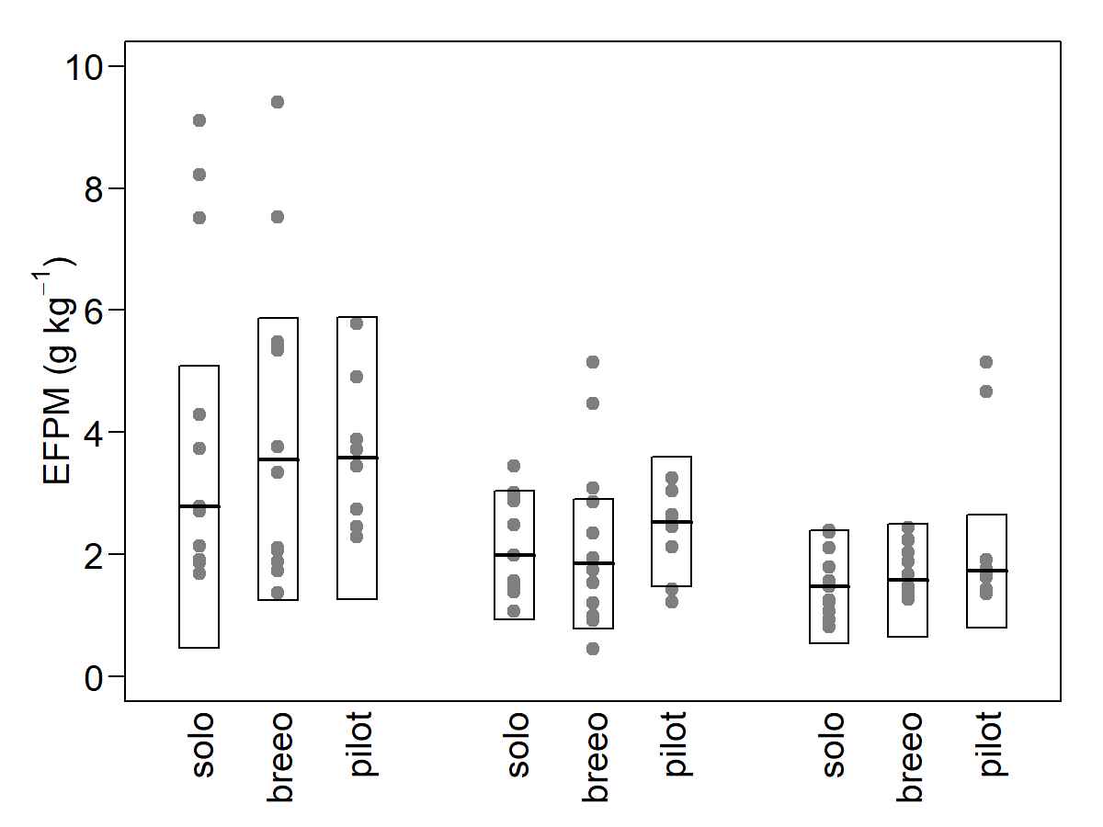
PM_{2.5} Emission Factors
Recreational Fire Pit Emissions Testing
Burn-up
Steady-burn
Burn-down
 | Burn-up | Steady- burn | Burn-down
EFPM (g kg⁻¹)
Solo | 2.8 | 2.0 | 1.5
Breeo | 3.6 | 1.8 | 1.6
Pilot | 3.6 | 2.5 | 1.7
All | 3.4 | 2.1 | 1.6
No. tests = 31, Moisture Content: 6 – 35%

Slide 12
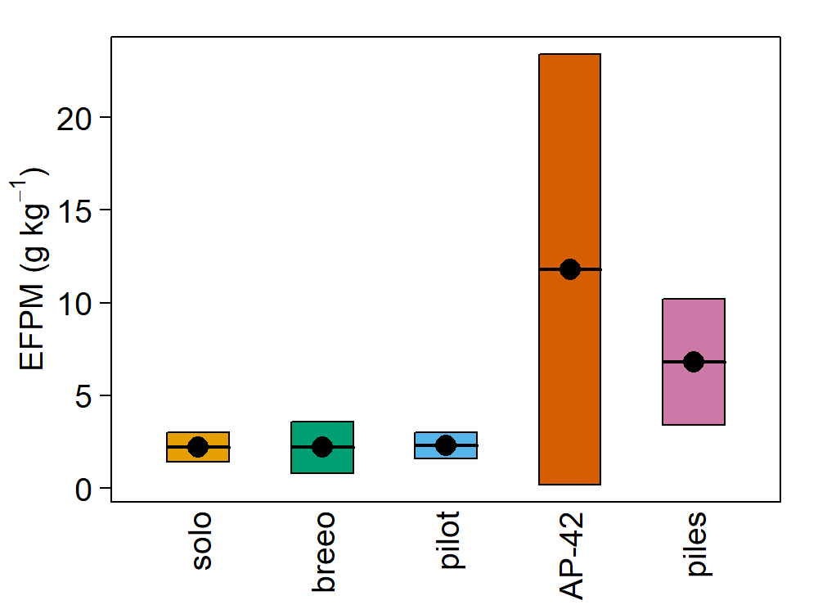
EFPM_{2.5}: “low-smoke”/barrel design fire pits versus AP-42 and pile burns of logging slash
Recreational Fire Pit Emissions Testing
“low-smoke” / barrel design fire pits ∼ 2.2 g kg⁻¹
AP-42 (outdoor woodburning device) = 11.8 g kg⁻¹
Pile burn of logging slash = 6.8 g kg⁻¹
Steady-burn
stage
AP-42 from Houck et al. (2001)
Pile burns from Wright et al. (2010)

Slide 13
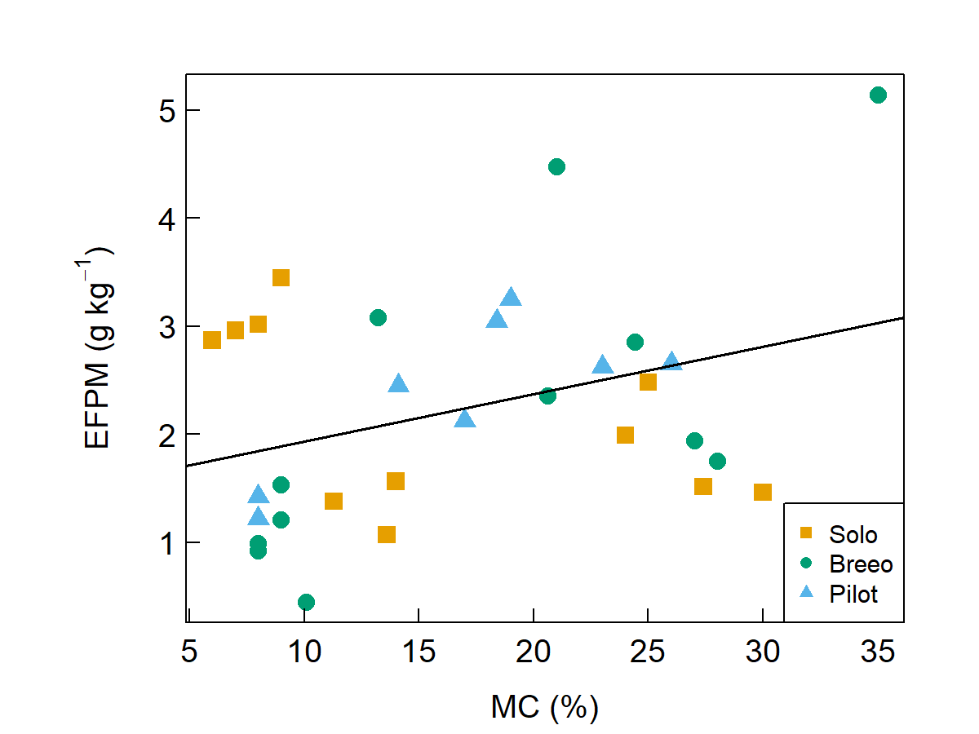
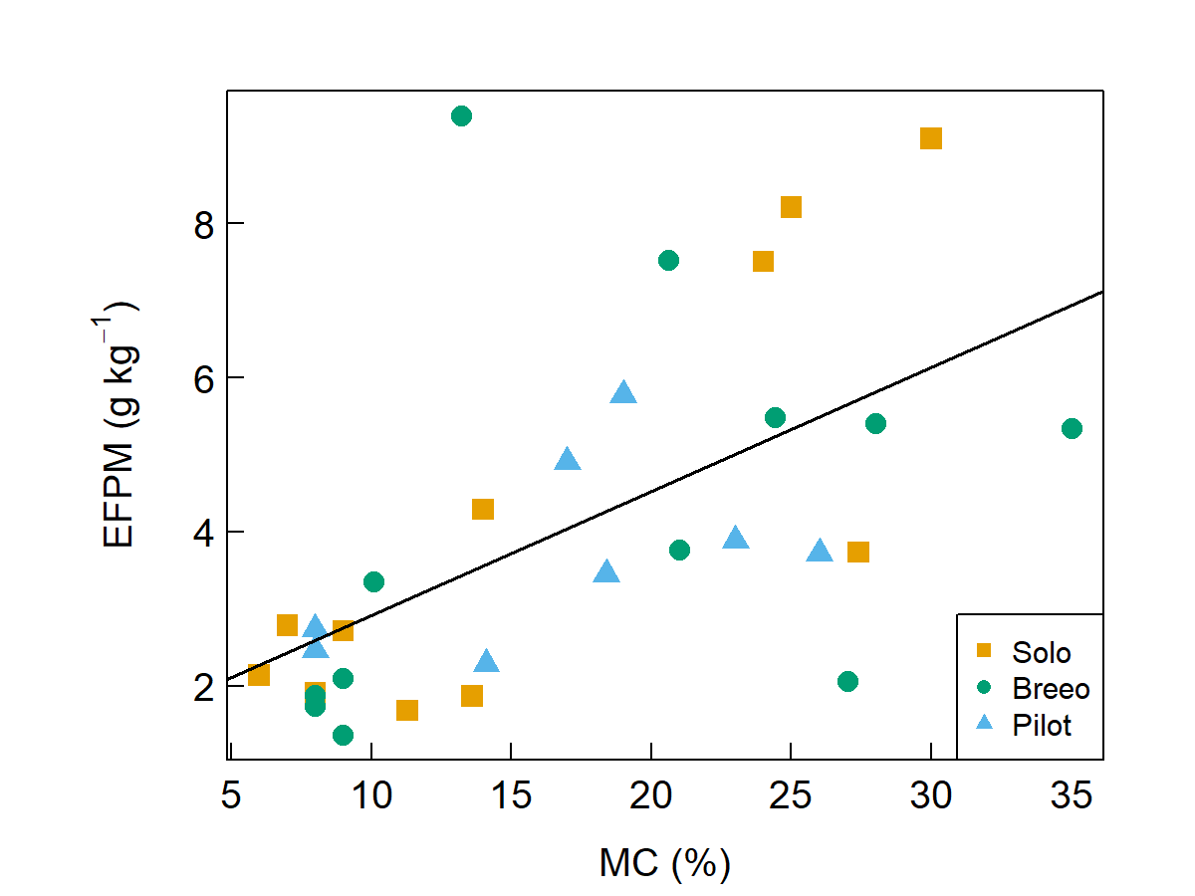
Does firewood moisture content influence EFPM?
Recreational Fire Pit Emissions Testing
No strong influence for steady-burn stage
Not enough tests to sort fire pit/MC effects
MC does impact burn-up stage:
EFPM increases with MC
Steady-burn Stage
y = 1.5 + 0.04x
R² = 0.12, p-value = 0.056
Burn-up

Slide 14
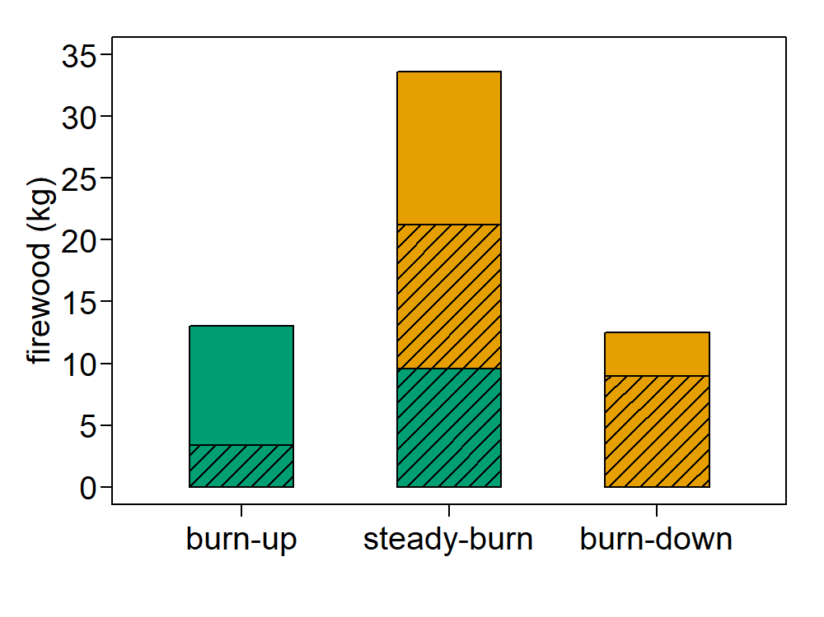
Weighting combustion phases for single EF based on firewood input
Recreational Fire Pit Emissions Testing
Weighted EF = 2.0 g kg⁻¹ (4.0 lb ton⁻¹)
Firewood addition & combustion
Create model of typical burn:
Test data – EF, firewood addition rate, combustion completeness
Assumptions for typical burn –
Similar fueling approach and appliance
Split hardwood at MC = 15%
Burn stage durations (minutes) –
Burn-up = 20, Steady-burn = 120, Burn-down = 60
consumed

Slide 15
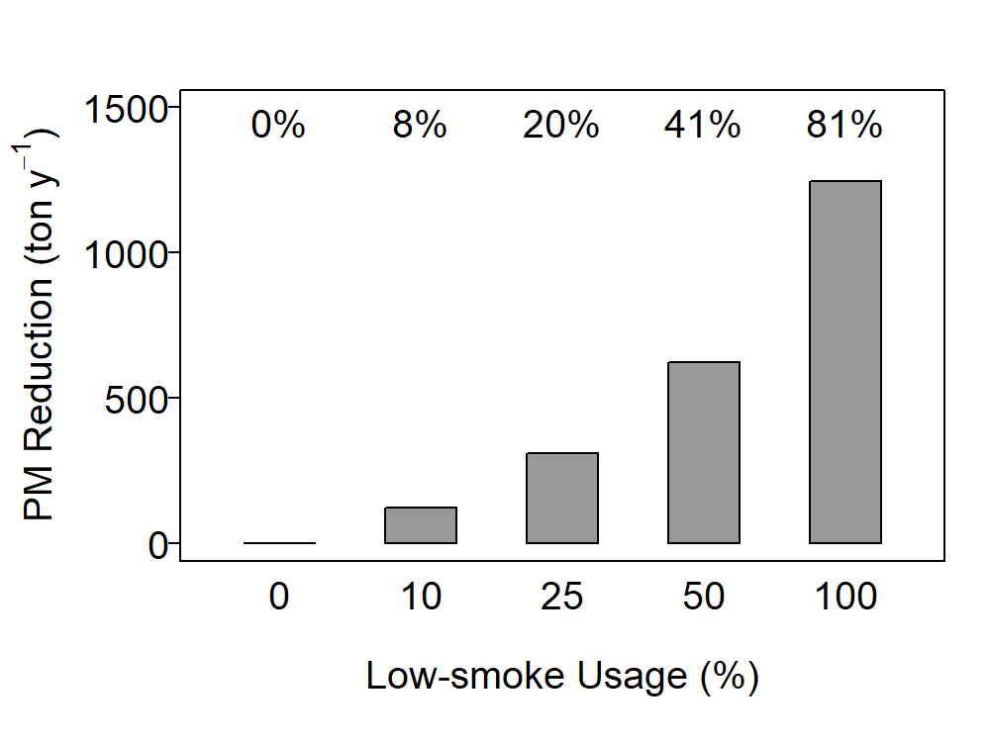
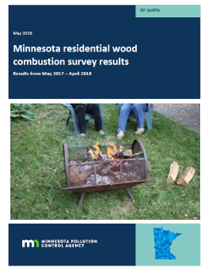
Emission Inventory Impact
Recreational Fire Pit Emissions Testing
Minnesota residential wood combustion survey MSP Metro region estimates for 2018:
# Outdoor Recreational Equipment (ORE) = 358,371
Annual wood use = 0.25 cord/piece = 0.363 ton/piece
Annual PM2.5 = 1533 ton (EFPM = 23.6 lb/ton)
Our ‘typical burn’ implies ∼ 9 burns / year/ ORE
Replacing 1 fire pit provides ∼ 7 lb y⁻¹ reduction in PM
1 pp increase ‘low-smoke’ ORE = 1.24% reduction in emissions

Slide 16
Conclusions
EFPM for “low-smoke”/barrel design fire pits 80% lower than AP-42
PM emissions normalized to radiant heat flux increase with MC
Higher MC → lower radiant heat yield → greater firewood use → more emissions
Improved MC handling and increased test number would have reduced uncertainty in emissions prediction

Slide 17
Additional Questions
How does real world fire pit activity compare with standardized fueling used in testing?
How do fire pits used in testing compare versus other designs?
Small EFPM difference between “low smoke” & Pilot suggests physical dimensions are important factor

Slide 18
THANK YOU
QUESTIONS?
Recreational Fire Pit Emissions Testing

