Slide 1
Educational Partnerships for Innovation in Communities (EPIC)
Highlights from African Cities Implementing the EPIC Capacity-Building Tool
Anthony Socci, Ph.D.
Senior Lead for International Climate Adaptation and Resilience Policy
US Environmental Protection Agency
Office of International & Tribal Affairs
Washington, DC USA
Notes:
MARC

Slide 2
Educational Partnerships for Innovation in Communities (EPIC) Capacity Building Tool
EPIC is a simple tool/framework for highly effective, action-oriented partnerships.
Brings the untapped and underutilized intellectual resources of universities to the service of local governments and communities.
To enhance local govt capacity to adapt, build resilience, develop more sustainably, and more.
EPIC model/tool matches existing university courses with local government and community needs without having to redesign courses or alter class schedules.
Minimal burden placed on faculty while students acquire experience grappling with real world issues of local concern.

Slide 3
Educational Partnerships for Innovation in Communities (EPIC) Capacity Building Tool
EPIC partnerships provide students with experience working on real world issues locally as part of their normal coursework.
EPIC partnerships tend to build trust and sustained relations over time between local governments and universities.
These are not one-off engagements but long-term results-oriented relationships that maintain over time.
EPIC tool is flexible and can accommodate differences in geographies, politics, economies and cultural norms.
EPIC partnerships are local in nature but scalable to state, country and international networks.

Slide 4
EPIC Matches Community Needs with University Capacity
Cities:
Limited capacity and skills
Limited resources and access to skills and new knowledge
Tendency to be risk averse
Universities:
Abundant skill & know how
Ready access to broad range of skills and new knowledge
Innovative & not risk averse

Slide 5
University Assets in Service to Local Communities
Multidisciplinary expertise
Multiple skill sets: design, policy analysis, engineering, law, planning, outreach & communication etc…
Technical skill, familiarity with best practices, knowledge and experience
New ways of thinking and looking at problems
Time, capacity and student energy

Slide 6
Benefits to Students
Gain real world experience by grappling with genuine local issues
Chance to work across disciplines
More energized and more focused
Better understanding of what local government does and how it operates
Gain greater sense of community and social responsibility as students and involved citizens
Opens door to additional unforeseen career opportunities at the local government level
Notes:
Courtney!!!!!

Slide 7
Partial Range of Disciplines & Expertise Involved
Climate Adaptation/Mitigation/Resilience
Sustainable Development
Affordable housing
Sustainable transportation
Engaging marginalized communities
Economic development/redevelopment
Brownfield redevelopment
Waste/Litter
Green architecture
Community education
Livability
Economic development/redevelopment
Brownfield redevelopment
Waste/Litter
Green architecture
Community education
Livability
Environmental Planning
Urban Planning
Risk Assessment
Ecological Systems
And so much more…

Slide 8
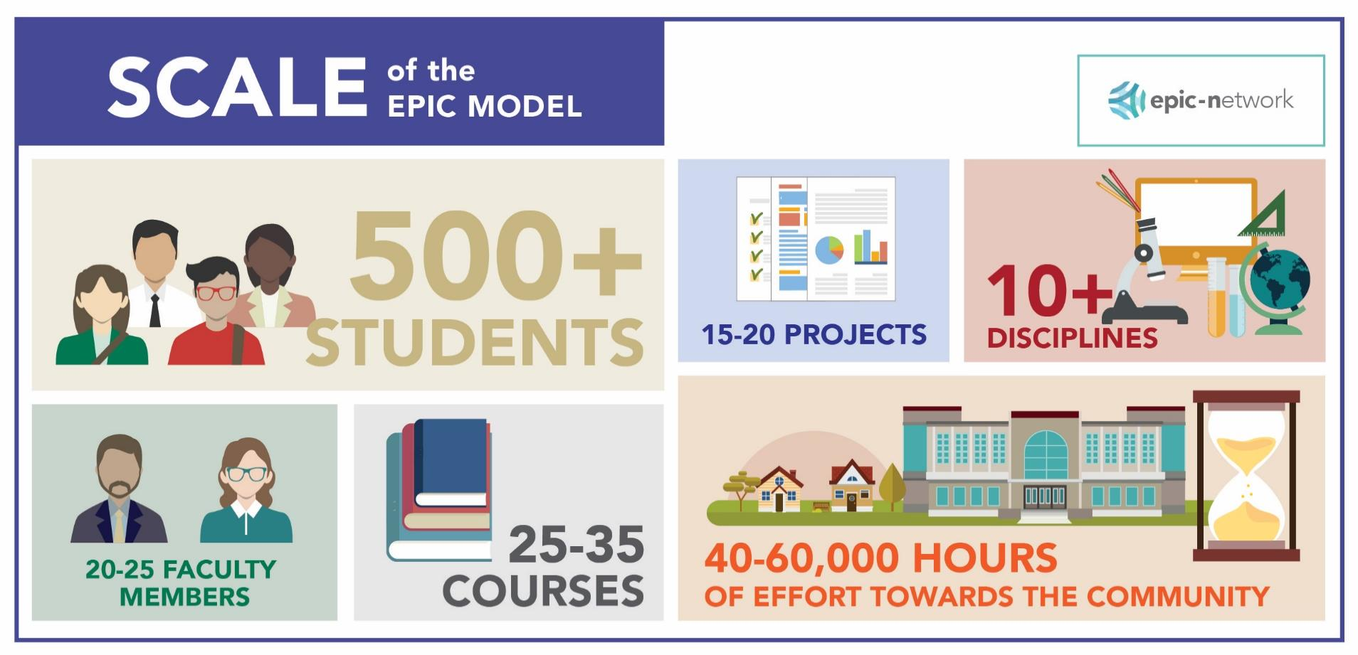

Scale of Typical Engagement During an Academic Year (US Example)

Slide 9
Sample Range of Community Projects
Climate Adaptation/Mitigation/Resilience
Nature-based Adaptation/Resilience
Disaster Risk Assessment & Risk Mapping
Disaster early warning systems
Sustainable Redevelopment Planning
Climate Risk Assessment & Planning
Affordable housing
Sustainable transportation
Waste/Litter
Green architecture
Community education
Livability
Engaging marginalized communities
Economic development/redevelopment
Brownfield redevelopment
And so much more…

Slide 10
Journey of the EPIC Tool from the U.S. A. to Africa [+ SE Asia & LA]
2009 - Idea for EPIC model/tool emerged from University of Oregon by 2 bored academicians.
May 2017 - EPA organizes international partnership (NSF - US National Science Foundation, ICLEI Global - Local Governments for Sustainability, UN GAN – Global Adaptation Network, ICMA – International City/County Management Association, START - System for Analysis, Research and Training, and EPICN - EPIC Network Secretariat) to host a first international training on the EPIC tool in Bonn, Germany.
Nov. 2017 - First regional training in Cape Town SA, for cities and universities from sub-Saharan Africa, November 2017. Emergence of EPIC Africa Regional Network.
February 2020 - Africa regional network leaders host first in-person African-led training on the EPIC model in Durban, South Africa, for other African city and university officials.
May 2021 -1st EPIC training workshop for city and university officials from various SE Asian cities. EPIC Asia Regional Network emerges, 2nd EPIC network outside of the U.S.
June - September 2022 – 4 EPIC training workshops were hosted in Pretoria South Africa, Windhoek Namibia, Gaborone Botswana, and Harare Zimbabwe.
September 2022 - Two EPIC training workshops hosted for Latin American cities spawning 10 new EPIC projects in cities in 5 Latin American countries. Advent of EPIC Latin American regional network.
April – October 2024 - 4 EPIC training workshops are currently taking place in Monrovia Liberia, Banjul Gambia, Mombasa Kenya and Lusaka Zambia.

Slide 11
The EPIC model has been implemented by more than 70 university-based programs in more than 350 diverse institutions/communities globally, to complete more than 1800 projects mobilizing more than a million hours of expert-supervised student effort

Slide 12
Outcomes of EPIC Capacity-Building Tool in Selected African Cities

Slide 13
Durban, South Africa
Durban city council partnered with University of KwaZulu-Natal and its students for assistance in developing and implementing a flood management plan and a flood early warning system for the Quarry Road west (QRW) informal community living along the Palmiet River.
April 2022 the Durban area struck by the worst rains and floods in the history of SA, resulting in over 600 deaths and damage or loss to over 19,000 dwellings, largely confined to informal communities.
But because of a community-led flood early warning system being in place, the QRW community along the Palmiet River suffered no deaths.

Slide 14
Durban, South Africa
Video of Durban Floods of 2022
https://fb.watch/l88kgNeJ6J/

Slide 15
Nairobi, Kenya
Nairobi city council collaborated with the University of Nairobi, working with 2 NGOs, to identify options for redeveloping and making more resilient, sustainable, and user-friendly, its notoriously deteriorated and pedestrian-unfriendly central business district along Luthuli Avenue in the CBD.
Following a localized student-led pilot effort aimed at showing the potential value of implementing one of the options presented to the city council, the President of Nairobi approved and supported a longer-term effort to implement the work beyond the pilot area.
The work of redeveloping the CBD to be more resilient, sustainable and user-friendly, is on-going and has the support of local businesses who found these efforts increased foot traffic and business.

Slide 16
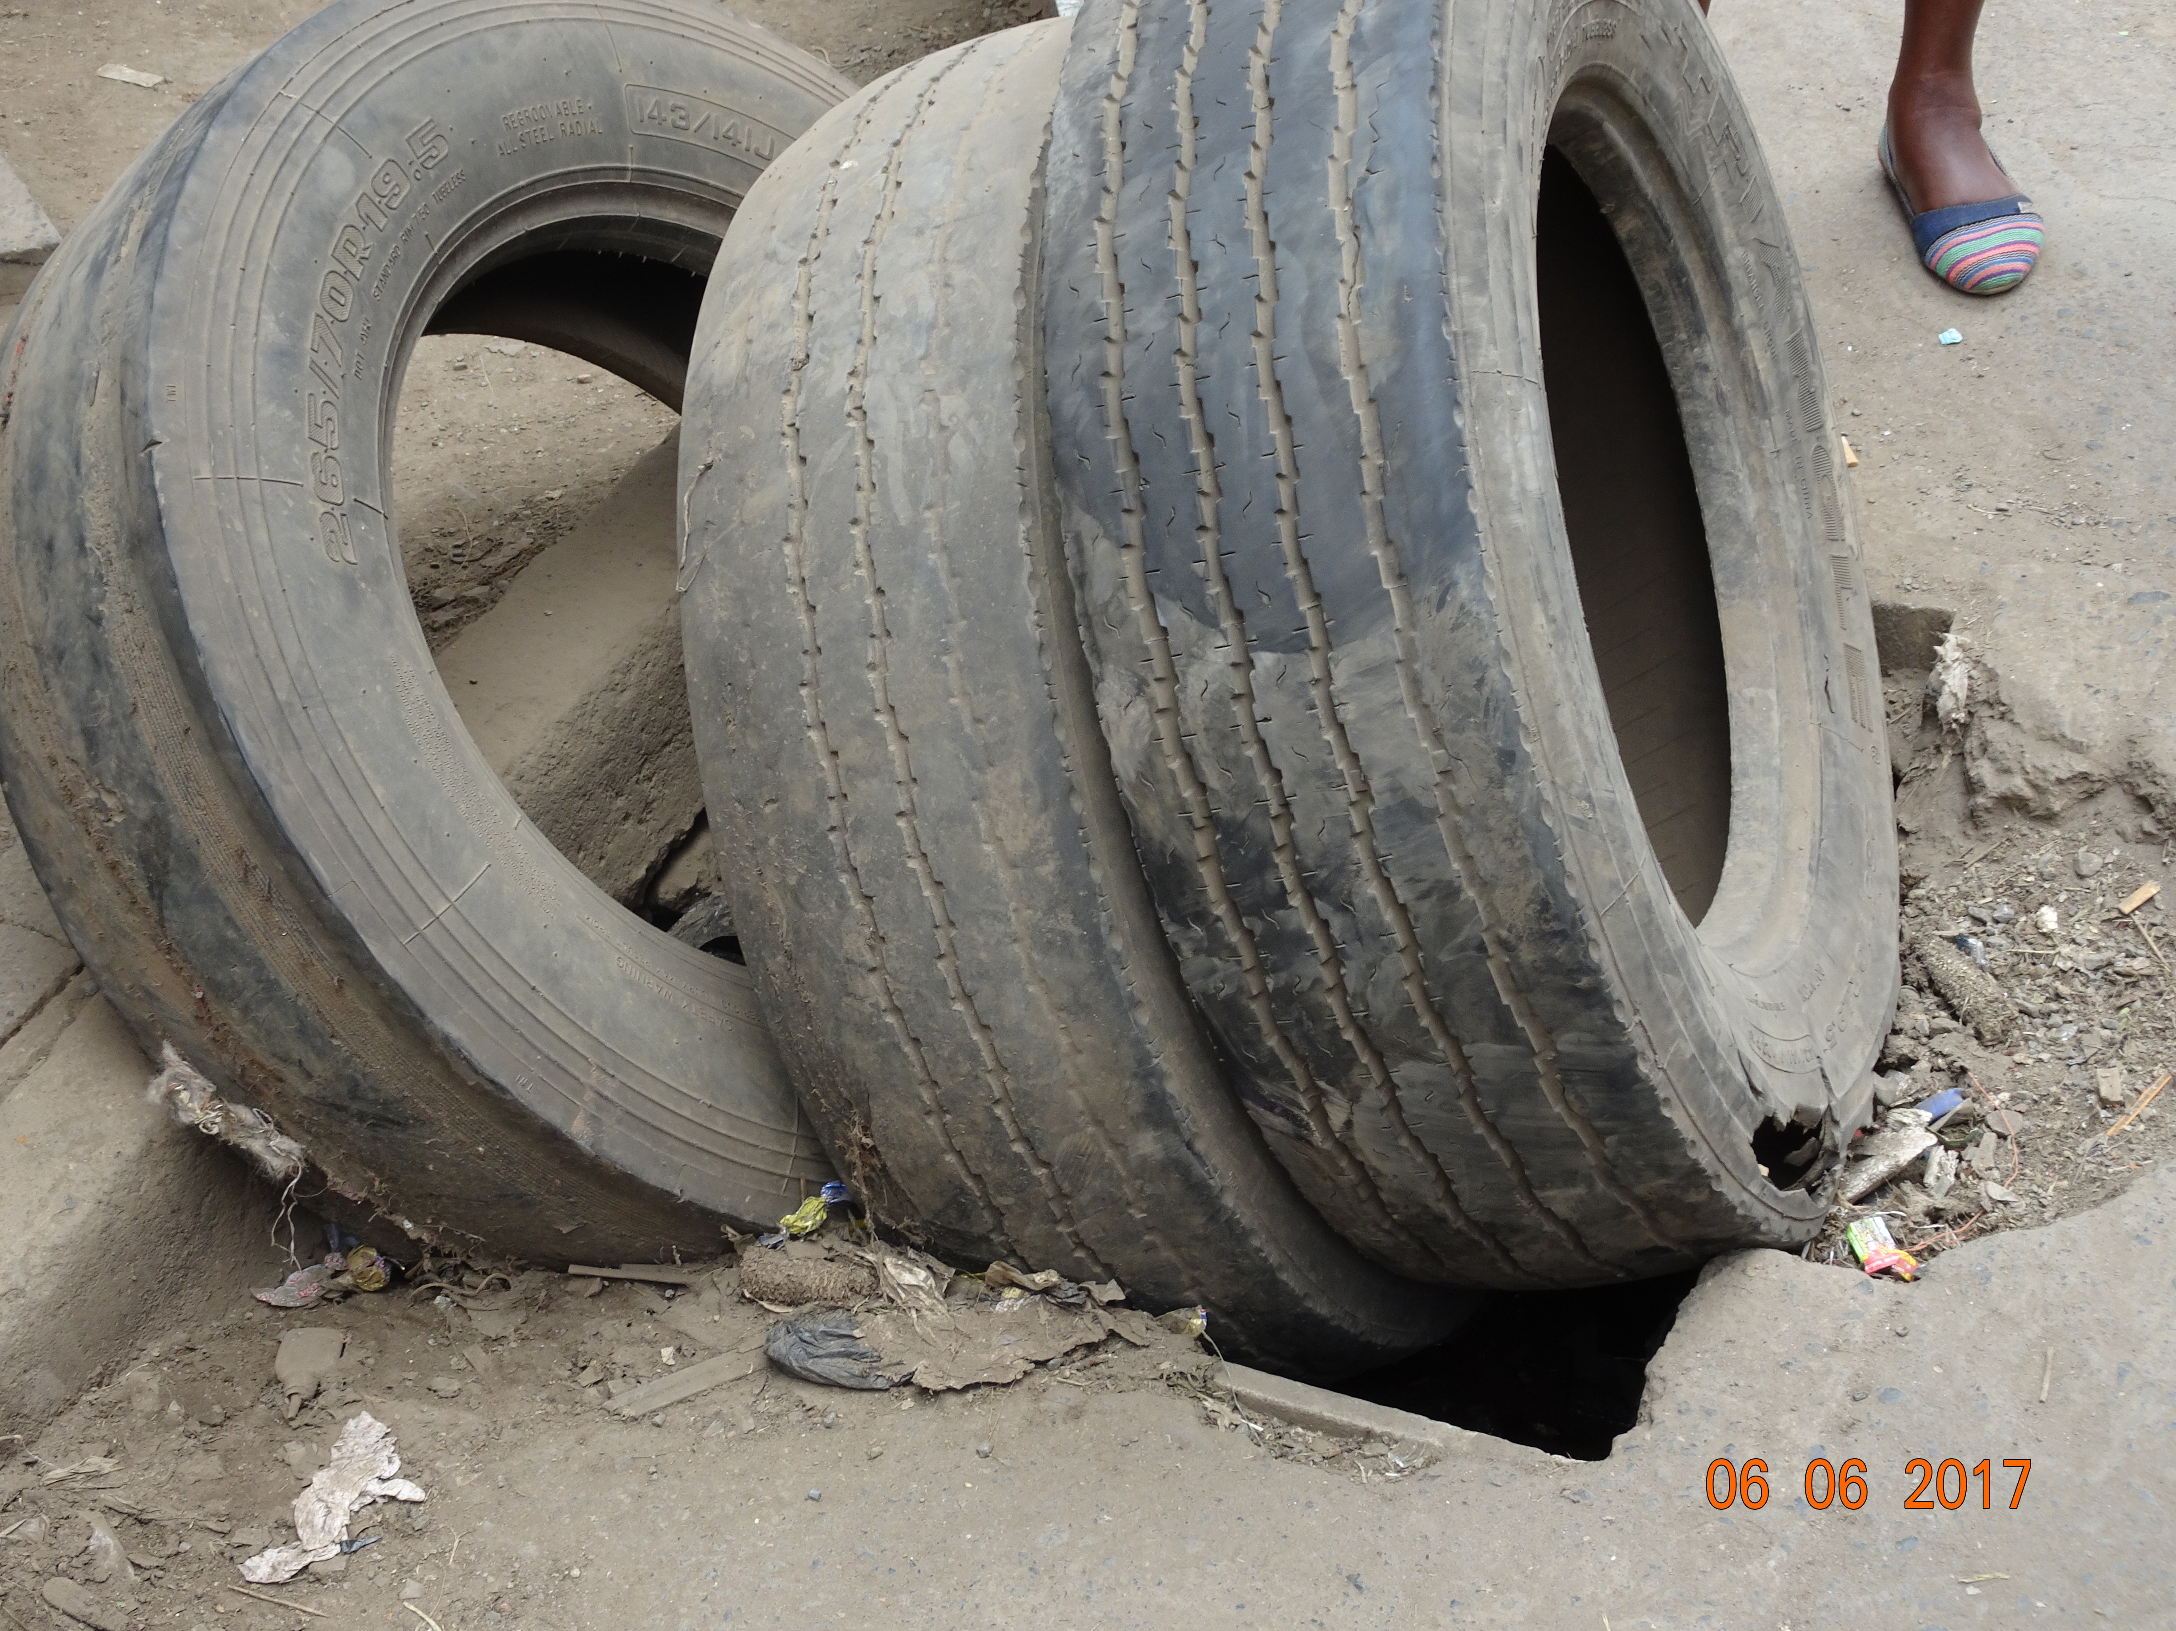
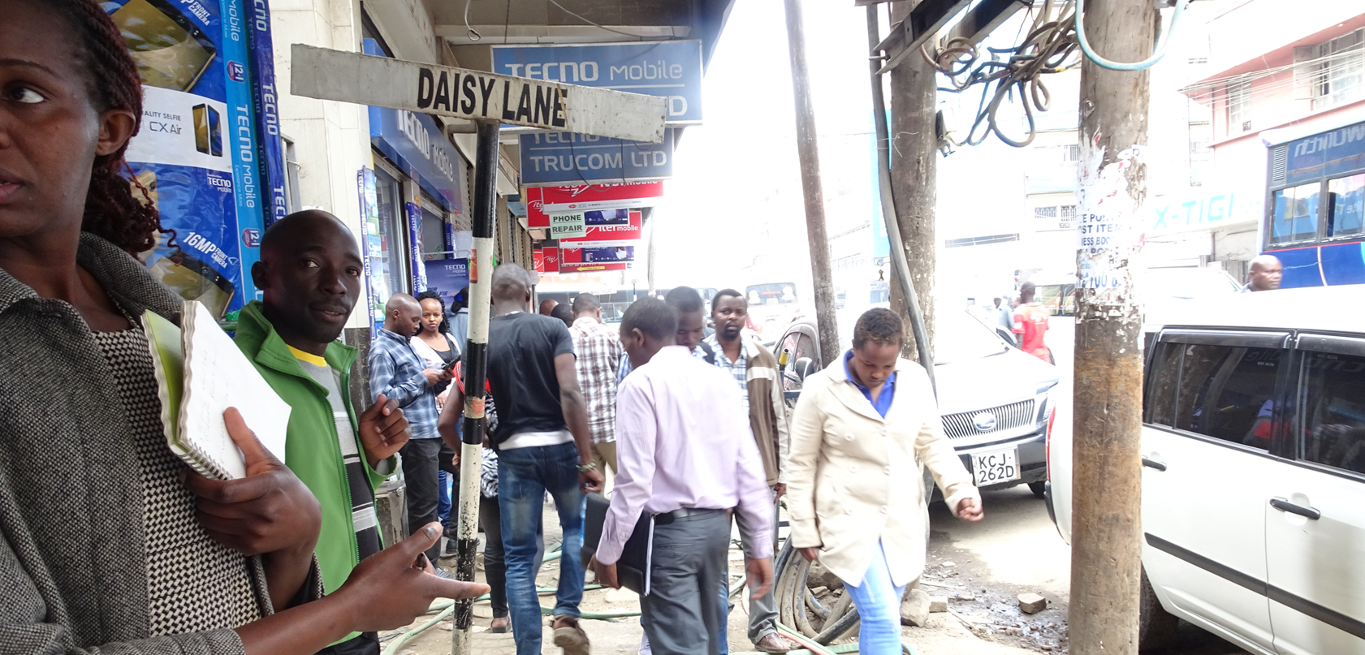
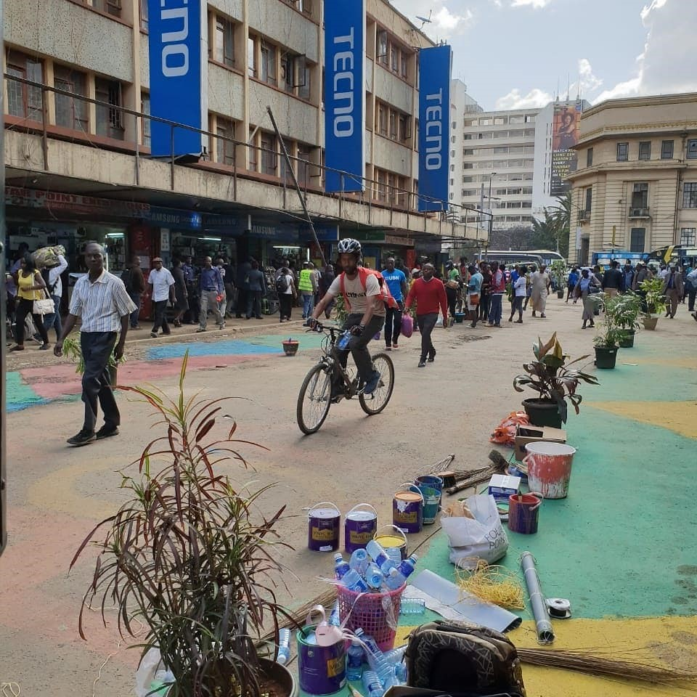
Luthuli Ave., CBD, Nairobi, Kenya

Slide 17
Lusaka, Zambia
Lusaka mayor and city council signed an MOU with the University of Zambia to provide them with options for identifying and mapping flood and other natural hazard risks within Kanyama, one of the city’s largest informal communities.
The university provided the city council with a natural hazard risk map of the area as well as options enhancing resilience and redevelopment within this informal community.
The mayor and city council were so impressed with the work that they extended support to the university for additional EPIC work at the rate of $25K per year for 5 years.
At the present, the city is beginning to implement some of the ideas presented by the university to increase resilience and reduce the risk of floods in high-risk areas.

Slide 18
Lusaka, Zambia

Slide 19
Mbale City, Uganda
Makerere University students worked with Mbale city officials and community members to generate maps of degraded and high-risk areas prone to floods and other hazards, and provide situational analysis reports, action plans, and policy briefs on selected aspects of urban development.
Students also reviewed 5-year development plans that local government officials had previously drafted.
Students also recommended ways of improving local livelihoods through actions such as opening evening markets by erecting street lighting, opening of roads and drainage systems, and construction of water reservoirs and public toilets. Several of these activities brought about climate benefits as well.

Slide 20
Mbale City, Uganda

Slide 21
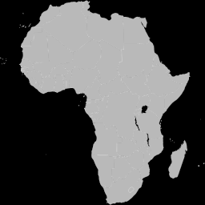
Idealized Fully Scaled Pan-African EPIC Network
of the Future
Durban and other metro centers, South Africa
Lusaka, Zambia
Windhoek, Namibia
Gaborone, Botswana
Harare, Zimbabwe,
Maputo, Mozambique
Mombasa and Nairobi, Kenya
Mbale, Uganda
Kinshasa, DRC
Brewerville City and Lake Piso, Liberia
Banjul, Gambia
EPIC North Africa
EPIC West Africa
EPIC East Africa
EPIC Central Africa
EPIC Southern Africa?

Slide 22
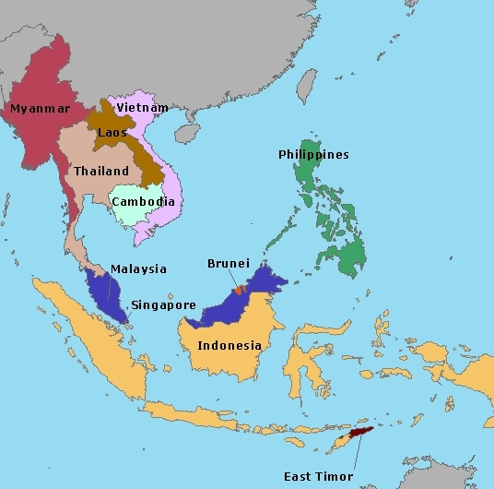
Seberang Perai City, Malaysia
Hat Yai, Thailand
Long Xuyen City, Vietnam
Penang, Malaysia
Chiang Mai, Thailand
Calamba City, Philippines
Alor Gajah, Malaysia
Thaklong Municipality, Thailand
Manado, Indonesia
Iloilo City, Philippines
Bandung, Indonesia
Bangkok, Thailand
VienAn Village, Vietnam
Pathum Thani, Thailand
EPIC Asia Network

Slide 23
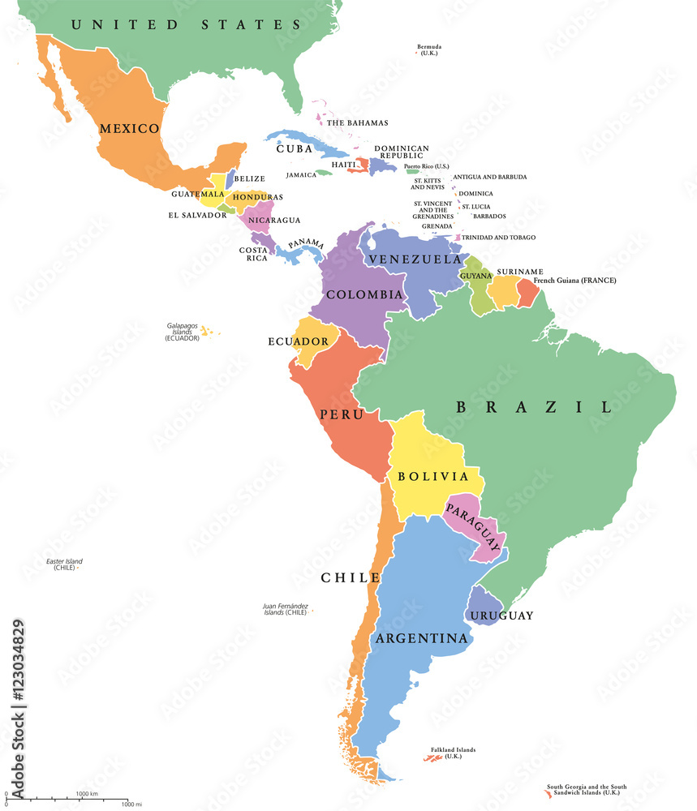
Veracruz, Mexico
Metro Mexico City, Mexico
Guadalajara, Mexico
Colima, Mexico
Lima, Peru
Santa Elena, Ecuador
Nova Xavantina, Brazil
Território do Confisco, Brazil
Curitiba, Brazil
EPIC Latin America

Slide 24

EPIC Europe
EPIC North America & EPIC-N Global Secretariat
EPIC Asia
EPIC Africa
EPIC Latin America
EPIC AU & NZ
Idealized Fully Built-Out Global EPIC Network of the Future

Slide 25
“One of higher education’s most successful and comprehensive service-learning programs.”
Scott Carlson, May 24, 2013
“Perhaps the most comprehensive effort by a university to infuse into its curricula sustainability and community outreach.”
Michael Burnham, Greenwire
August 23, 2010
“The EPIC model is a great resource because it connects academia to the local community and provides the community a chance to plan and work together with the local authority to help solve problems.”
Walia Funca, Lusaka City Council, Zambia, April 2024
‘I feel somewhat guilty in accepting this award as I feel I have become a serial abuser of the EPIC model because I have used it repeatedly over time, having initially been its biggest skeptic.’
Mike James, Former Asst. City Manager, Lemon Grove, CA – April 2018
Notes:
MOOCs!!
Caught on – simplicity of idea seems to resonate
Existing courses – Scale – Breadth
FUNDERS (interested)
50k -> 1million - PROVOST

Slide 26
Contacts and Selected Web Links
Worldwide EPIC Network Secretariat, USA
info@epicn.org; See also: www.epicn.org
EPIC Model Animation: https://www.youtube.com/watch?v=_OS3ci-NI9w; or https://www.epicn.org/the-epic-model/.
EPIC Africa Regional Network
Dr. Mzime Murisa, Harare, Zimbabwe, EPIC Africa Co-Lead and Network Manager - mzime@epicn.org
Dr. Sean O’Donaghue, Durban, South Africa, EPIC Africa Network Co-Lead - Sean.ODONOGHUE@durban.gov.za
Dr. Gilbert Siame, Lusaka, Zambia, EPIC Africa Network Co-Lead - siamegilbert@yahoo.co.uk
Additional Contact & Web Link
Dr. Anthony Socci, US EPA Office of International Affairs, International EPIC-N Partner, Washington, DC – socci.anthony@epa.gov; See also: www.epa.gov/international-cooperation/epas-role-international-climate-adaptation-and-resilience.

