Slide 1
Your CCAP Probably Pays for Itself:
Monetizing the Public Health Benefits of Climate Action Plans with EPA Tools
Colby Tucker
Policy Analyst
Office of Atmospheric Protection

Slide 2
CO-Benefits Risk Assessment Health Impacts Screening and Mapping Tool (COBRA) CPRG Presentation
September 2024

Slide 3
Outline
Overview of COBRA
What’s new in COBRA 5.0?
How does COBRA work?
Demonstration of COBRA and Future Year Scenario Tool
Health Benefits-per-kilowatt hour

Slide 4
Overview of COBRA
What is COBRA?
COBRA Features
Screening tool for estimating and mapping the air quality, human health, and associated economic impacts of emission reduction scenarios
Cost-free and easy to use
Peer-reviewed and based on rigorous methods used by EPA health benefits assessments
Available as a desktop application and web-based tool
Has built-in emissions inventories, simplified air quality model, health impact equations, and economic valuations
Enables users to import emissions inventories, population, incidence, health impact functions, and valuation function datasets
Covers 14 major emissions categories
Connections to EPA’s AVERT tool
Presents results in tabular and geographic form

Slide 5
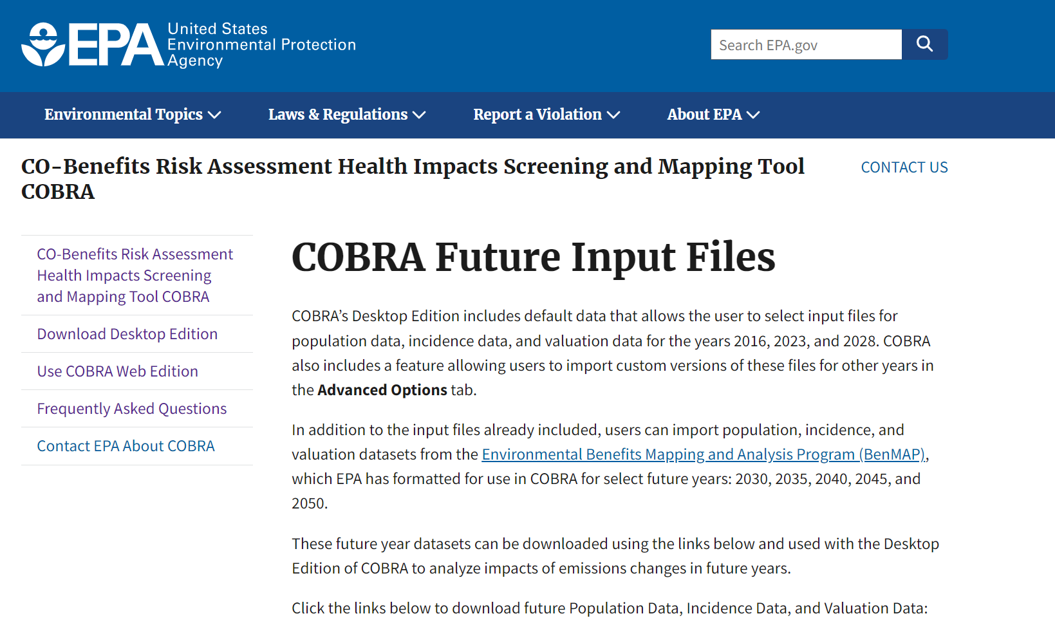
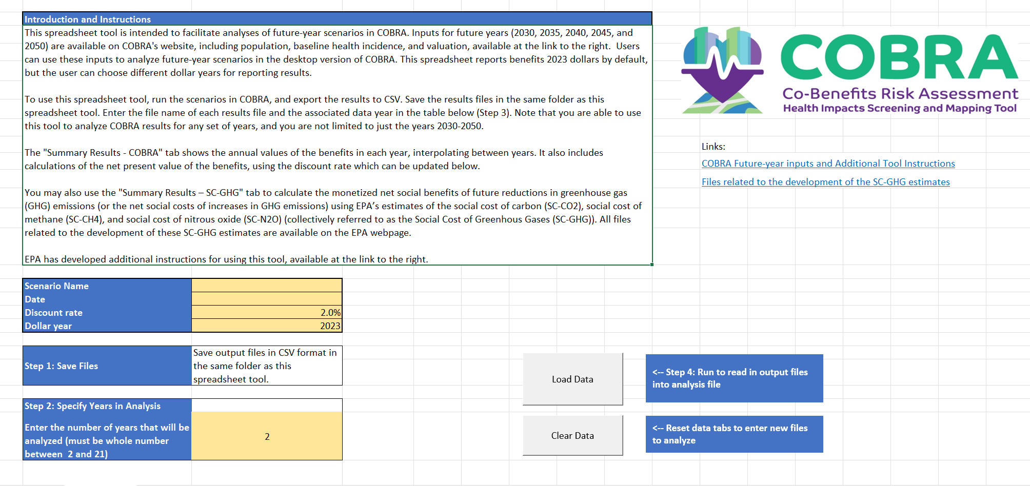
What’s new in COBRA 5.0?
NEW! COBRA Features
Updated air quality model that can estimate changes in annual ambient concentrations of both ozone (O₃) and particulate matter (PM_{2.5})
Estimates health impacts of O₃ formation from changes in nitrogen oxides (NO_{x}) and volatile organic compounds (VOCs)
Revised health impacts functions for PM2.5
Results in 2023 dollars
Updated discount rate – 2% and custom
Population, incidence, and valuation input data for 2030-2050
New Multi-Year Analysis Tool to analyze COBRA results from multiple years

Slide 6
How does COBRA work?
Inputs
COBRA
Outputs
Analysis year (2016, 2023, 2028)
Location (county or state)
Emissions tier (e.g., highway vehicles)
Emissions changes (PM_{2.5}, sulfur dioxide (SO₂), NO_{x}, and VOCs)
Discount rate (2% or custom)
Quantifies Changes in Air Quality
Uses a simplified air quality model, the Source Receptor (S-R) Matrix, to estimate effects of emissions changes on ambient PM_{2.5} and O₃ concentrations
The S-R Matrix accounts for the transfer of pollutants (i.e., emissions emitted in one county and transported to other counties)
Results tables and maps of changes in health outcomes and the related economic value in 2023 dollars
Export results to CSV or Excel
Calculates Change in Health Outcomes
Uses concentration-response functions to link the changes in PM_{2.5} and O₃ to changes in health outcomes
Calculates Monetary Value
Uses standard economic values based on willingness-to-pay, cost of illnesses, value of a statistical life and direct medical costs

Slide 7
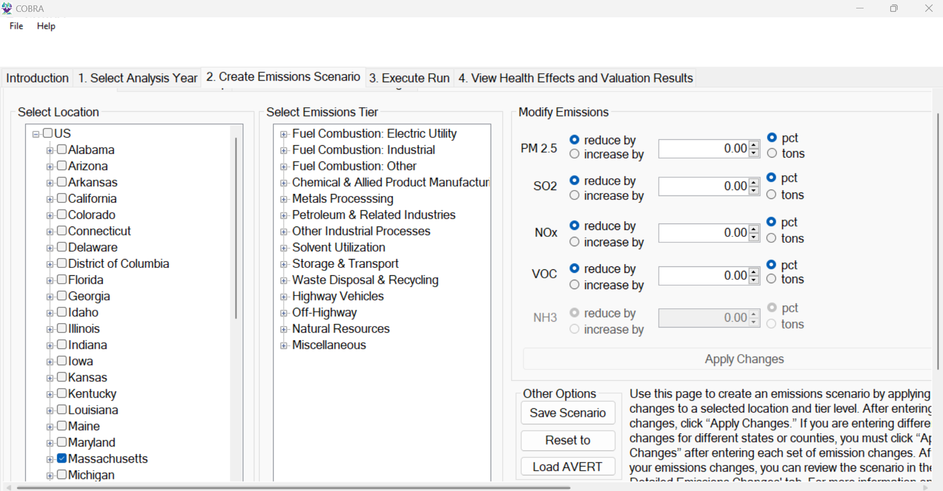
How does COBRA work?
Inputs
Analysis year (2016, 2023, 2028)
Location (county or state)
Emissions tier (e.g., highway vehicles)
Emissions changes (PM_{2.5}, sulfur dioxide (SO₂), NO_{x}, and VOCs)
Discount rate (2% or custom)

Slide 8
How does COBRA work?
Changes in Air Quality
COBRA
COBRA calculates changes in air quality using a simplified air quality model—the Source Receptor (S-R) Matrix.
The S-R Matrix estimates how emissions from each source county result in changes in ambient concentrations of PM_{2.5} and ozone in each receptor county.
These calculations model how pollution is transported in the atmosphere between counties.
It also accounts for the atmospheric chemistry that produces secondary particulate matter and ozone.
Quantifies Changes in Air Quality
Uses a simplified air quality model, the Source Receptor (S-R) Matrix, to estimate effects of emissions changes on ambient PM_{2.5} and O₃ concentrations
The S-R Matrix accounts for the transfer of pollutants (i.e., emissions emitted in one county and transported to other counties)
Calculates Change in Health Outcomes
Uses concentration-response functions to link the changes in PM_{2.5} and O₃ to changes in health outcomes
Calculates Monetary Value
Uses standard economic values based on willingness-to-pay, cost of illnesses, value of a statistical life and direct medical costs

Slide 9
How does COBRA work?
Changes in Health Outcomes
COBRA
COBRA estimates how changes in air quality result in changes in health outcomes.
These calculations use concentration-response (C-R) functions from epidemiological research that show the relationship between changes in air quality and health outcomes.
The C-R functions require estimates of the baseline health incidence.
COBRA includes default values for baseline health incidence at different resolutions for different health outcomes.
For some outcomes, county-level data is available; for others only national-level data is available.
Quantifies Changes in Air Quality
Uses a simplified air quality model, the Source Receptor (S-R) Matrix, to estimate effects of emissions changes on ambient PM_{2.5} and O₃ concentrations
The S-R Matrix accounts for the transfer of pollutants (i.e., emissions emitted in one county and transported to other counties)
Calculates Change in Health Outcomes
Uses concentration-response functions to link the changes in PM_{2.5} and O₃ to changes in health outcomes
Calculates Monetary Value
Uses standard economic values based on willingness-to-pay, cost of illnesses, value of a statistical life and direct medical costs

Slide 10
How does COBRA work?
Select Health Impacts Included in COBRA
COBRA
Health Outcome | Pollutant
Premature mortality | PM_{2.5}, O₃
Nonfatal heart attacks | PM_{2.5}
Hospital admissions, respiratory | PM_{2.5}, O₃
Hospital admissions, cardiovascular | PM_{2.5}
Hospital admissions, Alzheimers | PM_{2.5}
Hospital admissions, Parkinsons | PM_{2.5}
ER Visits, Respiratory | PM_{2.5}, O₃
ER Visits, Asthma | O₃
Asthma Onset | PM_{2.5}, O₃
Asthma Symptoms | PM_{2.5}, O₃
Lung Cancer Incidence | PM_{2.5}
School Loss Days | O₃
Work Loss Days | PM_{2.5}
Quantifies Changes in Air Quality
Uses a simplified air quality model, the Source Receptor (S-R) Matrix, to estimate effects of emissions changes on ambient PM_{2.5} and O₃ concentrations
The S-R Matrix accounts for the transfer of pollutants (i.e., emissions emitted in one county and transported to other counties)
Calculates Change in Health Outcomes
Uses concentration-response functions to link the changes in PM_{2.5} and O₃ to changes in health outcomes
Calculates Monetary Value
Uses standard economic values based on willingness-to-pay, cost of illnesses, value of a statistical life and direct medical costs

Slide 11
How does COBRA work?
Monetary Value of Benefits
COBRA
COBRA estimates the monetary value of the change in health outcomes.
These calculations use values developed from economic research, including:
Willingness-to-pay to avoid health outcomes
Cost of illnesses
The “value of a statistical life” is used to estimate the value of avoided premature mortality.
It typically accounts for most of the total monetized benefits of COBRA scenarios.
Quantifies Changes in Air Quality
Uses a simplified air quality model, the Source Receptor (S-R) Matrix, to estimate effects of emissions changes on ambient PM_{2.5} and O₃ concentrations
The S-R Matrix accounts for the transfer of pollutants (i.e., emissions emitted in one county and transported to other counties)
Calculates Change in Health Outcomes
Uses concentration-response functions to link the changes in PM_{2.5} and O₃ to changes in health outcomes
Calculates Monetary Value
Uses standard economic values based on willingness-to-pay, cost of illnesses, value of a statistical life and direct medical costs

Slide 12
How Has COBRA Been Used?
State-level Climate Action Plans
Maryland, New York, and Oregon
Renewable energy policies and programs
Renewable energy policies in Virginia
Solar installations in Long Island, NY
Energy efficiency policies and programs
North Carolina’s Clean Energy Plan
Illinois Energy Efficiency Portfolio Standard
Transportation policies
Analysis of reduced vehicle trips in Utah
Public transit program in Nevada
Other analyses
Impacts of bioenergy use
Benefits of urban tree planting
More than 150 citations as of September 2024

Slide 13
What are the options for running COBRA?
Desktop Edition
Downloads to your computer
Baseline data pre-loaded for 2016, 2023, 2028
Run time depends on your processor
Can modify baseline data (re: multi-year analysis)
Web Edition
Baseline data for 2023 only
Cannot modify baseline data
Runs quickly in the cloud
Runs in your internet browser
Runs on Windows only
Windows + Mac compatible
Batch runner
One-click connection to AVERT
Same methodology and data sources
Results available as tables and maps

Slide 14
Demo
This scenario is based off of emissions reduction in Massachusetts due to:
5% energy efficiency improvement in the electricity generation sector
200,000 electric vehicles for emissions reductions in the highway vehicles sector
Emissions reductions from this scenario were run through COBRA for three years
2030, 2035, and 2040
Total benefits over the analysis time frame were analyzed using COBRA Multi-Year Scenario Tool
Notes:
We developed these emissions reductions using AVERT but we manually entered them into COBRA.

Slide 15
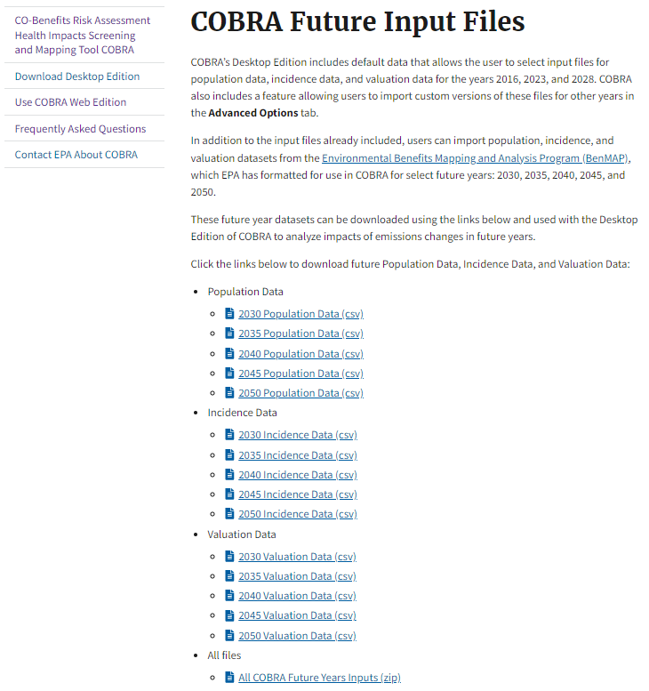
Download COBRA Future Input Files https://www.epa.gov/cobra/cobra-future-input-files
Notes:
Incidence changes over time only for mortality – based on projections of future mortality rates.
Valuation changes over time due to projections in income, which drives the willingness to pay to avoid health outcomes.

Slide 16
Open COBRA Desktop

Slide 17
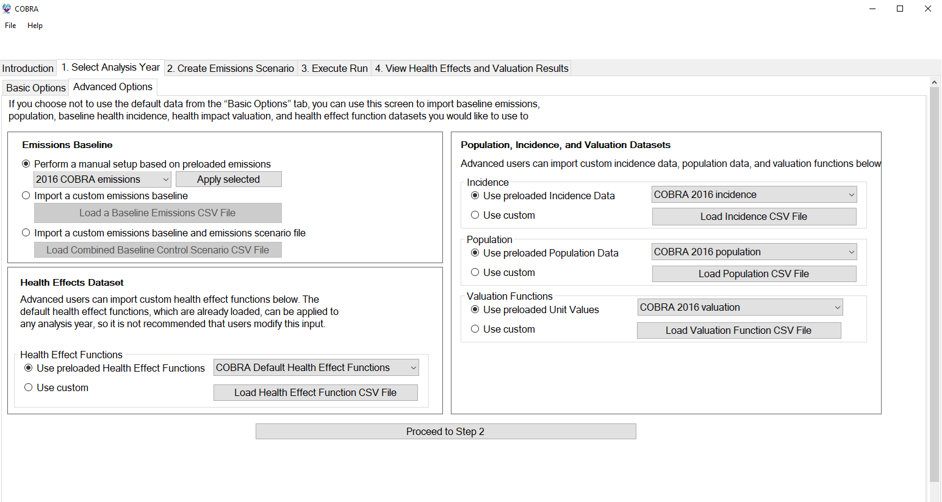
1. Select Analysis Year – Advanced Options – Load Emissions Baseline and SR Matrix

Slide 18
2. Create Emissions Scenario – Select Location

Slide 19
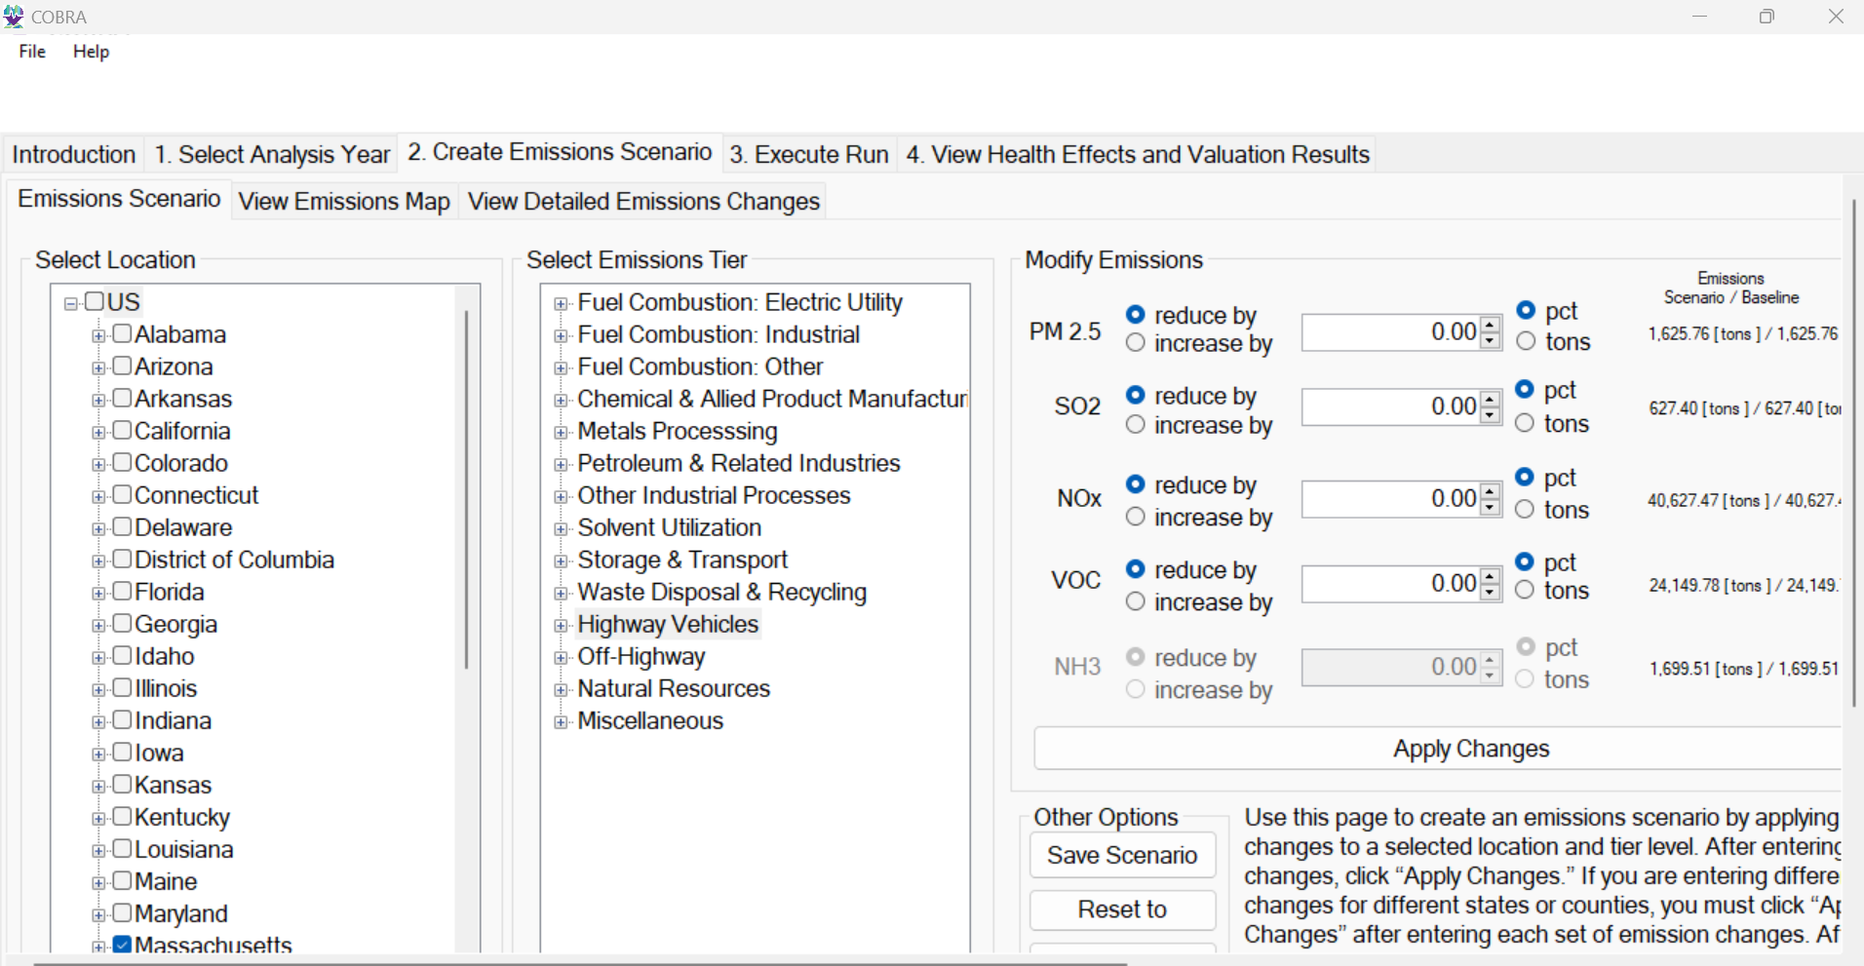
2. Create Emissions Scenario – Select Emissions Tier

Slide 20
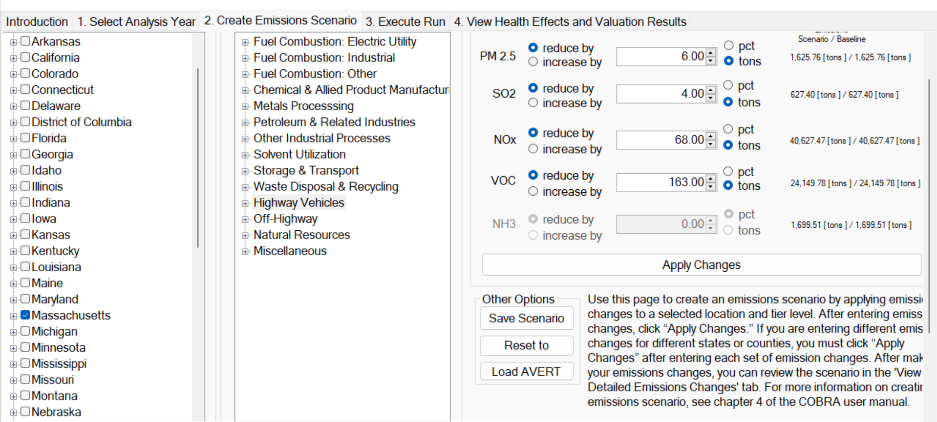
2. Create Emissions Scenario – Add Additional Emissions Changes

Slide 21
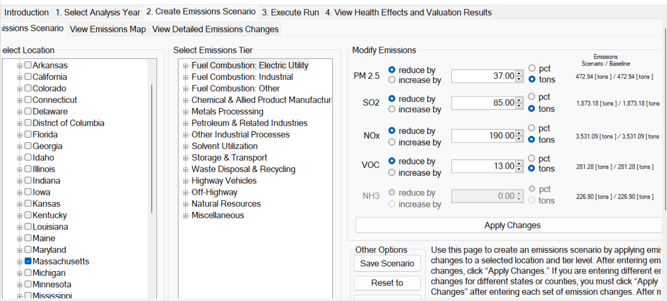
2. Create Emissions Scenario – Modify Emissions

Slide 22
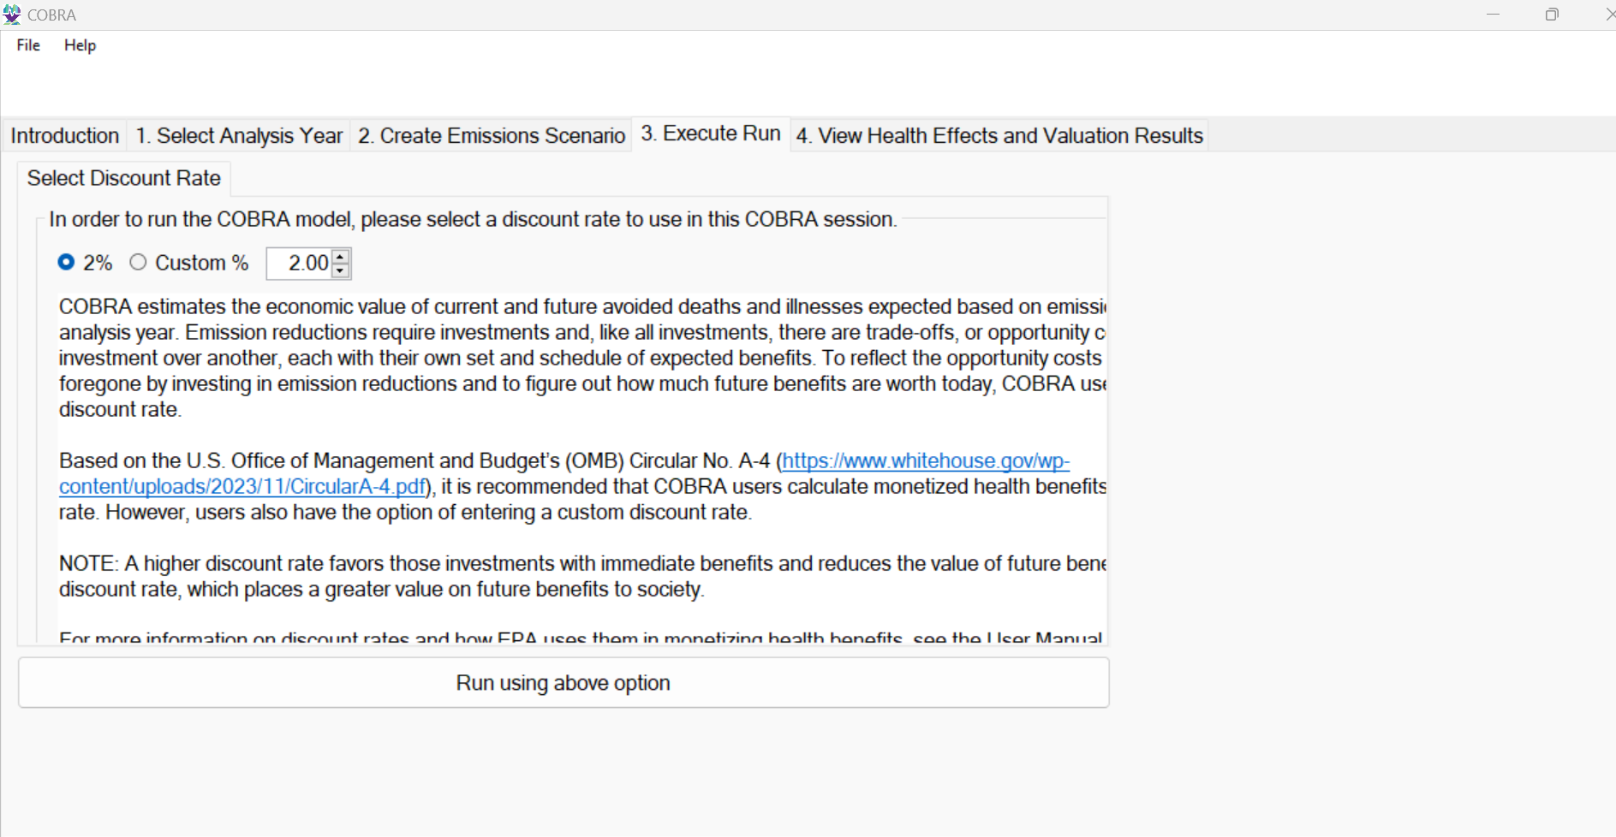
3. Execute Run

Slide 23
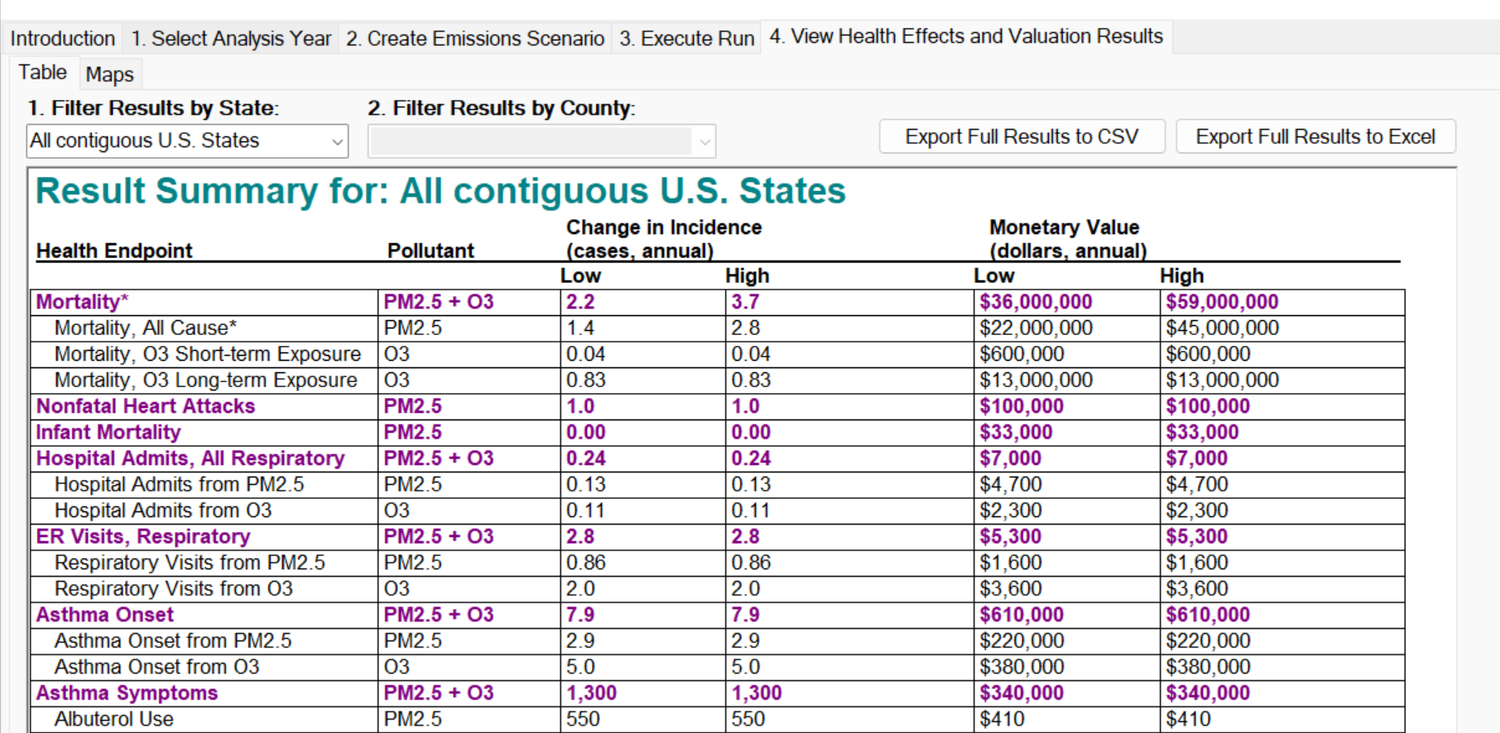
4. Export Results

Slide 24
Repeat Steps for Additional Years
E.g., population, incidence, and valuation function files for 2035 and 2040

Slide 25
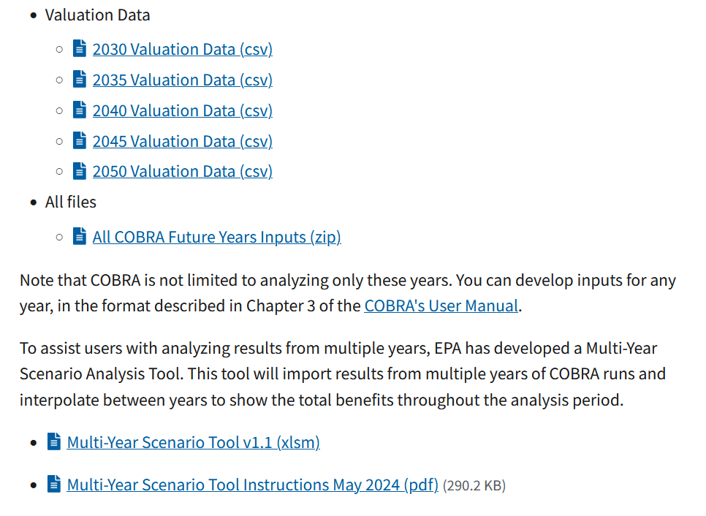
Download Multi-Year Tool https://www.epa.gov/cobra/cobra-future-input-files

Slide 26
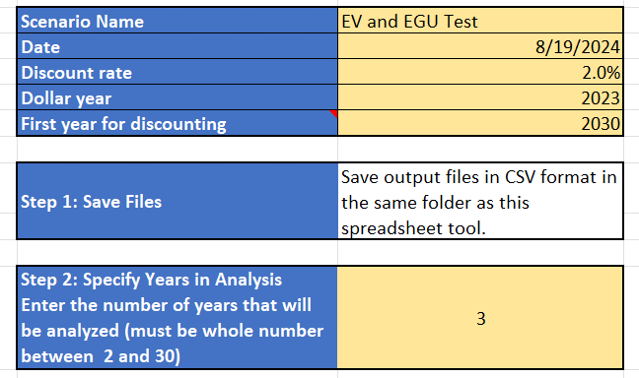
Set Scenario Details

Slide 27
Enter Data Files for Analysis

Slide 28
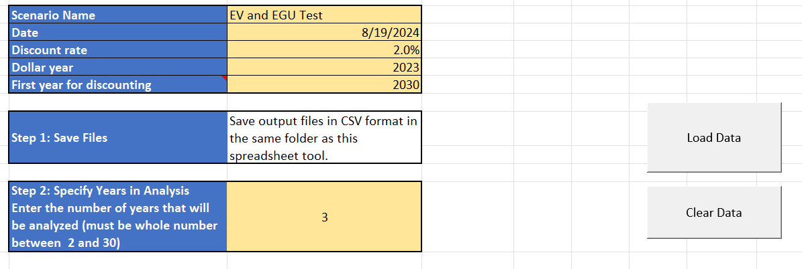
Load Data

Slide 29
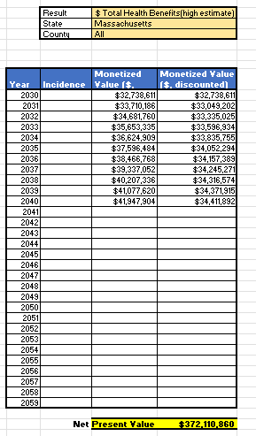
Summary Results - COBRA

Slide 30
Understanding the Results
COBRA results include:
Summary Table with change in incidence, monetary value, and total health benefits (low and high values).
County-level table with
Annual average PM_{2.5} concentrations and ozone season average of the maximum daily 8-hour average (MDA8) of O₃ concentrations for the control and baseline scenario
The change in PM_{2.5} and O₃ concentrations between the baseline and control scenarios (delta PM_{2.5} and O₃), and associated changes in health incidence and monetary values
More detailed data by health endpoint
Desktop Edition Results Summary Table
Full County-Level Results Table

Slide 31
AVERT-COBRA Demo
Develop an energy scenario and calculate emissions changes from energy efficiency, renewable energy, electric vehicle, and/or energy storage projects, programs, or policies.
Estimate the health and associated economics impacts of emissions changes from the energy scenario.
Desktop
Web

Slide 32
Health Benefits per kilowatt-hour (BPK)

Slide 33
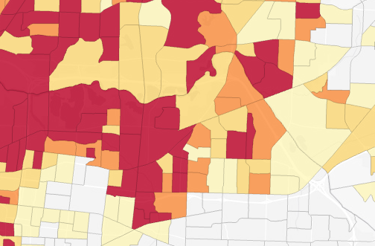
Future Developments
Census tract-level modeling
LIDAC Reporting
Air Quality modeling improvements
Example of Census Tract-level Results Resolution

Slide 34
How can I learn more?
Visit Our Website to find all the documentation for COBRA and to access the model:
https://www.epa.gov/cobra
Contact EPA:
cobra@epa.gov

