Slide 1
Pesticide Program Dialogue Committee Meeting
November 13, 2024
Ed Messina, Director
Office of Pesticide Programs
U.S. Environmental Protection Agency

Slide 2
Office of Pesticide Programs
Edward Messina, Director
Leo Gueriguian, Deputy Director, Management
Elizabeth Vizard, Deputy Director, Programs
Monique Perron, Senior Science Advisor
Catherine Aubee, Senior Advisor (EDSP)
Susan Jennings, Senior Advisor for Public Health
Antimicrobials Division
Anita Pease, Director
Kristen Willis, Deputy Director
Elizabeth Donovan,
Associate Director
Health Effects Division
Dana Vogel, Director
Currently vacant, Deputy Director
Greg Akerman, Associate Director
Biological and Economic Analysis Division
Donald Wilbur, Director
Neil Anderson, Deputy Director
Pesticide Re-evaluation Division
Anne Overstreet, Director
Tim Kiely, Deputy Director
Biopesticides and Pollution Prevention Division
Madison Le, Director
Shannon Borges, Deputy Director
Registration Division
Charles “Billy” Smith, Director
Daniel Rosenblatt, Deputy Director
Jennifer Saunders, (Acting) Assoc. Director
Environmental Fate and Effects Division
Jan Matuszko, Director
Amy Blankinship, Deputy Dir.
Brian Anderson, Assoc. Director
Endocrine Disruptor Screening Program

Slide 3
FY24 Priorities
PRIA 5 Implementation ​
Transparency, IT, Audit, Training, Tracking Bilingual Labeling
Registration and Registration Review​
ESA Efficiencies and Progress on our ESA Obligations ​
Implementation of Agency Priorities ​
Environmental Justice​
Climate Change​
Advancing State of the Art Science​​
PFAS – EDSP – NAMs
Rule-Making, Guidance, Litigation, OIG, and Petition Responses​
Advancing Digital Transformation
Employee Experience/Organizational Development /Process (GP2W) (People, Processes, and Technology)​

Slide 4
OPP FY24 Registration Highlights
Over 12,000 submissions received (includes resubmission to existing actions)
Over 5,800 PRIA and non-PRIA actions received via Portal
~8,700 PRIA and non-PRIA actions completed (1,458 PRIA [including 428 gold seal letters], 7,229 non-PRIA)
Over 16,200 actions currently pending (2,200 PRIA, 14,000 non-PRIA)
Registered 20 new biopesticide active ingredients; Proposed 2 new conventional and 1 new antimicrobial active ingredients
37 Section 18 emergency exemption decisions (e.g., spatial repellent to control dengue virus, invasive coconut rhinoceros beetle, etc.)
Reviewed labels and website materials for more than 80 products submitted by EPA regional offices and state partners to ensure compliance with device regulations

Slide 5
FY 24 Registration Division (RD) Registration Highlights
RD completed ~550 PRIA actions:
2 new active ingredient proposed decisions
100 new uses
445 PRIA new products and amendments
26 inert actions (15 food,6 nonfood,5 Additions to Commodity Inert Ingredients List)
RD completed over 4,300 non-PRIA actions
Over 700 product chem reviews, over 500 acute toxicity reviews, 28 efficacy reviews,12 child resistant packaging (CRP) reviews completed
Launched Salesforce in RD to track and assign all PRIA and Non-PRIA work for conventional pesticides, developing processes and SOPs for Salesforce use; developing and hosting training sessions.
Published Notice of Availability announcing mitigation measures for pesticides packaged in flexible pouches

Slide 6
FY 24 Antimicrobial Division (AD) Registration Highlights
AD completed 335 PRIA actions
including 3 new uses and 3 (Design for the Environment) DfE amendments/new product registrations
Completed over 1,050 PRIA and non-PRIA acute toxicology and chemistry reviews
Completed 110 PRIA efficacy reviews and 8 novel efficacy protocol reviews
Completed or closed out over 2,400 Non PRIAs (including both notifications and fast-track amendments), according to Salesforce analytics

Slide 7
FY 24 Biopesticide & Pollution Prevention Division (BPPD) Registration Highlights
BPPD completed 145 PRIA actions:
26 new active ingredient decisions
10 new use decisions
3 EUP decisions
38 M009 pesticide determinations
27 new product decisions
4 biochemical classification decisions
BPPD completed 500 non-PRIA actions

Slide 8
PRIA Appropriations
PRIA minimum appropriations level: $166,000,000
FY 2023 Final budget: $138,646,000
FY 2024 Final budget: $132,728,000
FY 2025 President’s budget: $175,000,000
STAG: $14,000,000
EPM: $150,000,000
S&T: $11,000,000

Slide 10
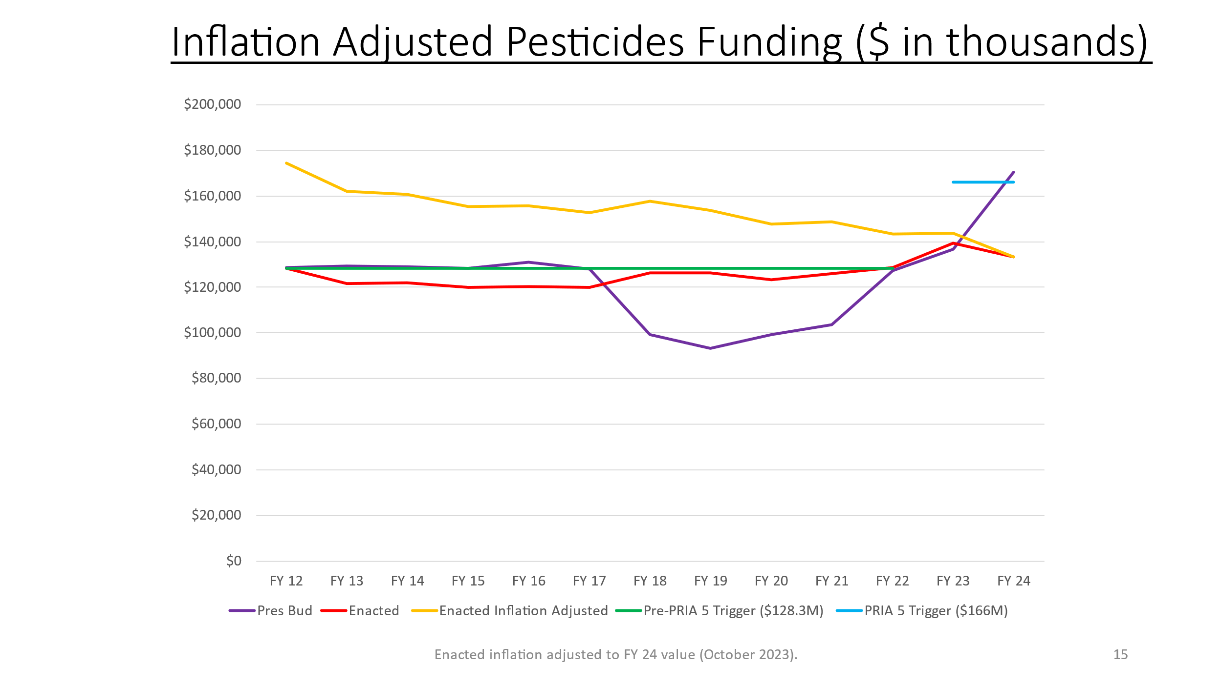
Notes:
NOTE: PRIA includes a provide that if appropriations fall below a certain minimum level (i.e., a “trigger”), OPP cannot assess PRIA fees. Each year, however, that Congress has appropriated funding for the pesticide below this trigger level, they have also included a provision in the appropriations bill that authorizes OPP to collect the PRIA fees that year.

Slide 11
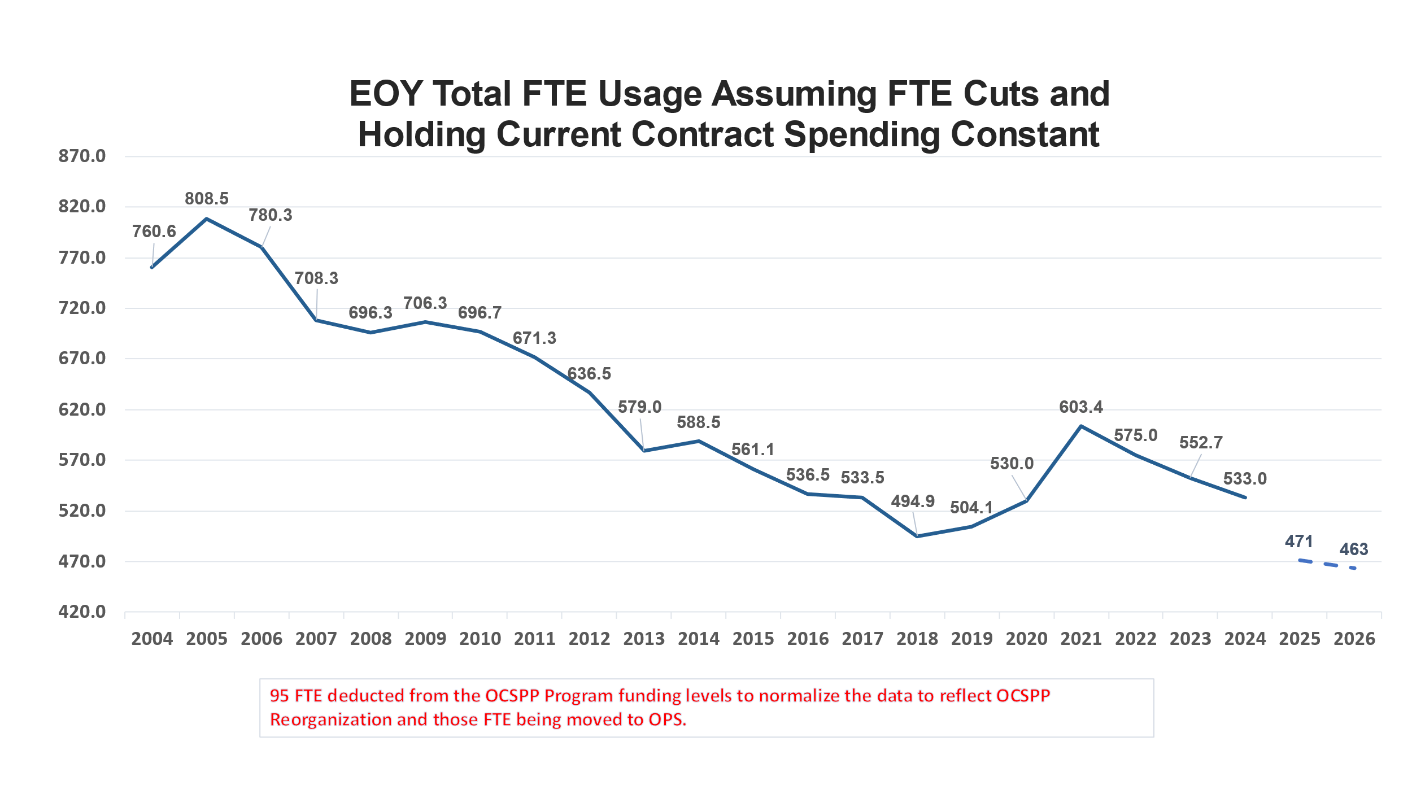
Notes:
$34M reduction to contracts over 3 years, FTE cuts, will deplete FIFRA and PRIA funds during FY26

Slide 12
95 FTE deducted from the OCSPP Program funding levels to normalize the data to reflect OCSPP Reorganization and those FTE being moved to OPS.
Notes:
$34M reduction to contracts over 3 years, FTE cuts, will deplete FIFRA and PRIA funds during FY26

Slide 13
OPP Funding FY21-FY25
 | 2021 | 2022 | 2023 | 2024 | 2025 (projected)
FIFRA Enacted Appropriations Total (Pesticides) | $125,201,000 | $128,169,000 | $138,646,000 | $132,728,000 | $132,728,000
Minus Region EPM and STAG | $22,624,000 | $23,911,000 | $24,772,000 | $24,568,000 | $24,940,000
Minus Agency Centrally-Managed Account & Other Support (OCFO, AO), OSCPP IO, OPS | $30,170,762 | $29,273,568 | $33,328,941 | $30,500,000 | $31,389,200
Plus EDSP (migration of EDSP to OPP in reorganization) | $7,341,000 | $7,449,000 | $7,498,000 | $7,498,000 | $7,498,000
Plus FIFRA Fees Collected (projected in FY25) | $32,687,422 | $31,600,000 | $40,131,688 | $44,000,000 | $42,000,000
Plus PRIA Fees Collected (projected in FY 25) | $20,676,730 | $23,900,000 | $20,615,609 | $18,000,000 | $18,000,000
Plus PRIA 4 Maintenance Fee Carryover (projected FY 25) | $42,285,000 | $26,164,000 | $17,500,000 | $13,975,000 | $8,488,000
Equals OPP Appropriations + Fees | $175,396,390 | $164,097,432 | $166,290,356 | $161,133,000 | $152,384,800
FTE levels | 604.1 | 575.0 | 549.1 | 557.1 | 543.0

Slide 14
Litigation
EPA is required to pay certain attorney fees when plaintiffs are successful in legal challenges against EPA.
As of 2024, all the ESA lawsuits and ESA claims in broader lawsuits have either been resolved or are expected to be resolved in the very near future.
In October 2024, EPA released a proposed plan to settle legal claims on the Agency's implementation of the Endocrine Disruptor Screening Program (EDSP).
Year | Sum of Dollar Amount
2022 | $311,750.00
2023 | $1,185,539.38
2024 | $916,025.00
2025 | $1.2M and counting

Slide 15
Pesticide Registration Improvement Act (PRIA) 5 Implementation - FY 24 Activities
EPA webpage on PRIA 5 Implementation: https://www.epa.gov/pria-fees/pria-5-implementation
FY 2023 PRIA Annual Report issued
Non-PRIA backlog reduction and review timeframes for new actions
IT modernization efforts
Bilingual labeling implementation- FAQs, implementation plan, outreach
Vector Expedited Review Voucher (VERV) Program
DER process implementation

Slide 16
Pesticide Registration Improvement Act (PRIA) 5 Implementation - FY 24 Activities
Set-aside to develop and administer training to EPA staff and registrants
Developing grant program to compete and award in FY25
Contract funded to administer training in interim
Continuation of existing cooperative agreements including Pesticide Safety Education Program cooperative agreement and a new partnership grant for the National Pesticide Information Center
New set-asides for farmworker training, health care clinician training and grant technical assistance cooperative agreements
Requested stakeholder input on program design for both farmworker and health care provider training grant programs
Third-party audit of business processes and workforce assessment; contract in review, anticipated award for FY25

Slide 17
Digital Transformation Update
New Portal and Customer Experience
Two-way interaction between OPP and external stakeholder
Modern submission and application tracking experience
e-CSF and e-label Projects
e-label workshop with Caliper to build on previous projects
DCI Modules; create, send, receive, track progress
Interact with the case via an automated workflow
Automated response pathways for registrants
CRM Analytics
Modern performance metrics identifying needs and opportunities across OPP to both internal and external stakeholders

Slide 18
Major Transformational Projects Solving for Data and Documents Solves Infrastructure!
Documentum Replacement
Target for Completion 9/2025
Project Timeline of 12 Months
Alternatives Analysis Complete
Kick-off and Scoping Completed October 2024
Three Phases: Planning, Deployment, Migration
OCSPP strategy
Data Management Solution
Interdependent with Document Repository Project
Interdependent with Infrastructure Project
Holistic plan to deal with legacy software and Data Solution
Critical to transforming workflows and allowing for data-centric approach to documents, risk assessments, e-label and e-CSF
INFRASTRUCTURE
Underlying physical and information technology devices
Legacy Apps: PRISM, OPPIN DE, OPPIN Query, etc. are all on prem
Interdependent on Data Management/Documents
12+ Months
Move to Cloud Solution
Build Business Capabilities in Salesforce
Phase 1 Deployment December 2024: Registrants Log In
Phase 2 Deployment January and TBD 2025: Registrant Dashboards
Phase 3 Deployments TBD Late 2025: Submissions (high dependence on other projects)
PORTAL

Slide 19
Application Experience Project roadmap Phase 1: Deploy Application/case management dashboard phase 3: deploy end to end application experience
Q1-2
Q3
Q4
2025
Requirements gathering
Phase 3 Development & Deployment
External Stakeholder Requirements gathering continues
Established Portal Workgroup with wide group of customers
Demo wireframes and begin active development of Phase 1
Phase 1/2 Deployment
Scoping
Internal and External meetings held to gather baseline requirements
Stakeholder Training December 2024
Customer Registration and Deployment January 2025
Post-launch focus groups and training
Gather additional feedback on Phase 1
OPP Requirements Gathering Q1-Q3
Q4 2025: Phase 2 Deployment

Slide 20
Notes:
Even when we strip out withdrawn or not reviewed case responses, we see a massive shift in the overall backlog of Non-PRIA Notifications and Amendments for RD. It completed 1,300 more than it received in FY24, a total reversal of the prior 3 fiscal years.

Slide 21
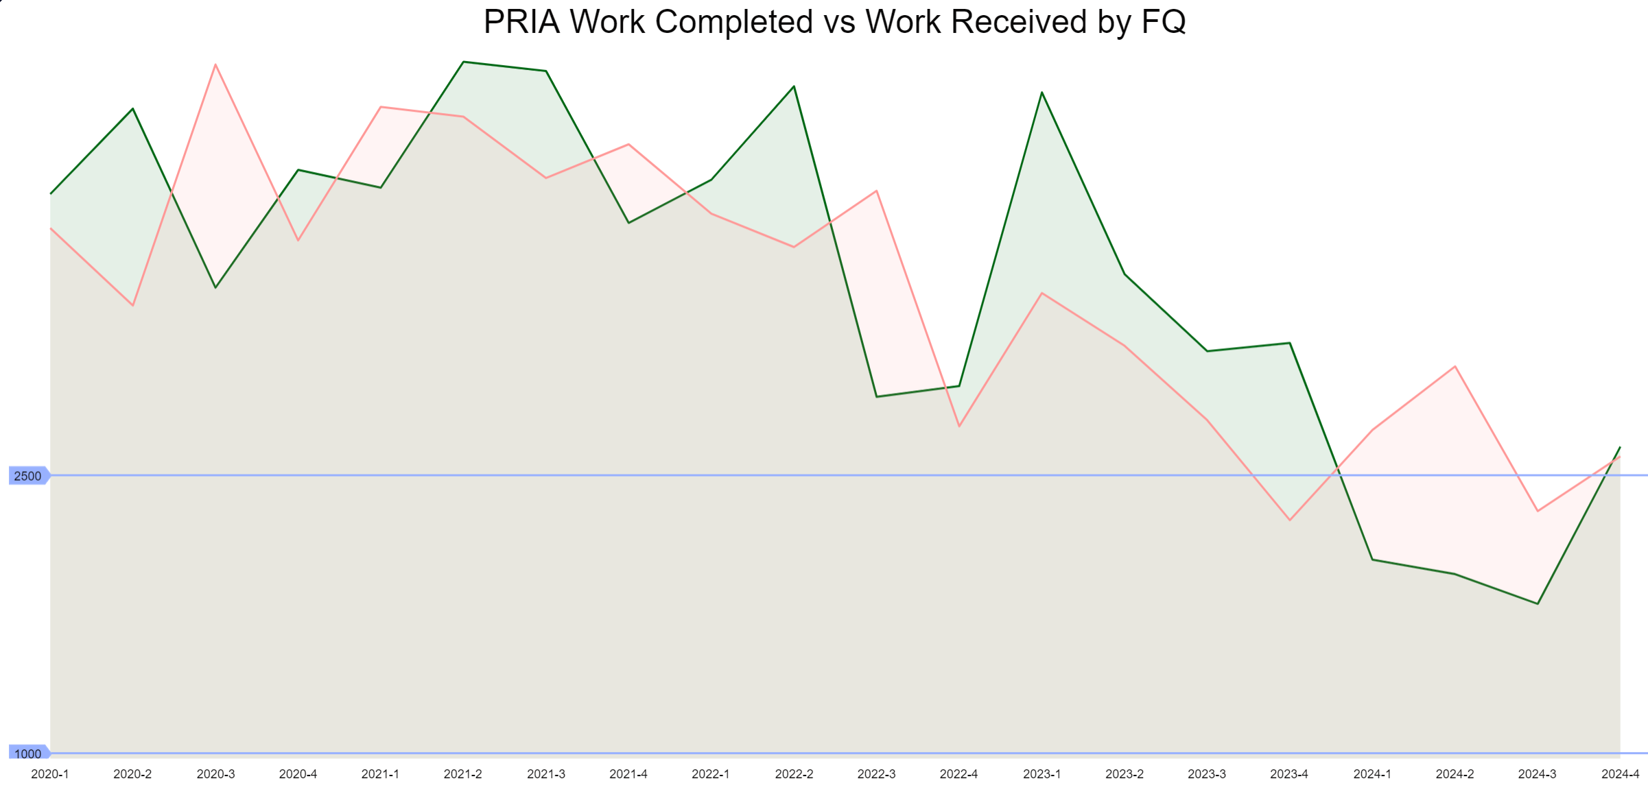

Slide 22
Total Backlog is Decreasing! PRIA Backlog is Increasing

Slide 23
The Registration Division Leverages Salesforce Data to Reverse the Trend of a Growing Backlog of Cases

Slide 24
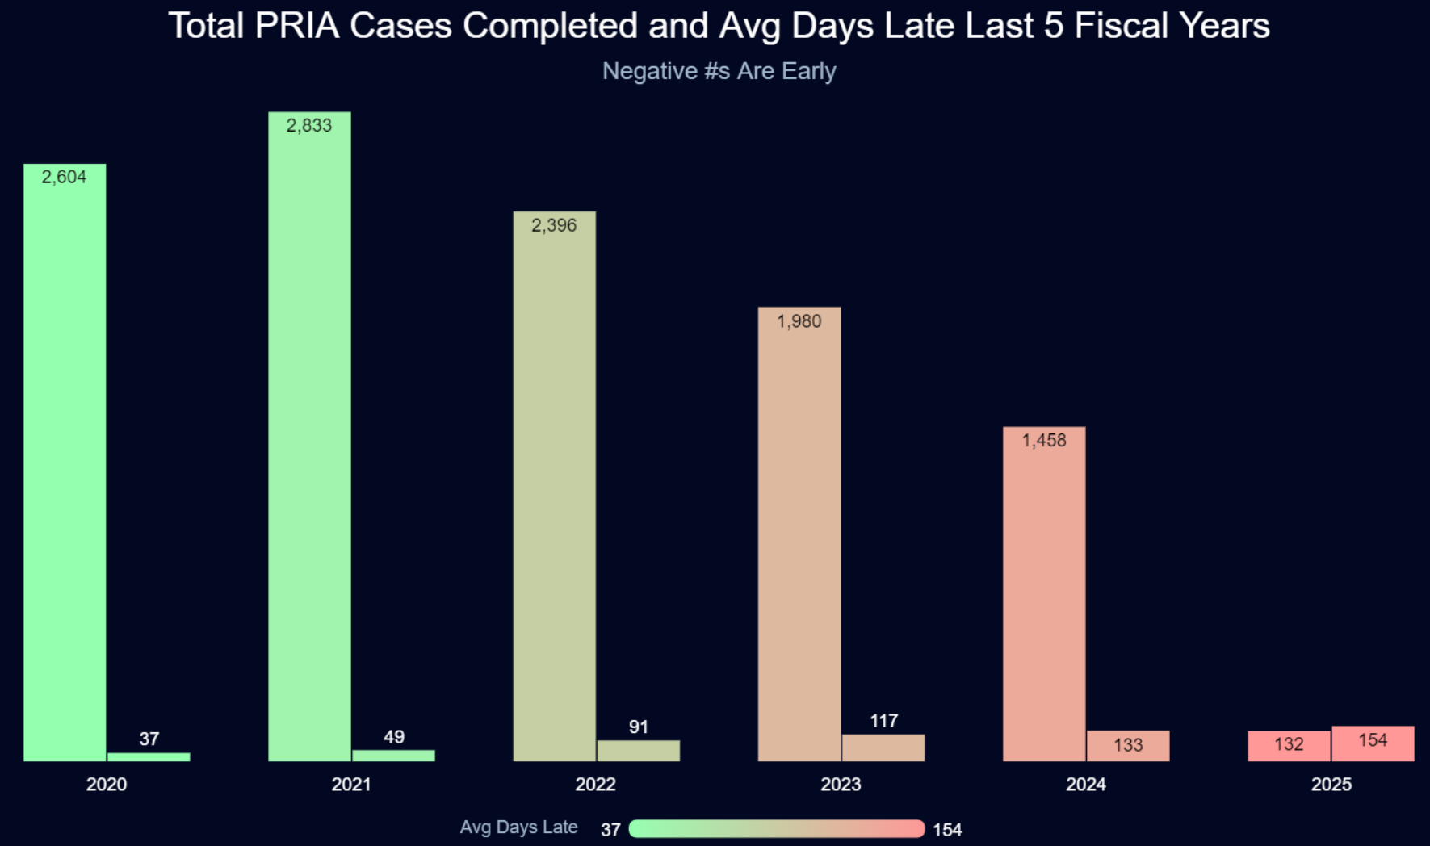
Total PRIA Cases Completed and Average Late Days Last Five Fiscal Years

Slide 25
Notable OPP Process Improvements
Non-PRIA Backlog Reduction: Implemented strategies across AD, BPPD, and RD to address the non-PRIA backlog and prevent future backlogs
RD implemented 17 specific efforts resulting in an increase in non-PRIA completions from ~1750 in FY23 to over 3500 in FY24
BPPD Biopesticide Regulatory Workshop: BPPD analyzed data compiled from 1,000 deficiencies in 10- and 75- day letters and co-hosted an industry workshop to provide information on common mistakes in applications and improve submission quality
Label Implementation Program: Allows the AD Reevaluation Branch to review and approve AD product labels with registration review label implementation all within the branch, allowing the other branches to focus on registration actions
Tolerance Rulemaking Process and Tracking Updates: PRD implemented improvements to the tolerance rulemaking process and launched an internal tolerance tracking database, creating efficiencies and consistency across the OPP divisions in tolerance rules

Slide 27
Pesticide Registration Review
The FY 2023 omnibus set a new deadline of October 1, 2026, for completing the first phase of registration review.
There are 789 registration review cases due by October 1, 2026 - 726 cases registered prior to FY 2007 that carried forward, and 63 new active ingredients registered after FY 2007 with registration review due dates that fall before October 2026.
Of the 789, through September 2024 there were:
719 cases (or 91%) for which draft risk assessments are completed (70 remain).
626 cases (or 79%) for which final or interim decisions are completed (163 remain).
*After publication EPA generally holds a 60-day public comment period.

Slide 28
FY2017: 59
FY2018: 52
FY2019: 46
FY2020: 75
FY2021: 99
FY2022: 66
FY2023: 96
FY2024: 83

Slide 29
Notable FY24 OPP Highlights
Issued an Emergency Order of Suspension for DCPA to address the imminent hazard to unborn babies whose pregnant mothers are exposed to DCPA
Approved additional sulfuryl fluoride safety measures for new product labels to prevent deaths and serious injuries when people re-enter homes fumigated
Created new PRIA 5 funding opportunities that focus on pesticide safety education for farmworkers, training for health care providers to better address pesticide-related illness, and technical assistance to support community-based nonprofits
Implemented new bilingual labeling requirements under PRIA 5 and developed a website explaining the requirements with a section for frequently asked questions
Published final revisions to the WPS Application Zone provisions as part of E.O. mandated reconsideration
Completed an Advanced Notice of Proposed Rulemaking to determine whether a rule under FIFRA section 3(a) to regulate certain use of treated seed and treated paint or other administrative action is appropriate considering questions raised by stakeholders

Slide 30
Notable FY24 Science and Policy Highlights
Issued the draft risk assessment for formaldehyde, a preservative to extend the shelf life of industrial and household consumer products and in industrial oil and gas injection water to prevent microbial contamination
Issued final Efficacy Test Methods and guidance for Legionella in cooling towers
Updated and modernized the disinfectants lists
Reset activation of the Emerging Viral Pathogens policy for Mpox in response to a new outbreak of Mpox in central Africa. Activation allows for use of products on List Q: Products with Emerging Viral Pathogens Claims, against these emerging viruses
Expanded the human health spray drift analyses to new registration decisions, which allows the agency to provide human health protections to a wider range of pesticide regulatory decisions in and around farming communities
Completed an updated human health draft risk assessment for the organophosphate insecticides dimethoate and malathion, released to amend 2016 human health risk assessments

Slide 31
Notable FY24 Science and Policy Highlights
Registered the world’s first sprayable dsRNA biopesticide product
Issued the first federal “Advisory to Beekeepers,” which provided guidance on the use of unregistered pesticides to control varroa mites in beehives
Developed an ESA approach for biopesticides and initiated the first biological evaluation of several anticipated programmatic/streamlined consultations
Executed new policies, guidance and PRIA M009 determinations for modified plants to provide additional exemptions and streamline review of PGR/PIPs under FIFRA
Developed and issued interactive web-based tool and decision tree for modified microbes, including updates to data requirements and delineation of responsibilities between EPA and USDA
Released two PFAS analytical methods to detect and quantitate PFAS in pesticide products containing complex surfactants and other inerts, and in high-density polyethylene containers
Developed, published and finalized an interagency framework for collaborating on antifungal and antibacterial resistance assessments

Slide 32
FY24 Endocrine Disruptor Screening Program (EDSP) Highlights
Published the new strategic plan, Endocrine Disruptor Screening Program: Near-Term Strategies for Implementation, and three supporting documents that provide a framework to more efficiently screen and communicate decisions regarding potential endocrine effects on human health
Updated the 2023 list of conventional pesticide active ingredients with adequate estrogen and androgen data for humans to inform FFDCA 408(p)(6) determinations
Identified 111 conventional pesticides with updated two-generation reproductive toxicity or extended one-generation reproductive toxicity studies and verified that all endocrine-related endpoints were sufficiently evaluated in those studies.
Updated three prioritization groups for the remaining registration review conventional pesticides
Announced proposed terms to settle litigation (public comment period ends Nov. 12), which align with EPA's commitments in the strategic plan
Issued 49 FIFRA DCIs for 23 Group 1 chemicals: (https://www.epa.gov/endocrine-disruption/status-endocrine-disruptor-screening-program-data-call-dci-notices-group-1)
DCIs were created and issued in Salesforce, allowing the registrants to send responses via email that are automatically dated and tracked in the Salesforce DCI platform

Slide 33
FY24 ESA Highlights - Upcoming Session
Released final Herbicide Strategy, a groundbreaking step for implementing early, practical protections for listed species and increasing the efficiency of meeting its ESA obligations
Released draft Insecticide Strategy, a key step in implementing early, practical protections for listed species and increasing the efficiency of meeting its ESA obligations
Released Vulnerable Species Action Plan that provides a framework to adopt early, meaningful protections for a subset of FWS’ listed species
Led a multi-stakeholder effort to develop and beta test an approach to refine maps for pesticide use limitation areas (PULAs)
Released single draft Biological Evaluation for 11 rodenticides and associated strategy that identified mitigations to address impacts identified in the draft BE
Co-hosted with FWS a workshop aimed at an ESA Strategy for Hawaii to identify mitigations for listed species to protect them from impacts associated with outdoor uses of conventional pesticides
In support of PRIA 5, finalized ESA guidance for registrants for new uses for conventional and biopesticides

Slide 34
FY24 Stakeholder Engagement Highlights
OPP’s Center for Integrated Pest Management hosted 8 IPM webinars (over 11,100 attendees), responded to over 2,800 calls/emails, and increased IPM email distribution list to almost 42,000 subscribers
OPP engaged throughout the year with industry on PRIA--PRIA information (EPA Quarterly Stakeholder Meeting slides, and monthly PRIA metrics provided by OPP) is housed at the PRIA Resources Website: https://www.pestfacts.org/pria-resources/
OPP staff participated in:
Industry regulatory conference and workshops, including with CLA/RISE, HCPA, and BPIA;
State co-regulator meetings including with the Association of American Pesticide Control Officials (AAPCO) & Association of Structural Pest Control Regulatory Officials (ASPCRO) annual conferences;
Tribal Pesticide Program Council (TPPC) meetings;
Quarterly farmworker advocacy stakeholder discussions;
Numerous ESA workshops and webinars; and
~25 individual meetings on ESA strategy efforts with various stakeholders including national and state level trade associations and grower groups.
Working Effectively with EPA’s Office of Pesticide Programs Webinar: Link to a recording of the event
Hosted by RISE and open to all PRIA Coalition member companies, over 180 attendees

Slide 35
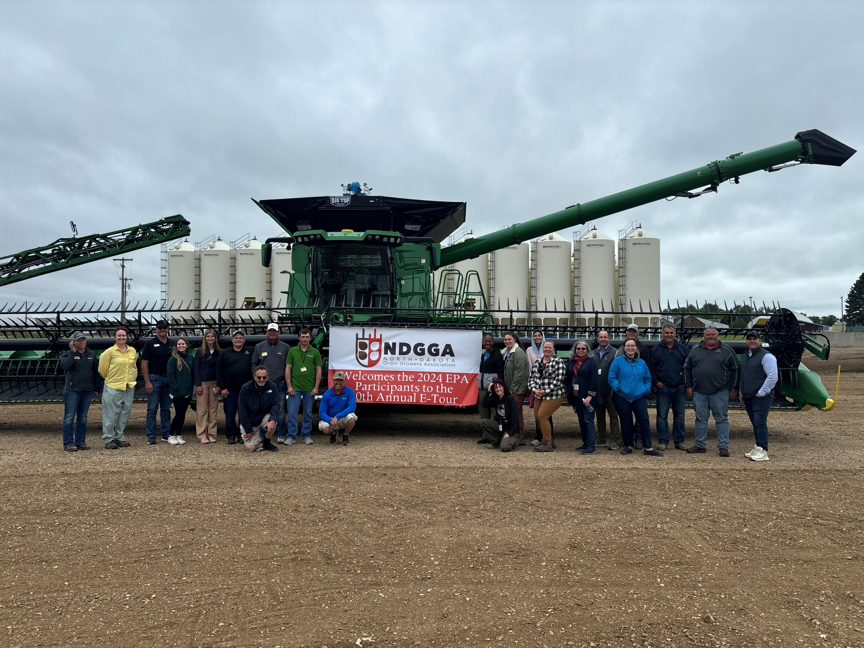
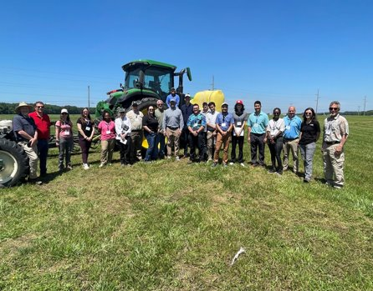
2024 Crop Tours
20 Grower Groups/Registrants communicated interest in field tours/site visits with OPP staff
17 Crop Tours were arranged with the generosity of grower groups gifting the majority of expenses
242 EPA staff (DAAs, ODs, DDs, DDDs, BCs, staff and OGC partners) were able to participate this year
~100 staff attended local tours
Significant discussions over ESA challenges took place

Slide 36
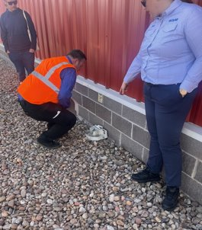
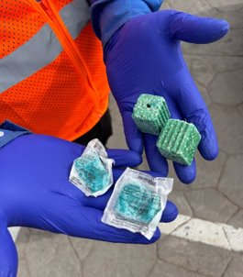
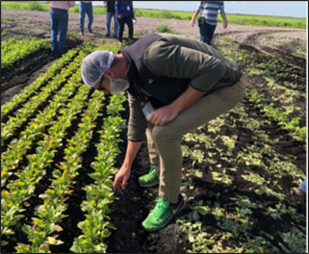
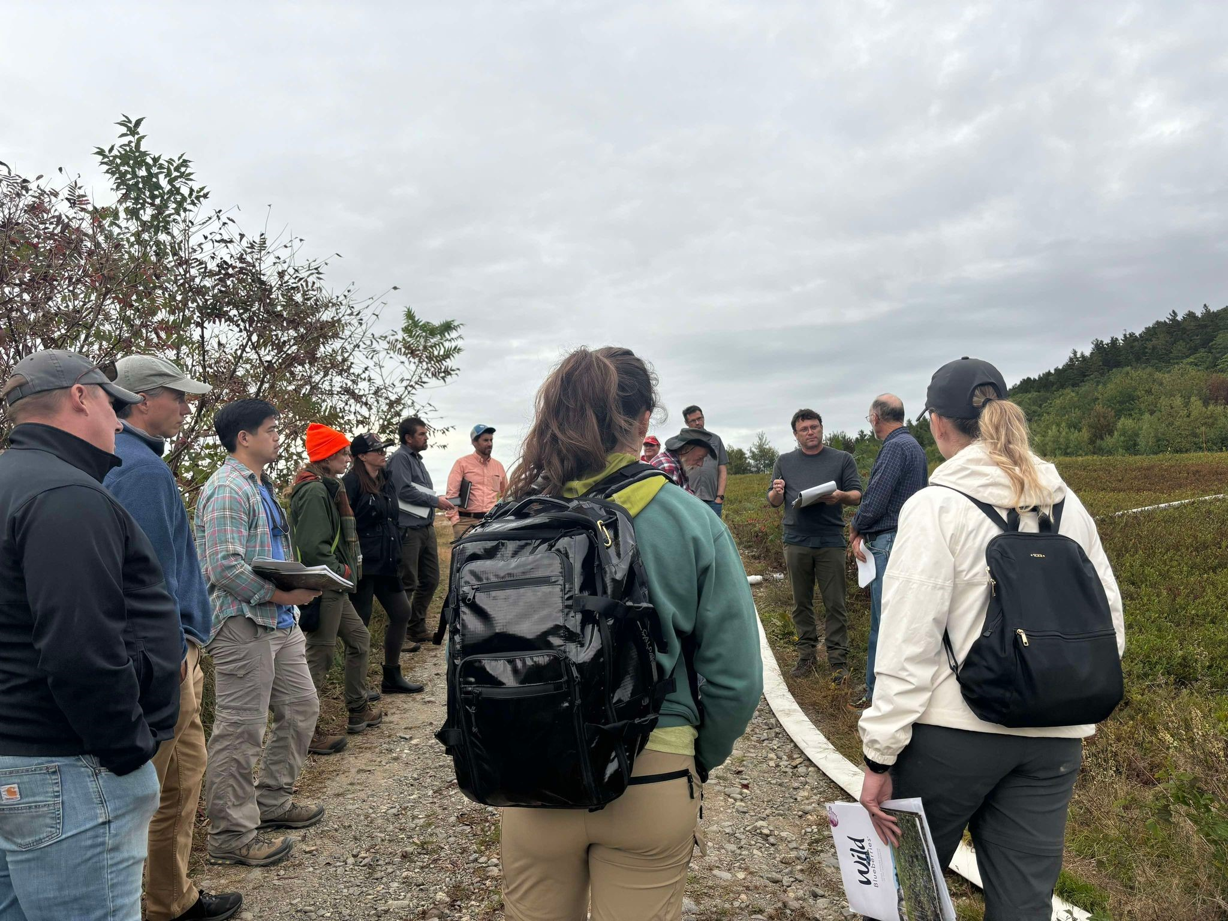
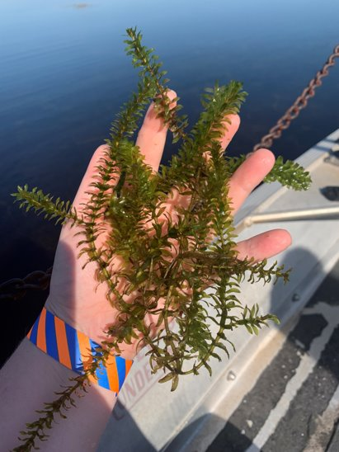
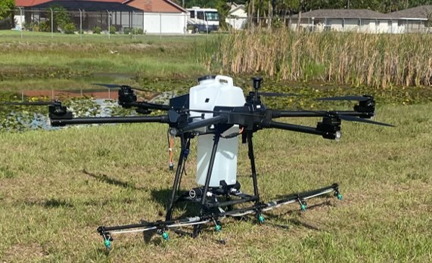
March 2024 Florida Fruit and Vegetable
Association, Fort Myers, Florida
Feb 2024 Rodenticide Tour​ hosted by Colorado Dept. of
Agriculture, Wyoming Dept. of Agriculture, Wyoming Weed
& Pest Council, and EPA Region 8​ Denver, Colorado and Douglas, Wyoming
June 2024 Aquatic Ecosystem Restoration Foundation Tour
Ft. Meyers, Clewiston, and Orlando, Florida
September 2024, Wild Blueberry Commission of Maine,
Bangor, Maine

Slide 37
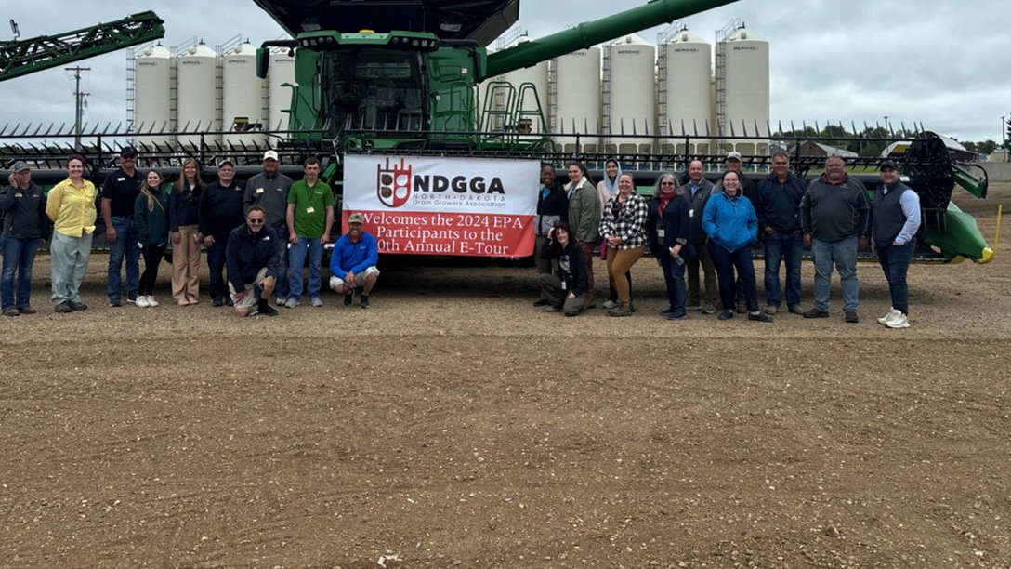
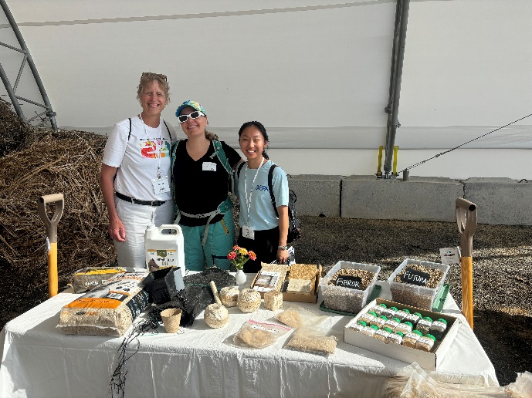
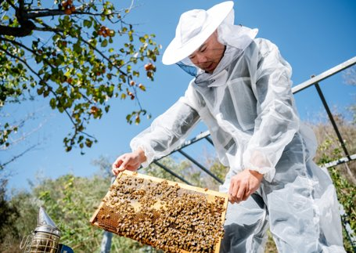
June 2024 North Dakota Grain Growers
Association Tour
August 2024, Snake River Sugarbeet Association, Boise, Idaho
June 2024 Michigan IPM tour,
Southwest Michigan
June 2024, IR-4 Local Tour, Pennsylvania
August 2024, California Specialty
Crops Council, Southern California
August 2024, Cotton Foundation,
Memphis, Tennessee

Slide 38
Sign-up for OPP Pesticide Updates
Get pesticide news story updates by email:
Go to epa.gov/pesticides
Go to the “Recent Highlights and Pesticide News” box in the right corner
Click on “View more pesticide news” at the top
Go to the “Other Resources” box at the right
Under, “Get pesticide updates by email,” enter your email address and click “Sign up”

Slide 39
Thank you!

Slide 40
OPP Updates Since June 5-6, 2024 PPDC Meeting

Slide 41
OPP Updates
EPA Releases Finalized Test Methods for Measuring Disinfectant Residue Levels on Hard Surfaces
EPA released an update finalizing test methods for measuring disinfect residues on hard surfaces treated with two classes of disinfectants- quaternary ammonium compounds and phenolic compounds — after they have been rinsed with water (known as a potable water rinse or “PWR”).
Where EPA does not have chemical-specific data, the Agency assumes that 100% of the disinfectant residues applied to the treated surface will contact food after the surface is rinsed with water, when evaluating the dietary risks of disinfectant pesticides. This estimated food-contact residue amount is then included in EPA’s dietary exposure assessments, which may produce an overly conservative risk assessment for a product. This may lead to a conclusion that more protective mitigation measures are necessary to register the product than would be required with more chemical-specific data.
These standardized test methods will not only serve as guidance in conducting residue studies in support of new and existing disinfectant product registration but will also enable more refined dietary risk assessments by the Agency through the use of chemical-specific residue data in lieu of the 100% default value.

Slide 42
OPP Updates
EPA Marks National Pollinator Week, Emphasizing Commitment to Protecting Pollinators
On Jun 17, 2024, U.S. EPA Administrator Michael S. Regan issued a proclamation announcing June 17-23, 2024, as National Pollinator Week.
This year’s proclamation underscores EPA’s commitment to protecting pollinators from pesticides, including through mitigation measures for several pesticides and the upcoming issuance of the final Herbicide Strategy to protect over 900 federally threatened and endangered species, including pollinators.
EPA has taken many steps to address the potential effects of pesticides on pollinators. The agency also proposed to register four new pesticide active ingredients that include protections for federally listed threatened or endangered species and for pollinators. EPA has also implemented measures to protect listed species and their critical habitats from the effects of three organophosphate insecticides. Those measures also help to protect pollinators.

Slide 43
OPP Updates
EPA Releases Updates on Organophosphates (OPs) Pesticides Dicrotophos, Dimethoate, and Tetrachlorvinphos
On June 18, 2024, EPA released the Proposed Registration Review Interim Decisions (PIDs) for dicrotophos and dimethoate, as well as an Interim Registration Review Decision (ID) for tetrachlorvinphos (TCVP), three organophosphate (OP) pesticides.
For each OP, EPA examined the available epidemiological studies (investigation of human populations for patterns and causes of health outcomes), animal toxicity studies performed with laboratory animals, and a battery of 17 in vitro assays (testing with cells from the nervous system) that evaluate a wide range of potential impacts on processes critical to the development of the human nervous system (referred to as the DNT battery). Data from all three lines of evidence are used to evaluate developmental neurotoxicity potential using a weight of evidence approach (WOE), which is a process that integrates all relevant evidence and considers the strengths and limitations of each line of evidence.
The documents are available at www.regulations.gov in the respective dockets of #EPA-HQ-OPP-2008-0440, #EPA-HQ-OPP-2009-0059, and #EPA-HQ-OPP-2008-0316.

Slide 44
OPP Updates
EPA Issues Final Cancellation Order and Updates to Existing Stocks Provisions for Several Chlorpyrifos Products
On June 25, 2024, EPA issued a final cancellation order for Corteva’s chlorpyrifos product “Dursban 50W in Water Soluble Packets” and three Gharda chlorpyrifos products, and an amendment to the existing stocks provisions for two Liberty and three Winfield chlorpyrifos end-use products.
The Agency has also updated the frequently asked questions about chlorpyrifos on its website.

Slide 45
OPP Updates
EPA Proposes Framework for Interagency Collaboration on the Review of Potential for Resistance from Antibacterial and Antifungal Pesticides
On July 2, 2024, EPA issued a final cancellation order for Corteva’s chlorpyrifos product “Dursban 50W in Water Soluble Packets” and three Gharda chlorpyrifos products, and an amendment to the existing stocks provisions for two Liberty and three Winfield chlorpyrifos end-use products.
The Agency has also updated the frequently asked questions about chlorpyrifos on its website.

Slide 46
OPP Updates
EPA Announces Update on Atrazine
On July 8, 2024, EPA announced an update to the level at which atrazine is expected to adversely affect aquatic plants. The new revised atrazine concentration of 9.7 micrograms per liter (µg/L), which was derived following an August 2023 peer review, will be used to develop a revised regulatory decision to help protect aquatic plants as well as fish, invertebrates, and amphibians.
The level at which atrazine is expected to adversely affect aquatic plants is also known as the concentration-equivalent level of concern or CE-LOC. Included in the announcement was an EPA memorandum that provides details on updates to EPA’s database of aquatic plant community studies and revised exposure modeling. Also included is an updated map that shows where the level of concern is expected to be exceeded. Collectively, these updates resulted in the removal of millions of acres of land from the 2022 map of watersheds that were expected to exceed the level of concern and added a much smaller number of acres in other areas of the country.

Slide 47
OPP Updates
EPA Shares Fish and Wildlife Service’s Draft Biological Opinion for Methomyl for Public Comment
On July 10, 2024, EPA posted for public comment the U.S. Fish and Wildlife Service (FWS) draft biological opinion (BiOp) for methomyl. The draft BiOp covers species under FWS’s purview.
The draft BiOp includes FWS's determinations that, under the ESA, use of methomyl is likely to jeopardize some listed species and adversely modify their critical habitats when used as registered. FWS determined that methomyl is likely to jeopardize 82 listed species and adversely modify 34 designated critical habitats.
The draft BiOp also suggests general categories of potential reasonable and prudent alternatives (RPAs), which are mitigation measures to prevent jeopardy to the species or adverse modification of the critical habitat. FWS will work with EPA and the registrants prior to issuing a final BiOp to tailor the proposed RPAs so they are technologically and economically feasible.
After the public comment period, EPA will provide FWS with a summary and the full text of comments received for consideration before FWS finalizes the BiOp. EPA will implement the final BiOp.

Slide 48
OPP Updates
EPA Announces New, Earlier Protections for People from Pesticide Spray Drift
On July 15, 2024, EPA announced protections being put in place sooner for farmworkers, their families, and the general public near where pesticides are applied. EPA will now assess the potential for people to be exposed to a pesticide when it drifts away from where it is applied earlier in the agency’s review process. This applies to new active ingredient pesticide registrations and new use decisions.
Historically, EPA has only conducted a chemical specific assessment of the potential for people to be exposed to pesticide ‘spray drift’ during registration review, which happen every 15 years after a pesticide is approved.
The agency will now also complete a chemical specific spray drift analysis during the initial registration process or the review process for new and amended uses of existing products, to ensure that any needed protections are put in place from the beginning of the pesticide’s use, rather than delaying them for 15 years. This will also ensure both new and old pesticide registrations are held to the same standard.

Slide 49
OPP Updates
EPA Releases Proposed Protections for Pesticide Malathion
On July 15, 2024, EPA opened a public comment period for the newly released Proposed Interim Registration Review Decision (PID) for malathion, as well as the revised Human Health Risk Assessment and Ecological Draft Risk Assessment released earlier in the year.
EPA did not find potential human health risks of concern when malathion is used in accordance with its current label, but did identify potential ecological risks of concern, even after considering the measures that EPA has adopted to protect listed species and their habitats.
The PID is proposing mandatory spray drift language for boomless ground applications (e.g., one or two nozzles spraying laterally from an all-terrain vehicle) and updated advisory spray drift language for all spray applications. Additionally, the Agency proposed a 96-hour water holding time before releasing floodwaters after the treatment of rice. Holding water used to flood rice fields allows for pesticide residues to dissipate before being released into the environment.

Slide 50
OPP Updates
EPA Opens Public Comment Period for Proposed Dicamba Herbicide from Syngenta
On July 23, 2024, EPA opened a public comment period fo an application from Syngenta for a new product containing the currently registered active ingredients dicamba and S-metolachlor. The product proposal includes over the top application on both dicamba-tolerant cotton and soybeans. Because the application involves a new use pattern for dicamba, the Agency provided a 30-day public comment period on the registration application consistent with FIFRA. EPA also sought comment on the associated draft labeling that Syngenta submitted, which is available in the docket.
Syngenta’s proposed label would allow application to dicamba-tolerant soybeans before, during, and immediately after planting, and over-the-top of the soybean plant through the ‘V2’ growth stage (where the second set of three leaves of the plant are fully unfolded), but no later than June 12 of each year. Application to dicamba-tolerant cotton in this Syngenta proposal would be allowed before, during, and immediately after planting, and over the top of the cotton plant through the 6-leaf growth stage, but no later than July 30 of each year.

Slide 51
OPP Updates
EPA Releases Draft Strategy to Better Protect Endangered Species from Insecticides
On July 25, 2024, EPA released its draft Insecticide Strategy for public comment, another milestone in the agency’s work to adopt early, practical protections for federally endangered and threatened (listed) species. The draft strategy identifies protections that EPA will consider when it registers a new insecticide or reevaluates an existing one. In developing this draft strategy, EPA identified protections to address potential impacts for more than 850 species listed by the U.S. Fish & Wildlife Service (FWS).
The draft identifies protections earlier in the pesticide review process, thus creating a far more efficient approach to evaluate and protect the FWS-listed species that live near these agricultural areas.
The draft insecticide strategy uses the most updated information and processes to determine whether an insecticide will impact a listed species and identify protections to address any impacts. To determine impacts, the draft strategy considers where a species lives, what it needs to reproduce (e.g., food or pollinators), where the pesticide will end up in the environment, and what kind of impacts the pesticide might have if it reaches the species. These refinements greatly reduce the need for pesticide restrictions in situations that do not benefit species.

Slide 52
OPP Updates
EPA Releases Draft Strategy to Better Protect Endangered Species from Insecticides
On July 25, 2024, EPA released for public comment its draft Insecticide Strategy for public comment, another milestone in the agency’s work to adopt early, practical protections for federally endangered and threatened (listed) species. The draft strategy identifies protections that EPA will consider when it registers a new insecticide or reevaluates an existing one. In developing this draft strategy, EPA identified protections to address potential impacts for more than 850 species listed by the U.S. Fish & Wildlife Service (FWS).
The draft identifies protections earlier in the pesticide review process, thus creating a far more efficient approach to evaluate and protect the FWS-listed species that live near these agricultural areas.
The draft insecticide strategy uses the most updated information and processes to determine whether an insecticide will impact a listed species and identify protections to address any impacts. To determine impacts, the draft strategy considers where a species lives, what it needs to reproduce (e.g., food or pollinators), where the pesticide will end up in the environment, and what kind of impacts the pesticide might have if it reaches the species. These refinements greatly reduce the need for pesticide restrictions in situations that do not benefit species.

Slide 53
OPP Updates
EPA Releases Updated Occupational Exposure Assessments for Seed Treatment Uses for Three Neonicotinoids
On July 26, 2024, EPA released for public comment its updated occupational exposure assessments for handling and treating seeds with clothianidin, imidacloprid, and thiamethoxam, which belong to a class of pesticides called neonicotinoids.
EPA has updated the occupational exposure assessments for handling and treating seeds with the pesticides by incorporating new data on the extent to which workers treating these seed are exposed to them. These data were submitted by the Agricultural Handler Exposure Task Force (AHETF), a consortium of agricultural chemical companies that jointly develop worker exposure data for pesticides. The AHETF provided additional information on dermal and inhalation exposure to workers in various seed treatment related worker tasks. Using the new data in the updated occupational assessments results in higher worker exposure and risk estimates for various seed treatment tasks than were previously estimated and presented in the 2020 Proposed Interim Decisions (PIDs).
Based on these updated occupational risk assessments, EPA has identified several activities associated with seed treatment that can pose risks from dermal or inhalation exposures to workers for these three neonicotinoids. The majority of these risks result from commercial seed treatment, particularly the cleaning of seed treatment equipment, even when the use of maximum personal protective equipment is considered.

Slide 54
OPP Updates
EPA Announces Next Steps to Protect People from Sulfuryl Fluoride used to Fumigate Residential Structures
On July 30, 2024, EPA announced hat it has approved additional safety measures to prevent deaths and serious injuries when people re-enter homes fumigated with sulfuryl fluoride. EPA approved new product labels containing additional protective measures. This is a result of the June 2023 final early mitigation decision for sulfuryl fluoride, which instructed companies to submit amended product labels that contained additional protective measures within 12 months.
An EPA Office of the Inspector General’s report was conducted in response to at least 11 deaths and two serious injuries during residential fumigation in California and Florida that had occurred since 2002. According to the report, the deaths and serious injuries occurred after homes had been “cleared” for re-entry. The report identified the need to restrict access to fumigated sites, increase and standardize product fumigation training requirements, and assess the reliability of clearance devices listed on product labels. Based on EPA testing results indicating that some of the clearance devices listed on previous sulfuryl fluoride labels do not accurately measure the clearance level, the agency determined that several mitigation measures were necessary to protect people returning to their homes after a fumigation with sulfuryl fluoride.
For all sulfuryl fluoride products registered for residential use, amended labels were submitted with the revised label language, which the agency approved on July 11, 2024. The revised product labels now contain the protective measures

Slide 55
OPP Updates
EPA Issues Emergency Order to Stop Use of Pesticide Dacthal to Address Serious Health Risk
On August 6, 2024, EPA announced the emergency suspension of all registrations of the pesticide dimethyl tetrachloroterephthalate (DCPA or Dacthal) under the Federal Insecticide, Fungicide and Rodenticide Act (FIFRA). This was the first time in almost 40 years EPA has taken this type of emergency action, following several years of unprecedented efforts by the Biden-Harris Administration to require the submission of long-overdue data and then assess and address the risk this pesticide poses.
EPA took this action because unborn babies whose pregnant mothers are exposed to DCPA, sometimes without even knowing the exposure has occurred, could experience changes to fetal thyroid hormone levels, and these changes are generally linked to low birth weight, impaired brain development, decreased IQ, and impaired motor skills later in life, some of which may be irreversible.
The Emergency Order was effective immediately. EPA determined that the continued sale and use of DCPA products during the time it would take to follow the normal cancellation process poses an imminent hazard to unborn babies. While AMVAC attempted to address these concerns, EPA determined there are no practical mitigation measures that can be put in place to allow DCPA’s continued use.

Slide 56
OPP Updates
EPA Issues Final Cancellation and Termination of Uses Order for Several Chlorpyrifos Products
On August 7, 2024, EPA issued a final order terminating food processing plant (food and non-food area) uses for Chemstarr’s chlorpyrifos product “Chlorpyrifos 61.5% MUP” and food uses for Tide International’s chlorpyrifos product “Chlorpyrifos 4 EC.” EPA also cancelled two Central Garden & Pet chlorpyrifos products “Equil Chlorpyrifos ULV 1” and “Equil Chlorpyrifos ULV 2.”
EPA published the Notice of Receipt of Requests from the registrants to voluntarily cancel or terminate uses for these product registrations on April 3, 2024, which was open for public comment until May 3, 2024. The Agency received two comments on this notice. After considering these comments, the Agency finalized its decision to accept the registrants’ voluntary requests to cancel or terminate uses for these products. Any distribution, sale, or use of existing stocks of these products is permitted only in accordance with the terms of the final order and existing stocks provisions of the final order.

Slide 57
OPP Updates
Register for EPA’s Webinar on Draft Strategy to Better Protect Endangered Species from Insecticides
On August 12, 2024, EPA announced a public webinar on September 5, 2024, from 1-2 PM ET to provide an overview of its draft Insecticide Strategy. Released on July 25, 2024, the draft strategy furthers the agency’s work to adopt early, practical protections for federally endangered and threatened (listed) species and designated critical habitats from the use of conventional agricultural insecticides.

Slide 58
OPP Updates
EPA Finalizes First-of-its-Kind Strategy to Protect 900 Endangered Species from Herbicides
On August 20, 2024, EPA released its final Herbicide Strategy, an unprecedented step in protecting over 900 federally endangered and threatened (listed) species from the potential impacts of herbicide, which are chemicals used to control weeds. EPA will use the strategy to identify measures to reduce the amount of herbicides exposure to these species when it registers new herbicides and when it reevaluates registered herbicides under a process called registration review. The final strategy incorporates a wide range of stakeholder input, ensuring EPA not only protects species but also preserves a wide range of pesticides for farmers and growers.
The final strategy itself does not impose any requirements or restrictions on pesticide use. Rather, EPA will use the strategy to inform mitigations for new active ingredient registrations and registration review of conventional herbicides.

Slide 59
OPP Updates
EPA Appoints New Members to the FIFRA Scientific Advisory Panel
On August 21, 2024, EPA appointed a new chair and two new members and reappointed two current members to serve on the Federal Insecticide, Fungicide, and Rodenticide Act (FIFRA) Scientific Advisory Panel (SAP).
The FIFRA SAP provides independent scientific advice, information, and recommendations to the EPA Administrator on pesticides and pesticide related issues. The FIFRA SAP was established in 1975 and is composed of a permanent panel of seven scientists appointed by the EPA Administrator to serve staggered terms of three to six years. These experts are appointed from a pool of candidates provided by the National Institutes of Health (NIH) and the National Science Foundation (NSF). The FIFRA SAP is supported by members of the Food Quality Protection Act (FQPA) Science Review Board (SRB).
A list of all current members and their biographies can be found on the FIFRA SAP website.

Slide 60
OPP Updates
EPA Publishes New Resources on Bilingual Pesticide Labeling
On August 27, 2024, EPA published new and updated resources on bilingual pesticide labeling. The Pesticide Registration Improvement Act of 2022 (PRIA 5) requires the safety and health portions of pesticide product labels to be translated into Spanish. Spanish is the primary language for most American farmworkers.
The new and updated resources include guidance on implementation timelines of these bilingual labeling requirements for various types of pesticide products based on their toxicity, as well as frequently asked questions and answers related to this requirements.
The Agency intends to update these website resources as various PRIA 5 requirements and deadlines are met, and new information is available. The resources will be available in English and Spanish on the Agency’s website.

Slide 61
OPP Updates
EPA Announces Voluntary Cancellation for the Pesticide Dacthal
On August 28, 2024, EPA initiated process to cancel all products containing dimethyl tetrachloroterephthalate (DCPA or Dacthal), following the U.S. Environmental Protection Agency’s emergency suspension of the pesticide DCPA.
On Aug. 19, 2024, EPA received a letter from AMVAC Chemical Corporation (AMVAC) stating its intent to voluntarily cancel the remaining pesticide products containing DCPA in the United States, and subsequently announced it intended to cancel all international registrations as well.
The August 2024 emergency suspension was the first time in almost 40 years EPA has taken this type of emergency action, following several years of efforts by the agency to require the submission of data that was due in January 2016 and then assess and address the risk this pesticide poses. EPA took this action because unborn babies whose pregnant mothers are exposed to DCPA, sometimes without even knowing the exposure has occurred, could experience changes to fetal thyroid hormone levels, and these changes are generally linked to low birth weight, impaired brain development, decreased IQ and impaired motor skills later in life, some of which may be irreversible. For this decision, EPA relied on the best available science, which included robust studies that all demonstrate thyroid toxicity.

Slide 62
OPP Updates
EPA Releases Final Guidance on Efficacy Testing of Antimicrobial Pesticides Against Legionella Pneumophila in Cooling Tower Water
On August 28, 2024, EPA released the final guidance and a test method to evaluate efficacy claims for antimicrobial products against Legionella pneumophila (L. pneumophila) in cooling tower water.
Legionnaires’ disease (LD) is a serious type of pneumonia (lung infection) acquired by breathing in water droplets contaminated with L. pneumophila bacteria. Cooling towers are a potential breeding ground for this bacterium. L. pneumophila can disperse through the air in water droplets if cooling towers are not properly maintained. The incidence of LD in the United States has been increasing since 2000. Outbreaks and illness clusters have been associated with decorative, recreational, domestic, and industrial water systems, with the largest outbreaks caused by cooling towers.
The finalized guidance provides an overview of the test method and additional information to registrants seeking to add L. pneumophila claims. The additional information includes data submission procedures, and example pesticide label use directions and claims for proposed antimicrobial product labels. Antimicrobial products with L. pneumophila claims may be used as part of a water management plan for cooling tower systems.

Slide 63
OPP Updates
EPA Awards $3 Million to Support Pesticide Inspector Residential Training Program
On September 3, 2024, EPA announced that the National Association of State Departments of Agriculture (NASDA) Foundation is the recipient of a cooperative agreement to implement the Pesticide Inspector Residential Training (PIRT) Program. EPA expects the total funding for the five-year period of the cooperative agreement, which began August 2, 2024, to be $3 million.
The PIRT program provides educational pesticide training to inspectors and staff of states, Tribes, and U.S. territories working under Federal Insecticide, Fungicide, and Rodenticide Act cooperative agreements. The training includes information on new policies, new technologies, and tools to improve the effectiveness and efficiency of pesticide inspections.

Slide 64
OPP Updates
EPA Proposes to Register New Antimicrobial Active Ingredient Glycerol Formate
On September 16, 2024, EPA released for public comment its proposed registration decision for pesticide products containing the new active ingredient glycerol formate. Products containing glycerol formate are intended to be used in healthcare settings (e.g., hospitals, medical premises and nursing homes) as a disinfectant for hard non-porous, non-food contact surfaces (e.g., stretchers) for bacteria, spores, and viruses, and as a sanitizer for soft surfaces (100% cotton or 100% polyester) for staphylococcus aureus and klebsiella aerogenes, which can cause serious infections. Glycerol formate is the first new antimicrobial active ingredient to be proposed for registration in four years.
After considering public comments on the proposed registration and the draft risk assessment, EPA will determine whether the registration action meets the FIFRA registration standard. If EPA determines that the registration action can be granted, EPA will finalize the decision and the risk assessment including the ESA effects determination.

Slide 65
OPP Updates
EPA Issues Update to Existing Stocks Provisions for One Chlorpyrifos Product
On September 16, 2024, EPA issued an amendment to the existing stocks provisions for the Kaizen Technologies LLC (Kaizen) chlorpyrifos end-use product “Bifenchlor” to allow for sale, distribution, and use for a limited time. The 2023 court decision vacating the 2021 chlorpyrifos tolerance revocation rule reinstated tolerances for products that registrants had previously voluntarily cancelled. Granting this amendment ensures greater consistency across chlorpyrifos products.
EPA has amended the existing stocks provisions for the Kaizen chlorpyrifos end-use product Bifenchlor (Reg. No. 86363-11), which was voluntarily cancelled on August 31, 2022. he sale and distribution of existing stocks of this product has been amended for consistency with the existing stock provisions for other registrants who requested this provision. Sale and distribution is now permitted until April 30, 2025, and use of existing stocks of this product is now permitted until June 30, 2025.

Slide 66
OPP Updates
EPA Publishes Report as Part of Agency Strategy to Reduce Animal Testing
On September 24, 2024, EPA released a detailed review of major environmental statutes that summarizes which EPA laws or regulations require vertebrate animal testing, such as laboratory testing done on rats, mice or rabbits. The report concludes that many statutes and regulations guiding EPA’s authority are broadly written and do not preclude the use of scientific information from New Approach Methods (NAMs), which are defined as any technology, methodology, approach, or combination that can provide information on chemical hazard and risk assessment to avoid the use of animal testing. With flexible regulatory statutes, EPA can successfully incorporate NAMs data in a range of chemical decisions, as long as it prioritizes scientific rigor and fully acknowledges the chosen method’s advantages and limitations.
This report is a deliverable in EPA’s NAMs Work Plan, which was originally released in June 2020 and updated in November 2021.

Slide 67
OPP Updates
EPA EPA Finalizes Plan to Protect Vulnerable Species Report as Part of Agency Strategy to Reduce Animal Testing
On September 24, 2024, EPA released its Vulnerable Species Action Plan (VSAP), finalizing its transition from its June 2023 Vulnerable Species Pilot (VSP) in order to help conserve federally threatened and endangered (listed) species from pesticides. As part of implementing EPA’s Endangered Species Act Workplan, the VSAP is intended to provide a framework for EPA to adopt early, meaningful protections to address potential impacts for listed species that EPA identifies as particularly “vulnerable” to pesticides.
The plan describes the framework that EPA will use for vulnerable species when considering FIFRA actions for conventional pesticides (such as new chemical registrations and registration review). EPA plans to incorporate mitigations from the VSAP into applicable pesticide actions, even if EPA has not yet determined effects under the Endangered Species Act (ESA) or consulted with FWS.
The VSAP identifies the potential for impacts (Step 1), the type and level of mitigation (Step 2), and where mitigation applies (Step 3). Any needed mitigations will only apply in geographically specific areas (referred to as Pesticide Use Limitation Areas or PULAs). EPA is refining the species maps that it will use for PULAs and will not implement the VSAP in registration review until those maps are refined, which will likely be later in 2024.

Slide 68
OPP Updates
EPA Finalizes Plan to Protect Vulnerable Species
On September 26, 2024, EPA released its Vulnerable Species Action Plan (VSAP), finalizing its transition from its June 2023 Vulnerable Species Pilot (VSP) in order to help conserve federally threatened and endangered (listed) species from pesticides. As part of implementing EPA’s Endangered Species Act Workplan, the VSAP is intended to provide a framework for EPA to adopt early, meaningful protections to address potential impacts for listed species that EPA identifies as particularly “vulnerable” to pesticides.
The plan describes the framework that EPA will use for vulnerable species when considering FIFRA actions for conventional pesticides (such as new chemical registrations and registration review). EPA plans to incorporate mitigations from the VSAP into applicable pesticide actions, even if EPA has not yet determined effects under the Endangered Species Act (ESA) or consulted with FWS.
The VSAP identifies the potential for impacts (Step 1), the type and level of mitigation (Step 2), and where mitigation applies (Step 3). Any needed mitigations will only apply in geographically specific areas (referred to as Pesticide Use Limitation Areas or PULAs). EPA is refining the species maps that it will use for PULAs and will not implement the VSAP in registration review until those maps are refined, which will likely be later in 2024.

Slide 69
OPP Updates
EPA Releases Draft Biological Evaluations for Bicyclopyrone and Benzovindiflupyr Effects on Endangered Species
On September 27, 2024, EPA released two draft biological evaluations (BEs), which include EPA’s draft Endangered Species Act (ESA) effects determinations for the pesticides bicyclopyrone and benzovindiflupyr on federally endangered and threatened (listed) species and their designated critical habitats. The draft BEs will be available for public comment for 60 days.
In its draft BEs, EPA evaluated the effects of bicyclopyrone and benzovindiflupyr on 1,725 listed species and 944 critical habitats in the United States and its territories and made draft effects determinations. EPA’s draft effects determinations in the draft BEs find that both bicyclopyrone and benzovindiflupyr are “likely to adversely affect” (LAA) listed species and their critical habitats.

Slide 70
OPP Updates
EPA Announces Proposed Registration for New Pesticide Metamitron
On September 27, 2024, EPA released its proposed registration decision for plant growth regulator products containing the new active ingredient (AI) metamitron for use on apple and pear trees. Metamitron is a chemical thinning agent applied to apple and pear tree leaves shortly after the blooming stage to thin excess fruit. This allows the remaining fruit to grow larger and may contribute to higher quality fruit and plant health.
In addition to its proposed registration decision, EPA has also released its draft human health and ecological risk assessments as well as a biological evaluation for the pesticide under the Endangered Species Act (ESA).
No human health risks of concern were identified when metamitron is used according to the label. EPA conducted an ecological risk assessment and biological evaluation (BE) under the ESA and initiated an informal consultation with the U.S. Fish and Wildlife Service (FWS). In its effects determination, EPA found that metamitron was not likely to adversely affect any of the identified species or critical habitats. EPA will not move forward with any final decision on these registrations until the informal consultation with FWS is complete.

Slide 71
OPP Updates
EPA Announces Next Steps to Protect Endangered Species from Chlorpyrifos
On October 1, 2024, EPA announced additional measures to protect federally threatened or endangered (listed) species and their designated critical habitats from the effects of chlorpyrifos. The measures include new product labels containing additional protections and Endangered Species Protection Bulletins that set geographically specific limitations on pesticide use. Collectively, these measures will not only protect listed species but also reduce exposure to non-listed species.
After consultation between EPA and the National Marine Fisheries Service (NMFS), and the chlorpyrifos registrants, on June 30, 2022, NMFS issued a “no jeopardy” BiOp for chlorpyrifos and two additional organophosphate pesticides, diazinon and malathion. During that consultation, the registrants committed to amend their product labels and registrations to include measures that reduce runoff and spray drift (the movement of a pesticide through the air to an area other than the intended application area) from treated areas into species’ habitats. The mitigations for chlorpyrifos include restrictions on when to apply, restrictions on tank mixing, and use limitations related to both runoff and drift, as well as wind speed restrictions.
All registrants have submitted these product labeling amendments to EPA, as well as amendments describing how to report ecological incidents associated with pesticide applications, should users observe any. EPA has also posted agreed-upon Bulletins.

Slide 72
OPP Updates
EPA Announces Funding Opportunities to Support Farmworker Communities
On October 1, 2024, EPA announced three new funding opportunities to support pesticide safety education for farmworkers, training for health care providers to better address pesticide-related illness, and technical assistance to support managing these grants. A total of almost $10 million will be awarded to at least four grantees to carry out this work over five years.
EPA is soliciting applications from community-based farmworker nonprofit organizations with experience in training agricultural workers or pesticide handlers or developing educational materials for them to support training, materials development and outreach to farmworker communities on pesticide safety, as well as to help them understand their rights under the Agricultural Worker Protection Standard.
EPA is soliciting applications from nonprofit organizations with experience training health care providers who serve farmworker populations for a five-year cooperative agreement of up to $2.1 million to improve health care providers’ ability to prevent, recognize, treat, manage and report pesticide-related illness.
EPA is soliciting applications for a cooperative agreement of up to $1.47 million to provide technical assistance with grants administration and compliance for grantees of the Farmworker Training and Education Program for Pesticide Safety and Pesticides Health Care Initiative agreements described above.

Slide 73
OPP Updates
EPA Finalizes Rule to Protect Farmworkers, Families and Communities from Pesticide Exposures
On October 2, 2024, EPA announced a final rule to restore the pesticide Application Exclusion Zone (AEZ) requirements under the 2015 Agricultural Worker Protection Standard (WPS). The AEZ is an area surrounding outdoor pesticide application equipment where people are prohibited while pesticides are applied.
This rule finalizes the agency’s 2023 proposed rule without change and advances the Biden-Harris Administration’s commitment to environmental justice, protecting farmworkers, pesticide handlers, their families and agricultural communities. It reinstates AEZ protections, extends protections for neighboring communities, makes requirements easier to understand, and provides flexibilities for family farms without compromising protections.

Slide 74
OPP Updates
EPA Approves New California-Specific Labels for Sulfoxaflor with Additional Protections for Threatened and Endangered Species
On October 8, 2024, EPA approved new California-only labels for the insecticide sulfoxaflor that include new mitigations to protect federally threatened and endangered (listed) species and designated critical habitats in California. The two sulfoxaflor product labels are approved for use on many commercial crops, including corn, wheat, and rice.
Sulfoxaflor is a liquid insecticide that targets aphids and other piercing and sucking insects and is considered compatible with Integrated Pest Management programs. Growers and applicators can use sulfoxaflor in rotation with other insecticides to reduce the potential spread of insecticide resistance.
Corteva, the registrant for both of the California-only sulfoxaflor products, submitted proposed label amendments to EPA to address the Agency’s predictions of potential likelihood of future jeopardy to listed species and adverse modification to critical habitats in California presented in EPA’s 2023 final biological evaluation for sulfoxaflor. Corteva subsequently proposed additional label amendments consistent with requests made by the California Department of Pesticide Regulation.

Slide 75
OPP Updates
EPA Finalizes Framework for Interagency Collaboration on Resistance Risks Associated with Antibacterial and Antifungal Pesticides
On October 9, 2024, EPA finalized its framework for expanding federal collaboration on the review of antibacterial and antifungal pesticides.
To develop the framework, EPA coordinated with the U.S. Department of Health and Human Services (HHS) and the U.S. Department of Agriculture (USDA), under the oversight of the White House Office of Science and Technology Policy.
The framework establishes a process for EPA to consider input from the other federal agencies when evaluating whether antibacterial or antifungal pesticides might result in the development or spread of resistance and reduce the effectiveness of some human and animal antibacterial and antifungal drugs.

Slide 76
OPP Updates
EPA Releases Interim Guidance to Expand Availability of Virus Claims to Additional Antimicrobial Products
On October 10, 2024, EPA released interim guidance describing how registrants of antimicrobial products may add label claims that sanitizing products (e.g., household antimicrobial wipes and sprays) are effective against viruses. If laboratory data indicate that a product registered only with sanitizing claims meets EPA's criteria for efficacy against viruses, the product can include claims against viruses on its label.
New virucidal claims for sanitizers rely on the same performance and testing standards currently used to assess products efficacy against disinfectants with virus claims. The guidance is expected to expand the availability of antimicrobial products that are effective against viruses such as SARS-CoV-2, which provides more products for reducing the spread of illnesses, including products that generally use lower amounts of active ingredients.
EPA will pilot this guidance for up to 10 years to assess implementation and the outcome of this guidance.

Slide 77
OPP Updates
EPA Releases Pesticide and Endangered Species Educational Resources Toolbox
On October 11, 2024, EPA released an online toolbox with educational materials related to pesticides and endangered species -- another step in the agency’s efforts to protect endangered species, support farmers, and provide critical environmental protections for communities across the country.
The Pesticide and Endangered Species Educational Resources Toolbox catalogs educational resources including guidance documents, handouts, presentations, informational webinars, and other resources relating to EPA’s endangered species work.
EPA developed the materials in this toolbox for a variety of stakeholders who may have differing levels of knowledge about EPA’s efforts to protect listed species.
This initial release of the toolbox primarily consolidates existing materials from various locations on EPA’s website into one location. EPA has also included a new one-page handout on Bulletins Live! Two.
EPA will continue adding new materials to the toolbox as they are developed.

Slide 78
OPP Updates
EPA Proposes Settlement for Claims Relating to Endocrine Disruptor Screening Program
On October 11, 2024, EPA released a proposed plan to settle legal claims on the Agency's implementation of the Endocrine Disruptor Screening Program (EDSP). EPA provided a 30-day public comment period on the proposed plan.
In 2022, a coalition of plaintiffs filed a complaint against EPA concerning EPA’s implementation of the EDSP.
In October 2023, EPA issued its new EDSP strategic plan to ensure that its assessments of pesticides more closely, quickly, and effectively evaluate the potential for endocrine effects in humans. The proposed plan aims to resolve legal claims raised by plaintiffs through a settlement between EPA and the plaintiffs. As part of the proposal, EPA is committing to several actions to confirm that its Federal Insecticide, Fungicide, and Rodenticide Act (FIFRA) assessments address the potential endocrine effects of conventional pesticide active ingredients on human health. These actions are consistent with and implement the EDSP strategic plan.

Slide 79
OPP Updates
EPA Registers New Herbicide Active Ingredient Glufosinate-P
On October 18, 2024, EPA announced its registration of the new active ingredient glufosinate-P that controls weeds in conventional and glufosinate-resistant field corn, sweet corn, soybean, cotton, and canola.
In addition to its final registration decision, EPA also released its final biological evaluation for the active ingredient under the ESA. This action is consistent with EPA’s obligations under the ESA and furthers the goals outlined in EPA’s April 2022 ESA Workplan.
Glufosinate-P is the first new active ingredient registration where EPA has used its new Herbicide Strategy Framework, released in August 2024, to inform the level of mitigation necessary to reduce exposure to listed species and critical habitat from runoff and erosion.
The proposed glufosinate-P products result in less chemicals entering the environment compared to the currently registered glufosinate because they only require approximately half the application rate to be as effective.

Slide 80
OPP Updates
EPA Finalizes Cancellation of the Pesticide Dacthal
On October 22, 2024, EPA announced the cancellation of all products containing the pesticide dimethyl tetrachloroterephthalate (DCPA or Dacthal) under FIFRA.
In making this decision, EPA relied on the best available science, which included robust studies demonstrating thyroid toxicity. Unborn babies whose pregnant mothers are exposed to DCPA from handling, entering or working in areas where DCPA has already been applied, could experience changes to fetal thyroid hormone levels. These changes are generally linked to low birth weight, impaired brain development, decreased IQ, and impaired motor skills later in life, some of which may be irreversible.
The August 2024 emergency suspension issued by EPA was the first time in almost 40 years EPA has taken this type of emergency action. Following EPA’s emergency suspension EPA received a letter from AMVAC stating its intent to voluntarily cancel the remaining pesticide products containing DCPA in the U.S. AMVAC subsequently announced that it intends to cancel all international registrations as well. On Aug. 29, 2024, EPA published a notice in the Federal Register requesting public comments on the voluntary cancellation. The comment period has concluded, and EPA published the final cancellation order.

Slide 81
OPP Updates
EPA Holds Virtual Pesticide Program Dialogue Committee Meeting
On October 23, 2024, EPA announced that it will hold a virtual public meeting of the Pesticide Program Dialogue Committee (PPDC) on November 13 and November 14, 2024, from 11:00AM – 5:00PM (EST). The PPDC provides feedback to EPA on pesticide regulatory, policy and program issues and includes representatives from environmental groups, pesticide manufacturers, trade associations, academia and federal and state agencies.
Topics for the meeting include:
An overview of the Office of Pesticide Programs’ priorities and accomplishments for Fiscal Year (FY) 2024, including Pesticide Registration Improvement Act 5 and Endangered Species Act implementation. Additional priorities include business process improvements and risk assessments for unmanned aerial vehicles.
Updates from PPDC sub-workgroups, including the Pesticide Label Reform Workgroup, Farmworker Workgroup, Emerging Pathogens Implementation Workgroup, and Pesticide Resistance Management Workgroup #2.
A discussion surrounding priorities for FY 2025 and additional topics to be considered for the 2025 PPDC Meetings.

Slide 82
OPP Updates
EPA Releases Final Biological Evaluations of Dinotefuran and Acetamiprid Effects on Endangered Species
On October 24, 2024, EPA released the final biological evaluations (BEs) and response to comments received on the draft BEs for the neonicotinoid insecticides dinotefuran and acetamiprid on federally threatened and endangered (listed) species and designated critical habitats. These final BEs are part of EPA’s efforts to meet its obligations under the ESA.
When EPA determines in a final BE that a Federal Insecticide, Fungicide, and Rodenticide Act (FIFRA) action may affect listed species or critical habitats, the Agency must initiate consultation with the Services. Because EPA’s final BEs of dinotefuran and acetamiprid made LAA determinations for species under both Services' jurisdiction, EPA will initiate formal consultation with both Services.
During formal consultation, the Services use EPA’s effects determinations to inform their biological opinions. If the Services determine in their final biological opinions that mitigations are necessary to address any jeopardy or adverse modification determinations (that the Services may make) or to address any incidental take beyond those mitigations, then EPA will work to ensure that any necessary registration or labeling changes are made.

Slide 83
OPP Updates
EPA Announces Proposed Registration for New Pesticide Veratrine
On October 31, 2024, EPA released its proposed registration decision for products containing the new active ingredient (AI) veratrine, an insecticide for direct application to walls and other man-made structures, such as transportation equipment for non-food commodities.
Veratrine acts against pests by targeting insect nervous systems in a manner similar to the pyrethroids, but potentially without concerns for cross-resistance with those other chemicals. Cross-resistance occurs when use of one insecticide confers resistance to other insecticides in the same class, resulting in pests with resistance to multiple pesticides, which then may not be able to be controlled using those pesticides.
In addition to its proposed registration decision, EPA has also released its human health and ecological risk assessments, with the latter including EPA’s No Effect determination for veratrine under the ESA.
No human health or environmental risks of concern were identified when veratrine is used according to the label. In its effects determination, EPA found that veratrine would have No Effect on all listed species because the proposed use sites are unlikely to overlap with a significant portion of the species’ ranges.

Slide 84
OPP Updates
EPA Releases Updates to Suggested Pesticide Benefits Information Submittals
On November 6, 2024, EPA released updates to suggestions EPA provides to registrants when they develop benefits information for new conventional pesticide registrations and new outdoor uses of conventional pesticides. These suggestions can help registrants ensure they are submitting useful and complete benefits-related information, helping save time in EPA’s review of new pesticide registrations and uses.
The updated suggestions provide registrants with expanded instructions on the preferred format and content for submitted benefits information including draft labels and summaries of use, key target pests, and other registered pesticides available.
During the registration process for pesticides under FIFRA, EPA conducts risk and benefit assessments to consider the economic, social, and environmental costs and benefits of the proposed pesticide. To assist EPA’s evaluation of the benefits, registrants may provide information regarding the potential benefits of a pesticide.
When benefit submissions are received, EPA reviews the information and considers it as part of its evaluation of the benefits of a pesticide’s use.

