Slide 1
Pesticide Program Dialogue Committee (PPDC): Emerging Pathogens Implementation Committee (EPIC) Final Report
Co-Chairs:
Tajah Blackburn (US EPA)
Rhonda Jones (SRC)
Anastasia Swearingen (CBC)

Slide 2
EPIC Core Members
Matt Arduino, CDC
Ellen Baldassare, LANXESS
Steve Bennett, HCPA
Diane Boesenberg, Exponent
Alex Cook, First Group
Patti Costello, AHA
Lisa Dreilinger, Arxada
Seth Goldberg, Greenberg Traurig, LLP
James Kim, ACI
Pat Quinn, The Accord Group
Kate Sande, Ecolab
Tajah Blackburn, EPA (Chair)
Rhonda Jones, SRC (Chair)
Anastasia Swearingen, CBC (Chair)
Nicole Karikari, US EPA

Slide 3
Agenda
Emerging Pathogen Implementation Committee (EPIC) Recap
Technical Work Group Reports
Policy Work Group Report
Education and Communication Work Group Reports
EPIC Accomplishments
PPDC Comments and Vote

Slide 4
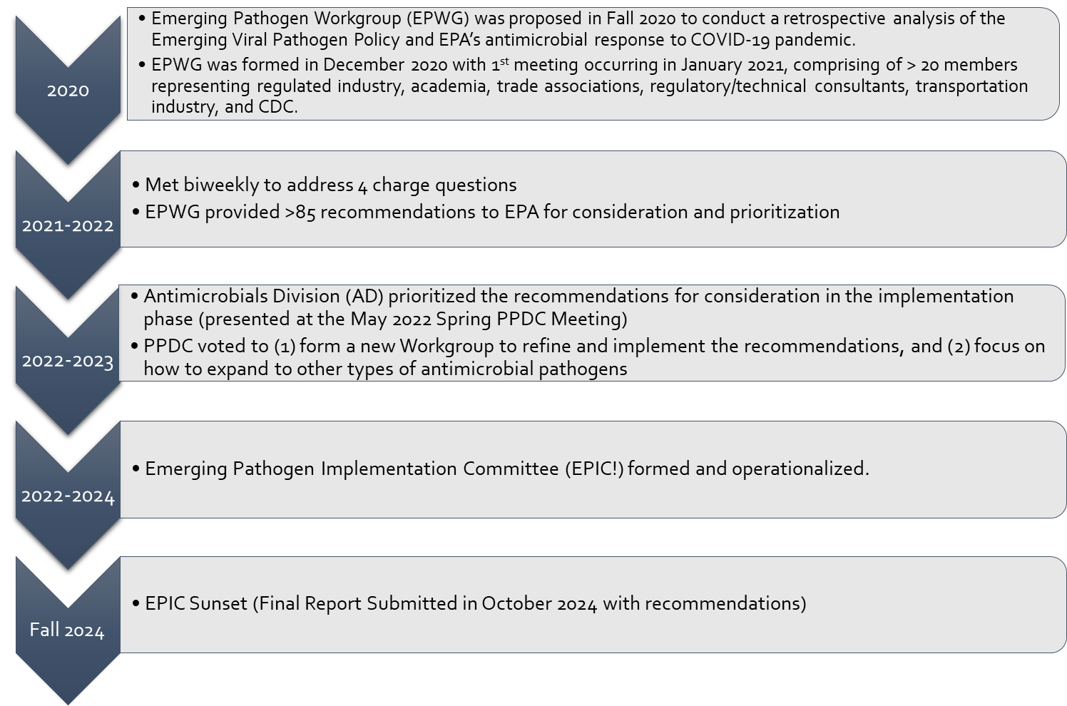
Timeline of Capstone Events

Slide 5
Emerging Pathogen Implementation Committee (EPIC) Operational Details
Focus on the prioritized recommendations regarding the (1) Emerging Viral Pathogen (EVP) Guidance (Technical Workgroup), (2) Communication/Educational gaps from several sectors (Comms/Education Workgroup), and (3) policy changes proposed and retained during the pandemic and normal operations (Policy Workgroup).
EPIC small workgroups were formed to address each of the prioritized recommendations for the 3 main headings identified.
Large group meetings (every 2 months) were conducted to bring all members up-to-date following small workgroup discussions.

Slide 6
Policy Work Group
Issue: No opportunity for users to determine EVP-eligible products at the point of sale/on packaging.
Recommendation: EPA should develop a pathway for registrants to communicate EVP activation on-packaging, with a preference for use of a multi-use QR Code option.
QR codes allow registrants to link to EPA-approved EVP language in response to EVP activation without having to re-print labels or concerns about products in commerce with out-of-date EVP language on-packaging. Wide understanding and use of QR codes, including for compliance with Spanish labeling requirements under PRIA 5.

Slide 7

Policy Work Group
Issue: Section 18 submission and training tools aren’t tailored to national public health emergencies.
Recommendation: EPA could provide an addendum to the Section 18 checklist to assist applicants during public health emergencies.
Recommendation: Should EPA resources and grants allow, PPDC EPIC also recommends updating the existing FIFRA Section 18 Emergency Exemption training modules with a module specifically on public health emergencies.
Notes:
General Recommendations: Test Strain/Method and other related expert recommendations will be provide to EPA in a report format

Slide 8
PPDC EPIC
Technical Work Group
PPDC Fall Meeting 2024
Rhonda Jones, RM (AAM)
Scientific & Regulatory Consultants, Inc.

Slide 9
Current Team:
Rhonda Jones, SRC, Lead
Tajah Blackburn, PhD, EPA AD
Anastasia Swearingen, CBC
Kristie Restrepo, Ecolab
Shanen Conway, Element
Diane Boesenberg, Exponent
Pat Quinn, Accord Group
Lisa Dreilinger, PhD, Arxada
Matt Arduino, PhD, CDC
Ellen Baldassare, Lanxess
Dan Klein, PhD, Steris
Joe Sexton, PhD, CDC
Ligia Duarte, HCPA
Lizzie Ortolano, AHA
Tina Pham, EPA AD
Nicole Karikari, EPA AD
Syed Sattar, PhD, CREMco
J. Hudson Garrett, PhD, U of Louisville
Vipin Rastogi, PhD, EPA ORD
Judith Noble-Wang, PhD, CDC
Tony Buhr, PhD, US Navy
Mrudula Srikanth, Clorox
Karen Ramm, Microchem Laboratory
Grace Rapai, Neogen
Rebecca Pines, EPA BEAD MLB

Slide 10
PPDC Charge to Technical Work Group
Revise the Existing Emerging Viral Pathogen 2016 Policy per the EPWG
Research/Prepare Emerging Pathogen Policies for remaining microbes
Status of Draft Policies:
Draft Complete; Await EPA Publication
Draft Complete; Await EPA Publication
Draft Complete; Await EPA Publication
Draft Complete; Await EPA Publication
Draft Complete; Await EPA Publication
Draft Complete; EPA Internal use

Slide 11
How do the Policies Work?
Allows Registrants to pre-register for emerging pathogen claims
EPA pre-reviews the “standardized” claims
EPA reviews scientific studies on more stringent organisms to support the claims
Claims are “off label” only
Claims can only be used after EPA confirms the identity of the strain, assures it is transmitted via surfaces/use, and triggers the claims via website
EPA also will halt the use of claims once the emergency has passed
When the strains become available for testing, Registrants may submit testing for “on-label” claims

Slide 12
Proposed Revisions to the EVP Policy
Expanded surface types (hard/soft porous and fabric surfaces for non-residual and residual uses)
Expanded uses (Laundry, Food contact and non-food contact sanitization, Sterilant/Sporicides)
  Provided EPA with flexibility to add more uses as the need arises or to maintain supply chain
Expanded the eligibility criteria (e.g., sporicidal data; animal/human viruses may support each other)
Expanded communication language and where it could be used
Established the EPA Web landing page as the communication hub to trigger/close out the use of emerging pathogen claims
Added allowance for a QR code or equivalent “on label” link to EVP communications
Expanded to outbreaks outside the US where potential exists to impact the US
Expanded the Regulatory Agencies the EPA may rely upon to identify outbreaks, viral structure, and transmission (e.g., USDA, HAN Alerts)
Added/Updated registration process and templates (e.g., cover letter, “terms”, Master Label) for registrant use and to standardize the registrant process.

Slide 13
Creation of Additional Policies
Used EVP as the basis for Sporeformer, Mycobacteria, Fungi & Bacteria Policies
General Recommendations Report
  Change recommendations for test methods, test strains, test conditions, test carriers, etc.
  Recommendations to move away from reliance on suspension test methods
  Internal use emerging pathogen recommendations

Slide 14
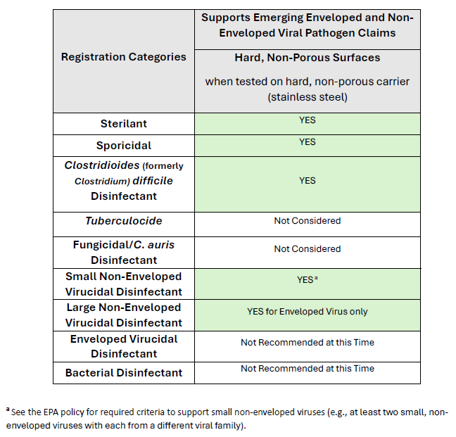
Viral
Proposed Revised Policy

Slide 15
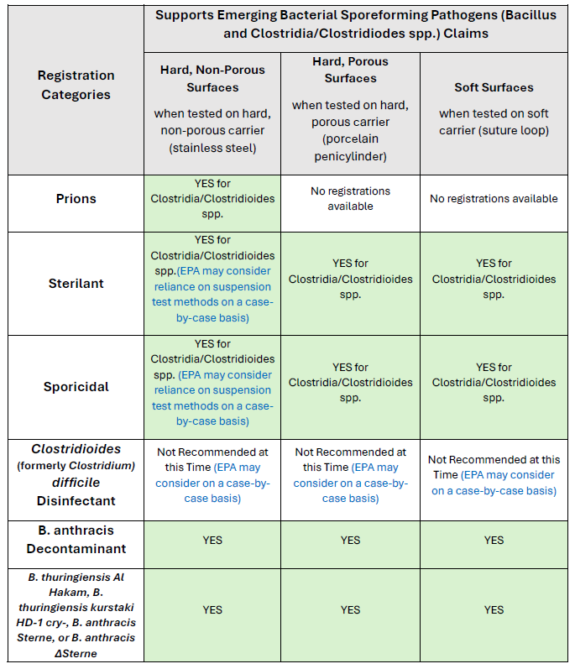
Bacterial Sporeformers
Proposed Revised Policy

Slide 16
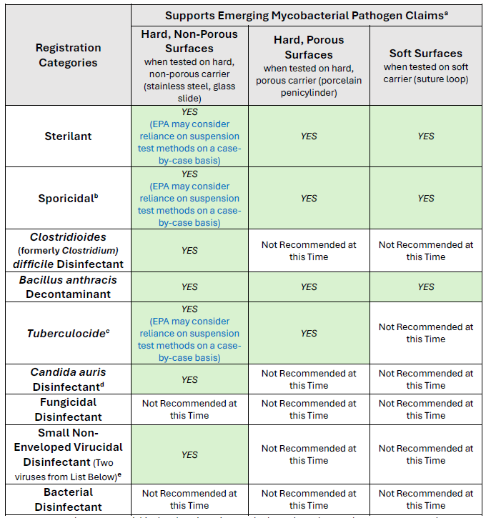
Mycobacteria
Proposed Revised Policy

Slide 17
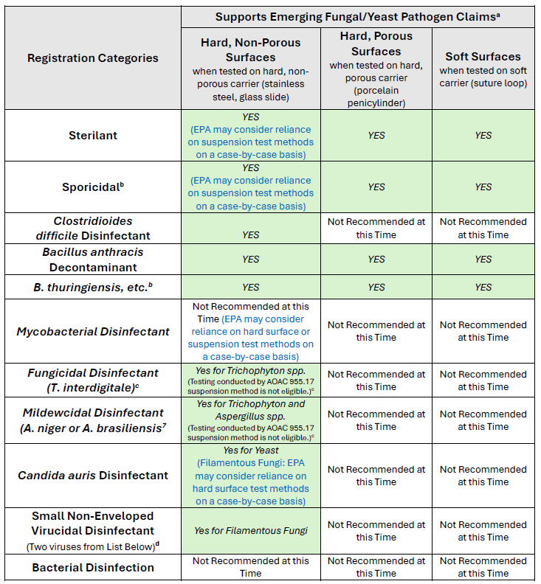
Fungi/Yeast
Proposed Revised Policy

Slide 18
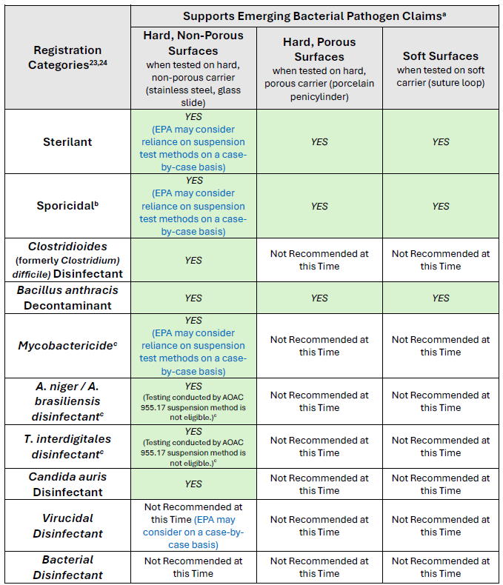
Bacteria
Proposed Revised Policy

Slide 19
What’s the next step for the Policies?
EPA will vet recommendations
1
EPA will post for public comment/ Interim Use
2
EPA will review public comments and publish a final policy
3

Slide 20
Technical Work Group Recommendations to PPDC
Recommendation 1: EPA should consider the PPDC Committee’s proposed revisions to the Emerging Viral Pathogen (“EVP”) Policy and publish an updated policy as quickly as possible to assure readiness for the next viral emerging pathogen. The revised EVP should be published for immediate implementation during the public comment period.
Recommendation 2: EPA should consider the PPDC Committee’s proposed drafts of Emerging Pathogen policies for Bacterial Sporeformers, Mycobacteria, Fungi/Yeast, and Bacteria Policy and publish policies as quickly as possible to assure readiness for the future emerging pathogens. These policies should be published as draft documents for public comment prior to implementation.
Recommendation 3: PPDC should request annual updates from EPA on the progress in developing, reviewing, and publishing all 5 Emerging Pathogen Policies.
Recommendation 4: EPA should create a process to periodically reassess the published emerging pathogen policies to assimilate or make changes based on new research and experience with emerging pathogens. This may include PPDC initiating future work groups similar to the current group to aid EPA in this endeavor.

Slide 21
PPDC EPIC Education and Communication Workgroup
Tajah Blackburn, USEPA, Lead
Alex Cook, First Group
Matt Arduino, CDC
Ellen Baldassare, LANXESS
Steve Bennett, HCPA
Jim Kim, ACI
Darius Stanton, ACI
Anastasia Swearingen, CBC
Rhonda Jones, SRC

Slide 22
EPWG Charge Question #3
What education is needed during a pandemic or other emergency for the public, end users, and other regulating authorities?
Issue: There was ineffective messaging across several sectors due to information and education gaps.
Response: Develop targeted resources and references for general and specialized messaging for key sectors at different stages of a pandemic/emergency gathered through planned outreach tools (surveys, etc.) and lessons learned.
Revenue by year

Slide 23
Recurring Gaps Across Different Sectors
Exposure Issues
Overuse
No Worker Protections Standard (WPS) Information for Antimicrobial Pesticides
Confusion/misinterpretations for the use of “disinfectants” and “sanitizers”
Language barriers
Dialect issues
Overall literacy challenges
Incompatibility issues with exposed surfaces

Slide 24
EPIC! Completed Spanish Translations For Certain Sections of EVP Guidance And Instructions For List Q Websites
(December 2023)
EPIC! Proposed Products/Locations (Infographics, Centralize Information, etc.)
(Incomplete)
Office of General Counsel (OGC) Assessment of Proposed Infographics
(Incomplete)
Education & Communication Work Group Updates

Slide 25
EPIC Education & Communications Work Group Recommendations
#1: EPA should partner with stakeholders to co-develop training materials to address antimicrobial education and communication gaps through infographics/pictograms.
#2: EPA should develop online training tools and modules for using EPA Lists.
#3: When developed, EPA should centralize the location of training tools expanding these tool into multiple languages.
#4: EPA should develop infographics/pictograms to better interpret Tier 1, 2, and 3 descriptions.
#5: EPA should provide additional context for users to assist with a better understanding of use surfaces.
#6: EPA should provide clear instructions and hyperlinks for sector centric use concerns.
#7: EPA should develop joint messaging with FDA where jurisdictional overlap may be confusing and challenging.
#4: EPA should consider expanding QR codes options for point-of-sale education and informed decision making.
EPA should expand translated resources.

Slide 26
Accomplishments
Landing Page: Emerging Viral Pathogen Guidance and Status for Antimicrobial Pesticide
Translated Documents
  Emerging Viral Pathogen Guidance and Status for Antimicrobial Pesticides
  Disinfectants for Emerging Viral Pathogens (EVPs): List Q
Proposed Revisions to EVP (Will be implemented FY2025)
Proposed Projects for external assistance with EPA process efficiencies after EPIC sunset
Technical Documents
  Several proposed emerging pathogen resources for bacterial spore formers, Mycobacterium species, Filamentous fungi and yeasts, and vegetative bacteria
  Multiple proposed recommendations for future changes to test methods, required test strains, test carriers, test conditions, etc.

Slide 27
PPDC Vote
Motion 1: We request that PPDC vote on submitting our final report to EPA OPP for their consideration
Motion 2: We request PPDC vote to sunset the Emerging Pathogen Implementation Committee (EPIC)
Revenue by year

Slide 28
Thanks!

