Slide 1
ESA Outreach and Education Update
Anne Overstreet November14, 2024

Slide 2
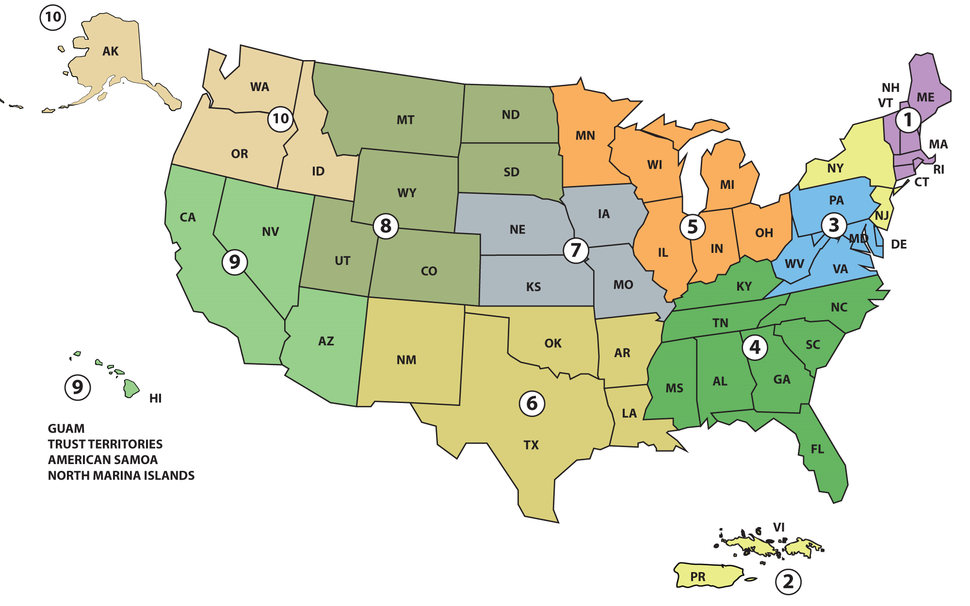
ESA Outreach Workgroup
Includes members from PRD, RD, BEAD, EFED, OECA, OPS and Regions
Currently focusing on a “train the trainer” approach, with goal of getting outreach and education materials to pesticide applicators and growers
Regions are participating in efforts within their Regions (e.g., giving presentations, participating in workshops, etc.)

Slide 3
Coordination Efforts
OPP meetings with AAPCO/SFIREG, AAPSE, TPPC, WSSA, USDA OPMP, Compliance Services International, CLA, ARA, CDPA, others
Regions reached out to state SLAs/PSEPs and tribes
Also coordinating internally with different strategy teams; development of tools, etc.

Slide 4
Outreach Feedback - Highlights
Training Need or Request
EPA needs to establish an authoritative source of information – i.e., website
Why is mitigation suddenly necessary, big picture on ESA and pesticides, and consultation process.
Timeline for implementation
Walkthrough on each strategy – handouts, fact sheets, checklist, videos
Walk through mitigation measures, simplified flowchart, instruction key, etc. on how to implement mitigation requirements (how to add up points).
Trainings on runoff/erosion mitigation, spray drift
Additional training on BLT - BLT brochure/handouts – could include how to access, use and print bulletins, etc.
Notifications – email blasts, social media, newsletters, Listserv
Definitions of terms
Short videos for training (variety of topics, including different scenarios, BLT, how credits work, strategies, mitigation measures)
Technical manual/resource how to do mitigation measures in Bulletins
Attend workshops, meetings

Slide 5
Other Considerations
Limited EPA resources for outreach and education efforts
Need to be strategic
- Top 2-3 priority items?
Opportunities to get involved: interested in collaboration, feedback
Develop resources as EPA’s ESA work, such as the Herbicide Strategy, is finalized

Slide 6
Initial EPA Priorities Based on Feedback and Available Resources
Establishing a source of information, e.g., webpage
Provide initial information/materials for meetings, training, etc.
Continuing to connect with partners and stakeholders to adjust our priorities based on needs

Slide 7
Pesticides and Endangered Species Educational Resources Toolbox
Catalogs educational resources including guidance documents, handouts, presentations, informational webinars, and other resources
Sortable and searchable
Will continue adding new materials to the toolbox as they are developed.
Available at: https://www.epa.gov/endangered-species/pesticides-and-endangered-species-educational-resources-toolbox

Slide 8
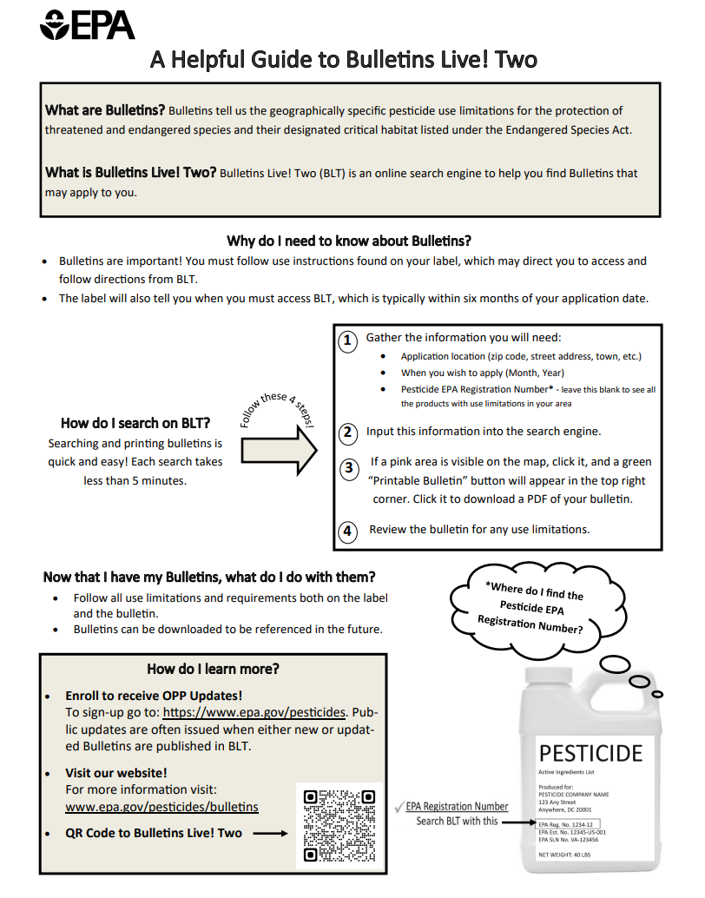
Bulletins Live! Two Flyer
One-pager
Includes the following topics:
What are Bulletins
What is Bulletins Live! Two
Why need to know about Bulletins
How to search on BLT
How to find a product registration number
What to do with Bulletins
How to learn more
QR code to Bulletins Live! Two
https://www.epa.gov/system/files/documents/2024-10/blt-flyer_2024.09.24.pdf

Slide 9
Mitigation Menu Update
Updated on October 16, 2024
A table describing the number of runoff/erosion points for each mitigation measure
Updated mitigation measure descriptions with photos
Runoff/erosion calculator and user guide
Links to the Crosswalk to EPA’s Ecological Mitigation Measures with USDA NRCS Conservation Practices in Support of EPA’s Endangered Species Strategies
https://www.epa.gov/pesticides/mitigation-menu

Slide 10
Runoff Calculator
EPA provides this calculator for informational purposes to assist the user in determining whether the necessary level of mitigation has been met before applying a pesticide product. Certain mitigation may be required through labeling that directs users to access the mitigation menu website and achieve a certain number of mitigation points. The calculator may also be used as a mitigation tracker. In the worksheet below: - select from the drop down box or enter value in all cells highlighted in orange (note: a drop down box will show when the user clicks on the relevant cell). Results for the field/management unit are provided in Green shaded cells - if additional mitigation may be necessary, results for the pesticide application mitigations and the field/managment unit points are provided in Blue shaded cells. These two sources of mitigation points are summarized to provide the total mitigation points for the field/management unit and the pesticide product application mitigations. - click on the Mitigation Measure Title (bolded) to go directly to the mitigation measure description on EPA's Mitigation Menu Website. - to duplicate this worksheet for an additional field(s)/management unit(s) use the button "Create New Worksheet for Another Field/Management Unit" - to clear all user inputs on this worksheet use the button "Clear all user inputs". CAUTION: This calculator will allow the user to input mitigation measures that are logically incompatible (e.g., no till and reservior till). Users are responsible for ensuring that the mitigation measures they input are possible and represent the management used on their field/management unit.
General Field/Management Unit Information (Optional Information- Does not Impact Calculation)
Name:
Date:
Field/Management Unit Identification:
Other Landscape Considerations
Category | Select Value | Number of points
Mitigation Relief if the Area at Least 1000 Feet Down-Gradient from the Treated Farm/Field Contains Only Managed Areas. Managed areas are defined as: a. Agricultural fields, including untreated portions of the treated field, b. Roads, paved or gravel surfaces, mowed grassy areas adjacent to field, and areas of bare ground from recent plowing or grading that are contiguous with the treated area; c. Buildings and their perimeters, silos, or other man-made structures with walls and/or roof; d. Areas maintained as a mitigation measure for runoff/erosion or spray drift control, such as vegetative filter strips (VFS), field borders, hedgerows, Conservation Reserve Program lands (CRP), and other measures on EPA’s Mitigation Menu Website; e. Managed wetlands including constructed wetlands on the farm, and f. On-farm contained irrigation water resources that are not connected to adjacent water bodies, including on-farm irrigation canals and ditches, water conveyances, managed irrigation/runoff retention basins, and tailwater collection ponds. | make selection | Continue Calculating Mitigation Points
Systems that Capture Runoff and Discharge
Category | Select Value | Number of points
Systems that Capture Runoff and Discharge (water retention pond, sediment control basin, irrigation tailwater return system, perimeter berm system (present at the time of application and throughout the cropping season), subsurface or tile drainage with a controlled outlet or without a controlled outlet) | make selection | 0
Pesticide Runoff Vulnerability
Select State | Select County | Number of points
make selection | make selection | Select state then county from dropdown menus to the left
Downloadable Excel file
Links to mitigation measure descriptions
Can create tabs for multiple fields
Working on a static, worksheet version

Slide 11
Questions?

