Slide 1
Introduction to the Toxics Release Inventory and How Companies Manage Chemical Waste

Slide 2
Learning Objectives
During this presentation, you will learn about:
What the Toxics Release Inventory (TRI) is and why it’s important.
What basic information companies report to the TRI Program.
What are chemical releases?
How do companies manage chemical waste?
How do companies prevent chemical pollution?
How TRI data and information can be used.
How to access TRI data specific to where you live.

Slide 3
Introduction
Chemicals are used to make everyday products, like clothes, tires, and electronics. Some of these chemicals can harm people and the environment.
When the chemicals are no longer useful, they become waste.
The companies that make the products decide what to do with the chemical waste, but they must follow all environmental laws.
Companies are required to tell EPA how much of certain chemicals they use and how they manage the waste.
3
Notes:
Instructor Notes:

Slide 4
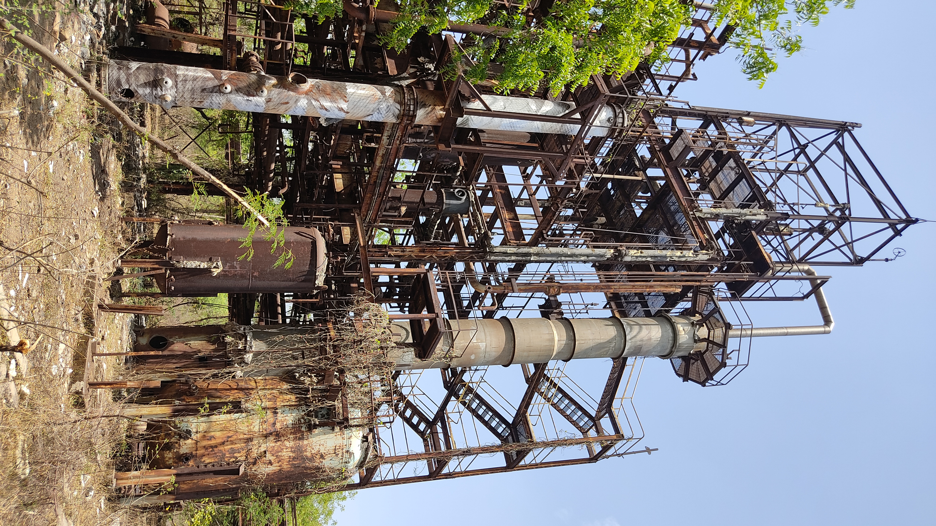
Why was the Toxics Release Inventory (TRI) created?
In the early 1980s, many people in the U.S. were worried about the safety of workers handling chemicals and whether local governments and community members had enough information to prepare for potential chemical accidents.
Two major incidents increased this concern.
Bhopal, India December 1984
An accidental release of methyl isocyanate gas—a highly toxic, flammable gas—occurred at a chemical plant.
Thousands of people died the first night and many others later due to long-term health effects.
Institute, West Virginia August 1985
A chemical release at a smaller scale occurred at a chemical plant facility.
Over 100 people hospitalized.
Congress passed the Emergency Planning and Community Right-to-Know Act (EPCRA) in 1986 as part of the U.S. response to these incidents, creating the TRI.
Abandoned plant in Bhopal, India
4

Slide 5
It’s Everyone’s “Right to Know”
Because of EPCRA, we have the right to know about the chemicals companies use in our communities.
Companies must tell EPA what chemicals they use and what they do with their chemical waste. EPA must make the information available to the public in the Toxics Release Inventory.
People can use the TRI to learn about potential impacts to their health and the environment.

Slide 6
What is the Toxics Release Inventory?
A public database created for people to access information about the toxic chemicals used by companies in and near their communities, including:
What chemicals companies use;
How much of each chemical is released into the environment or managed using other methods;
How companies prevent chemical pollution.
35+ years of data from over 64,000 companies.
6

Slide 7
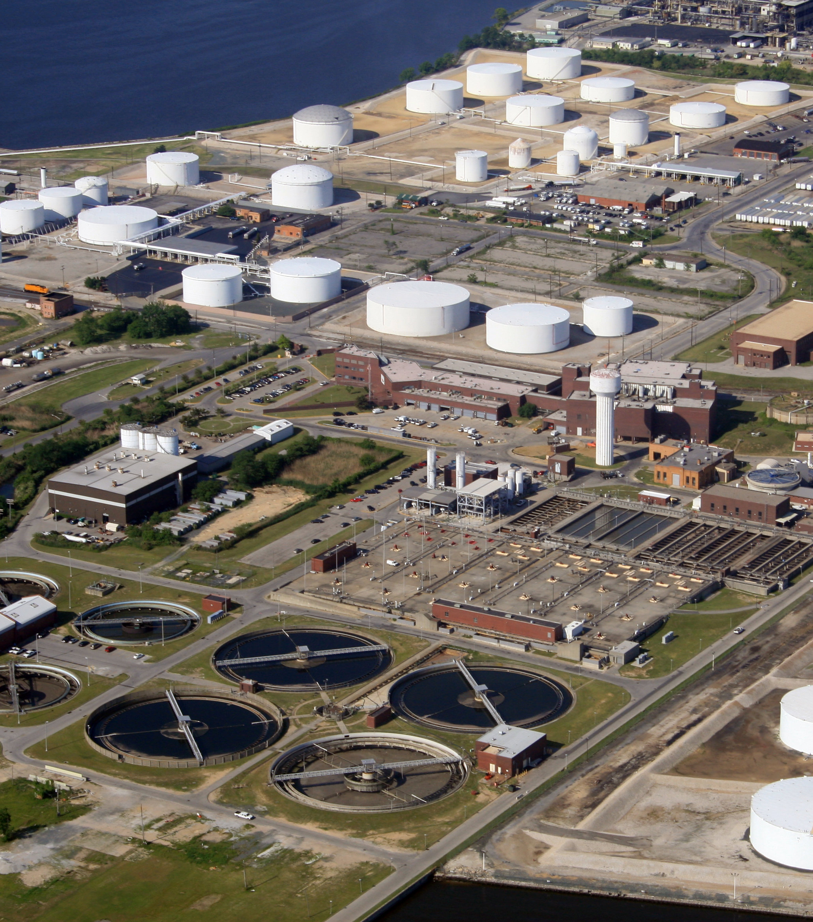
Who reports to the TRI?
Certain industrial and federal facilities that use toxic chemicals must report to the TRI.
Industrial facilities are places owned by companies where chemicals are produced or used, such as factories, mines, and power plants.
Federal facilities are places owned or managed by the U.S. government.
EPA has a list of more than 800 chemicals, called the “TRI chemical list.” If a facility uses a certain amount of one of the chemicals on this list, they must report to the TRI Program.
7

Slide 8
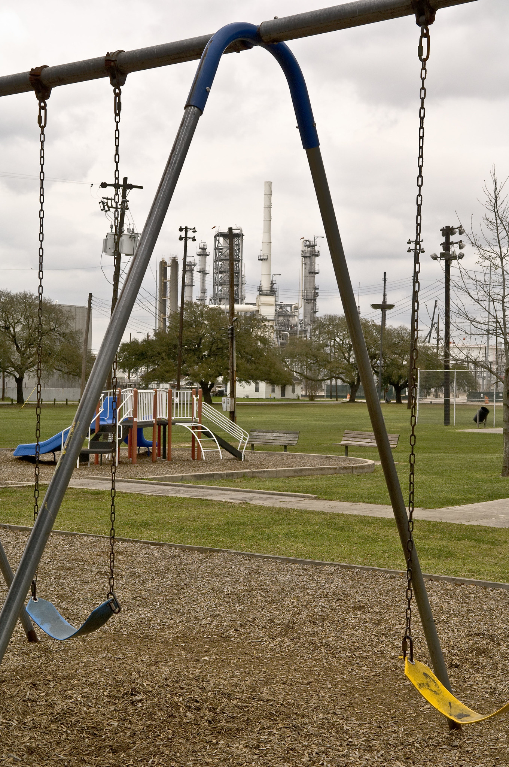
Why is the TRI important?
A central hub for information about industrial activities in your community:
Environmental releases of toxic chemicals.
Pollution prevention activities.
Encourages companies to reduce their chemical pollution.
Shows how toxic chemical releases change over time.
Can help you start a conversation about your community’s environmental health with:
People in your neighborhood;
Managers of local industrial facilities;
Elected officials;
Local, state, and federal government agencies;
Researchers and scientists.
8

Slide 9
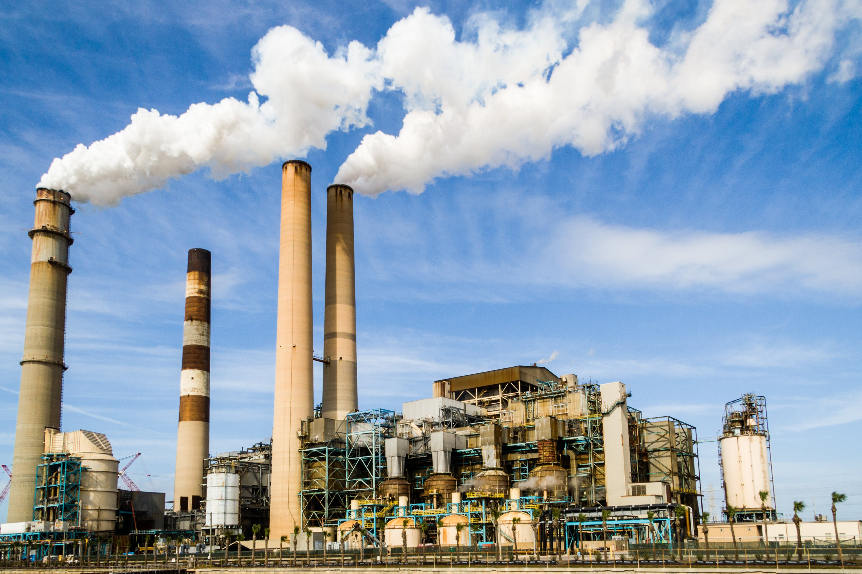
What are chemical releases?
The TRI tracks chemical releases at industrial facilities across the U.S.
A release happens when toxic chemicals enter the air, water, and land.
Examples include spilling, leaking, pouring, dumping, or disposing into the environment.
Releases can come from “point” and “non-point” sources.
Point source: A single, identifiable spot like a factory smokestack or the end of a pipe.
Non-point source: A broader area or multiple spots.
Examples of releases from non-point sources:
Chemicals on a field get washed into a nearby stream when it rains.
Leaking equipment lets chemicals into the air.
9

Slide 10
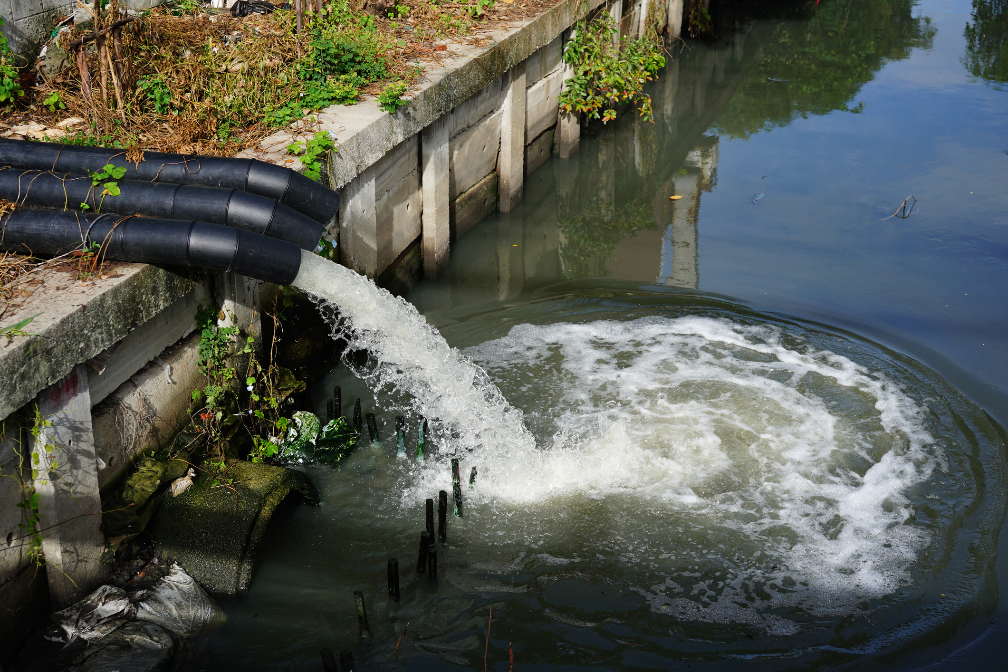
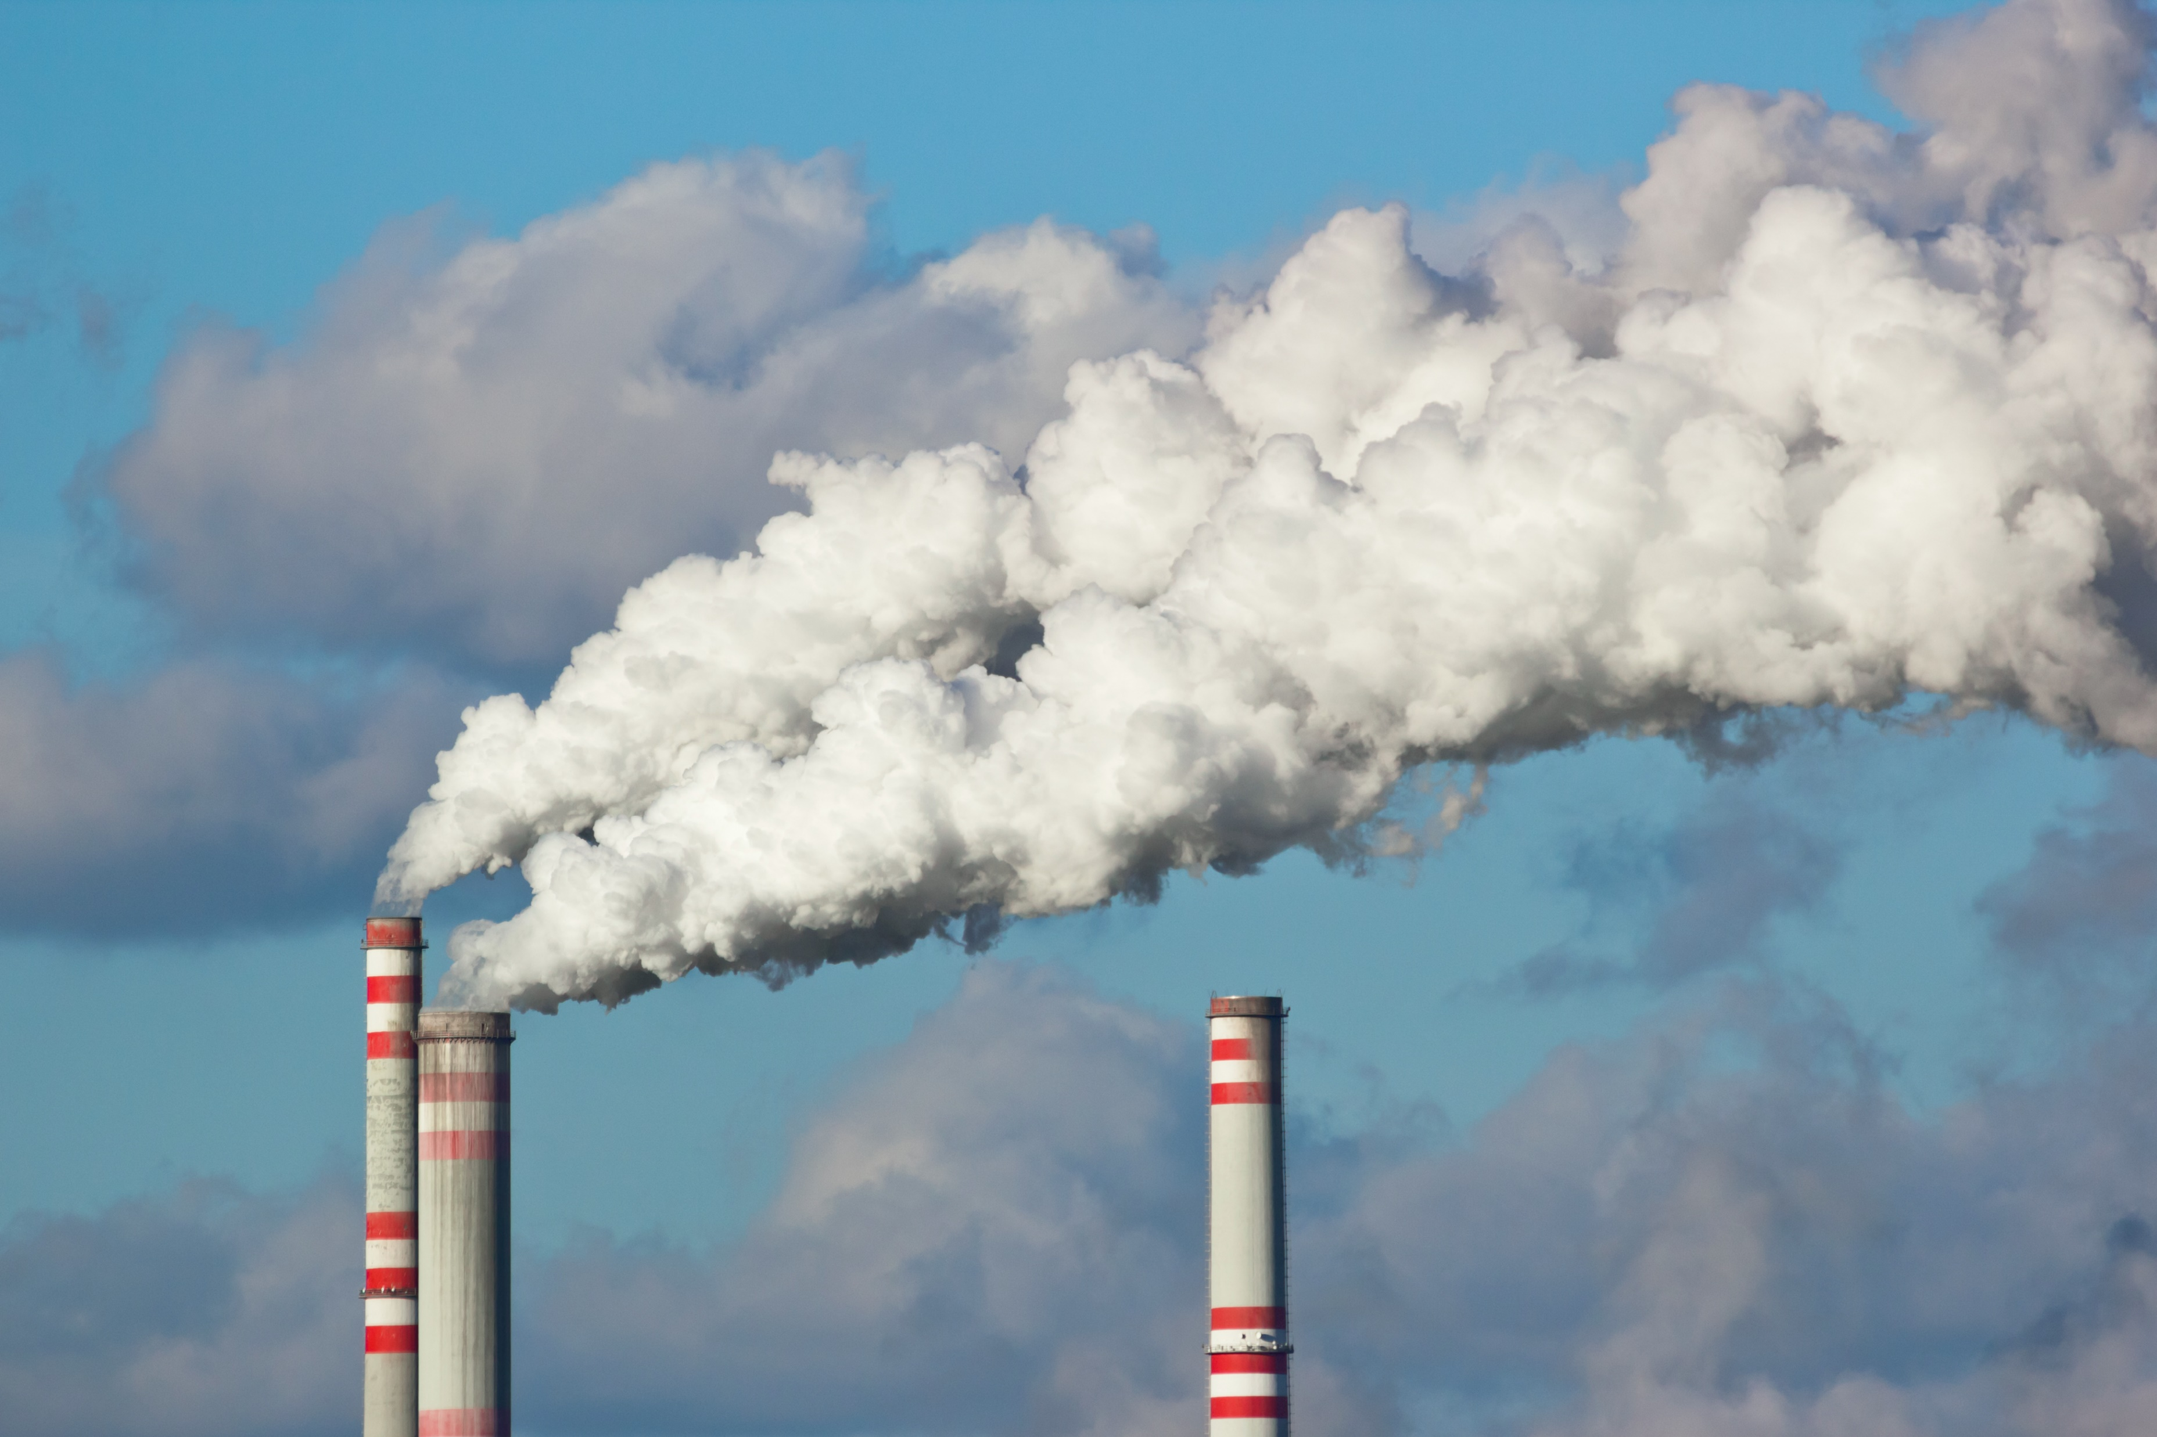
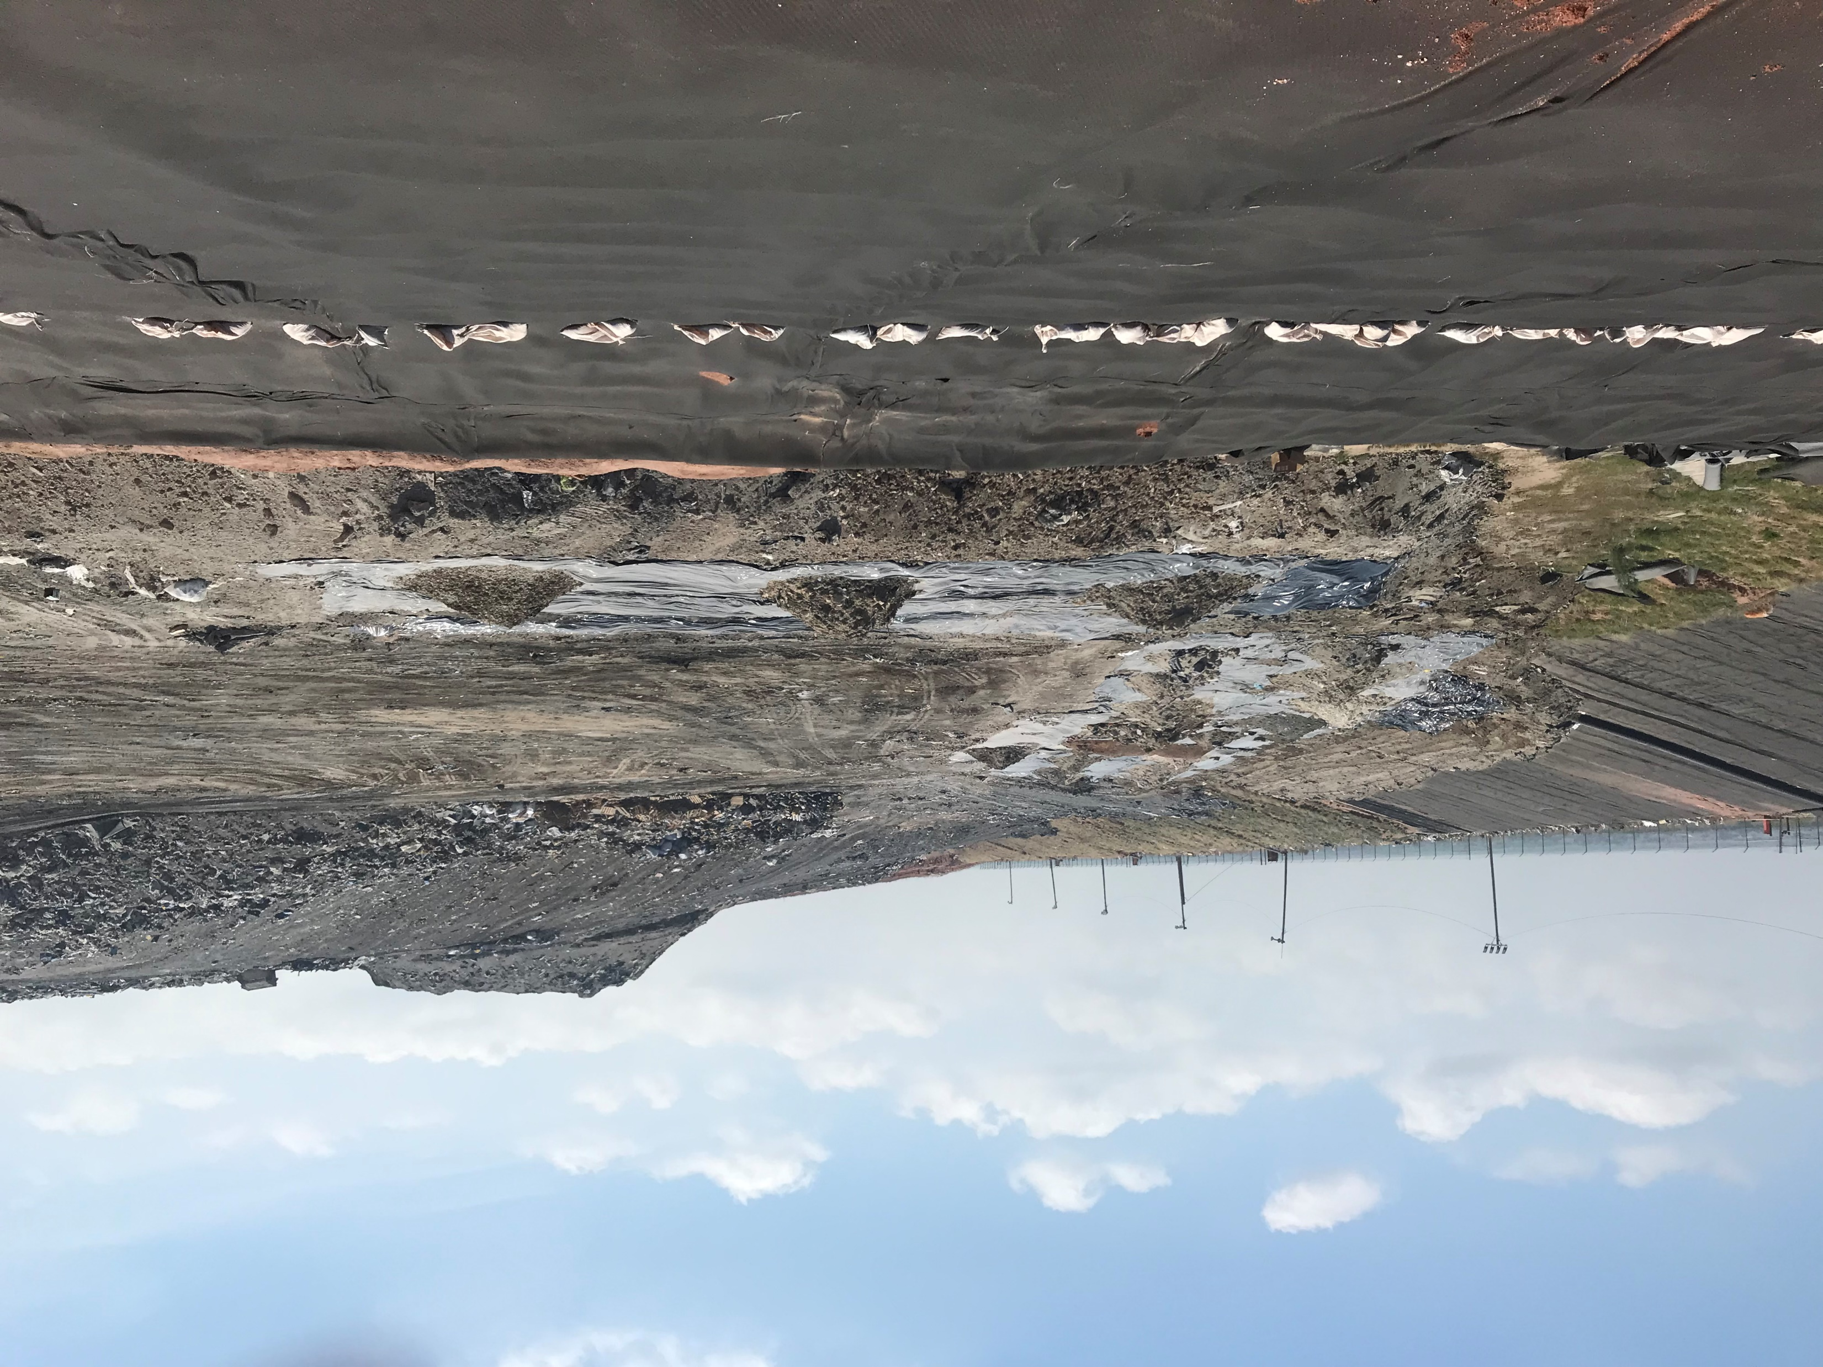
Types of releases
On-Site Releases: Chemicals that enter the environment at the facility.
Facilities report to the TRI how much of each chemical is released each year and if it went to the air, water, or land.
When chemicals get into the wind, rivers or groundwater, they can travel to other locations farther away from the facility that released them.
Off-Site Releases: Chemicals sent to another facility for disposal.
Facilities report:
Where they sent the waste;
How much of each chemical was in the waste;
What happened to the waste at the new facility.
10

Slide 11
What do companies do with chemical waste?
Companies decide how to manage chemical waste based on how much there is, the types of chemicals in the waste, and the type of equipment available at the facility.
Waste Management Options
Recycling | Energy Recovery | Treatment | Disposal or Release
Some of or all the chemicals in the waste are removed and used again. | The chemical waste is burned in a furnace or boiler to produce energy. | The waste is put into special equipment to be destroyed or changed into chemicals that are less harmful. | The waste that is left after facilities use the first three methods is released into the environment or disposed of.
11
Notes:
Instructor Notes:

Slide 12
Do companies try to prevent pollution?
Companies take action to prevent or reduce the creation of chemical pollution.
Producing less pollution can:
Improve the health of people who live and work near industrial facilities;
Keep workers safer;
Save companies money.
Facilities report how they reduce pollution to the TRI.
The methods are known as “pollution prevention” or “source reduction.”
12

Slide 13
How are TRI data used?
TRI data are widely used by individuals and organizations. Examples include:
Ranking air and water polluters: Researchers and scientists at the University of Massachusetts-Amherst use TRI data to create the annual Toxic 100 Air Polluters Index, Toxic 100 Water Polluters Index, and Air Toxics at School Database.
Learning about pollution prevention methods: Highschool students in Louisville used TRI data to find out how a local poultry products factory prevents water releases of ammonia.
Informing community action: Community activists in Seadrift, Texas used TRI data to identify companies releasing toxic chemicals into local waterways. Residents encouraged these companies to reduce pollution that impacted their health and the local economy.
13

Slide 14
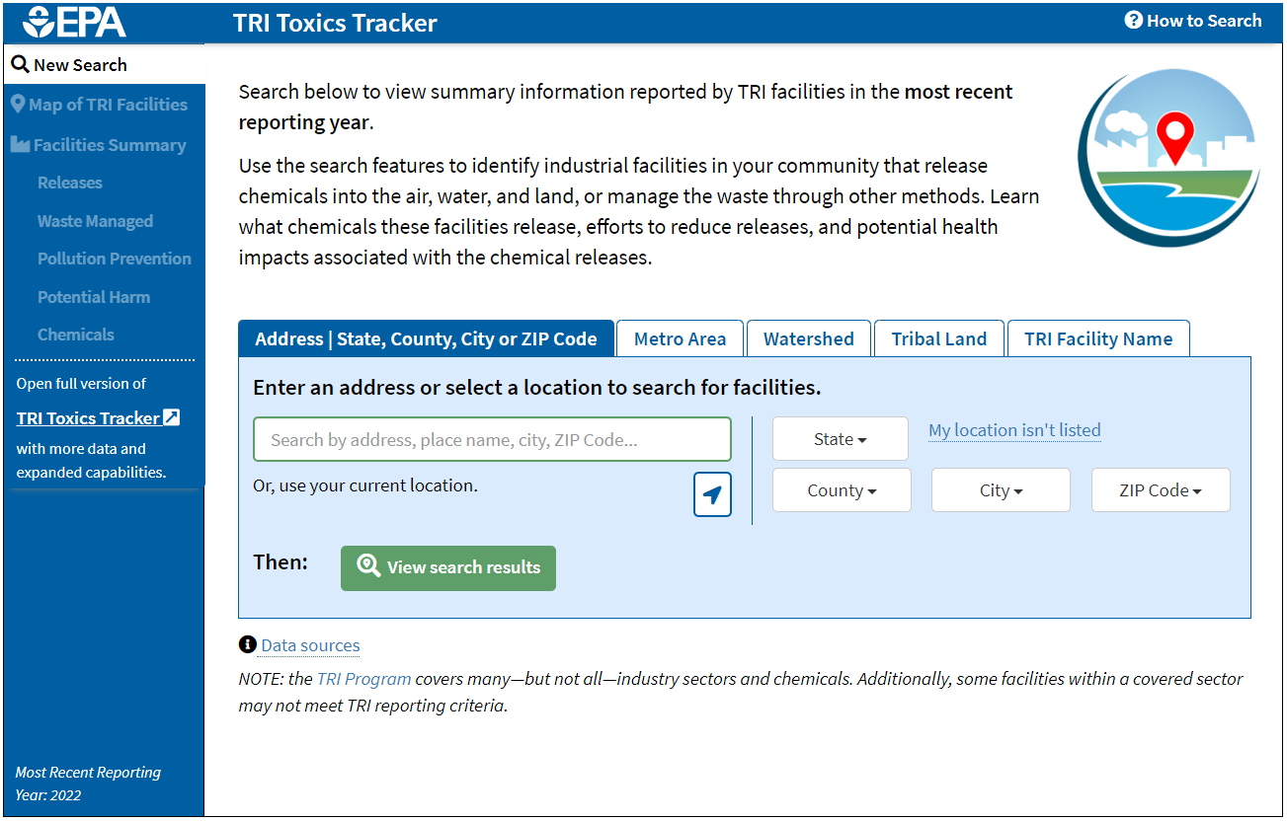
Getting TRI data and information
The online TRI Toxics Tracker tool is an easy way to find TRI data.
You can search for companies near a specific address or use your current location.
Company locations will be displayed on a map, with options for viewing their reported data available using the side navigation bar.
Access the TRI Toxics Tracker at the bottom of the TRI homepage: www.epa.gov/tri
Snapshot of TRI Toxics Tracker on the TRI homepage
14

