Slide 1

Combined Air Emissions Reporting System (CAERS)
Welcome to CAERS for New
Preparers and Certifiers
12/16/2024
Notes:
On behalf of the US EPA, I’d like to welcome you to the Combined Air Emissions Reporting System or CAERS. This presentation will cover highlights of CAERS.

Slide 2
Note
Keep yourselves muted, type your questions in the chat box. We will pause at times to review incoming questions as we go.
A copy of this power point presentation, and the recording of the webinar will be available for distribution after the training on the CAERS website.

Slide 3
Goal of Training
Provide new CAERS users with an understanding of:
  What is CAERS?
  User Roles
  System Requirements
  TRI-bound HAPS Data
  Timing of Submissions
  Registration Process
  Highlights of CAERS Features
  Help and Resources

Slide 4
Disclaimers
This presentation is intended for instructional purposes only. Any data or facility information shown in the training, is for illustration purposes only, and does not constitute a facility’s actual live report for any given inventory year.
If possible, live demos for this training will be held in the CAERS test environment. Any material that cannot be presented today will be re-recorded and published on the CAERS website if necessary.

Slide 5
What is CAERS?
Combined Air Emissions Reporting System (CAERS) is an application that allows industry from subscribed State, Local, or Tribal authorities (or SLTs) to report their air emissions so you can:
Meet SLT-specific air emissions reporting requirements
Report annually or triennially to Air Emissions Reporting Rule (AERR per 40 Code of Federal Regulations or CFR, Part 51) via your SLT.
Optionally, get a head start on Toxics Release Inventory (TRI) air toxics emissions (per 40 CFR, Part 372), to be finished in TRI-MEweb
You should check with your SLT to determine if you meet the criteria for reporting.

Slide 6
System Requirements
To use CAERS, you will need:
A recent version of any internet browser such as Chrome, Explorer, Edge, or Firefox. Your internet connectivity and facility report size will determine how fast the system will respond.
Microsoft Excel: Bulk uploads will be in “XLSX”.
Reporters now also have the option to upload reports in JSON.
A login.gov account.

Slide 7
CAER User Roles - Preparer
Authorized to prepare an emissions report for that facility (e.g., consultant, staff person working for the facility).
May have more than one preparer per facility (each with your own account, each account associated to the facility). If submitting HAPs data for TRI within CAERS, this could include the TRI preparer.
May have a single preparer for more than one facility (with your individual account associated with several facilities).
Cannot certify and submit the report on behalf of the facility.

Slide 8
CAERS User Roles - Certifier
Can prepare the emissions report and is also authorized to certify the emissions report to meet your legal obligation for reporting to your SLT.
May have only one Certifier for a facility.
May have a single Certifier for more than one facility (multiple facilities associated with the certifier account).
May also be the preparer (if so, only one NEI Certifier CAERS account needed).
Total toxics air emissions are made available for TRI-MEweb once the facility has certified the report in CAERS. Certification of the report signals to CAERS that the report is complete, but it is not a certification of the TRI submission. Toxics air data is certified in TRI-MEweb, not CAERS.

Slide 9
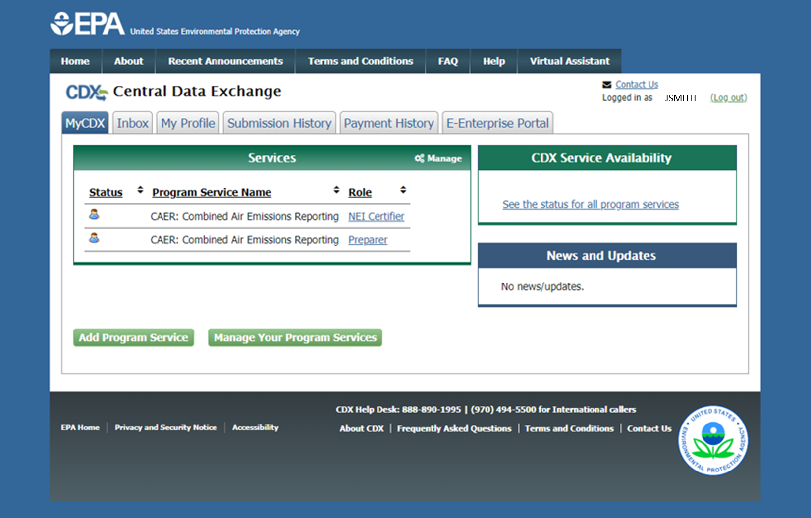
Preparer and NEI Certifier in MyCDX Page
When you go into your “My CDX” page, you will see your role listed next to your CAERS account.
Remember if you are both a Preparer and NEI Certifier for a given facility, you only need the NEI Certifier account.

Slide 10
TRI – bound HAPs Data
If your SLT requires HAPs to be reported as part of your emissions inventory report, and/or your facility reports to TRI, this feature can help reporters save reporting time and be clear on the reported data in case there are questions.
CAERS aggregates shared HAP pollutant data to facility totals (stack and fugitive type releases) and makes it ready for pre-population in TRI-MEweb.
How does this help facilities?
Enter data into CAERS directly vs. separate workbooks for calculations of totals to then be entered to TRI-MEweb.
SLT review of your criteria pollutant data before your data gets to TRI-MEweb gives you the opportunity to correct any related toxics data before it is available in TRI-MEweb.
  E.g., SLT finds throughput error for a unit/process affecting CO and NOX, that is also affecting your VOC calculations. As you correct that throughput, all affected emissions are corrected.
We encourage facilities to submit HAPS data at process level in CAERS.
  If HAPS aren’t reported, EPA does HAP augmentation on your data which could be inaccurate.
  By submitting their own HAPs emissions at process level in CAERS, facilities take ownership of their data.
  Reach out and coordinate with the TRI reporter for your facility so data is consistently reported to both programs (NEI and TRI).

Slide 11
Timing of Submissions
TRI-MEweb submission deadline is July 1st
  NEI/TRI facilities should certify their NEI forms before you start a TRI-MEweb submission because data is pushed from CAERS to TRI-MEweb.
  Early data submittal and SLT review allows us to keep data consistent across NEI and TRI programs.
To your SLT submission deadline date, factor in:
  Leave time for questions and resolution of issues and in case we need to address bugs.
  Leave time for the SLT to review and issue corrections so any updated reports are certified and submitted before July 1st.
Registration: Include or delete registered Preparers and Certifiers no later than two weeks after opening CAERS for 2024 Inventory Year (IY) Reporting on January 6th, 2025, or as determined by your SLT.
Reporting: Start no later than one month before and submit no less than 2 weeks before the SLT deadline.
We want to avoid last minute submissions. Submit your data early!

Slide 12
Registration Process
Three major steps:
Establish reporting requirements and reporting roles (especially Certifiers) with your SLT. Each SLT has their own process.
a) Register in CDX, if you are a new user or
  b) Migrate to login.gov and set up CAERS in CDX (if you haven’t previously reported through CAERS).
3. Request access to your facility in CAERS.
Notes:
Next, we’ll go over each one of these steps in more detail.

Slide 13
1. Establish Preparer/Certifier Roles
Each SLT has its own process with its reporting facilities to establish who is preparer/certifier. If you have not heard from your SLT about this already, or if you are new and missed the relevant communication from them, you should reach out to them directly (see the POC information listed at the end of this presentation). Don’t try to register in CDX until you’ve communicated with your SLT, to avoid further delays or unnecessary steps.
What if I don’t know who will certify yet? You will be able to begin the report, but you won’t be able to send it to your SLT for review. As soon as you know who your certifier will be, let your SLT know, and then the new certifier should go to CDX to register and can then certify and submit the report.
What if our preparer or certifier leaves the company? Let your SLT know of the staff change as soon as possible. The new staff person should register in CDX and CAERS per this presentation. The departing staff person should remove their association with the facility in CAERS, and remove their CDX account if they will no longer need it. The SLT will remove the previous preparer/certifier in CAERS if the old preparer/certifier has not been removed within a reasonable amount of time.

Slide 14
2. a) Register in CDX as a New User
If you already have a CDX account you may skip to 2 b).

Slide 15
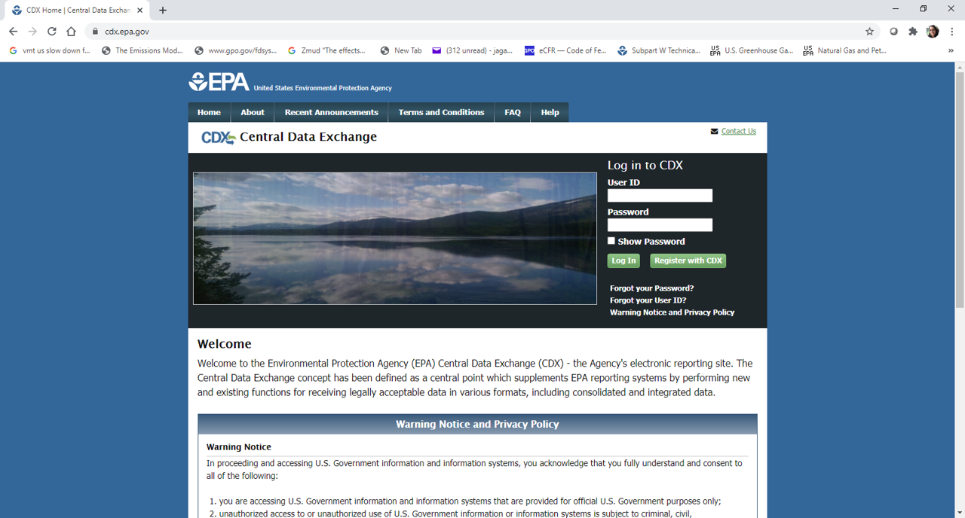
CDX Login Page
Enter the URL “https://cdx.epa.gov/” in your preferred web browser. This will bring you to the CDX login screen where you will click the “Register with CDX” button.

Slide 16
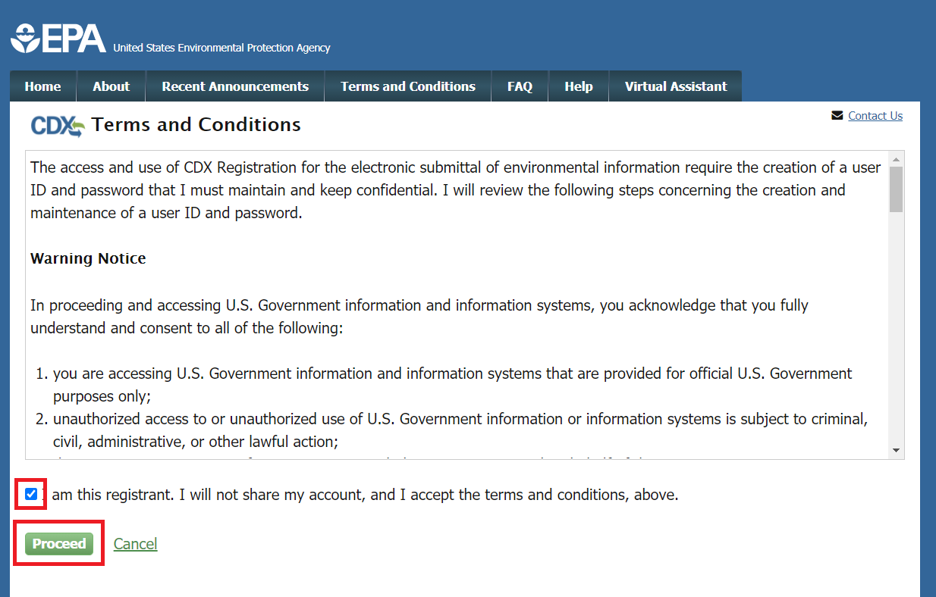
CDX Terms and Conditions
You will be directed to the Terms and Conditions screen for CDX registration. After reading these, check the box confirming that you are the registrant and click “Proceed” at the bottom left of your screen.

Slide 17
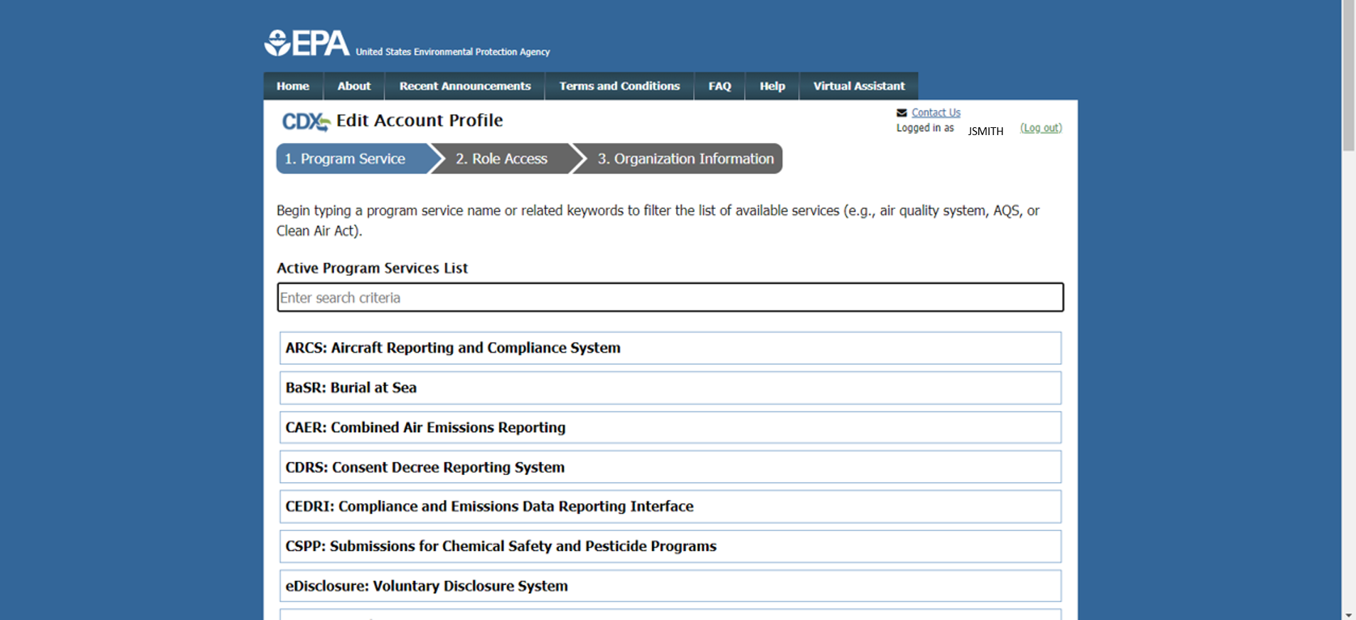
CDX CAERS Program Service Selection
You will be directed to a list of EPA Systems. Find “CAER: combined Air Emissions Reporting” in that list and click on it.

Slide 18
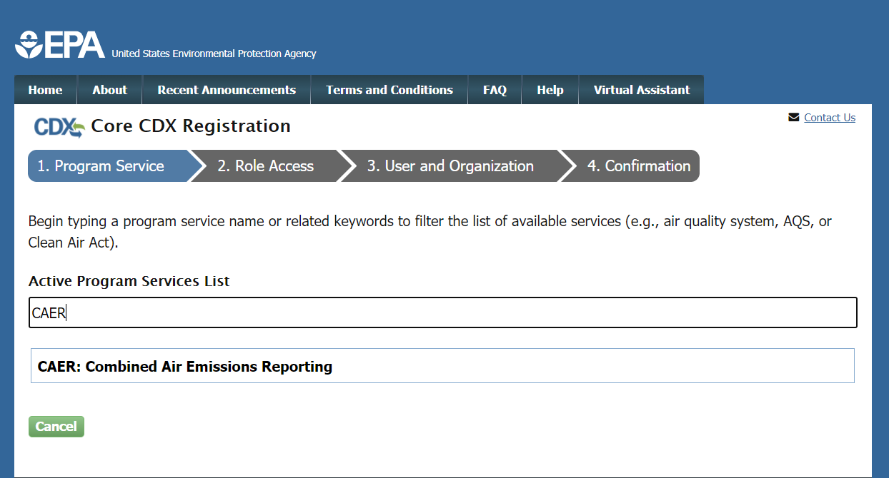
CDX Program Service Search
Or you can search for “CAER” in the Active Program Services List field. This will filter the list to only include “CAER: Combined Air Emissions Reporting”. Select “CAER” from the list.

Slide 19
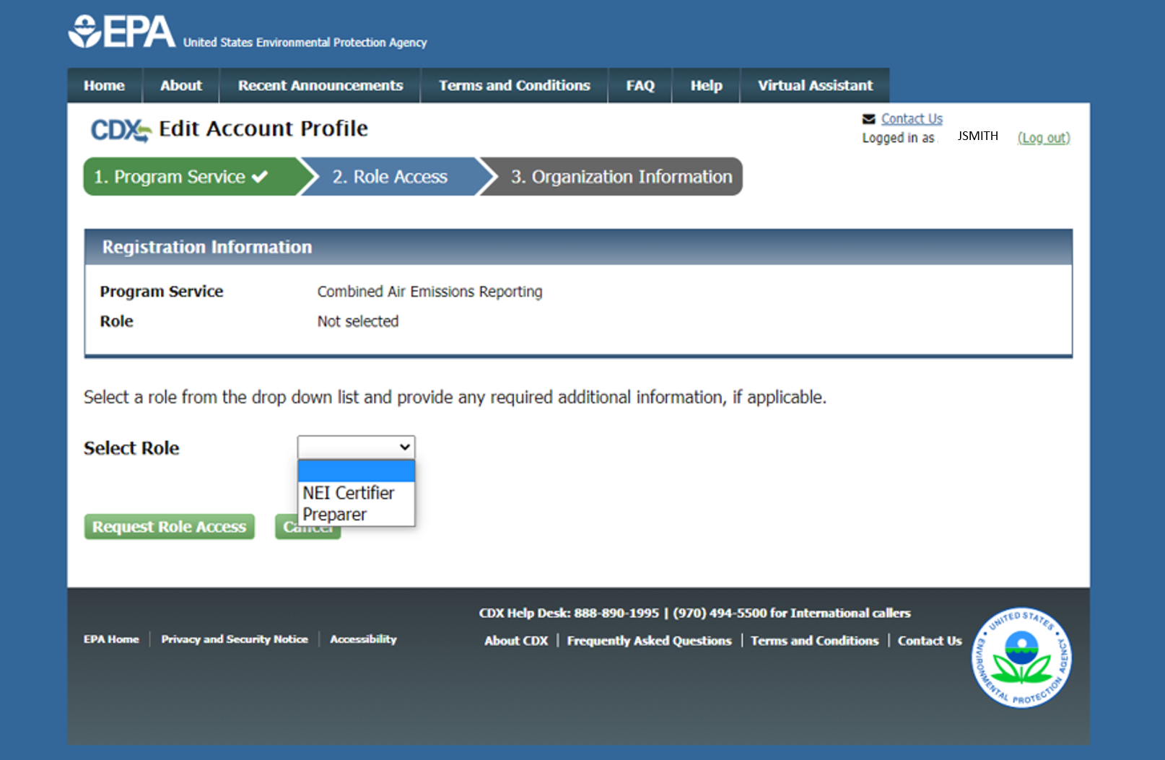
CDX Selecting a Role
If you are both preparer and certifier for a facility, you only need to select “Certifier”.

Slide 20
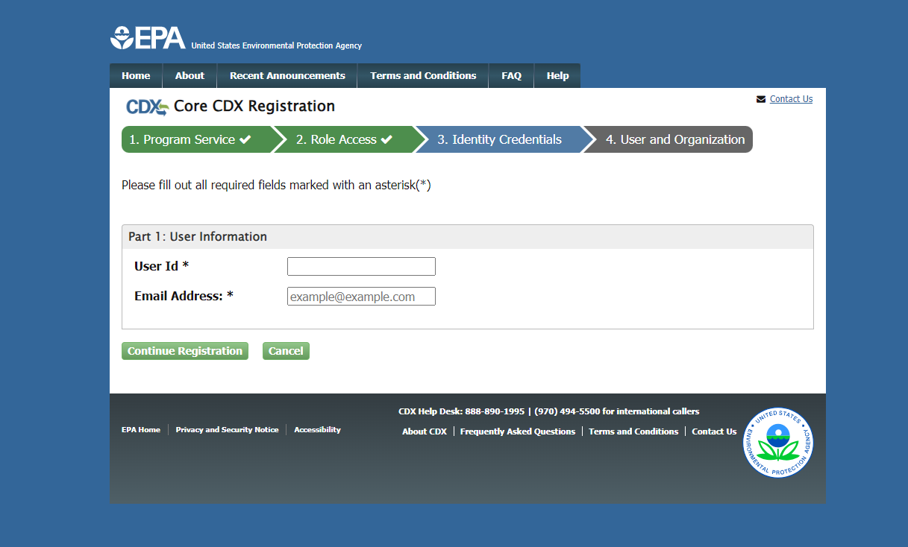
Select Username and Enter Email

Slide 21
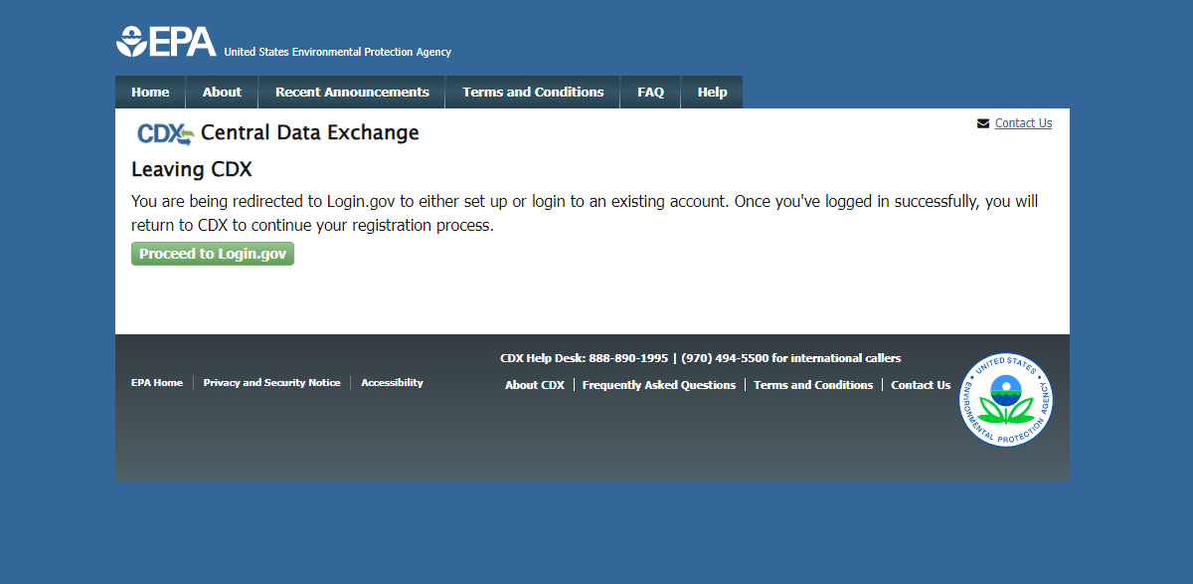
Redirect to Register in Login.gov

Slide 22
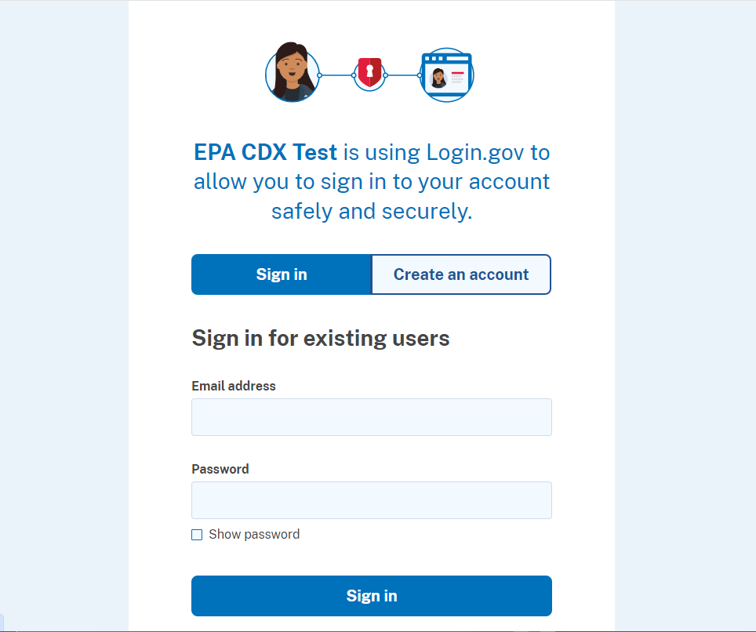
Create Account in Login.gov

Slide 23
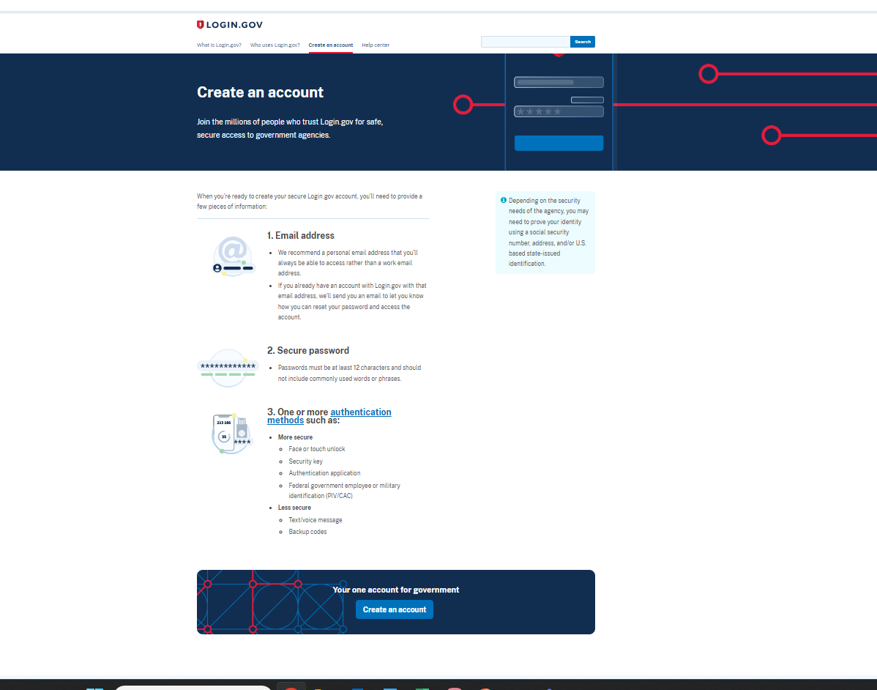
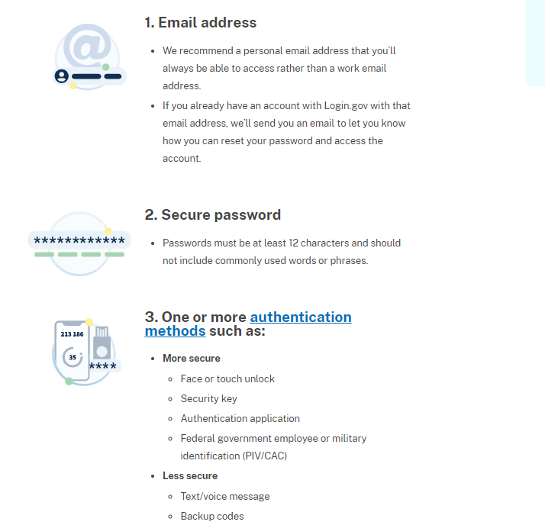
Requirements for Login.gov Account

Slide 24
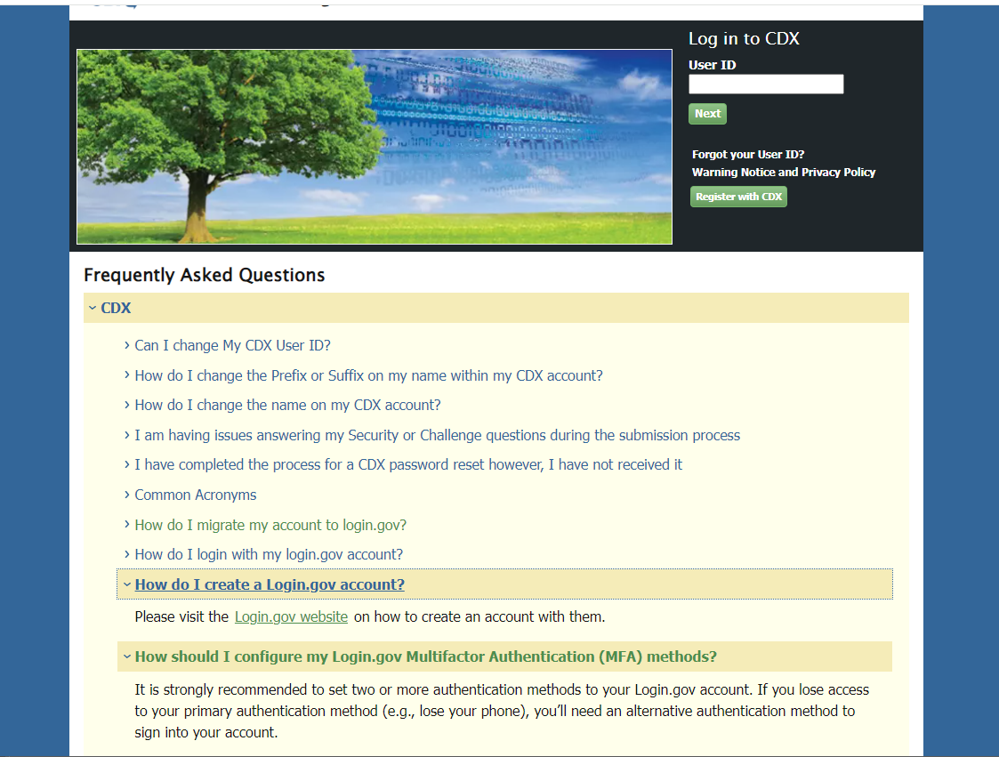
CDX and Login.gov
The CDX registration process are the same, after registering, it will go to login.gov to create a new account or connect to an existing account. It is not necessary to make the login.gov account first and separately from the CDX registration.
Scroll down to the FAQs on the CDX main page.
Here are the important EPA FAQ about the new migration/ login.gov process that these FAQs will take you to:
https://cdx.epa.gov/FAQ#CDXQ9
https://cdx.epa.gov/FAQ#CDXQ10
https://cdx.epa.gov/FAQ#CDXQ11

Slide 25
2. b) Add CAERS to an Existing CDX Account
If you have already used CDX in the past e.g. to report to CEDRI, you will log in, follow the prompts, and add CAERS to your account.
If you have not used CDX since the migration to Login.gov (Summer 2024), you will login to CDX as normal and then follow the prompts that will help you relate your CDX account to your Login.gov account.

Slide 26
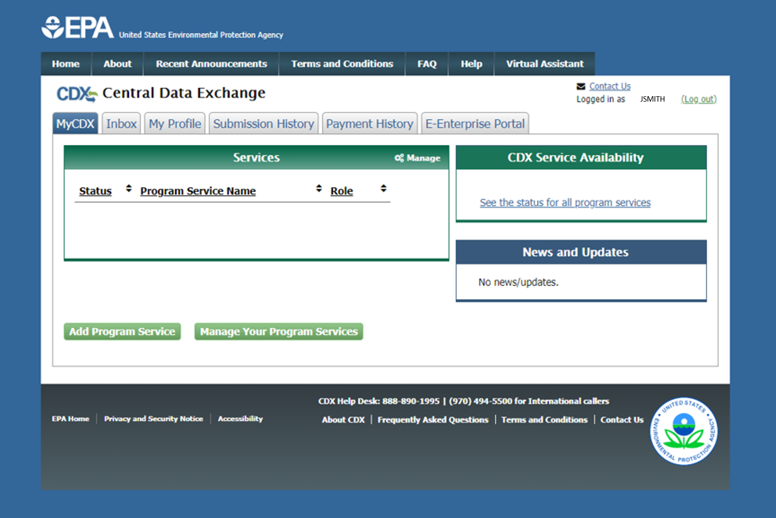
CDX Adding a Program Service
Already have a CDX account? Add CAERS by clicking here.

Slide 27
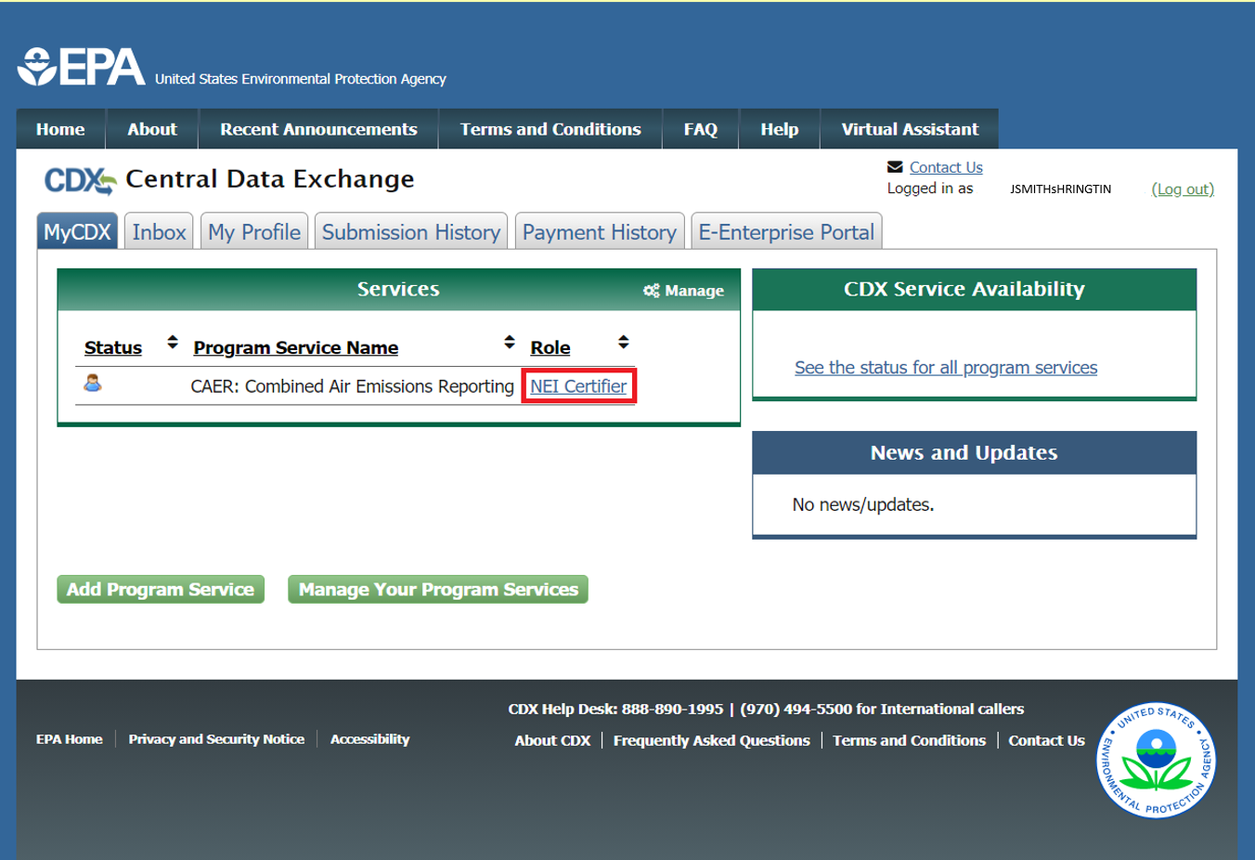
MyCDX Page After Registration

Slide 28

Help in CDX

Slide 29
3. Receive Approval Notification from CAERS
With the previous steps completed your SLT will:
  Verify that your preparer and certifier contact information.
  Approve your association with the correct facility(ies) in CAERS.
  Send you a confirmation email – then you will be ready to begin reporting.

Slide 30
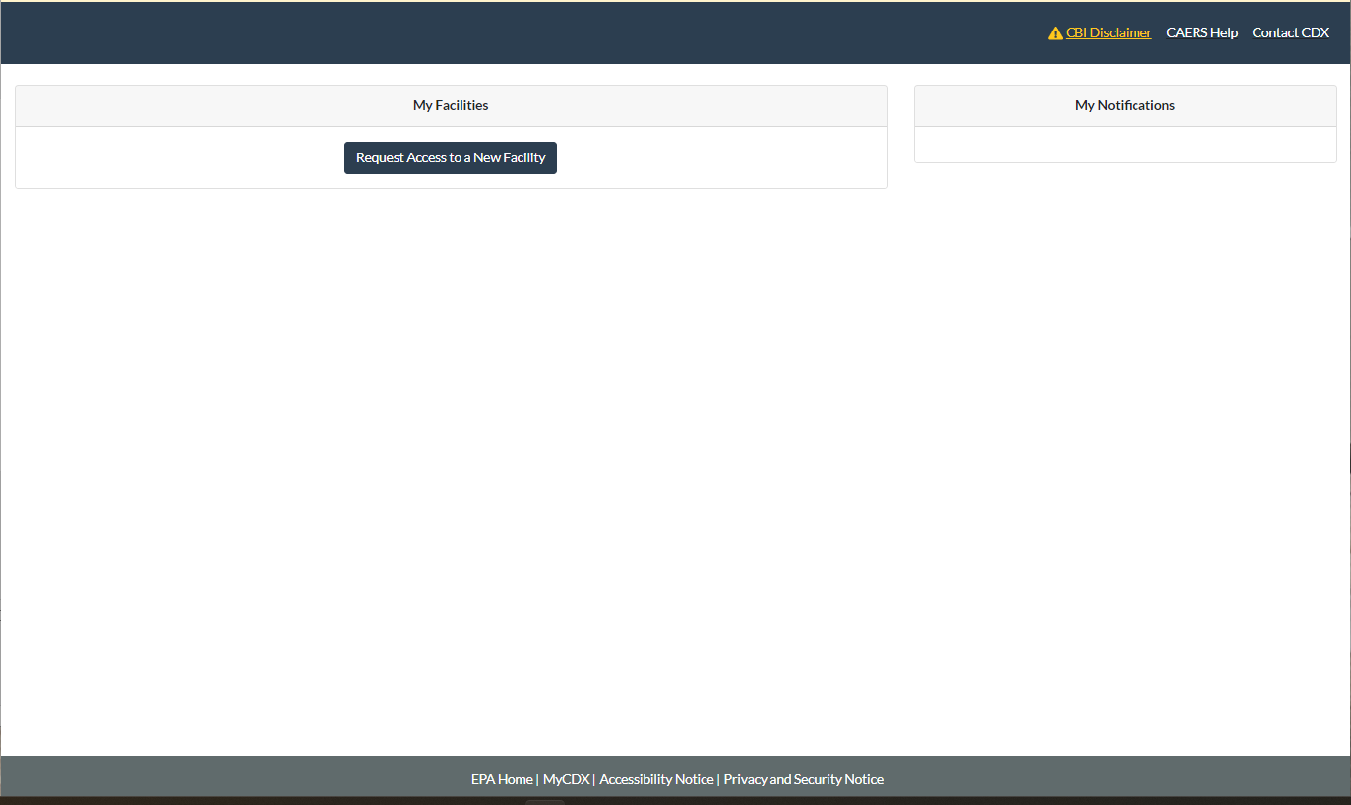
CAERS My Facilities Page
To get access to start reporting for a facility click on “Request Access to a New Facility”.
Once you have received your confirmation from your SLT, you should see all the facilities that your account is associated to listed in your “My Facilities” page. The My Facilities page in CAERS where the user can see a list of the facilities they are associated to.

Slide 31
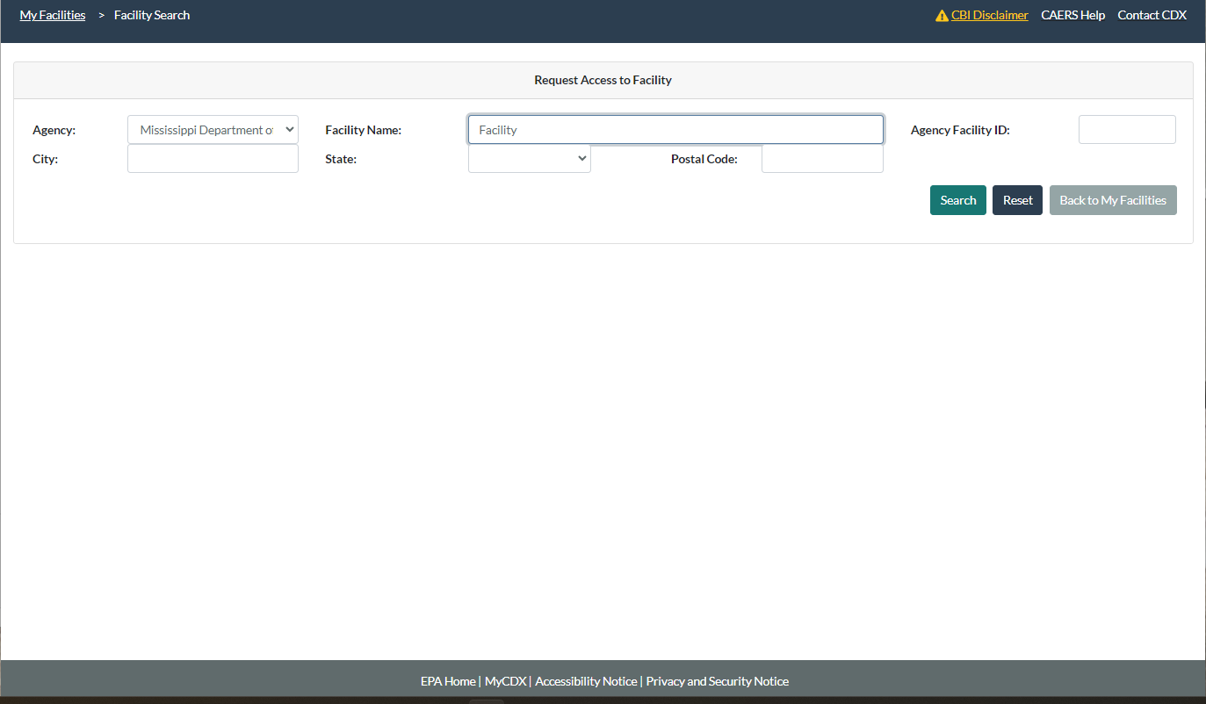
Request Access to Facility
Find your Agency from the drop the drop-down menu and type in search terms to find your facility. Then click “Search”.

Slide 32
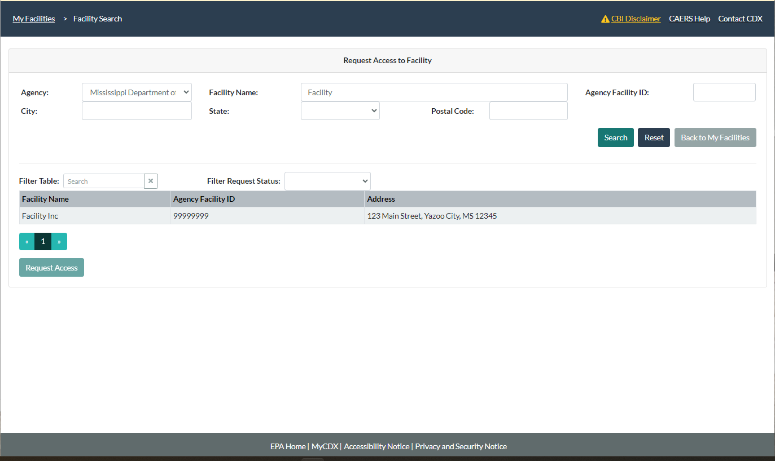
Finding Your Facility
A list of facilities matching your search terms will appear. Select the facility you want to report to. When you do, the “Request Access” button will be active. Click on “Request Access”

Slide 33
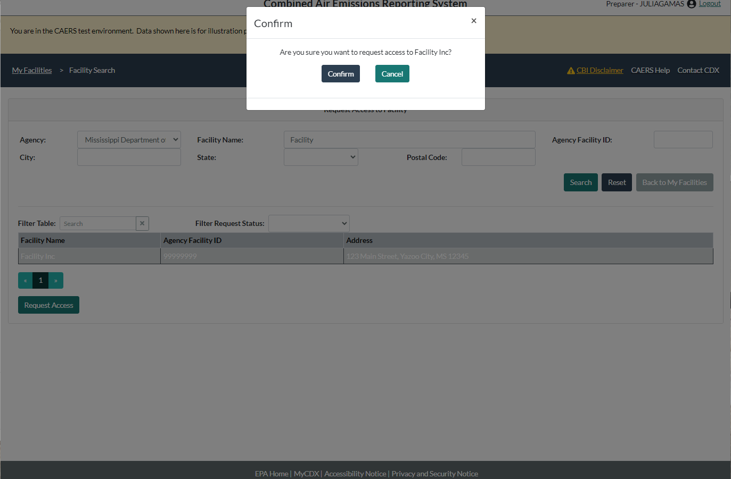
Confirm Access to Facility
Make sure you have the right facility, so you don’t have to go through the process again. If SLT staff find that your name doesn’t match the facility you must report to, they will not accept your request.

Slide 34
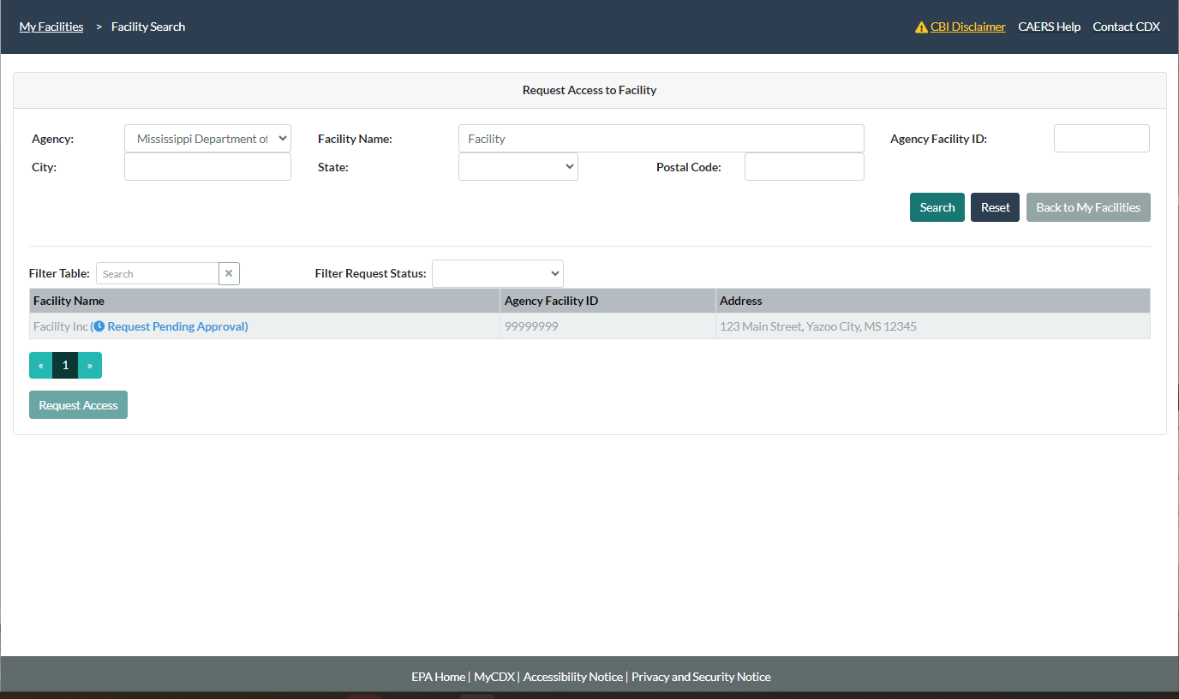
Request Sent
You should wait for the SLT to approve your request. You will get an email when this has happened. Note that CDX emails are from the system, you cannot reply to them and get a response. They may also go to your spam folder.

Slide 35
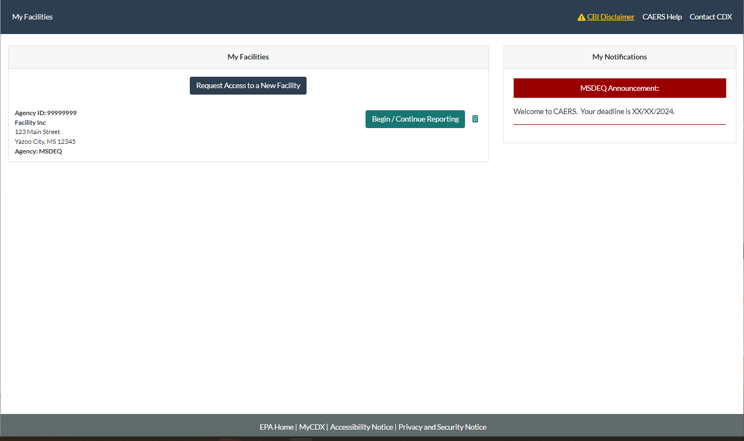
Request Granted
Once the SLT has granted you access, you will be able to see your facility on your My Facilities page, together with any announcements from the SLT.
If you report to multiple facilities that are in different states, you will see announcements for each of those states on the right hand side of the screen.
Click on Begin/Continue Reporting to start your report.

Slide 36
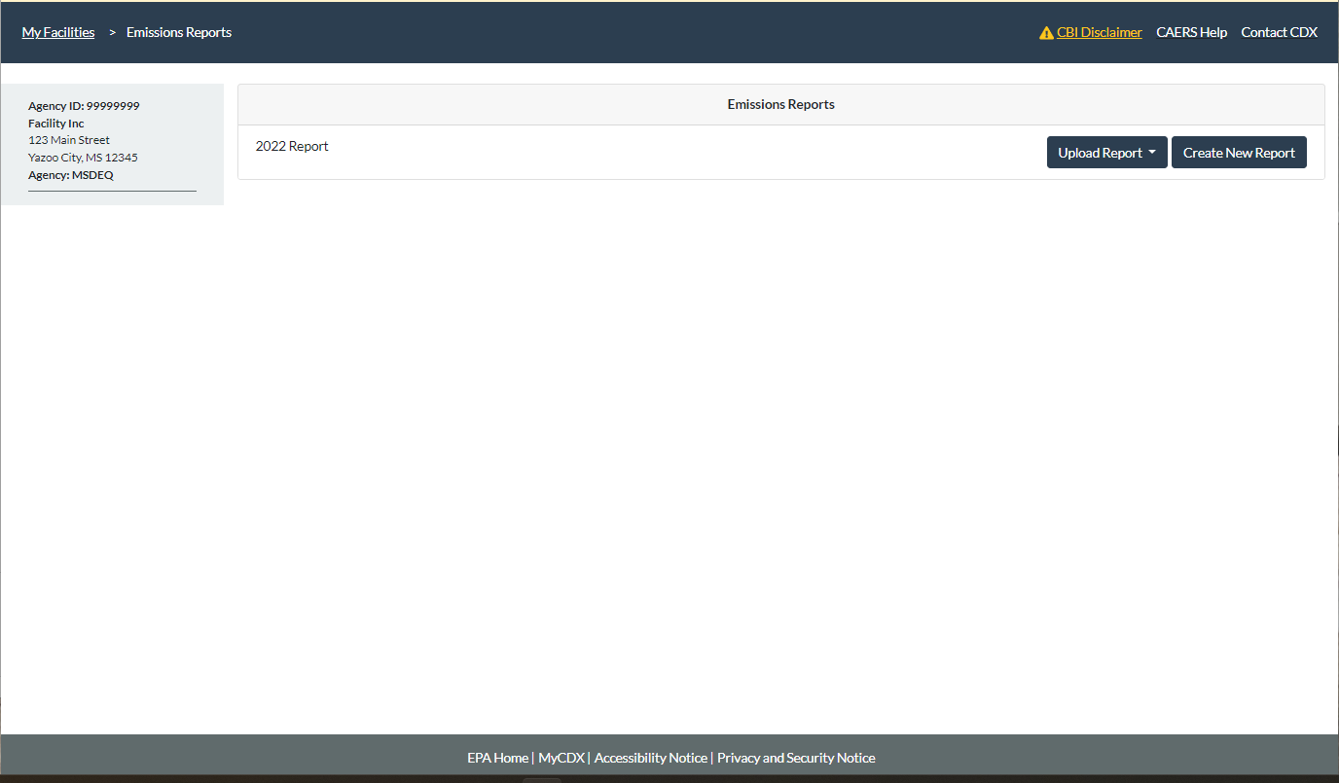
Begin/Continue Report
Click on “Create New Report” to start a new report.
You should create a new report before attempting to upload a template or JSON.

Slide 37
Questions so Far?

Slide 38
Highlights of CAERS Features
Familiarize you with CAERS features but not exhaustive
Detailed trainings on specific aspects of CAERS are forthcoming:
  CAERS User Interface: Thursday 01/16/2025 from 3:30 to 5 PM Eastern
  CAERS Bulk Upload Template: Tuesday 01/21/2025 from 1 PM to 2:30 PM Eastern
  CAERS Control Device Reporting: Thursday 01/30/2025 from 3 to 4:30 PM
Go to the User Guide for more information (will be updated by January 6th, 2025)

Slide 39
Highlights of CAERS Features - 1
Three options for data entry:
  User interface
Notes:
To enter data you will have three options. First, the User interface – is for users with few changes to a previous year report, and with different kinds of changes. It can also be used to update a report if a few additional changes are needed after using the bulk upload.

Slide 40
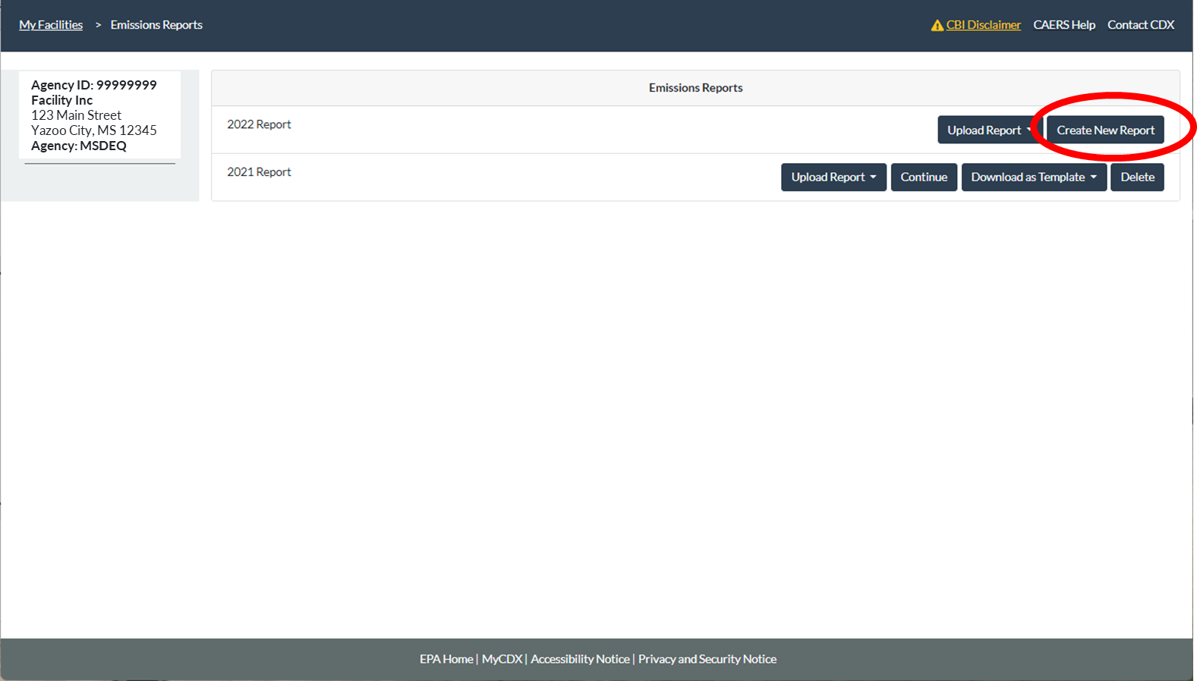
CAERS Facility Emissions Reports Page
Notes:
Previous year data is available as a starting point for a current inventory year report. When you start a new report, data from your last report is automatically prepopulated in your current year report. For example, if you reported last in 2018, your starting point for your 2020 report would be 2018 data that you would then update.

Slide 41

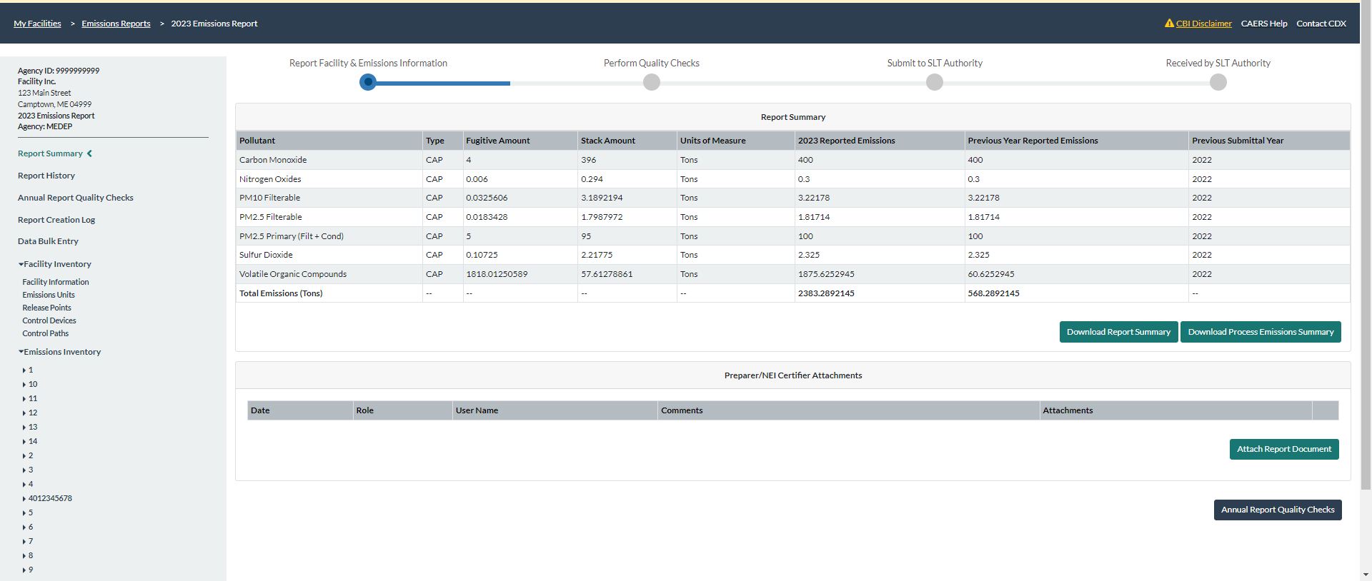

CAERS Main Report Page
Notes:
Whatever method you choose, you will eventually be in the user interface, so knowing the basics of this page will be very helpful. At the top of the screen, there is a trail of breadcrumbs at the top left of the screen so you can go back to previous screens. There is a step-by-step menu at the top-middle of your screen so you know which step of the process you are in. The left-hand side menu has a series of links for both your facility inventory and your emissions inventory, plus other features, so you can access all of them from there.

Slide 42
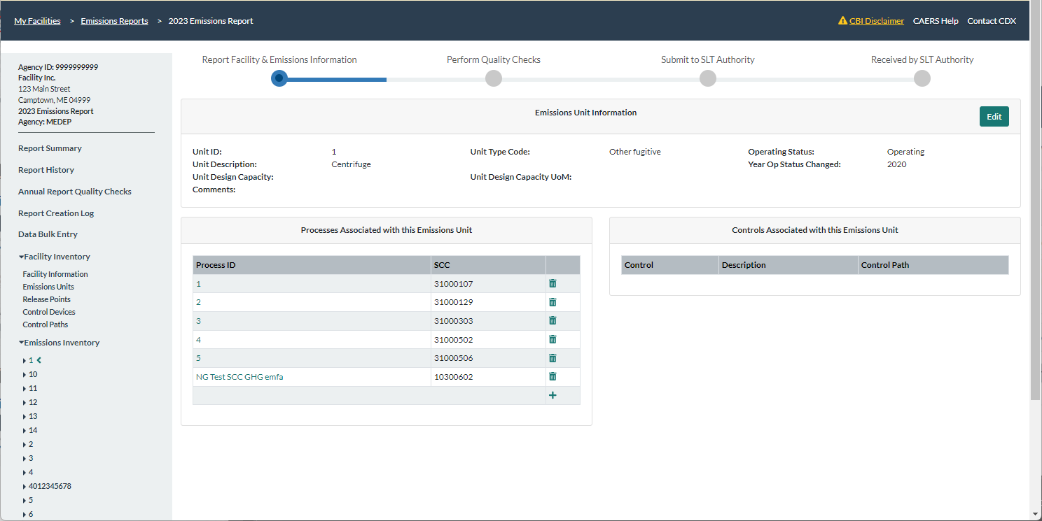
CAERS Emissions Unit Information Page
Notes:
Each screen will behave the same way. For example, you can edit any part of your submission by clicking on the “Edit” button which will then open that box of information. Data that shouldn’t be changed is greyed out. Once you’ve entered your new data or edits, then you can click on “Save” and this will take you back to the previous screen. If you click “Cancel” it will take you back to the previous screen without saving any changes you might have made.

Slide 43
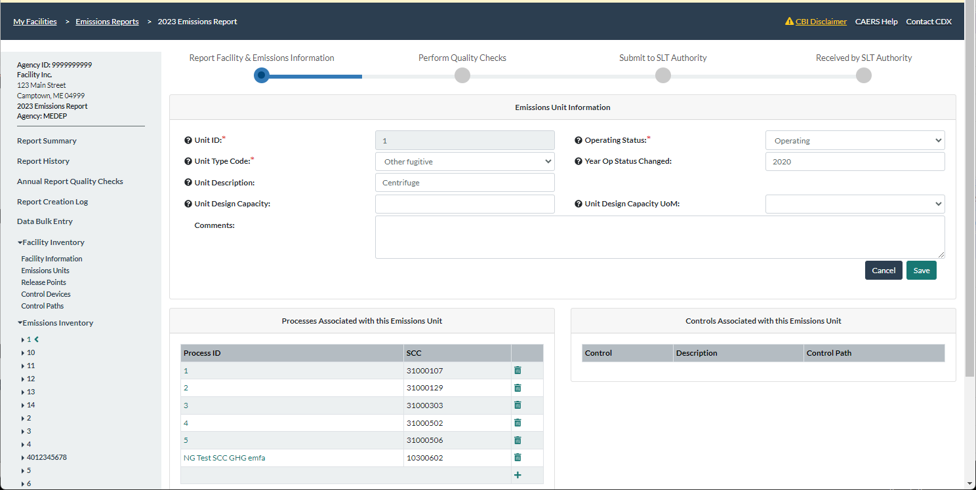
CAERS Emissions Unit Information Edit Page
Notes:
Data that shouldn’t be changed will not allow for entry. Once you’ve entered your new data or edits, then you can click on “Save” and this will take you back to the previous screen. If you click “Cancel” it will take you back to the previous screen without saving any changes you might have made.

Slide 44
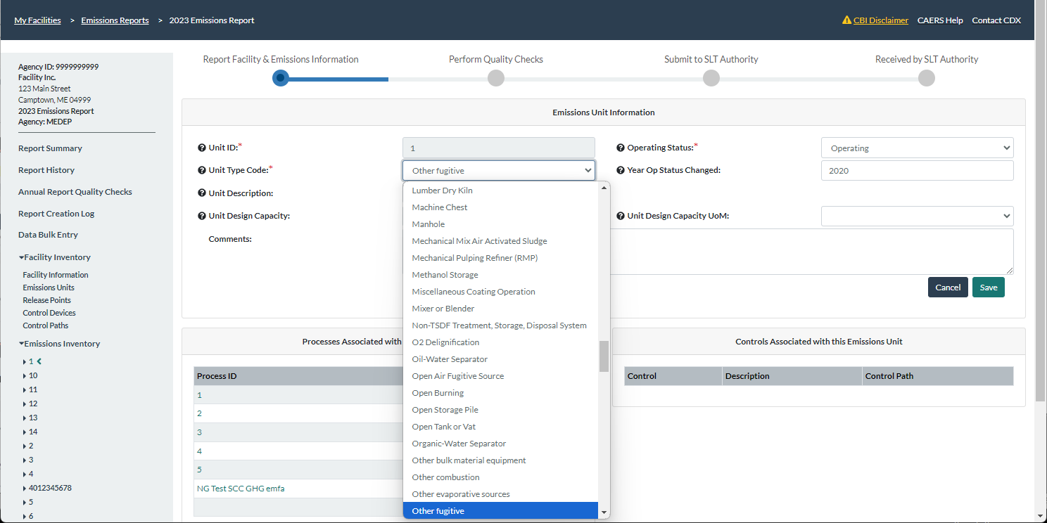
CAERS Drop Down Menu Example
Notes:
Drop down menus allow you to select options to help you avoid typos or other entry errors.

Slide 45
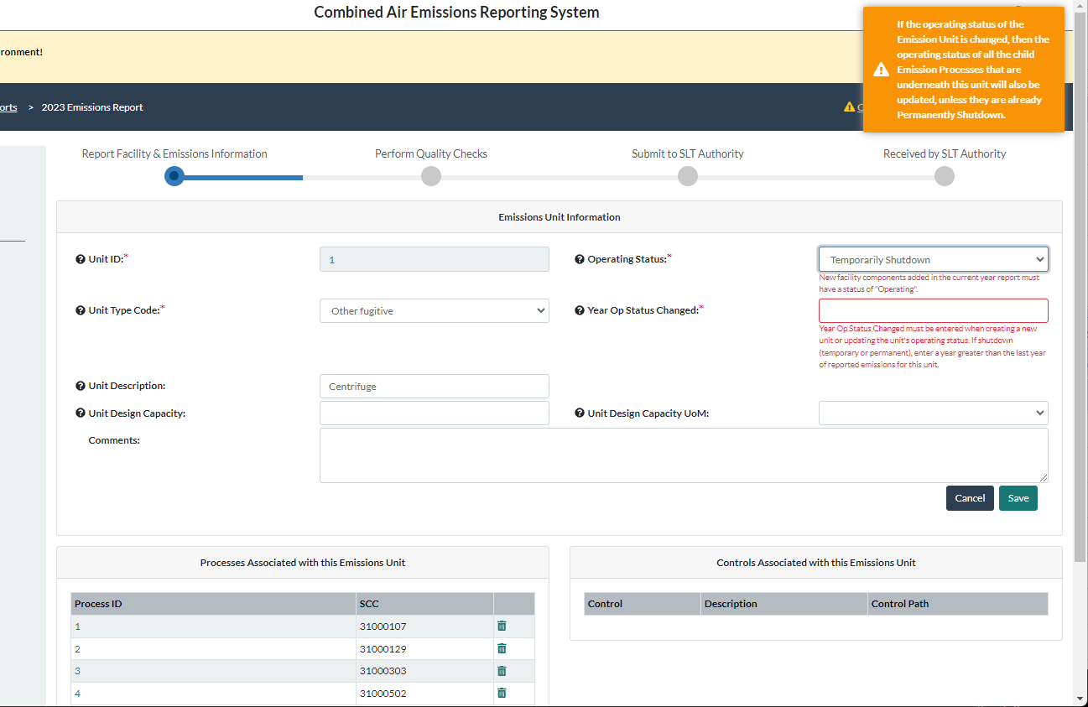
CAERS On-screen Quality Assurance Checks
Notes:
On screen QA checks help you avoid having issues later.

Slide 46
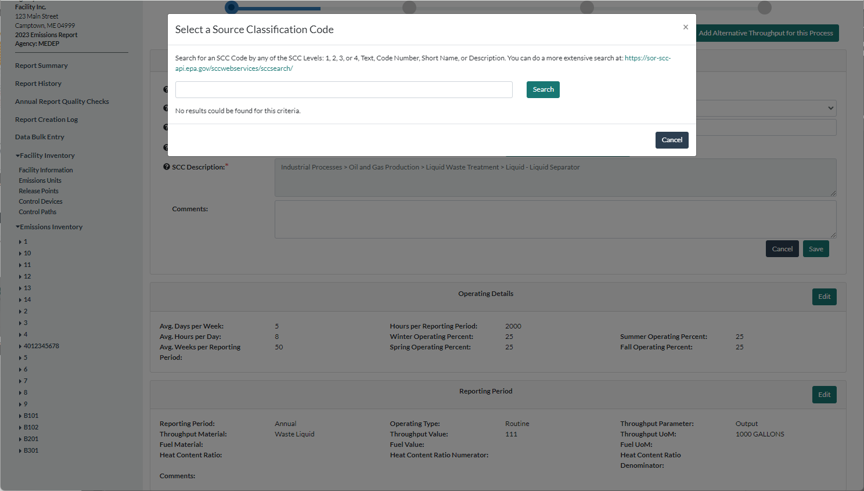
CAERS Search Pop-Up Window
Notes:
Modal windows help with searches such as for Source Classification Codes or SCCs and North American Industrial Classification System codes or NAICS.

Slide 47
Highlights of CAERS Features - 2
Three options for data entry:
  User interface
  Bulk entry
Notes:
Bulk entry – is for users with a few changes to their annual throughput and emissions estimation method, but with few to no changes to their facility inventory. This method is also convenient if you do not have any control equipment information to include in your report. There are two tabs.

Slide 48
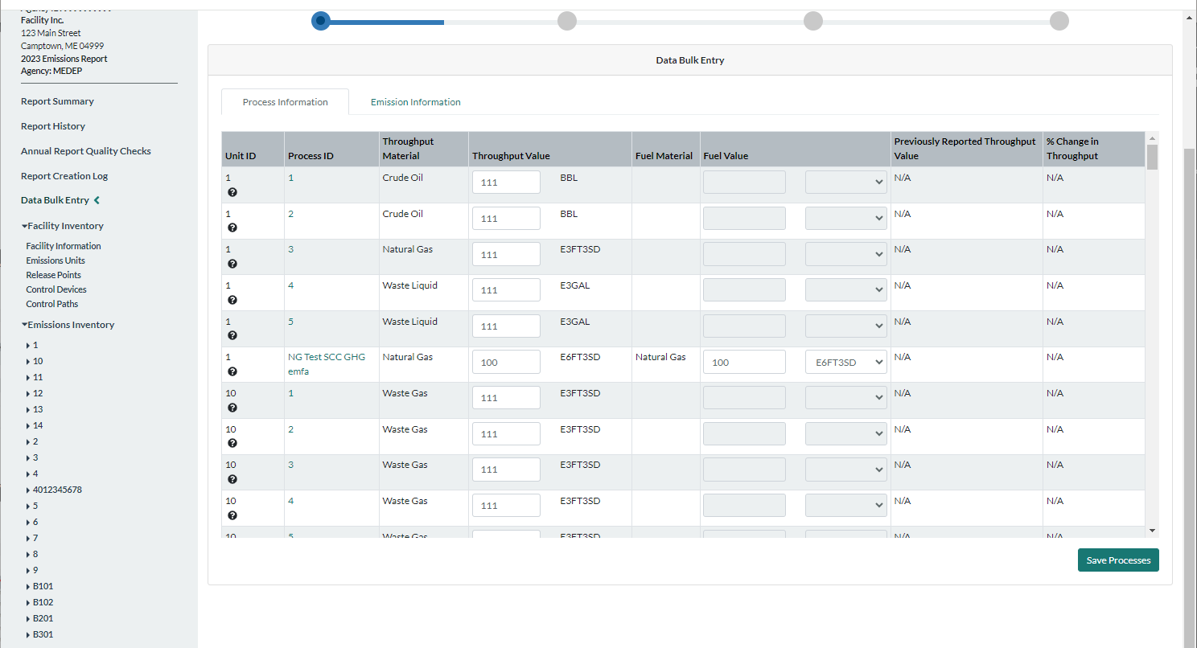
CAERS Throughput Bulk Entry
Notes:
To use bulk-entry you should already have your units and processes set up. Then all you have to do is enter the new throughput information in the “Process Information” tab.

Slide 49
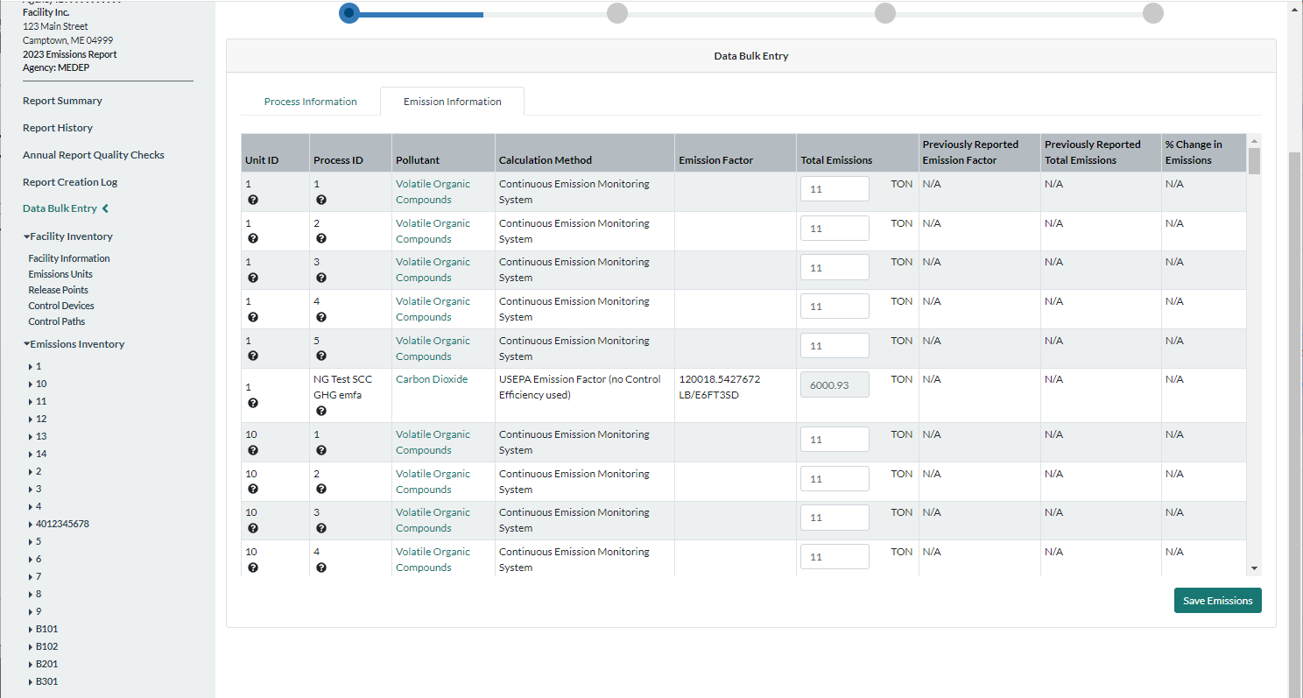
CAERS Total Emissions Bulk Entry
Notes:
Enter emissions information in the “Emissions Information” tab.

Slide 50
Highlights of CAERS Features - 3
Three options for data entry:
  User interface
  Bulk entry
  Bulk upload
    Via Pre-formated Excel template
    Via JSON upload (Refer to the CAERS website for instructions and how to get to the reference data, API specs, and data exchange template)
Notes:
Bulk upload – is for users with a large number of changes, and/or with a variety of changes from a previous year report, this includes new and/or large facilities with no previous reporting history who will want to start a brand new report.
Via excel template – for users who would like to work with excel
Via JSON upload – for users who would like to send data directly from their custom systems.

Slide 51
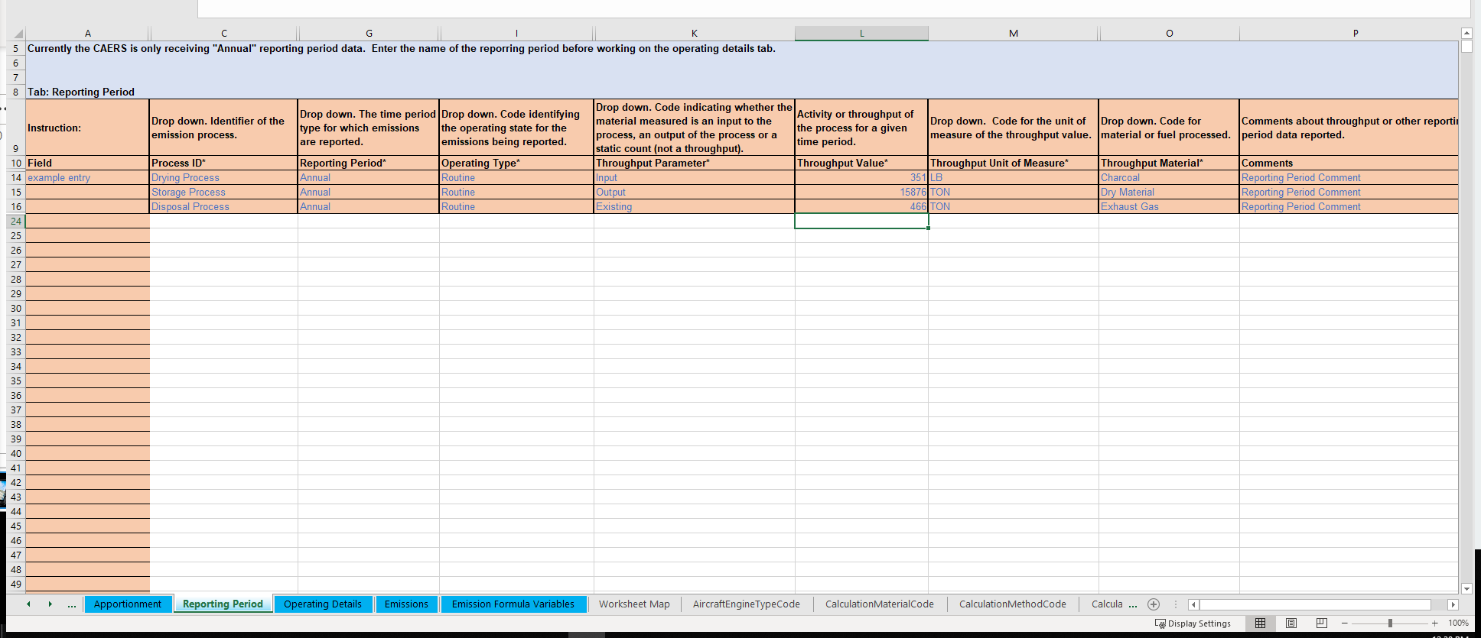
Example of Bulk Upload Excel Template
Notes:
The template has blue and gray tabs. The gray tabs have reference data. The blue tabs are where you enter the data. While you may need to invest some time entering the data in the blue tabs, and getting used to the format, in subsequent years, updating the bulk upload spreadsheet should be easier as you’ll only have to update the data.

Slide 52
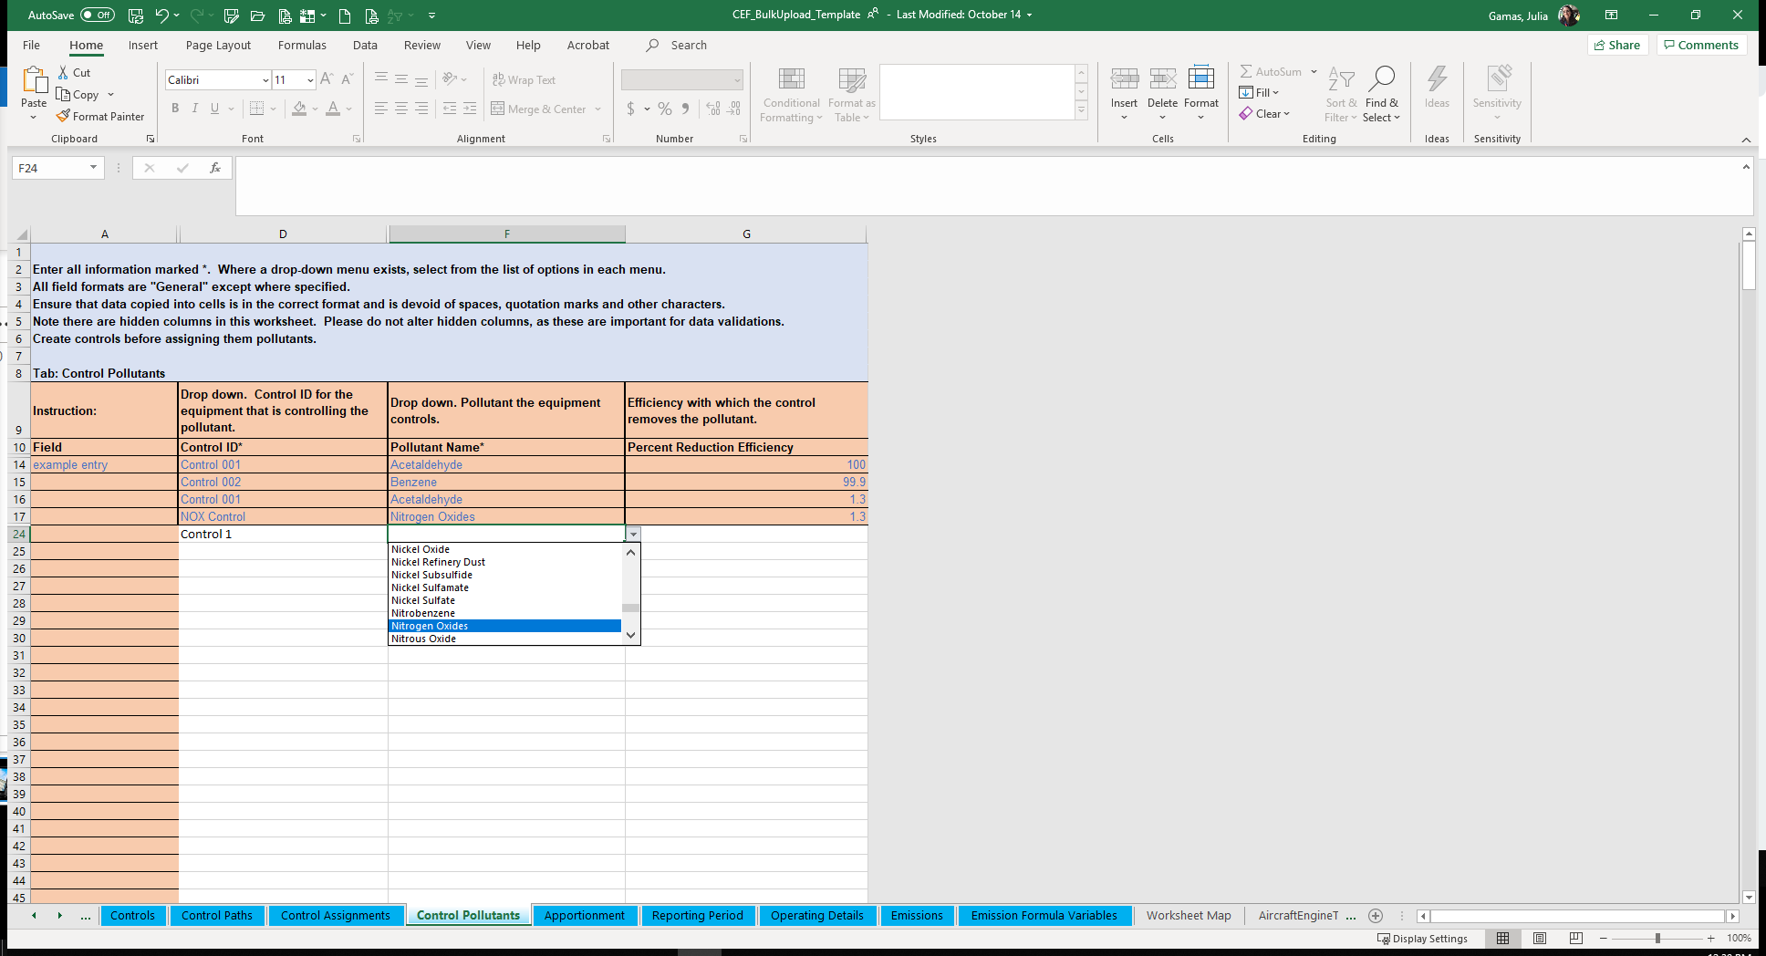
Bulk Upload Excel Template Example Continued
Notes:
The bulk upload template should be used carefully, as it also contains drop down menus and some formulas and references. If you have a lot of data to update every year, you may consider using the JSON upload. For more information about that send us an email to caer@epa.gov.

Slide 53
Highlights of CAERS Features - 4
Three Options for Data Entry
Previous Year Data Pre-populated in New Report
Notes:
However you choose to enter your data, your data will be pre-populated from data from your previous year submission unless you are reporting for a brand new facility.

Slide 54
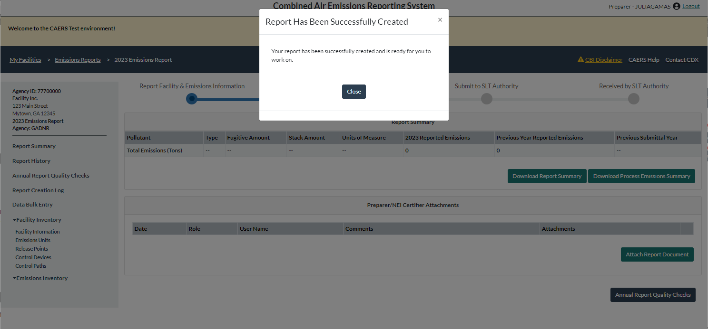
Start New Report with Previous Year Data

Slide 55
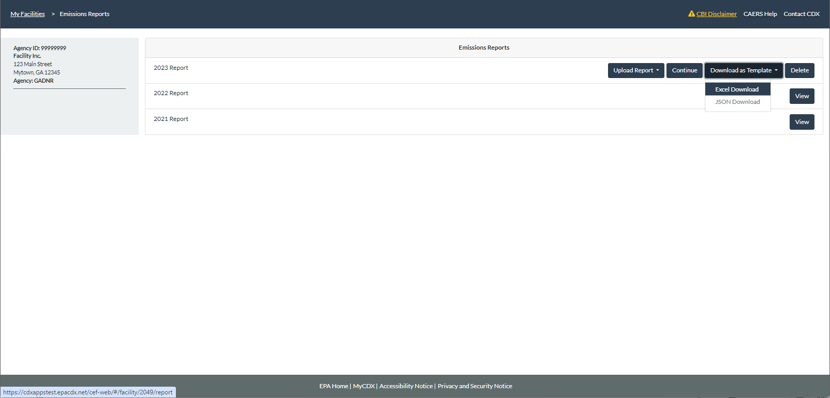
CAERS Emissions Reports Prepopulated Template Download
Notes:
By clicking on “Download as Template” from your Emissions Reports screen, you’ll be able to download your emissions report in the relevant excel template. You’ll then be able to edit it and re-load it. You’ll need to take care that any time you upload a template, you’ll be erasing everything that was there before.

Slide 56
Highlights of CAERS Features - 6
Three Options for Data Entry
Previous Year Data Pre-populated in New Report
File Attachments
Notes:
Your SLT requires you to provide supplemental information to your estimates so they can replicate your estimates, such as data fields, formulas, and references to specific souces of emission factors.

Slide 57
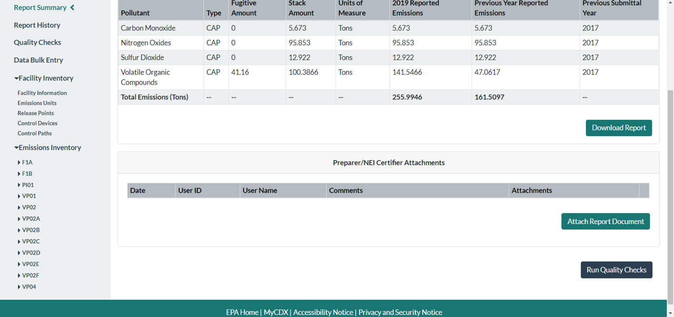
CAERS Document Attachment Page
Notes:
This can be done by attaching any excel files that contain your calculations to your report.

Slide 58
Highlights of CAERS Features - 7
Three Options for Data Entry
Previous Year Data Pre-populated in New Report
File Attachments
Report History & Log
Notes:
A report summary contains a summary of your submission in an excel file, and is available for download in CAERS.

Slide 59
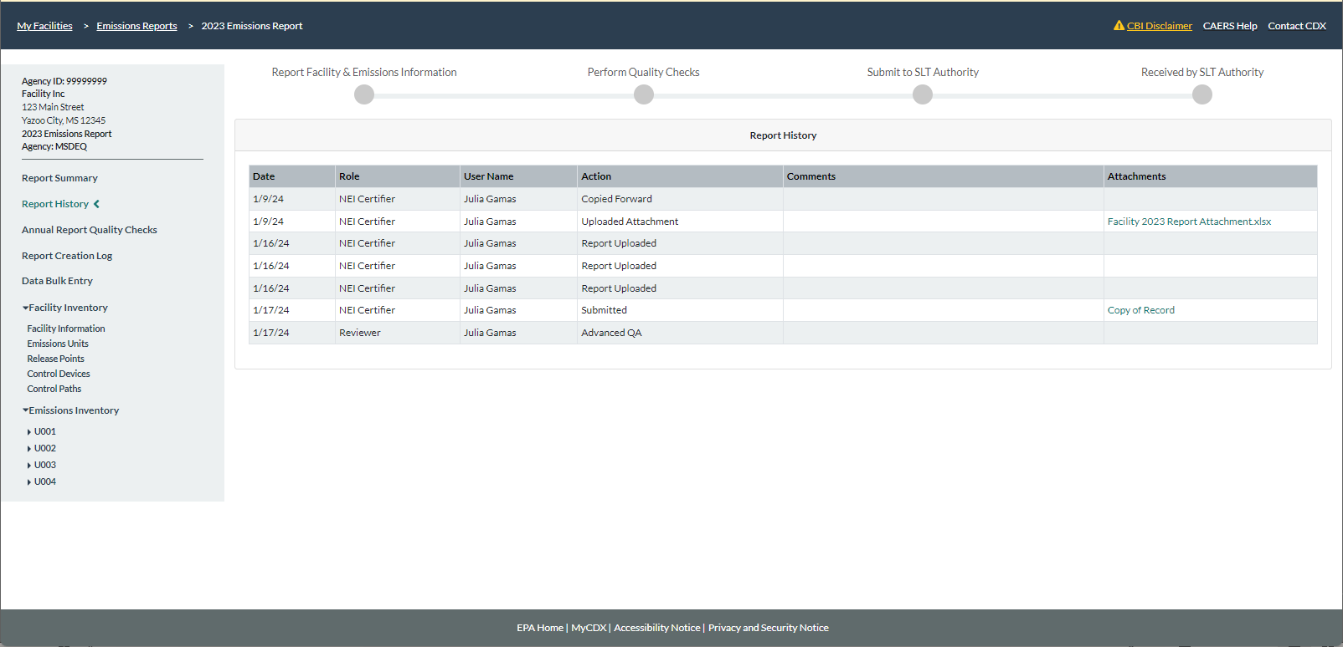
CAERS Report History Page
Notes:
A “Report History” page tracks major activities from reporters and certifiers such as attachments, certification, and submission of the report. You can always refer to the report history page to see if another reporter has worked on the report, for example.

Slide 60
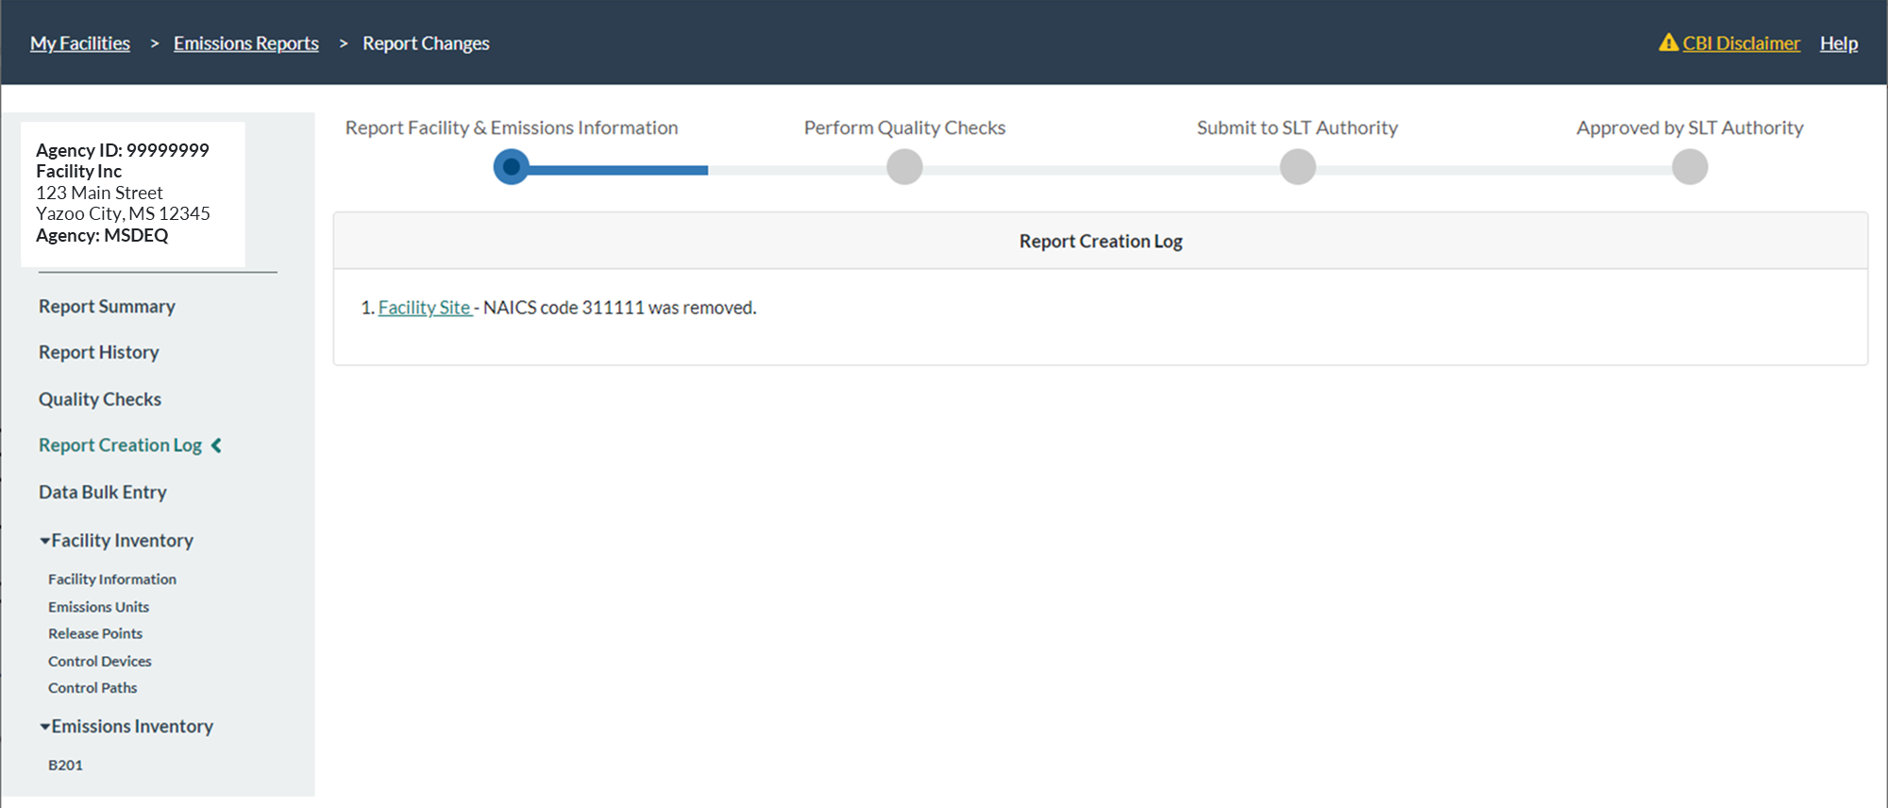
CAERS Report Log Page
Notes:
A log page tracks relevant actions done in the report.

Slide 61
Highlights of CAERS Features - 8
Three Options for Data Entry
Previous Year Data Pre-populated in New Report
File Attachments
Report History & Log
Report Summary Download
Notes:
A report summary contains a summary of your submission in an excel file, and is available for download in CAERS.

Slide 62
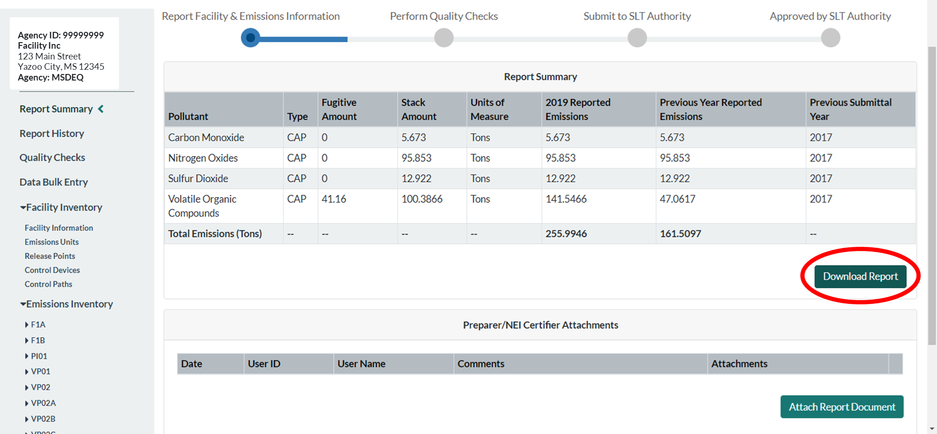
Report Summary Download
Notes:
It should not be confused with a bulk download, as the report will not provide a previous year submission in the correct excel template and is only a summary as opposed to the complete report with detailed data. If you submit HAPs emissions at process level, you will get facility-wide summary for TRI-ME HAPs reporting.

Slide 63
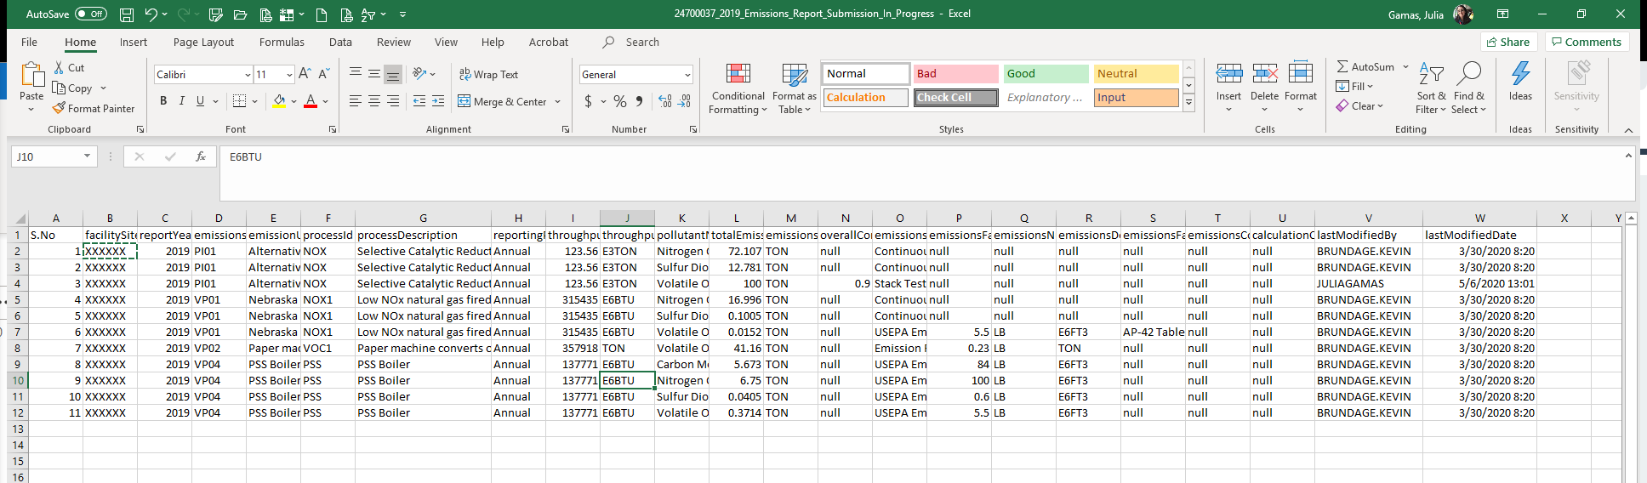
CAERS Example Summary Report
Notes:
You’ll be able to see the summary of your report in an excel file. The summary report will list your processes, estimation methods, throughputs, and other information.

Slide 64
Highlights of CAERS Features - 9
Three Options for Data Entry
Previous Year Data Pre-populated in New Report
File Attachments
Report History & Log
Report Summary Download
Toxics Air Emissions Calculated and Added for TRI-MEweb

Slide 65
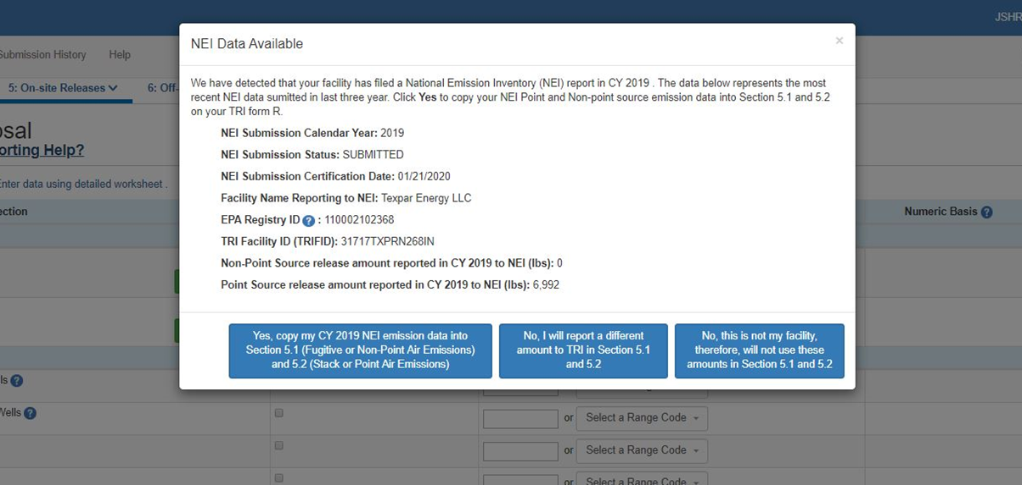
TRI-MEweb Page for Use of CAERS Data
Notes:
You’ll enter your data in CAERS, as shown, at the unit/process level. Toxics data will be added up to totals by facility. Once a reporter enters TRI-MEweb, they’ll be able to select the relevant report. This feature is optional, but we highly encourage you to take advantage of it. Furthermore, if you have HAPS, as explained earlier in the training you may want to enter your HAPS data rather than have EPA perform HAP augmentation on it. The raw data that you provide will always provide better information than the HAP augmentation estimate, which may not be as accurate. If your facility’s NEI reporter is a different person from your TRI-MEweb reporter, you may want to have them coordinate so that the TRI reporter is in TRI, once you have certified your submission.

Slide 66
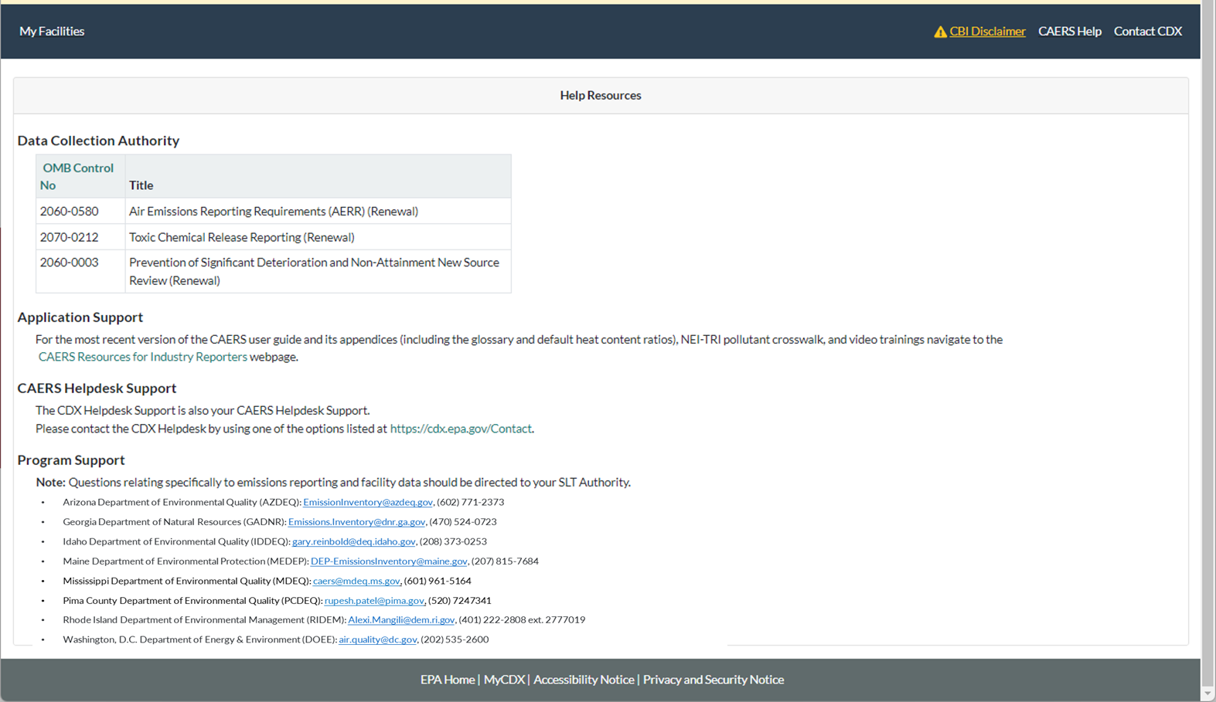
CAERS Help Resources Page
The CAERS “Resources for Industry Reporters” webpage includes the user guide, video trainings, and power point presentations given during trainings.
Facilities on Tribal Lands in EPA Region 10 (EPA_R10): brown.carl@epa.gov, (208) 378-5747
Notes:
It is also available by clicking on the “Help” link in CAERS. Here you will find the user guide, a glossary, and also the information for the CDX help desk, program support with your SLT email or POC, and additional resources.

Slide 67
Help from CDX Help Desk
For CDX questions such as:
  Can’t login/Password resets
  Repudiation
For CAERS application questions such as:
  Unexplained errors while using the CAERS application
  How to enter a specific piece of data
  How to navigate from one screen to another
CDX Help Desk:
Phone: Person-to-person telephone support from 8:00 am to 6:00 pm (EST/EDT). Call our toll-free line at 888-890-1995 or our direct line at (970) 494-5500 for International callers.
E-mail: Technical Support at helpdesk@epacdx.net
Notes:
If you have any questions about how to use the application itself, you should reach out to the help desk for questions about how to enter data into CAERS:
By Phone: Person-to-person telephone support is available from 8:00 am to 6:00 pm (EST/EDT). Call our toll-free line at 888-890-1995 or our direct line at (970) 494-5500 for International callers.
By E-mail: Send e-mail our Technical Support team at helpdesk@epacdx.net
Note that the help desk above is not the right resource for questions about the data itself. Those questions should be referred to your SLT Authority.

Slide 68
Program Questions
Reach out to your SLT POC for program questions such as:
What data to use to fix critical errors that appear in red.
Selecting an appropriate SCC and/or emission factor.
Finding out the unit capacity measure of a unit.
The appropriateness of a calculation method for the emission being estimated.

Slide 69
Want to make CAERS better?
Please help us make CAERS better by sending us feedback to caer@epa.gov. Help us prioritize upcoming features and functionality.
To make your reporting easier:
What else should CAERS be able to do?
What data elements should CAERS collect to send to other SLT and EPA air programs?
How should CAERS do this?
How should CAERS not do this?
Notes:
At any time during your use of CAERS you can send us feedback via our caer email, caers@epa.gov, letting us know what else you think CAERS should be able to do, and how CAERS can best do what you need it to do.

Slide 70
Questions

