Slide 1
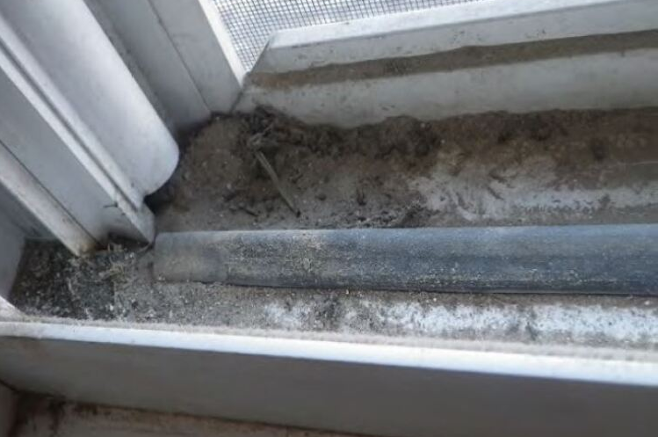
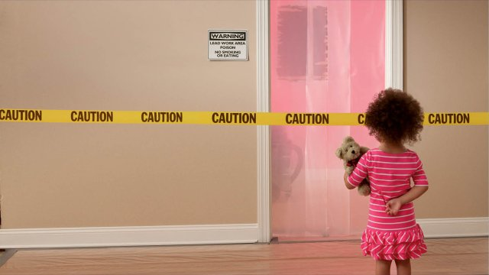
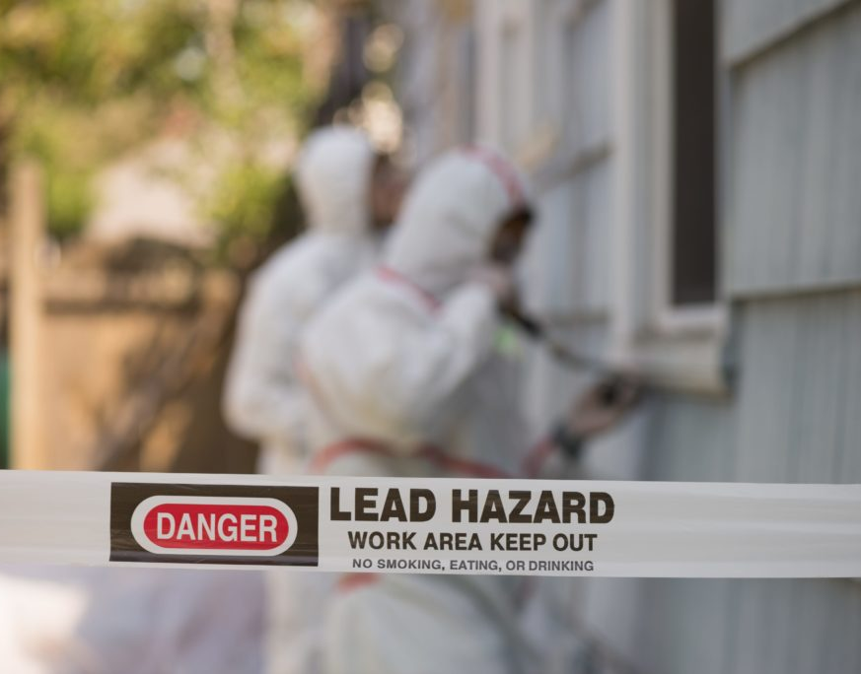
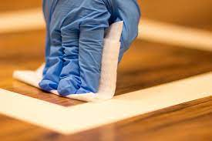
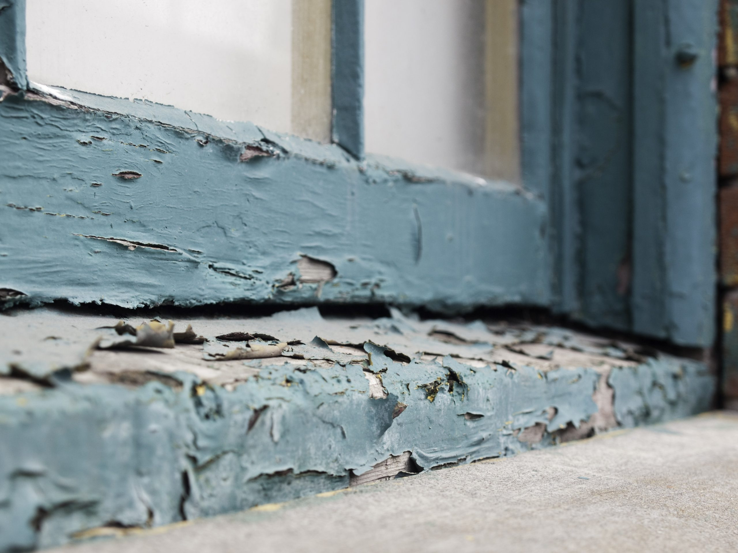
Dust-Lead Hazard Standards and Dust-Lead Clearance Levels Reconsideration Rulemaking
Public Webinar
December 5, 2024
OCSPP-OPPT
www.uswateralliance.org

Slide 2
Dust-Lead Reconsideration Rulemaking
BACKGROUND
OCSPP-OPPT
2
www.uswateralliance.org

Slide 3
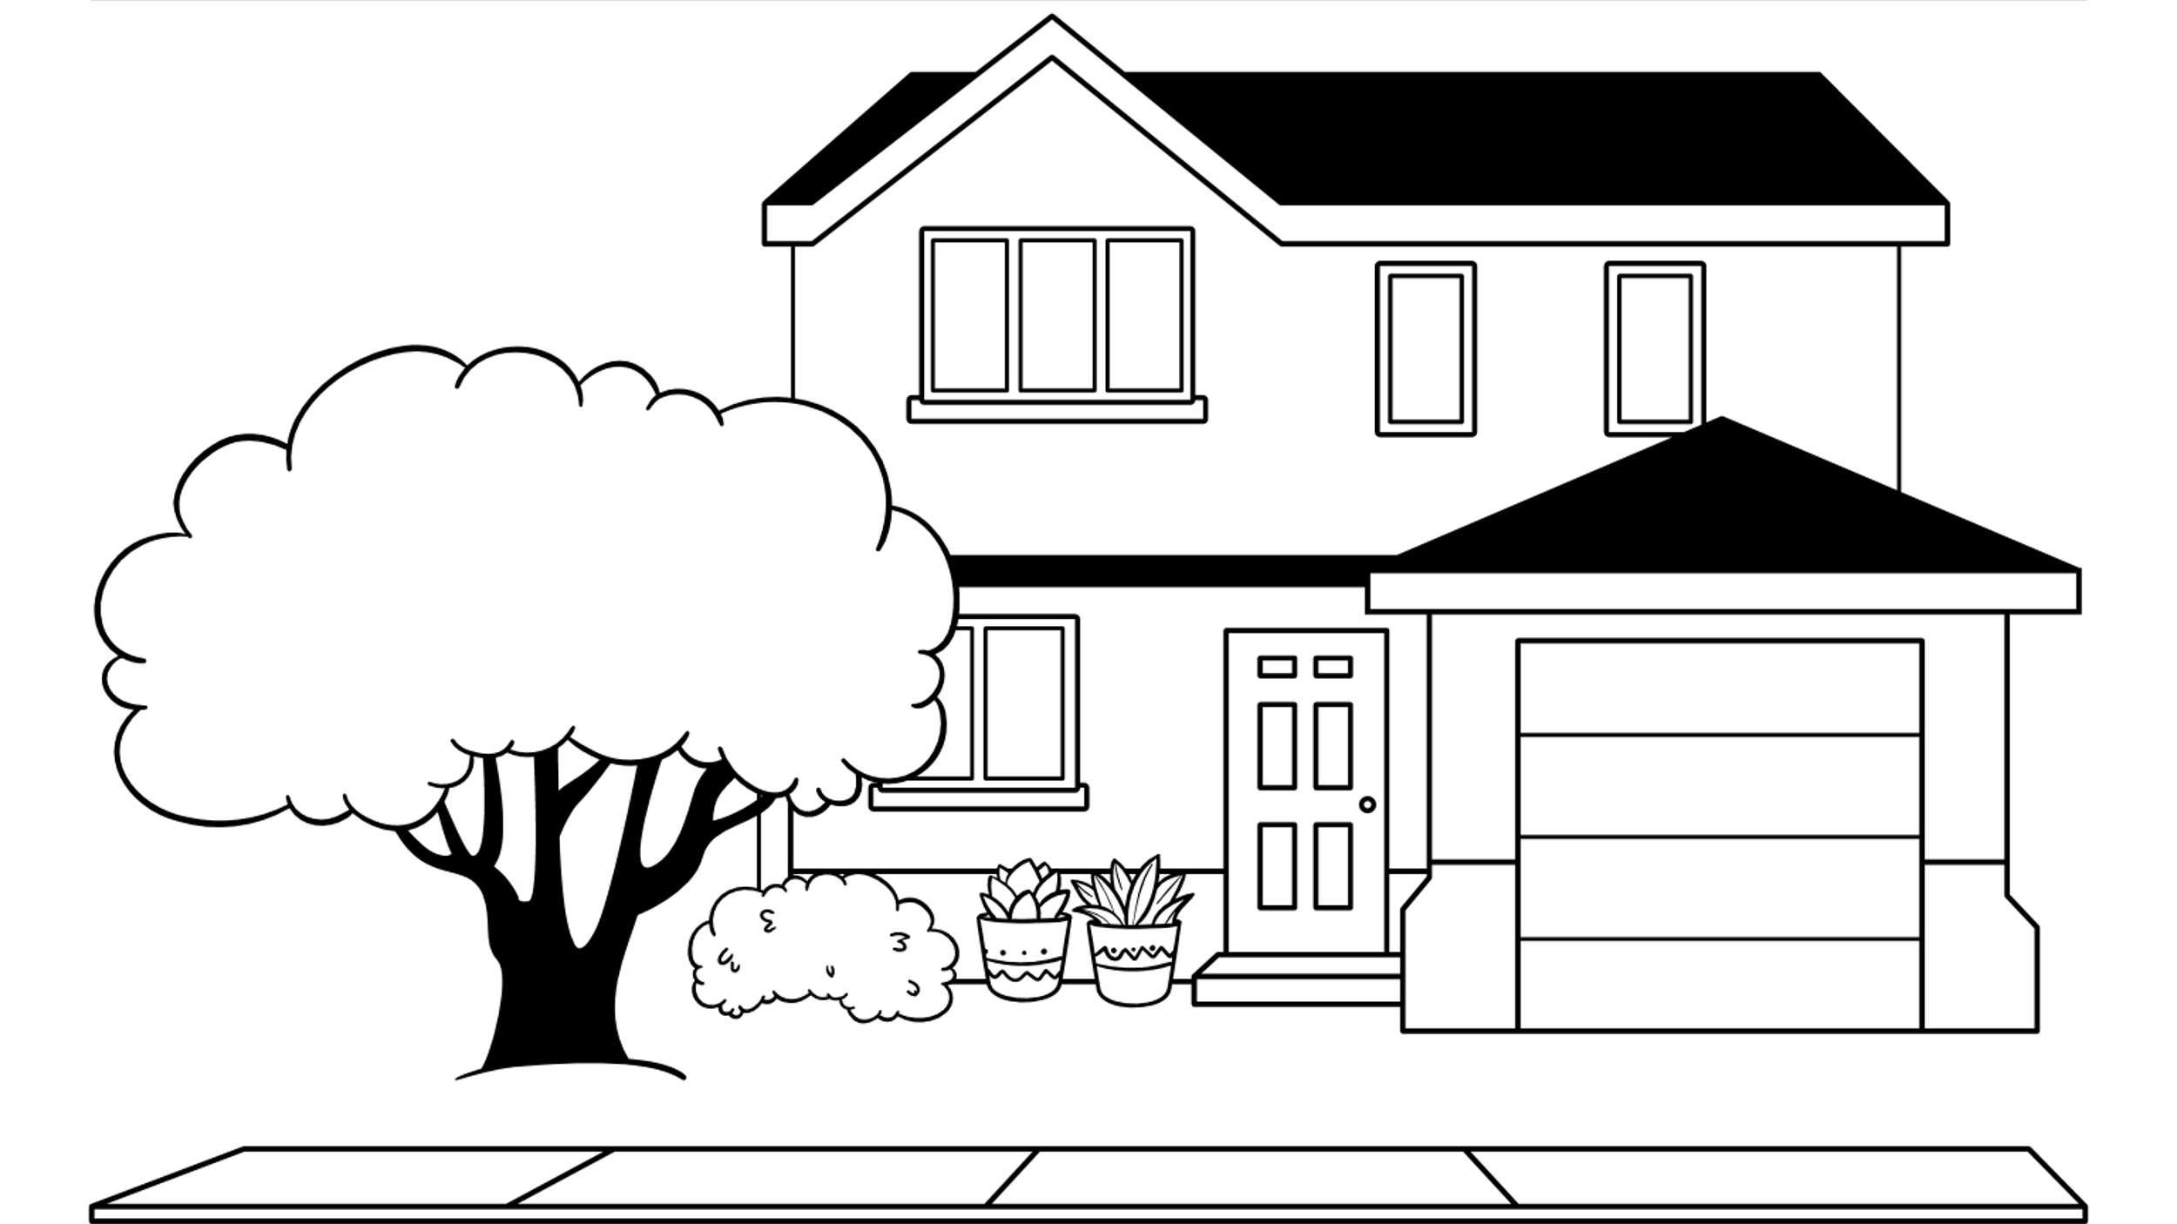
Dust & Lead-Based Paint
Lead-contaminated dust is one of the most common causes of elevated blood lead levels in children, and even low levels of exposure can be harmful
Lead dust commonly results when lead-based paint in pre-1978 housing or child-occupied facilities deteriorates or is disturbed
It is estimated that 31 million pre-1978 houses still contain lead-based paint, and 3.8 million of them have one or more children under the age of six living there
OCSPP-OPPT
3
www.uswateralliance.org

Slide 4
Rule Overview
Consistent with EPA’s Lead Strategy to strengthen public health protections and address legacy lead contamination for communities with the greatest exposures
Protects children’s health by reducing lead related IQ loss (as well as other health benefits and adult cardiovascular mortality)
Lead exposure is especially harmful to young children and can cause irreversible effects including behavioral problems, lower IQ, ADHD and low birth weight
EPA finalized “any reportable level” (ARL) for the dust-lead hazard standards (DLHS) with a dust-lead clearance levels (DLCL) for floors, window sills, and troughs of 5/40/100 µg/ft²
EPA also finalized a series of other amendments and a name change for the standards to dust-lead reportable levels (DLRL) and dust-lead action levels (DLAL)
The final rule applies to target housing and child-occupied facilities (i.e., pre-1978)
OCSPP-OPPT
4
www.uswateralliance.org

Slide 5
Key Messages
EPA estimates that this rule will reduce the lead exposures of up to nearly 1.2 million people every year, of which 178,000 to 326,000 are children under the age of six
EPA finalized changes to the regulatory definition of abatement so that the recommendation for action applies when dust-lead loadings are at or above the dust-lead action levels, rather than at or above the dust-lead hazard standards, as has been the case historically
EPA's lead-based paint (LBP) regulations do not compel property owners or occupants to evaluate their property for lead-based paint hazards or to take control actions
However, if a lead-based paint activity such as an abatement is performed, then EPA's regulations set requirements for doing so
The timing of when portions of this rule become enforceable depends on whether EPA runs the program in your area, as explained on a later slide
OCSPP-OPPT
5
www.uswateralliance.org

Slide 6
EPA Lead Terminology
Refer to 40 CFR 745.223 and 40 CFR 745.63 for more detail
Lead-based paint activities: Inspections, risk assessments, and abatements in target housing and child-occupied facilities.
Lead-based paint hazards: Conditions that cause exposure to lead from lead-contaminated dust, lead-contaminated soil, or lead-contaminated paint that is deteriorated or present in accessible surfaces, friction surfaces, or impact surfaces that would result in adverse human health effects.
Target housing: Any housing constructed prior to 1978, except housing for the elderly or persons with disabilities or any 0-bedroom dwelling (unless any child who is less than 6 years of age resides or is expected to reside in such housing).
Child-occupied facility: A building, or portion of a building, constructed prior to 1978, visited regularly by the same child, under 6 years of age, on at least two different days within any week (Sunday through Saturday period), provided that each day's visit lasts at least 3 hours and the combined weekly visit lasts at least 6 hours, and the combined annual visits last at least 60 hours. Child-occupied facilities may include, but are not limited to, day-care centers, preschools and kindergarten classrooms.
OCSPP-OPPT
6
www.uswateralliance.org

Slide 7
How are these dust-lead standards used?
The dust-lead standards are used throughout EPA’s lead-based paint activities program and beyond
Lead-based paint activities include inspections, risk assessments, and abatements in target housing and child-occupied facilities
Dust samples are taken as both part of the risk assessment process, and once abatement work is complete
States, territories, and federally recognized tribes can become authorized to administer their own lead-based paint activities programs
HUD also uses these standards throughout their regulatory program under the Lead Safe Housing Rule
INSPECTION
A surface-by-surface investigation to determine the presence of lead-based paint and the provision of a report explaining the results of the investigation
RISK ASSESSMENT
On-site investigation to determine the existence, nature, severity, and location of lead-based paint hazards + a report explaining the results of the investigation and options for reducing lead-based paint hazards
ABATEMENT
Any measure or set of measures designed to permanently eliminate lead-based paint hazards (in the case of dust-lead hazards to below the action levels)
OCSPP-OPPT
7
www.uswateralliance.org

Slide 8
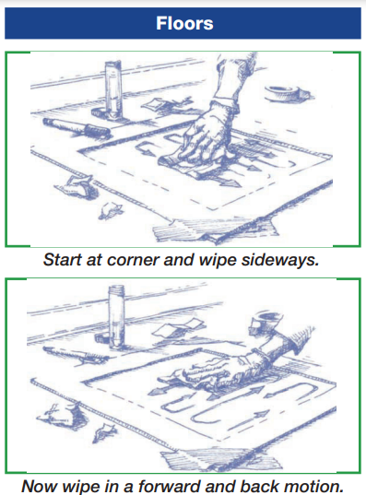
How are these dust-lead standards used?
Dust-samples are taken as both part of the risk assessment process, and once abatement work is complete
DLHS/DLRL = Identify conditions that would result in adverse human health effects
These samples are taken during the investigation and/or risk assessment part of the process
DLCL/DLAL = Indicate the enforceable regulatory level of lead in dust allowed on a surface following the completion of an abatement activity
To achieve clearance when dust sampling is required, values below these levels must be achieved
OCSPP-OPPT
8
www.uswateralliance.org

Slide 9
Regulatory Background
2001 LBP Hazards Rule | 2001 LBP Hazards Rule |  |  | 2019 Rule |  | 2021 Rule |  | 2024 Final Rule
μg/ft² | DLHS | DLCL |  | DLHS |  | DLCL |  | DLRL | DLAL
Floors | 40 | 40 |  | 10 |  | 10 |  | Any reportable level by an EPA-recognized laboratory | 5
Sills | 250 | 250 |  | 100 |  | 100 |  | X | 40
Troughs | no standard | 400 |  | no standard |  | 400 |  | no standard | 100
August 2019
Lawsuit was filed by public health advocates in the Ninth Circuit Court of Appeals against the 2019 final rule
May 2021
The court remanded EPA's 2019 rule, stating that the dust-lead hazard standards were not lowered to “a level sufficient to protect health as Congress directed, because EPA has looked to factors in addition to health”
The court also affirmed that EPA could consider other factors (i.e., reliability, effectiveness, and safety) when setting clearance levels
October 2024
EPA finalized “any reportable level” for the DLRL with a DLAL of 5/40/100 µg/ft² for floors, window sills, and troughs
OCSPP-OPPT
9
www.uswateralliance.org

Slide 10
Authorized Programs – Regulatory Landscape
Pursuant to TSCA Section 404 and 40 CFR part 745, Subpart Q:
States, territories, and federally recognized tribes can become authorized to administer their own lead-based paint activities programs (i.e., inspections, risk assessments, and abatements in target housing and child-occupied facilities)
These programs must be as least as protective of human health and the environment as EPA’s program and provide adequate enforcement.
States, territories or tribes must demonstrate that their programs meet any new requirements imposed by this rulemaking, no later than two years after the effective date.
EPA administers the lead-based paint activities program only where states, territories or tribes are not authorized by EPA to operate their own.
EPA administers the program in the following areas: AK, AZ, FL, ID, MT, NV, NM, NY, SC, SD, WY, American Samoa, Guam, Northern Mariana Islands, and the U.S. Virgin Islands, as well as most Tribal Lands
39 states, four tribes, Puerto Rico and Washington, DC have EPA-authorized programs (typically run through health departments, environmental departments, etc.)
OCSPP-OPPT
10
www.uswateralliance.org

Slide 11
Potentially Impacted Entities
States, territories or federally recognized tribes with authorized programs (including the health, environmental, or other departments that run these lead-based paint activities programs)
Public housing authorities, which can be subject to EPA’s Lead-Based Paint Activities Rule and HUD’s Lead Safe Housing Rule
Any locally run lead-based paint activities program, such as at the city level, that must comply with the EPA or EPA authorized state requirements
All lead-based paint professionals, especially certified risk assessors and firms that perform abatements
Laboratories certified by EPA’s National Lead Laboratory Accreditation Program
Note that this is not an all-inclusive list of potentially impacted entities, and the requirements of this rule will apply to both target housing and child-occupied facilities. See the final rulemaking for more information
OCSPP-OPPT
11
www.uswateralliance.org

Slide 12
Dust-Lead Reconsideration Rulemaking
REGULATORY REVISIONS
OCSPP-OPPT
12
www.uswateralliance.org

Slide 13
Key Revision: #1 Nomenclature Change
Stakeholder Input:
In 2023 EPA proposed no change to the terminology or the nomenclature of the standards
However, numerous public commenters expressed concern over confusion about “greater than zero” and an interest in changing the language surrounding the dust-lead hazard standards and the dust-lead clearance levels to better communicate the purpose of the standards
The majority of those who suggested specific language changes to the standards preferred “disclosure level” and “action level”
EPA wanted to avoid triggering any confusion with the Disclosure Rule with the terminology “disclosure level”
Final Revision:
Revised the standards within the regulatory landscape to the following:
Dust-Lead Hazard Standards → Dust-Lead Reportable Levels (abbreviated DLRL)
Dust-Lead Clearance Levels → Dust-Lead Action Levels (abbreviated DLAL)
OCSPP-OPPT
13

Slide 14
Key Revision: #2 Dust-Lead Reportable Levels
Background:
Lead-based paint hazards are conditions that cause “exposure to lead from lead-contaminated dust, lead-contaminated soil, lead-contaminated paint … that would result in adverse human health effects” (15 U.S.C. 2681(10))
EPA is not attempting to set the standard at zero, as zero would not identify a level of exposure to dust-lead loadings that would cause adverse health effects
In 2021, the Ninth Circuit held that EPA must reconsider the hazard standards using only health factors
In 2023 EPA proposed “greater than zero” codified as any reportable level with two alternative approaches
OCSPP-OPPT
14

Slide 15
Key Revision: #2 Dust-Lead Reportable Levels
Final Revision: Finalized “any reportable level” as proposed
EPA reconsidered the hazard standards using health-only factors, which do not include broader public health concerns and are specifically focused on the health impacts of dust-lead exposure, without consideration of housing instability, source of the lead in the dust, cost, etc.
There is no evidence of a threshold for lead exposure below which there are no harmful effects on cognition in children
Any reportable level is a more protective approach and is supported by the modeling results, which show that children's blood lead levels and IQ decrements are lower when they are exposed to less dust-lead
Codified that any level of reportable dust-lead could result in adverse health effects, allowing disclosure to the public
Similar to EPA’s Maximum Contaminant Level Goal under the Safe Drinking Water Act, which for lead is zero
This would allow residents to know there is dust-lead present and that lead from dust can pose health hazards
Note in applying the any reportable level approach, the “action level” for laboratories and for recommended action such as abatement, will become the dust-lead action levels (rather than the dust-lead reportable levels)
OCSPP-OPPT
15

Slide 16
Key Revision: #2 Dust-Lead Reportable Levels
Final Revision: Finalized “any reportable level” as proposed
Previous/Coupled Approach
Any Reportable Level/Decoupled Approach
Abatement
Recommended
Abatement
Recommended
Lead > Dust-Lead Hazard Standards
Lead > Dust-Lead
Action Levels
Lead < Dust-Lead Action Levels;
Lead > Reportable Levels
Triggering event
Inspection, and/or risk assessment
Inspection, and/or risk assessment
Cleaning recommended (not abatement)
Lead < Dust-Lead Hazard Standards
Triggering event
Lead < Reportable Levels
No Dust-Lead Hazard Present
Recommended activity
No Dust-Lead Hazard Present
OCSPP-OPPT
16

Slide 17
Key Revision: #3 Revising the Definition of Abatement
Final Revision: Finalized revisions to the definition of abatement in EPA’s lead-based paint activities regulations (40 CFR 745.223)
This final revision modified the trigger for when EPA recommends an abatement (which would apply when dust-lead loadings are at or above the dust-lead action levels, rather than at or above the dust-lead hazard standards, as has been the case historically)
Note owners of properties covered by the LBP Activities Rule are not compelled by EPA to evaluate their properties for the presence of dust-lead hazards or to take action (such as an abatement) if dust-lead hazards are identified at or above the dust-lead clearance levels, although HUD and some state or local governments may require action
OCSPP-OPPT
17

Slide 18
Key Revision: #4 Dust-Lead Action Levels
Background:
Clearance levels (described as dust-lead action levels moving forward) indicate the amount of lead in dust on a surface following the completion of an abatement activity
Reminder that in 2021, the Ninth Circuit held that EPA could consider other factors, i.e., reliability, effectiveness, and safety, when setting clearance levels
EPA performed outreach to laboratories throughout the rulemaking process
In 2023 EPA proposed 3/20/25 µg/ft² for the clearance levels with an alternate of 5/40/100 µg/ft²
Action Levels
Pass
Dust wipe sampling and laboratory analysis
Abatement
Lead < all Dust-Lead
Action Levels
Lead > a Dust-Lead
Action Level
Abatement complete
Fail
Reclean
Required activity
OCSPP-OPPT
18

Slide 19
Key Revision: #4 Dust-Lead Action Levels
Final Revision: Finalized the alternative clearance levels (described as DLAL moving forward) of 5/40/100 µg/ft²
According to the HUD Clearance Survey 70-95+% of post-job clearance wipes can achieve this level
Due to practical considerations such as laboratory capacity, turnaround time, feedback from lead-based paint professionals during the public comment period (e.g., challenges to clean to lower levels) and EPA’s understanding that 5/40/100 µg/ft² is achievable given the current levels in New York City, which are routinely being reached
EPA does not want to create a program that raises significant feasibility concerns, or that inadvertently reduces the number of abatement jobs that the regulated community is able to perform (due to a dilution of intervention resources), thus potentially impacting families and children and resulting in less of an overall reduction in dust-lead
OCSPP-OPPT
19

Slide 20
Health Impact Analysis
Children are especially vulnerable to the impacts of lead exposure, which can cause irreversible and life-long health effects, including behavioral problems, lower IQ, slowed growth and more. In adults, exposure can cause increased risk of cardiovascular disease, affect kidney and blood health, affect reproduction, and more
Health impacts of the rule were assessed by modeling the relationship between residential dust-lead exposure and resulting blood lead levels in children and adults, including women of childbearing age
The models and input parameters used in the Technical Support Document have been the subject of Science Advisory Board Review, workshops and publications in the peer reviewed literature
OCSPP-OPPT
20

Slide 21
Economic Analysis Benefits
Events Affected Per year Nationally
Housing units and COFs | 328,000 to 413,000
Individuals Affected Per Year Nationally
Children 0-5 years old (IQ benefits) | 178,000 to 326,000
Children 0-15 years old (ADHD benefits) | 261,000 to 484,000
Adults 40-79 years old (cardiovascular mortality benefits) | 246,000 to 288,000
Annual Benefits Nationally ($ millions, 2% discount rate)
IQ benefits | $831 to $3,105
ADHD benefits | $129 to $274
Cardiovascular mortality benefits | $614 to $6,936
Total Benefits | $1,574 to $10,315
OCSPP-OPPT
21
www.uswateralliance.org

Slide 22
Economic Analysis Costs and Net Benefits
Annual Costs Nationally ($ millions, 2% discount rate)
Cost of proposed rule | $536 to $784
Cost of final rule | $207 to $348
Reduction in costs between proposed and final rules | $329 to $436
Annual Net Benefits Nationally ($ millions, 2% discount rate)
Final rule net benefits | $1,367 to $9,966
OCSPP-OPPT
22
www.uswateralliance.org

Slide 23
Funding
Who must pay for cleanup of lead-based paint hazards?
If you own your home, you may be responsible for any cleanup you choose to pursue
If you live in housing funded by HUD, different rules may apply
In some cases, HUD or state, local, Tribal or territorial governments may require landlords or housing authorities to pay for lead abatement
If you rent housing that is not funded by HUD, local laws may require your landlord to pay for abatement
In October 2024, HUD announced more than $420 million in awards to remove lead hazards from homes, including HUD-assisted homes, ensuring the safety of children, residents, and families
This includes $2 million to remove other housing-related hazards from homes in conjunction with weatherization efforts, and nearly $10 million to facilitate research on better identifying and controlling lead and other housing-related hazards
OCSPP-OPPT
23
www.uswateralliance.org

Slide 24
Dust-Lead Reconsideration Rulemaking
OTHER AMENDMENTS
OCSPP-OPPT
24
www.uswateralliance.org

Slide 25
Other Amendments: Abatement Report Revision
Final Revision: Require additional language in each abatement report to educate the public on how to take action against exposure after an abatement is considered complete, if levels fall between dust-lead action levels and the dust-lead reportable levels
After the completion of an abatement, a report is required to be developed and the certified firm (or individual) must provide a copy to the individual or entity who contracted for its services (40 CFR 745.227(i))
The specific language refers the public to a useful reference titled “Protect Your Family From Lead in Your Home” and acknowledges that lead-based paint hazards (particularly dust-lead hazards) could remain after an abatement
The goal of including this language in an abatement report is to ensure that occupants are provided information and tools available to them to minimize dust-lead hazards and take actions to protect themselves from exposure even after the abatement is complete
OCSPP-OPPT
25
www.uswateralliance.org

Slide 26
Other Amendments: Target Housing Revisions
Final Revision: Updated the regulatory definitions to include 0-bedroom dwellings where children under 6 may reside
The definition of target housing defines which housing is subject to EPA’s lead-based paint rules (both for lead-based paint activities and the renovation, repair, and painting (RRP) programs)
In 2017, Congress amended the definition of target housing to include 0-bedroom dwellings where children under 6 are expected to live (see blue text below). 15 U.S.C. §2681(17)
Term "target housing" means any housing constructed prior to 1978, except housing for the elderly or persons with disabilities or any 0-bedroom dwelling (unless any child who is less than 6 years of age resides or is expected to reside in such housing). for the elderly or persons with disabilities) or any 0-bedroom dwelling. . . .
EPA has finalized the regulatory definitions of target housing to conform with the 2017 statutory change and adjust the age range to “less than 6 years” along with any other necessary edits throughout the lead-based paint activities regulatory text
These changes establish consistency throughout the program
OCSPP-OPPT
26
www.uswateralliance.org

Slide 27
Other Amendments: Child-Occupied Facility and Living Area Revisions
Final Revision: Finalized revisions to the definition of COF in 40 CFR 745.223 and related regulatory language in 40 CFR 745.227 to children “under 6 years of age”
This was finalized in order to establish consistency throughout the lead-based paint regulations and simpler for the regulated community (i.e., making “under 6 years of age” ubiquitous)
OCSPP-OPPT
27
www.uswateralliance.org

Slide 28
Other Amendments: Electronic Submission Revisions
Final Revision: EPA finalized requiring submissions for application payments, applications, and notices to be done electronically via EPA’s Central Data Exchange
In 2016, the U.S. Treasury Department changed their process so that paper checks would no longer be allowed for payment of fees associated with RRP or abatement programs
Overall, these revisions will reduce administrative costs, conform to the 2016 U.S. Treasury Department process and provide further clarification and uniformity to the application process
Note that the majority of application payments, applications and notices were already being done electronically via EPA’s Central Data Exchange prior to this rule being finalized
See Unit IV.F in the Federal Register Notice for the complete list of other amendments and for more information
OCSPP-OPPT
28
www.uswateralliance.org

Slide 29
Dust-Lead Reconsideration Rulemaking
IMPACTS/NEXT STEPS
OCSPP-OPPT
29
www.uswateralliance.org

Slide 30
Effective/Compliance Timeframe
EPA’s final dust-lead reconsideration rulemaking was published on November 12, 2024
The rule is effective on January 13, 2025
This applies in all EPA run programs (i.e., AK, AZ, FL, ID, MT, NV, NM, NY, SC, SD, WY, American Samoa, Guam, Northern Mariana Islands, and the U.S. Virgin Islands, as well as most Tribal Lands)
This applies to almost all elements of the final rulemaking except the changes to the standards themselves and the abatement report language
Those three changes (the new dust-lead reportable levels, the new action levels, and the new abatement report language) have a compliance timeframe of 1 year from the effective date, or January 12, 2026
If you are located in an EPA authorized program (i.e., 39 states, four tribes, Puerto Rico or Washington, DC), the authorized program must demonstrate that it is at least as protective as EPA’s no later than two years after the final rule’s effective date by January 11, 2027
OCSPP-OPPT
30
www.uswateralliance.org

Slide 31
Effective/Compliance Timeframe Continued
Where do you perform lead-based paint activities or abatement work?
EPA RUN PROGRAMS
AK, AZ, FL, ID, MT, NV, NM, NY, SC, SD, WY
American Samoa
Guam
Northern Mariana Islands
U.S. Virgin Islands
Most Tribal Lands
EPA AUTHORIZED PROGRAMS
Any state that is not AK, AZ, FL, ID, MT, NV, NM, NY, SC, SD, WY
Cherokee Nation
Upper Sioux Community
Lower Sioux Indian Community in the State of Minnesota
Minnesota Chippewa Tribe - Boise Forte (Nett Lake)
Puerto Rico
Washington, DC
The effective date for all but 3 elements of the rulemaking is on January 13, 2025
3 significant changes (the new dust-lead reportable levels, the new action levels, and the new abatement report language) have a compliance timeframe of 1 additional year, and will be enforceable starting on
January 12, 2026
Authorized programs must demonstrate that they are at least as protective as EPA’s program no later than two years after the final rule’s effective date (i.e., January 13, 2025)
If you work in an authorized program, these changes could be incorporated any time before January 11, 2027, please monitor any changes to your authorized program as appropriate
OCSPP-OPPT
31
www.uswateralliance.org

Slide 32
Effective/Compliance Timeframe Continued
Where do you perform lead-based paint activities or abatement work?
EPA RUN PROGRAMS
AK, AZ, FL, ID, MT, NV, NM, NY, SC, SD, WY
American Samoa
Guam
Northern Mariana Islands
U.S. Virgin Islands
Most Tribal Lands
EPA AUTHORIZED PROGRAMS
Any state that is not AK, AZ, FL, ID, MT, NV, NM, NY, SC, SD, WY
Cherokee Nation
Upper Sioux Community
Lower Sioux Indian Community in the State of Minnesota
Minnesota Chippewa Tribe - Boise Forte (Nett Lake)
Puerto Rico
Washington, DC
Local Level Requirements: States with EPA run or EPA authorized programs may also have local level requirements, such as at the city level. Ultimately the more stringent requirements would apply on the same timeline as EPA’s rule
HUD Requirements: In both EPA run and EPA authorized programs there are layered HUD requirements for specific types of assistance under the lead-safe housing rule; while HUD may have additional requirements, the timing for the change in the standards themselves still follows EPA or the authorized programs requirements
OCSPP-OPPT
32
www.uswateralliance.org

Slide 33
Retroactivity for EPA’s Lead-Based Paint Activities Program
Under EPA’s lead-based paint activities program, the dust-lead reportable levels do not compel specific EPA actions, and thus would not compel any actions retroactively or otherwise
Inspection reports and risk assessments describe conditions at a specific time
A report that indicates no lead-based paint hazard is present should not imply the absence of those conditions in perpetuity
The final dust-lead action levels of 5 μg/ft² for floors, 40 μg/ft² for window sills, and 100 μg/ft² for troughs would not impose retroactive requirements on regulated entities that have previously performed clearance
In addition, this rulemaking does not impose retroactive requirements to regulated entities that have previously complied with the Disclosure Rule
OCSPP-OPPT
33

Slide 34
NLLAP Recognized Laboratory Impacts
Dust-wipe testing is required to be done by a laboratory that is recognized by EPA’s National Lead Laboratory Accreditation Program (NLLAP)
Under version 4 of Laboratory Quality System Requirements/Standards for Recognition (LQSR), which was published in October 2024, laboratories accredited by NLLAP must demonstrate they can achieve a quantitation limit (or reporting limit) equal to or less than 80% of the lowest action level for dust wipe samples (i.e., the dust-lead action levels)
The quantitation limit must also be “at least 1.6 times but no greater than 10 times the method detection limit”
Laboratories currently participating in NLLAP will have until December 22, 2025 to conform to the new standards stated in the LQSR 4.0 to maintain participation in NLLAP
All laboratories under NLLAP are required to undergo on-site assessments conducted by an accreditation body/organization (which is not EPA)
OCSPP-OPPT
34
www.uswateralliance.org

Slide 35
Renovation, Repair, and Painting Program Impacts
The dust-lead reportable levels and dust-lead action levels would not trigger new requirements under EPA’s existing RRP Rule (40 CFR part 745, subpart E)
EPA’s existing RRP work practices are required where lead-based paint is present (or assumed to be present) and are not predicated by dust-lead loadings exceeding the dust-lead reportable levels
EPA’s existing RRP regulations do not require dust-lead sampling prior to or at the conclusion of a renovation and are not affected by a change to the dust-lead reportable levels or dust-lead action levels
Certified renovators and RRP firms should be aware of the conforming amendments to the definition of “target housing” (i.e., the inclusion of zero-bedroom dwellings where children under 6 reside or are expected to reside), the amendments about electronic submissions, as well as the change in the dust-lead action levels for optional dust-wipe sampling
Note, while optional under EPA’s program, clearance is required after RRP under HUD’s Lead Safe Housing Rule
While EPA finalized no additional changes to clearance or the cleaning verification process for RRP in the final rulemaking, the Agency may consider whether to revise the RRP program at a later date
OCSPP-OPPT
35
www.uswateralliance.org

Slide 36
Resources
Regulatory References
2024 Final Rule (docket)
2023 Proposed Rule
2021 Final Rule
2019 Final Rule
Fact Sheets
EPA Fact Sheet
White House Fact Sheet
Frequently asked questions & answers on lead
EPA Lead Website
National Lead Information Center
Call and speak with a specialist at the National Lead Information Center Monday through Friday, 8:00 am to 6:00 pm Eastern time (except federal holidays) at 1 (800) 424-LEAD [5323] or leave a message 24-hours a day, seven days a week
Reporting Violations (Tip Line)
OCSPP-OPPT
36
www.uswateralliance.org

Slide 37
Thank You
OCSPP-OPPT
www.uswateralliance.org

