Slide 1



Happy 50th birthday
Safe Drinking Water Act!
Notes:
Caption: The #SafeDrinkingWaterAct set the standard for how we protect drinking water in America. 50 years later, the #SafeDrinkingWaterAct defines what is clean, safe drinking water, by reducing contaminants, building capacity at local utilities, and financing infrastructure improvements. Join us and @epagov as we envision what the next 50 years of progress can and should look like for #SafeDrinkingWater.

Slide 2
Happy 50th birthday
Safe Drinking Water Act!

Slide 5



water is life
Celebrating
50 years of
safe drinking water
Notes:
Caption: Today, @epagov and [organization name] are celebrating the 50th Anniversary of the #SafeDrinkingWaterAct. 50 years ago, the Safe Drinking Water Act set the standard for how we protect drinking water in America. It allows our schools, businesses, and communities to function. You use it everyday for a range of activities - for cooking, washing, bathing to the ice maker on the refrigerator door. Let’s take today to celebrate safe drinking water.

Slide 7
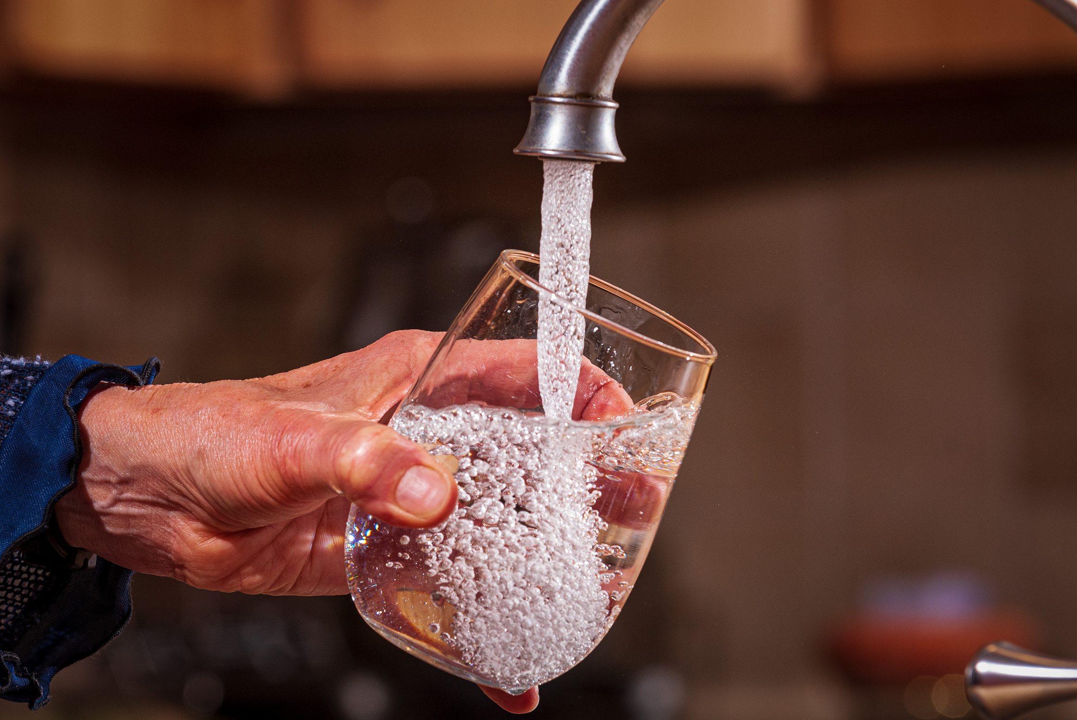
OVER 90
CONTAMINANTS
50
YEARS
Notes:
Caption: Today, @epagov and [organization name] are celebrating the 50th Anniversary of the #SafeDrinkingWaterAct. 50 years ago, the Safe Drinking Water Act set the standard for how we protect drinking water in America. 50 years later, the #SafeDrinkingWaterAct defines what is clean, safe drinking water, by reducing contaminants, building capacity at local utilities, and financing infrastructure improvements. What does #water mean to you? Let’s use #SDWA50 as a time to envision what the next 50 years of progress can and should look like for #SafeDrinkingWater.

Slide 9
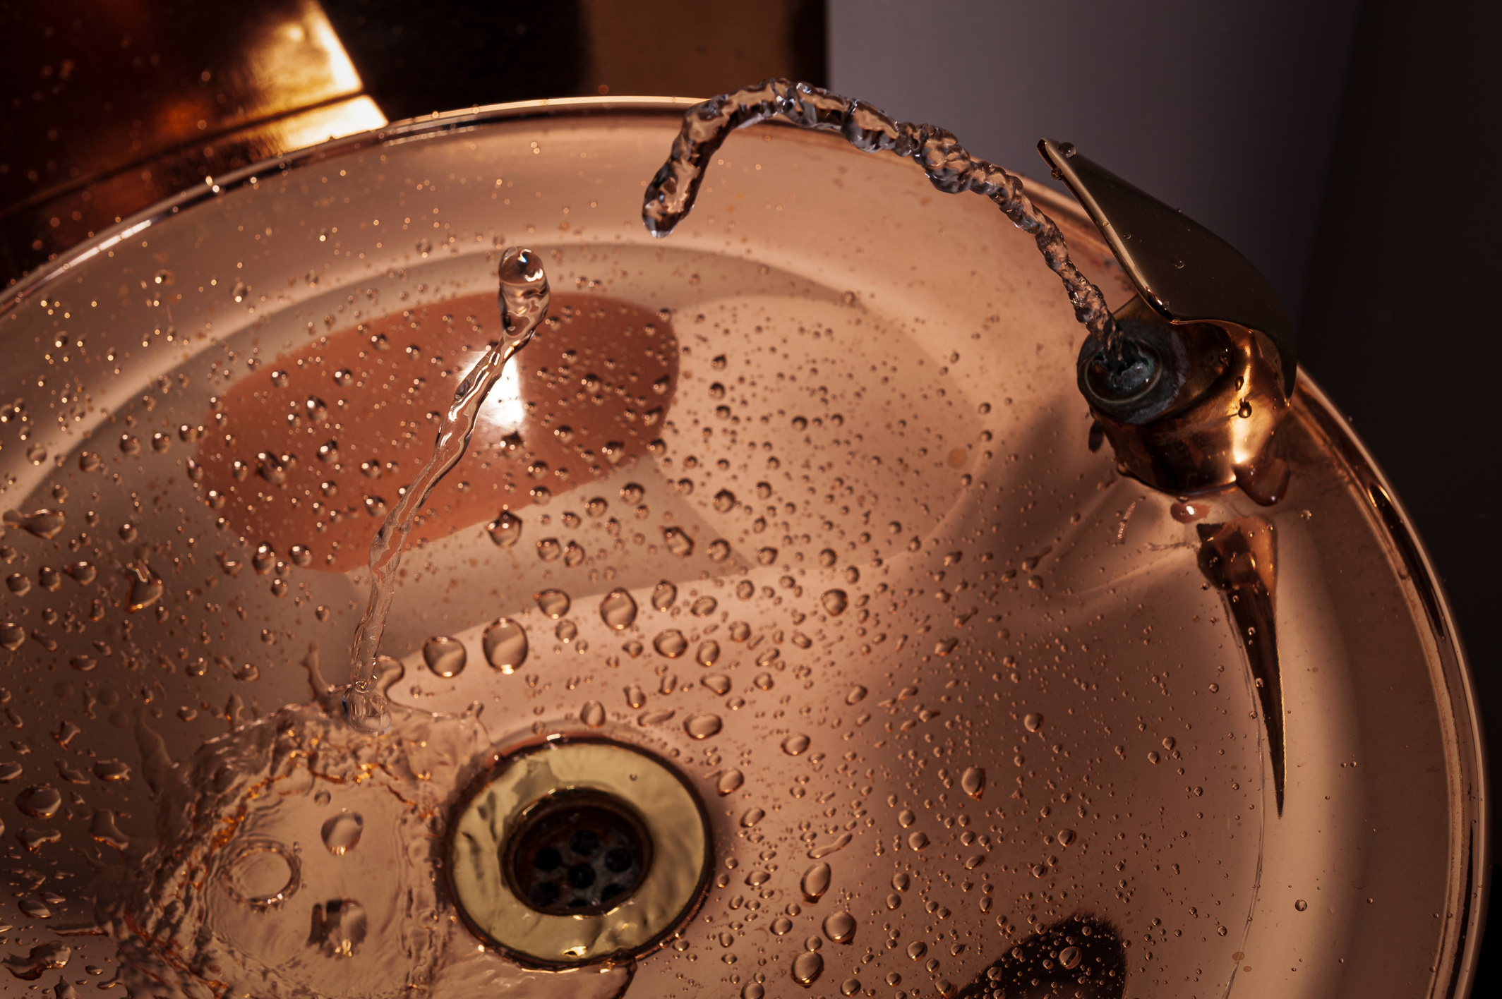
PUTTING DRINKING WATER FIRST
FOR 50 YEARS
Notes:
Caption: Today, @epagov and [organization name] are celebrating the 50th Anniversary of the #SafeDrinkingWaterAct. 50 years ago, the Safe Drinking Water Act set the standard for how we protect drinking water in America. 50 years later, the #SafeDrinkingWaterAct defines what is clean, safe drinking water, by reducing contaminants, building capacity at local utilities, and financing infrastructure improvements. What does #water mean to you? Let’s use #SDWA50 as a time to envision what the next 50 years of progress can and should look like for #SafeDrinkingWater.

Slide 11
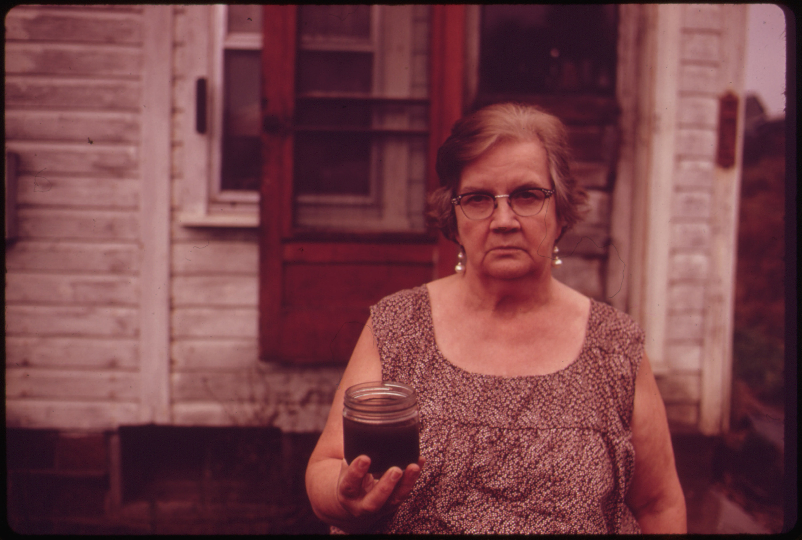
On December 16, 1974, Congress passed the Safe Drinking Water Act.
Notes:
Caption: This picture was documented in 1973, a year later Congress passed the Safe Drinking Water Act on December 16, 1974. Today, @epagov and [organization name] are celebrating the 50th Anniversary of the #SafeDrinkingWaterAct. 50 years ago, the Safe Drinking Water Act set the standard for how we protect drinking water in America. 50 years later, the #SafeDrinkingWaterAct defines what is clean, safe drinking water, by reducing contaminants, building capacity at local utilities, and financing infrastructure improvements. What does #water mean to you? Let’s use #SDWA50 as a time to envision what the next 50 years of progress can and should look like for #SafeDrinkingWater.

Slide 12
Notes:
Caption: Today, @epagov and [organization name] are celebrating the 50th Anniversary of the #SafeDrinkingWaterAct. 50 years ago, the Safe Drinking Water Act set the standard for how we protect drinking water in America. 50 years later, the #SafeDrinkingWaterAct defines what is clean, safe drinking water, by reducing contaminants, building capacity at local utilities, and financing infrastructure improvements. What does #water mean to you? Let’s use #SDWA50 as a time to envision what the next 50 years of progress can and should look like for #SafeDrinkingWater.

Slide 13
