Slide 1

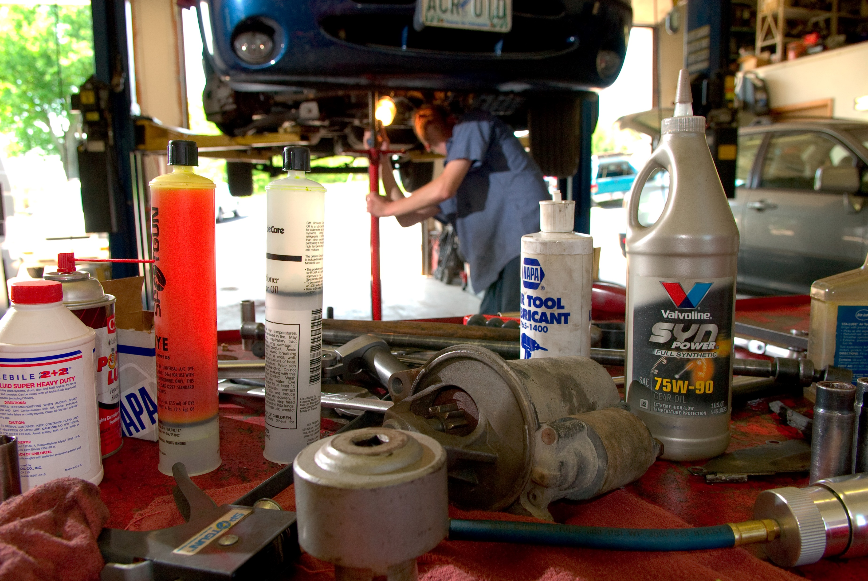

SIMILAR TO MC
Public Webinar
Regulation of PCE under TSCA Section 6(a)
January 15, 2024
RIN 2070-AK84
U.S. Environmental Protection Agency

Slide 2
Agenda
Overview of Toxic Substances Control Act (TSCA)
Overview of PCE Rulemaking
Summary of Proposed Regulation
Public Comment and Outreach
Final Regulation
Benefits
Next Steps
Opportunities for Engagement
Additional Resources

Slide 3
Overview of the Toxics Substances Control Act (TSCA)
In June 2016, Congress amended the Toxic Substances Control Act (TSCA)
  Amended TSCA requires EPA to assess and address risks from chemicals currently in commerce
  Amended TSCA imposes statutory timeframes for regulation
  Provides protection for the public and predictable process for the regulated community
PCE was identified as one of the first chemicals for risk evaluation
Per TSCA section 6(b)(4)(A) risk evaluation and determination of “unreasonable risk of injury to health or the environment under the conditions of use,” EPA must by rule apply requirements such that the “chemical substance or mixture no longer presents such risk.”

Slide 4
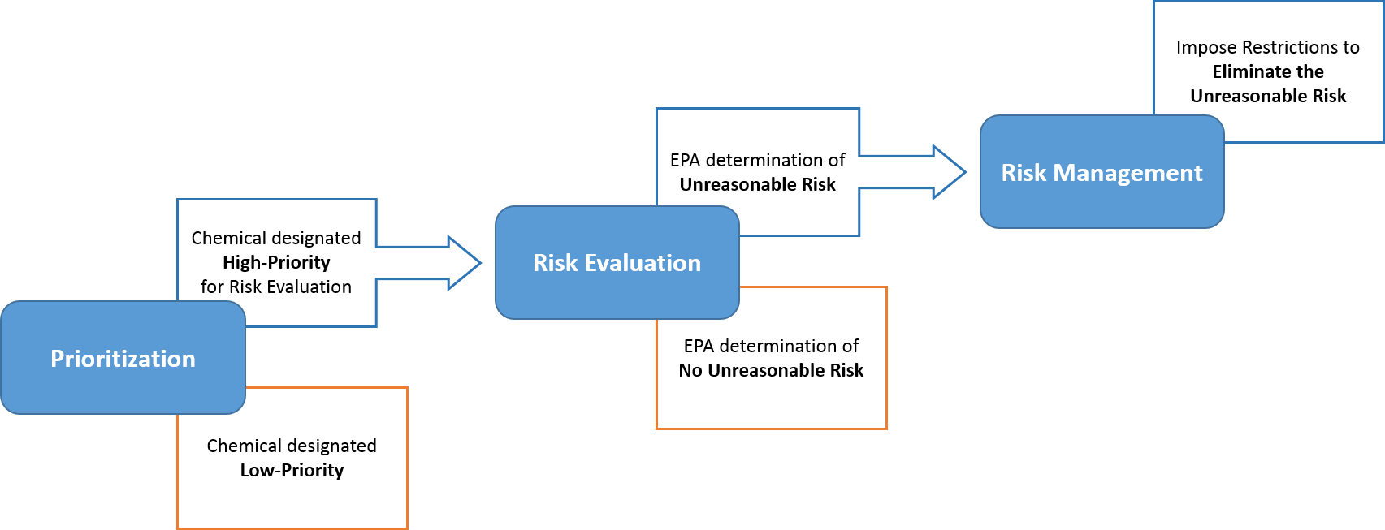
Process to Assessing and Managing Existing Chemicals under TSCA
Take action to
Address the Unreasonable Risk
EPA determination of Unreasonable Risk
Risk Management
Chemical designated High-Priority
for Risk Evaluation
Risk Evaluation
Prioritization
EPA determination of No Unreasonable Risk
Chemical designated Low-Priority
9 – 12 months
3 – 3.5 years
2 years

Slide 5
TSCA Section 6 – Risk Management Consideration and Regulatory Scope
Requires addressing unreasonable risk with consideration of alternatives, selecting among options, statement of effects, and economic analysis
Input from stakeholders is essential to the process, and robust coordination with interagency partners is necessary
TSCA provides authority to regulate entities including:
  Manufacturers (including importers) and processors (e.g., formulators)
  Distributors
  Commercial users (workplaces and workers)
  Entities disposing of chemicals for commercial purposes
Cannot directly regulate consumer users
  Under TSCA, EPA has authority to regulate at the manufacturing, processing and distribution levels in the supply chain to eliminate or restrict the availability of chemicals and chemical-containing products for consumer use
  These authorities allow EPA to regulate at key points in the supply chain to effectively address unreasonable risks to consumers

Slide 6
TSCA Section 6(a) Regulatory Options
Prohibit, limit or otherwise restrict manufacture, processing or distribution in commerce
Prohibit, limit or otherwise restrict manufacture (includes import), processing or distribution in commerce for particular use or for use above a set concentration
Require minimum warnings and instructions with respect to use, distribution, and/or disposal
Require recordkeeping, monitoring or testing
Prohibit or regulate manner or method of commercial use
Prohibit or regulate manner or method of disposal by certain persons
Direct manufacturers/processors to give notice of the unreasonable risk determination to distributors, users, and the public and replace or repurchase
The section 6(a) menu of regulatory options can be applied alone or in combination

Slide 7
Overview of PCE under the Toxics Substances Control Act (TSCA)
PCE is a volatile chemical used in a wide range of industrial, commercial, and consumer applications
PCE is a neurotoxicant and carcinogen, and chronic exposure is associated with liver and kidney effects, immune system toxicity, developmental/reproductive toxicity, and cancer
EPA found that 60 of 61 conditions of use of PCE contribute to the unreasonable risk of injury to health of workers, consumers, and bystanders

Slide 8
Previous TSCA Actions on PCE
December 2016: EPA designates PCE among the first ten chemicals to undergo risk evaluations under amended TSCA
December 2020: Risk Evaluation released after peer review of draft risk evaluation
December 2022: Final Revised Risk Determination published
June 2023: EPA Proposal for the Regulation of PCE under Section 6(a) signed and published

Slide 9
Summary of Proposed Rule for PCE Under TSCA 6(a)
On June 16, 2023, EPA proposed to:
  Prohibit manufacture, processing, and distribution for all consumer uses
  Prohibit most industrial and commercial uses
    Provide a 10-year phaseout for dry cleaning
  Allow some industrial and commercial uses to continue under a Workplace Chemical Protection Program (WCPP)
  Require workplace controls for laboratory use​
  Grant time-limited exemption under TSCA section 6(g)​ for emergency uses in furtherance of NASA’s mission
  Provide a de minimis regulatory threshold level of 0.1%
  The alternative regulatory actions included several additional uses under WCPP and longer compliance timeframes
The proposed rule was open for public comment from June 16 to August 15, 2023 (60 days)

Slide 10
Summary of Comments
Received 749 total comments on various aspects of the proposed rule
Vast majority of comments, received from a mass mailer campaign, requested that EPA strengthen or maintain the proposed risk mitigations
Other commenters requested additional time for compliance, additional prohibitions with shorter timelines, and additional section 6(g) exemptions
Specific information was provided from several industry sectors supporting changes from the proposed rule

Slide 11
Developing Effective Regulations
EPA’s mandate is to address identified unreasonable risk
TSCA additionally requires EPA to consider:
  Effects and magnitude of exposure to human health and the environment
  Benefits of a chemical substance
  Economic consequences of the rule
  Availability of alternatives
EPA’s proposed rule and final rule are based on best available science and reasonably available information
EPA’s final rule includes information received from commenters and targeted outreach
EPA considered all information received on the proposed rule and modified elements of the proposed regulatory action
EPA’s goal is to promulgate regulations that are both practical and protective

Slide 12
The Final Regulation
EPA’s final rule will:
Prohibit manufacture, processing, and distribution of PCE for all consumer uses
Prohibit industrial and commercial uses where successful implementation of stringent workplace controls cannot be accomplished
Require a Workplace Chemical Protection Program (WCPP) for 16 specified conditions of use (see slide 20)
Establish recordkeeping and downstream notification requirements
Require workplace controls for laboratory use
Provide regulatory threshold of 0.1% for regulation
Time-limited exemption under TSCA section 6(g)​ for NASA emergency uses
Require workplace controls for energized electrical cleaning

Slide 13
Final Regulation: Applicability
TSCA Chemical Substance: the provisions of this final rule only apply to chemical substances as defined under TSCA section 3, which excludes:
  “any food, food additive, drug, cosmetic, or device (as such terms are defined in Section 201 of the Federal Food, Drug, and Cosmetic Act [21 U.S.C. 321]) when manufactured, processed, or distributed in commerce for use as a food, food additive, drug, cosmetic, or device” and “any pesticide (as defined in the Federal Insecticide, Fungicide, and Rodenticide Act [7 U.S.C. 136 et seq.]) when manufactured, processed, or distributed in commerce for use as a pesticide.”
Regulatory Threshold for Compliance:
  EPA’s final rule is adopting a regulatory threshold of 0.1% to account for impurities and the unintended presence of PCE
  In other words, the provisions of this rulemaking only apply when PCE is present in a formulation at 0.1% or greater

Slide 14
Final Regulation: Prohibition of Consumer Use
EPA determined PCE could not be used safely in consumer products
  As with the proposed rule, the final rule will prohibit manufacturing (including import), processing, and distribution for consumer use, and provides time for retailers to phase out their consumer product inventory
  In almost all cases, alternatives are available
  EPA is prohibiting manufacture, processing, and distribution in commerce of PCE for all consumer use, including:
Automotive care products (brake cleaner and parts cleaner)
Aerosol cleaner (vandalism mark and stain remover)
Non-aerosol cleaner (marble and stone polish)
Lubricants and greases (cutting fluid, lubricants and penetrating oils)
Adhesives for arts and crafts (industrial adhesive, gun ammunition sealant, livestock grooming adhesive, column adhesive, caulk and sealant)
Cleaners and degreasers
Solvent-based paints and coatings (outdoor water shield, coatings and primers, rust primer and sealant, metallic overglaze)
Metal (e.g., stainless steel) and stone polishes
Inks and ink removal products
Welding
Metal mold cleaning, release and protectant products

Slide 15
Final Regulation: Prohibition of Industrial and Commercial Use
All industrial and commercial uses would be prohibited, except for uses covered by WCPP or prescriptive controls.
Prohibited industrial and commercial uses of PCE include:
In specialty DOD uses (oil analysis and water pipe repair)
In solvent-based paints and coatings
Dry cleaning and spot cleaning post-2006 dry cleaning
Dry cleaning and spot cleaning 4th/5th generation only dry cleaning
As solvent for aerosol spray degreaser/cleaner*
As solvent for cold cleaning*
In other textile processing
In wood furniture manufacturing
As solvent for aerosol lubricants
In wipe cleaning
In other spot cleaning and spot removers, including carpet cleaning
In automotive care products (e.g., engine degreaser and brake cleaner)
In non-aerosol cleaner
In metal (e.g., stainless steel) and stone polishes
In foundry applications
In welding
For mold release
As solvent for penetrating lubricants and cutting tool coolants
For photographic film
In inks and ink removal products (based on printing)
In inks and ink removal products (based on photocopying)
In mold cleaning, release, and protectant products
* Some applications will continue. These are discussed later in this presentation.

Slide 16
Final Regulation: Timeframe of Prohibition of Industrial and Commercial Use
Compliance dates for prohibition are staggered according to the supply chain and for specific uses
Lifecycle Designation | Final Prohibition Date | Implementation Timeframe from Publication of Final Rule
Manufacturers | June 11, 2026 | 18 months
Processers | September 9, 2026 | 21 months
Distributing to retailers | December 8, 2026 | 24 months
Retailers distributing | March 8, 2027 | 27 months
All other distributors | March 8, 2027 | 27 months
Industrial and commercial use | June 7, 2027 | 30 months
Dry cleaning and spot cleaning | December 19, 2034 | 10 years

Slide 17
Final Regulation: Dry Cleaning Phaseout
EPA is prohibiting PCE use in dry cleaning and spot cleaning through a 10-year phaseout to provide dry cleaners time to transition to an alternative process
Considered earlier state regulations, dry cleaning NESHAP, and stakeholder information:
  Average lifespan of PCE dry cleaning machine: 15 - 25 years
  Few new machines produced or sold in the U.S.
  Alternatives are available (wet cleaning, hydrocarbons, multi-solvent dry cleaning machines)
  Dry cleaners are mostly small businesses; can be located in densely populated communities
Phaseout Provision | Final Prohibition Dates | Phaseout Timing
Prohibition on use of PCE in any newly acquired dry cleaning machine | June 16, 2025 | 6 months​
Prohibition on use of 3rd generation PCE machines | December 20, 2027 | 3 years
Full implementation of prohibition, including: Prohibition on the use of PCE in all dry cleaning and spot cleaning, including in 4th and 5th generation machines Prohibition on the manufacturing, processing, and distribution in commerce of PCE for use in dry cleaning solvent | December 19, 2034 | 10 years

Slide 18
Final Regulation: Exemption Under TSCA Section 6(g)
Section 6(g) permits EPA to grant an exemption if EPA finds that:​
  The specific condition of use is a critical or essential use for which no technically and economically feasible safer alternative is available;
  Compliance with the rule would significantly disrupt the national economy, national security, or critical infrastructure; or
  The specific condition of use, as compared to alternatives, provides a substantial benefit to health, the environment, or public safety
EPA is finalizing: ​
  10-year exemption for emergency uses of PCE in furtherance of NASA’s mission​ until December 19, 2034
    Must document efforts to comply with provisions of the WCPP, to the extent technically feasible in light of the emergency, until prohibition takes effect

Slide 19
Final Regulation: Workplace Chemical Protection Program
A Workplace Chemical Protection Program (WCPP) protects people from unreasonable risk posed by occupational exposures from certain conditions of use
  Workers are one of the potentially exposed or susceptible subpopulations (PESS) under TSCA
  EPA’s WCPP applies to owners or operators and potentially exposed persons, which in some cases is broader definition than “employers” and “employees”
  EPA consulted with OSHA and NIOSH and coordinated on WCPP development and finalization, and aligned requirements where possible
  Includes requirements to meet an exposure limit, prevent skin contact, and implement an exposure control plan, among other requirements

Slide 20
Final Regulation: Workplace Chemical Protection Program (cont.)
The following uses will continue with strict controls under the WCPP in the final rule:
Manufacturing (Domestic)
Manufacturing (Import)
Processing: processing as a reactant*
Processing: incorporation into a formulation, mixture, or reaction products (cleaning and degreasing products, adhesive and sealant products, paint and coating products, other chemical products and preparations)*
Processing: recycling
Processing: repackaging
Industrial and commercial use as solvent for vapor degreasing (open-top batch, closed-loop batch)*
Industrial and commercial use in maskant for chemical milling
Industrial and commercial use in solvent-based adhesives and sealants*
Industrial and commercial use as a processing aid in catalyst regeneration in petrochemical manufacturing
Industrial and commercial use as a processing aid in sectors other than petrochemical manufacturing*
Industrial and commercial use for cold cleaning of tanker vessels
Disposal
Uses marked with an asterisk (*) are trichloroethylene (TCE) uses prohibited in the TCE regulation, and for which PCE may be a viable alternative.

Slide 21
Final Regulation: Workplace Chemical Protection Program (Cont.)
The WCPP finalizes an inhalation exposure limit (Existing Chemical Exposure Limit, or ECEL):​
  8-hour time-weighted average (TWA): 0.14 ppm (OSHA PEL is 100 ppm)​
  Includes monitoring, recordkeeping requirements, dermal and respiratory protection requirements
  Provides flexibility for preventing exceedances of the identified EPA exposure limit

Slide 22
Final Regulation: Workplace Chemical Protection Program (cont.)
The WCPP reduces compliance burdens by following a familiar framework: ​
  Initial monitoring to determine frequency of periodic monitoring ​
  Periodic monitoring every 3 months, 6 months, or 5 years, based on ECEL and ECEL action level
  Requirements to reduce exposures based on the NIOSH hierarchy of controls​
  Respirator selection criteria to protect workers from any remaining risks​
Hierarchy of Controls
Elimination
Substitution
Engineering Controls
Administrative Controls
PPE
Most Effective
Least Effective

Slide 23
Final Regulation: Timeframe for Workplace Chemical Protection Program
WCPP uses will have additional time to achieve successful implementation​​
WCPP Compliance Phase​ | Final Compliance Dates & Implementation Timeframes from Publication of Final Rule​
 | General Industry​ | Federal Agencies and Federal Contractors​
Initial Monitoring​ | December 15, 2025 / 12 months | June 21, 2027 / 30.5 months
ECEL | March 13, 2026 / 15 months​ | September 20, 2027 / 33.5 months
DDCC, PPE/Respirators​ | March 13, 2026 / 15 months | September 20, 2027 / 33.5 months​
Establish Regulated Area​ | March 13, 2026 / 15 months​ | September 20, 2027 / 33.5 months​
Exposure Control Plan​ | June 7, 2027 / 30 months​ | December 20, 2027 / 36.5 months

Slide 24
Final Regulation: Workplace Controls for Laboratory Use
For the industrial and commercial use of PCE as a laboratory chemical, owners and operators are required to:
  Ensure ventilated lab safety devices (e.g., fume hoods) are in use and functioning properly to minimize exposures when using PCE in laboratory settings​
  Provide dermal PPE (e.g., impervious gloves) to prevent direct dermal contact
Prescriptive controls are required by December 15, 2025 (within 360 days of publication)
EPA considered existing good laboratory practices and OSHA’s Occupational exposure to hazardous chemicals in laboratories standard at 29 CFR 1910.1450

Slide 25
Final Regulation: Workplace Controls for Energized Electrical Cleaning
EPA considered the lack of currently available alternatives that do not pose a flammability risk for the industrial and commercial use of PCE as an energized electrical cleaner
Workplace controls: EPA is requiring either:
  1) Specific prescriptive controls including dermal protection, such impermeable gloves and protective clothing, and the use of respiratory protection in confined/enclosed spaces and within a minimum approach distance, as well as comprehensive training; or
  2) Implementation of the WCPP
TCE use as an energized electrical cleaner is prohibited by December 18, 2027, in the TCE regulation. PCE can be a viable alternative. Until the TCE prohibition is in effect, workplace controls are required.

Slide 26
Final Regulation: Workplace Controls for Energized Electrical Cleaning (Cont.)
Workplace controls are required by March 13, 2026 (within 15 months of publication)
Owners or operators must attest that they are in compliance with the energized electrical cleaning provisions by providing a self-certification statement
A label must be provided and attached to each PCE-containing energized electrical cleaning product

Slide 27
Final Regulation: Recordkeeping and Downstream Notification
SDS updates are required for downstream notification of the prohibitions
  For conditions of use that are not prohibited under the final regulation, the Safety Data Sheets (SDSs) must be updated by adding information on prohibitions and relevant dates​
  Downstream notification spreads awareness throughout the supply chain of the restrictions on PCE under TSCA as well as provide information to commercial end users about allowable uses of PCE​
Recordkeeping requirements include maintenance of normal business records and records related to prohibitions and restrictions of this rule

Slide 28
Benefits of Final Rule
Addresses unreasonable risks for consumers and bystanders​
Addresses unreasonable risks for workers and occupational non-users​
Encompasses the majority of facilities, addressing the potential exposures to the neighboring communities ​
Directly addresses conditions of use that have previously resulted in injuries and illnesses
Provides regulated community with confidence in a protected and healthier workforce​
Ensures adequate time for successful phase out, implementation of workplace controls, and scaling up of the safety industry to meet demand​
Ensures operational continuity of federal agencies towards critical infrastructure and national security needs​
Includes a regulatory threshold to aid with implementation​
Includes additional uses from the proposal under the WCPP and use-specific workplace controls

Slide 29
Next Steps: Overview of Compliance Dates
Timeframes for Restrictions | General Industry | Federal Agencies (and Federal Contractors)​
WCPP - Initial Monitoring ​ | December 15, 2025 | June 21, 2027
WCPP - ECEL, DDCC, PPE/Respirator, Regulated Area​ | March 13, 2026 | September 20, 2027
WCPP - Exposure Control Plan​ | June 7, 2027 | December 20, 2027
Prescriptive controls - laboratory use | December 15, 2025 | December 15, 2025
Prescriptive controls - energized electrical cleaning | March 13, 2026 | March 13, 2026
Downstream notification - manufacturers update SDS | February 18, 2025 | February 18, 2025
Downstream notification - processors and distributors update SDS | June 16, 2025 | June 16, 2025
Recordkeeping | February 18, 2025 | February 18, 2025
Timeframes for Prohibitions | Final Prohibition Date
Manufacturers​ | June 11, 2026
Processors​ | September 9, 2026
Distributing to retailers​ | December 8, 2026
Retailers distributing​ | March 8, 2027
All other distributors​ | March 8, 2027
Industrial and commercial use​ | June 7, 2027
Dry Cleaning Phaseout Timeframes | Final Prohibition Date
Prohibition on use of PCE in any newly acquired dry cleaning machine | June 16, 2025
Prohibition on use of PCE in 3rd generation machines | December 20, 2027
Full implementation of prohibition, including: In all dry cleaning and spot cleaning, including in 4th and 5th generation machines Prohibition on the manufacturing, processing, and distribution in commerce of PCE for use in dry cleaning solvent | December 19, 2034

Slide 30
Additional Resources
Risk management for PCE: https://www.epa.gov/assessing-and-managing-chemicals-under-tsca/risk-management-perchloroethylene-pce
  PCE risk evaluation, supplemental risk evaluation materials, and proposed rulemaking are in dockets EPA-HQ-OPPT-2019-0502, EPA-HQ-OPPT-2016-0732, and EPA-HQ-OPPT-2020-0720 respectively, and may be accessed through www.regulations.gov
Risk management for TCE: https://www.epa.gov/assessing-and-managing-chemicals-under-tsca/risk-management-trichloroethylene-tce
General TSCA: https://www.epa.gov/assessing-and-managing-chemicals-under-tsca/frank-r-lautenberg-chemical-safety-21st-century-act
Chemicals Undergoing Risk Evaluation under TSCA: https://www.epa.gov/assessing-and-managing-chemicals-under-tsca/chemicals-undergoing-risk-evaluation-under-tsca​
Current Chemical Risk Management Activities: https://www.epa.gov/assessing-and-managing-chemicals-under-tsca/current-chemical-risk-management-activities​
PCE Fact Sheet: https://www.epa.gov/system/files/documents/2024-12/pce-fact-sheet_english.pdf
  Spanish: https://www.epa.gov/system/files/documents/2025-01/pce-fact-sheet_-spa.pdf
  Korean: https://www.epa.gov/system/files/documents/2025-01/pce-fact-sheet_kor.pdf
PCE Dry Cleaning Compliance Guide: https://www.epa.gov/system/files/documents/2025-01/pce-dry-cleaner-compliance-guide.pdf
  Spanish: https://www.epa.gov/system/files/documents/2025-01/pce-dry-cleaner-compliance-guide_spa.pdf
  Korean: https://www.epa.gov/system/files/documents/2025-01/pce-dry-cleaner-compliance-guide_kor.pdf
PCE Energized Electrical Cleaning Guide: https://www.epa.gov/system/files/documents/2025-01/pce-eec-compliance-guide.pdf
TSCA hotline: 1-800-471-7127 and tsca-hotline@epa.gov

Slide 31
Contact Us
For general questions, email EPA at:
  PCE.TSCA@epa.gov or
  TCE.TSCA@epa.gov.
Thank you!

