Slide 1
Module 4:
Hiring Certified Lead Professionals

Slide 2
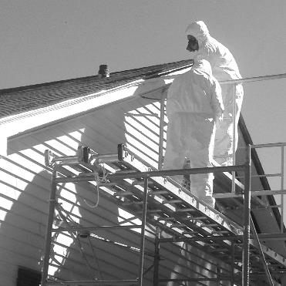
Outline
Deteriorating Lead-Based Paint Hazards
Testing Your Home for Lead
Lead Abatement
Renovation, Repair and Painting (RRP) Rule
Lead Abatement Versus RRP Projects
Photo provided by Shaun West, Environmental Programs Manager, Cherokee Nation
Notes:
Today’s session will be approximately 75 minutes long, we will discuss:
Deteriorating Lead-Based Paint Hazards
Testing Your Home for Lead
Lead Abatement
Renovation, Repair and Painting (RRP) Rule
Lead Abatement Versus RRP Projects

Slide 3
Outcomes
List three potential lead-based paint hazards
Compare the difference between a lead-based paint inspection and a lead risk assessment
List three things that Lead-Safe Certified Firms do when conducting renovation, repair and painting activities
Explain how to find a Lead-Safe Certified Firm
Notes:
Upon the completion of Module 4, participants will be able to:
List three potential lead-based paint hazards;
Compare the difference between a lead-based paint inspection and a lead risk assessment;
List three things that Lead-Safe Certified Firms do when conducting renovation, repair and painting activities; and
Explain how to find a Lead-Safe Certified Firm.

Slide 4
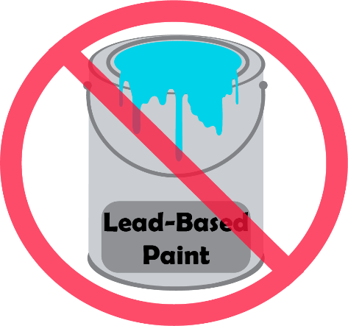
Lead-Based Paint
In 1978, the federal government banned the residential use of lead-based paint
  Housing
  Child care facilities
  Preschools
Notes:
I. Introduction
In this session, we are going to discuss what to do if you are concerned that your home, child care facility or preschool, whether owned or rented, contains lead-based paint. In 1978, the federal government banned the residential use of lead-based paint, which made residential lead-based paint no longer available for purchase in stores. The focus of this session will be on housing, child care facilities, or preschools built prior to 1978.

Slide 5
Has anyone ever heard that you should hire a certified lead professional to do work on your home?
Notes:
Before we begin, I have a few questions for the group to gain a better understanding of what you already know:
1. Has anyone ever heard that you should hire a certified lead professional to do work on your home? Instructor Note; This can be as simple as having participants raise their hands to respond with “yes” or “no” or you can allow participants time to share.

Slide 6
When should we hire certified lead professionals?
Notes:
2. When should we hire certified lead professionals?

Slide 7
How can you tell if your home has lead-based paint and you might need to hire a certified lead professional?
Notes:
3. How can you tell if your home has lead-based paint and that you might need to hire a certified lead professional?

Slide 8

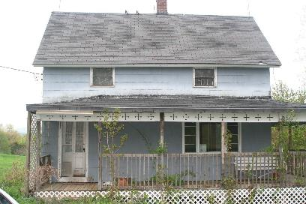

Which house has lead-based paint?
Notes:
ANIMATED SLIDE – multiple clicks required (second click will reveal the answer).
4. Instructor Note: Show participants the two photos of houses. Looking at these photos can you tell which house has lead-based paint? Instructor Note: Allow participants a moment to think and respond.
It is not possible to tell just by looking at these houses if they have lead. We know there is lead in the house on the left photo example because the paint was analyzed and was found to contain lead. The other house was built in 2007.

Slide 9
Pre-1978 Homes
“Pre-1978 homes” refers to homes, child care facilities or preschools built before 1978
Lead-based paint may be:
  On interior or exterior surfaces
  Stored and then used years later
Notes:
Throughout this session, I will use the phrase “pre-1978 homes” to refer to homes, child care facilities or preschools built before 1978.
The federal government banned the sale of paint containing lead for use in residential homes in 1978 to reduce children’s exposure to lead. If your home was built before 1978, it may have lead-based paint on interior and/or exterior surfaces. In some instances, lead-based paint may have been purchased before it was banned, stored and then used years later.

Slide 10
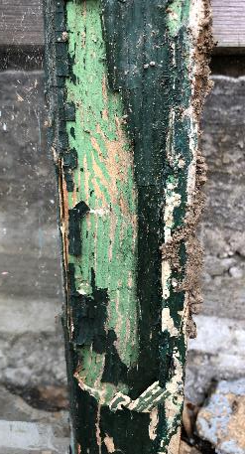
Lead-Based Paint
May be present under layers of paint
If paint is kept intact and surfaces are kept clean, children can live safely in a home containing lead-based paint
Paint can deteriorate, peel, chip, chalk or crack and become a hazard
Lead dust can be breathed in and swallowed
Notes:
Today, lead-based paint may still be present under layers of paint in pre-1978 homes. If paint is kept intact and surfaces are kept clean, children can live safely in a home containing lead-based paint. However, when painted surfaces are not properly maintained, paint can deteriorate, peel, chip, chalk, or crack, becoming a hazard. When lead-based paint is old and worn or is subject to constant rubbing (as on doors and windowsills) lead-based paint chips and dust can scatter and become a hazard. These hazards can be breathed in or swallowed by children, residents and workers. Lead dust can also be scattered when paint is disturbed during renovation, repair or remodeling. In addition, lead-based paint chips, dust and contaminated soil can end up on a child’s hands and toys which younger children put in their mouths, leading to ingestion of lead.

Slide 11
If painted surfaces are deteriorating and you are concerned that they may contain lead-based paint, what would be the first step to take to reduce potential exposure to lead in your home?
Notes:
If painted surfaces are deteriorating and you are concerned that they may contain lead-based paint, what would be the first step to take to reduce potential exposure to lead in your home? Instructor’s Note: Allow participants a moment to think and then ask them to share their answers with the group.
A good first step would be to check with the local tribal housing authority or environmental department to get more information. If you own your home, hire a certified lead professional to conduct a lead inspection and/or a lead risk assessment. Another possible first step is to clean using the techniques, such as wet mopping, covered in Module 2. We will discuss lead inspections and lead risk assessments in more detail later.
When renovation, repair and painting (RRP) jobs occur in a pre-1978 home with lead-based paint, the disturbance of the paint creates lead dust, which can be inhaled or swallowed. Even if you try to keep the work area neat and clean, lead dust cannot be contained unless proper lead-safe work practices are followed. Therefore, it is important to have a Lead-Safe Certified Firm perform the work. We will discuss this later.

Slide 12
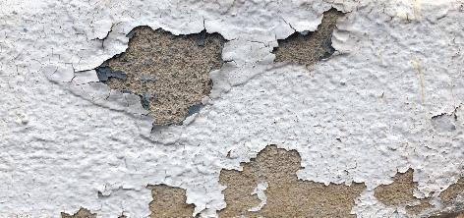
Deteriorating Lead-Based Paint
Refers to peeling, chipping, chalking, or cracking lead-based paint
Needs immediate attention
Impact or friction surface
  Window
  Door jamb
Notes:
II. Deteriorating Lead-Based Paint Hazards
Deteriorating lead-based paint (peeling, chipping, chalking, or cracking paint) is a hazard and needs immediate attention. A lead-based paint hazard is any condition resulting from deteriorating paint, which causes exposure to lead from paint, dust or soil. Lead-based paint is usually not a hazard if it is in good condition and is not on an impact or friction surface like a window or door jamb or surfaces that children chew.

Slide 13
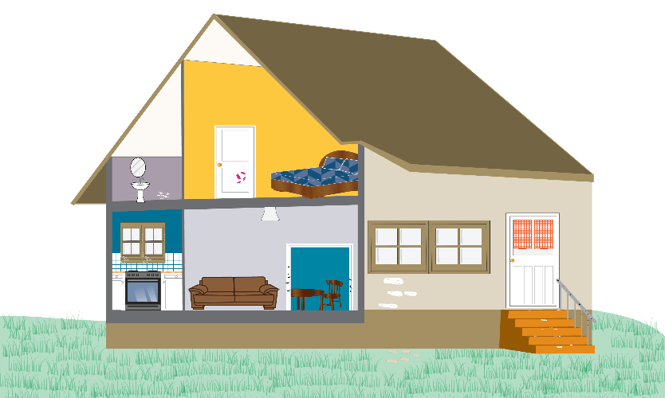
Lead-Based Paint Hazards
The home has 8 lead-based paint hazards
Notes:
Instructor’s Note: Give a copy of the Module 4 Worksheet, Module 4 Key Messages and a pencil to each participant.
The home shown on the worksheet has eight lead-based paint hazards. Using the worksheet, find and circle the areas in the home where it looks like the paint is peeling, chipping, chalking or cracking.

Slide 14
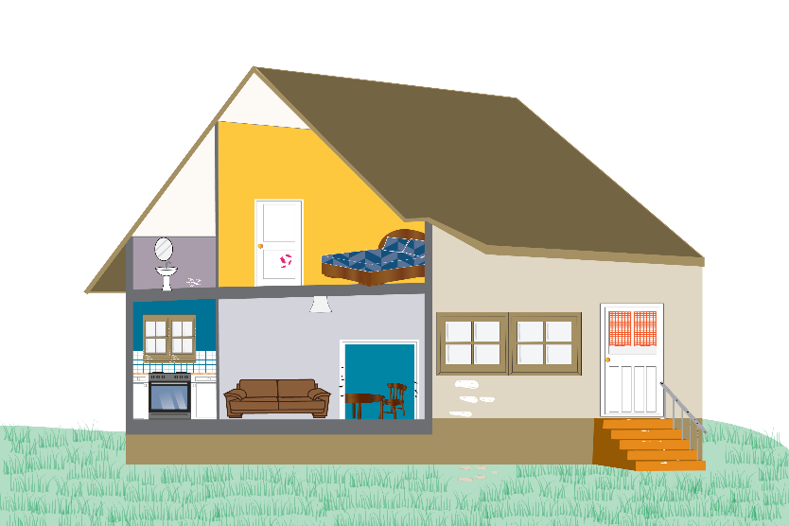
Lead-Based Paint Hazards
1. Door
5. House
exterior
2. Wall
6. Soil
3. Windows
7. Railing
4. Trim/door frame
8. Stairs
Notes:
ANIMATED SLIDE – multiple clicks required (each click will reveal another correct answer).
Let’s review the answers and see if you found all eight lead-based paint hazards. Instructor’s Note: The correct answers are circled within the presentation slides and can be found upside down at the bottom of the worksheet.
The lead-based paint hazards in this home, where the paint is deteriorating, peeling, chipping, chalking or cracking are: 1. Door (bedroom); 2. Wall (bathroom); 3. Windows (kitchen); 4. Trim/door frame (living room); 5. House exterior; 6. Soil; 7. Railing (outside); and 8. Stairs (outside).
Areas where lead-based paint is disturbed can become dangerous when paint chips form and dust is created. Lead-based paint chips and dust can settle on food preparation surfaces, floors, rugs, furniture, children’s toys, pets and many other surfaces and objects.
Settled lead dust can also re-enter the air when the home is vacuumed or swept, or when people walk through it. Families have been exposed to and affected by lead after scraping, sanding or heating (from a heat gun or torch) lead-based paint, which releases lead dust into the air. Lead in soil can also be a hazard when children play in bare lead-contaminated soil or when people bring lead-contaminated soil into their home on their shoes. Lead dust from RRP work, if not conducted in a lead-safe manner, remains in a home long after the work is completed.

Slide 15
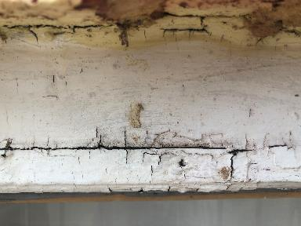
Painted Surfaces
Check for deteriorating paint
Monitor activities that may disturb painted surfaces
Usually not a hazard if paint is in good condition and is not on an impact or friction surface like a window
Notes:
Caring for painted surfaces in your home is important, especially those surfaces that you suspect of having lead-based paint. Owners and occupants should check for deteriorating paint (peeling, chipping, chalking or cracking paint) and monitor activities that may disturb painted surfaces. Remember that lead-based paint is usually not a hazard if it is in good condition and is not on an impact or friction surface like a window, that can create dust when the painted surfaces rub against each other when opened or closed.
Lead-based paint chips, which you can see, and lead dust, which you may not be able to see, can both be hazards. The only way to find out if paint, dust or soil lead hazards exist is to test them, which is what we will be talking about next.

Slide 16
Has anyone had their home tested for lead-based paint?
Notes:
III. Testing Your Home for Lead
The only way to know if your home has lead-based paint in it is to have it tested. Has anyone ever had their home tested for lead-based paint? Instructor’s Note: If someone responds yes, give them time to share their experience.

Slide 17

Testing Your Home
Two options:
  Lead-based paint inspection
  Lead-based paint risk assessment
If renting, contact your landlord or tribal housing authority
If purchasing a home, contract must include a warning statement
Notes:
There are two options available to test your home for lead-based paint: a lead-based paint inspection or a lead-based paint risk assessment. For either option, you should hire a certified lead professional. These professionals have special training and are licensed to perform these types of in-home tests. Lead inspections and lead risk assessments are important steps to take to find out if your home has lead-based paint, the results of which can help you make decisions on managing lead-based paint and lead hazards.
If you are renting your home or apartment and think it may contain lead-based paint or lead hazards, you should contact your landlord or tribal housing authority about hiring a certified lead professional. Instructor’s Note: Provide participants with any landlord or tribal housing authority contact information you find.
If you are purchasing a home, real estate contracts must include a specific warning statement about lead-based paint. Buyers have up to 10 days after signing the real estate contract to check for lead. Instructor’s Note: For more information on real estate disclosures about potential lead hazards, visit: https://www.epa.gov/lead/real-estate-disclosures-about-potential-lead-hazards

Slide 18
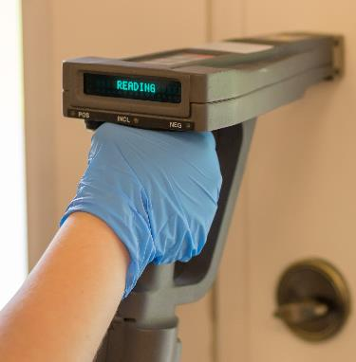
Lead-Based Paint Inspection
Activity that tells if your home has lead-based paint and where lead-based paint is located
X-ray fluorescence (XRF) instrument or paint samples
Most helpful:
  When buying a home
  When signing a lease
  Before renovating
X-ray fluorescence (XRF) instrument
Notes:
a. Lead-based Paint Inspection
A lead-based paint inspection is an activity that tells you if your home has lead-based paint and where lead-based paint is located. The inspection will not tell you whether your home currently has lead hazards or how to deal with them. A trained and certified lead inspector will inspect the paint in your home using a portable X-ray fluorescence (XRF) instrument or take small paint samples for laboratory analysis
A lead-based paint inspection is most helpful:
When buying a home;
When signing a lease; and
Before renovating.
Instructor’s Note: If your tribe has access to an XRF instrument, invite a trained operator to come to the session and demonstrate how the XRF instrument works.

Slide 19
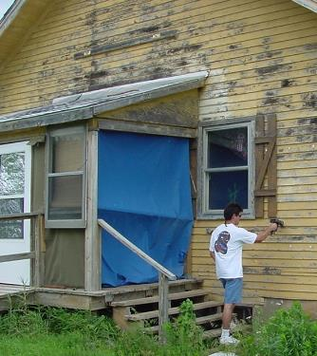
Lead-Based Paint Risk Assessment
Activity that tells if your home has any lead hazards from lead in paint, dust or soil and what actions to take
XRF instrument or paint samples
Most helpful:
  Home is known or suspected to contain lead-based paint
  To develop a plan to address existing hazards
Photo provided by Shaun West, Environmental Programs Manager, Cherokee Nation
Notes:
b. Lead-based Paint Risk Assessment
A lead-based paint risk assessment is an activity that tells you if your home has any lead hazards from lead in paint, dust or soil and what actions to take to address those hazards. A trained and certified lead risk assessor will collect samples of deteriorated paint, dust and soil and send them to a laboratory for analysis and/or may use an XRF instrument.
A lead-based paint risk assessment is most helpful
If your home is known or suspected to contain lead-based paint; and
To develop a plan to address existing hazards.
When you hire a certified lead professional to either conduct a paint inspection or a risk assessment, you can expect to receive the testing results anywhere from a few hours to a few days.

Slide 20
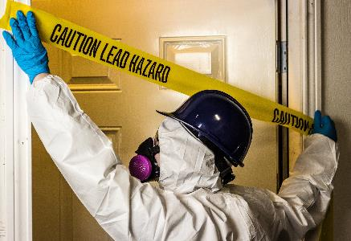
Lead Abatement
Designed to address existing lead-based paint hazards
Tribal, state or local government may order lead abatement if a child has been diagnosed with lead poisoning
Recommended by certified lead professional
Homeowner’s choice
Notes:
IV. Lead Abatement
Lead abatement is designed to address existing lead-based paint hazards. There are four types of lead abatement: replacement, removal, enclosure and encapsulation. While replacement and removal completely remove lead-based paint, enclosure and encapsulation methods are applied on top of lead-based paint in good condition without removing the lead-based paint.
The decision to conduct lead abatement in a home can be determined by different parties, such as:
A tribal, state or local government may order lead abatement if a child has been diagnosed with an elevated blood lead level;
A certified lead professional recommends lead abatement after a lead-based paint inspection or risk assessment; or
The homeowner may choose lead abatement.

Slide 21
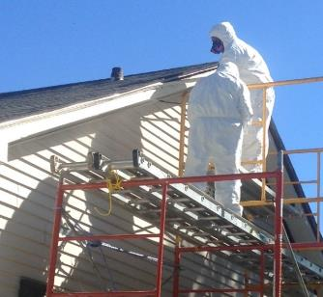
Lead Abatement
Involves specialized techniques
Hire a trained and certified lead abatement contractor
EPA requires individuals and firms who perform lead abatement projects to be certified and follow specific work practices
Photo provided by Shaun West, Environmental Programs Manager, Cherokee Nation
Notes:
Lead abatement involves specialized techniques beyond the training of most residential contractors, and you should hire a trained and certified lead abatement contractor. EPA requires individuals and firms who perform lead abatement projects in homes, child care facilities or preschools built before 1978 to be certified and follow specific work practices. Lead abatement can create even more dangerous lead hazards if done improperly. If lead abatement is necessary, you should always use a lead abatement firm or professional who has been trained and certified by a tribal, state or an EPA lead-based paint program.

Slide 22
Lead-Based Paint Programs
 | EPA-authorized Lead-Based Paint Programs | EPA-administered Lead-Based Paint Programs
Tribes | Cherokee Nation, Upper Sioux Community, Lower Sioux Indian Community in the State of Minnesota, Minnesota Chippewa Tribe – Bois Forte (Nett Lake) | All Other Tribes
States | AL, AR, CA, CO, CT, DC, DE, GA, HI, IN, IA, KS, KY, LA, ME, MD, MA, MI, MN, MS, MO, NE, NH, NJ, NC, ND, OH, OK, OR, PA, RI, TN, TX, UT, VT, VA, WA, WV, WI | AK, AZ, FL, ID, MT, NV, NM, NY, SC, SD, WY
Territories | Puerto Rico, Virgin Islands | American Samoa, Guam, the Northern Marianas
Website | https://www.epa.gov/lead/renovation-repair-and-painting-program-firm-certification#1 | https://www.epa.gov/lead/renovation-repair-and-painting-program-firm-certification#1
Notes:
Currently, there are four tribes with EPA-authorized lead-based paint programs: Cherokee Nation, Upper Sioux Community, Lower Sioux Indian Community in the State of Minnesota and Minnesota Chippewa Tribe - Bois Forte (Nett Lake). Most states and two territories are authorized by EPA to run their own lead-based paint abatement programs. EPA administers the lead-based paint program only in areas where tribes, states or territories are not authorized by EPA to operate their own lead-based paint programs.
Instructor’s Note: If you have internet access, go to the appropriate website and show participants how to find a lead abatement firm in their area.

Slide 23
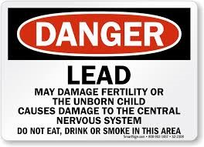
Lead Abatement Lead-Safe Work Practices
Relocate children and pregnant women from the home
Remove all furniture, carpets, drapes, etc.
Cover everything that remains with plastic drop cloths
Notes:
When a lead abatement takes place in your home, a certified lead abatement professional will follow lead-safe work practices, which include:
Relocating children and pregnant women away from the home (or child care facility) until after the work is completed;
Removing all furniture, carpets, drapes, etc.; and
Covering everything that remains with plastic drop cloths.

Slide 24

Renovation, Repair and Painting (RRP) Rule
Notes:
V. Renovation, Repair and Painting (RRP) Rule
Before we begin our discussion about the Renovation, Repair and Painting (RRP) Rule let’s watch a short EPA video that discusses tribal lead-based paint safe work practices. Instructor’s Note: Play EPA’s Lead-Based Paint Safe Work Practices (YouTube) video, https://www.youtube.com/watch?v=XqUssA-PsD0.

Slide 25
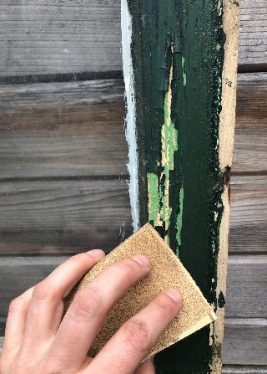
Renovation, Repair and Painting (RRP) Projects
Can create hazardous lead dust and chips
Performed for:
  Aesthetics
  Interim control actions to minimize lead hazards
    Repair damaged painted surface
Not designed to address lead-based paint hazards
Notes:
Any time surfaces painted with lead-based paint are disturbed during common renovation, repair and painting (RRP) activities like sanding, cutting and replacing windows, this can create hazardous lead dust and chips, which can be harmful to both adults and children.
RRP projects are typically performed at the option of the property owner for aesthetic or other reasons, or as interim control actions (such as: repairing damaged painted surfaces or planting grass to cover contaminated soil) to minimize lead hazards. RRP projects are not designed to address lead-based paint hazards.

Slide 26
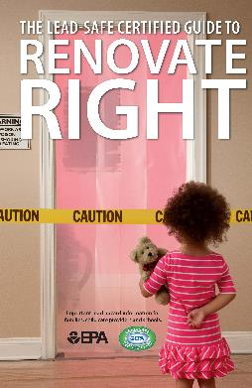
RRP Rule Requirements
Firms must be certified and their employees trained in lead-safe work practices that include:
  Containing the work area
  Minimizing the dust
  Cleaning up properly
  Disposing of waste properly
The Lead-Safe Certified Guide to Renovate Right
Notes:
The RRP rule requires firms to be certified and their employees trained (either as a certified renovator or on-the-job by a certified renovator) in the use of lead-safe work practices that minimize occupants’ exposure to lead hazards by:
Containing the work area;
Minimizing the dust;
Cleaning up properly; and
Disposing of waste properly to prevent lead contamination.
Federal law requires that individuals receive a copy of the EPA document, “The Lead-Safe Certified Guide to Renovate Right” before renovating six square feet or more of painted surfaces in a room for interior projects or more than twenty square feet of painted surfaces for exterior projects. The law applies to any project in a pre-1978 home involving window replacement or demolition regardless of the size of the area disturbed. Instructor’s Note: Show the slide with the picture of the EPA document, “The Lead-Safe Certified Guide to Renovate Right,” to the participants: https://www.epa.gov/lead/renovate-right-important-lead-hazard-information-families-child-care-providers-and-schools. Additional requirements may exist for federal assistance housing (see box in Lesson Plan).

Slide 27
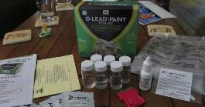
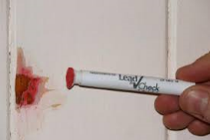
Prepare for RRP Projects
In pre-1978 homes, Lead-Safe Certified renovators may:
  Take paint chip samples for lab analysis and/or use an XRF instrument
  Use EPA-recognized test kits (except in housing receiving Federal Assistance)
  Presume that lead-based paint is present and use lead-safe work practices
D-Lead® Paint Test Kit
3M™ LeadCheck™ Lead Test Kit
Notes:
In preparing for RRP projects in a pre-1978 home, Lead-Safe Certified renovators may:
Take a paint chip sample and send it to a laboratory for analysis or use an XRF instrument to determine if lead-based paint is present;
Use EPA-recognized test kits (except in housing receiving federal assistance); or
Presume that lead-based paint is present and use lead-safe work practices.

Slide 28
RRP Programs
 | EPA-authorized RRP Programs | EPA-administered RRP Programs
Tribes | Minnesota Chippewa Tribe – Bois Forte (Nett Lake) | All Other Tribes
States | AL, DE, GA, IA, KS, MA, MI, NC, OK, OR, RI, UT, WA, WI | All Other States
Territories | None | All Territories
Website | https://www.epa.gov/lead/renovation-repair-and-painting-program-firm-certification#1 | https://www.epa.gov/lead/renovation-repair-and-painting-program-firm-certification#1
Notes:
If renovation, repair or painting is being conducted and lead-based paint is present or in any pre-1978 home that has not been shown to be lead-free, then the work is required to be done by a Lead-Safe Certified firm who must:
Be approved by EPA or an EPA-authorized tribal or state program;
Use qualified trained individuals who follow specific lead-safe work practices to prevent lead contamination; and
Provide you with a copy of EPA’s lead hazard information document, The Lead-Safe Certified Guide to Renovate Right (https://www.epa.gov/lead/renovate-right-important-lead-hazard-information-families-child-care-providers-and-schools), before conducting renovations in pre-1978 homes.
One tribe and 14 states are EPA-authorized to run their own RRP programs. EPA administers the RRP program in most states, territories and tribes, as shown in the RRP Programs table.

Slide 29
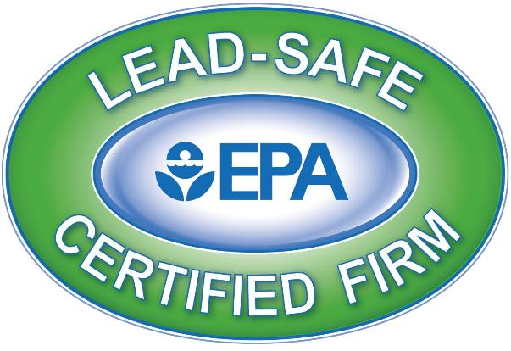
EPA’s Lead-Safe Certified Firm Logo
Notes:
If you live in a pre-1978 home and need to hire a renovator or contractor, make sure you use an EPA, tribal or state Lead-Safe Certified renovation firm in your area. To find one, visit EPA’s website: https://cfpub.epa.gov/flpp/pub/index.cfm?do=main.firmSearch. Instructor’s Note: If you have internet access, go to the website and show participants how they can find a Lead-Safe Certified firm in their area.
When hiring a Lead-Safe Certified contractor to do RRP work on your home or child care facility, make sure to look for EPA’s Lead-Safe Certified Firm logo.
Use a certified lead inspector or risk assessor to check to see if there is lead paint in your home prior to doing any RRP work yourself. If lead is present, you should hire a Lead-Safe Certified firm to perform the RRP job.
The RRP Rule typically does not apply to homeowners renovating, repairing or painting their own homes, unless the home or a portion of the home is a rental or is used to provide child care services. Do-it-yourself projects can easily create dangerous lead dust. Protect your family and home – work safely, control the dust and clean up completely. Instructor Note: If participants want to discuss this further, then utilize the list of safeguards identified in Appendix B: Renovation, Repair and Painting Program: Do-It-Yourselfers.

Slide 30
Understanding Lead Terms
3
___ An activity designed to address lead-based paint hazards. There are four options: replacement, removal, enclosure and encapsulation. Replacement and removal activities completely remove lead-based paint. Enclosure and encapsulation methods are applied on top of lead-based paint in good condition without removing the lead-based paint.
___ An activity that tells you if your home has any lead hazards from lead in paint, dust or soil and what actions to take to address those hazards. Most helpful if a home is suspected or known to contain lead-based paint or to develop a plan to address existing hazards.
2
Notes:
ANIMATED SLIDE – multiple clicks show answers
Please pull out and flip over your worksheet to the section labeled Understanding Lead Terms. We are going to do a quick review about the differences between a lead inspection, lead risk assessment, lead abatement and the RRP rule. Write the number of the term next to its definition and then we will go over the correct answers as a group. Instructor’s Note: The correct answers are at the end of the Important Lead Terms to Know section on the worksheet.

Slide 31
Understanding Lead Terms
1
___ An activity that tells you if your home has lead-based paint and where lead-based paint is located. Most helpful when buying a home, signing a lease and before renovating.
___ A federal law that requires firms that disturb painted surfaces in homes, child care facilities and pre-schools, built before 1978 to be certified and their employees trained in the use of lead-safe work practices that minimize occupants’ exposure to lead hazards by: containing the work area; minimizing dust; cleaning up properly; and disposing of waste properly to prevent lead contamination.
4
Notes:
ANIMATED SLIDE – multiple clicks show answers

Slide 32
Lead Abatement Activities Versus RRP Projects
 | Lead Abatement Activities | Similar or Different | RRP Projects
Purpose | Address existing lead-based paint hazards | Different | Conduct renovations, repairs or painting to reduce lead-based paint hazards
Initiated By | Tribal, state or local government Voluntary request by property owner | Different | Voluntary request by property owner
Certifications | Individuals must be trained and certified in lead abatement activities Firms must be certified to conduct lead abatement activities | Similar | Individuals must be trained and certified in RRP activities Firms must be certified to conduct RRP activities
Occupant Protection | Firms are required to make sure occupants are out of the home, child care facility or preschool | Different | Firms are not required to make sure occupants are out of the home, child care facility, or preschool Firms must distribute EPA's The Lead-Safe Certified Guide to Renovate Right before starting renovation work Occupants should not be present in the work area.
Learn More | About abatement and EPA's Lead-Based Paint Activities Program at: https://www.epa.gov/lead/lead-abatement-inspection-and-risk-assessment |  | About EPA’s RRP certification and training program at: https://www.epa.gov/lead/renovation-repair-and-painting-program
Notes:
VI. Lead Abatement Activities and RRP Projects
Lead abatement activities and RRP projects may sometimes look similar, but they are two separate programs that require different certifications and are regulated differently by EPA.
Lead abatement is a specialized activity designed to address lead-based paint hazards in pre-1978 homes. RRP projects in pre-1978 homes are often undertaken for reasons unrelated to lead issues. The differences and similarities between the two activities are shown in the Lead Abatement Activities Versus RRP Projects table. Instructor Note: This table can also be found in the Module 4 Key Messages handed out at the beginning of the session.
To continue reviewing what we learned today, answer the questions in the Lead Abatement and Renovation, Repair and Painting (RRP) Review section at the bottom of your worksheet. Instructor’s Note: Allow participants time to answer the questions and then go over the correct answers with the whole group. Correct answers can be found upside down at the bottom of the worksheet.

Slide 33
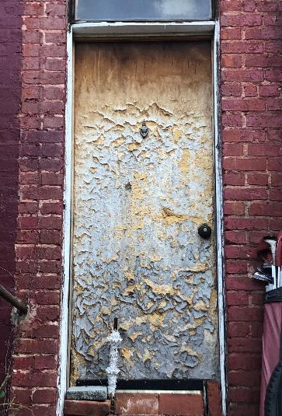
Review
A lead-based paint hazard is any condition resulting from deteriorating paint which potentially causes exposure to lead from paint, dust or soil
Found in common areas of homes
Notes:
VII. Conclusion
A lead-based paint hazard is any condition resulting from deteriorating paint (peeling, chipping, chalking, or cracking), which potentially causes exposure to lead from paint, dust or soil. We learned that lead-based paint hazards may be found in common areas of homes that include:
Doors;
Walls;
Windows;
Trim/door frames;
House exterior;
Soil;
Railings; and
Stairs.

Slide 34
What are lead-based paint activities?
Notes:
I have a few discussion questions for the group:
What are lead-based paint activities? Possible answers:
Lead-based paint activities include lead-based paint inspections, lead risk assessments and lead abatements (addressing lead-based paint hazards). Lead inspections are designed to locate all lead-based paint in a home and lead risk assessments are designed to identify lead hazards and management strategies. Individuals must be trained and certified to conduct lead-based paint activities, and firms must be certified.

Slide 35
What are lead abatement activities?
Notes:
What are lead abatement activities? Possible answers:
Lead abatement activities are designed to address existing lead-based paint hazards. They may be ordered by a tribal, state or local government in response to a lead-poisoned child or other reason or may be undertaken voluntarily at any time.
There are four types of lead abatement: replacement, removal, enclosure and encapsulation. While replacement and removal remove lead-based paint, enclosure and encapsulation methods are applied on top of lead-based paint in good condition without removing the lead-based paint.
Individual lead abatement contractors must be trained and certified to conduct lead abatement jobs. Cherokee Nation, Upper Sioux Community, Lower Sioux Indian Community in the State of Minnesota, Minnesota Chippewa Tribe – Bois Forte (Nett Lake) are four tribes that have EPA-authorized lead-based paint programs. Most states and two territories are authorized by EPA to run their own lead-based paint programs. EPA administers the lead-based paint program in areas where states, territories or tribes are not authorized by EPA to operate their own lead-based paint programs. For help in locating a certified lead abatement firm in your area, visit the EPA website.

Slide 36
What are RRP projects?
Notes:
What are RRP projects? Possible answers:
RRP projects that involve renovation, repair and painting activities like sanding, cutting and replacing windows and are typically performed at the option of the property owner. They are not designed to address lead-based paint hazards. Individual renovators must be trained and certified in lead-safe work practices, and firms must be certified. One tribe, Minnesota Chippewa Tribe – Bois Forte (Nett Lake), and 14 states are EPA-authorized to run their own RRP programs. EPA administers the RRP program in most states, territories and tribes. To search for Lead-Safe Certified RRP firms, visit the EPA website. When hiring a Lead-Safe Certified contractor to do RRP work make sure to look for EPA’s Lead-Safe Certified Firm logo.
Lead abatement and RRP activities may sometimes look similar, but they serve different purposes and require different certifications.

Slide 37
National Lead Information Center
1 (800) 424-LEAD [5323]
Provides the public and professionals with information about lead, lead hazards and prevention
Ask an Information Specialist questions about lead
Monday to Friday, 8:00 am to 6:00 pm ET (except federal holidays)
Hearing- or speech-challenged individuals may access this number through TTY by calling the Federal Relay Service at 1-800-877-8339
Notes:
To receive general information about lead or ask questions, you can call the National Lead Information Center (NLIC). The NLIC provides the public and professionals with information about lead, lead hazards and prevention. Call and speak with a specialist Monday through Friday, 8:00 am to 6:00 pm Eastern time (except federal holidays) at 1 (800) 424-LEAD [5323]. Hearing- or speech-challenged individuals may access this number through TTY by calling the Federal Relay Service at 1-800-877-8339.

Slide 38
Thank You!
Module 4: Hiring Certified Lead Professionals take-home resources include, the:
Worksheet;
Key messages; and
Kids activity sheet.
Notes:
Thank you for participating in this session. Does anyone have any questions about the information covered?
Here is the Module 4 Kids Activity Sheet for you to take home. The kids activity sheet has several activities that teach children about what we learned today. Instructor Note: Give each participant a copy of the Module 4 Kids Activity Sheet to take home with them.

