Slide 1







Safe Drinking Water Act (SDWA) Section 1433
Risk and Resilience Assessments and Emergency Response Plans
Office of Water
Notes:
On October 23, 2018, America's Water Infrastructure Act (AWIA) was signed into law. AWIA section 2013, which amended section 1433 of the Safe Drinking Water Act (SDWA), requires community (drinking) water systems (CWSs) serving more than 3,300 people to develop or update risk and resilience assessments (RRAs) and emergency response plans (ERPs). This presentation will provide an overview of SDWA section 1433 RRA and ERP requirements, as well as brief demonstrations of how to use EPA’s tools and templates to help develop an RRA and ERP.

Slide 2
Agenda
Overview of AWIA section 2013/SDWA section 1433
Creating or Revising an RRA using EPA’s VSAT
Creating or Revising an RRA using EPA’s Small System RRA Checklist
Checklist of Priority Cybersecurity Practices for Water Systems
Creating or Revising an ERP using EPA’s ERP Template

Slide 3
Overview of AWIA 2013/SDWA 1433(a) – (f)
On October 23, 2018, America’s Water Infrastructure Act (AWIA) was signed into law. AWIA section 2013 revised Safe Drinking Water Act (SDWA) section 1433.
Community drinking water systems (CWSs) serving more than 3,300 people shall:
  Create or update Risk and Resilience Assessments (RRAs) and Emergency Response Plans (ERPs)
  Submit certifications to EPA by specified deadlines
  Review and revise RRAs and ERPs and re-certify to EPA every 5 years
  Coordinate with local emergency planning committees (LEPCs), to the extend possible, when preparing or revising an RRA or ERP
  Maintain records at the water system for 5 years
Notes:
Many of you know this law by the shorthand term “AWIA”. For background, in October 2018, America's Water Infrastructure Act (AWIA) was signed into law. Section 2013 of AWIA amended section 1433 of the Safe Drinking Water Act (SDWA). AWIA section 2013 is essentially a synonymous term to SDWA section 1433 because AWIA section 2013 updated the language of SDWA section 1433. Henceforth throughout this presentation, we will refer to this law as SDWA section 1433, or SDWA 1433 for short.
This federal law requires community drinking water systems (CWSs) serving more than 3,300 people to:
Create or update, if they already have one, a RRA and ERP
Certify completion of the RRA and ERP to EPA by specified deadlines in the law
Review and revise, as needed, and re-certify RRAs and ERPs to EPA every 5 years
Coordinate with local emergency planning committees (established under the Emergency Planning and Community Right-To-Know Act of 1986), to the extend possible, when preparing or revising an RRA or ERP.
Maintain the RRA and ERP at your facility for 5 years after the certification due date.

Slide 4

2025-2026 Certification Deadlines
Population Served | RRA Deadline | ERP Deadline
Over 100,000 | March 31, 2025 | September 30, 2025
50,000 – 99,999 | December 31, 2025 | June 30, 2026
3,301 – 49,999 | June 30, 2026 | December 31, 2026
Check if your PWSID is expected to certify a SDWA section 1433 RRA and ERP in 2025-2026 here on EPA’s website.
Notes:
The first round of certification deadlines specified in SDWA 1433 occurred in 2020-2021. The next 5-year certification period is quickly approaching in 2025-2026. Check out the table on the slide to see when your CWS’s RRA and ERP certifications are due.
To provide clarity on who needs to comply according to EPA’s data, we published a list of which PWSIDs are expected to certify a SDWA 1433 RRA and ERP in 2025-2026 here on EPA’s website.

Slide 5
RRA Requirements
CWSs serving over 3,300 people must prepare or revise their assessment of the risks to and resilience of the following specified assets to malevolent acts and natural hazards:
  physical barriers;
  source water;
  pipes and constructed conveyances, water collection and intake;
  pretreatment and treatment;
  storage and distribution facilities;
  electronic, computer, or other automated systems (including security of such systems);
  monitoring practices;
  financial infrastructure;
  the use, storage, or handling of chemicals;
  operation and maintenance of the system;
  May include an evaluation of capital and operational needs for risk and resilience management.
Notes:
The law specifies that a CWS’s RRA must include the risk to the system from both malevolent acts (human-made threats such as a cybersecurity attack, contamination, theft, etc.) and natural hazards (e.g. fires, floods, earthquakes, hurricanes, etc.) for the following asset categories:
Physical barriers,
Source water,
Pipes, conveyances, water collection and intake,
Pretreatment and treatment,
Storage and distribution facilities,
Electronic, computer, or other automated systems which are used by the system (i.e., cybersecurity);
Monitoring practices of the system;
Financial infrastructure of the system (includes billing, payment, financial management systems)
Use, storage, or handling of various chemicals by the system; and
Operation and maintenance of the system.
The assessment may also include an evaluation of capital and operational needs for risk and resilience management for the system, but it’s not required.

Slide 6
ERP Requirements
CWSs serving over 3,300 people must prepare or revise an ERP that incorporates findings from the RRA. ERPs must include:
  Strategies and resources to improve resilience, including physical security and cybersecurity;
  Plans, procedures, and equipment for responding to a malevolent act or natural hazard;
  Actions, procedures, and equipment to lessen the impact of a malevolent act or natural hazard, including alternative source water, relocation of intakes, and flood protection barriers;
  Strategies to detect malevolent acts or natural hazards.
Notes:
SDWA 1433 requires CWSs to prepare or revise an emergency response plan that incorporates findings from the RRA. The law specifies four required components of ERPs:
Strategies and resources to improve resilience. We call these resilience strategies for short.
Plans, procedures and equipment for responding to a hazard. We call these emergency plans.
Actions, procedures and equipment to lessen the impact of a hazard. We call these mitigation actions.
Strategies to detect malevolent acts or natural hazards. We call these detection strategies.

Slide 7
Use of Standards and Tools
SDWA section 1433 does not require the use of any standards or tools to develop an RRA or ERP
EPA recommends the use of standards and tools from EPA or other reputable water sector organizations to facilitate development of sound RRAs and ERPs
No method or tool “guarantees” compliance with SDWA section 1433 - the CWS is responsible for ensuring it complies with all SDWA section 1433 requirements
Notes:
SDWA section 1433 does not require the use of any standards or tools to develop a RRA or ERP. EPA recommends the use of tools from EPA or other reputable water sector organizations to facilitate development of sound RRAs and ERPs.
However, no method or tool “guarantees” compliance with SDWA section 1433 - the CWS is responsible for ensuring it complies with all SDWA section 1433 requirements. After the RRA and ERP are done, double check that each, individual required component detailed on this slide and the last is clearly in the RRA and ERP!

Slide 8



Three Ways to Certify
  Electronic submission through secure online portal *preferred method*
  Email
  Regular mail
  For information on how to certify, visit www.epa.gov/waterresilience/how-certify-your-risk-and-resilience-assessment-or-emergency-response-plan
  Note: Do NOT send in your actual RRA or ERP to EPA
Notes:
There are three ways to certify completion of your RRA and ERP to EPA. These include:
1. Electronic submission through EPA’s secure, online portal. **This is the preferred method! It is the quickest way to get your certification to EPA, the only method where you will be sent a confirmation email of receipt for your records, and it is the only method that allows you to view your submission history at any time by logging into your account.
2. Email and
3. Regular mail submission are also available using EPA’s PDF certification statements.
Note: Please do NOT send in your actual RRA or ERP to EPA! EPA only needs the certification statements. These documents often contain sensitive information so please safeguard the information by keeping the them in a secure location at your utility.

Slide 9

Reviewing and Revising your RRA and ERP
Update your RRA and ERP to include emerging as well as ongoing threats
EPA’s website, www.epa.gov/waterresilience, has resources on many threats of concern to water systems, including cyber threats, supply chain disruptions, and more
Notes:
If you already have a SDWA 1433 RRA and ERP, you need to review, updated, and re-certify your RRA and ERP to EPA before the 2025-2026 deadlines. You don’t have to restart the RRA and ERP from scratch.
The requirements for RRAs and ERPs as written by Congress in SDWA section 1433 have not changed, however your water system and the threats facing the water sector has changed over the past 5 years. We want to underscore the importance of conducting a thorough review and making substantial updates to your RRA and ERP so they will be useful to you when emergency strikes! We encourage CWSs to consider adding to existing sections based on the latest knowledge of threats for the water sector. EPA has free resources available on www.epa.gov/waterresilience with information on a wide variety of threats, including cybersecurity, supply chain resilience, and more, that used to help bolster sections of your RRA and ERP.

Slide 10
Creating or Revising a Risk and Resilience Assessment (RRA) using EPA’s Vulnerability Self Assessment Tool (VSAT)
Notes:
Let’s discuss how to create, or revise if you already have one, a risk and resilience assessment using EPA’s Vulnerability Self Assessment Tool (VSAT).

Slide 11
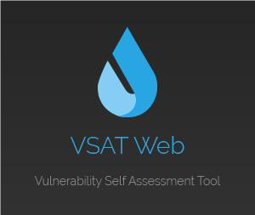
VSAT
VSAT is an e-tool that water utilities may use to develop a SDWA 1433 RRA
Access VSAT here https://www.epa.gov/waterresilience/vulnerability-self-assessment-tool-conduct-drinking-water-or-wastewater-utility (overview webpage) or here https://vsat.epa.gov/vsat/ (tool webpage)
Notes:
VSAT is an e-tool that water utilities can use to create an RRA. It existed before AWIA was passed and was updated to meet the law’s requirements for an RRA. You can access VSAT at the link on the slide.

Slide 12
VSAT: Required vs. Optional Sections
VSAT Page | Requirements for SDWA section 1433-Compliant Risk and Resilience Assessment
Utility Type | Required
Utility Information | Required
Utility Resilience Index | Required
Qualitative Risk Assessment | Required
Quantitative Risk Assessment | Optional, but recommended
Countermeasure Analysis | Optional, but recommended
Report | Required
SDWA Section 1433 Certification | Self-Certification Instructions Provided
Notes:
This table shows pages in VSAT that must be completed, thoroughly and completely and in a way that is unique to your water system, for complying with the requirements SDWA 1433(a). Minimal compliance requires only a qualitative assessment, although conducting a quantitative assessment and countermeasure analysis for significant risks is recommended.
The Risk Assessment Summary Report provides the data entered and assessment results. It is necessary documentation of compliance.

Slide 13
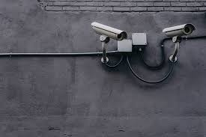

VSAT Terminology
  Threat
    Malevolent Acts (See Baseline Information on Malevolent Acts for Community Water Systems Version 3.0 for more information)
    Natural Hazards
    Dependency/Proximity Threats
  Asset
  Asset-threat pair
  Countermeasures
Notes:
This slide introduces some common terminology used in VSAT.
Threat – An event that could impair the utility from achieving its mission.
Malevolent Act – intentional acts, e.g. cyberattacks or vandalism. Additional information about these malevolent acts can be found in the Baseline Information on Malevolent Acts for Community Water Systems Version 3.0 document.
Natural Hazards – e.g. floods, droughts, earthquakes.
The assessment of dependency and proximity threats is not required for SDWA section 1433 compliance, but they are included in VSAT. They are defined as follows.
Dependency Threat – e.g. the utility’s reliance on key customers, employees, suppliers, and external utilities. E.g. most utilities are reliant on external utilities, such as electrical power.
Proximity Threat – threat that arise from the nearby proximity of another industry or organization that, if damaged by human or natural causes, would impair function or mission of the utility asset being assessed. E.g. a nearby DoD facility that is considered high risk may carry over threat to a nearby utility.
Asset – Assets are system components that are critical to providing safe water to your community. This could be the asset category listed in the law (e.g., physical barriers), a piece of equipment or a facility (e.g., a storage tank). VSAT allows you to define multiple assets for each asset category.
Asset-threat (A/T) pair – When you assign a specific threat is an asset. For each asset/threat pair, you can assess an actual numerical value of risk in VSAT, which allows you to do a cost benefit analysis of potential countermeasures.
Countermeasures – Countermeasures are practices that reduce the risk from a threat to the utility’s assets.

Slide 14
Training Scenario: Example VSAT RRA
VSAT analysis file available upon request to dwresilience@epa.gov
Notes:
Now we will walk through a hypothetical scenario of a water utility assessing the risk and resilience using VSAT.
This presentation will hit the highlights of VSAT, but we do have a longer version of this “VSAT Training Presentation” available on the VSAT website if you’d like to see it. Also the ‘Training Scenario Analysis’ VSAT file is available upon request. It contains the analysis information included in the training presentation. This analysis file may be imported into VSAT and used as a reference, in conjunction with the training presentation. Email dwresilience@epa.gov if you are interested in the file.

Slide 15
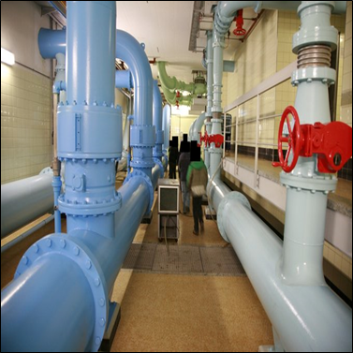
Training Scenario Utility Overview
Utility Name: Spring View Water District
Size and Location: Medium-sized (75,000 people served) drinking water utility the far south suburbs of Chicago, Illinois.
Critical assets:
  14 pumping stations
  SCADA system
  Water treatment plant
  IT business and financial systems
Notes:
We’ll use a fictional water system: Spring View Water District, a medium-sized water utility located in the far south suburbs of Chicago, Illinois.
This scenario will focus on threats to four critical assets:
14 pumping stations,
their SCADA system,
the water treatment plant,
and their IT business and financial systems.

Slide 16
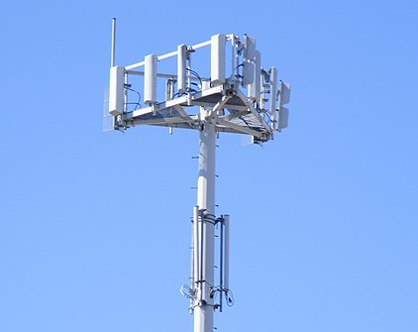
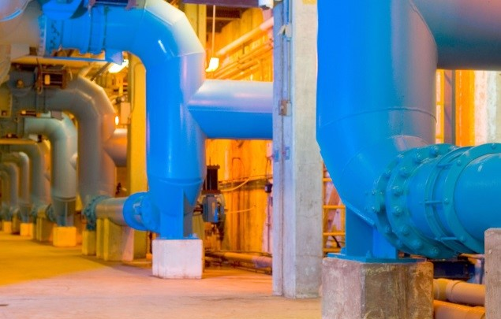
Hypothetical Threat:
Cell Tower Cyberattack
Spring View Water District relies on cellular provider to remotely operate its pumping stations
Cell tower attack by malicious actor could prevent remote (cellular) operation of a critical pumping station
Notes:
We are going to go over some hypothetical threats that Spring View Water District may face.
Two cyberattack scenarios are covered. In this first cyberattack scenario, if a malicious cyber actor attacks the cell tower, it could knock out cell service and prevent the district from remotely operating a critical pumping station.

Slide 17

Hypothetical Threat:
Ransomware Cyberattack
Ransomware attack propagates through Spring View Water District’s entire local area network
Ransomware attack prevents Spring View Water District’s communications with customers and the access to financial systems
Utility systems connected to the network are also impacted (e.g., laboratory equipment, work order systems)
Notes:
In the second cyberattack scenario, Spring View Water District assesses the threat of ransomware propagating through the utility’s entire local area network (LAN).
This hypothetical ransomware attack prevents communications with customers, access to the utility’s financial systems, and their laboratory equipment and work order system are impacted.

Slide 18
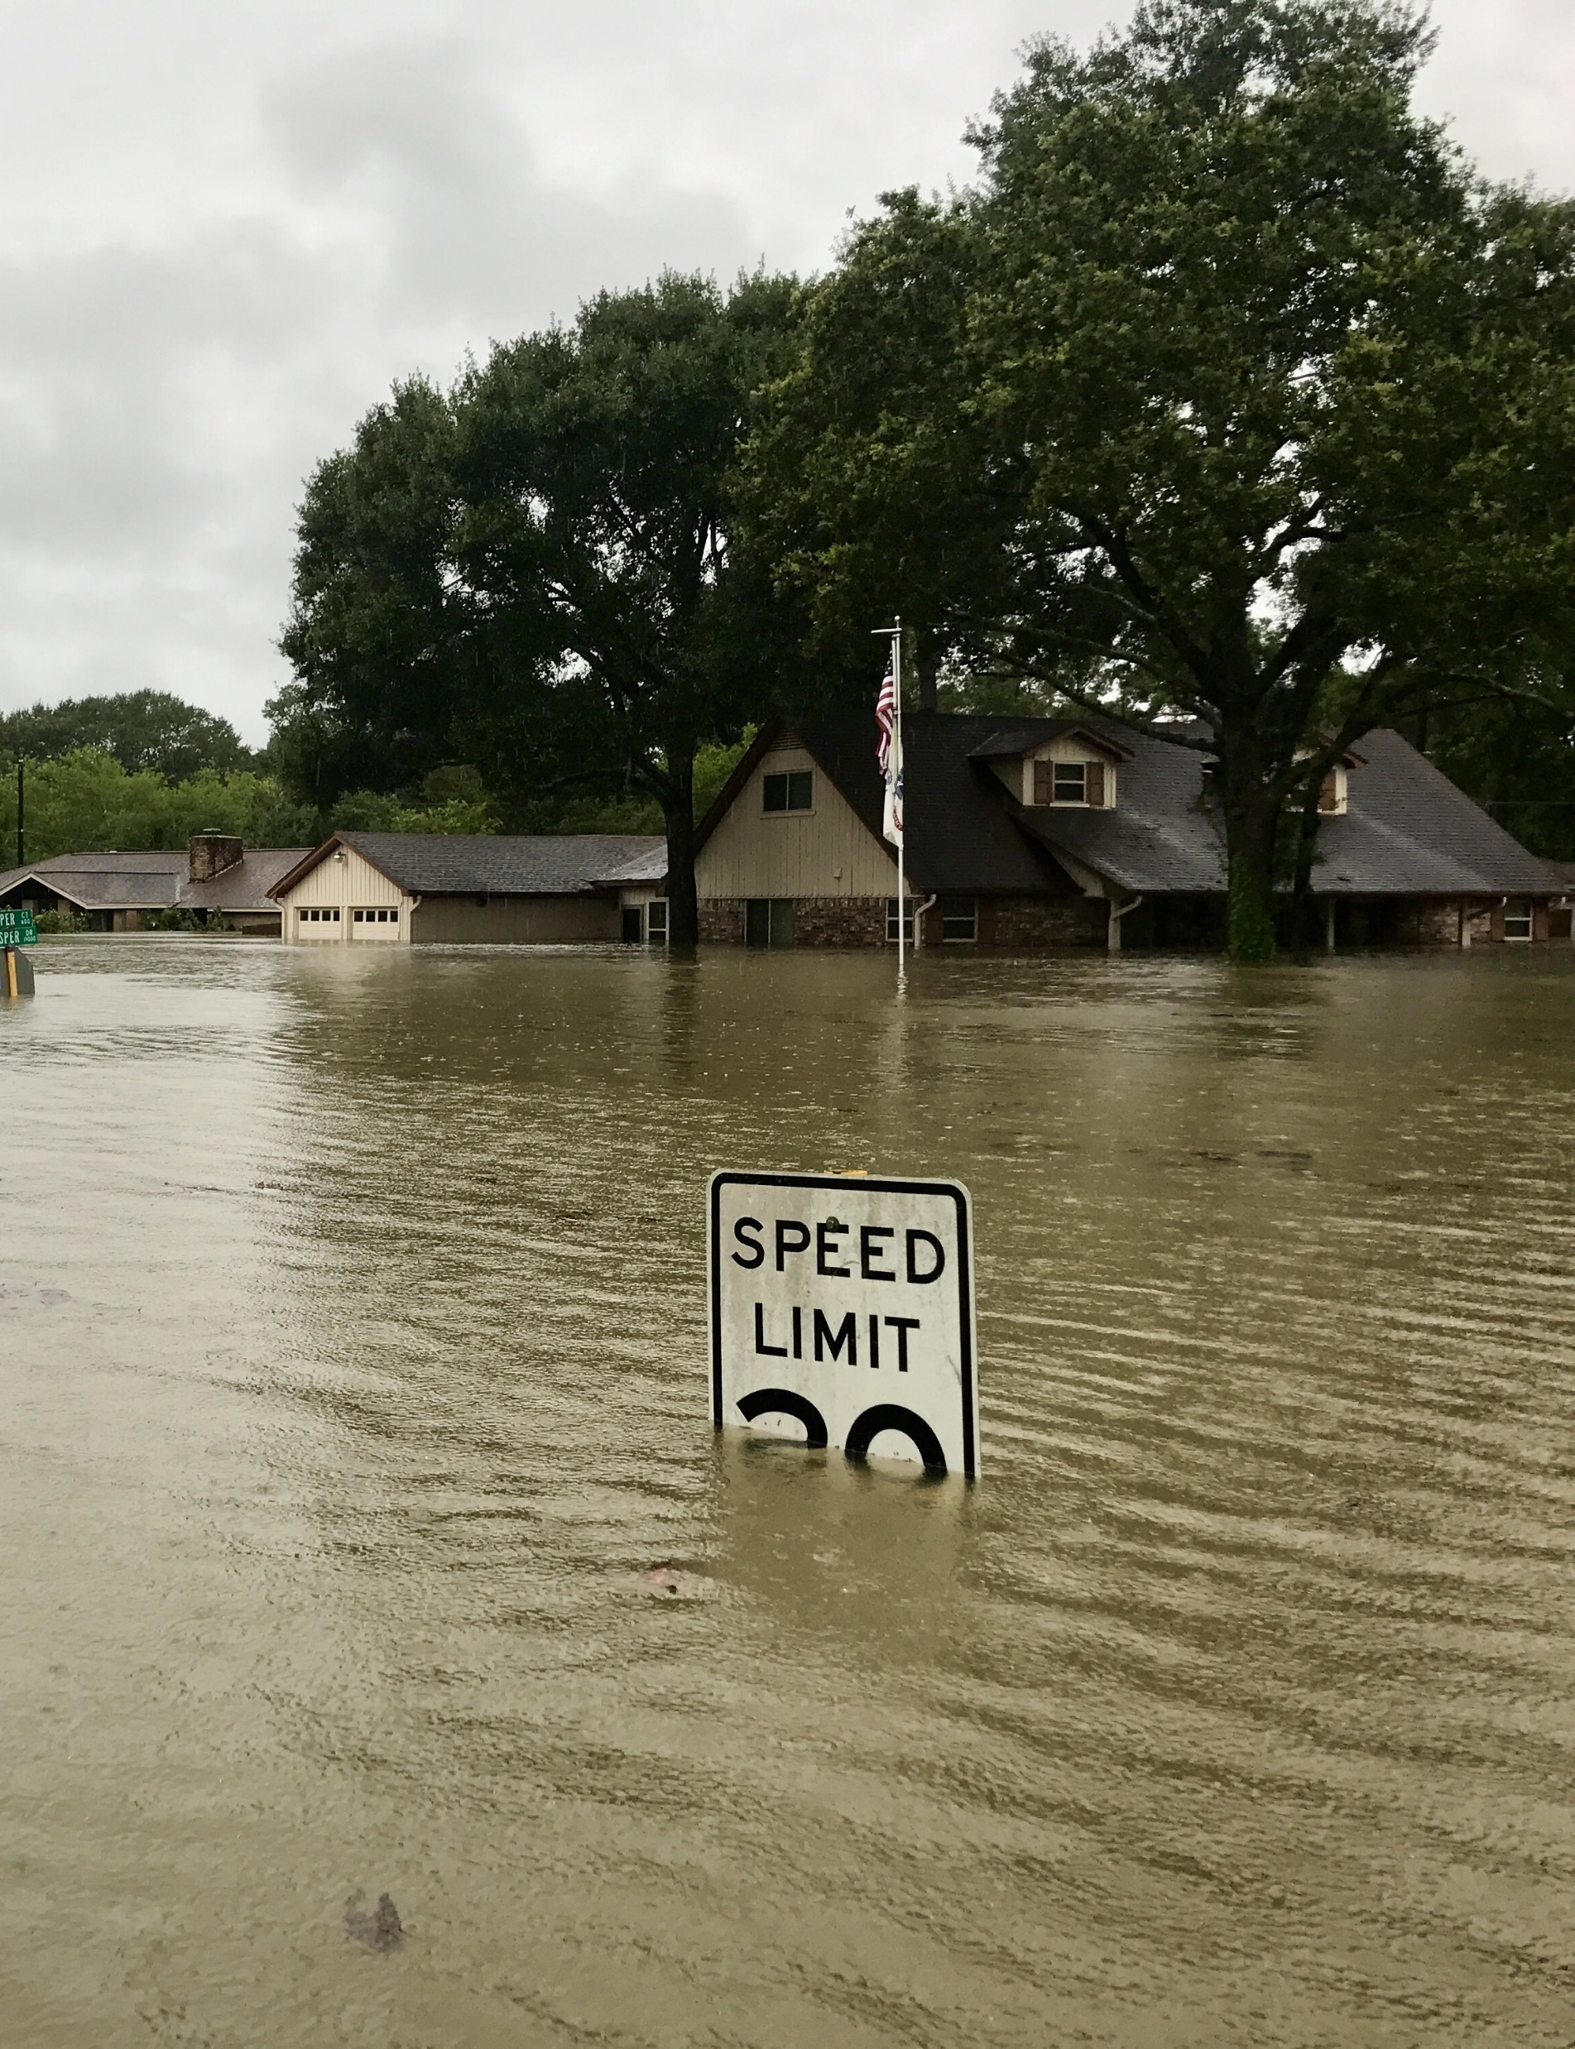
Hypothetical Threat: Flooding
Spring View Water District is located near and draws its source water from the Winding River
100-year flooding event occurs
Electrical components of the utility’s online water quality monitoring equipment (not elevated) could be damaged
This could disable continuous monitoring of the finished water leaving the treatment plant
Notes:
In the hypothetical flood scenario, the utility considers the threat to Spring View Water District from a flooding event from the nearby Winding River, which provides the utility’s source water.
Electrical components of the utility’s online water quality monitoring (OWQM) equipment, which are currently at ground level, could be damaged by the flood. That could disable continuous monitoring of the finished water leaving the treatment plant.

Slide 19
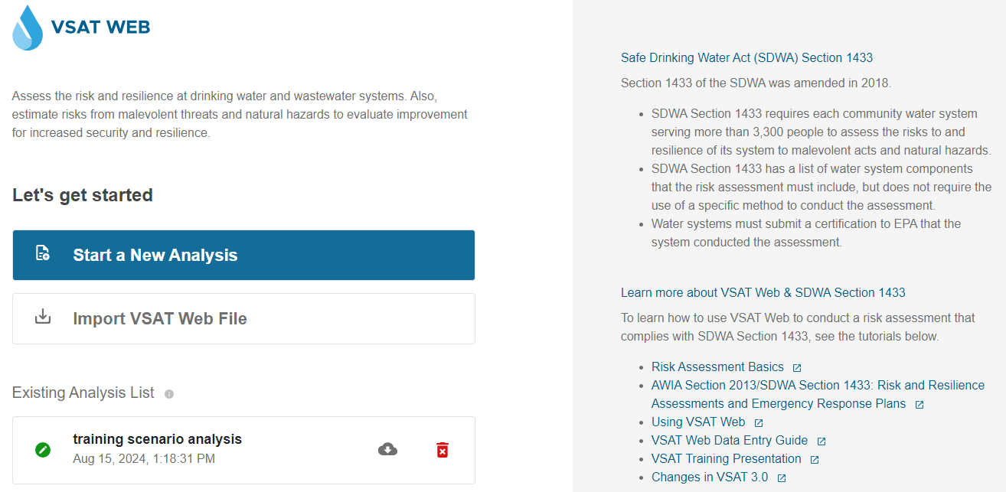
VSAT Web Home Screen
CAUTION Regarding Encryption Password:
EPA is unable to recover or reset a forgotten encryption password. Store password in a secure location. Save PDF report so you have a record of data input into VSAT in case you lose your password.
https://vsat.epa.gov/vsat/
Start a new analysis or import a VSAT Web file
Save locally (download or email)
Notes:
Spring View Water District pulls up the VSAT website. The home page provides options for starting a new VSAT RRA, importing a previously saved VSAT Web file, and opening an existing analysis stored within the web browser cookie. An existing analysis may be saved locally or emailed by clicking the download button (cloud symbol) next to the analysis name.
Spring View Water District takes some time to browse the resources on the right-hand side of the webpage to familiarize themselves with how to use VSAT. Then they import an existing file that they had previously started. Spring View Water District wrote down their password in a secure location and they type in that password to import their VSAT web file.
IMPORTAT CAUTION: Please note that EPA does not have the ability to recover or reset a forgotten encryption password. EPA worked with a panel of water sector organizations when developing VSAT. It was presented to EPA as critical that EPA not have any access to water system’s sensitive data. And we don’t, we designed VSAT that way. The downside is this approach is that we don’t have access to reset a forgotten password.
Because of this, I want to heavily emphasize that you should store your analysis password in a secure location. Also please save the PDF report so you have a record of data input into VSAT in case you lose your password.

Slide 20
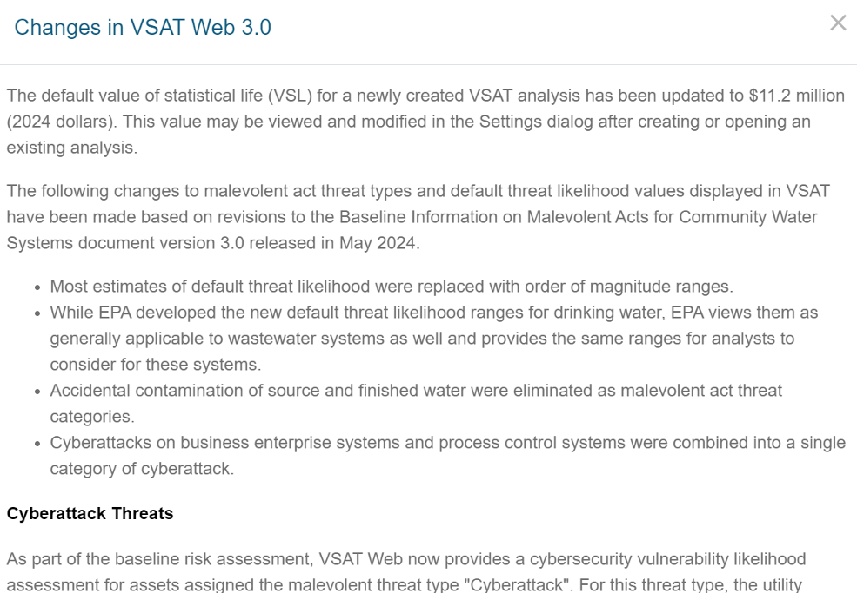
Dialog Box: Changes in VSAT Web 3.0
Value of Statistical Life default updated to $11.2 million (2024 dollars)
Malevolent act changes:
  Default threat likelihood ranges
  Threat type changes
    Accidental water contamination removed
    A single cyberattack threat type
Notes:
This is the first time that Spring View has opened this newest version of VSAT Web (released in Dec 2024), so this “Changes in VSAT Web 3.0” dialog box displays with a summary of the changes made in the latest version:
The default Value of Statistical Life was updated to 2024 dollars, $11.2 million.
There were also some changes made to align with May 2024 updates to the Baseline Information on Malevolent Acts for Community Water Systems version 3.0. This is an underlying document for VSAT that EPA waws required to develop under the law SDWA 1433. If you want more information on the threat likelihood values for malevolent acts in VSAT, this document has it.
Most estimates of default threat likelihood were replaced with order of magnitude ranges.
Threat type changes:
Accidental contamination of source and finished water were eliminated as threat categories to be more consistent with the statutory requirement since accidental contamination technically isn’t a malevolent act because it isn’t intentional. Intentional contamination is still a threat category in VSAT.
The cyberattack threat types for business enterprise systems and process control systems were combined into a single cyberattack category to be consistent with the J100 standard.

Slide 21
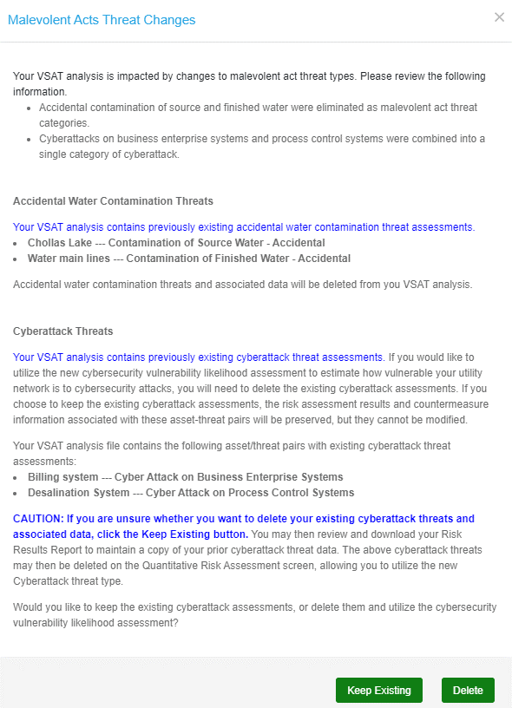
Dialog Box: Malevolent Acts Threat Changes
Displays if existing VSAT analysis is impacted by threat type changes
Impacted threats are displayed
May ‘Keep Existing’ or ‘Delete’ prior Cyber Attack threats
Notes:
Next, the Malevolent Acts Threat Changes dialog pops up because Spring View Water District’s existing VSAT analysis contains asset/threat pairs impacted by threat type changes. This dialog displays when you import or first open an analysis in the new version of VSAT.
Impacted threats may include:
Contamination of Water – Accidental (both source and finished water),
Cyber Attack on Process Control Systems,
or Cyber Attack on Business Enterprise Systems.
Spring View Water District had all of these impacts.
You can see the dialog box gives the district a heads up that “Accidental water contamination threats for source or finished water and associated baseline and countermeasure risk assessment data will be removed from the analysis. VSAT no longer assesses these threats.”
If VSAT detects previously existing cyberattack threat, VSAT provides the option to keep the existing data in a locked state or delete it. Spring View Water District isn’t sure if they want to delete their existing cyberattack threats and associated data or not, so they click the Keep Existing button. Then District is allowed to review and download their Risk Results Report to maintain a copy of their prior cyberattack threat data to reference. The District also has the option to delete the cyberattack threats later the Quantitative Risk Assessment screen so that they can select the new cyberattack threat type and use the new cybersecurity vulnerability likelihood assessment calculator.

Slide 22
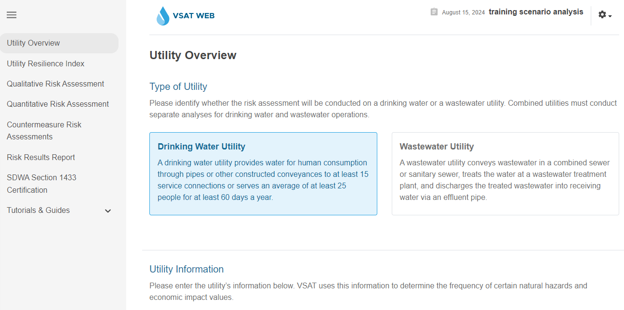
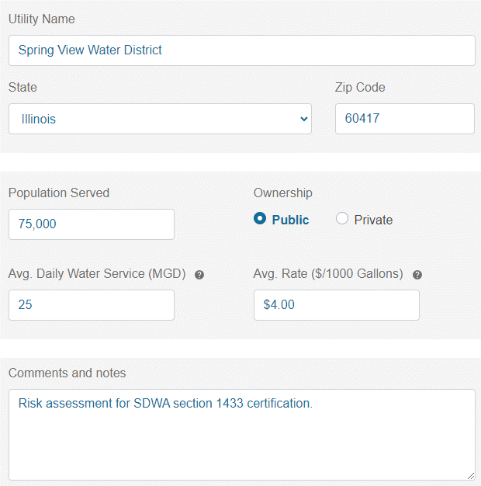
Utility Overview
Identify the utility type and input utility details.
Notes:
Now VSAT asks whether the risk assessment will be conducted on a drinking water or a wastewater utility. Spring View Water District is a drinking water utility.
Next on this screen, Spring View Water District must enter utility information including:
Utility Name
State
Zip Code
Population Served
Ownership
Average Daily Water Service (MGD)
Average Rate ($/1000 Gallons)
Comments and Notes (Optional)
Spring View Water District is a public utility located near Chicago, Illinois. The utility serves a population of 75,000, has an average daily water service of 25 MGD, and an average rate of $4.00/1000 gallons. VSAT uses the utility information to determine the frequency of certain natural hazards and economic impact values.

Slide 23
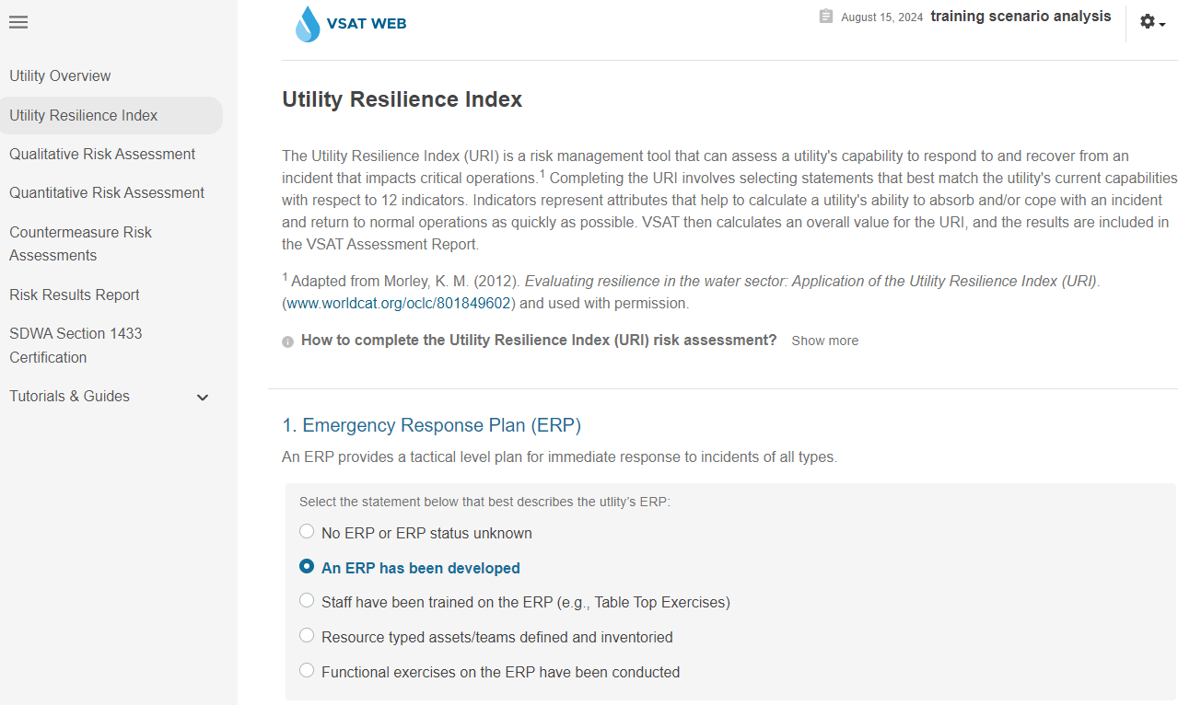
Utility Resiliency Index (URI)
Assesses capability to respond to and recover from an incident impacting critical operations
Notes:
Next, Spring View Water District fills out their Utility Resilience Index (a tool designed by American Water Works Association to assess a utility’s ability to respond and recover from an incident). Completing the URI involves selecting statements that best match the utility's current capabilities with respect to 12 Indicators to help calculate ability to cope with an incident and return to normal operations.
VSAT then calculates an overall URI value. The results are included in the VSAT Assessment Report.

Slide 24
Spring View Water District URI Selections
Emergency Response Plan (ERP): An ERP has been developed
National Incident Management System (NIMS) Compliance: ICS 200/300 provided to key staff
Mutual Aid and Assistance (MAA): Intrastate (e.g., WARN)
Emergency Power for Critical Operations (EPCO): Up to 24 hours of backup power
Minimum Daily Demand/Treatment (MDDT): 25 hours to 48 hours
Critical Parts and Equipment (CPE): 1 week to less than 3 weeks
Critical Staff Resilience (CSR): Greater than 50 to 75%
Business Continuity Plan (BCP): BCP completed
Utility Bond Rating (UBR): AA
Government Accounting Standards Board (GASB) Assessment: 41 to 60% assessed
Unemployment: > +/- 2 National Average
Median Household Income (MHI): +/- 5% State Median
Notes:
Spring View Water District made the following selections for the 12 indicators:
Emergency Response Plan (ERP): An ERP has been developed
National Incident Management System (NIMS) Compliance: ICS 200/300 provided to key staff
Mutual Aid and Assistance (MAA): Intrastate (e.g., WARN)
Emergency Power for Critical Operations (EPCO): Up to 24 hours of backup power
Minimum Daily Demand/Treatment (MDDT): 25 hours to 48 hours
Critical Parts and Equipment (CPE): 1 week to less than 3 weeks
Critical Staff Resilience (CSR): Greater than 50 to 75%
Business Continuity Plan (BCP): BCP completed
Utility Bond Rating (UBR): AA
Government Accounting Standards Board (GASB) Assessment: 41 to 60% assessed
Unemployment: > +/- 2 National Average
Median Household Income (MHI): +/- 5% State Median

Slide 25
Qualitative Risk Assessment
Asset categories
  Physical barriers
  Source water
  Pipes and Constructed Conveyances, Water Collection, and Intake
  Pretreatment and Treatment
  Storage and Distribution Facilities
  Electronic, Computer, or other Automated Systems (including security)
  Monitoring Practices
  Financial Infrastructure
  The Use, Storage, or Handling of Chemicals
  The Operation and Maintenance of the Utility
Notes:
Next up is the qualitative risk assessment. Asset categories in VSAT include (straight from SDWA 1433):
Physical barriers
Source water
Pipes and Constructed Conveyances, Water Collection, and Intake
Pretreatment and Treatment
Storage and Distribution Facilities
Electronic, Computer, or other Automated Systems (including the security of such systems)
Monitoring Practices
Financial Infrastructure
The Use, Storage, or Handling of Chemicals
The Operation and Maintenance of the Utility
If you do not see a critical asset category listed in VSAT that applies to the utility, you will have the option to add it later.

Slide 26
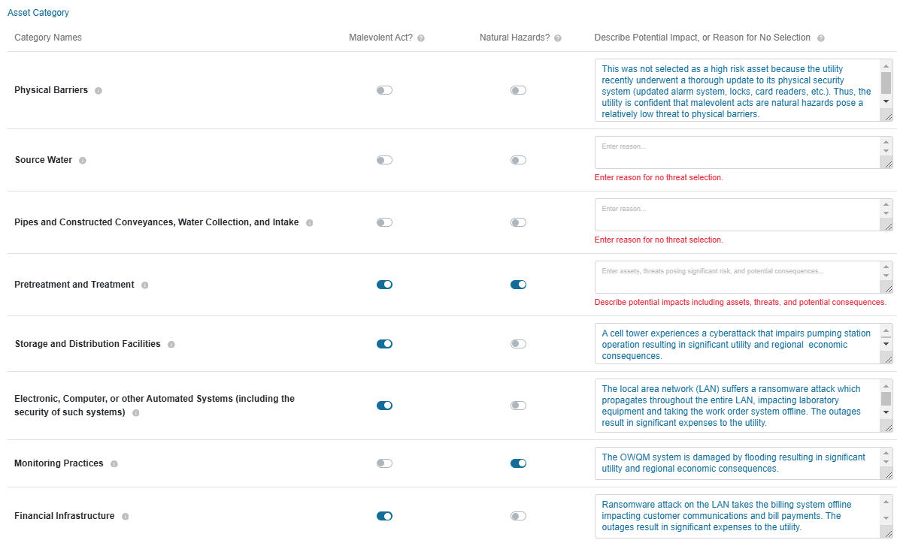
Spring View Water District Qualitative Risk Assessment
Notes:
For each critical asset at risk from a malevolent act or natural hazard, use the text box to describe:
the specific asset(s),
the malevolent act(s) and/or natural hazard(s) that present a risk to the asset, and
the potential consequences to the utility and the region served by the utility if the malevolent act(s) and/or natural hazard(s) impact(s) the asset.
For any asset category that you do not select a threat, a reason must be entered describing why there are no critical assets in this category at risk.
In our scenario, Spring View is concerned about:
A cell tower attack that prevents remote operation of a critical pumping station
A ransomware attack that propagates through their entire local area network (LAN), preventing communications with customers and access to financial systems and utility systems connected to the network (e.g., laboratory equipment, work order systems)
A 100-year flooding event that damages electrical components of the utility’s online water quality monitoring equipment (not elevated) and disables continuous monitoring of the finished water leaving the treatment plant
For the cyberattack scenario, the utility identified the following critical asset categories as likely to suffer significant adverse impacts: Storage and Distribution Facilities; Electronic, Computer, or other Automated Systems; and Financial Infrastructure.
For the 100-year flood scenario, the utility identified Monitoring Practices as the critical asset category.
Here is a screenshot of Spring View Water District working through their qualitative risk assessment.
The information icon provides a definition of each category. E.g. if you are wondering what “physical barriers” means, however over that icon for more information.
Choose which threat type(s) (Malevolent Act or Natural Hazard or both) are likely to pose a high risk (likely to cause significant public health or economic impacts) to the utility’s critical asset categories.
For physical barriers, Spring View isn’t really concerned about impacts from malevolent acts or natural hazards so Spring view doesn’t toggle on malevolent acts or natural hazards for this asset category. But you must assess physical barriers according to SDWA 1433 so in the text box, they explain their reason for not selecting either. It was not selected a high risk asset because the utility recently underwent a thorough update to it’s physical security (updated alarm system, locks, card readers). So Spring View is pretty confident that malevolent act and natural hazards pose a relatively low threat to physical barriers.
For the next 3 asset categories, Spring View hasn’t completed their analysis yet and when they tried to skip ahead to go to the next page, VSAT gave them a red error box to remind them that they must write a qualitative description in the box for each asset category in order to comply with SDWA 1433. (Please take your time, be thorough. Explain why you selected or didn’t select a threat with a description that is unique to your water system)
If an asset category were at high risk from both malevolent acts and natural hazards, as shown for the Pretreatment and Treatment asset category, the potential impacts of both threat types would be described by the user.
In these bottom 4 examples, you will see that Spring View describes their concern that:
A malevolent act, specifically a cyber attack as explained in the description box, poses a significant threat to their storage and distribution facility. If there is a cyberattack on a cell tower, it could impair a critical pumping station, which would result in significant consequences.
For electronic, computer, or other automated systems, they also selected malevolent act and explained how that asset category could be impacted by a ransomware attack.
For monitoring practices, they select natural hazards and specify floods as the specific hazard of concern.
For financial infrastructure, they select malevolent acts and explain how the ransomware attack could mess with their fin infrastructure.
This screenshot isn’t complete, Spring View still has some work to do to finish their qualitative assessment, but it gives you an idea of the process you would take to complete the qualitative assessment piece for your utility. Every single text box should be filled out. Even if you chose not to select a threat for an asset category, you must include a reason describing why there are no critical assets in this category at risk (you must analyze the asset category under SDWA 1433). This is important – it makes the assessment unique to your facility. Also if someone else takes over updating the RRA in the future, they have a written description of why you chose to select or not select a given asset category. During the last VSAT update, we made it so that you will get a red box error if you leave one of these required text fields blank.

Slide 27
Quantitative Assessment: Perform Baseline Risk Assessment for Each Asset/Threat Pair
Estimate Public Health and Economic Consequences
  VSAT’s WHEAT Calculator can help you estimate this
Estimate Threat Likelihood
  VSAT provides a range of threat likelihoods for you to consider as a starting point
Estimate Vulnerability Likelihood
    VSAT’s Cybersecurity Vulnerability Assessment Calculator can help you estimate this for cyber threats
    VSAT’s Vulnerability Likelihood Calculator can help you estimate this for non-cyber threats
    Risk = Threat x Vulnerability x Consequence
Notes:
Next, Spring View Water District will perform a quantitative risk assessment (which is recommended but not required for SDWA section 1433 compliance).
EPA recommends that the quantitative risk assessment be limited to a small number of the assets and threats that present the highest risk. Attempting to analyze a high number of asset/threat pairs in a single assessment will make the assessment difficult to complete and make it harder to interpret results. Strategies to reduce the number of asset/threat pairs include 1) grouping similar assets into a single asset category and 2) limiting threats to those with the highest likelihood of occurrence.
The first part of the quantitative assessment is to do a baseline risk assessment (baseline means do an assessment of your facility as it is right now; later on you have the option of also doing a countermeasure quantitative assessment so you can compare how your risk may be reduced if you implement new countermeasures).
This slide provides a summary of the numbers you need to estimate in order to calculate risk. During each step of the Baseline Risk Assessment, consider any existing countermeasures your utility may have in place for the selected asset/threat pair. Then, evaluate values for:
Consequences if the threat occurred and damaged the asset (by using the WHEAT calculator);
The likelihood of the threat occurring; and
The vulnerability that the threat will damage the asset (by using the vulnerability likelihood calculator). For cyberattack threats, a Cybersecurity Vulnerability Assessment Calculator is available to help assess the utility’s vulnerability to cyberattacks. This is accomplished by assessing the security controls and practices currently in place to help identify, protect, detect, respond, and recover from a cybersecurity incident.
Once you do that, VSAT will calculate risk by multiplying Threat x Vulnerability x Consequence.

Slide 28
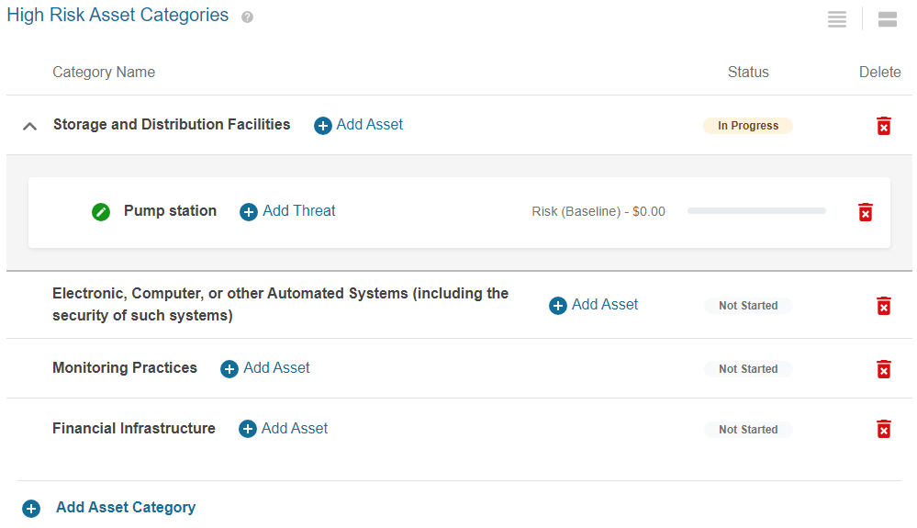
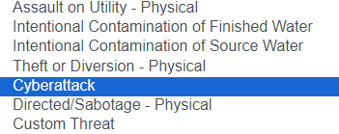
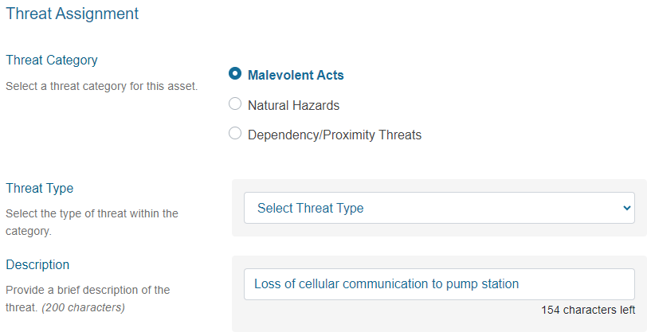
Assign Threats (Quantitative Risk Assessment)
Enter assets and assign threats
Notes:
We will now walk through the first asset threat pair in the cyberattack scenario – the threat that a cyberattack poses to the cellular service to a critical pumping station in the utility’s distribution system, with 10,000 downstream customers.
For each asset category, the utility will define a specific asset that is at risk. For this hypothetical threat, the high-risk asset category is “storage and distribution facilities.” Spring View Water District identified the “pump station” specifically.
Additional asset categories may be added, if needed, using the “Add Asset Category” button at the bottom of the screen.
Once an asset has been added, the asset name may be edited by clicking the pencil icon that appears next to the asset name.
Next, the utility will assign at least one specific threat, which may be a malevolent act, natural hazard, or dependency/proximity threat, for each asset.
Because Spring View Water District’s hypothetical threat involves a cell tower attack, the utility selects “Malevolent Acts” as the threat category and “Cyberattack” for the threat type. If you worked with VSAT previously, note that this new ‘Cyberattack’ threat replaces two previously existing cyberattack threats.

Slide 29
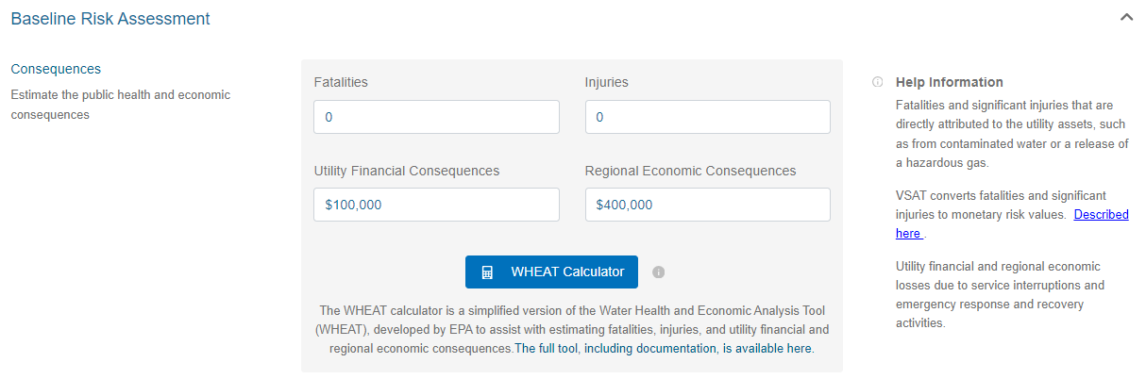
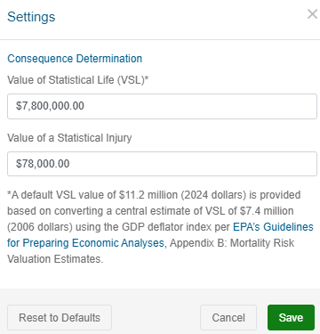

Estimate Public Health and Economic Consequences (Baseline Quantitative Risk Assessment)
Public health consequence is calculated by multiplying fatalities and injuries by Value of a Statistical Life (VSL) and Value of a Statistical Injury (VSI) values.
Notes:
First, the utility will estimate the public health and economic consequences that would result from the selected threat occurring and impacting the selected asset. Specifically, you must estimate:
Fatalities and significant injuries that are directly attributed to the utility assets, such as from contaminated water or a release of a hazardous gas; and
Utility financial and regional economic losses due to service interruptions and emergency response and recovery activities.
In our hypothetical scenario, Spring View has determined that no fatalities or injuries would occur due to the disruption of remote operation of a critical pumping station. The utility has determined that it would take two days to restore the operation of the pumping station and estimated that there estimated cost would be $100,000 in lost revenue for a two-day outage for 10,000 customers. They also estimated $400,000 for regional economic consequences.
VSAT provides default values for Value of a Statistical Life (VSL) and Value of a Statistical Injury (VSI). These values may be viewed or edited by clicking the gear icon in the top right corner of the VSAT window, and then selecting the Settings option. Spring View chose to enter values based on their site-specific knowledge.
If you don’t know what values to use, click the Water Health and Economic Analysis (WHEAT) Calculator, which was developed to estimate those costs. VSAT converts fatalities and significant injuries to monetary risk values by multiplying the number of fatalities by the VSL value and by multiplying the number of injuries by the VSI value.

Slide 30
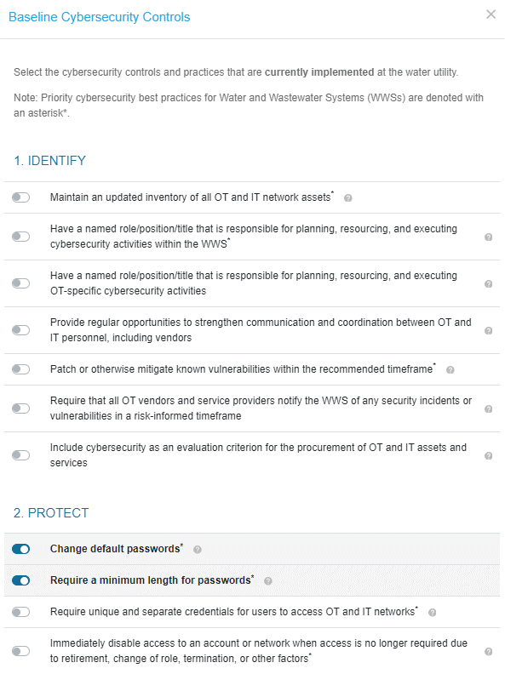
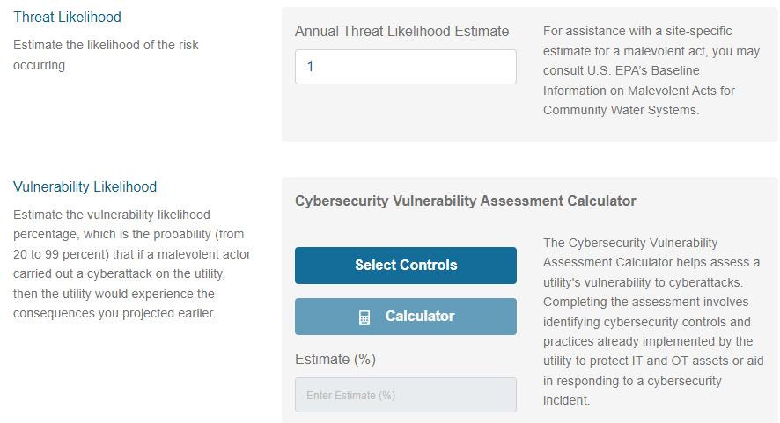
Estimate Cybersecurity Threat and Vulnerability Likelihood (Baseline Quantitative Risk Assessment)
Select cybersecurity controls and practices already implemented
Click Calculator (VSAT calculates likelihood value based on selections)
Notes:
Spring View assesses their capability to respond and recover from a cyberattack on a cell tower using the Cybersecurity Vulnerability Assessment Calculator in VSAT.
Priority cybersecurity best practices for Water and Wastewater Systems are denoted on the list of baseline cybersecurity controls with an asterisk*.
In the protect category, the utility has selected the following cybersecurity controls and practices that are currently implemented at the water utility. Three of the four selections are priority cybersecurity best practices.
Change default passwords*
Require a minimum length for passwords*
Require approval before new software is installed or deployed
Backup systems necessary for operations (e.g., network configurations, PLC logic, engineering drawings, personnel records) on a regular schedule, store backups separately from the source systems, and test backups on a regular basis*
Using the calculator button, VSAT calculates the vulnerability likelihood estimate based on a linear scale of -2.32% vulnerability per control with a maximum vulnerability percentage of 99% and a minimum vulnerability percentage of 20%.
Based on the utility’s selections, the calculator returned a vulnerability likelihood estimate of 90%.
For all other threat types besides cybersecurity, the utility goes through a similar process to estimate the likelihood that the selected threat will occur in a one-year period, considering the capabilities of any existing countermeasures. A “vulnerability likelihood calculator” is available to help you do this.

Slide 31
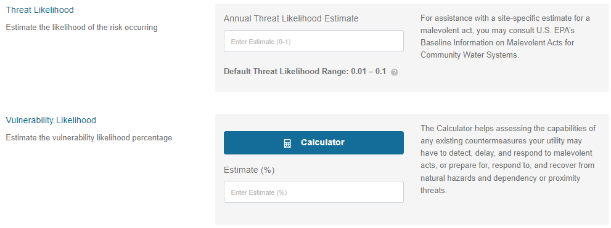
Estimate Non-Cyber Threat and Vulnerability Likelihood (Baseline Quantitative Risk Assessment)
Threat likelihood: Probability that the threat will occur in a one-year period, considering the capabilities of existing countermeasures
Vulnerability likelihood: Estimated percentage (%) that the threat would result in the consequences projected earlier, if the threat occurred, given effectiveness of existing countermeasures
Notes:
For all other threat types, the utility similarly estimates the likelihood (probability) that the selected threat will occur in a one-year period, considering the capabilities of any existing countermeasures. The estimate of annual threat likelihood must be a quantitative value between 0 and 1.
For malevolent act threat types other than cyberattack, VSAT may provide an annual default threat likelihood value or a default range of values to use as a starting point for estimating the annual threat likelihood. These are order-of-magnitude estimates based on national trends and may not apply to specific utility situations. The provided value can be changed by the user based on site-specific information. In this example, VSAT provided a default range for the “Assault on Utility-Physical” threat type and the user filled in an appropriate value for the utility.
For natural hazards and dependency/proximity threats, the user estimates the annual threat likelihood (probability), typically using historical data. VSAT provides historical frequency data for tornados, earthquakes, and hurricanes based on the utility location, and links to FEMA flood maps to identify assets in flood zones.
The utility then estimates the vulnerability likelihood (%) that the selected threat would result in the estimated consequences projected earlier if the threat occurred, considering the effectiveness of existing countermeasures.
For malevolent acts other than a cyberattack, the vulnerability likelihood is the likelihood that the attack would be successful. For a natural hazard or dependency/proximity threat, this is the likelihood that the threat would damage or impair operation of the asset.

Slide 32
Quantitative Risk Assessment: Cyber Attack Scenarios
Baseline Quantitative Risk Assessment data entered for training scenario
Asset | Threat | Public Health Consequences | Economic Consequences | Threat Likelihood | Vulnerability Likelihood
Pump Station | Cyberattack – Loss of cellular communication to pump station | Fatalities: 0 Injuries: 0 | Utility Financial: $100,000 Regional Economic: $400,000 | Annual Baseline Estimate: 1 | Baseline Estimate: 90%
Business enterprise systems (i.e., email, lab equipment, work order system) | Cyberattack – Ransomware attack | Fatalities: 0 Injuries: 0 | Utility Financial: $300,000 Regional Economic: $0 | Annual Baseline Estimate: 1 | Baseline Estimate: 99%
Billing System | Cyberattack – Ransomware attack | Fatalities: 0 Injuries: 0 | Utility Financial: $200,000 Regional Economic: $0 | Annual Baseline Estimate: 1 | Baseline Estimate: 99%
Notes:
This table shows the baseline risk assessment data that Spring View entered in VSAT for each of the three asset-threat pairs associated with the hypothetical cyberattack threats.

Slide 33
Quantitative Risk Assessment: Flood Scenario
Baseline Quantitative Risk Assessment data entered for training scenario
Asset | Threat | Public Health Consequences | Economic Consequences | Threat Likelihood | Vulnerability Likelihood
Online Water Quality Monitoring Sensors | Flood – F1 – Flood – 100 Year | Fatalities: 0 Injuries: 0 | Utility Financial: $76,000 Regional Economic: $80,944,600 | Annual Baseline Estimate: 0.01 | Baseline Estimate: 72%
Notes:
This table shows the baseline risk assessment data that Spring View Water District will enter in VSAT for the one asset-threat pair associated with the hypothetical flooding threat.

Slide 34
Perform Countermeasure Analysis (Optional)
The countermeasure analysis is a two-step process.
1. Select potential countermeasures.
2. Perform improvement risk assessment for each asset/threat pair.
  Assess improvement with potential countermeasures in place:
    Enter Public Health and Economic Consequences
        WHEAT Calculator
    Estimate Threat Likelihood
    Estimate Vulnerability Likelihood
        Vulnerability Likelihood Calculator
        Cybersecurity Vulnerability Assessment Calculator
Notes:
Spring View finished the baseline quantitative analysis. Now they have the option to do a countermeasure analysis, which can show potential improvements, reduction in risk. Start by selecting potential countermeasures. Then you assess “improvement”, risk reduction that the countermeasure could provide. You follow the same process for the countermeasure analysis as the baseline analysis.

Slide 35
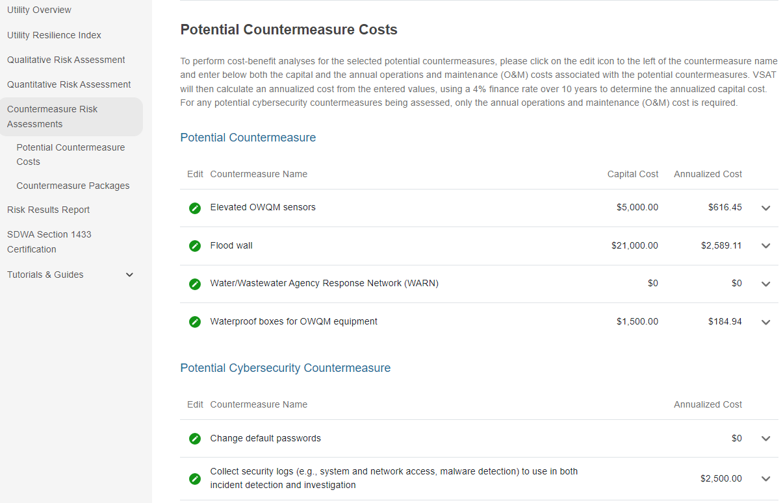
Potential Countermeasure Costs
Countermeasure costs may be specified.
Notes:
We will now review the costs associated with the various potential countermeasures. In order to perform a cost-benefit analyses for the selected potential countermeasures, the utility has entered capital cost and operations and maintenance (O&M) costs associated with the potential countermeasures, as appropriate.
For the potential cybersecurity countermeasures being assessed, only the annual operations and maintenance (O&M) cost is required. These potential countermeasures are listed in a separate section without the capital cost column.
For this training scenario, we see that the utility has estimated the capital cost of a flood wall to be $21,000.00 with $0 annual operations and maintenance cost.
VSAT then calculates an annualized capital cost from the entered values, using a 4% finance rate over 10 years.

Slide 36
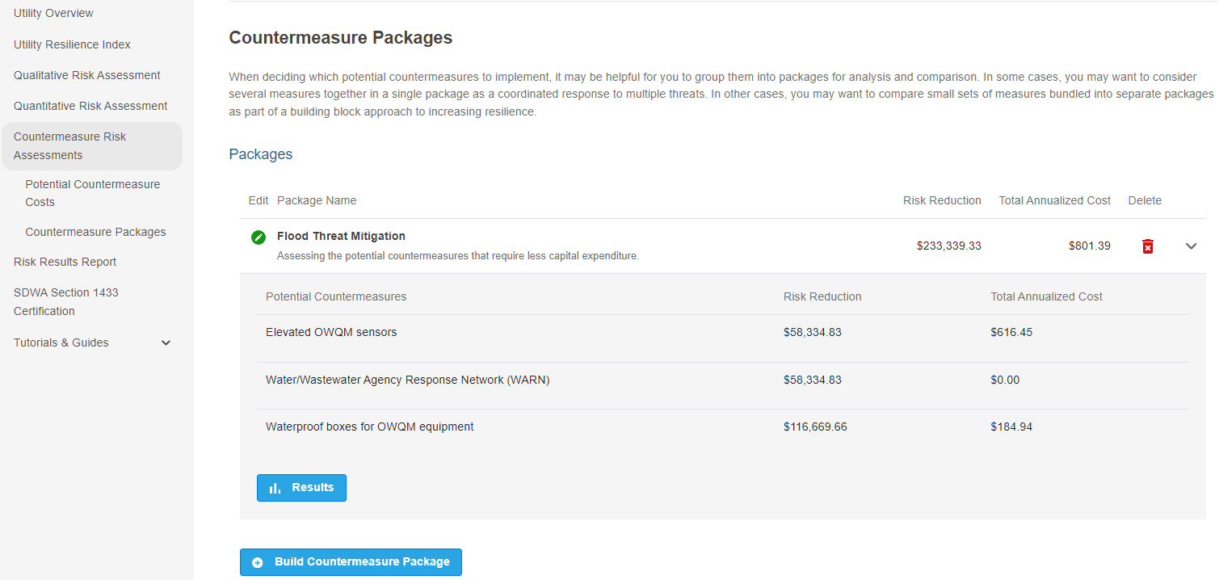
Countermeasure Packages
Countermeasure packages save time by grouping potential countermeasures. Can be applied to multiple asset-threat pairs.
Notes:
When deciding which potential countermeasures to implement, it may be helpful to group them into packages for analysis and comparison. In some cases, you may want to consider several measures together in a single package as a coordinated response to multiple threats.
In other cases, users may want to compare small sets of measures bundled into separate packages as part of a building block approach to increasing resilience. Select the “Build a Countermeasure Package” button to select potential countermeasures to include in named packages.
Packages may contain security controls and processes selected in the potential cybersecurity countermeasures as well as potential countermeasures selected for other, non-cyberattack threats.
This slide shows a countermeasure package created by the Spring View Water District. This ‘Flood Threat Mitigation’ countermeasure package contains three potential countermeasures.
After building the desired number of countermeasure packages, you can review and compare the monetized risk reduction results to the annualized cost for each.

Slide 37
Countermeasure Analysis: Cyber Attack Scenarios
Improvement risk data entered for training scenario
Asset | Threat | Public Health Consequences | Economic Consequences | Threat Likelihood | Vulnerability Likelihood
A/T Pair #1 Pump Station | Cyberattack – Loss of cellular communication to pump station | YES Fatalities: 0 Injuries: 0 | YES Utility Financial: $50,000 Regional: $200,000 | YES Annual Improvement Estimate: 0.08 | YES Improvement Estimate: 80%
A/T Pair #2 Business enterprise systems (i.e., email, lab equipment, work order system) | Cyberattack – Ransomware attack | YES Fatalities: 0 Injuries: 0 | YES Utility Financial: $75,000 Regional Economic: $0 | YES Annual Improvement Estimate: 0.1 | YES Improvement Estimate: 50%
A/T Pair #3 Billing System | Cyberattack – Ransomware attack | YES Fatalities: 0 Injuries: 0 | YES Utility Financial: $50,000 Regional Economic: $0 | YES Annual Improvement Estimate: 0.1 | YES Improvement Estimate: 50%
Notes:
The table shows the improvement risk assessment data to be entered in VSAT by the utility for each of the three asset-threat pairs associated with the cyberattack threat.

Slide 38
Countermeasure Analysis: Flood Scenario
Improvement risk data entered for training scenario
Asset | Threat | Public Health Consequences | Economic Consequences | Threat Likelihood | Vulnerability Likelihood
A/T Pair #4 Online Water Quality Monitoring Sensors | Flood – F1 – Flood – 100 Year | YES Fatalities: 0 Injuries: 0 | YES Utility Financial: $0 Regional Economic: $0 | YES Annual Improvement Estimate: 0.01 | YES Improvement Estimate: 3%
Notes:
This table shows the improvement risk assessment data to be entered in VSAT by the utility for the one asset-threat pair associated with the flooding threat.

Slide 39

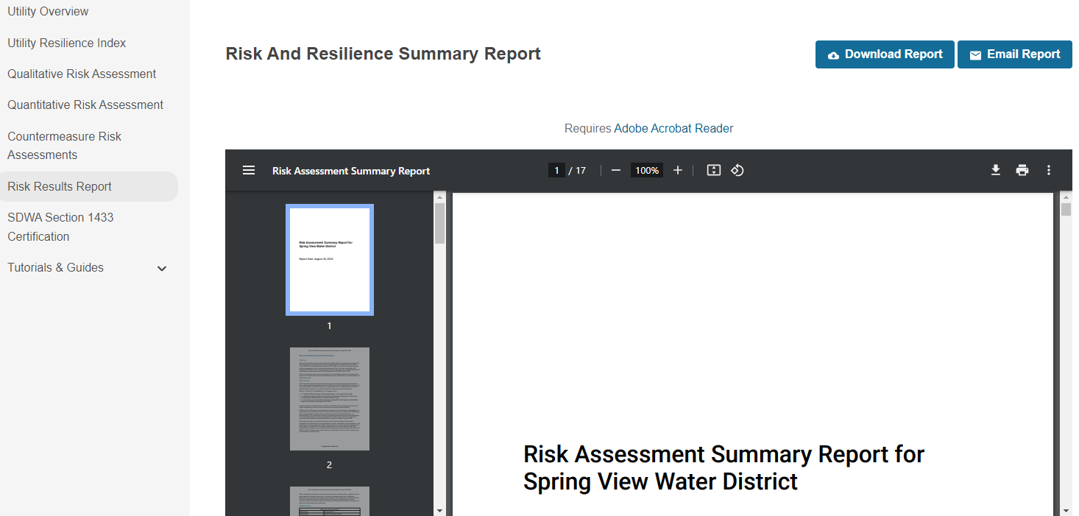
Risk and Resilience Summary Report
Report summarizes all data entered for the assessment.
Provides analysis of quantitative risk, qualitative risk, and countermeasures.
May be downloaded or emailed to retain a record of data and results.
Notes:
After completing the countermeasure analysis and clicking the ‘Go to Final Report’ button, the Risk Assessment Summary Report for Spring View is displayed. The report may be downloaded using the web browser’s download option. It may also be emailed using the ‘Email Report’ button shown at the top of the screen. Spring View saves a copy of this PDF Report in a secure location on their computer and prints out a hard copy and saves it in a locked filing cabinet. If they need to review the report or if an EPA inspector asks to see it, they are ready.
The report contains numerous sections beginning with Purpose, Methodology, and the Utility Overview information. It also summarizes the data entered for the Utility Resilience Index, Qualitative Risk Assessment, Quantitative Risk Assessment, and the Countermeasure Risk Assessment.
The Assessment Summary section includes a monetized risk summary for each asset/threat pair including both the baseline and improvement estimates.
The Countermeasures Costs and Packages section of the report details the countermeasures contained within each countermeasure package and their associated net benefits, which are the differences between the monetized risk reductions and the annualized costs attributed to the potential countermeasure or countermeasure package, are shown in Risk and Resilience Summary Report.

Slide 40
Creating or Revising an RRA using
EPA’s Small System Checklist
Notes:
Next let’s discuss how to create, or revise if you already have one, a risk and resilience assessment using EPA’s Small System Checklist.

Slide 41



EPA’s RRA Tools
  Small System RRA Checklist
  Qualitative risk assessment – identifies threats, vulnerabilities, and consequences but does not estimate risk value
  Countermeasures may be identified, and the benefits described but not estimated
  “Paper” analysis that requires minimal resources to complete
  Recommended for smaller water systems (serving under 50,000 people)
  Vulnerability Self Assessment Tool (VSAT)
  Quantitative risk assessment – estimates threats, vulnerabilities, consequences and monetized risk
  Countermeasures may be quantified for cost, risk reduction, and cost-benefit analysis
  E-tool analysis can require significant time and information resources to complete
  Recommended for larger water systems (serving over 50,000 people)
Notes:
Here’s a side-by-side comparison of the two tools that EPA has available to water systems to help them create a SDWA 1433 risk and resilient assessment:
The checklist is qualitative in nature while the VSAT tool has the option for a quantitative risk assessment
For the checklist, countermeasures can be identified. For VSAT, countermeasures can be quantified and then used for cost and risk reduction analyses.
And the checklist is a paper analysis (PDF or Word) while VSAT is an e-tool analysis that can require a significant amount of time and resources to do
The checklist was written for small system. The VSAT tool is suggested for larger systems.
VSAT and the checklist are just 2 different options for how your utility can present your risk and resilience assessment analysis in an organized way. Use whatever method works best for you.

Slide 42
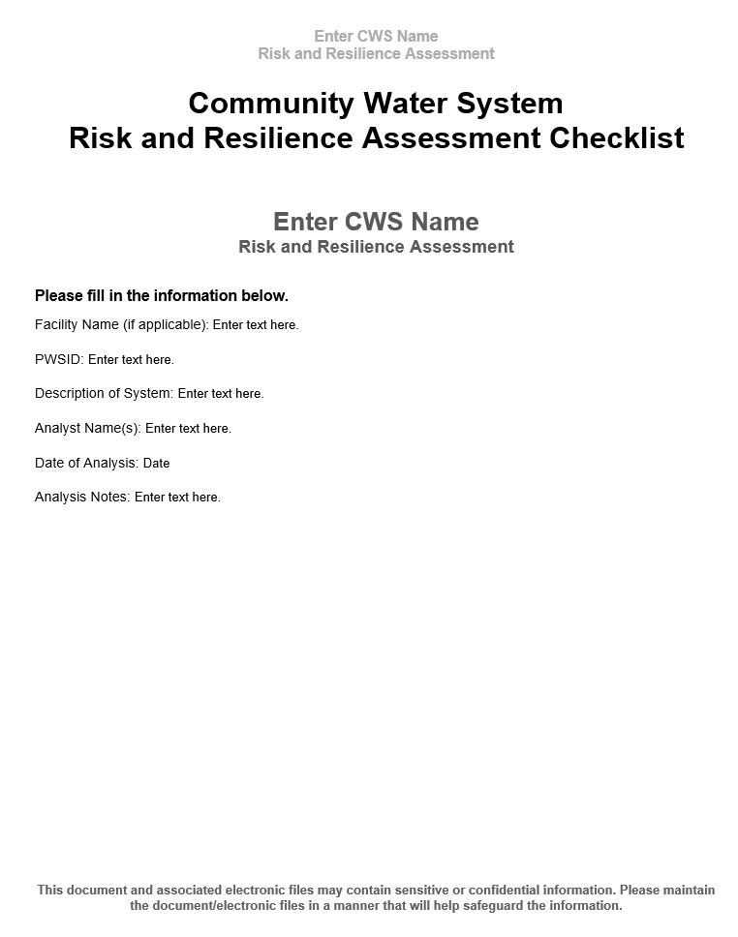
Small Systems RRA Checklist
Qualitative risk assessment
PDF and Microsoft Word versions available
Download English Version Here
Download Spanish Version Here
Notes:
The Small System Risk and Resilience Assessment Checklist is another option water systems may use to develop their RRA. We recommend that larger systems use VSAT and smaller systems use the RRA checklist. The reason we have two RRA template options – VSAT and this checklist – was because we heard feedback from rural water technical assistance providers that some smaller systems were intimidated by VSAT, especially the quantitative component. So we developed and published the checklist in June 2020 to provide a simpler method that’s qualitative.
The checklist a PDF/Microsoft word document (CWS can pick whichever they would prefer to use, PDF or word, they are identical) with fillable tables that walk water systems step-by-step through the process of assessing their risk and resilience to natural hazards and malevolent acts for each of the asset categories required in SDWA section 1433. There is a Spanish version of the checklist available as well.

Slide 43
Small System RRA Checklist July 2024 Updates
Combined cyberattacks on business enterprise systems and process control systems into a single category of cyberattack.
Eliminated accidental contamination of source and finished water as malevolent act threat categories.
Updated the definition of “Electronic, Computer, or Other Automated Systems” to align with terminology commonly used in the cybersecurity field.
Added Table 11: Checklist of Priority Cybersecurity Practices for Water Systems to provide a further method to evaluate cybersecurity at a CWS.
Notes:
The new version of the checklist was published in July 2024. You may come across the June 2020 version or the July 2024 version in the field. Here’s what changed:
The first three bullets essentially update the document to match the updates to the Malevolent Acts document.
“Cyberattack on Process Control Systems” and “Cyberattack on Business Enterprise Systems”, which were presented as separate malevolent acts in the original version, have been combined into a single threat, “Cyberattack”. Done for consistency with AWWA’s J100 standard.
“Accidental Contamination” of source and finished water, which were presented as malevolent acts in the original version, have been eliminated (intentional contamination threats were retained).
The definition of “Electronic, Computer, or Other Automated Systems” has been updated to align with terminology commonly used in the cybersecurity field.
Added Table 11: Checklist of Priority Cybersecurity Practices for Water Systems to provide a further method to evaluate cybersecurity at a CWS. Cameron is going to demo this checklist later in this presentation.

Slide 44
Identifying Critical Assets within the SDWA 1433 Categories
CWSs serving over 3,300 people must assess the risks to and resilience of specified assets to malevolent acts and natural hazards:
  physical barriers;
  source water;
  pipes and constructed conveyances, water collection and intake;
  pretreatment and treatment;
  storage and distribution facilities;
  electronic, computer, or other automated systems (including the security of such systems);
  monitoring practices;
  financial infrastructure;
  the use, storage, or handling of chemicals;
  operation and maintenance of the system.
Example: Pick your utility’s physical barrier critical assets,
e.g., fencing, walls, gates and facility entrances, intrusion detection alarms.
  *May include an evaluation of capital and operational needs for risk and resilience management.
Notes:
Here are the 10 asset categories that CWSs must address in their RRA to comply with SDWA 1433. That being said, water systems may have many different types of assets that fall under each of the 10 asset categories. In our trainings we encourage water systems to prioritize and select critical assets within these asset categories; i.e. assets that, if impacted, would result in the biggest econ or public health consequences. We have heard complaints from water systems where an inspector had a different idea of what specific “critical” asset should have been included. I don’t have the specific details on those complaints, just wanted to mention the way we talk about selecting critical assets in our trainings – basically it’s up to each water system to define what assets are “critical” within these categories.
For example, your system may have multiple assets that fit under number 1, physical barriers, such as fencing, bollards, and perimeter walls; gates and facility entrances; intrusion detection alarms; access control systems; and hardened doors. Of those types of physical barriers, we recommend that you focus on critical assets, assets that would cause the largest public health or economic consequences if they were damaged within each category. You would then repeat this for each of the 10 asset categories.
Bottom line is: Your utility must consider each of these 10 asset categories to be compliant with SDWA 1433, but within the 10 categories, you only need to pick your select critical assets to look at in your RRA.

Slide 45
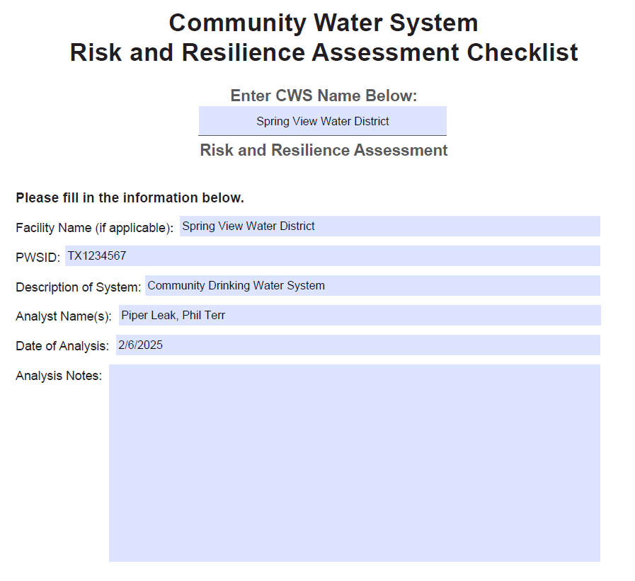
Cover Page
Notes:
On the cover page you just fill out the basic information for the water system.

Slide 46
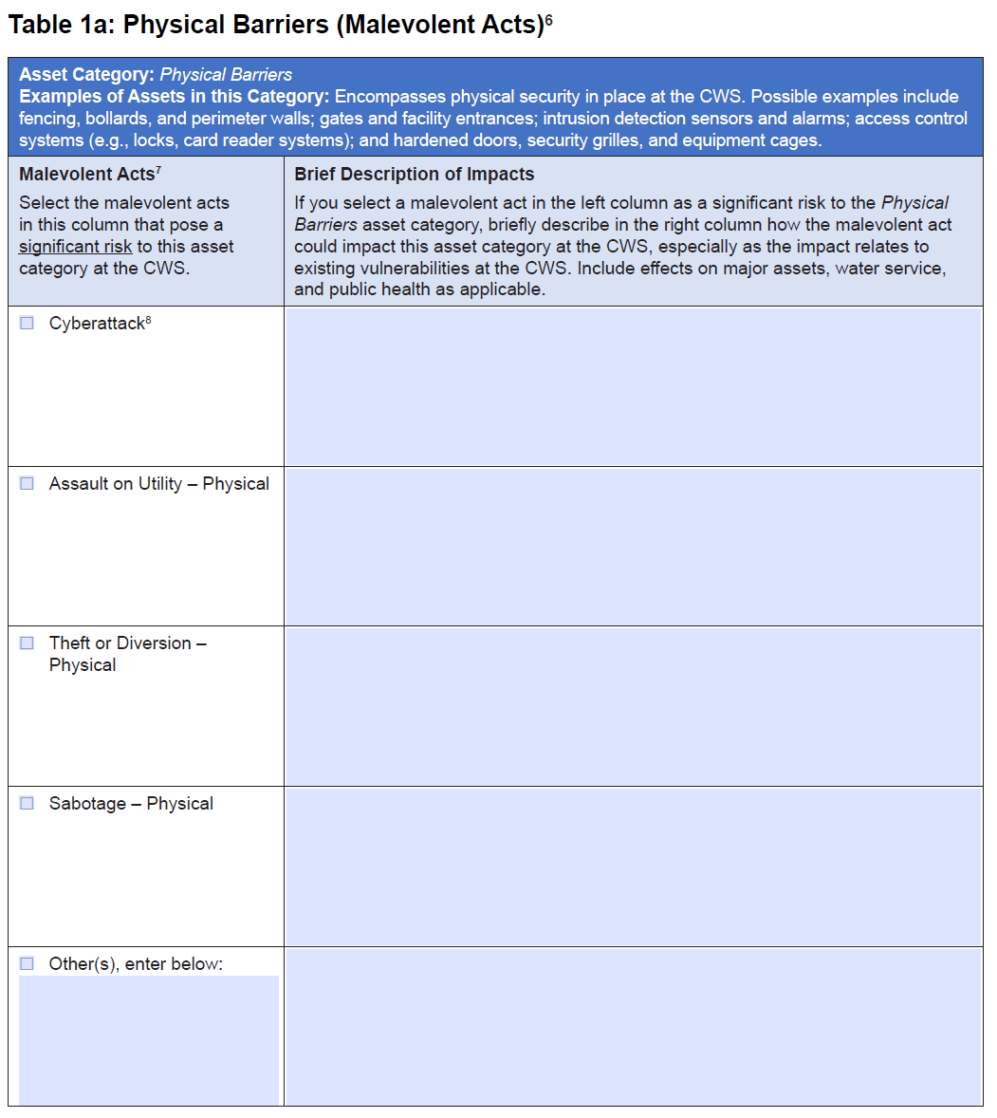
Example of a Malevolent Acts Table (Tables 1a-10a)
Notes:
Here is table 1a. At the top, the table states the asset category. This table is looking at physical barriers, which refers the physical security at the water system. The water system would check off any of these malevolent acts that they believe could cause significant risk to the system and then write a description of the impacts it could have on the given asset.

Slide 47
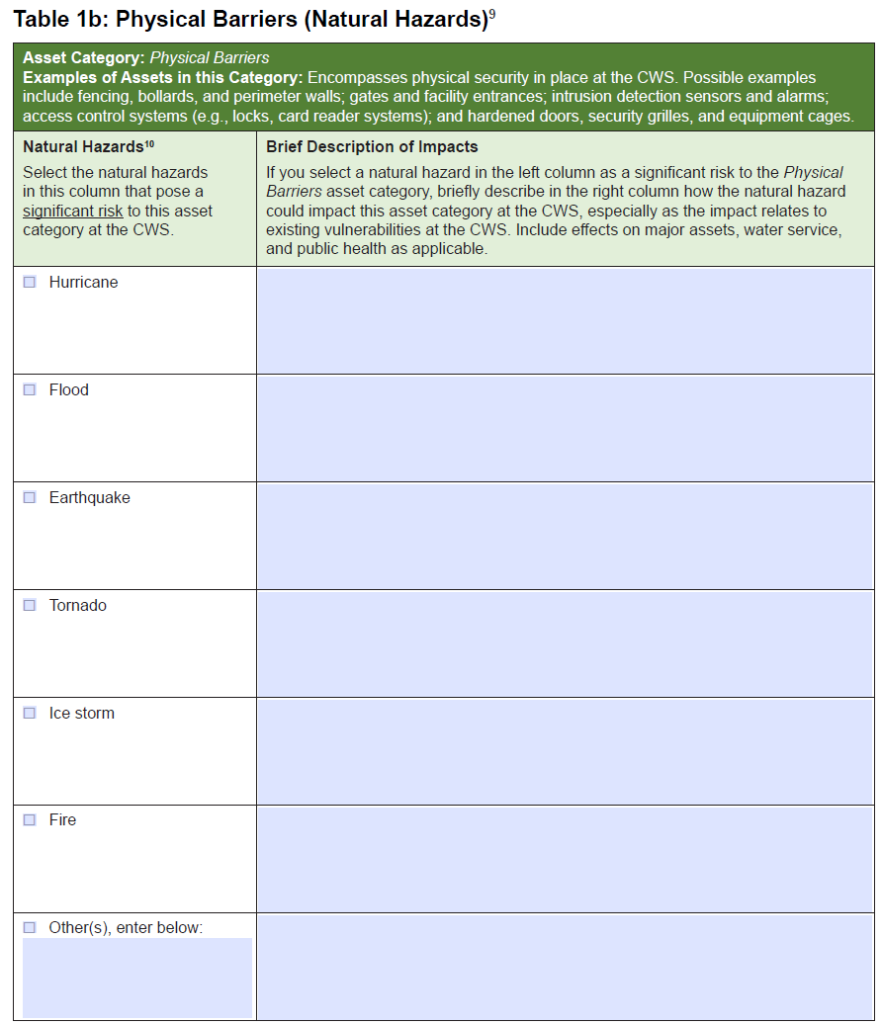
Example of a Natural Hazards Table (Tables 1b-10b)
Notes:
Here is table 1b. At the top, the table states the asset category. This table is looking at physical barriers, which refers the physical security at the water system. The water system would check off any of these natural hazards that they believe could cause significant risk to the system and then write a description of the impacts it could have on the given asset.
The rest of the tables in the checklist follow the same pattern – blue tables are for malevolent acts and green tables are for natural hazards. All tables have an “other(s), enter below” row for you to list threats of concern that aren’t pre-populated in the checklist. The threats EPA included in the checklist are a few examples, not an all-exhaustive list.

Slide 48
Example Scenario
Utility Name: Spring View Water District
Size: Small utility that serves 35,000 people
Critical assets:
  8 pumping stations
  Supervisory control and data acquisition (SCADA) system
  Water treatment plant
  IT business and financial systems
Example threats:
  Flooding
  Cyberattack
  Viral Pandemic
Notes:
Today we will be working through the Small Systems Risk and Resilience Checklist for the fictitious water utility Spring View Water District. Spring View Water District is a small utility located in outside of Dallas, TX, that serves 35,000 people. Spring View Water District went through their inventory and chose their most critical assets to consider through the checklist:
8 pumping stations
Supervisory control and data acquisition (SCADA) system
Water treatment plant
IT business and financial systems
Remember, Spring View Water District must address all 10 asset categories to meet the requirements of SDWA 1433. Within those 10 asset categories, the water system may decide which assets are their most critical assets that they want to focus on in this risk assessment.

Slide 49
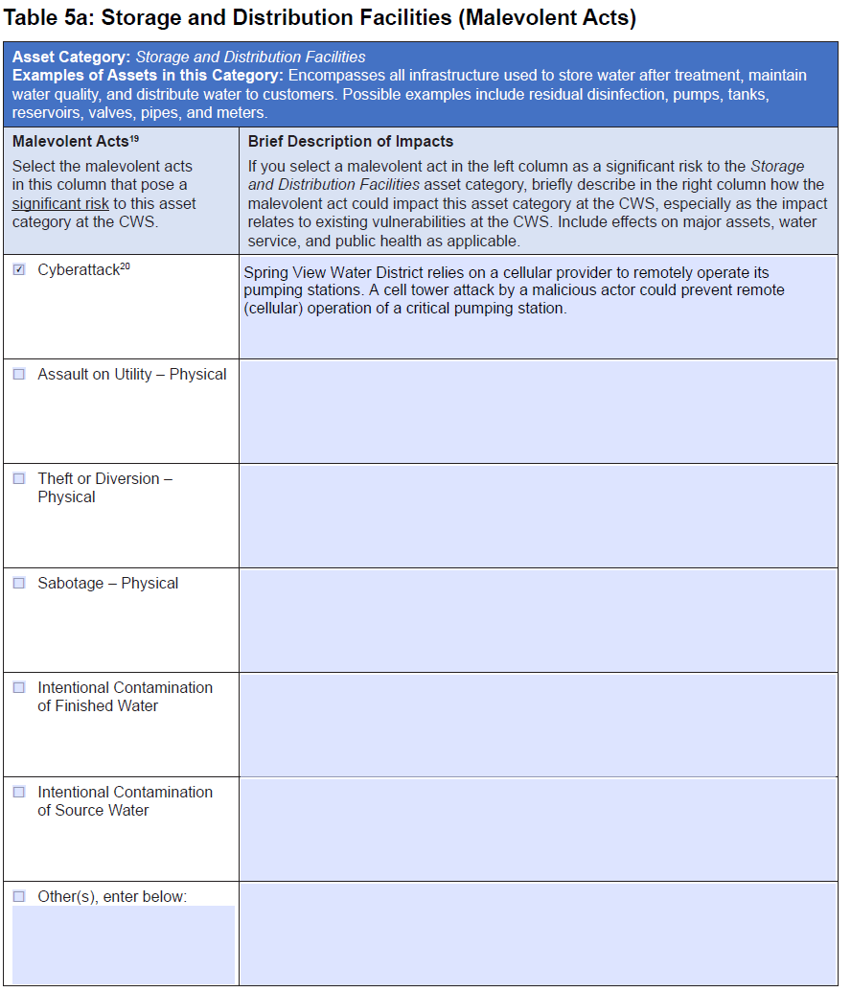
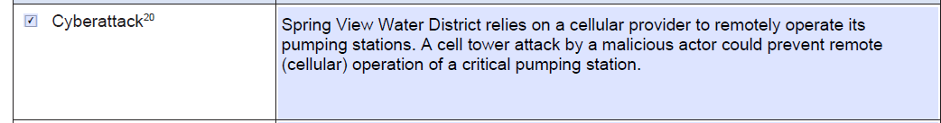
Cell Tower Cyberattack
Notes:
In this scenario, Spring View Water District has determined that a cyberattack poses a significant risk to the District’s Storage and Distribution Facilities. In table 5a, the district checks cyberattack as a significant malevolent act of concern. Then they describe their concern of how a cyberattack could prevent remote operation of a critical pumping station.
With a checked box and a written description, we have completed a qualitative assessment of the risk of a cyberattack on storage and distribution facilities. When your system is creating your RRA, you may want to add more than one check box and description to a given table but for the sake of our time-limited training, lets move on to some of the other required areas of the assessment.

Slide 50
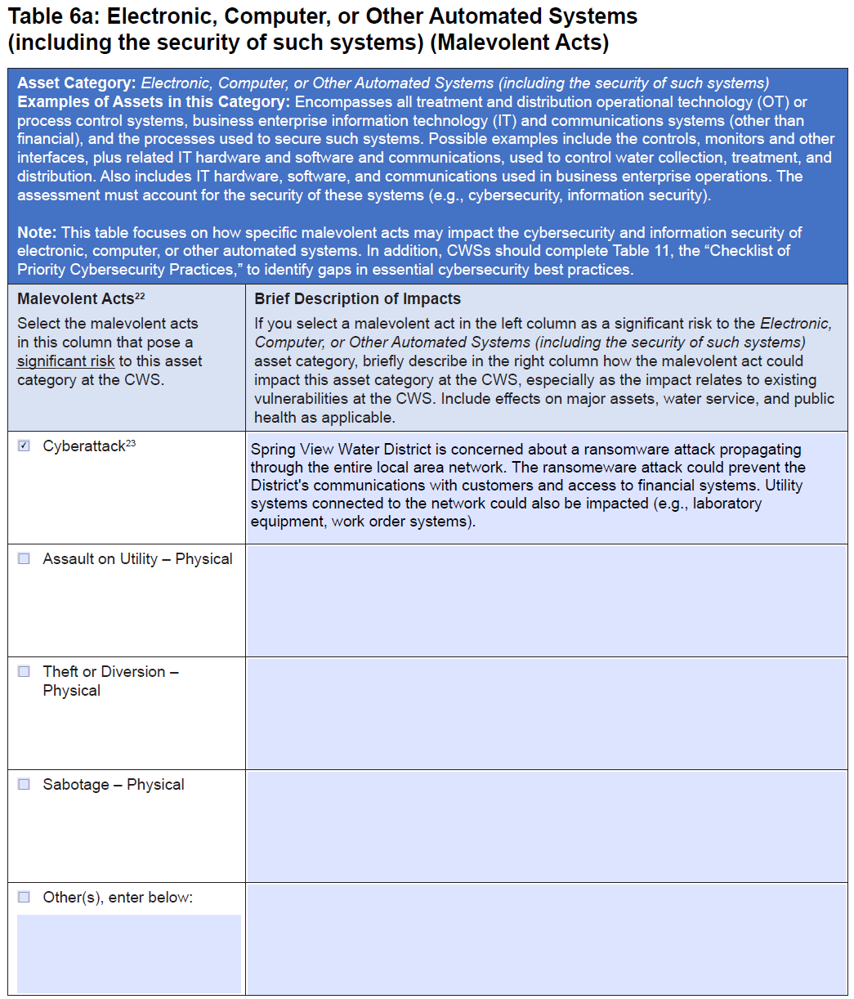
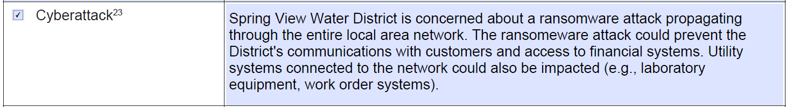
Ransomware Cyberattack
Notes:
In this scenario, Spring View Water District has determined that a ransomware cyberattack poses a significant risk to the District’s Electronic, Computer, or Other Automated Systems. In table 6a, the district checks cyberattack as a significant malevolent act of concern. Then they describe their concern of how a ransomware attack could negatively impact several of their computer systems.

Slide 51
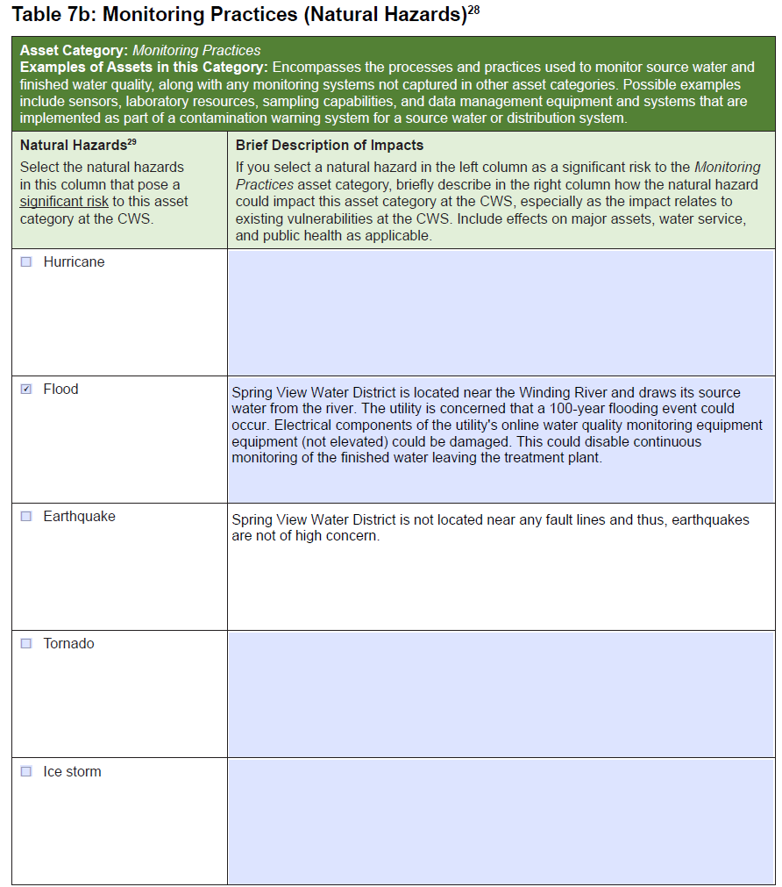
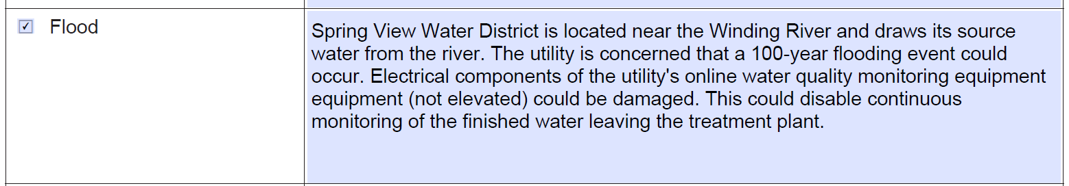
Flooding
Notes:
In this scenario, Spring View Water District has determined that a flood poses a significant risk to the District’s monitoring practices. The district uses Table 7b: Monitoring Practices (Natural Hazards).
The district checks flood as a significant natural hazard of concern. Then they describe their concern that a 100-year flood could damage electrical components for the utility’s online water quality monitoring equipment's (which is not currently elevated).

Slide 52
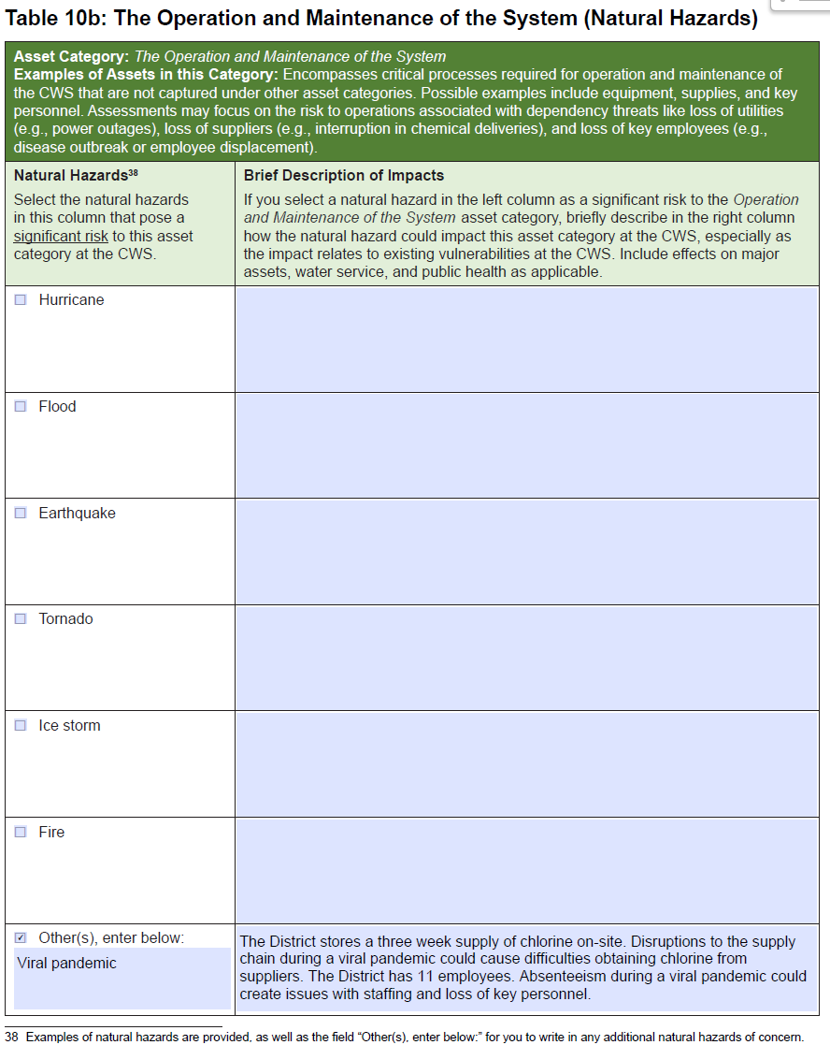
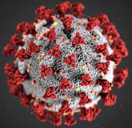
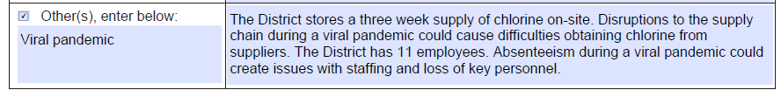
Viral Pandemic
Notes:
The example threats in the checklist are not an exhaustive list! If it was, the RRA checklist would be 100 pages long. That’s why we have the “Other(s), enter below:” row. In the word document, you can easily add more rows if a water system has multiple threats they want to add.
In this example, Spring view water district determined that a viral pandemic poses a significant risk to the District’s operation and maintenance of the system. We use the natural hazards table, 10b, and typed in our natural hazard, viral pandemic. In the description box, the utility wrote an explanation of their concern that the pandemic could affect their ability to obtain chlorine and that absenteeism could cause loss of staff and key personnel.
Those are a few examples for you to give you an idea of the type of things you could write in the “brief description of impacts” section. Your water utility is not Spring View Water District, though. Make sure that your RRA is specific to the threats and critical assets at your unique water utility.

Slide 53
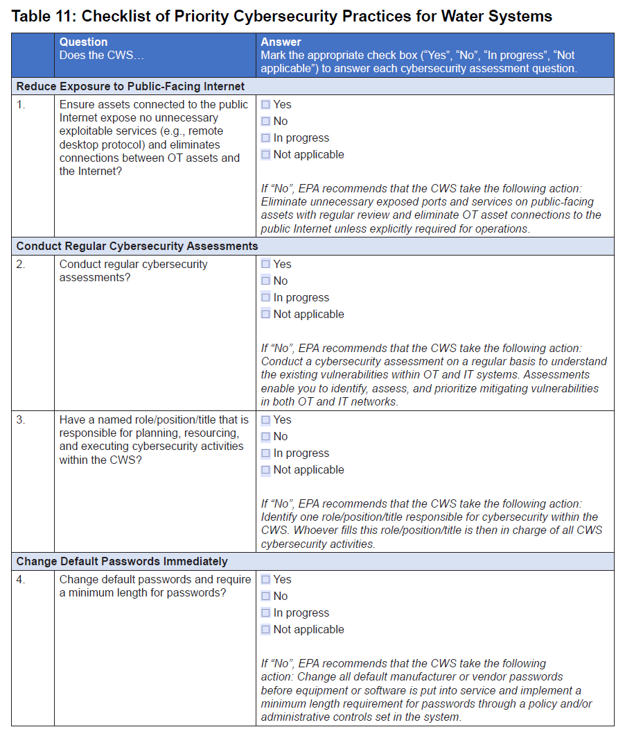
NEW Cybersecurity Checklist (Table 11 in latest version)
Includes 15 cybersecurity controls and their recommendations
The questions are derived from the Top 8 Cyber Actions for Securing Water Systems + 7 Priority Controls from EPA’s Cybersecurity Risk Assessment Guidance (full list of 33 questions available here in the WCAT Tool)
Notes:
Table 11 was recently added to the Small Systems RRA Checklist in July 2024! This table includes 15 cybersecurity controls and recommendations on how to implement them, if they have not yet been implemented at your facility. If you already have an RRA, EPA recommends that your water system fill out and add this checklist to your existing RRA for a deeper dive into cybersecurity resilience.
The questions are derived from the Top 8 Cyber Actions for Securing Water Systems + 7 Priority Controls from EPA’s Cybersecurity Risk Assessment Guidance.
If you want to go above and beyond, you can find the full list of 33 questions available here in the WCAT Tool – you will see the 15 questions from Table 11 come from the full list of 33 questions. EPA just prioritized the top 15 controls to make Table 11 more manageable in size, but the option exists to do the full 33 questions and add that to your RRA!

Slide 54
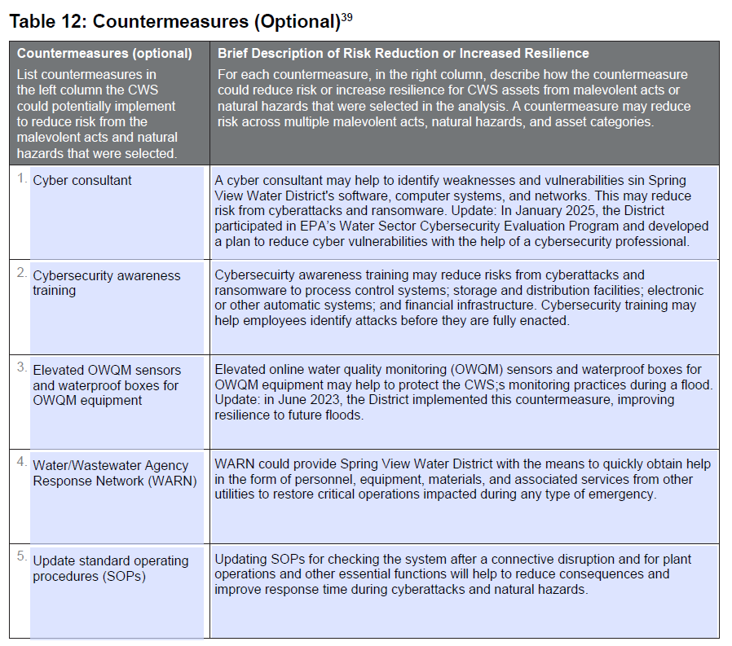
OPTIONAL Countermeasures Table (Table 12 in latest version)
Notes:
In table 12 of the Checklist, which is optional, you can identify countermeasures the CWS could potentially implement to reduce risk from the malevolent acts and natural hazards that you selected in in this assessment.
For malevolent acts, countermeasures are intended to deter, delay, detect, and respond to an attack
For natural hazards, countermeasures are intended to prepare, respond, and recover from an event
A single countermeasure, such as emergency response planning or power resilience, may reduce risk across multiple malevolent acts, natural hazards and asset categories.
Here’s table 11 of the Checklist filled out with 5 countermeasures that the district identified that they could implement to reduce risk from the malevolent acts and natural hazards that they used in their assessment:
To help with the cyber attacks, they could hire a consultant to find vulnerabilities in the districts networks that could make them vulnerable to a cyberattack.
They could also institute cybersecurity awareness trainings for their employees to help them identify attacks quicker and potentially stop them from infecting the water system’s electronic systems.
A countermeasure they listed for floods is to elevate sensors and waterproof boxes for equipment to protect monitoring practices.
The first 3 measures identified in this example are countermeasures for specific types of incidents. The 4th and 5th countermeasures identified could help Spring View Water District with a wide variety of threats. For example, Spring View Water District could join a Water Agency Response Network (WARN) in their area to be able to quickly get help from nearby utilities during an emergency. If you’re interested in joining a WARN in your area, you can find that information on our website (searching “EPA WARN” will get you to the correct webpage).
Another countermeasure that could help Spring View Water District reduce risk to many threats is included in the last row of table 11: to update their Standard Operating Procedures for checking their system.
Ask the audience: Can anyone think of additional counter measures related to today’s examples that could go in this table?
Please note that the table is OPTIONAL.
We recommend that you fill out this table if your utility has the time and resources to do so, however, because it can help you take the next step towards making your utility more resilient. It can also help get you thinking about the information you will need to include in your emergency response plans, which you must certify to EPA 6 months after you certify your risk assessment.
Also note that table 12 doesn’t require a specific number of countermeasures; you may have fewer than five countermeasures or add more countermeasures and describe them in a separate document.

Slide 55
EPA’s Checklist of Priority Cybersecurity Practices for Water Systems
Notes:
The biggest content update for our RRA and ERP resources was that we added a new Checklist of Priority Cybersecurity Practices for Water Systems to all of our resources (VSAT, the small systems checklist, and the ERP template) in 2024.

Slide 56
NEW Cybersecurity Checklist
Includes 15 cybersecurity controls and their recommendations
The questions are derived from the Top 8 Cyber Actions for Securing Water Systems + 7 Priority Controls from EPA’s Cybersecurity Risk Assessment Guidance (full list of 33 questions available here in the WCAT Tool)
Includes cybersecurity resources to assist utilities in implementing each cybersecurity control
Notes:
Table 11 was recently added to the Small Systems RRA Checklist in July 2024! This table includes 15 cybersecurity controls and recommendations on how to implement them, if they have not yet been implemented at your facility. If you already have an RRA, EPA recommends that your water system fill out and add this checklist to your existing RRA for a deeper dive into cybersecurity resilience.
The questions are derived from the Top 8 Cyber Actions for Securing Water Systems + 7 Priority Controls from EPA’s Cybersecurity Risk Assessment Guidance.
If you want to go above and beyond, you can find the full list of 33 questions available here in the WCAT Tool – you will see the 15 questions from Table 11 come from the full list of 33 questions. EPA just prioritized the top 15 controls to make Table 11 more manageable in size, but the option exists to do the full 33 questions and add that to your RRA!

Slide 57

Key Points to Remember
We understand you are not cybersecurity experts.
There is no “one size fits all” approach to cybersecurity.
Implementation of the 15 cybersecurity controls may vary between utilities.
Some cybersecurity controls may be overseen and implemented by third-parties.
If in doubt, submit cybersecurity-related questions to EPA’s Cybersecurity Technical Assistance Program for the Water Sector.
Notes:
We understand you are not cybersecurity experts, nor do we expect you to become a cybersecurity expert.
2. There is no “one size fits all” approach to cybersecurity. What works for you might not work for the next utility. What works for them might not work for you.
3. Implementation of the 15 cybersecurity controls from the checklist may (and probably will) vary between utilities.
4. Some cybersecurity controls may be overseen and implemented by third-parties. Vendors, service providers, county offices and departments may have their hands in a utility’s cybersecurity program. Consult with these third-party groups to help you answer the questions on cybersecurity controls that they oversee.
5. When in doubt, you can submit a cybersecurity-related question to our Cybersecurity Technical Assistance Program for the Water Sector and consult with a cybersecurity subject matter expert. They strive to have responses to you within two business days. They are here to help you!

Slide 58
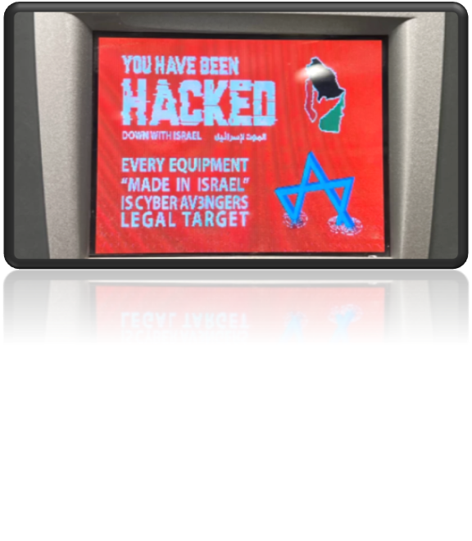
1. Ensure that assets connected to the public Internet expose no unnecessary exploitable services (e.g., remote desktop protocol) and eliminate connections between OT assets and the Internet?
Why is this control important?
Ports are how computers communicate and provide services with other computers.
Attackers can use these ports as “entrances” to a utility’s network if they are left unsecured.
Internet-facing devices can be easily found by cyber criminals and exploited.
Notes:
Let’s go over the 15 questions in the checklist. Here is the first question, I’m going to keep this at a high level and not delve into too much detail.
Does the utility ensure that assets connected to the public Internet expose no unnecessary exploitable services (e.g., remote desktop protocol) and eliminate connections between OT assets and the Internet?
When you have OT systems, sometimes you may connect them to the internet. And sometimes there are features of those systems that you will not use and should turn off. For example, you have a SCADA system and you have no reason that you would want to remote into it. In this case, you should turn off the ability to remote into that SCADA system since you don’t plan on using it. If your SCADA system is hooked up to the internet and you did not disable the remote desktop protocol function, a bad actor could try to remotely hack into your SCADA from 5 states over.
In summary, if your system has extra features, you aren’t planning on using them, and that system is connected to the internet, turn those extra features off so no bad actor can use them.

Slide 59
2. Conduct regular cybersecurity assessments? **
Why is this important?
Cybersecurity assessments enable you to identify, assess, and prioritize mitigating vulnerabilities in both OT and IT networks.
Utilities should conduct an assessment on a regular basis to understand existing and new vulnerabilities within OT and IT systems.
Notes:
Does the utility conduct regular cybersecurity assessments?
When you buy a home, you don’t buy it sight unseen. You want to assess the state of the house, see if the HVAC is working, see which floorboards are creaking. The same applies to cybersecurity at your utility. You want to assess the areas where you might be vulnerable, are there any steps you should be taking to protect these vulnerabilities? We recommend conducting these at least annually. They are quick and easy to do and at the end of the 15 questions, I will provide links for you to either conduct the assessment yourself or you can ask EPA to do it for you.

Slide 60
3. Have a named role/position/title that is responsible and accountable for planning, resourcing, and execution of cybersecurity activities within the utility?
Why is this control important?
A top-down strategy is essential for a utility’s cybersecurity program.
The cybersecurity lead can plan awareness training and exercises, request budget resources, meet with potential service providers, etc.
This individual does not need to be a cybersecurity expert.
Notes:
Does the utility have a named role/position/title that is responsible and accountable for planning, resourcing, and execution of cybersecurity activities within the utility?
Your utility should have a person with a named role, position, or title that is in charge of the cybersecurity stuff so that all the information cybersecurity wise is running through one person. It is ok if this person has a high or low understanding of cybersecurity, again we know you may not be cybersecurity experts; it still helps to have one person responsible for having cybersecurity related procedures flow through them.

Slide 61
4. Change default passwords and require a minimum length for passwords?
Why is this control important?
Factory default settings often include simple passwords that appear in the product’s user manual.
Weak and simple passwords can be cracked almost instantly.
It is estimated to take 898,000 years to crack a 15-character password that uses upper and lowercase letters.
Notes:
Does your utility change default passwords and require a minimum length for passwords?
Off-the-shelf hardware and software is designed for easy installation and use. Factory default settings often include simple passwords that appear in a product’s user manual and/or documentation. Attackers can easily obtain these passwords and use these credentials to potentially gain unauthorized access to systems. This happened recently! Bad actors from over seas hacked into PLCs that had factory set default passwords of “1111” that were never changed by the utility. Remember to change default passwords to prevent this!!

Slide 62
5. Require multi-factor authentication (MFA) wherever possible, but at a minimum to remotely access the OT network?
Why is this control important?
Provides additional layer of security for accounts. Without MFA, attackers only need to obtain the password to access an account.
Example: Something you know + something you have.
The FBI Cyber Division has reported that 99.9% of hacked accounts don’t use MFA.
Notes:
Does the utility require multi-factor authentication (MFA) wherever possible, but at a minimum to remotely access the OT network?
You may be wondering, what is Multi-Factor Authentication (MFA)? Something you know (password) + something you have (a pin sent to your device) = Multi-Factor Authentication
We have all come across MFA at some point. If we are trying to log in to our Netflix or our email, after you log in with your username and password it sends you a PIN code to your phone number or email. That process of the username & password plus PIN code is MFA.
MFA should be used at a minimum to remotely access the OT network. With the example I gave on the last slide where bad actors used the default password “1111”, you should have MFA set up for that so the bad actor would get stopped at the second stage of authentication. MFA prevents an attacker from accessing a user’s account, even if they have obtained the user’s password.

Slide 63
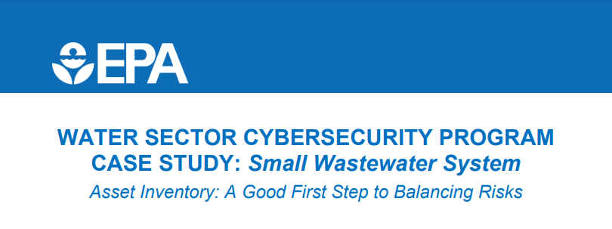
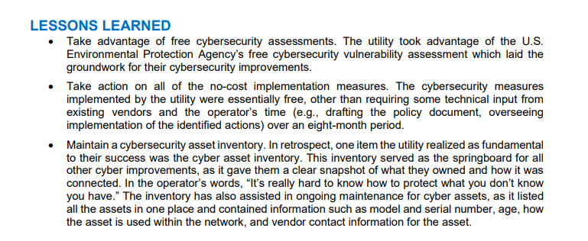
6. Maintain an updated inventory of all OT and IT network assets?
Why is this control important?
“You can’t protect what you don’t know you have.”
Cybersecurity improvements can’t begin without a plan.
An accurate inventory will assist in identifying and mitigating vulnerabilities.
Notes:
Does the utility maintain an updated inventory of all OT and IT network assets?
“You can’t protect what you don’t know you have.”
Think of this like insurance. If you have a flood, you have to let the insurance company know what has been damaged or lost. The same concept applies to cybersecurity OT and IT network assets. What do you have on your network? If something happens, you need to know what you have, what version it is, what year you purchased it, etc. If anything goes wrong, you need to know what you have so you can protect it.

Slide 64
7. Maintain current documentation detailing the set-up and settings (i.e., configuration) of critical OT and IT assets?
Why is this control important?
Attackers often exploit vulnerabilities that only exist in certain versions or settings.
“You can’t protect what you don’t know you have.”
Allows a utility to stay-up-to date on latest threats.
Notes:
Does the utility maintain current documentation detailing the set-up and settings (i.e., configuration) of critical OT and IT assets?
On the previous slide, we talked about how the utility needs to know what OT and IT assets they have. This slides says you also need to know how it is set up. E.g. if your SCADA system goes down and you have to use a backup to get it back online, you may not remember how you had it set up. Keeping that documentation on how it is set up will help you easily get things back up in running.

Slide 65
8. Have a written cybersecurity Incident Response (IR) Plan for critical threat scenarios which is regularly practiced and updated?
Why is this control important?
Describes the strategies, resources, and procedures to prepare for, respond to, and recover from a cyber incident.
The IR plan is essential in helping a utility recover quickly from cybersecurity incidents.
Being prepared is half the battle.
Notes:
Does the utility have a written cybersecurity Incident Response (IR) Plan for critical threat scenarios which is regularly practiced and updated?
This plan will highlight how to prepare for, respond to, and recover from a cybersecurity incident if it does happen to you. Being prepared is half the battle.

Slide 66
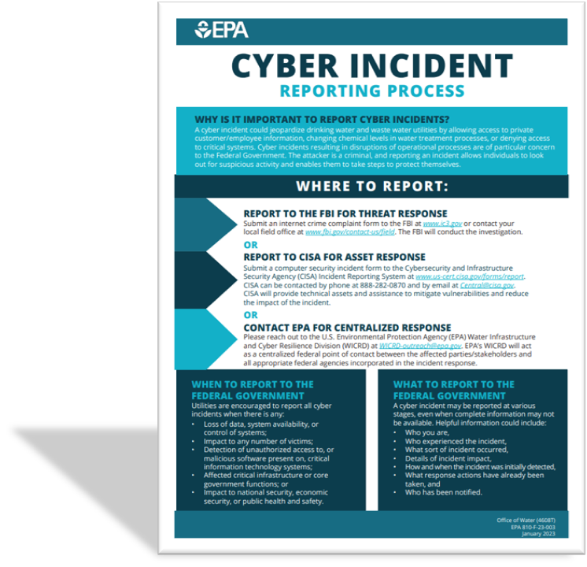
9. Have a written procedure for reporting cybersecurity incidents, including how and to whom?
Why is this control important?
Supports incident response procedures and allows a utility to receive support if they are experiencing a cyberattack.
Reported information may also help stop cybercrime from occurring at other utilities.
Notes:
Does the utility have a written procedure for reporting cybersecurity incidents, including how and to whom?
This procedure will make sure utility staff know what to do, who to contact for help, and what kind of info you are going to need to tell them.
This screenshot is of EPA’s cyber incident reporting fact sheet. It details how you can report to FBI for threat response, CISA for your asset response, or EPA for a centralized response – you may feel overwhelmed in the moment so feel free to just reach out to EPA and EPA can help talk to CISA and FBI for you and relay information back to you.
The fact sheet also covers when to report to the federal government and what to report.
In summary, it’s important to know what to do when a cyber incident occurs and who to contact to report the indecent. Reporting incidents helps us become more equipped to protect other utilities – learning from your incident could prevent a similar situation at another utility in the future!

Slide 67
10. Backup systems necessary for operations on a regular schedule, store backups separately from the source systems, and test backups on a regular basis?
Why is this control important?
Backups are a critical element of a utility’s restoration and recovery activities.
Backups are important for cyber incidents, hardware malfunctions, or physical destruction of equipment.
First line of defense for ransomware and similar attacks.
Notes:
Does the utility backup systems necessary for operations on a regular schedule, store backups separately from the source system, and test backups on a regular basis?
This is how you get back up as fast as possible and in the right way. For example, let’s say your utility becomes a victim of ransomware where a bad actor demands that you give them $25k or they won’t give you back critical information that they stole from you. If you have backups, you can just report this to local law enforcement or FBI or CISA and just work off the backups of the information they stole.

Slide 68
11. Patch or otherwise mitigate known vulnerabilities within the recommended timeframe?
Why is this control important?
Vulnerabilities are weaknesses in software or hardware.
Cyber criminals will actively research vulnerabilities to exploit.
The 2023 attacks on Unitronics PLCs is an example of a known vulnerability being exploited.
Notes:
Does the utility patch or otherwise mitigate known vulnerabilities within the recommended timeframe?
If a utility down the road just went through a cybersecurity incident due to a vulnerability and they provide you with the steps they took to fix it, is your utility going to patch that recently discovered vulnerability on your system in a reasonable timeframe? You can’t sit on it for 2 months for someone to make a decision or wait for new equipment to come in, once you find out that you have a vulnerability that has been exploited by bad actors, you need to patch it quickly.

Slide 69
12. Require unique and separate credentials for users to access OT and IT networks and separate user and privileged (e.g., System Administrator) accounts?
Why is this control important?
Attackers use compromised credentials to access other accounts and it may not raise alarms
This can lead to a utility not recognizing it as a security incident
Administrator accounts have full control over a system
Improper handling of administrator accounts makes an attacker’s job easier
Notes:
Does the utility require unique and separate credentials for users to access OT and IT networks and separate user and privileged (e.g., System Administrator) accounts?
When you utility has accounts, you will have your OT side and your IT side. You should not have the same log in credentials for both the OT and IT side. E.g. if you are logging in to your main computer at your desk, you should not use that same username and password for your SCADA system. If an attacker can determine a user’s login on one network, they will try to use that login information to access other accounts. This type of attack may not raise alarms if system monitoring does not recognize this activity as “abnormal” and can lead to a utility not recognizing it as a security incident.
For the part that says “separate user and privileged accounts”: let’s say you just hired a brand-new employee. The new employee’s user account should not have the same level of access as your IT manager of 10 years. Your new employee should have a basic level user account while your IT manager would have a “privileged” account with more access to things like making essential changes, scheduling updates, etc.

Slide 70
13. Prohibit the connection of unauthorized hardware (e.g., USB drives) to OT and IT assets?
Why is this control important?
Inserting unauthorized hardware can lead to system breaches, disruptions, or damage.
Cyber criminals can “drop” malicious USBs in or around buildings.
Employees can unknowingly cause system breaches by connecting unauthorized hardware.
Notes:
Does the utility prohibit the connection of unauthorized hardware (e.g., USB drives) to OT and IT assets?
A bad actor could put bad code on a USB drive, label it “family vacation 2022”, and drop it on the ground outside the utility. Then a kind utility employee finds it and plugs it in to see if they can get the family photos back to the person and boom, that bad actor now has access to your system. At your utility, you should prevent anything that is not supposed to be plugged in. That extends to cell phones, sometimes we want to charge them but you should not allow your systems to be used to charge phones.

Slide 71
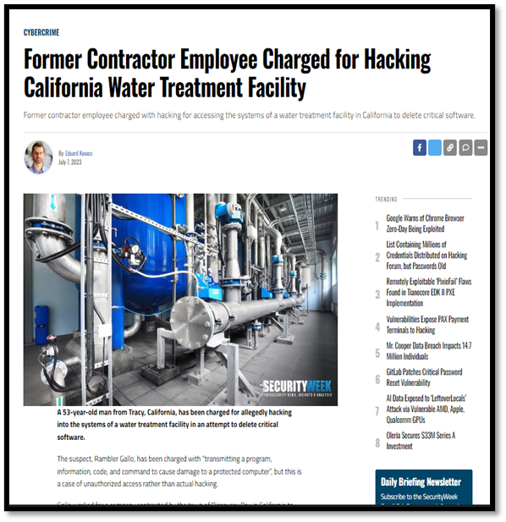
14. Immediately disable access to an account or network when access is no longer required due to retirement, change of role, termination, or other factors?
Why is this control important?
Inactive accounts may appear harmless.
Attackers can use these accounts and go undetected.
This control protects against insider threats.
Notes:
Does the utility immediately disable access to an account or network when access is no longer required due to retirement, change of role, termination, or other factors?
Why is this control important?
Inactive accounts may appear harmless, but this is a commonly used attack method. If someone quits or retires, their account should be disabled immediately, especially if they were able to remote into your system!
This is also important when an employee changes roles at the utility. Let’s say someone transfers from HR to the IT team, their HR access should be disabled, and they should be only able to access the things that the IT folks do.

Slide 72
15. Provide at least annual training for all utility personnel that covers basic cybersecurity concepts?
Why is this control important?
Regular cybersecurity training builds a culture of cybersecurity awareness.
Utilities staff that receive regular training are more likely to identify cyber-attacks.
Regular training is critical as cybersecurity threats evolve.
Notes:
Does the utility provide at least annual training for all utility personnel that covers basic cybersecurity concepts?
Why is this control important?
Regular cybersecurity training builds a culture of cybersecurity awareness.
Utilities staff that receive regular training are more likely to identify cyber-attacks.
Regular training is critical as cybersecurity threats evolve.
These trainings may be boring but know that it is super important to train you to see the signs of a cyber attack. One day you may be the one who gets the email from FedEx saying you missed a package, but because you did the cybersecurity training, you don’t click the link on the email and you report it to your IT folks.

Slide 73

Additional Cybersecurity Assessment Resources
Self-Assessment: 33 Question Checklist and Water Cybersecurity Assessment Tool (WCAT) available at epa.gov/waterresilience/cybersecurity-assessments
Third-Party Assessment: Water Sector Cybersecurity Evaluation Program available at epa.gov/waterresilience/forms/epas-water-sector-cybersecurity-evaluation-program
Notes:
We are now done with the 15 question checklist. As mentioned before, we have a longer, 33 question version of the 15 question checklist we went over today. WCAT is a self-assessment tool you can use to work through the longer, 33 question version.
Alternatively, you can reach out to EPA and we’ll do the cyber assessment for you! For assistance with completing this 15 question cyber assessment checklist, or if you want to do the full 33 questions, please feel free to reach out to EPA through the EPA Cybersecurity Evaluation Program form. We went through these 15 questions quickly today – please don’t hesitate to reach out to EPA if you have any questions about them. Cybersecurity subject matter experts will assist in explaining the questions further in detail, or will complete the entire assessment for the utility: https://www.epa.gov/waterresilience/forms/epas-water-sector-cybersecurity-evaluation-program.

Slide 74
Creating or Revising an Emergency Response Plan (ERP) using EPA’s ERP Template
Notes:
Finally, let’s discuss how to create, or revise if you already have one, an emergency response plan using EPA’s ERP template.

Slide 75
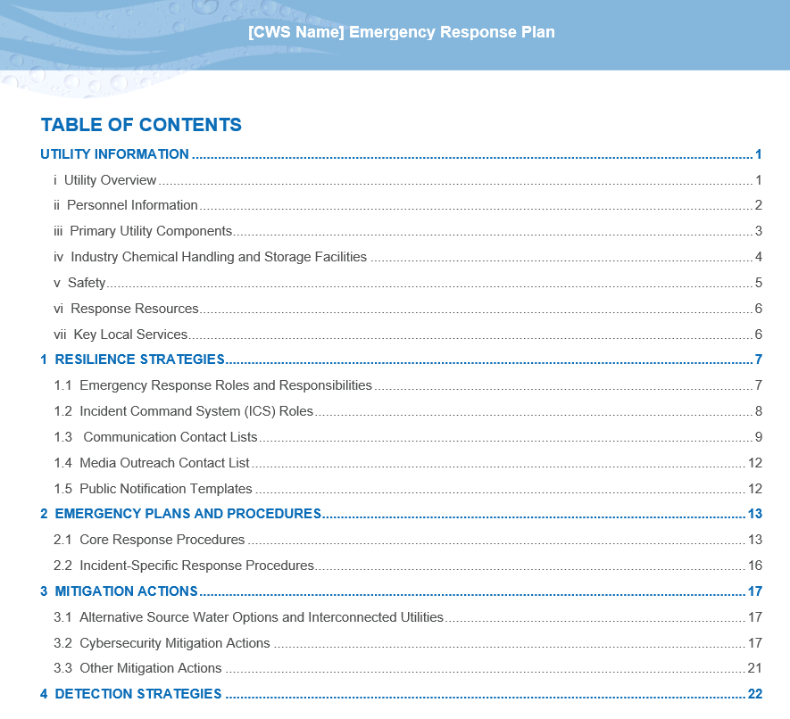
Emergency Response Plan Guidance and Template
Download English Template Here
Download Spanish Template Here
Notes:
EPA has one ERP template that is easy for any sized CWS to use. We have a Spanish version available as well.
Just like with our RRA resources, we recorded past workshop that you can check out for a demo on how to use the template.
Note, there are TWO components to the guidance, the guidance and the template. It will help to have both open at the same time. The link will open the pdf of the ERP Instructions document in your browser. It is very important that you DOWNLOAD the pdf onto your computer, and not work from the browser, so that you can access the imbedded blank, Microsoft Word ERP template.
EPA’s Emergency Response Plan Guidance and Template is an easy-to-use template with fillable tables and checklists that you can customize to fit the needs of your unique utility. The ERP template consists of 5 sections, outlined here in the Table of Contents. First is the Utility Information section, which contains helpful, overview-type of information about your facility. The next 4 sections of the template are modelled around the four criteria that your ERP must contain, as required by SDWA 1433:
Resilience Strategies
Emergency Plans and Procedures
Mitigation Actions
Detection Strategies

Slide 76
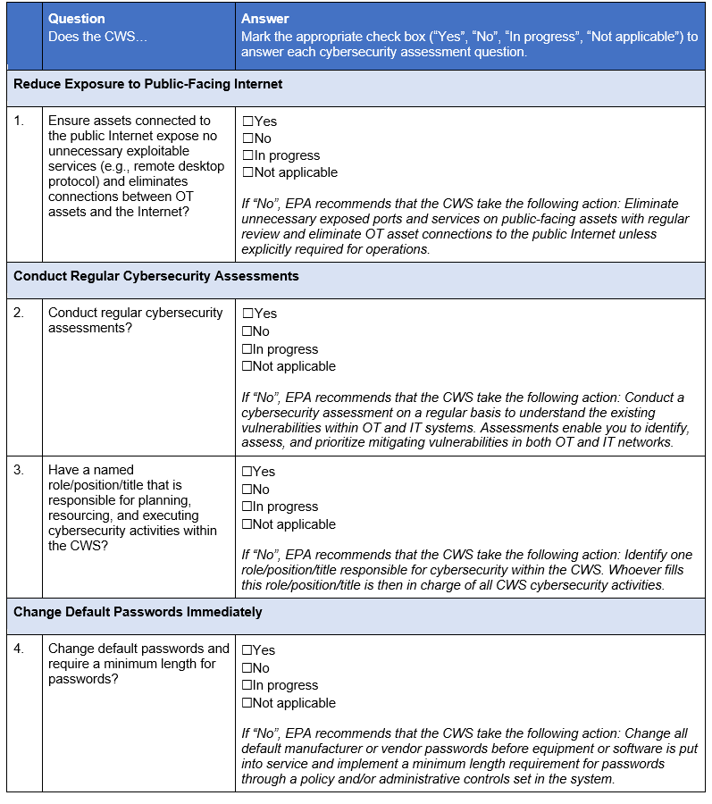
ERP Template
September 2024 Updates
Added additional cybersecurity materials and corresponding practical mitigation options for utilities
Updated ERP Template to be easier to use and more customizable
Notes:
The updated ERP was published in Sep 2024. Here are the changes:
Added additional cybersecurity materials and corresponding practical mitigation options for utilities
Updated ERP Template to be easier to use and more customizable

Slide 77
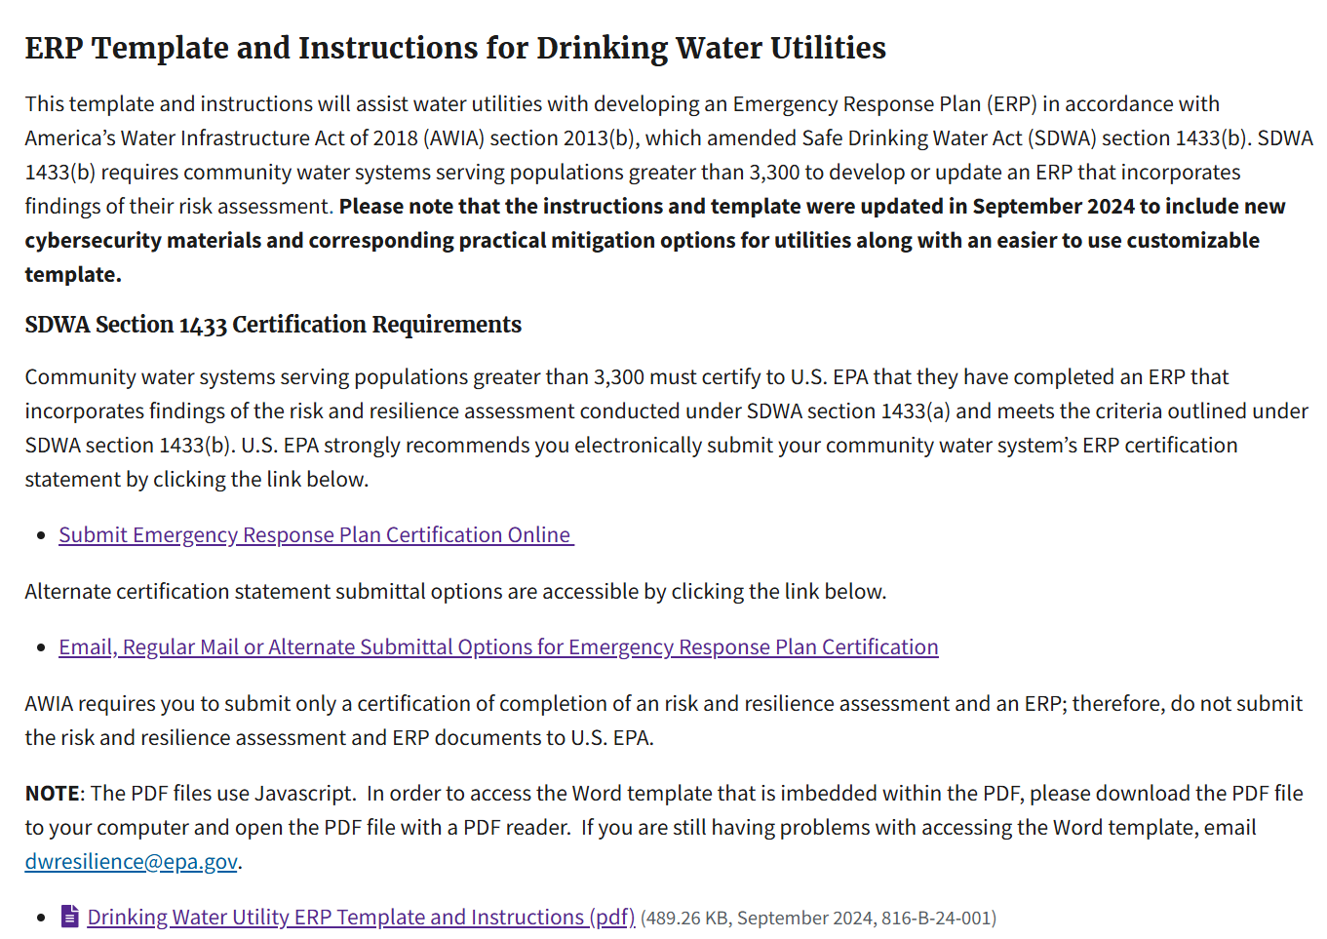
ERP Guidance – How to Access
Visit www.epa.gov/waterresilience OR search “EPA ERP” in a search engine of your choice
Notes:
First thing’s first, let me show you how to access the guidance and template. You can navigate to the materials from the water resilience homepage, or you can use a search engine and type in “EPA ERP”.
On the ERP guidance webpage, circled in red is the link you will click to download the guidance materials.

Slide 78
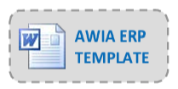
ERP Guidance – Two Components
A single PDF document provides guidance on what information should be provided in each section of the ERP template. Includes useful links for additional information and guidance
A blank ERP template in Word format is embedded in the PDF document and can be easily accessed and modified to meet your own utility’s needs.
Notes:
The link I just showed will open the pdf of the ERP guidance document in your browser. It is very important that you DOWNLOAD the pdf onto your computer and not work from the browser. This means saving the file to an accessible your folder HARDDRIVE.
This single pdf document will serve as your step-by-step, paint by numbers approach to developing your ERP, complete with useful links and information. Embedded in the pdf document is a blank word document version of the ERP. You access this word document by clicking the gray box pictured here. This button may not work if you have not downloaded the guidance pdf to your computer.
Note, there are TWO components to the guidance, the guidance and the template. It will help to have both open at the same time

Slide 79
ERP Template Outline
Sections
  Utility Information
  Resilience Strategies
  Emergency Plans and Procedures
  Mitigation Actions
  Detection Strategies
Modify the template to meet individual utility needs!
Notes:
The ERP template consists of 5 sections, outlined here in the Table of Contents.
The Template is modelled around the four criteria that your ERP must contain, as required by AWIA. EPA has included a fifth section, titled Utility Information for ease of use. The four mandated sections are:
Resilience Strategies
Emergency Plans and Procedures
Mitigation Actions
Detection Strategies
The template is designed to be user-friendly and features fillable tables, checklists and charts to use as a starting point for your utility's ERP. You can modify the template in any way you want to meet your utilities' needs.
In the following slides, I will explain the 5 sections are as we walk through some examples.

Slide 80
Utility Information
During an incident, you should have information about your water utility readily available for your personnel and response partners.
    Utility Overview
    Personnel Information
    Primary Utility Components
    Industry Chemical Handling & Storage Facilities
    Safety
    Response Resources
    Key Local Services
Notes:
Consider the Utility Information section the “orientation materials” for your response partners (or new staff) to get familiar with your system. When you open up your ERP during an incident the first section you will come to is the utility overview.
1.1. Utility overview – This section will include the utility name and address, and the primary and alternate contact info for the system owner/administrator. You may choose to provide additional info here, such as your facilities and distribution system maps. Next;
1.2. Personnel information – This is your personnel roster, which includes Names, numbers, and titles of all staff.
1.3 .Primary Utility comp. –Answers the question “What is your treatment and distribution system comprised of?” This can include names and locations of wells, intakes, treatment plants, and storage facilities. Details on the location and operation these components can be given here.
1.4. Industry Chem handling and storage – Industries surrounding your utility can also be impacted by incidents, resulting in accidental releases. Under AWIA, it is required that you are aware of what chemicals may be released in your area during an incident.
1.5. Safety - Having easy access to safety materials and procedures will help protect utility personnel during an incident. You can use the tables in this section of the ERP template to record that information, or, if your utility has a Health and Safety Plan, you can simply reference that in this section.
1.6. Response Resources - Having an accurate inventory of available resources, either onsite or readily available, allows any utility responders to know is immediately available during an incident. The term “resources” can be used interchangeably in different scenarios, but in this case resources refers to supplies and equipment.
1.7. Key loc. Services- These include hospitals, gas stations, and other facilities like drugstores, ATMs, and 24 hour restaurants. Include a map or maps if available.

Slide 81
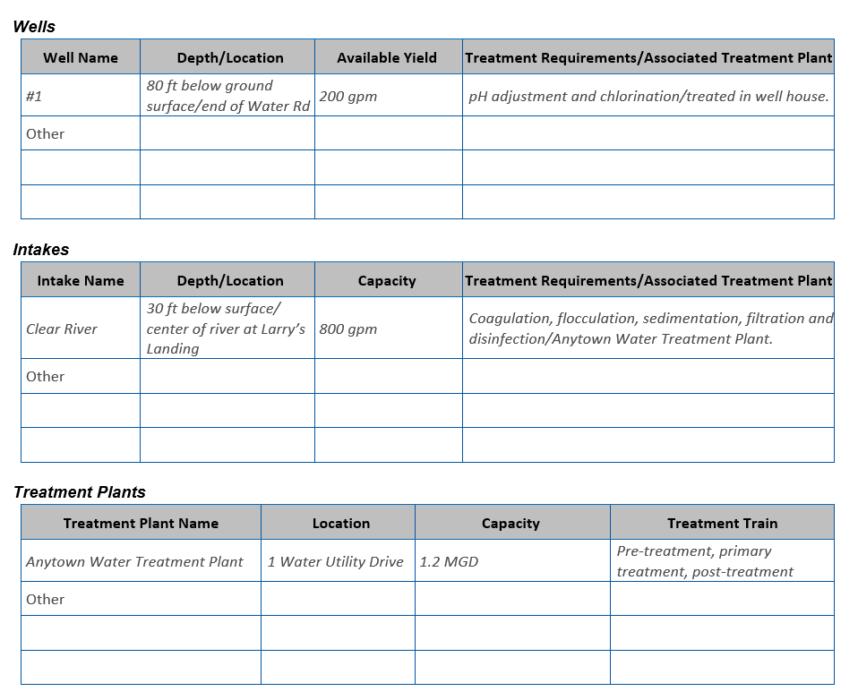
1.3 Primary Utility Components
List components necessary to maintain effective operation of your utility.
Notes:
This is our first example of the tables within the ERP template. The tables in the template will include examples written in italics to provide an idea of the level of detail you should include in your ERP. Remember, you can always edit these tables to suit your needs and preferences.
In this section, as stated, this is where you will list all the components necessary to maintain effective operation of your utility. Simply add more rows to the tables below if you have additional components. Text in italics represents examples – be sure to delete italicized text as necessary as you fill out the tables below and throughout this template.

Slide 82
Section 1: Resilience Strategies
This section of your ERP contains strategies and resources to improve the resilience of your system.
    1.1 - Emergency Response Roles and Responsibilities
    1.2 - Incident Command System (ICS) Roles
    1.3 - Communication Contact List
    1.4 - Media Outreach Contact List
    1.5 - Public Notification Templates
Notes:
Resilience strategies incorporate how you will assign roles and responsibilities, how you will work with response partners, and how you intend to communicate during an incident.
1.1. Emergency Response roles – Answers the question “When the time comes, who is responsible for what?” An effective ERP involves active participation of both utility and response partners, each having well defines roles and responsibilities.
1.2. Incident command system roles – For those who are not familiar, ICS was developed by FEMA and is used to organize both small and large, field-level operations for a broad spectrum of emergencies. ICS is used by all levels of government, as well as the private sector.
1.3. Communication - Communication during an incident is critical to relay information to employees, government agencies, the public, the media, and others about potential risks to health, infrastructure, and the environment.
Internal – “How you will coordinate with your utility personnel?”
External/Response Partner – “Who outside of your utility should you notify; i.e. who will be providing you support and resources
Critical Customers – Includes hospitals, long-term care facilities, emergency shelters, and sensitive populations or could be based on usage (large commercial, significant industrial users) as well as government buildings like the EOC! How will these critical customers be notified? (Directly or indirectly, via social media, posted bulletins, door-to-door)
Communication equip. inv. – Use this table to inventory your communications equipment (e.g., mobile phones, two-way radios)
1.4. Will include your list of contacts for media outlets, such as newspapers, TV, and radio.
1.5. Public Notification Templates – Here you can insert your templates for public notifications, which can include boil notices, health advisories, and draft press releases; for quick reference and distribution.

Slide 83
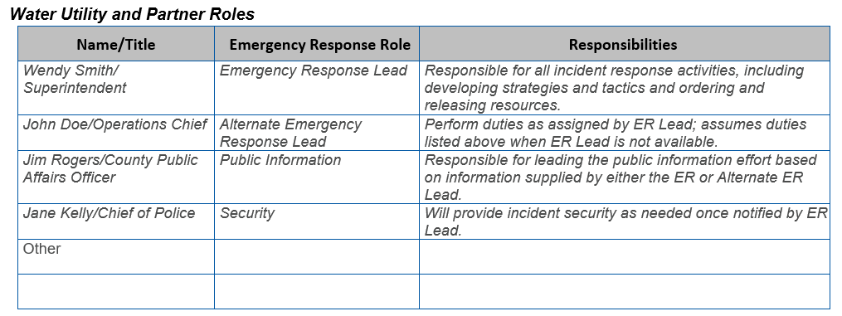
1.1 Emergency Response Roles & Responsibilities
Describe the roles and responsibilities for key utility and external response partner personnel. You can add, edit, or delete rows as necessary.
Notes:
Describe the roles and responsibilities for key utility and external response partner personnel in the tables below. You can add, edit, or delete rows as necessary.
It is important to first establish an Emergency Response Lead (ER Lead) and Alternate ER Lead at your utility. The ER Lead should be the main point of contact during an incident and will also have a role in developing and updating the ERP.
It is very important to keep this table up to date, and for the responsibilities to be accurately defined and communicated.

Slide 84


1.3 Communication Contact Lists
List all utility emergency response team members, their response role, title and contact information.
List all external response partners, their response role or position as well as contact information.
Notes:
Communication during an incident is critical to relay information to employees, response partners and critical customers about potential risks to health, infrastructure, and the environment.
List all utility emergency response team members, their response role, title and contact information below.
This is an important reference table! The ERP consists of many sections that can be modular. You should consider printing and posting certain sections, as you may need to access them quickly during an emergency.

Slide 85
Section 2: Emergency Plans & Procedures
This section of your ERP should contain plans, procedures, and equipment that can be used during an event that threatens your utility’s ability to treat and distribute drinking water.
    2.1 - Core Response Procedures
    2.2 - Incident-Specific Response Procedures (ISRPs)
Notes:
Next is the Emergency Plans & Procedures section. This section of your ERP should contain plans, procedures, and equipment that can be used during an event that threatens your utility’s ability to treat and distribute drinking water.
Two types of emergency response plans and procedures should be included as part of your ERP:
2.1 - Core Response Procedures
2.2 - Incident-Specific Response Procedures (ISRPs)

Slide 86

Core Procedures
Core procedures are the “building blocks” for incident response, since they apply across a broad variety of incidents (e.g., hurricane, earthquake, flood).
    Access
    Physical Security
    Cybersecurity
    Power Loss
    Emergency Alternate Drinking Water Supplies
    Sampling & Analysis
    Family and Utility Personnel Well Being
Notes:
Here we have listed the set of core response procedures that are included in the ERP guidance document. I will give a brief overview of each:
Access – A common, and sometimes exceedingly difficult challenge your utility may face during an incident is accessing your critical facilities. Access to sites may be hampered by debris, downed power lines, flood waters, or roadblocks established by law enforcement agencies. For example, under a mandatory evacuation, members of the public would not be allowed to return the affected area, therefore the access procedures should account for what documentation would be needed for reentry.
Physical security procedures will cover protecting facilities, equipment, and vital records. Use this section to describe the physical security measures for your utility's assets.
Cybersecurity –As you may be hearing more lately, cyber-attacks on information technology (IT) and operation technology (OT) are increasingly common. Your utility should consider the adoption of cybersecurity best practices to reduce the threat of cyber attack, including drill response and recovery procedures after a successful cyber attack.
Power Loss can be the most immediate and significant impact to your plant's ability to produce water. An extended power loss can have devastating impacts on your water utility and the community you serve. Use this section to describe your utility’s resources and procedures in the event of the loss of grid power.
Emergency Alternate Water Supply – During an emergency, your utility should have procedures for supplying alternate drinking water to your community, for both short- and long-term outages. Alternate water services can include interconnections with neighboring, operational utilities (if possible), as well as for providing bulk or bottled water
Sampling & Analysis –Water contamination emergencies could result in a surge of water sampling and analysis needs that can quickly overwhelm the laboratory resources available. In the event you would need to outsource your sampling/analysis, you should have established procedures for handling the sample collection, chain of custody, sample preservation, and transport to an alternate lab.
Family and Utility Personnel Well Being – Your personnel are more likely to report for duty and stay on the job during an incident if they know that they and their families are safe and cared for. The Family and Utility Personnel Well Being section can be used to identity what actions can be taken before, during, and after an incident to prepare for the demands of emergency response. Actions may include alternate work locations, on-site emergency supplies, and ensuring staff have developed family disaster plans. Your utility should also consider how it wants to support personnel who may be working extended shifts during an incident.: This can include the staff's needs to eat, sleep, bathe, and have working facilities.

Slide 87

Incident Specific Response Procedures (ISRPs)
ISRPs are specialized procedures tailored to a particular type of incident.
They provide a quick approach for responding to an incident and complement the actions already taken under your ERP.
Notes:
There are many ISRPs ready-to-go on our website and listed in the guidance document. Feel free to use them as a starting point and customize them to meet the specific needs at your utility. You will not need to include all of them in your ERP, but you should consider having a few included that can be detached and brought to the field during an emergency.

Slide 88


ISRP Example - Wildfire
www.epa.gov/waterutilityresponse/incident-action-checklists-water-utilities
Notes:
Here we have an excerpt from the Wildfire ISRP. The check list includes actions you can take to prepare, respond to, and recover from a wildfire.
The "prepare" checklist includes sections for pre-planning and coordination and have items such as identifying critical infrastructure and coordinating with local emergency responders. These are excellent tools for becoming familiar with the functions of emergency response, especially for those new to the world of emergency management.

Slide 89
Section 3: Mitigation Actions
This section of your ERP includes actions which can lessen the impact of a malevolent act or natural hazard on the public health and water services provided to your community.
    3.1 –Alternate Source Water Options and Interconnected Utilities
    3.2 – Cybersecurity Mitigation Actions
    3.3 – Other Mitigation Actions
Notes:
Mitigation actions are cost effective. They help your utility better withstand and rapidly recover from an incident, which increases overall resilience. There are two groups of mitigations actions highlighted in the template:
3.1 – Alt source water options, and interconnected utilities – “How will you prevent a disaster from impacting your ability to treat and distribute drinking water?"
3.2 - Identify the priority cybersecurity mitigation actions that your utility intends to implement to better protect against a cyberattack. To accomplish this, you can use the Checklist of Priority Cybersecurity Practices for Water Systems
3.3 – The other mitigation actions section should be based on the countermeasures identified in you RRA and implemented before an incident. These actions will be specific to vulnerabilities that affect your unique utility. For example, identifying fire-hardened areas to store your critical assets, or removing vegetation and flammable debris in the area around your facility.

Slide 90

3.1 Alt. Source Water and Interconnected Utilities
Notes:
An interconnection to a neighboring water utility would be most preferable option to be able to supply safe drinking water during an emergency , followed by “damage control” mitigation actions. In the example, we identified in the template example the option to tap into a well used for irrigation for an emergency water supply (note, that this may be a special case, as allowed by State/Federal Law).

Slide 91
Section 4: Detection Strategies
This section of your ERP contains strategies that can aid in the detection of malevolent acts or natural hazards that threaten the security or resilience of your utility, including;
  Unauthorized Entry into Utility Facilities
  Water Contamination
  Cyber Intrusion
  Hazardous Chemical Release
  Natural Disasters
  Power Outages
Effective response to an emergency requires timely detection, which allows your utility to implement its ERP as soon as possible.
Notes:
The most appropriate method of detecting a possible incident depends on the type of threat. Where possible, multiple detection methods should be used.
Remember: Effective response to an emergency requires timely detection, which allows your utility to implement its ERP as soon as possible. I.E. The sooner you detect, the sooner you can respond.

Slide 92

Contact Us
Water Infrastructure and Cyber Resilience Division
WICRD-outreach@epa.gov
www.epa.gov/waterresilience
SDWA Section 1433/AWIA Section 2013
dwresilience@epa.gov
www.epa.gov/waterresilience/awia-section-2013
Notes:
Please visit our website for additional information, access to EPA’s free resources and guidance, and links electronically certify your RRA or ERP using our secure, online platform. If you have additional questions about SDWA section 1433/AWIA section 2013, please email us at dwresilience@epa.gov.

