Slide 1
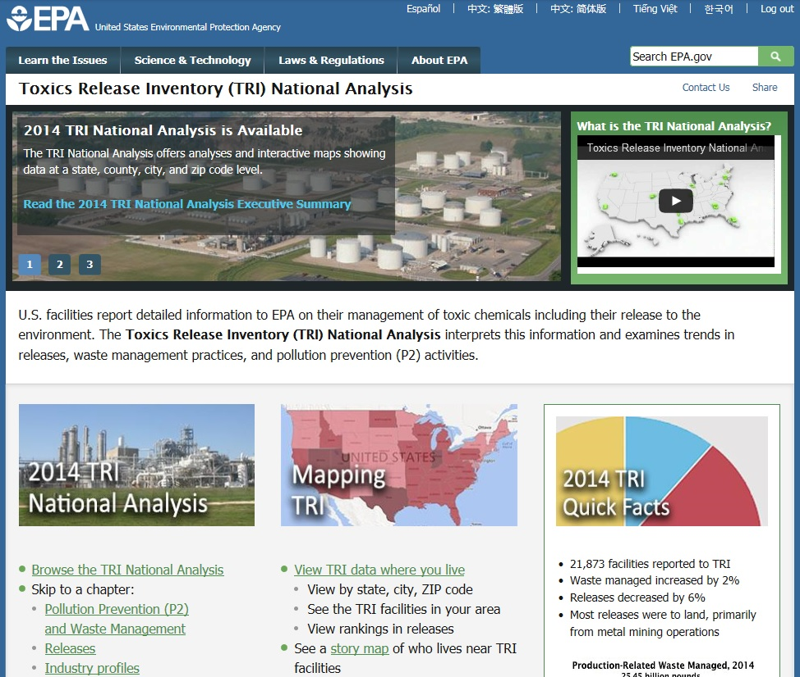
Introduction to the
Toxics Release Inventory
and the
2014 TRI National Analysis Report

Slide 2
Overview
Introduction to TRI
Reporting Year 2014 TRI National Analysis
Interactive web-based format
Using TRI Explorer to analyze TRI data
Questions & Discussion

Slide 3
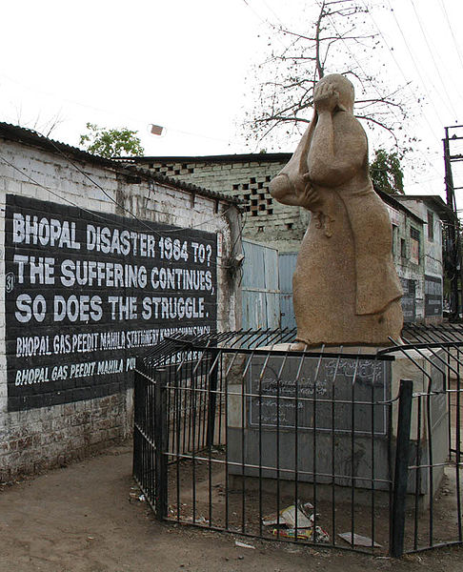
Why was the Toxics Release Inventory created?
Bhopal, India December 1984
Methyl isocyanate gas released at a Union Carbide chemical plant
Thousands died the first night
Thousands more have died due to long-term health effects
Survivors continue to suffer with permanent disabilities
Institute, West Virginia August 1985
Chemical release at a similar facility in the U.S.
Over 100 people hospitalized
Bhopal memorial for those killed and disabled by the 1984 toxic gas release
Increased concern in the U.S. about chemical accident preparedness and availability of information on toxic chemical releases from industrial facilities
Notes:
Mention that EPCRA in 1986 was part of the response to these events

Slide 4
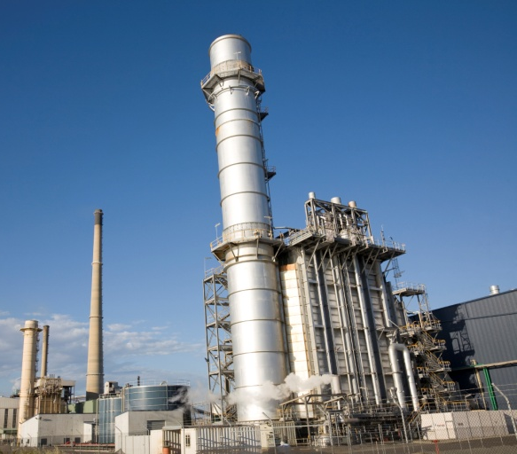
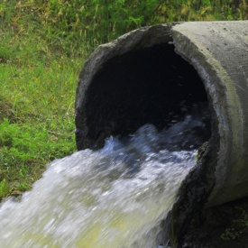
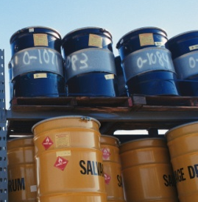


What is the Toxics Release Inventory (TRI)?
TRI tracks the waste management of certain toxic chemicals that pose a threat to human health and the environment.
TRI includes information on:
And much more!
Releases
Waste
transfers
Recycling
Pollution prevention
Notes:
TRI can help communities:
Identify which chemicals are being released by TRI facilities
Track increases or reductions of toxic chemical releases from facilities located in the community over time
Prioritize efforts to reduce pollution from facilities located in the area
TRI is the only EPA program that collects pollution prevention information, as required by the Pollution Prevention Act of 1990 – TRI is about more than just releases!

Slide 5

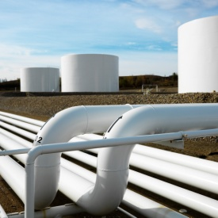
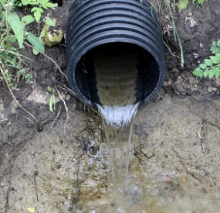
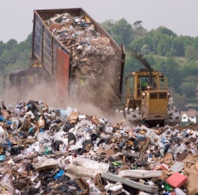
What is a “release”?
A "release" refers to different ways that toxic chemicals from industrial facilities enter the:
  Air Water Land
The likelihood of residents coming into contact with toxic chemicals depends on the type of release and other factors
For more information, see “Factors to Consider When Using TRI Data” at: http://www.epa.gov/toxics-release-inventory-tri-program/factors-consider-when-using-toxics-release-inventory-data
Notes:
Mention that secure land disposals are included in “releases”
Release means any spilling, leaking, pumping, pouring, emitting, emptying, discharging, injecting, escaping, leaching, dumping, or disposing into the environment (including the abandonment or discarding of barrels, containers, and other closed receptacles) of any toxic chemical.
Disposal means any underground injection, placement in landfills/surface impoundments, land treatment, or other intentional land disposal.
So “disposal” is limited to releases to land, while “releases” includes amounts entering air, water, or land (including disposal). (“Disposal” is a subset of “releases;” we use the term “disposal and other releases” to emphasize the fact that “releases” includes “disposal.”)

Slide 6
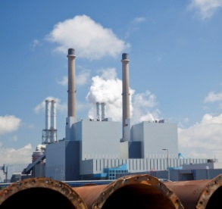
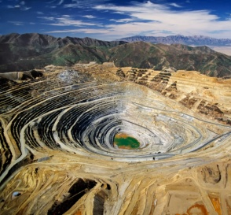
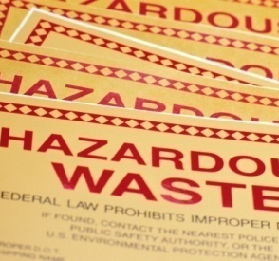

Which facilities must report to TRI?
Facility must be in a TRI-covered industry sector or category, including:
Facility must have the equivalent of at least 10 full-time employees
Facility must manufacture, process or use more than a certain amount of a TRI toxic chemical per year
Manufacturing
Coal/Oil electricity generation
Certain Mining Facilities
Hazardous Waste Management
Federal Facilities
Notes:
If a facility meets these criteria, it must submit a TRI reporting form for each TRI-listed chemical it manufactures, processes, or otherwise uses in quantities above the reporting threshold

Slide 7
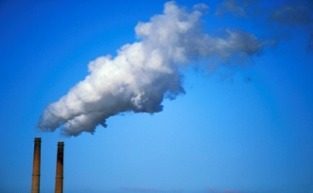


What information do facilities report to TRI?
On-site releases of TRI chemicals to:
  Air
  Water
  Land
Transfers of chemical waste to off-site locations
Other waste management:
  Recycling
  Treatment
  Energy Recovery
Pollution prevention activities (www.epa.gov/tri/p2)
Notes:
On-site releases of TRI Chemicals – reported due to EPCRA
Waste management activities – reported due to PPA

Slide 8
Considerations When Using TRI
TRI covers an important subset of toxic chemicals managed at U.S. facilities, but doesn't cover all chemicals or facilities
Data reflect annual totals and don't indicate the frequency or duration of a release
Quantities reflect chemicals released into air and water and managed through recycling, energy recovery, treatment and disposal
Toxicity level varies among the chemicals on the TRI list
TRI doesn't include information about public exposure to chemicals
TRI facility operations and releases are regulated under other EPA programs with requirements designed to limit human and environmental harm
For more information, see “Factors to Consider When Using TRI Data” at: http://www.epa.gov/toxics-release-inventory-tri-program/factors-consider-when-using-toxics-release-inventory-data

Slide 9
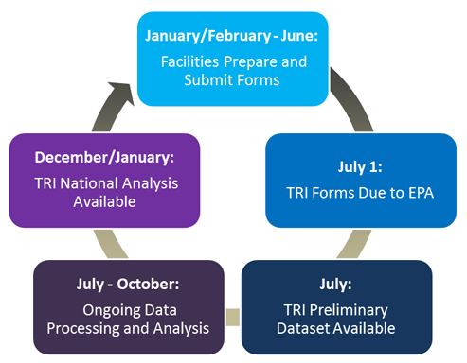
Annual TRI Cycle and Data Quality Process
Facilities submit their TRI forms for each calendar year to EPA by July 1st of the following year
The preliminary TRI dataset is released in July
EPA conducts data quality checks and compliance assistance activities from July - October
The TRI National Analysis (EPA’s official annual TRI report) is published in January

Slide 10
TRI Preliminary Dataset
Most recent TRI data available in July in Envirofacts and downloadable data files
Dataset ~ 95% complete in July
Opportunity to see most recent data prior to National Analysis publication
Can be used to begin looking at facility-level data
Dataset updated several times during summer and fall as EPA processes late TRI submissions and revisions, and performs data quality checks

Slide 11
TRI National Analysis
Notes:
Going to dive into the 2014 data…

Slide 12
Key Messages for 2014 TRI National Analysis
Total production-related waste increased 2% from 2013 to 2014
  Includes amount of chemicals recycled, treated and burned for energy recovery, as well as the amount disposed of or otherwise released into the environment.
    All waste management activities except Energy Recovery decreased; Energy Recovery increased 21%
    Good news: Of 25 billion pounds of waste managed in 2014, 22 billion pounds (84%) were not released due to preferred waste management practices like recycling.
Total disposal or other releases decreased 6% from 2013 to 2014
  Land disposal decreased – Metal mines
  Air releases decreased – Electric utilities and chemical manufacturing
  Some industries, including petroleum and stone/clay/glass manufacturing, increased
  2014: Of the 3.9 billion lbs released, 2.5 billion lbs (65%) were released to land, 738 million lbs (19%) were released to air, and 216 million lbs (6%) were released to water
New this year:
  National Analysis hosted on its own website
  Integrated TRI facility location information and demographic information from the Census
  Highlight federal facilities and “zero releasers”
  Highlight automotive manufacturing sector
Notes:
Automotive manufacturing releases since 2009 have increased 21% while production has increased 89%

Slide 13
Key Messages for 2014 TRI National Analysis
Notes:
2014: Total waste managed was 25.4 billion lbs
2003-2014: Waste managed decreased by 4% (1.09 billion lbs)
2013-2014: Waste managed increased by 2% (401 million lbs)
Recycling decreased 1% (47 million lbs)
Energy Recovery increased 21% (597 million lbs)
Treatment decreased 1% (108 million lbs)
Releases decreased 1% (40 million lbs)
In 2014, a total of 2,732 facilities (13% of all TRI facilities) reported initiating 8,388 source reduction activities, compared to 3,386 facilities (16%) in 2013
Total on- and off-site releases and disposal (calculated from Section 5 and 6) decreased by 6% from 2013-2014, while releases (calculated from Section 8.1) decreased by 1%.
This is primarily due to the one-time release of 193,035,900 lbs reported by Kennecott in 2013, which is excluded from Section 8 (one-time releases in 2014 were similar to 2010-2012).
Number of facilities has held constant since 2011 after years of steady decline = 21,873 facilities total
The number of facilities reporting in 2014 decreased by 114 from 2013 (including all chemicals)

Slide 14
Key Messages for 2014 TRI National Analysis
Notes:
2014: Total releases was 3.9 billion pounds
2013-2014: Total releases decreased by 6% (234 million lbs)
Driver: On-site releases decreasing by 6% due primarily to metal mining
Total releases decreased by only 2% if you exclude metal mining
2013-2014: Air releases decreased by 4% (34 million lbs)
Chemical manufacturing air releases decreased by 12% (21.8 million lbs)
Electric utilities air releases decreased by 8% (15.9 million lbs)
Changes from 2013:
Total on-site releases decreased 6% (237 million lbs)
On-site air releases decreased 4% (34 million lbs)
On-site land disposal decreased 8% (205 million lbs)
On-site surface water discharges increased 1% (2 million lbs)
Off-site releases increased 1% (3 million lbs)
Net Releases
Trend graph excludes hydrogen sulfide (2012-2014) or individual NTP chemicals (2011-2014)
Text on slide includes all chemicals, because it only presents 2013-2014 data (note: the text does not change if you limit to core chemicals)
Releases to other land (S 554) decreased from 1,412 million lbs in 2013 to 1,208 million lbs in 2014, decrease of 204 million lbs (99% of change in On-site Land Disposal)
Decrease from 2013-2014 is driven by metal mining on-site land disposal (195.8 million lbs, or 83% of the decrease in total releases)
If you exclude all metal mining, then total gross on- and off-site releases decreased by 2% (41 million lbs)
Two Kennecott mines with total decrease of 321 million lbs in total releases; Red Dog mine with 198 million lbs increase in total releases (all an order of magnitude greater in change than any other facilities)
Kennecott Barneys Canyon Mining Co (Copperton, UT): on-site releases decreased by 193 million lbs (one-time release previously reported in 2013)
Two greatest chemicals from the 2013 one-time release: barium compounds (101,419,778 lbs one-time release) and arsenic compounds (79,433,847 lbs one-time release)
TRIFID: 84006KNNCT8200S
Kennecott Utah Copper Mine Concentrators and Power Plant (Bingham Canyon, UT): on-site releases decreased by 128.3 million lbs
Lead compounds decreased by 110 million lbs (86% of decrease from 2013)
TRIFID:84006KNNCT12300
Red Dog Operations (Kotzebue, AK):on-site releases increased by 198 million lbs
Lead compounds increased by 52 million lbs, zinc by 146 million lbs
Increasing trend in releases since 1998
TRIFID: 99752RDDGP90MIL
Note that total releases in 2014 (3.894 billion) is lower than it was 2011 (4.144 billion) which excludes NTP and H2S (lower releases even with more chemicals included)
Release means any spilling, leaking, pumping, pouring, emitting, emptying, discharging, injecting, escaping, leaching, dumping, or disposing into the environment (including the abandonment or discarding of barrels, containers, and other closed receptacles) of any toxic chemical.
Disposal means any underground injection, placement in landfills/surface impoundments, land treatment, or other intentional land disposal.
So “disposal” is limited to releases to land, while “releases” includes amounts entering air, water, or land (including disposal). (“Disposal” is a subset of “releases;” we use the term “disposal and other releases” to emphasize the fact that “releases” includes “disposal.”)

Slide 15
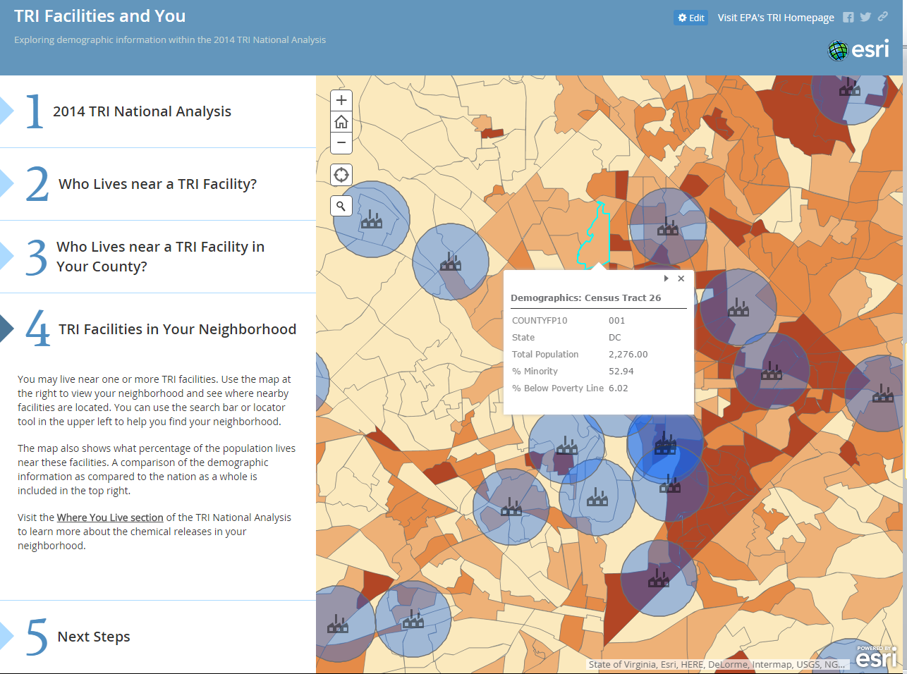
New Analyses: Demographics
Story Map feature from ArcGIS Online
Provides demographic information from Census in context of proximity to TRI facilities (i.e., “Who Lives near a TRI Facility?”)

Slide 16
New Analyses: Federal Facilities
Highlight reports from federal facilities, similar to existing Industry Profiles
Include distribution among government organizations and sectors
Case study showing source reduction efforts at a federal facility
Notes:
2 EPA facilities included in analysis:
US EPA National Vehicle & Fuel Emissions Lab in Ann Arbor, MI
US EPA Fund-Lead Superfund Site/Bunker Hill CTP in Kellogg, ID

Slide 17
New Analyses: Automotive Manufacturing Sector
Highlight Automotive Manufacturing in Industry Sectors (in addition to three main industries)
Releases have remained relatively constant since 2009 while production has increased
Notes:
Petroleum Refineries was highlighted last year

Slide 18
New Analyses: Zero-Releasers
3,065 facilities managed waste but reported zero releases of TRI chemicals in RY2014
American NTN Bearing Manufacturing Corp. (owned by NTN USA Corp.) manufactures ball and roller bearings in Cook County, IL. In 2012, they implemented a recycling process for the chips and debris generated as part of the metal grinding process. By 2013, releases of chromium had been reduced to zero and all other chromium waste was recycled.
Notes:
American NTN Bearing: 60176MRCNN9515W – Cook County, IL

Slide 19
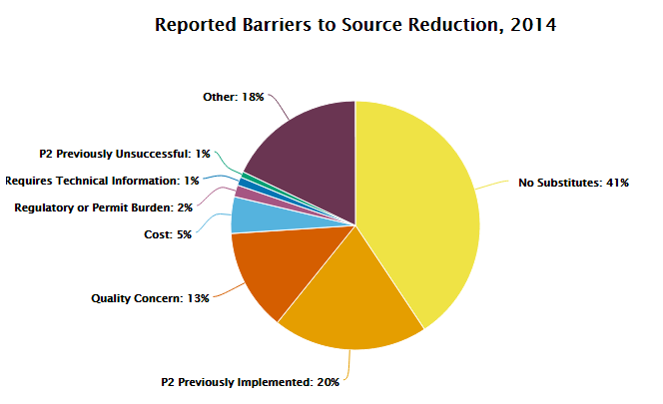
New Analyses: Barriers to P2
Notes:
Highlight Section 8.11 reports on barriers to source reduction activities

Slide 20
New Analyses: Estimated Annual Reduction – Source Reduction
New field illustrating estimated source reduction from facilities by measures implemented in RY2014
Categorized by type of activity and expected % annual reduction
Notes:
Switched from previous version of graph (and recolored) to emphasize which source reduction activities were more often associated with the higher estimated annual reduction
(e.g., raw materials modifications results in 100% reduction more than any other method)
Helps other facilities think about which activities might be most effective

Slide 21
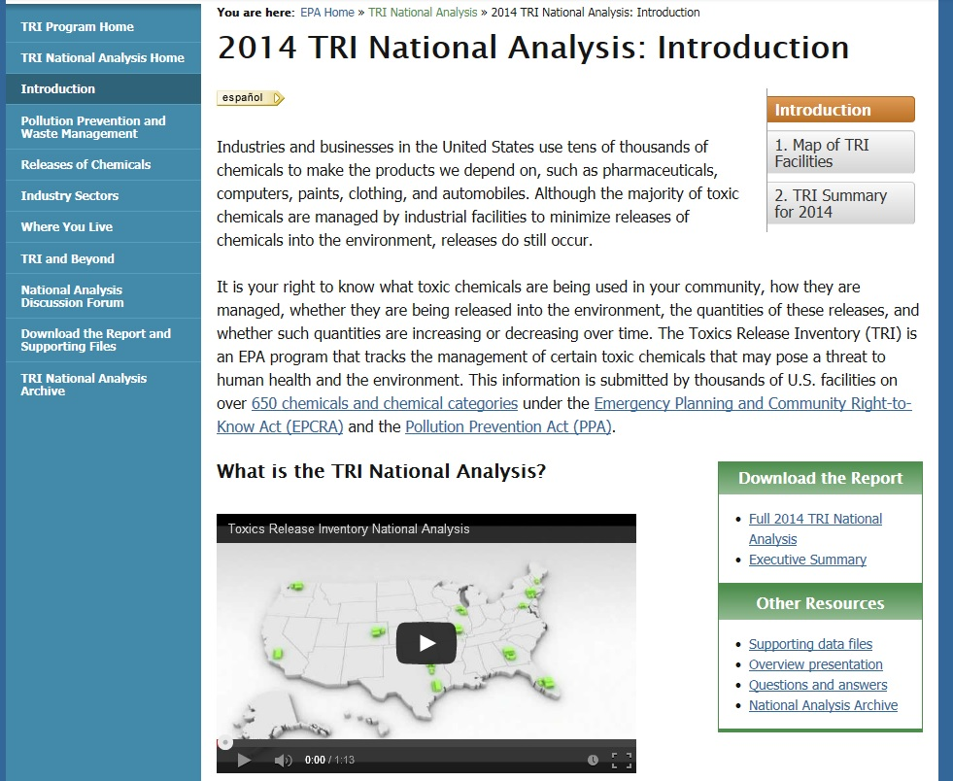
www.epa.gov/trinationalanalysis
National Analysis Website
Notes:
Demo of new website – focus on “Where You Live” chapter and new navigation

Slide 22
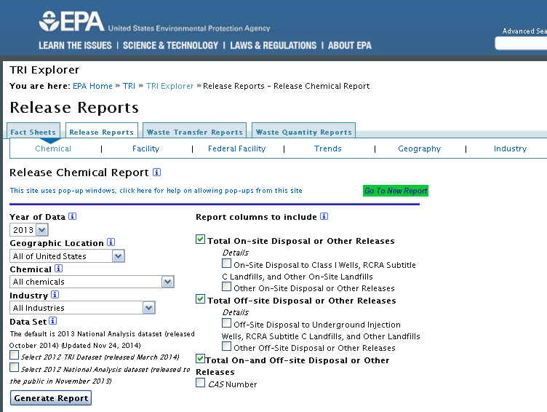
Using TRI Explorer
http://iaspub.epa.gov/triexplorer/tri_release.chemical
Notes:
Use TRI Explorer to display values and trends which will appear in the PR.
Show reporters how to get to the report used and touch on:
Variables used and how to customize reports
How to drill down to additional details
How to view in alternate formats and extract graphs
How to find definitions and explanatory text

Slide 23
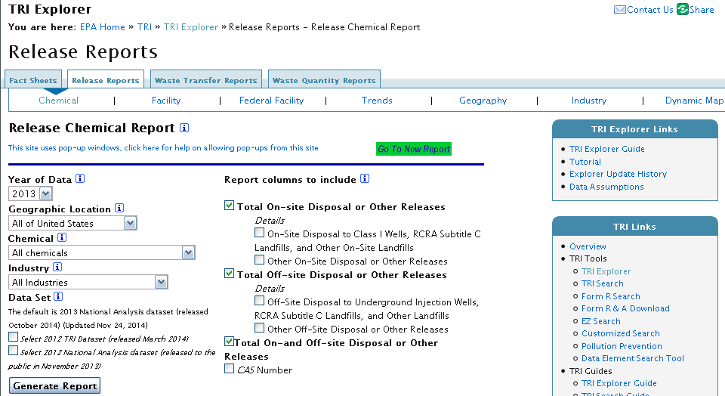
TRI Explorer
Five Steps to generate a report
Step 1. Choose Report Type
Step 2. Select a Report Grouping (How data will be summarized)
Step 3. Choose Filters (Optional - All filters have a default)
Step 4. Choose Columns to be displayed (All options have a default)
Step 5. Click on the Generate Report button.
Red ovals identify available user aids or key references

Slide 24
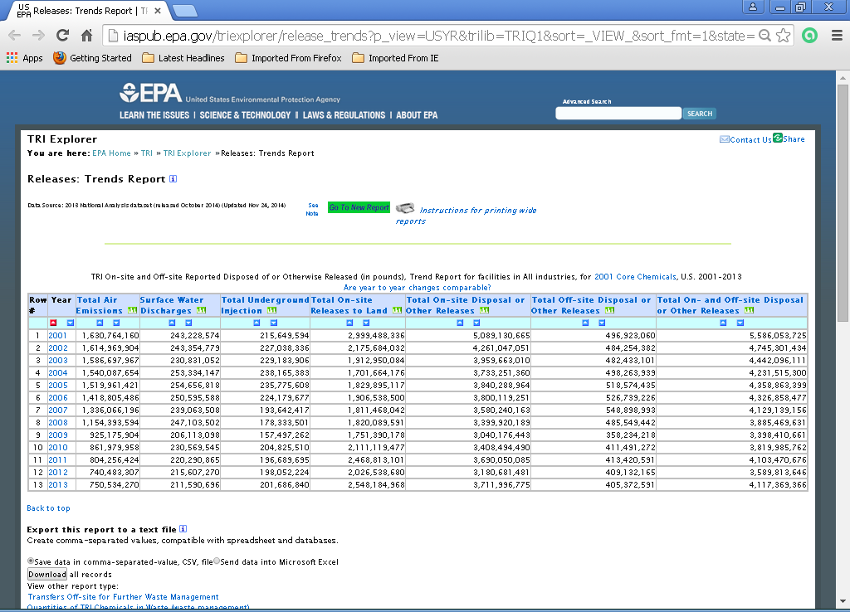
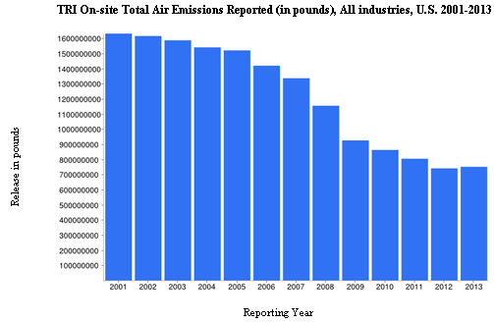
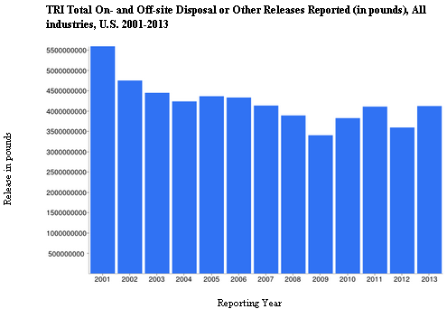
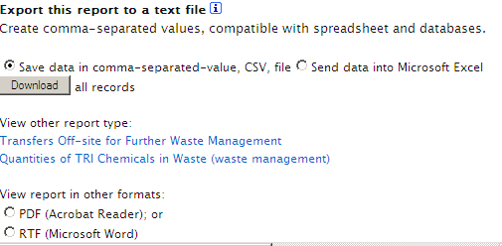
Note: The above trend report excludes quantities for hydrogen sulfide added in 2012 and additional PACs added in 2011.
Total quantities reported to TRI may be viewed in any report aggregated for a single year

Slide 25
Questions and Discussion

