Slide 1
Federal Ethics Rules & The Deferred Resignation Program (DRP)
EPA Ethics
Office of General Counsel
June 2025

Slide 2
Overview
If accepted for Deferred Resignation/Early Retirement, you will remain an EPA employee subject to the federal ethics rules and the Hatch Act until you separate in September or December.
Once you formally separate from EPA, you will then be subject to the post-employment statute.
NOTE: How the rules apply to you depend on your unique situation. We are providing you with general information only.

Slide 3
What We Will Cover:
Representational Conflict of Interest Laws (Criminal)
Misuse of Position
Partisan Political Activity (Hatch Act)
Post-Government Employment Obligations
Outside Activities & Employment

Slide 4
Representational Conflict of Interest Laws (18 U.S.C. § 203 and § 205)
Do not represent anyone else, including a new employer or client, as their agent or attorney in connection with any matter in which the US is a party or has a direct and substantial interest.
The US does not have to be a party for there to be a direct and substantial interest
If you are compensated, you can’t receive payment for anyone else’s representational services while you are in admin leave.
Also, the non-fed entity can’t pay you for representational services provided by you or someone else.
Do not contact any United States government official on behalf of a non-federal employer, client, or even your own company.
You can represent yourself, a parent, spouse, child, or entity or
person for whom you have fiduciary obligations but ask EPA Ethics.

Slide 5
Outside Activities & Employment
You can engage in outside activities/employment that do not conflict with your official duties
But certain outside activities and employment (compensated or uncompensated) will require prior approval from an ethics official, in accordance with EPA supplemental ethics rules (See 5 C.F.R. § 6401.103):
Consulting services;
Practicing a profession (e.g., accountant, Realtor, lawyer, or something else that requires specialized knowledge, training or education);
Holding State or local public office;
Any subject matter that deals in significant part with the policies, programs, or operations of EPA, or any matter to which you are currently assigned or to which you have been assigned in the previous year; or
Providing services to an EPA contractor or subcontractor, the holder of an EPA assistance agreement or sub-agreement, or a firm that is regulated by your Region or Office.

Slide 6
Outside Activities & Employment (cont’d)
How to Seek Approval: Send your request for approval of the outside activity to the EPA Ethics Office at ethics@epa.gov and provide the following information:
Communication with your ethics official is important! Although some outside activities and employment require prior approval from your ethics official, ALL potentially implicate the ethics rules! Be vigilant about your continued ethics obligations!
Your Full Name
Your EPA Office & Subdivision (e.g., OAR/Office of Transportation and Air Quality or OGC/Air & Radiation Law Office)
Your EPA Title
Your Grade (e.g., GS-13)
Name of the business, person, or organization you will work for (in cases of self-employment, indicate the type of services to be rendered and estimate the number of clients or customers anticipated during the next 6 months)
Does the entity have any assistance agreements (e.g., grants) or contracts with EPA? If so, do you know what they are?
Description of the services to be performed for this entity. NOTE: If the services will involve any federal agency, please explain what your role will be.
Amount of compensation expected for the services performed (e.g., uncompensated, flat $2000 fee, $45/hour, etc.)
Estimated time to be devoted to the activity (e.g., full time, 10 hours a week, etc)
Affirm in writing that you have read, are familiar with, and will abide by the restrictions described at 5 C.F.R. part 2635 and 6401.102.

Slide 7
Outside Activities & Employment: Teaching, Speaking, and Writing (5 C.F.R. § 2635.807)
General Rule: you may not receive compensation from any non-federal source for teaching, speaking, or writing that occurs while you are a federal employee that "relates significantly to your official duties" including the ongoing or announced programs of the EPA.
Exceptions:
With prior approval, teaching courses offered as part of a regularly established curriculum of an institution of higher education; elementary or secondary school; or a program of education or training sponsored and funded by federal, state, or local government.
Teaching, speaking, or writing on a general subject matter based on your expertise
Scope of ‘Writing’
Covered activities: Substantive writing and editing about EPA programs/operations; Updating or modifying the content of a book; Keeping diaries or notes during government service to be used later as a basis for publication.
Permissible activities: proofreading and copy editing/formatting such as correcting spelling, grammar, or punctuation—activities that do not change the meaning of the content of the writing.

Slide 8
Outside Activities & Employment: Teaching, Speaking, and Writing (5 C.F.R. § 2635.807) (cont’d)
If writing occurs: | Compensation is received: | Is compensation permitted?
Before government service | Before government service | Yes
 | During government service
 | After government service
During government service | Before government service | Only if writing is not “related to official duties”
 | During government service
 | After government service*
After government service | Before government service | Yes
 | During government service
 | After government service
* Section 2635.807 does not apply, however, if an employee writes a work “on speculation,” without any agreement to receive compensation for the writing that occurs during government service.

Slide 9
Unique Circumstances
Agency Attorneys – State Bar Restrictions
Even while in DRP status, your client is still the United States
Because you are licensed to practice law, you must continue to adhere to obligations to your client and to your state bar rules.
You cannot reveal attorney-client privileged information nor take adverse positions to the federal government (your current client). See Rules 1.6 & 1.7.
Activities that may be off limits to you include advising opposing counsel on how to interpret statutes, regulations, policies, or terms and conditions; discussing litigation strategy; and advising, reviewing and revising draft complaints, briefs, and other similar legal documents.
After you separate from EPA, you still have a continuing duty to your former client under Rule 1.9 and must be mindful of restrictions on any successive government and private employment under Rule 1.11.
You should seek advice from your state bar counsel about your professional responsibility obligations.
Procurement Professionals – Acceptance of compensation from contractor
If your EPA duties include significant procurement responsibilities for a government procurement in excess of $10 million, you may be barred from accepting compensation from the winning contract of an Agency procurement for one year from the date you held certain positions or made certain decisions. See generally, 41 C.F.R. § 3.104-3.
Grants Professionals – Competition Policy may limit competition by new employer in EPA grants
If you were involved in certain grant activities, including but not limited to the development, review, and preparation of solicitations, then you, your family members, or your new employer may be constrained in competing for grants under the solicitations in which you participated. For more information about grants conflicts of interest and competitive advantage policies, contact the Grants Competition Advocate at GrantsCompetition@epa.gov.

Slide 10

Misuse of Position
Use of Nonpublic Information
You may not use or allow the use of non-public information to either conduct a financial transaction, to further your own private interest or the interest of others including giving advice or recommendation or unauthorized disclosure.
What makes information non-public is that it is gained by reason of your Federal employment and has not been made available to the general public.
Reference to EPA Position/Title
You cannot refer solely to your EPA position or title in connection with outside activity, including any listing on a website.
If your bio mentions EPA, then it must also include other significant biographical details (at least two others) with EPA not having any undue prominence. See 5 C.F.R. § 2635.807(b).

Slide 11

Partisan Political Activity (Hatch Act)
You are still subject to the Hatch Act, which governs the political activity of federal employees even in your personal capacity.
“Political activity” is defined as any activity directed at the success or failure of a candidate for partisan election, a political party, or a partisan political group.
Even in your personal capacity, the following prohibitions apply to you, all the time, 24/7. NEVER:
Solicit, accept, or receive political contributions
Run for partisan political office
Use your EPA affiliation or title in connection with political activity
Engage in political activity in the federal workplace, including displaying candidate photos or partisan political items such as paraphernalia or campaign slogans
Coerce subordinates to engage in political activity
Accept volunteer services from a subordinate
Use your official EPA authority to interfere with the outcome of an election
Solicit or discourage political activity of anyone with business before EPA

Slide 12
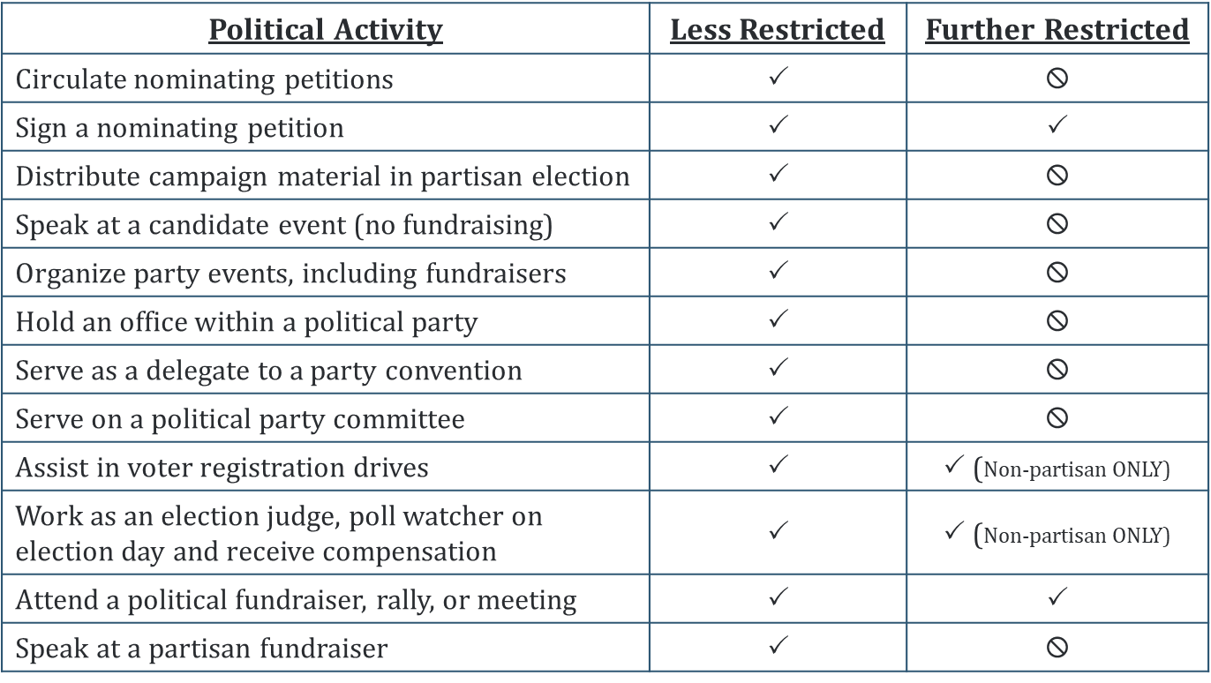
Partisan Political Activity (Hatch Act) (cont’d)
How the rest of the Hatch Act applies to you depends on your type of appointment:
Lesser Restricted: MOST employees – GS, SL/ST, Title 42
Further Restricted: SES, ALJs, and Public Health Service Officers

Slide 13
Application of Ethics Rules Over Time
 | Signed DRP Agreement | Administrative Leave | Separated from Government
Financial Conflicts of Interest | Yes | Yes | No
Representation Back Prohibitions | Yes | Yes | No
Impartiality Rules | Yes | No | No
Misuse of Position | Yes | Yes | No
Gifts Rules | Yes | Yes | No
Hatch Act | Yes | Modified* | No
Outside Activity Approvals | Yes | Yes | No
Seeking and Negotiating for Employment | Yes | Yes | No
Financial Disclosure Reporting | Yes | Modified* | No
Post-Government Employment Restrictions | No | No | Yes

Slide 14

Post-Government Employment Obligations
After you officially separate from EPA, you—like all former employees— are still subject to the post-employment laws and rules.
Financial Disclosure Filers:
Public Filers: 278 Termination Report must be submitted in INTEGRITY no more than 30 days after official separation date.
Failure to timely file will result in $200 late filing fee
Confidential Filers: No reporting obligations related to termination of employment.

Slide 15
Post-Government Employment Obligations (cont’d)
Representation Back Restrictions (18 U.S.C. § 207):
Permanent Bar: You may never appear before or communicate with government officials on behalf of another with the intent to influence government action on any specific party matter in which you personally or substantially participated as a federal employee. See generally 18 U.S.C. § 207(a)(1).
Supervisors: For 2 years after official separation, you may not appear before or communicate with government officials on any such matters that were under your official responsibility during your last year of government service. 18 U.S.C. § 207(a)(2).
“Senior Employees”: Additional 1 year cooling off restrictions:
Any matter pending before EPA; and
Representation of foreign entities before United States: May not aid, advise, or represent a foreign entity on any matter pending before any official of the United States, including Congress, the President, or Vice President. See 18 U.S.C. § 207(c), (f).

Slide 16

Recap
Individuals in administrative leave status are still employed by EPA and therefore subject to the federal ethics laws and regulations.
You cannot represent the interests of someone else back to the United States government, including a non-federal employer.
You may need to seek prior approval from an ethics official before engaging in outside activity while in DRP.
You cannot misuse your federal position for the benefit of anyone else.
Under the Hatch Act, you still can’t solicit, accept, or receive political contributions or use your EPA title or position in connection with political activity.
When you formally separate from EPA, you will become subject to the post-government employment restrictions (which are different from the representational conflict of interest rules that apply while you are still a federal employee).

Slide 17
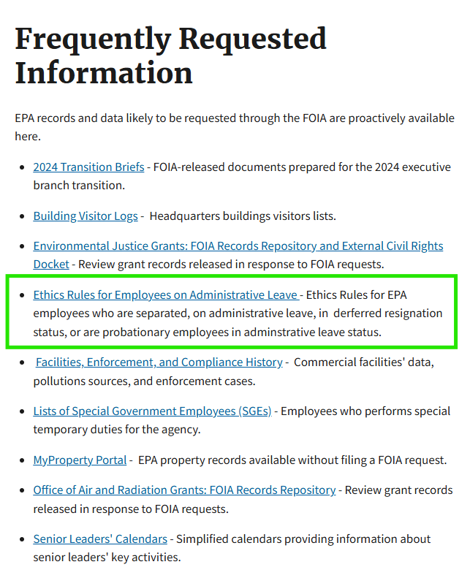
Need More Information?
Navigate to the EPA FOIA website (https://www.epa.gov/foia).
Click the ‘Frequently Requested Information’ button.
Check out Ethics Rules for EPA Employees on Administrative Leave.

