Slide 1
20 Years Of Progress Closing LUST Sites
% Of LUST Sites Closed (Cumulative) By State
U.S. Environmental Protection Agency
Office of Underground Storage Tanks
www.epa.gov/ust
December 2025

Slide 2
The Problem
Contamination from underground storage tank releases threatens groundwater, the source of drinking water for nearly half of all Americans. Addressing UST release sites remaining to be cleaned up continues to be a high priority for EPA and our state, territorial, and Tribal partners.
Working Towards a Solution
The national UST program has cleaned up nearly 528,000 UST release sites over the history of the program. As of September 2025, thirty-nine states have closed over 90 percent of their UST release sites.
Recognizing 20 Years of Progress
EPA and our partners have reduced the backlog of UST release sites from over 119,000 in 2005 to under 54,000 in 2025. The maps on the following slides show progress each state and territory have made over the past 20 years (in 5-year intervals). The maps display the percentage of sites closed, representing cumulative cleanups completed out of cumulative confirmed releases.
More information on cleanups and other program performance measures can be found at www.epa.gov/ust/ust-performance-measures.
* UST release sites are also commonly referred to as Leaking Underground Storage Tank sites or LUST sites.

Slide 3
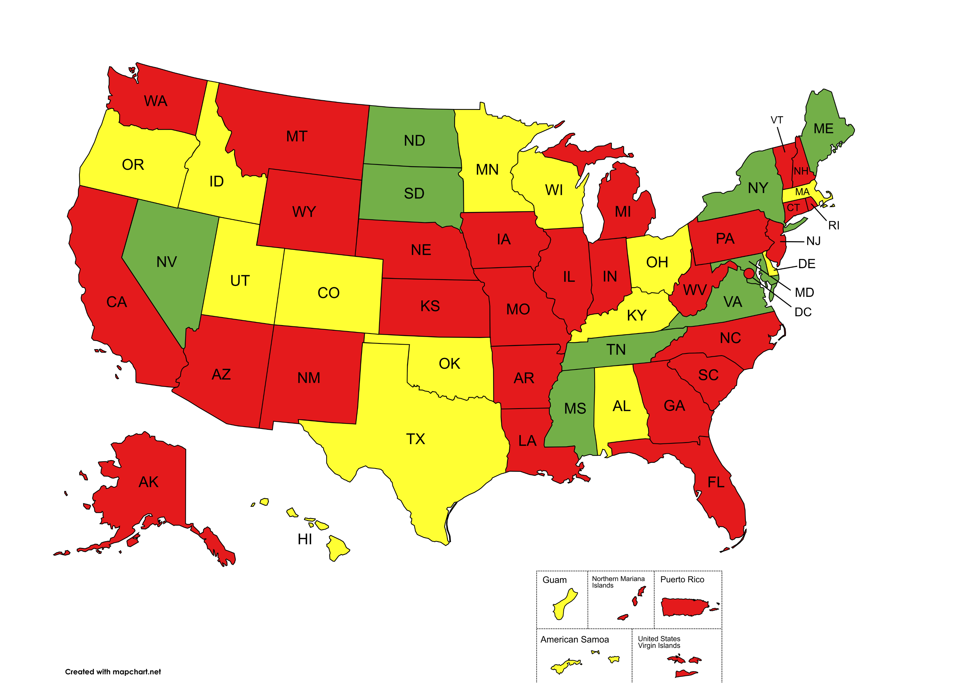
2005
% Backlog Reduction
≤79%
80-89%
90-100%

Slide 4
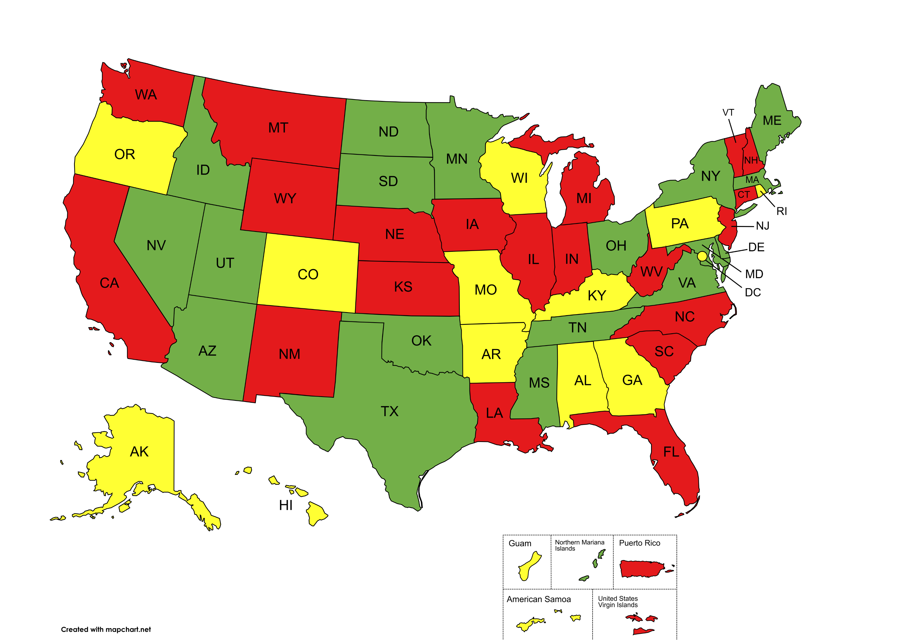
2010
% Backlog Reduction
≤79%
80-89%
90-100%

Slide 5
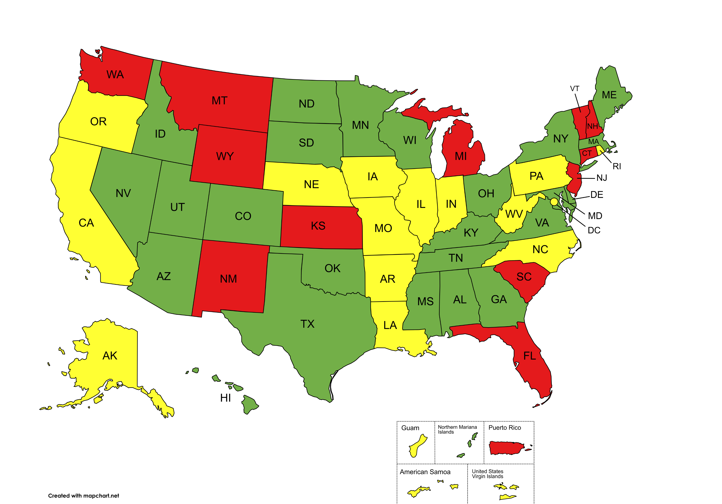
2015
% Backlog Reduction
≤79%
80-89%
90-100%

Slide 6
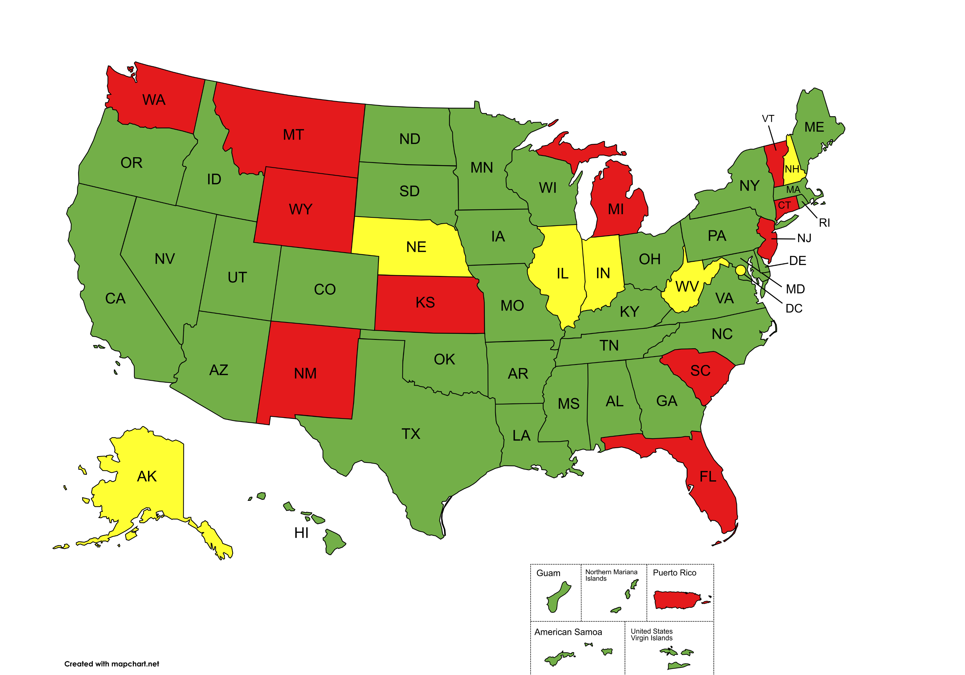
2020
% Backlog Reduction
≤79%
80-89%
90-100%

Slide 7
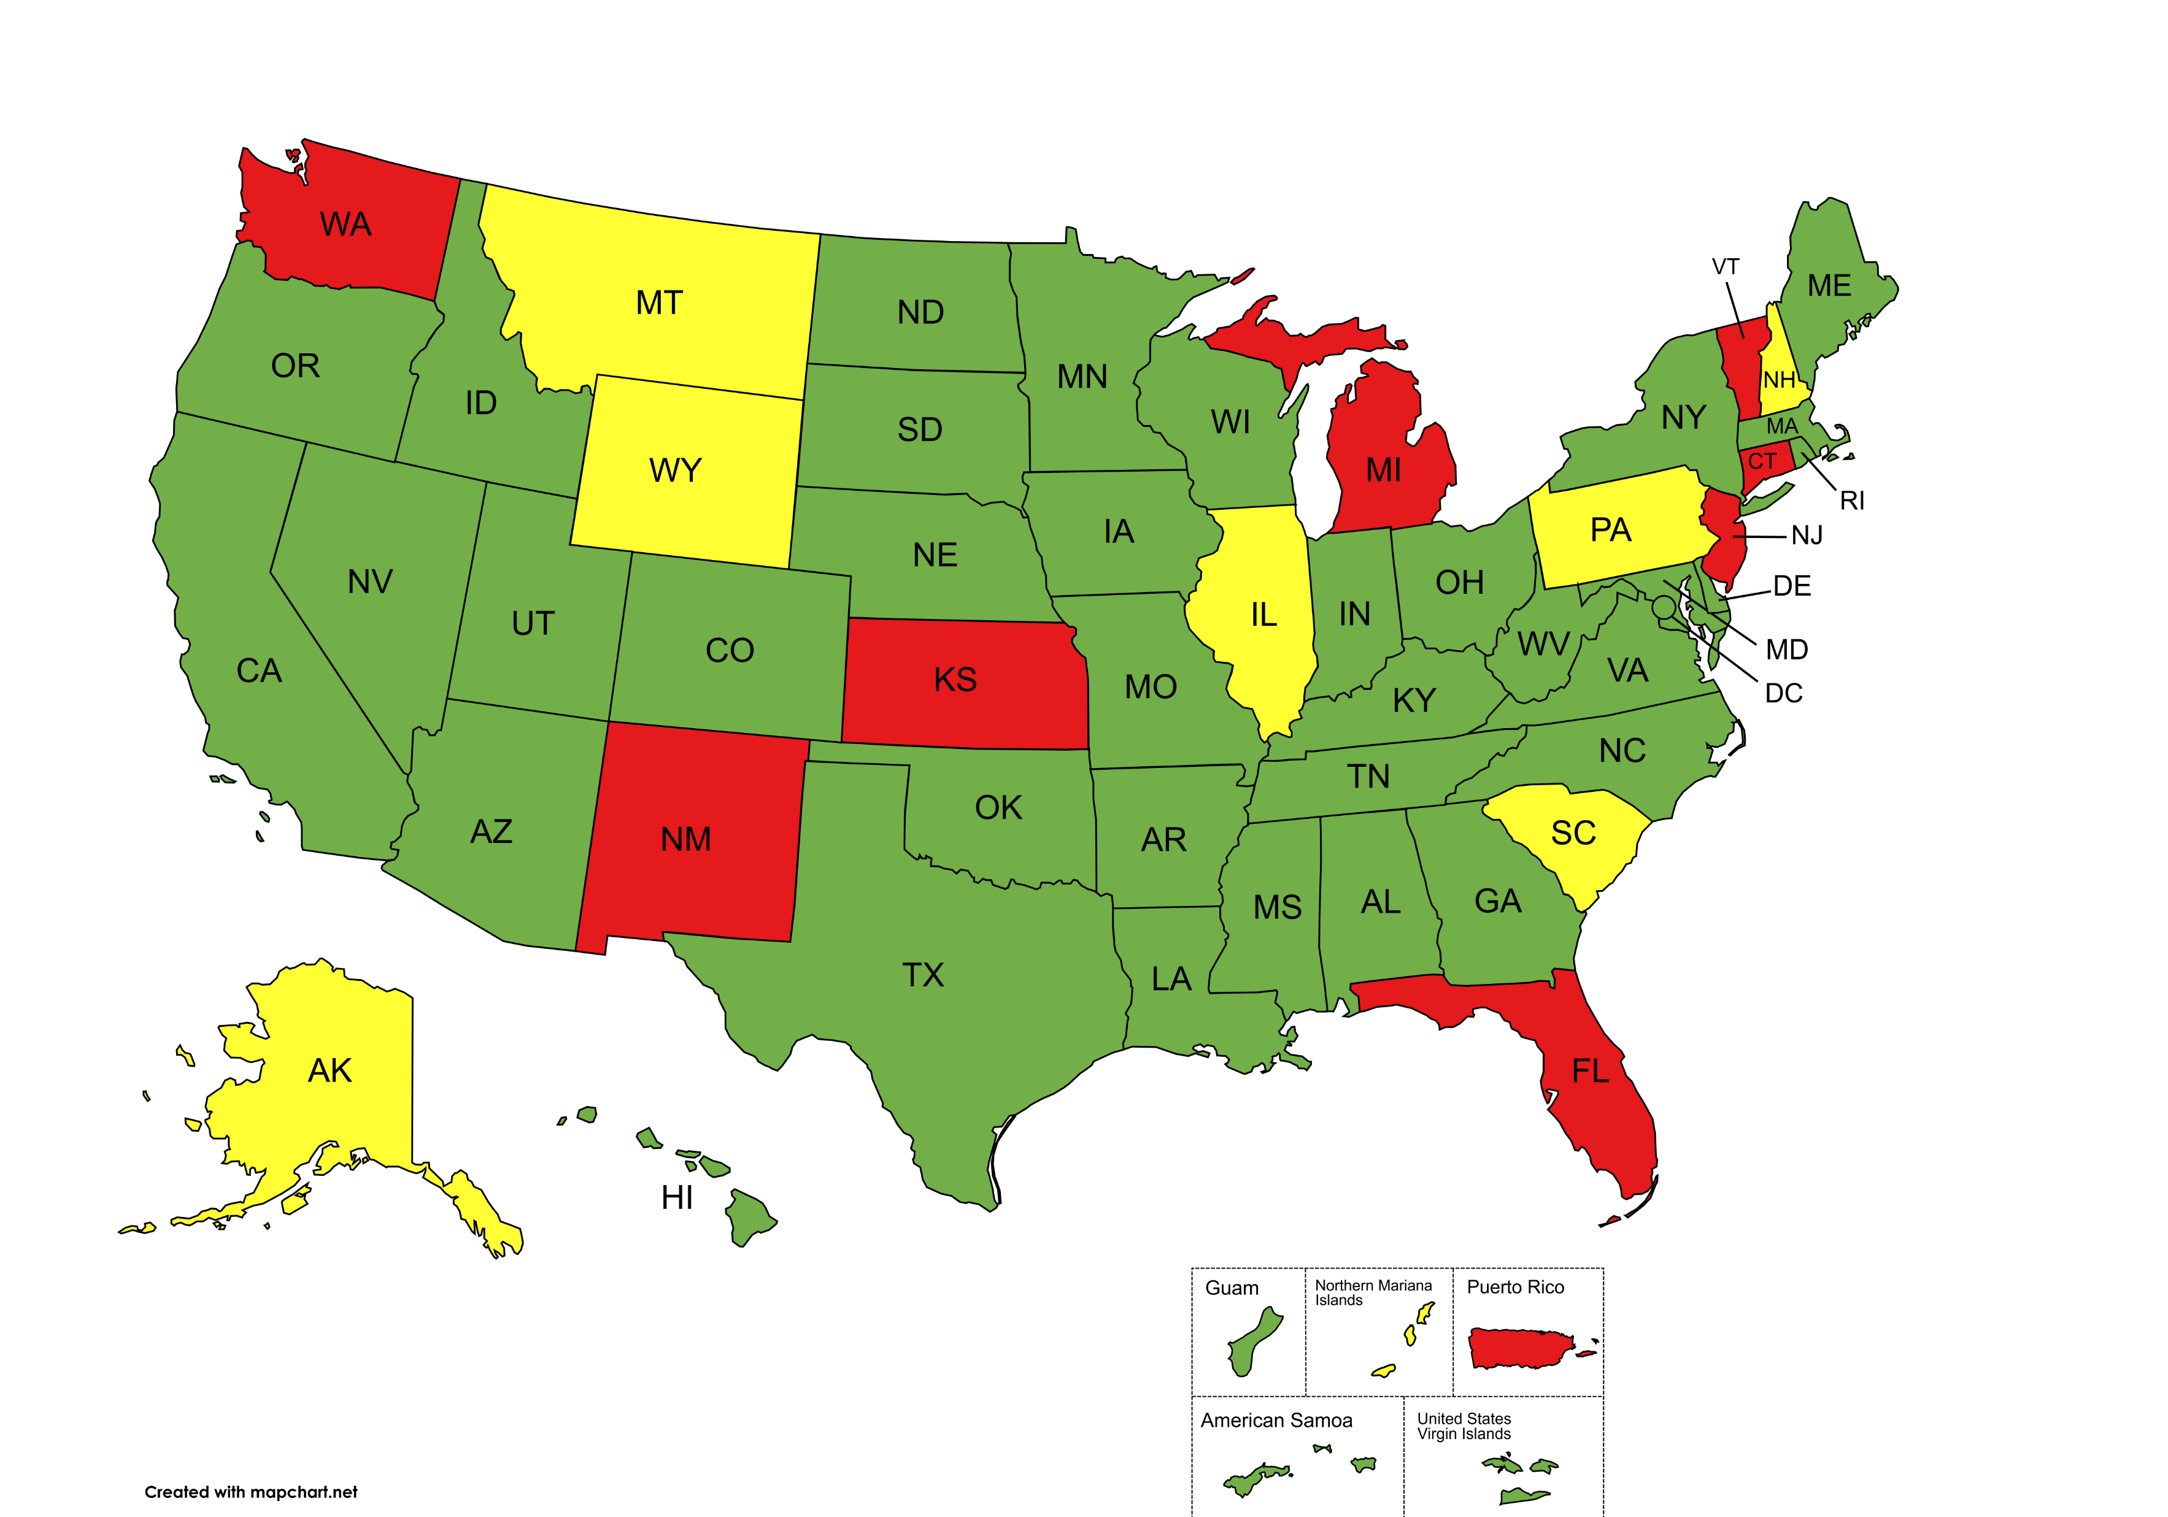
% Backlog Reduction
≤79%
80-89%
90-100%
2025

Slide 8
20 Years Of Progress
2005
% Backlog Reduction
≤79%
80-89%
90-100%
2025

