Slide 1

Combined Air Emissions Reporting System (CAERS)
Welcome to CAERS
Region 10 FARR Gas Stations
3/19/2026
Notes:
On behalf of the US EPA, I’d like to welcome you to the Combined Air Emissions Reporting System or CAERS. This presentation will cover highlights of CAERS.

Slide 2
System Requirements
To use CAERS, you will need:
A recent version of any internet browser such as Chrome, Explorer, Edge, or Firefox. Your internet connectivity and facility report size will determine how fast the system will respond.
A login.gov/CDX account.

Slide 3
CAER User Roles - Preparer
Authorized to prepare an emissions report for that facility (e.g., consultant, staff person working for the facility).
May have more than one preparer per facility (each with your own account, each account associated to the facility).
May have a single preparer for more than one facility (with your individual account associated with several facilities).
Cannot certify and submit the report on behalf of the facility.

Slide 4
CAERS User Roles - Certifier
Can prepare the emissions report and is also authorized to certify the emissions report to meet your legal obligation for reporting to your SLT.
May have only one Certifier for a facility.
May have a single Certifier for more than one facility (multiple facilities associated with the certifier account).
May also be the preparer (if so, only one NEI Certifier CAERS account needed).

Slide 5
Registration Process
Three major steps:
Establish reporting requirements and reporting roles (especially Certifiers) with Region 10
a) Register in CDX, if you are a new user or
  b) Migrate to login.gov and set up CAERS in CDX (if you haven’t previously reported through CAERS).
3. Request access to your facility in CAERS.
Notes:
Next, we’ll go over each one of these steps in more detail.

Slide 6
1. Establish reporting requirements and roles
Region 10 keeps track of POCs for FARR facilities.
Reach out to them if you are new to this process and have not previously reported to FARR via FORS.

Slide 7
2. a) Register in CDX as a New User
If you already have a CDX account because you were previously reporting to FORS, you may skip to 2 b).

Slide 8
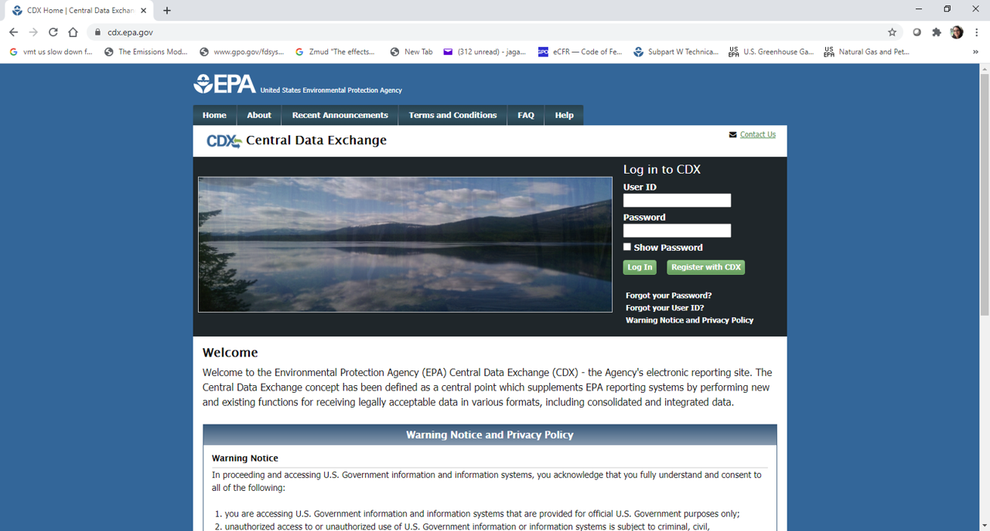
CDX Login Page
Enter the URL “https://cdx.epa.gov/” in your preferred web browser. This will bring you to the CDX login screen where you will click the “Register with CDX” button.

Slide 9
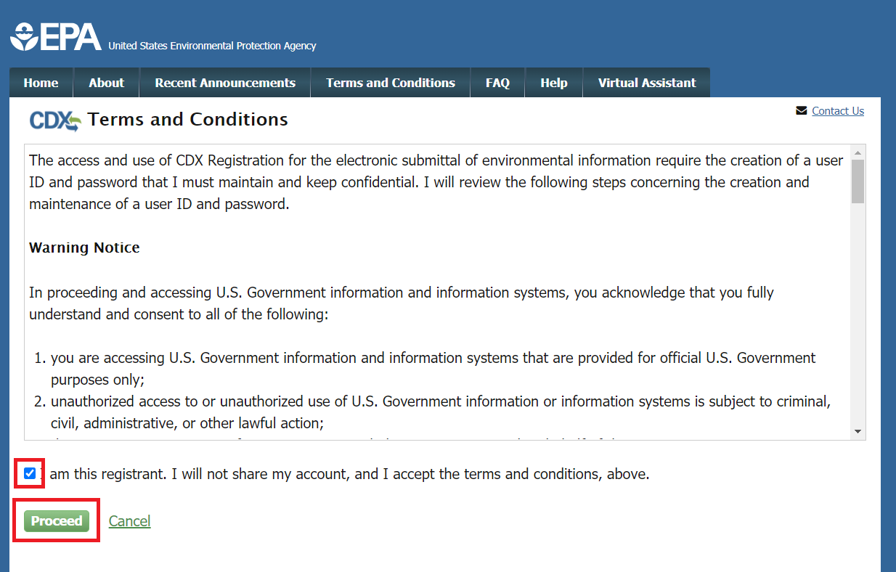
CDX Terms and Conditions
You will be directed to the Terms and Conditions screen for CDX registration. After reading these, check the box confirming that you are the registrant and click “Proceed” at the bottom left of your screen.

Slide 10
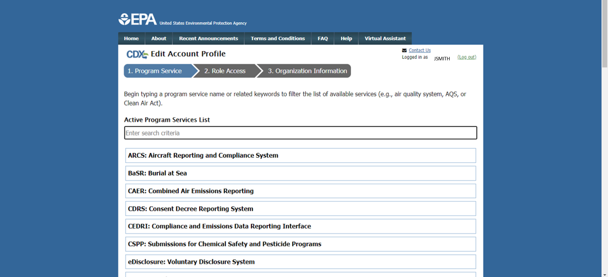
CDX CAERS Program Service Selection
You will be directed to a list of EPA Systems. Find “CAER: combined Air Emissions Reporting” in that list and click on it.

Slide 11
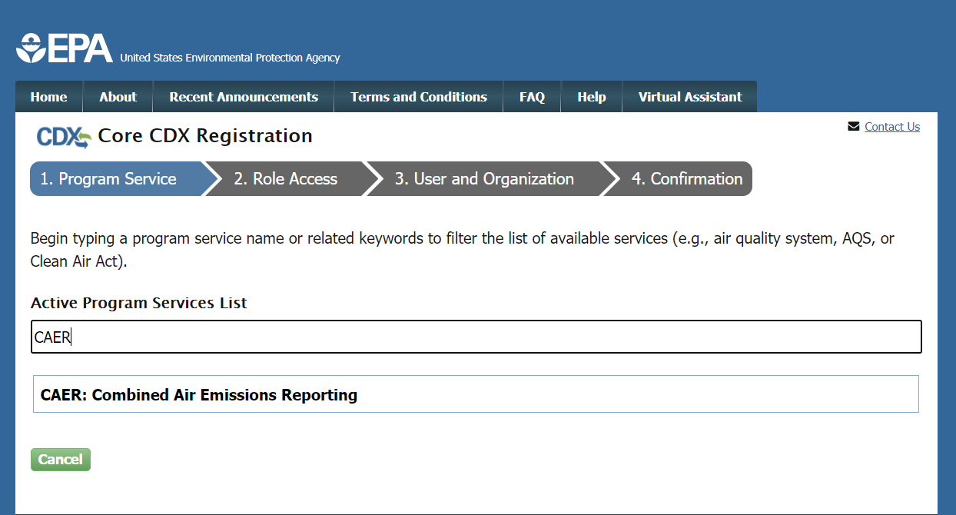
CDX Program Service Search
Or you can search for “CAER” in the Active Program Services List field. This will filter the list to only include “CAER: Combined Air Emissions Reporting”. Select “CAER” from the list.

Slide 12
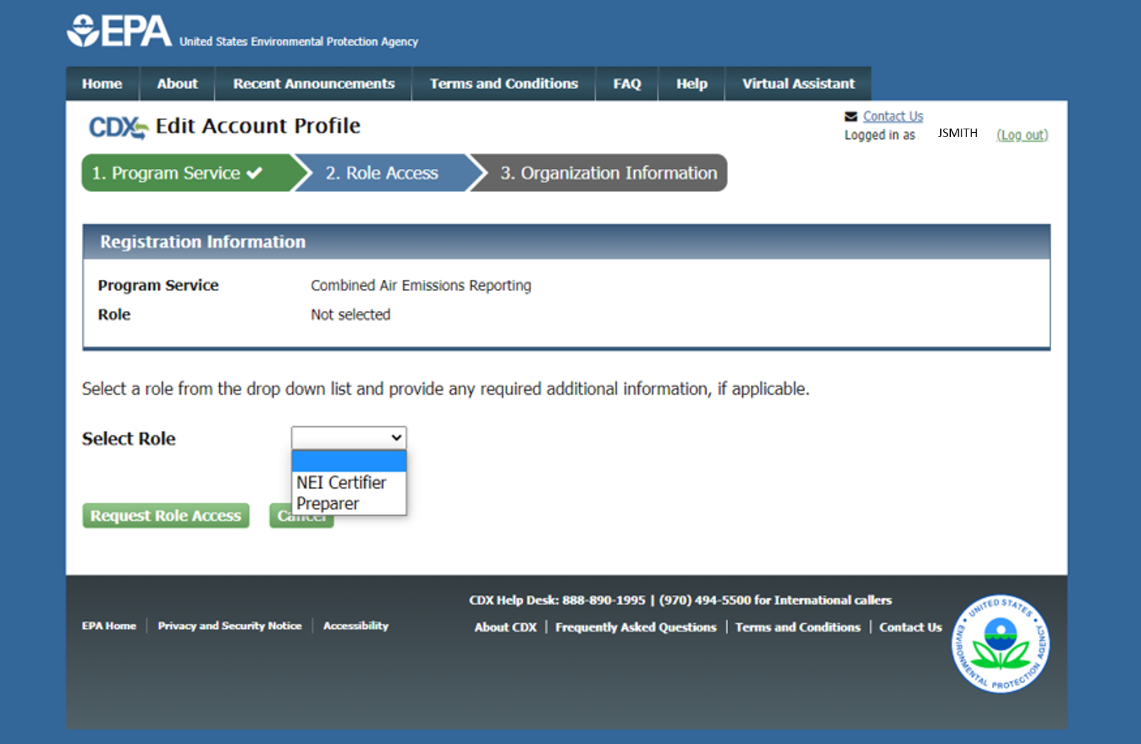
CDX Selecting a Role
If you are both preparer and certifier for a facility, you only need to select “Certifier”.

Slide 13
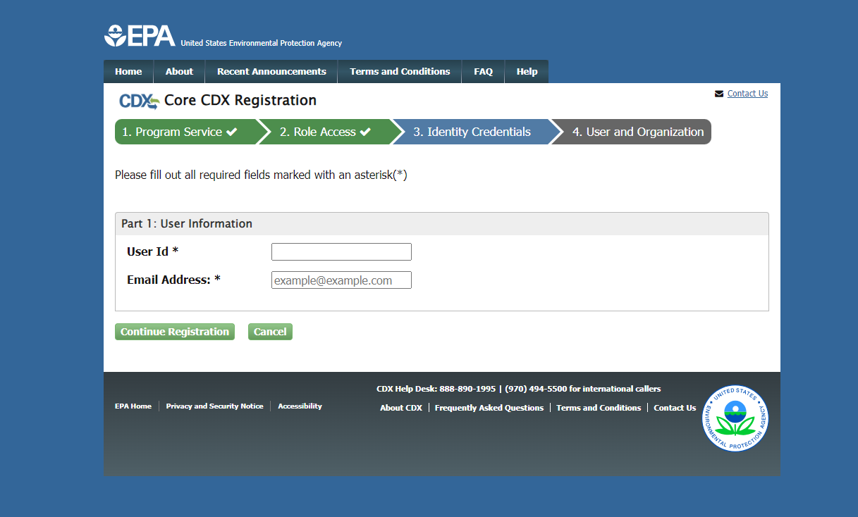
Select Username and Enter Email

Slide 14
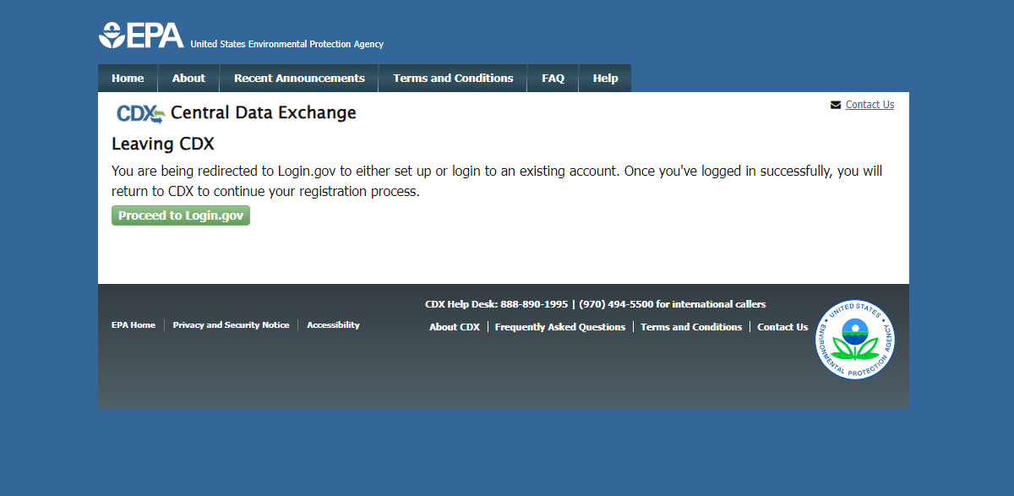
Redirect to Register in Login.gov

Slide 15
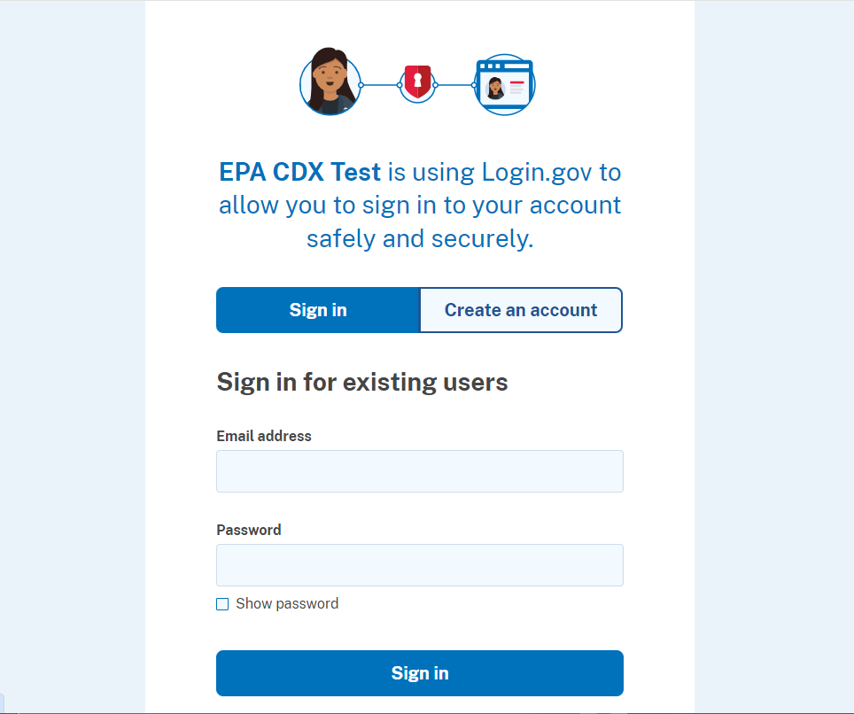
Create Account in Login.gov

Slide 16
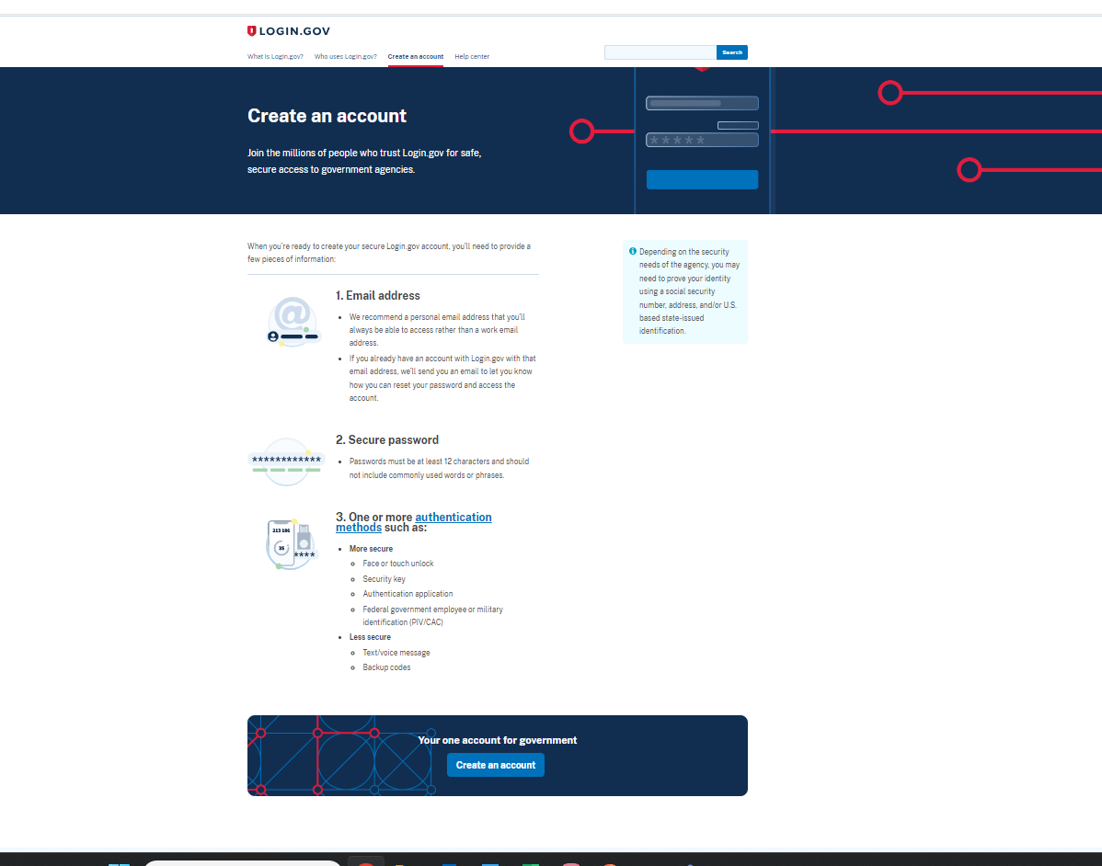
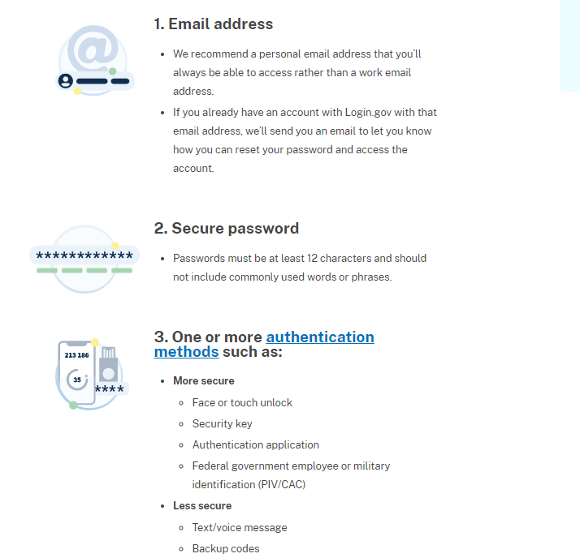
Requirements for Login.gov Account

Slide 17
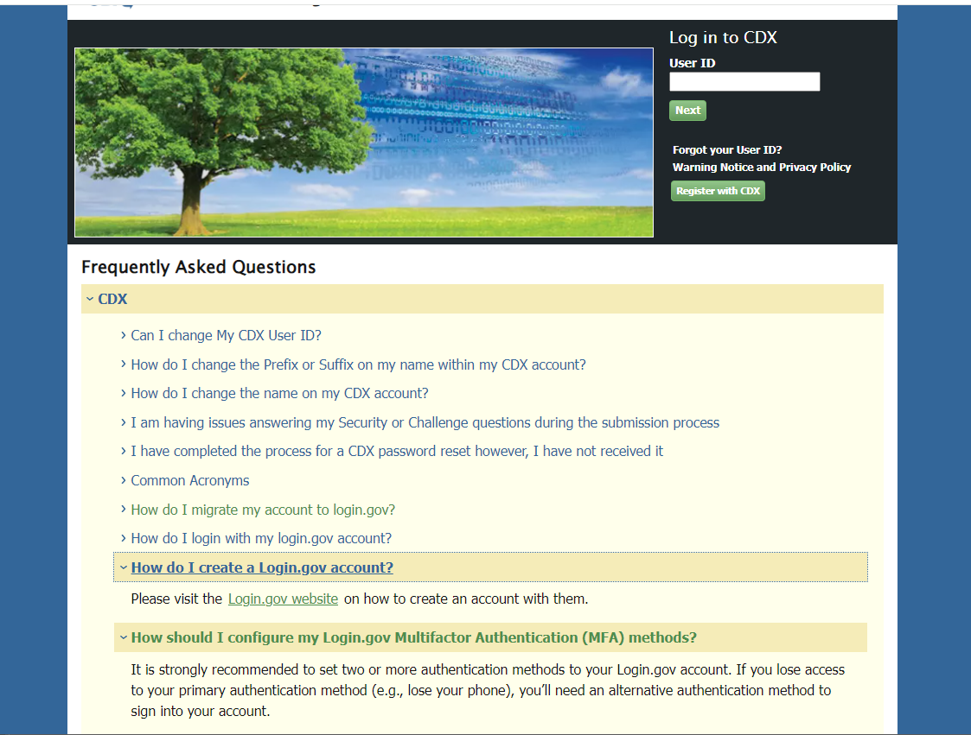
CDX and Login.gov
The CDX registration process are the same, after registering, it will go to login.gov to create a new account or connect to an existing account. It is not necessary to make the login.gov account first and separately from the CDX registration.
Scroll down to the FAQs on the CDX main page.
Here are the important EPA FAQ about the new migration/ login.gov process that these FAQs will take you to:
https://cdx.epa.gov/FAQ#CDXQ9
https://cdx.epa.gov/FAQ#CDXQ10
https://cdx.epa.gov/FAQ#CDXQ11

Slide 18
2. b) Add CAERS to an Existing CDX Account
If you have already used CDX in the past e.g. to report to FORS, you will log in, follow the prompts, and add CAERS to your account.
If you have not used CDX since the migration to Login.gov (Summer 2024), you will login to CDX as normal and then follow the prompts that will help you relate your CDX account to your Login.gov account.

Slide 19
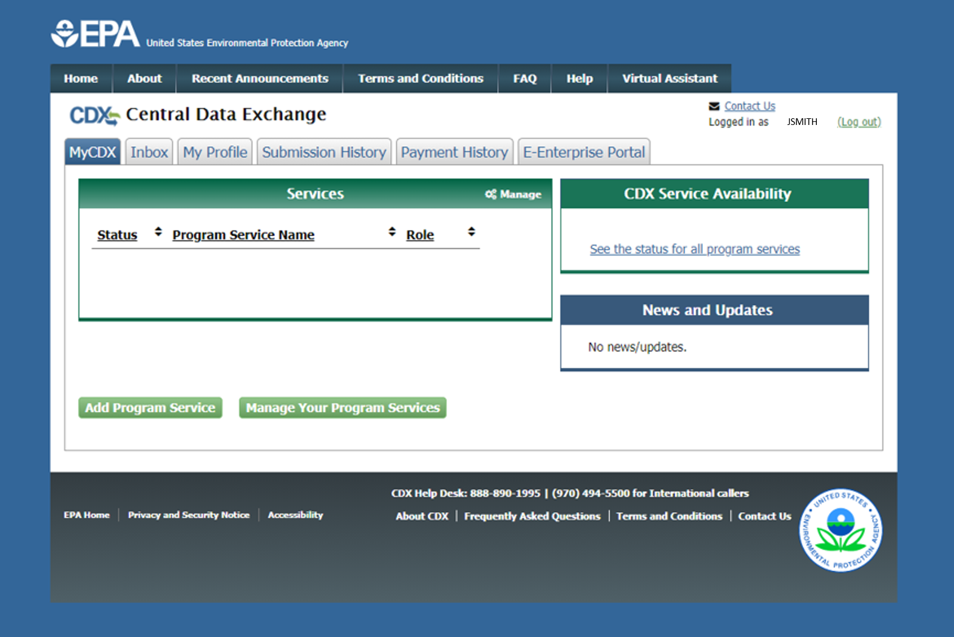
CDX Adding a Program Service
Already have a CDX account? Add CAERS by clicking here.

Slide 20
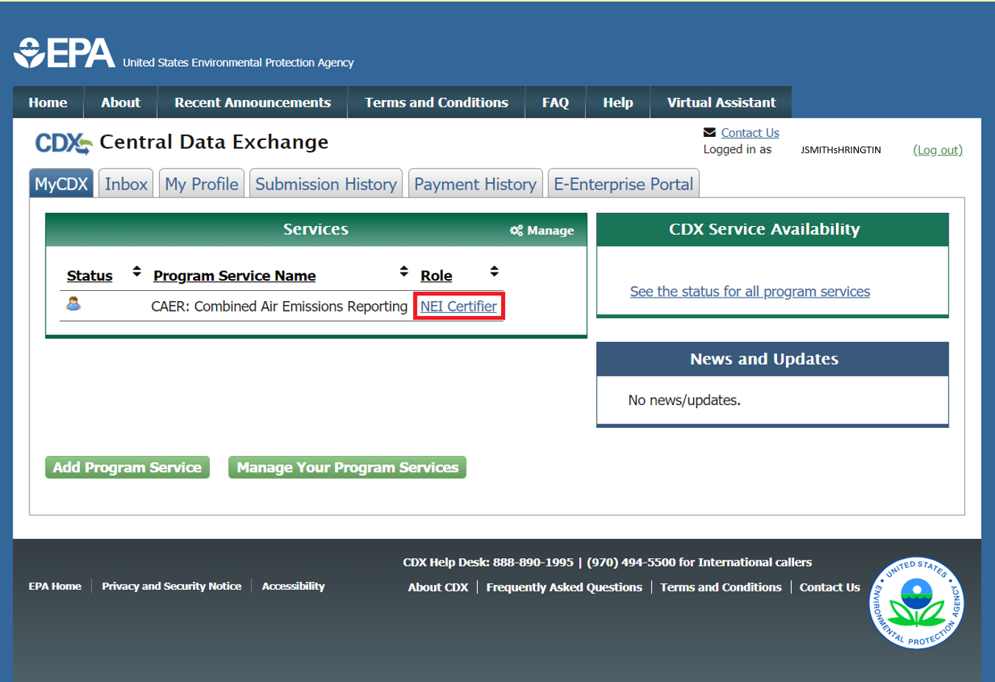
MyCDX Page After Registration

Slide 21

Help in CDX

Slide 22
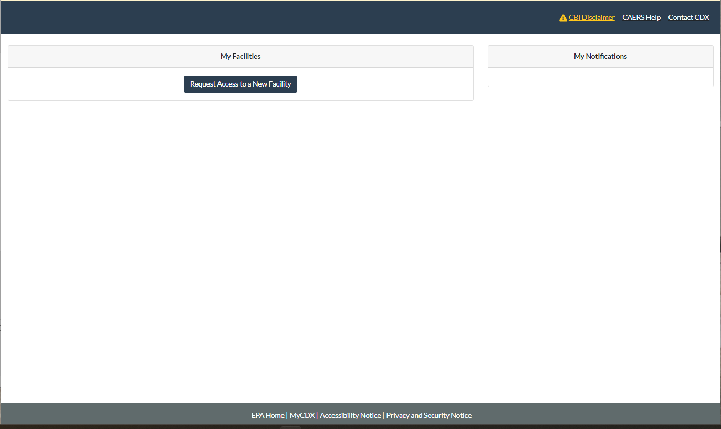
CAERS My Facilities Page
To get access to start reporting for a facility click on “Request Access to a New Facility”.

Slide 23
3. Request Access to Your Facilities

Slide 24
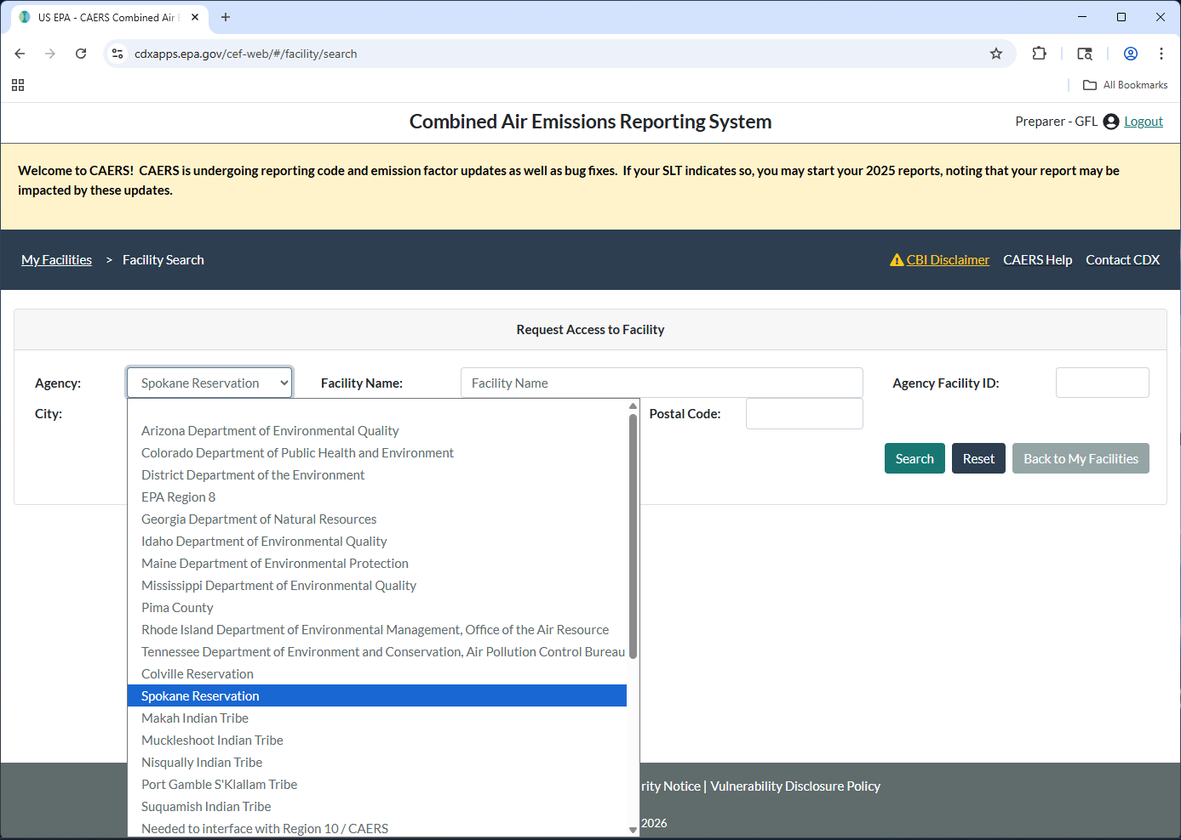
Find Facility
Enter your Tribal Name and information about your facility, then click “Search”.
Notes:
Please note CAERS contains an error for Puyalllup Tribe. If you need to select Puyallup, then you should select “Needed to interface with Region 10/CAERS”.

Slide 25
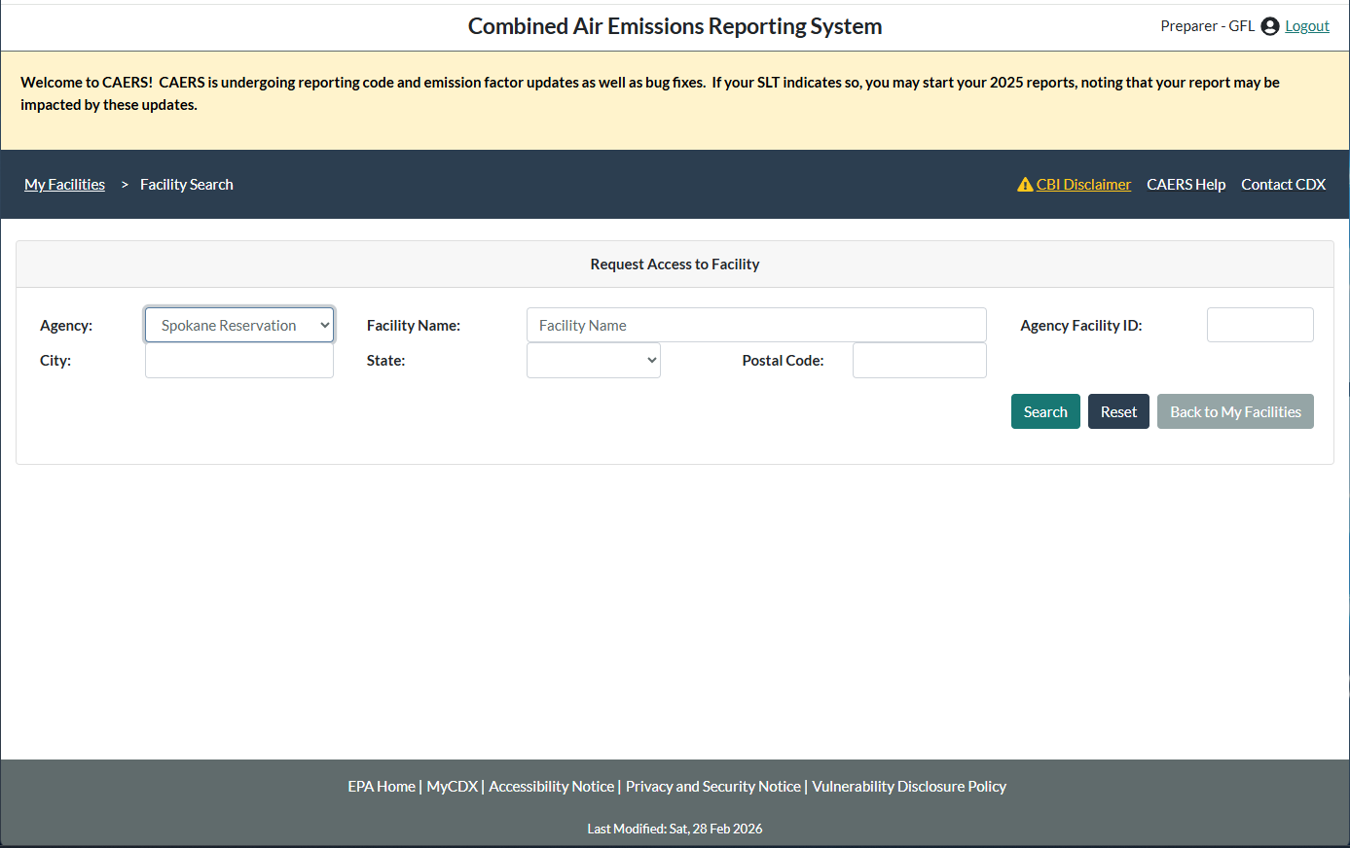
Finding Your Facility
From the drop-down menu, select your tribe
A list of facilities matching your search terms will appear. Select the facility you want to report to. When you do, the “Request Access” button will be active. Click on “Request Access”
Enter part or all of the facility’s name, then click “Search”.

Slide 26
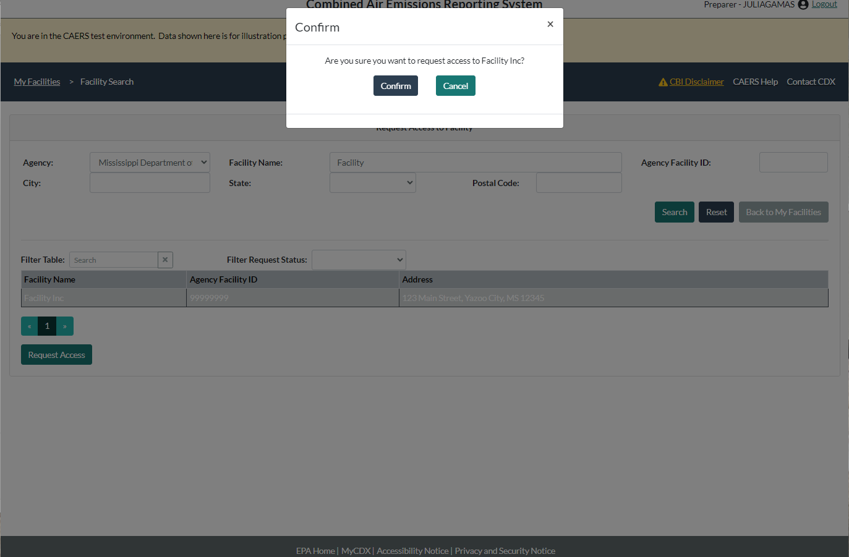
Confirm Access to Facility
Make sure you have the right facility, so you don’t have to go through the process again. If Region 10 staff find that your name doesn’t match the facility you must report to, they will not accept your request. If you have the correct facility click “Confirm”.

Slide 27
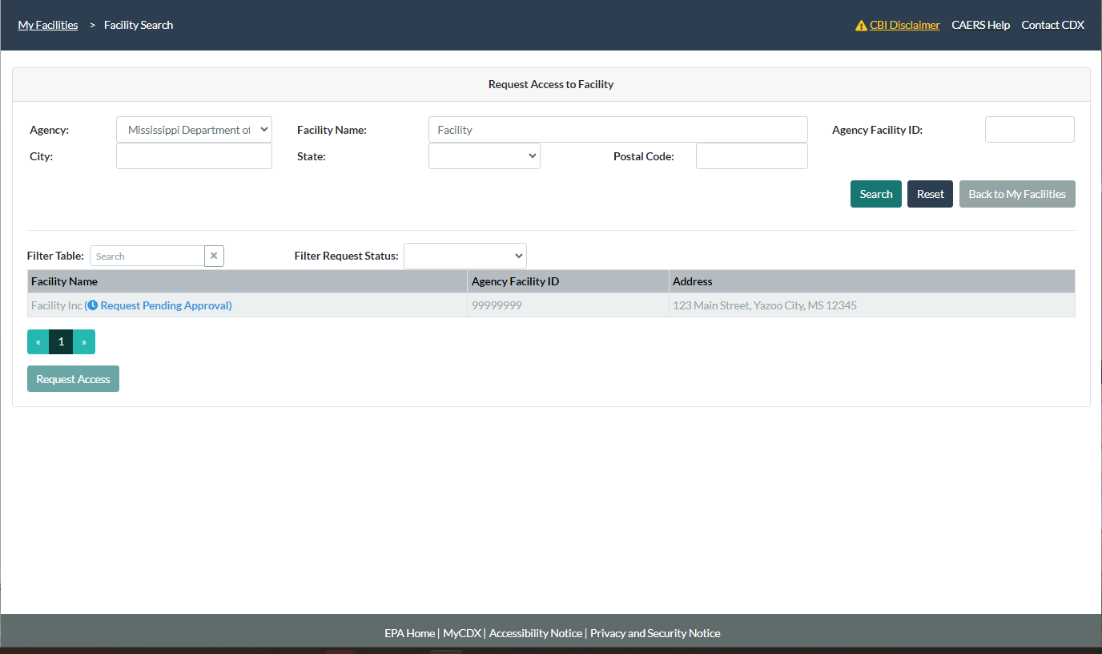
Request Sent
You should wait for the SLT to approve your request. You will get an email when this has happened. Note that CDX emails are from the system, you cannot reply to them and get a response. They may also go to your spam folder.
Repeat these steps for each facility you need to report to.

Slide 28
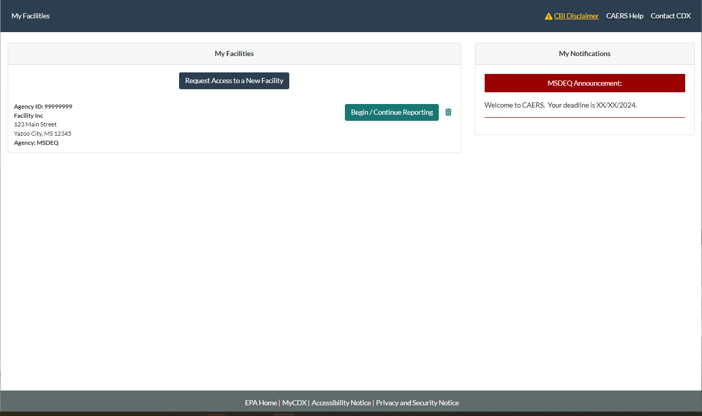
Request Granted
Once the SLT has granted you access, you will be able to see your facility on your “My Facilities” page, together with any announcements from the SLT.
If you report to multiple facilities that are in different tribal lands, you will see announcements for each of those tribal lands on the right hand side of the screen.
Click on “Begin/Continue Reporting” to start your report.

Slide 29
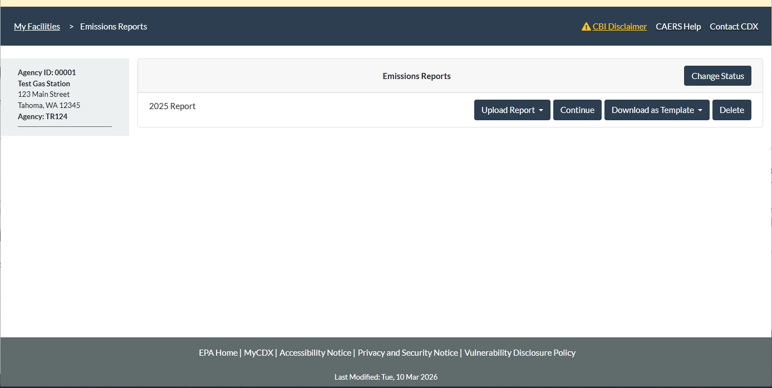
Begin/Continue Report
Your next step would be to click on “Create New Report” to start a new report. This year, the report has already been started for you so you would click “Continue”.

Slide 30
Reporting in CAERS

Slide 31
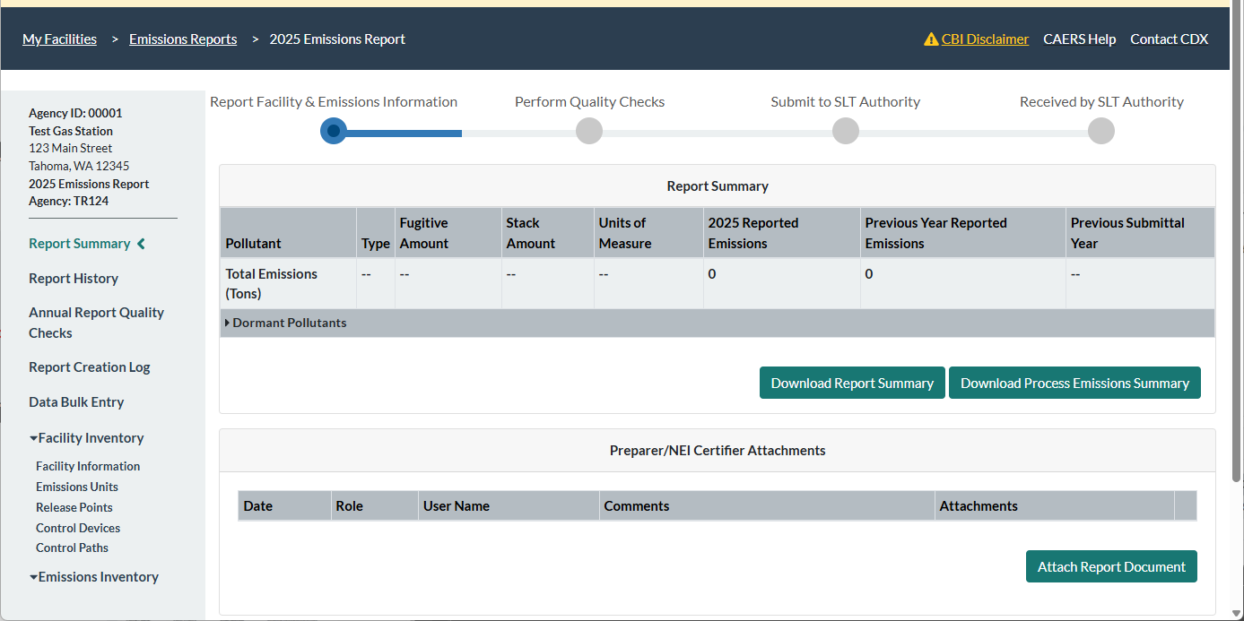
Your Facility Report Summary Page

Slide 32
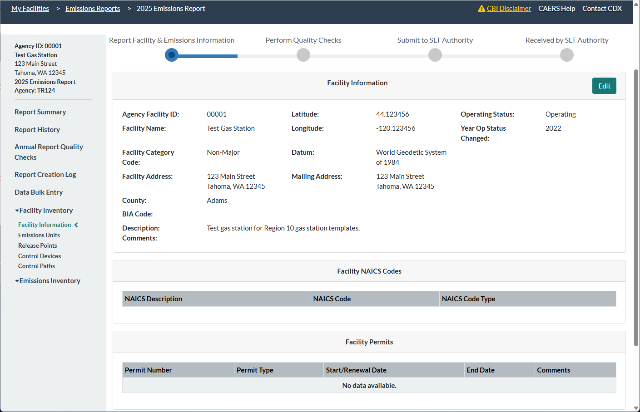
Check your Facility Information
On the left-hand side click on the “Facility Information” link and your facility information will appear. If anything isn’t correct, let staff from Region 10 know and do not certify your report until the information has been corrected.

Slide 33
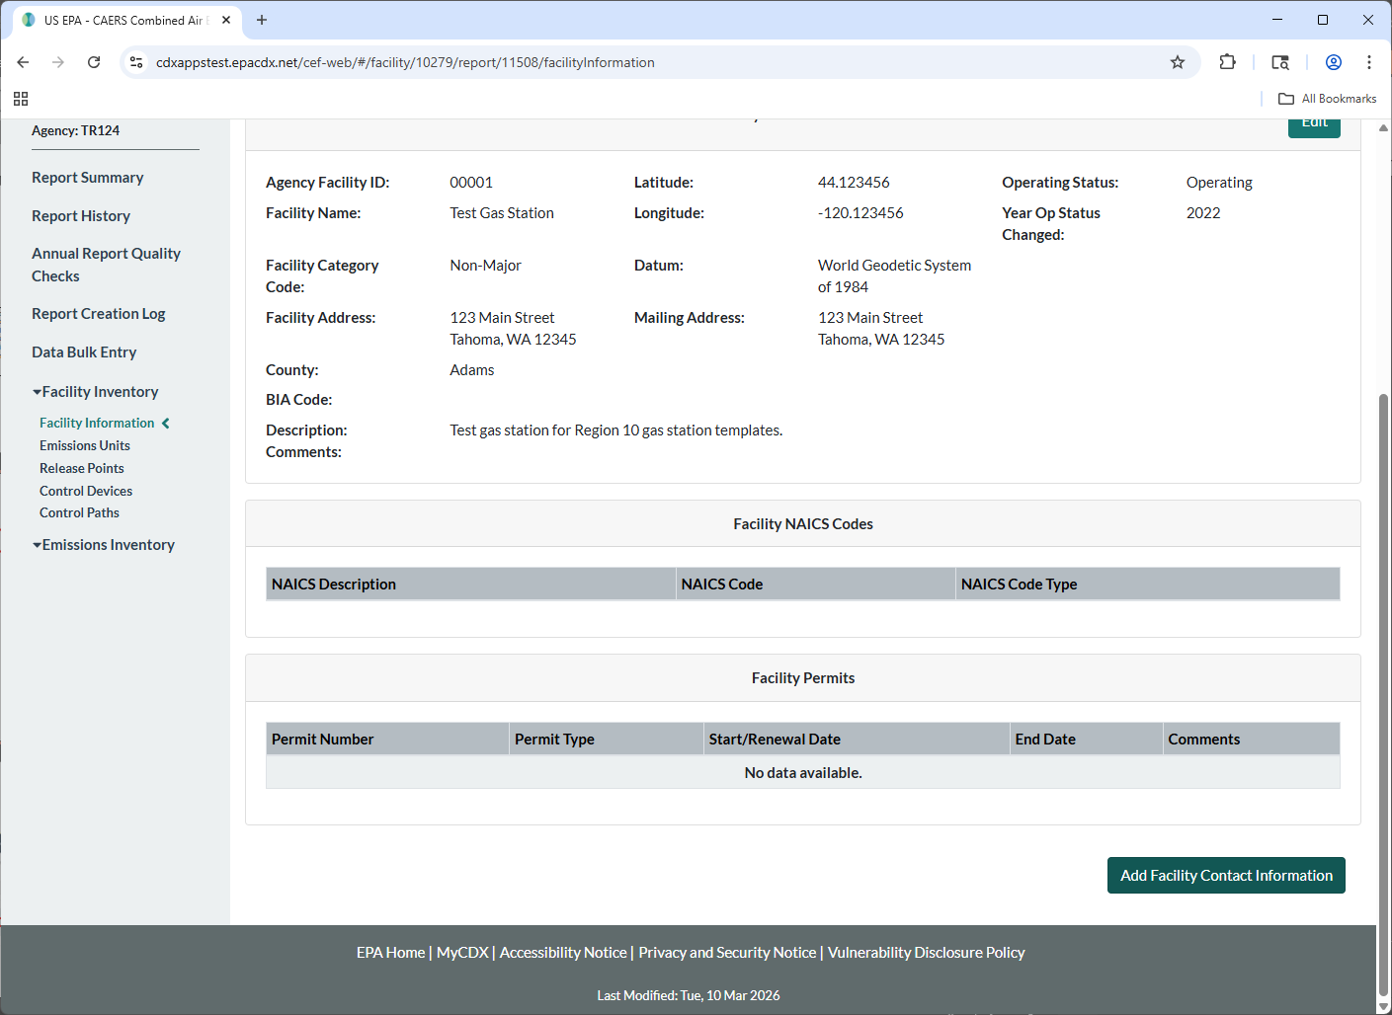
Check/Edit/ Add Contact Information
In the same Facility Information screen, scroll down and click edit to change or add contact information.

Slide 34
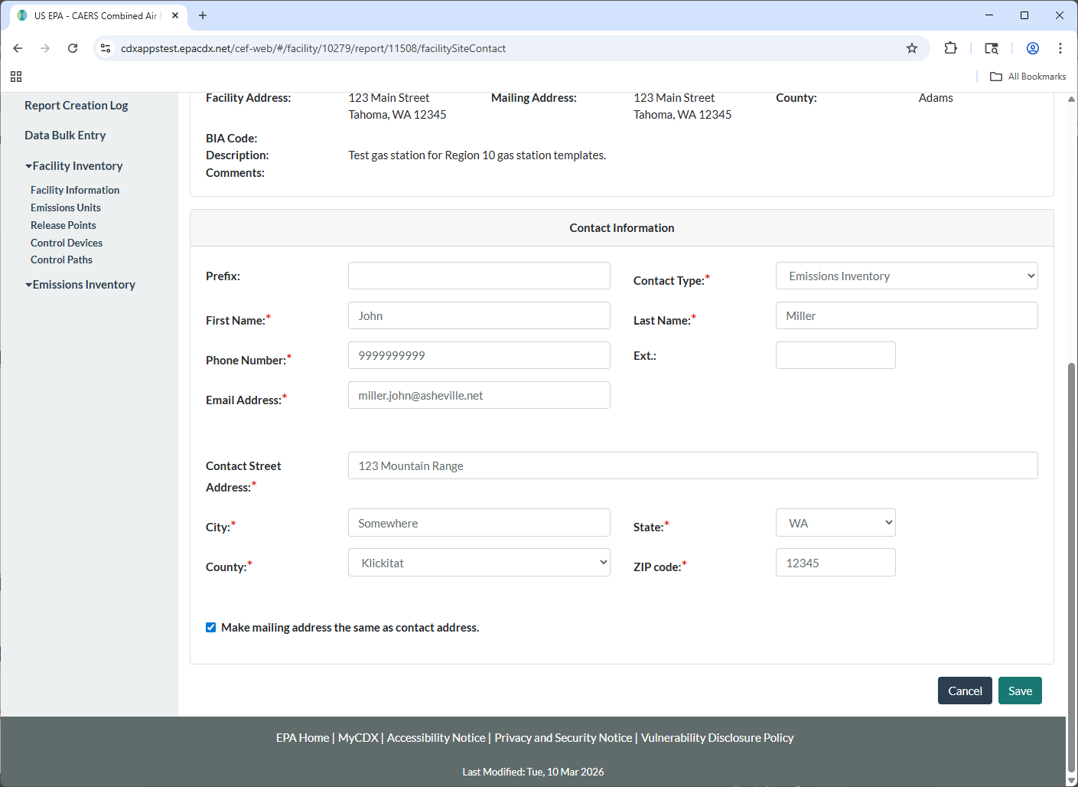
Contact Information
Check with Region 10 staff which contacts you must include. Note that at least one must be designated “Emissions Inventory” contact. Click Save when you are done.

Slide 35
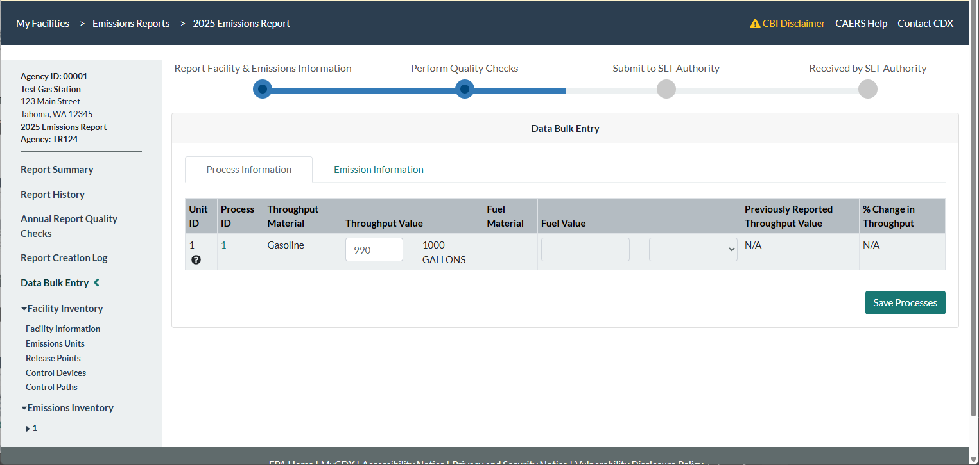
Enter Throughput Data
On the left-hand side menu, click on “Data Bulk Entry”. Enter the amount of gasoline that was held in the underground tanks for 2025. Click on “Save Processes”. You will get a green pop-up saying your data have been saved.

Slide 36
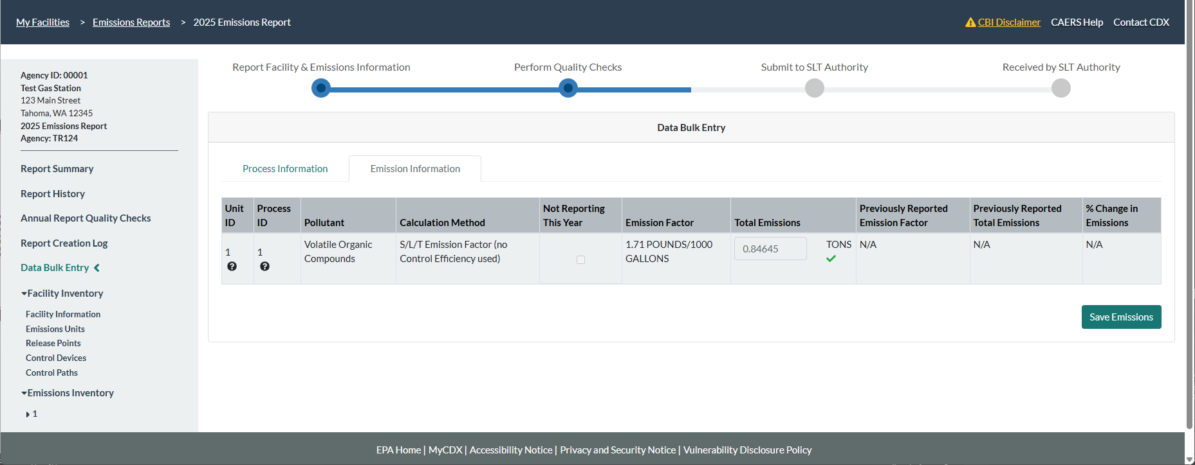
Calculate Emissions
Click on the Emissions Information tab at the top of the screen and you will see emissions for each unit and process. Click “Save Emissions.”

Slide 37
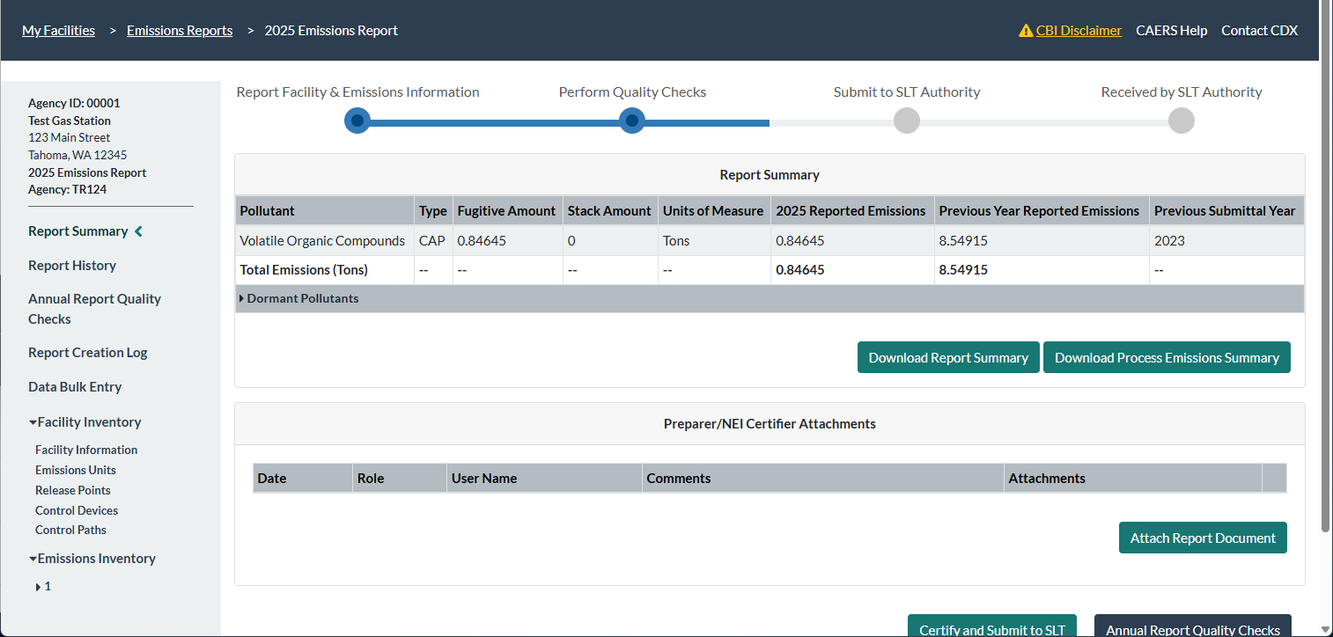
Attachments
If Region 10 requires attachments for your report, you can add those by clicking on “Report Summary” on the left hand side menu. Scroll down to the bottom of the page and click on “Attach report Document” and follow the prompts.

Slide 38
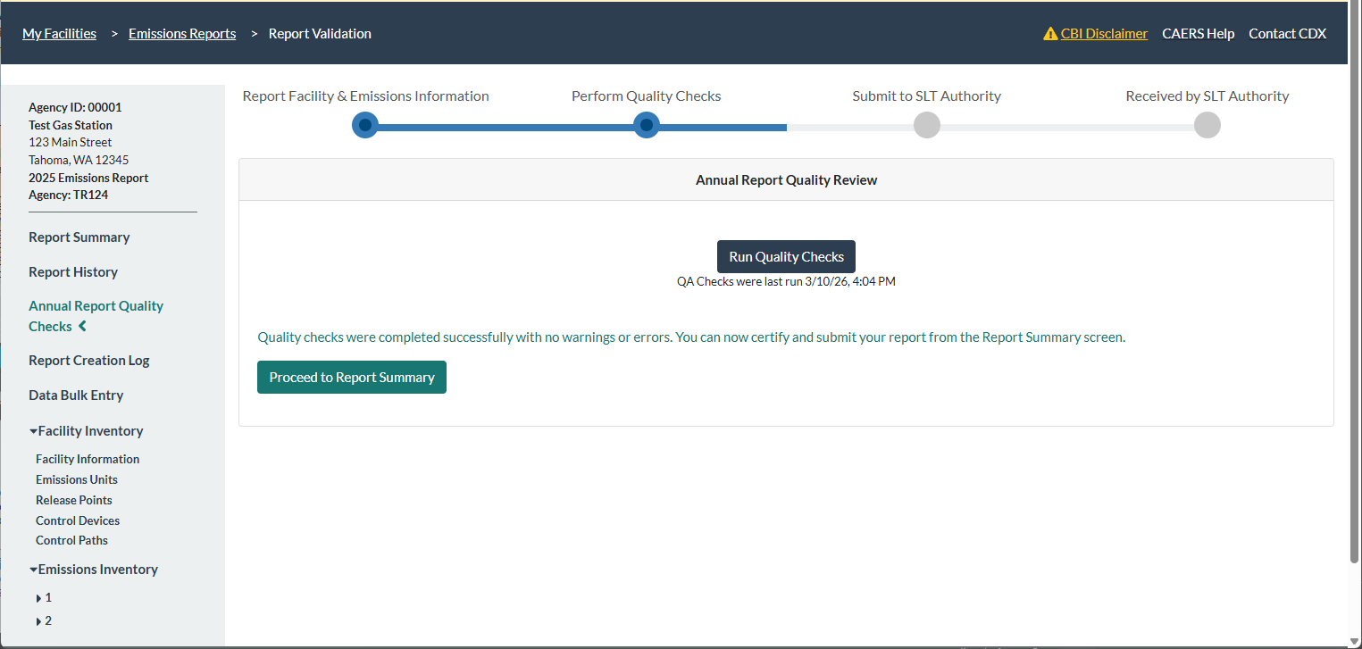
Run QA Checks
Click on the “Annual Report Quality Checks link, then click on the “Run Quality Checks” button. You should get a screen that shows checks have been completed without error. If you get any red errors, please reach out to Region 10 staff for assistance.

Slide 39
QA Checks
Note that if you get this check, it means you have not entered your throughput data in the previous step. You should not submit the report with this QA check pending or Region 10 may have to send it back to you for corrections:
Emissions Unit: 1, Emissions Process: 1, Pollutant: Volatile Organic Compounds - The total emissions for this Emissions Process and Pollutant are exactly the same as your 2023 submission. Please check to ensure that the emissions for this year are correct and have not changed.

Slide 40
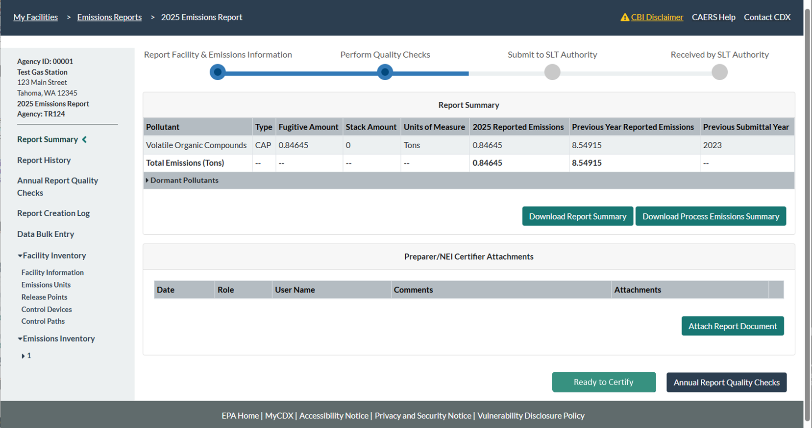
Ready to Certify
After running the QA checks go back to the “Report Summary” page via the left-hand side link. Scroll down. Click on “Ready to Certify” if you are the Preparer and someone else signs the report.

Slide 41
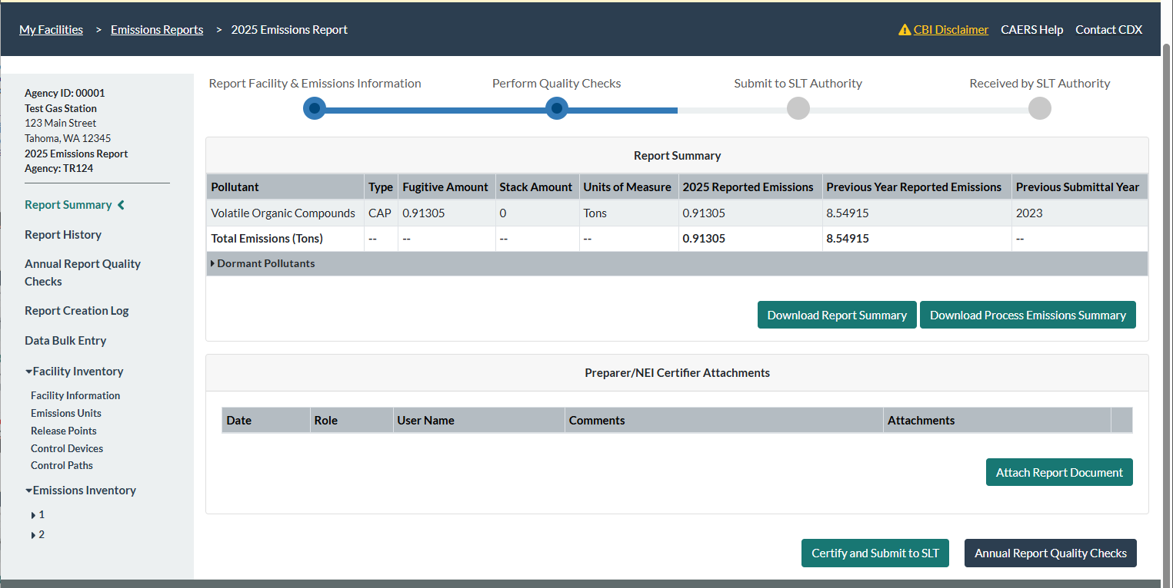
Certify and Submit
After the preparer has passed the QA checks and clicked on “Ready to Certify” the certifier will get an email that the report is ready to sign.
The certifier will go into the report and click on “Certify and Submit to SLT” button at the bottom of their screen.
If you both prepare and certify the report, then after passing QA checks you will see the “Certify and Submit to SLT” button on the bottom of the screen.
Follow the prompts to sign and submit your report.

Slide 42
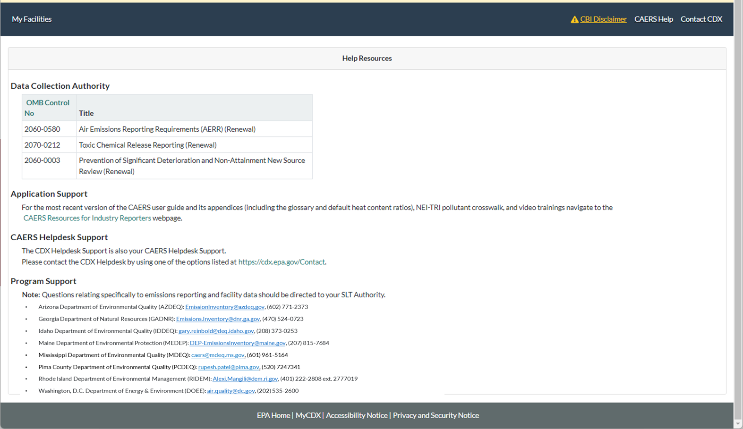
CAERS Help Resources Page
The CAERS “Resources for Industry Reporters” webpage includes the user guide, video trainings, and power point presentations given during trainings.
Facilities on Tribal Lands in EPA Region 10 (EPA_R10): brown.carl@epa.gov, (208) 378-5747
Notes:
It is also available by clicking on the “Help” link in CAERS. Here you will find the user guide, a glossary, and also the information for the CDX help desk, program support with your SLT email or POC, and additional resources.

Slide 43
Help from CDX Help Desk
For CDX questions such as:
  Can’t login/Password resets
  Repudiation
For CAERS application questions such as:
  Unexplained errors while using the CAERS application
  How to enter a specific piece of data
  How to navigate from one screen to another
CDX Help Desk:
Phone: Person-to-person telephone support from 8:00 am to 6:00 pm (EST/EDT). Call our toll-free line at 888-890-1995 or our direct line at (970) 494-5500 for International callers.
E-mail: Technical Support at helpdesk@epacdx.net
Notes:
If you have any questions about how to use the application itself, you should reach out to the help desk for questions about how to enter data into CAERS:
By Phone: Person-to-person telephone support is available from 8:00 am to 6:00 pm (EST/EDT). Call our toll-free line at 888-890-1995 or our direct line at (970) 494-5500 for International callers.
By E-mail: Send e-mail our Technical Support team at helpdesk@epacdx.net
Note that the help desk above is not the right resource for questions about the data itself. Those questions should be referred to your SLT Authority.

