Slide 1
Example of
Application
Materials
Documenting Sensor and Network Performance for Inclusion on the Fire and Smoke Map
Photo of Sensor Make X, Model Y
June 2026

Slide 2
Purpose and Anticipated Use of this Slide Set
Informational slide only – do not include in actual submission
Purpose
This slide set provides an example of the level of detail requested in applications for inclusion of air sensor networks on the Fire and Smoke Map (FASM).
How will this slide set be used?
  Serves as the application package for the FASM technical review team.
  Will be presented to other Partners (e.g., larger FASM team, management, EPA Regions, and State, local, and Tribal Agencies) as the approval process moves along.
  Approved applicants should post this slide set publicly.
  Applicants can include links to other publicly available information that give more detail on any information in this slide set (e.g., API documentation, quality assurance).
2

Slide 3
Important Notes
Informational slide only – do not include in actual submission
All performance results in this example are fictitious.
Slides should not include proprietary information or confidential business information.
Applicants should consider marking the slide set “draft/deliberative” until the final version is accepted.
When the slides are finalized, the FASM team will share the slides with stakeholders.
If accepted, the applicant should share the final presentation online publicly.
3

Slide 4
Color coding
Informational slide only – do not include in actual submission
Suggestions for applicants filling in slides
Do not need to include in real submission slides
Information on target values and denotes the submission met the targets
Keep in real submission slides for easy interpretation
Applicant’s notes on interpretation
Likely helpful to keep in submission slides
4

Slide 5
Applicant Information
  Provide information about your organization and contact info
Contact should be the primary point of contact for the FASM team [if clearly specified for the purpose, a secondary contact for stakeholders asking questions can be provided]

Slide 6
Overview
Background Information
Quality assurance, quality control, and correction details
Sensor performance from true collocation results
Network performance from nearby sensor monitor pairs
  Applicants can indicate on this slide that the slide set is “draft/deliberative” until the final version is accepted.

Slide 7
Background information
This information is required as part of Step 1 (express interest and initial discussion) in the application process
Number of sensors and hardware may change over time. Make sure to indicate when these statistics were collected.
As of June 2026
(requested in Acceptance Protocol, Step 1, Table 1)

Slide 8
Hardware and measurement needs
PM_{2.5} sensor: Make, model
Temperature, relative humidity and Pressure sensor: Make, model
  Specify whether these are sensor internal or ambient measurement
Other sensors: O₃ (make, model), CO₂ (make, model), TVOC (make, model)
Power: Either Solar or wall power
Connectivity/Communication: Wi-Fi, cellular, etc.
Internal Photo of Sensor Make X, Model Y

Slide 9
Data reporting and retrieval
Frequency of sensor measurements: 90 seconds every 2 minutes
Frequency of sensor reporting: average every 2 minutes
Data retrieval options
  Real-time API, historic API
  2-min, 10-min, 1-hr, or daily averages
Data sent via: WiFi/Cellular
  If there is a communication outage
    Sensor data will be back filled up to X hours when the sensor comes back online
    Or sensor data will not be back filled
Interdependencies: None
  Raw data is bias corrected before reporting and the methodology is public and depends only on information collected by the sensor
Make sure to link to API documentation

Slide 10
Network location and size
Geographic Extent: 45 U.S. states (except: XX, XX, XX, XX, XX)
Expected number of sensors to appear = 5,000
Map showing 5,000 sensor locations across the U.S.

Slide 11
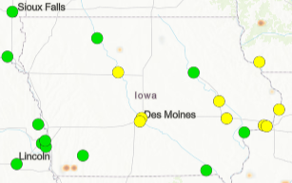
Data Deserts: where sensors provide additional data
Network set up by city X fills in gaps in neighborhoods without previous monitoring/sensors
Sensors set up in rural counties in State XX fill in gaps
More data in state XX than other networks
Other maps showing where the sensors add additional data
Sensor X
Additional sites in Iowa compared to current FASM locations

Slide 12
Typical sensor owners & data users
Owners
Individuals ~65%
Local agencies (e.g., city X) ~20%
Community groups ~10%
School systems (e.g., county Y) ~5%
Data users
Individuals
School systems (e.g., outdoor activity decisions)
Data aggregators (e.g., X, Y, Z)
Applicants can also give specific numbers by owner
Or applicants can provide discussion if they feel this is confidential

Slide 13
Quality assurance, quality control, and correction
This and all subsequent sections are required during application process Step 3.
(Requested in Acceptance Protocol, Step 3, Table 2)

Slide 14
Quality assurance and quality control – Network setup
Sensors are set up and maintained by state/local agency staff
Sensors are returned for annual calibration/correction/maintenance
Sensors are set up by the public and the user submits a photo of their installation for verification before data goes public
The precision of sensors is checked by X and is within X% before leaving the factory
Suspicious sensors identified by algorithms (see slide X) reviewed weekly with local agency staff
Please write bullets that describe QA in your network. The information provided here are all examples.

Slide 15
Quality assurance and quality control – Sensor design
Suspect data points are flagged by duplicate internal sensors
  Exclude if 10-min averaged |A-B|> 5 µg/m³ and |A-B|*2/(A+B) > 70%
Other QA variables provided by the sensor (e.g., flowrate) and evaluated in this way …
A heater is included that keeps the RH between X-Y%
Please write bullets that describe QA that was built into your sensor's design. The information provided here are all examples.

Slide 16
Quality assurance and quality control – Data
Raw PM_{2.5} concentrations exclude > X μg/m³
PM_{2.5} concentrations excluded if RH < 0% or RH > 100%
Exclude if internal check variable is > X (e.g., flowrate)
Outliers removed using method X
Description of other kinds of mathematical QA of individual data points
Description of other kinds of mathematical QA of air sensors
Please write bullets that describe QA done on your real-time data to be sent to the FASM. The information provided here are all examples.

Slide 17
Correction description
Data correction approach (if applicable), including:
Procedure used to correct the data including:
  [a] how the data are corrected (e.g., manufacturer derived multilinear correction),
  [b] variables used to correct the data (e.g., RH, T),
  [c] where the correction variable(s) comes from (e.g., on-board RH sensor), and
  [d] how the data are validated or calibrated (e.g., RH sensor is calibrated by the manufacturer)
If the way data are corrected does not change and is static, record this information and any mathematical approaches used
If the way data are corrected changes or is a dynamic process, record the following:
  (a) when the process changes,
  (b) why the process changes,
  (c) how/where changes are recorded, and
  (d) how the correction method is validated
Our equation form is
  C = corrected PM_{2.5} (μg/m³)
  R = Raw PM_{2.5} (μg/m³)
  RH = relative humidity (sensor internal, %)
R = 0-30 μg/m³
  C = R*RH*a + R*b + RH*c + d
R > 30 μg/m³
  C = R*RH*e + R*f + RH*g + h
Static correction
Please provide all equation coefficient values (i.e., a, b, c, d, etc.) or ranges of values if they differ by sensor
If it cannot be written out, please provide as many details as possible (e.g., machine learning type)
Do not provide confidential business information
If the equations are proprietary, then all dependent variables, and general methods should be described (e.g., machine learning, variables X, Y, Z)

Slide 18
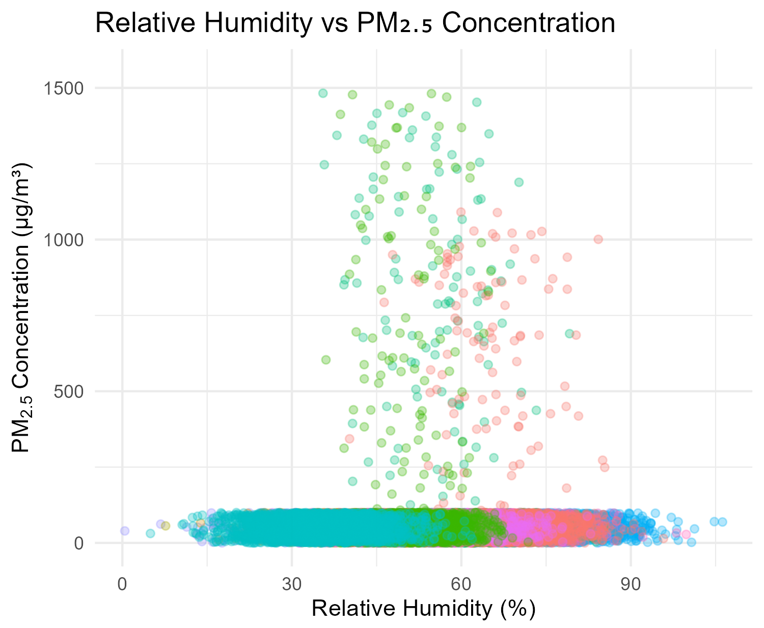
Correction Development Range
If more than 2 variables are used more plots will be needed to show the relationship between all variables. For example, if the equation includes PM_{2.5}, RH, and Temperature. Plots of PM_{2.5} v RH, PM_{2.5} v T, and T v RH. Multiple slides may be needed. Colors may indicate site or a 3rd variable.
Note: What data is used (e.g., monitor vs sensor)
Since our equation considers the interaction between PM_{2.5} and RH we have provided a plot illustrating the combination of conditions experienced during training
The dataset used for correction development
  Was independent of the collocation dataset evaluated
    Different sites were used
    The same sites were used but date X-Y used for correction and Y-Z used for evaluation
Monitor
Describe how this correction dataset compares to your collocation dataset. Examples are shown here.

Slide 19
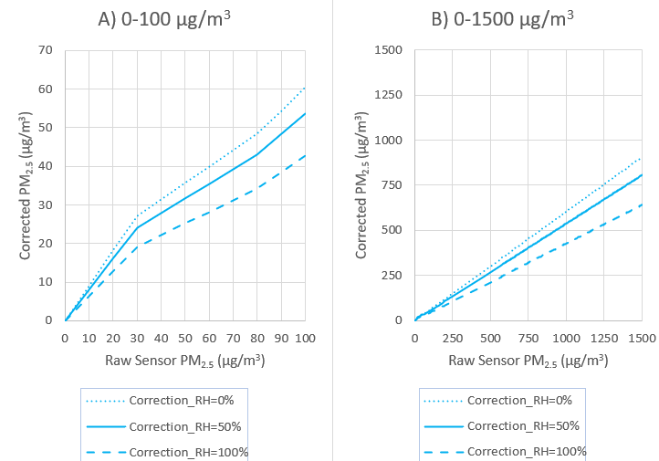
Correction Extrapolation
The influence of RH varies as a function of PM_{2.5} concentration
If corrections differ for different sensor provide a few examples
This is trying to understand how the model will perform at all expected combinations of variables even those not experienced during testing.

Slide 20
Data flow and timing
On the device
In the cloud
Final data
Collecting X data points for X seconds/ hour and then averaging to Y and then sending to the cloud
Correction applied?
If the transmition is interrupted
  Will be resent when connected
  Will be sent if reconnect within X min
  Will be lost
Outliers removed
Correction applied?
Data averaged to 10-min and hourly
QC’d dataset available 5 minutes after collection (e.g., data collected from 8:00 –8:10 available at 8:15)

Slide 21
Sensor performance from true collocation results
True Collocation Definition: sensors installed on-site or at the fence line of air monitoring sites or alongside temporary smoke monitors
(Requested in Acceptance Protocol, Step 3, Table 3)

Slide 22
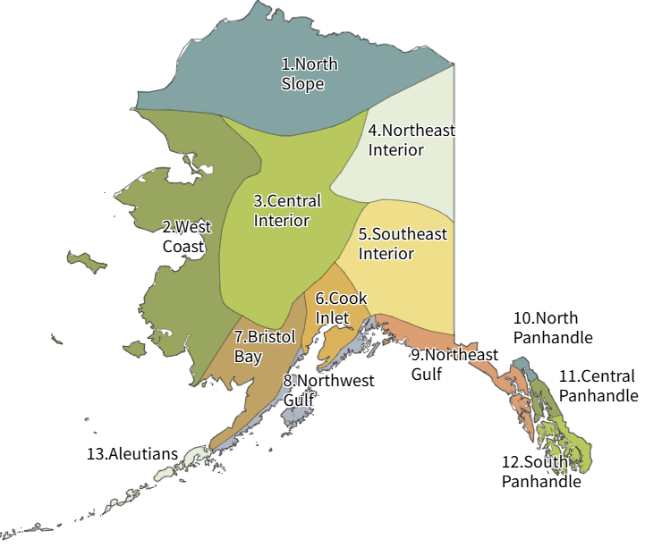
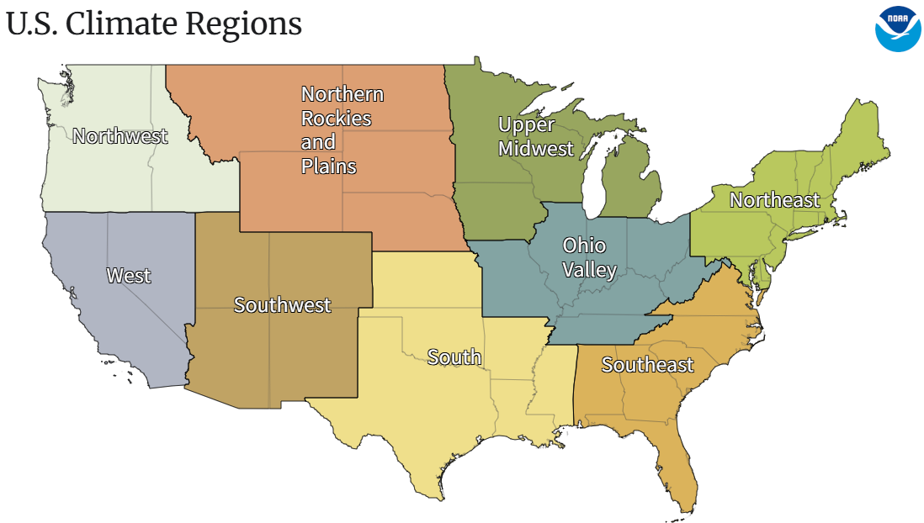
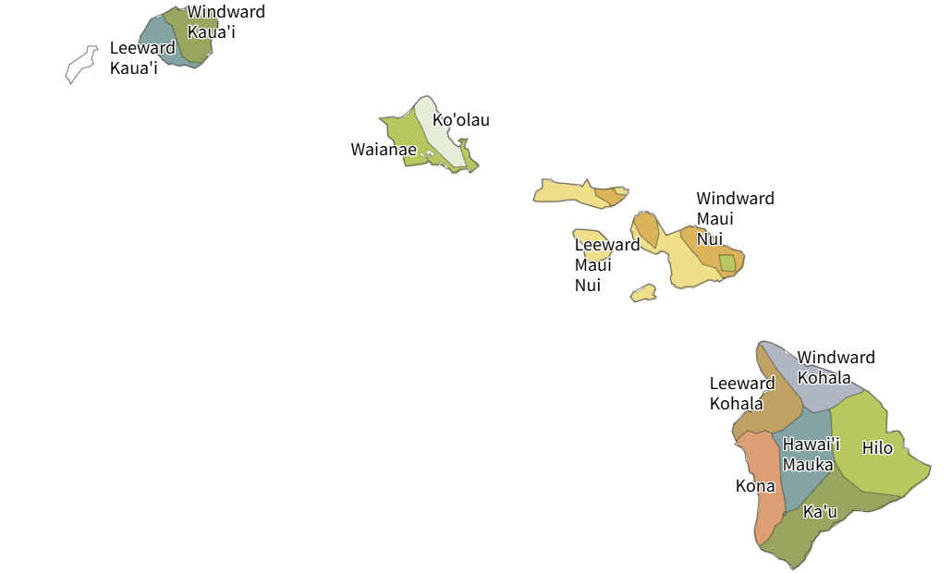
Collocation Sites
= collocation sites
Image source: https://www.ncei.noaa.gov/access/monitoring/reference-maps/us-climate-regions

Slide 23
Sites: True Collocation
Shows meeting the target or bold/underlined
 | Location† | Collocation Period | Days of data* | Number of sensors | Monitor | Hourly Temperature Range (°C) | Hourly RH Range (%) | Hourly PM_{2.5} Range (µg/m³)
Criteria | ≥ 4 sites, ≥ 90 days |  | ≥ 4 sites, ≥ 90 days | ≥ 2 sites in different climates with ≥ 3 sensors | FEM or temporary smoke monitor | -25 - 43 | 5 - 100 | ≥ 2 sites ≥ 250 µg/m³
 | Fairbanks, AK | Oct 1, 2024 – Jul 6, 2025 | 230 | 1 | BAM-1022 | -34 - 24 | 30 - 100 | 5 - 400
 | Los Angeles, CA | Mar 15, 2024 – Jun 25, 2024 | 90 | 3 | BAM-1020 | 10 - 35 | 20 - 70 | 10 - 100
 | Tampa, FL | Mar 1, 2024 – Oct 31, 2024 | 197 | 1 | T640x | 16 - 35 | 50 - 100 | 5 - 40
 | Denver, CO | Jul 1, 2024 – Oct 5, 2024 | 90 | 9 | BAM-1020 | 7 - 32 | 20 - 60 | 5 - 50
 | Phoenix, AZ | Jul 1, 2025 – Jul 31, 2025 | 29 | 2 | BAM-1020 | 30 - 45 | 5 - 40 | 5 - 30
 | Rural, OR | Aug 8, 2024 – Aug 28, 2024 | 20 | 1 | E-BAM | 15 - 35 | 30 - 80 | 5 - 1000
†May have multiple rows for the same site if the number of sensors changed
*May not match collocation period due to instrument downtime, power loss, etc. but should be the hours of matched monitor and sensor data

Slide 24
Collocation Additional Details
Location | Collocation Period | Lat, Long | Smoke events | Likely other sources and aerosol composition
 |  |  | ≥ 2 smoke events (max list 10)
Fairbanks, AK | Oct 1, 2024 – Jul 6, 2025 | 64.8378° N, 147.7164° W | 1. Jun Smoke from Fire Y lasted for 5 days 2. Winter woodsmoke | Urban
Los Angeles, CA | Mar 15, 2024 – Jun 25, 2024 | 34.0522° N, 118.2437° W |  | Near Road
Tampa, FL | Mar 1, 2024 – Oct 31, 2024 | 27.9506° N, 82.4572° W |  | Urban
Denver, CO | July 1, 2024 – Oct 5, 2024 | 39.7392° N, 104.9903° W |  | Urban, fireworks
Phoenix, AZ | Jul 1, 2025 – Jul 31, 2025 | 33.4484° N, 112.0740° W |  | Urban, dust storm, fireworks
Rural, OR | Aug 8, 2024 – Aug 28, 2024 | 42.4658° N, -121.7617° W | 3. Aug Smoke from Fire X lasted for 10 days | Background
Performance testing should include at least two real-world wood/wildland fire smoke events that last a day or more and should include high concentrations (> 250 µg/m³), though concentrations do not need to be that high for the full event. The FASM or local media may be good sources of fire information.

Slide 25
Justification for Limited Temperature and RH Range
Acceptable
This is a state/regional run network
  Across the state/region over the full year hourly temperature typically ranges from X-Y °C and hourly RH typically ranges from X-Y %
  Our testing covers the expected range of conditions across our state
  We will submit a new application if the network expands outside this state/region
Unacceptable
Sensors’ operating range is > X °C (e.g., 0 °C)
  But these conditions are expected in our network
Sensors’ operating range is < X% RH (e.g., 90%)
  But these conditions are expected in our network
Information provided here are examples of justifications.

Slide 26
Performance: Precision
Sensors meet precision (SD) at 2 sites
2 climate zones (West and Southwest) represented
Location | Climate Zones | Days of data* | Number of sensors | Standard Deviation (SD)* (µg/m³) | Coefficient of Variation (CV)* (%)
≥ 2 | ≥ 2 | ≥ 90 days | ≥ 3 | ≤ 5 | ≤ 30
Los Angeles, CA | West | 90 | 3 | 2.5 | 35
Denver, CO | Southwest | 90 | 9 | 1.1 | 41
Shading shows meeting the target
*Should meet CV or SD, but do not have to meet both
(SD target likely met at ambient concentrations, CV likely met under higher concentrations (e.g., smoke))

Slide 27
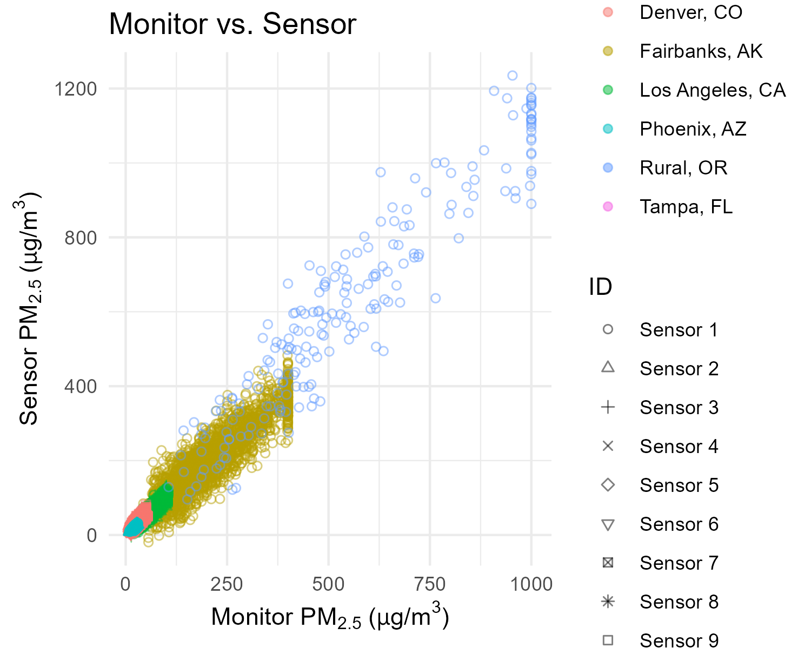
Performance: Accuracy scatterplot
Sensor vs. Monitor
Data QAed and corrected using methodology presented on slides X-X
  These are the same QA methods that will be used for the data feed to FASM
1:1
Optionally include some time series by site either here or in the supplemental slides
Optionally the plot may be dynamic allowing for reviewers to select the sites individually

Slide 28
Performance: Bias & linearity
Location | Sensor ID | Slope | R²
Target | > 90% of sensors | 1 ± 0.35 | ≥0.70
Fairbanks, AK | Sensor 1 | 0.87 | 0.76
Los Angeles, CA | Sensor 1 | 1.05 | 0.82
Los Angeles, CA | Sensor 2 | 0.97 | 0.88
Los Angeles, CA | Sensor 3 | 1.12 | 0.91
Tampa, FL | Sensor 1 | 1.18 | 0.60
Denver, CO | Sensor 1 | 0.95 | 0.84
Denver, CO | Sensor 2 | 1.10 | 0.87
Denver, CO | Sensor 3 | 0.92 | 0.79
Denver, CO | Sensor 4 | 1.25 | 0.81
Denver, CO | Sensor 5 | 1.07 | 0.90
Denver, CO | Sensor 6 | 0.88 | 0.77
Denver, CO | Sensor 7 | 1.14 | 0.89
Denver, CO | Sensor 8 | 1.02 | 0.85
Denver, CO | Sensor 9 | 1.30 | 0.83
Phoenix, AZ | Sensor 1 | 1.03 | 0.92
Phoenix, AZ | Sensor 2 | 0.98 | 0.87
Rural, OR | Sensor 1 | 1.13 | 0.91
100% (17/17) of sensors meet slope target
94% (16/17) of sensors meet R² target
Shading shows meeting the target
  Add discussion about performance when metrics are not met.

Slide 29
Performance: Normalized Mean Bias Error (NMBE) at AQI breakpoints
AQI Breakpoint | Current AQI breakpoint | Concentration Range (µg/m³) Current AQI breakpoint ±20% | N | MBE (µg/m³) | NMBE
 |  |  |  | |MBE| ≤ 1.5 | |NMBE| ≤ 10%
Moderate | 9.0 | 7-11 | 15,205 | 1.4 | 16%
Unhealthy for Sensitive Groups | 35.4 | 28–42 | 2196 | 1.4 | 4%
Unhealthy | 55.4 | 44–66 | 1291 | 5.2 | 9%
Very Unhealthy | 125.4 | 100–150 | 503 | 2.2 | 2%
Hazardous | 225.4 | 180–270 | 475 | -9.3 | −5%
Cal/OSHA | 500 | 400–600 | 230 | 0.5 | 0%
< 10% bias at each AQI breakpoint
Shading shows meeting the target
Verify the current AQI breakpoints on https://aqs.epa.gov/aqsweb/documents/codetables/aqi_breakpoints.html
*Must meet MBE or NMBE

Slide 30
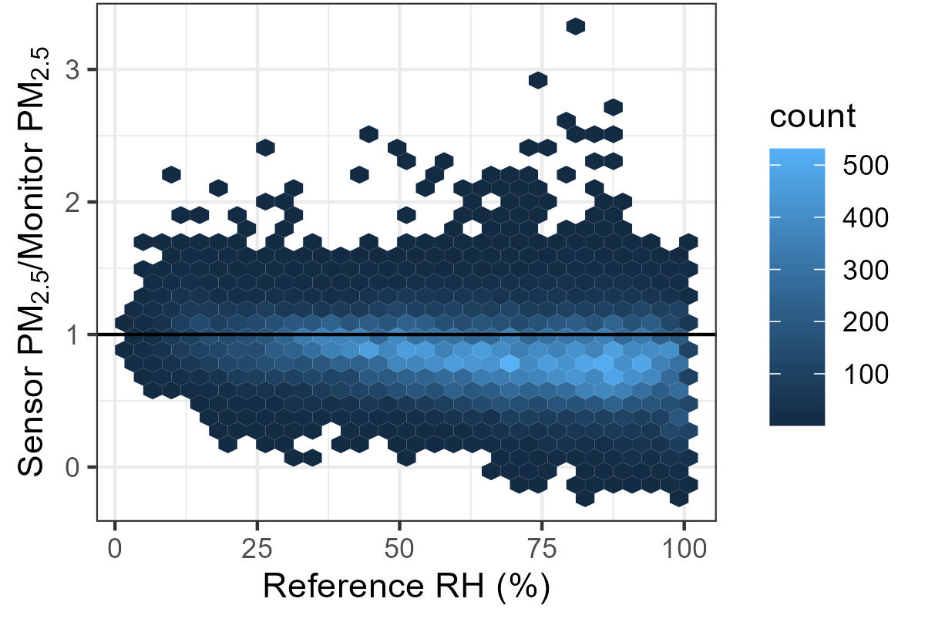
Performance:
Influence of RH
Sensor slightly overcorrects for RH influence
RH influence does not lead to twice the bias at high compared to low or low compared to high RH
Mean PM_{2.5} sensor/monitor 0-30% (unitless) | Mean PM_{2.5} sensor/monitor 90-100% (unitless) | Higher value/lower value (unitless) | Difference (unitless)
 |  |  | < 2
1.22 | 0.90 | 1.22/0.90 | 1.35
Optional analysis but helpful for reviewers. EPA is exploring the possibility of generating this through automated tools
Shading shows meeting the target

Slide 31
Acknowledgments
Thank you to State XX, City Y, and University Z for hosting air sensor collocations
Optional, could go anywhere in the presentation
31

Slide 32
Supplemental Information
    Optional. More detailed slides may be moved to “supplemental information” depending on presentation length
32

Slide 33
Network performance from nearby sensor-monitor pairs
(Requested in Acceptance Protocol, Step 3, Table 4)

Slide 34
Dataset used
Timeframe: Jan 2024-July 2025
Sensor-Monitor pairs within 250 m
  105 pairs – 5 pairs excluded (justification described on next slide), 100 pairs total
Data QC applied the same way as data feed will be sent to the Fire and Smoke Map
PM_{2.5} NowCast AQI Averages
Target:
Timeframe ≥ 1 year
Sensor-monitor pairs within no more than 1000 m in distance
34

Slide 35
Justification for pairs excluded from analysis
Sensor ID | Time period | Reason
AA | Jan 2024 - Jul 2025 | Sensor located in mountainous area and shows weak agreement with monitor that is at a different elevation.
BB | Jun 2024 | 2 weeks of sensor failure data before sensor was replaced were removed*
CC | Jul 2024 - Jul 2025 | Based on PM_{2.5} and temperature trends sensor was moved indoors.*
DD | Jul 2024 - Jul 2025 | Based on PM_{2.5} and temperature trends sensor was moved to a different location and not updated.*
EE | Jul 1 - Jul 5, 2025 | Issue with temporary smoke monitor or pre-QCed monitor data leading to unlikely values.
*Ideally these issues would be removed by the QC before data is sent to the fire and smoke map
35

Slide 36
Justification for pairs excluded from analysis - additional details
Sensor X ID | Monitor ID | Monitor Lat/Long | Sensor Lat/Long
AA | 36-061-0013 | 40.712776, -74.005974 | 40.712796, -74.006194
BB | 12-086-2004 | 25.761680, -80.191790 | 25.761900, -80.192010
CC | 17-031-4002 | 41.878113, -87.629799 | 41.878333, -87.629579
DD | 48-201-0051 | 29.760427, -95.369803 | 41.878333, -87.629579
EE | lon_.118.550_lat_34.415_arb2.1035 ARB 1035 | 34.415000, -118.550000 | 34.415220, -118.550220
36

Slide 37
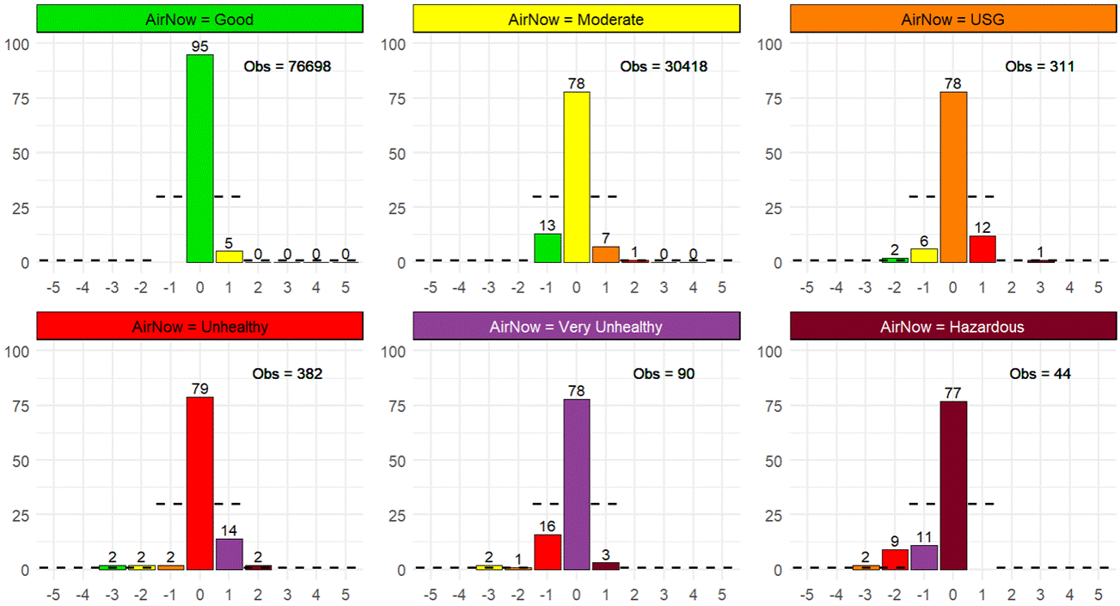
NowCast AQI Category Comparison: SensorX vs Reference by AQI category (100 pairs within 250 m radius)
Hourly NowCast data Jan 1, 2024 to Jul 31, 2025
SensorX AQI
Good
Moderate
Unhealthy for Sensitive Groups
Unhealthy
Very Unhealthy
Hazardous
Percentage of Sensor X NowCast Datapoints
AQI category difference (SensorX – Reference)
37
See slide X for justification

Slide 38
NowCast AQI Category Comparison: Sensor X vs. Reference by AQI category - Tabular results
Sensor X vs. Reference (Data from AirNow); 100 pairs within 250 m radius
Hourly NowCast data Jan 1, 2024 to Jul 31, 2025
Shows meeting the target
Target
Correct category ≥ 70%
+ 1 category ≤ 30%
- 1 category ≤ 30%
+ 2 category ≤ 1%
- 2 category ≤ 1%
+ 3 category ~0%
- 3 category ~0%
At least 30 data points in each NowCast AQI category
 | AirNow (“observed”)
Sensor X (“predicted”) | Good | Moderate | Unhealthy for Sensitive Groups | Unhealthy | Very Unhealthy | Hazardous
Goal Monitor observations | >30 | >30 | >30 | >30 | >30 | >30
Total Monitor observations | 76698 | 30418 | 311 | 382 | 90 | 44
Good | 95% | 13% | 2% | 2% | 0% | 0%
Moderate | 5% | 78% | 6% | 2% | 2% | 0%
Unhealthy for Sensitive Groups | 0% | 7% | 78% | 2% | 1% | 2%
Unhealthy | 0% | 1% | 12% | 79% | 16% | 9%
Very Unhealthy | 0% | 0% | 0% | 14% | 78% | 11%
Hazardous | 0% | 0% | 1% | 2% | 3% | 77%
Interpret vertically = 100%
38
Notes:
API
Note – don’t yet have comparison for Purple Air

Slide 39
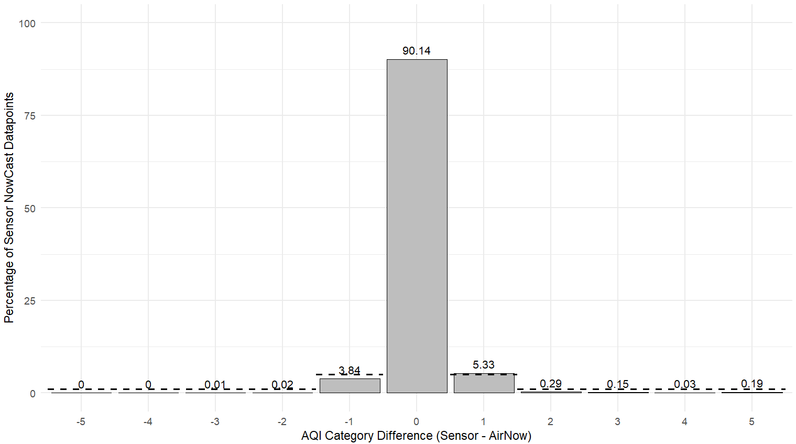
Overall NowCast AQI category agreement
Overall agreement meets targets
Combined across all categories
+ 1 category must be ≤ 5%
  - 1 category must be ≤ 5%
+ 2 categories must be ≤ 1%
  - 2 categories must be ≤ 1%
+ (3 or more) categories must be approximately zero %
  - (3 or more) categories must be approximately zero %

Slide 40
Overall NowCast AQI category agreement–Tabular Results
Overall agreement meets targets
AQI category difference (Sensor X – Reference) | Frequency of agreement or disagreement (%) | Target (%)
0 | 90.14 | N/A
+1 | 5.33 | ≤5
-1 | 3.84 | ≤5
+2 | 0.29 | ≤1
-2 | 0.02 | ≤1
+3 or more | 0.37 | ~0
-3 | 0.01 | ~0
Shading shows meeting the target
Combined across all categories
+ 1 category must be ≤ 5%
  - 1 category must be ≤ 5%
+ 2 categories must be ≤ 1%
  - 2 categories must be ≤ 1%
+ (3 or more) categories must be approximately zero %
  - (3 or more) categories must be approximately zero %

Slide 41
Justification for missed NowCast AQI category targets
Strong underestimation in the hazardous category was due to a single sensor
5.33% overestimation overall is mostly due to sensors slightly overestimating near the break

Slide 42
Contact Info: firesmokemap@epa.gov
Informational slide only – do not include in actual submission
Protocol Website:
coming soon Smoke.airnow.gov/professionals
Disclaimer: The views expressed in this presentation are those of the author and do not necessarily reflect the views or policies of the U.S. EPA or USFS. Mention of trade names or commercial products does not constitute endorsement or recommendation for use.

